Slide 1
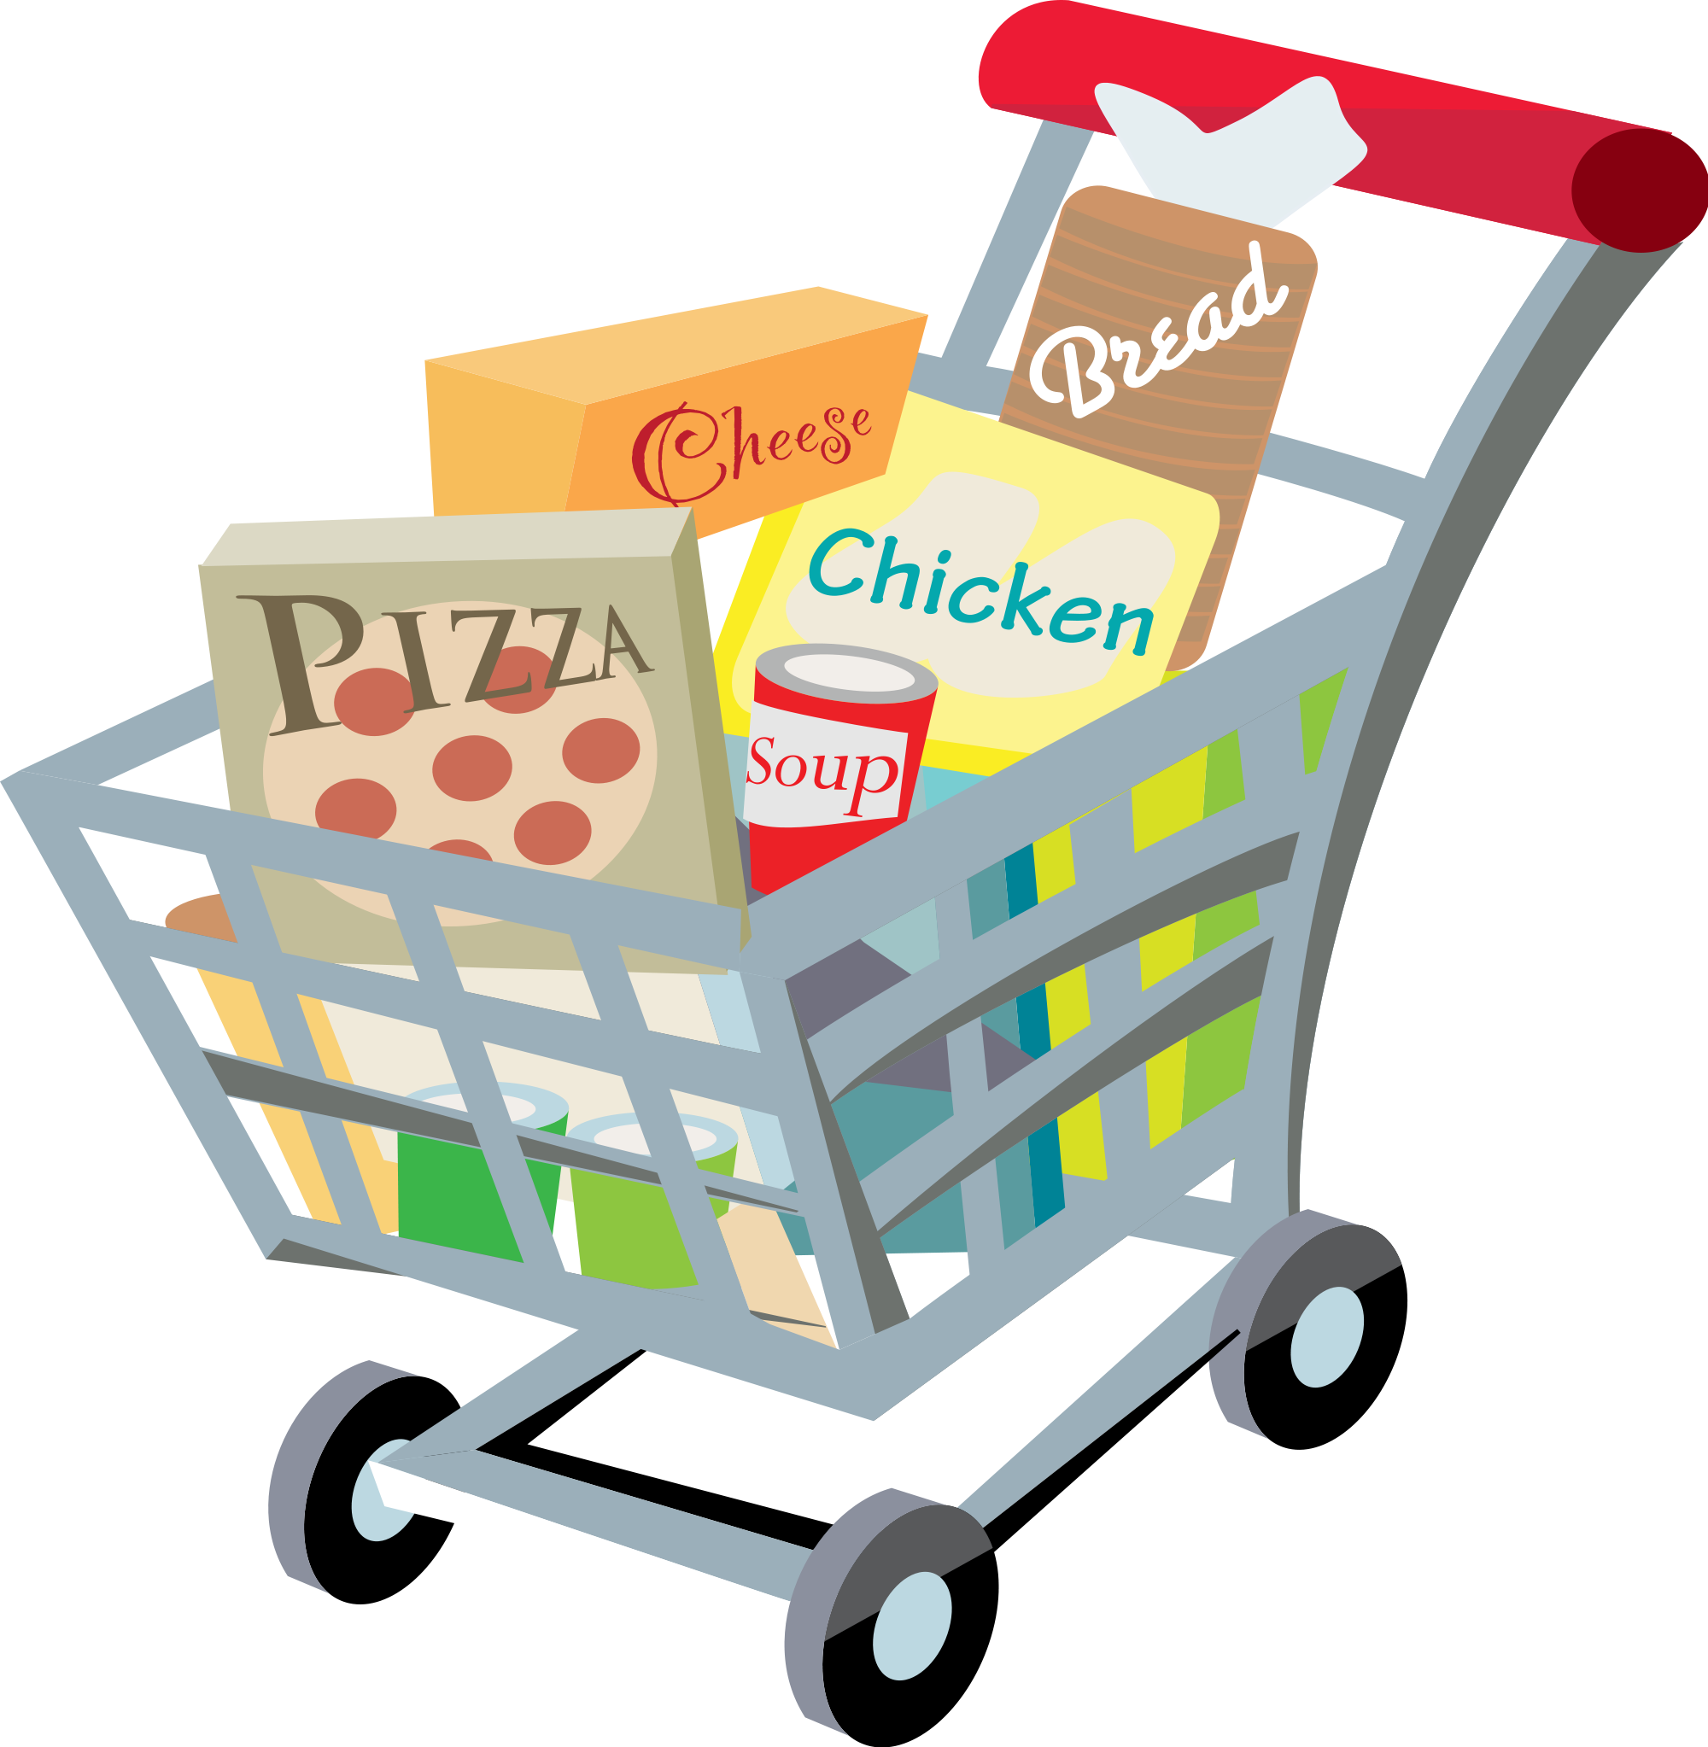
The Future of Seamless Grocery Shopping
Revolutionizing Retail with Forecasting and Image Processing
Selvin Furtado - 220990115
Muskan Sekhri - 221195466
Eva Wang - 221303458
Abhinav Vig - 221189428
Neeraj Nagula - 221743265

Slide 2
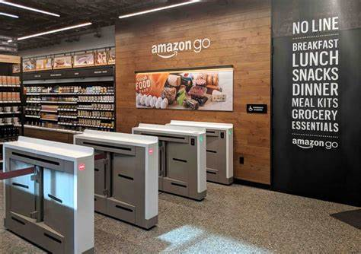
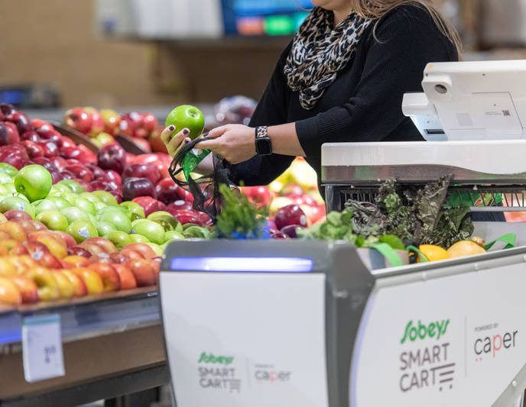
Competitive Landscape
Amazon GO
Sobeys AI cart

Slide 3
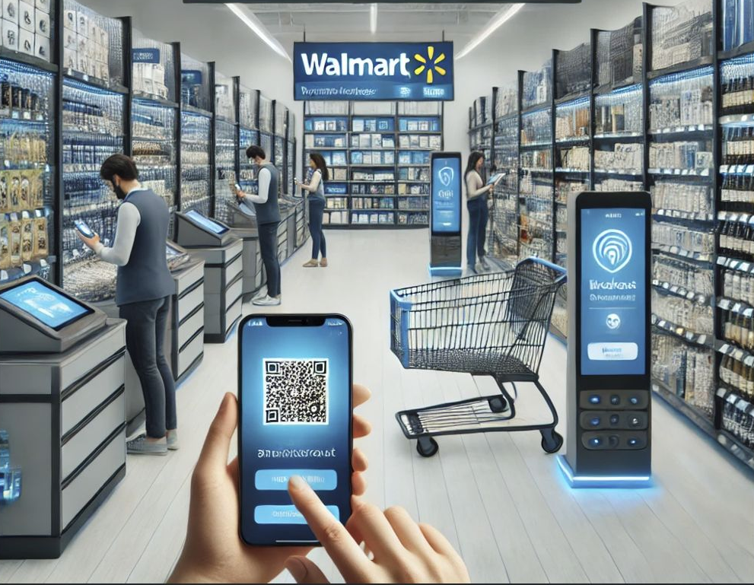
Business Model
Real-Time Barcode Scanning - Users can scan barcodes via the app to instantly update their virtual cart.
Running Total Functionality - App provides real- time cost updates, helping customers monitor spending.
Seamless Checkout Process - Secure in-app payments eliminate checkout queues and simplify transactions.
Operational Benefits - Increased efficiency and reduced costs for retailers.

Slide 4

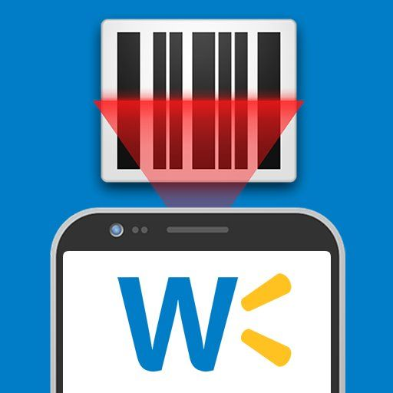
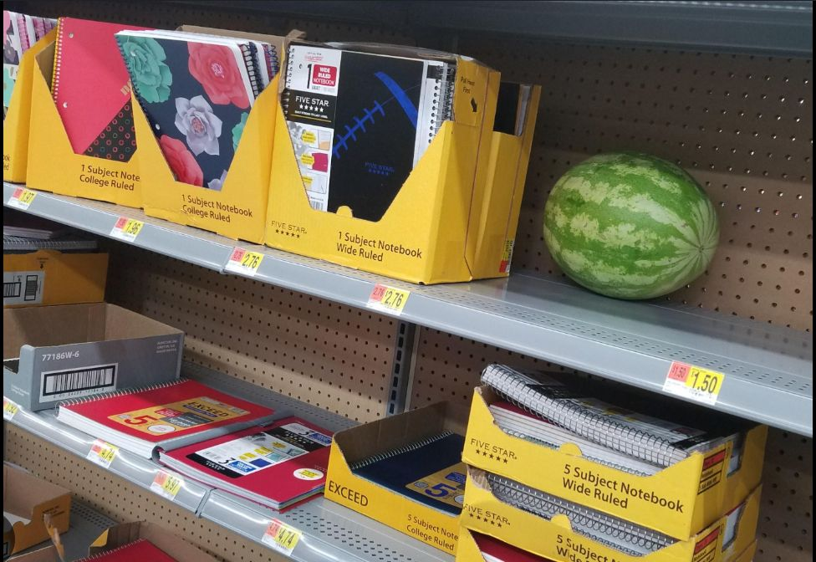
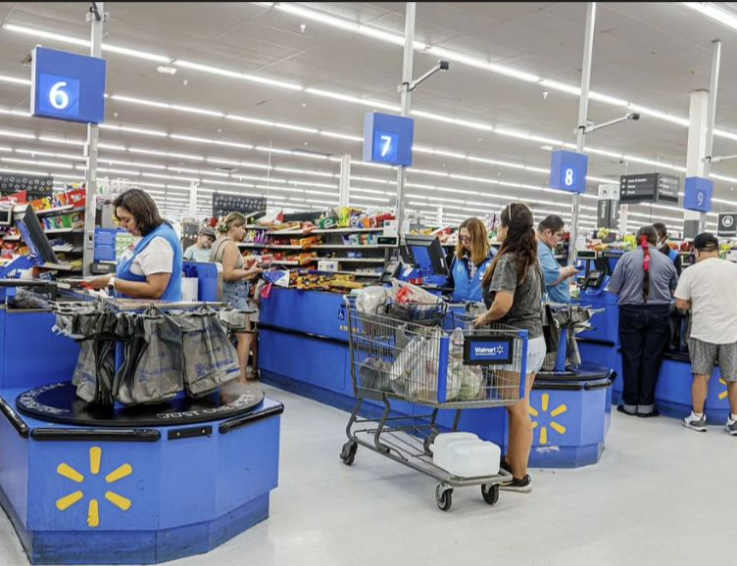
Why Walmart?
In App Scanner
In App Scanners
Misallocated Product
Long Checkout Lines

Slide 5
Data Target
Objective:
Use historical consumption data to predict the next consumption amount of each customer.
Help optimize inventory management, personalized promotions, and improve customer satisfaction.
Data Description:
The data is randomly generated by us and contains the following main information:
Customer information: customer ID and transaction record.
Time information: transaction date.
Consumption information: consumption amount, purchased goods, and commodity categories.
Data volume:
Contains a total of about 10,000 transaction records, covering the historical consumption of all customers.
Notes:
Use customers' historical consumption pattern to predict their next purchase amount.
Can help the store in many ways，like 库存管理，个性化促销，客户满意度，等

Slide 6
Data Overview
product_id | product_name | product_price | average_weight_kg | product_category | customer_id | customer_name | product_count | total_amount | customer_start_date | last_transaction_date | transaction_time
48443 | Tortilla(6pck) | 5 | 0.3 | Bakery | 359816 | Kylie Davis | 4 | 20 | 5/28/2023 | 5/6/2024 | 5/6/2024 10:53
44817 | White Bread | 4 | 0.5 | Bakery | 972886 | Delina Ivanova | 3 | 12 | 10/11/2021 | 8/15/2024 | 8/15/2024 6:56
60571 | Tomato Ketchup | 5.5 | 0.75 | Sauce | 121533 | John Castillo | 3 | 16.5 | 2/15/2023 | 11/3/2024 | 11/3/2024 3:40
55644 | Beef | 18 | 1 | Meat | 121533 | John Castillo | 2 | 36 | 2/15/2023 | 11/3/2024 | 8/21/2024 17:59
67243 | Shredded Cheese(350g) | 7 | 0.35 | Dairy | 703094 | Leslie Pitts | 3 | 21 | 3/15/2021 | 9/20/2024 | 9/20/2024 10:29
32815 | Eggs(0.5dozen) | 4.5 | 0.3 | Dairy | 972886 | Delina Ivanova | 2 | 9 | 10/11/2021 | 9/4/2024 | 9/4/2024 18:07
11013 | Cookies | 4.25 | 0.35 | Snacks | 770025 | Matthew Gordon | 4 | 17 | 7/19/2020 | 11/8/2024 | 11/8/2024 13:51
79206 | Eggs(1.5dozen) | 11.25 | 0.9 | Dairy | 197461 | Kim Scott | 3 | 33.75 | 12/1/2020 | 3/15/2024 | 3/15/2024 7:10
38954 | Mustard | 4.5 | 0.35 | Sauce | 703094 | Leslie Pitts | 3 | 13.5 | 3/15/2021 | 9/20/2024 | 8/24/2024 16:32
Notes:
Our data is randomly generated based on products, 商品信息比如什么什么。。。 who bought the products and the amount was sold, and the total price. It also recored the transaction time.
However, this is not very suitable for our prediction goal, which is the customer's next purchase amount. So we transformed the data.

Slide 7
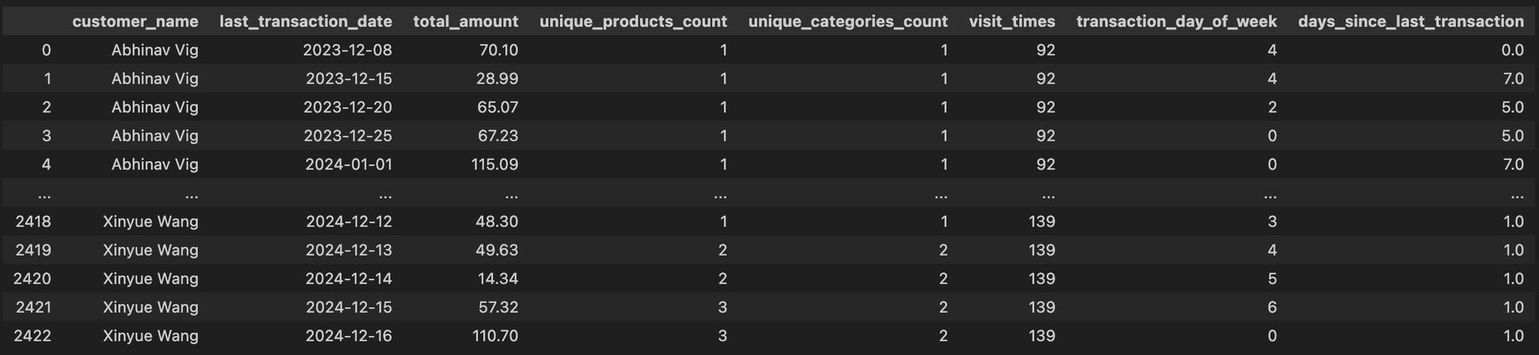
Data Preparation
Capture customer purchasing behavior patterns:
The number of unique products and categories reflects the customer's diverse purchasing tendencies.
Explore the impact of time features:
The day of the week when the transaction occurs may affect consumer behavior (such as weekend shopping peak).
The number of days since the last transaction can be used to analyze the customer's purchase cycle.
Provide more information for the model:
These features can improve the model's predictive ability and help more accurately predict the customer's next spending amount.
Notes:
We reorganize the table product base into customers based. By checking the transaction date and time of each item, we can know how many times a customer has visited the store and how much he or she spent each time.
This step helps the next modeling part.

Slide 8
Data Preparation
To capture the products and categories purchased by customers in more detail, the following features are constructed using Pivot Tables:
Create a product pivot table product_pivot to count the number of purchases of each product by customer and transaction date.
Create a category pivot table category_pivot to count the number of purchases of each category by customer and transaction date.
Merge the product and category pivot tables with the main table (df_customer_total_amount_by_date) respectively.
In order to evaluate the performance of the model, the training set and test set are divided in chronological order:
Training set (70%): includes records with earlier history, used for training the model.
Test set (30%): includes records with later dates, used to verify the model effect.
Notes:
But this changes will reduce the number of variables, so we sorted out the customer's spending habits.
We used the Pivot Tables function to count how much of each item the customer bought each time and what catagory they liked to buy.
Then we divided the data into 70% traning data and 30% testing data for running the model.

Slide 9
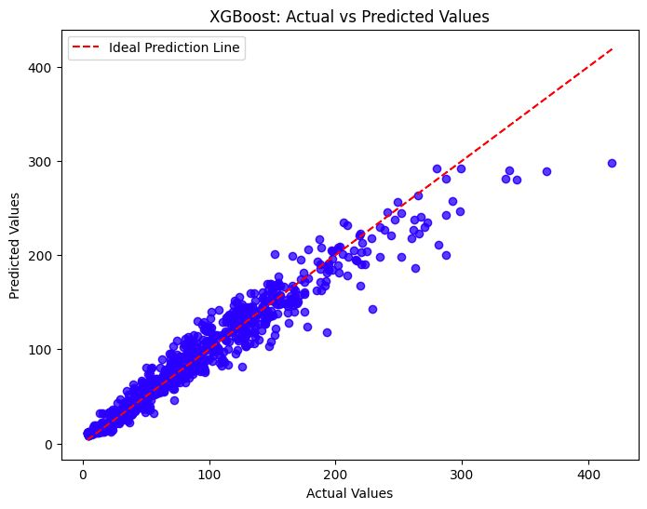
Model selection & Results
Our final choice is XGboost. The following indicators are used to evaluate the model performance:
MSE : 492.42
RMSE : 22.19
MAE : 14.15
R² score: 0.94 (close to 1), indicating that the model can explain most of the consumption patterns.
Notes:
We ran 3 models, random forest, ridge regression and xgboost. The result of XGboost was the best.
We found that the average prediction error of the model was $22.19. (RMSE)
Our model can explain 94% of customer consumption behavior, which means that most consumption patterns are consistent with the rules learned by the model.

Slide 10
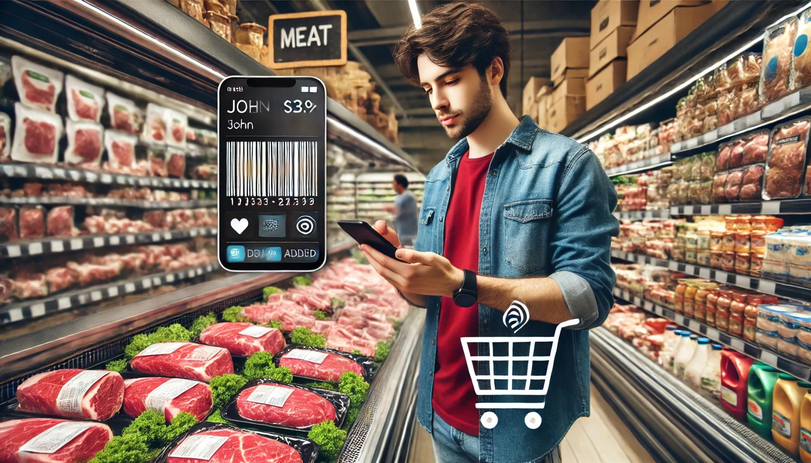
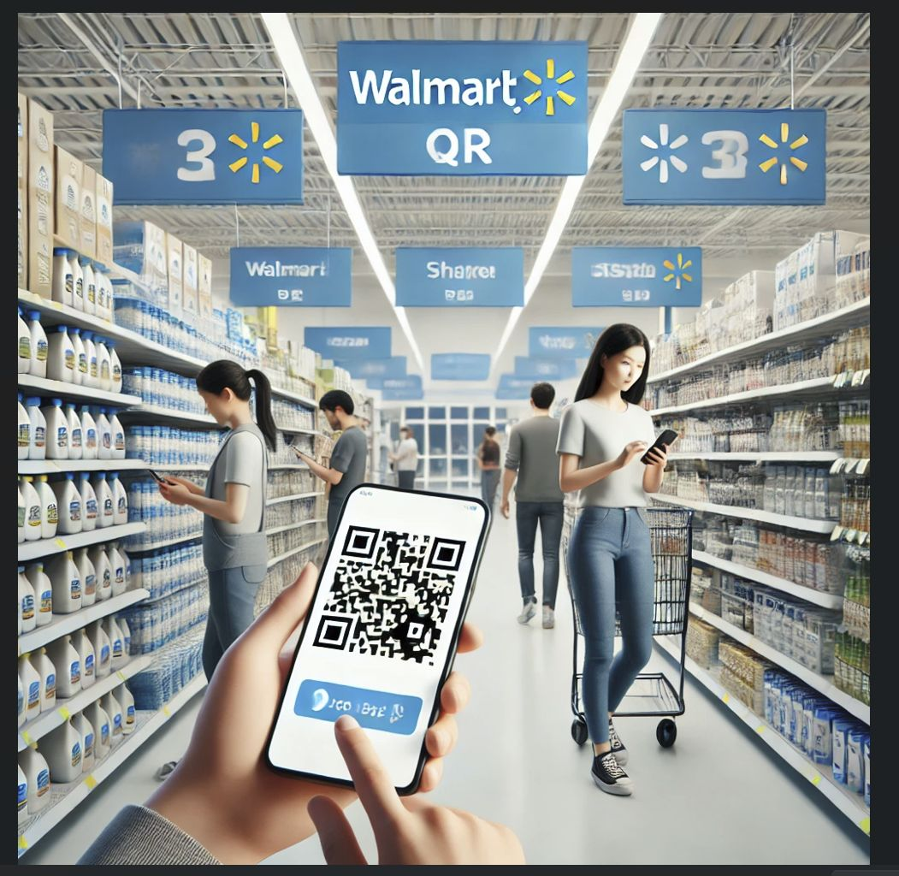
App Overview
Problem Overview:
John visits a grocery store for a quick shopping spree but skips calculating his total as he adds items to his cart. By the time he reaches the checkout, he is unsure of the overall bill and starts feeling anxious about exceeding his budget.
Solution Using the App:
With the barcode scanner app, John can scan each item as he picks it, and the app dynamically calculates his subtotal, tax, and total amount in real-time. It also allows him to adjust quantities or remove items instantly. By the time he reaches the checkout, John already knows his exact total, including taxes, ensuring he stays within budget and avoids surprises.

Slide 11
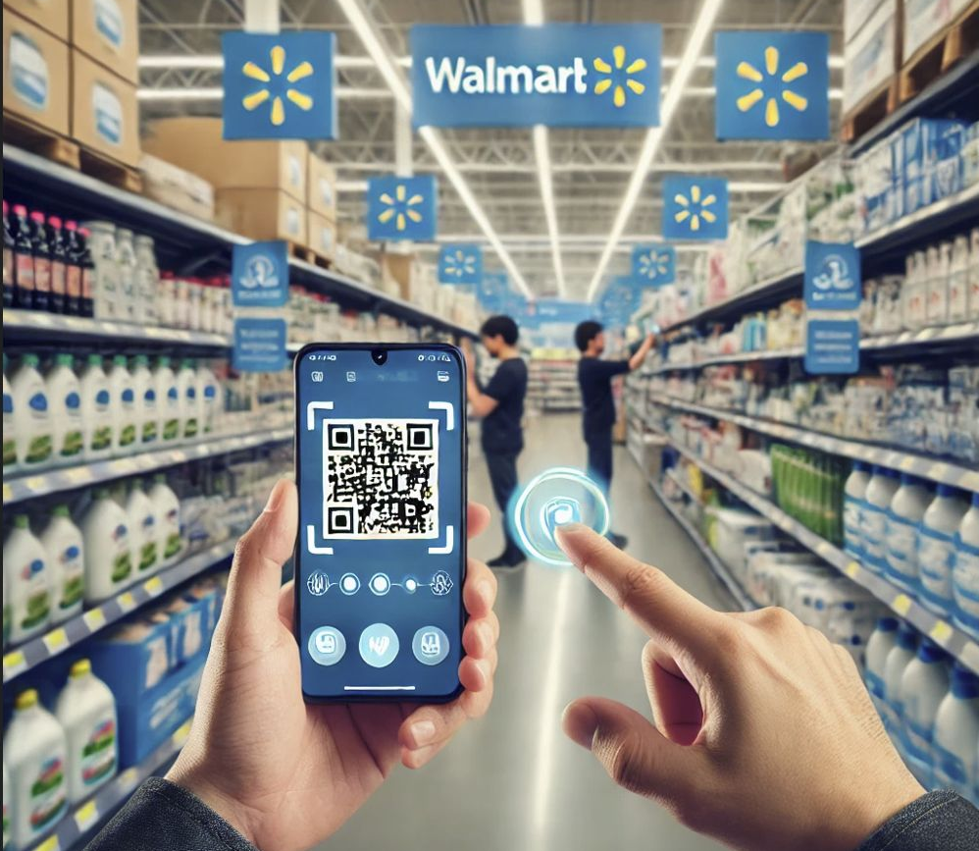
App Demonstration
Initialization and Setup
The app initializes a grocery data frame from a CSV file
It uses session state to maintain the app's state (cart contents, product ID, navigation between screens).
The main screen toggles between Scan Page, Food Cart, and Payment Page based on user actions.
2. Barcode Scanning
The Scan Page activates the webcam to capture live frames.
It decodes barcodes extracting the product ID.
The app validates scanned product IDs against the grocery dataset.
Valid products are redirected to the cart, while invalid scans prompt error messages.
4. Cart Management Options
Users can clear the cart entirely or proceed to the Payment Page for checkout.
If the cart is empty, an appropriate message is displayed.
5. Adding Tips on Payment Page
The Payment Page offers predefined tip percentages (e.g., 10%, 12%, 15% and 18%) with calculated values.
Users can also enter a custom tip amount.
The final total with the selected tip is prominently displayed.
3. Interactive Food Cart
The Food Cart displays scanned products along with details like name, price, quantity, and total price.
Users can adjust product quantities using Add (+) and Remove (-) buttons.
The app dynamically updates the cart and recalculates the subtotal, tax (13%), and total amount in real-time.
6. Order Confirmation
Once the payment is confirmed, the app resets the session state, clears the cart, and redirects back to the Scan Page, ready for new transactions.

Slide 12
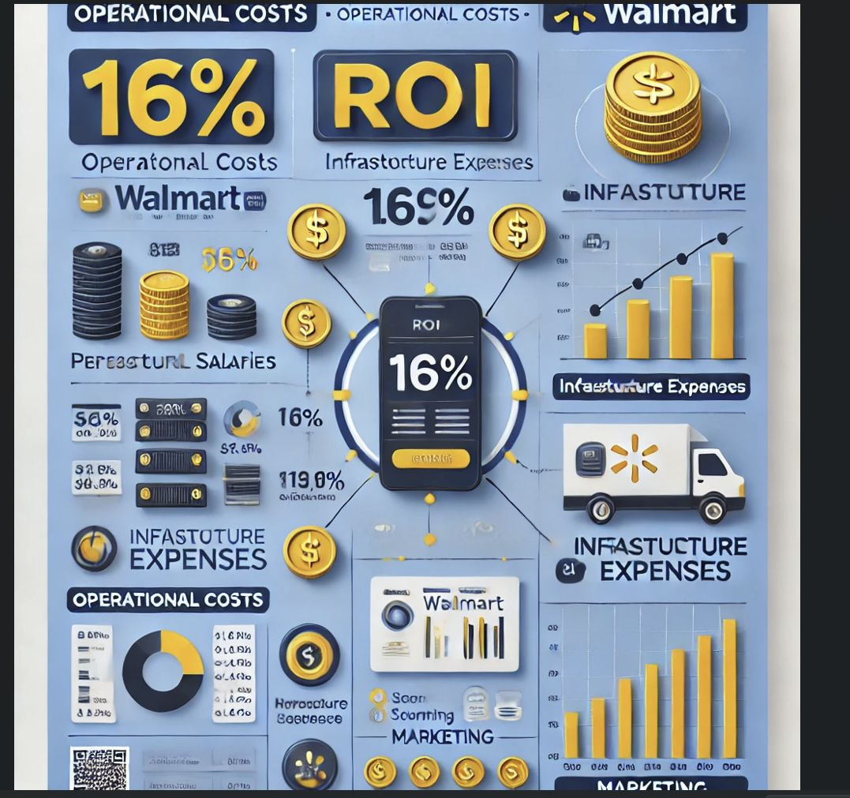
Operating Costs
Development Costs:
Image segmentation or processing and their training: $100,000
Mobile app updates: $150,000
Integration with Walmart's existing systems: $100,000
Total Development Costs: $350,000
Infrastructure Costs:
Cloud storage and computing for ML models: $120,000
Server maintenance: $80,000
Total Infrastructure Costs: $200,000
Personnel Costs:
Salaries for data scientists, change managers, and project managers: $100,000
Customer support for app-related issues: $100,000
Total Personnel Costs: $200,000
Operational Costs:
Periodic retraining of ML models to adapt to new data: $60,000
Marketing and user education campaigns: $40,000
Total Operational Costs: $100,000
ROI – 16%
Total Costs are calculated by summing up all expenditures mentioned above.
Net Gains
Cost Savings:
Labor Costs: By automating the checkout process, Walmart can reduce the need for cashiers, saving approximately $400,000 annually.
Revenue Growth:
Increased Sales Through Promotions: ML-powered personalized promotions can increase basket sizes and drive sales. Projected revenue: $386,000 annually.
Improved Customer Retention: Faster checkout and better user experience increase repeat visits and loyalty. Projected additional revenue: $200,000 annually.

Slide 13
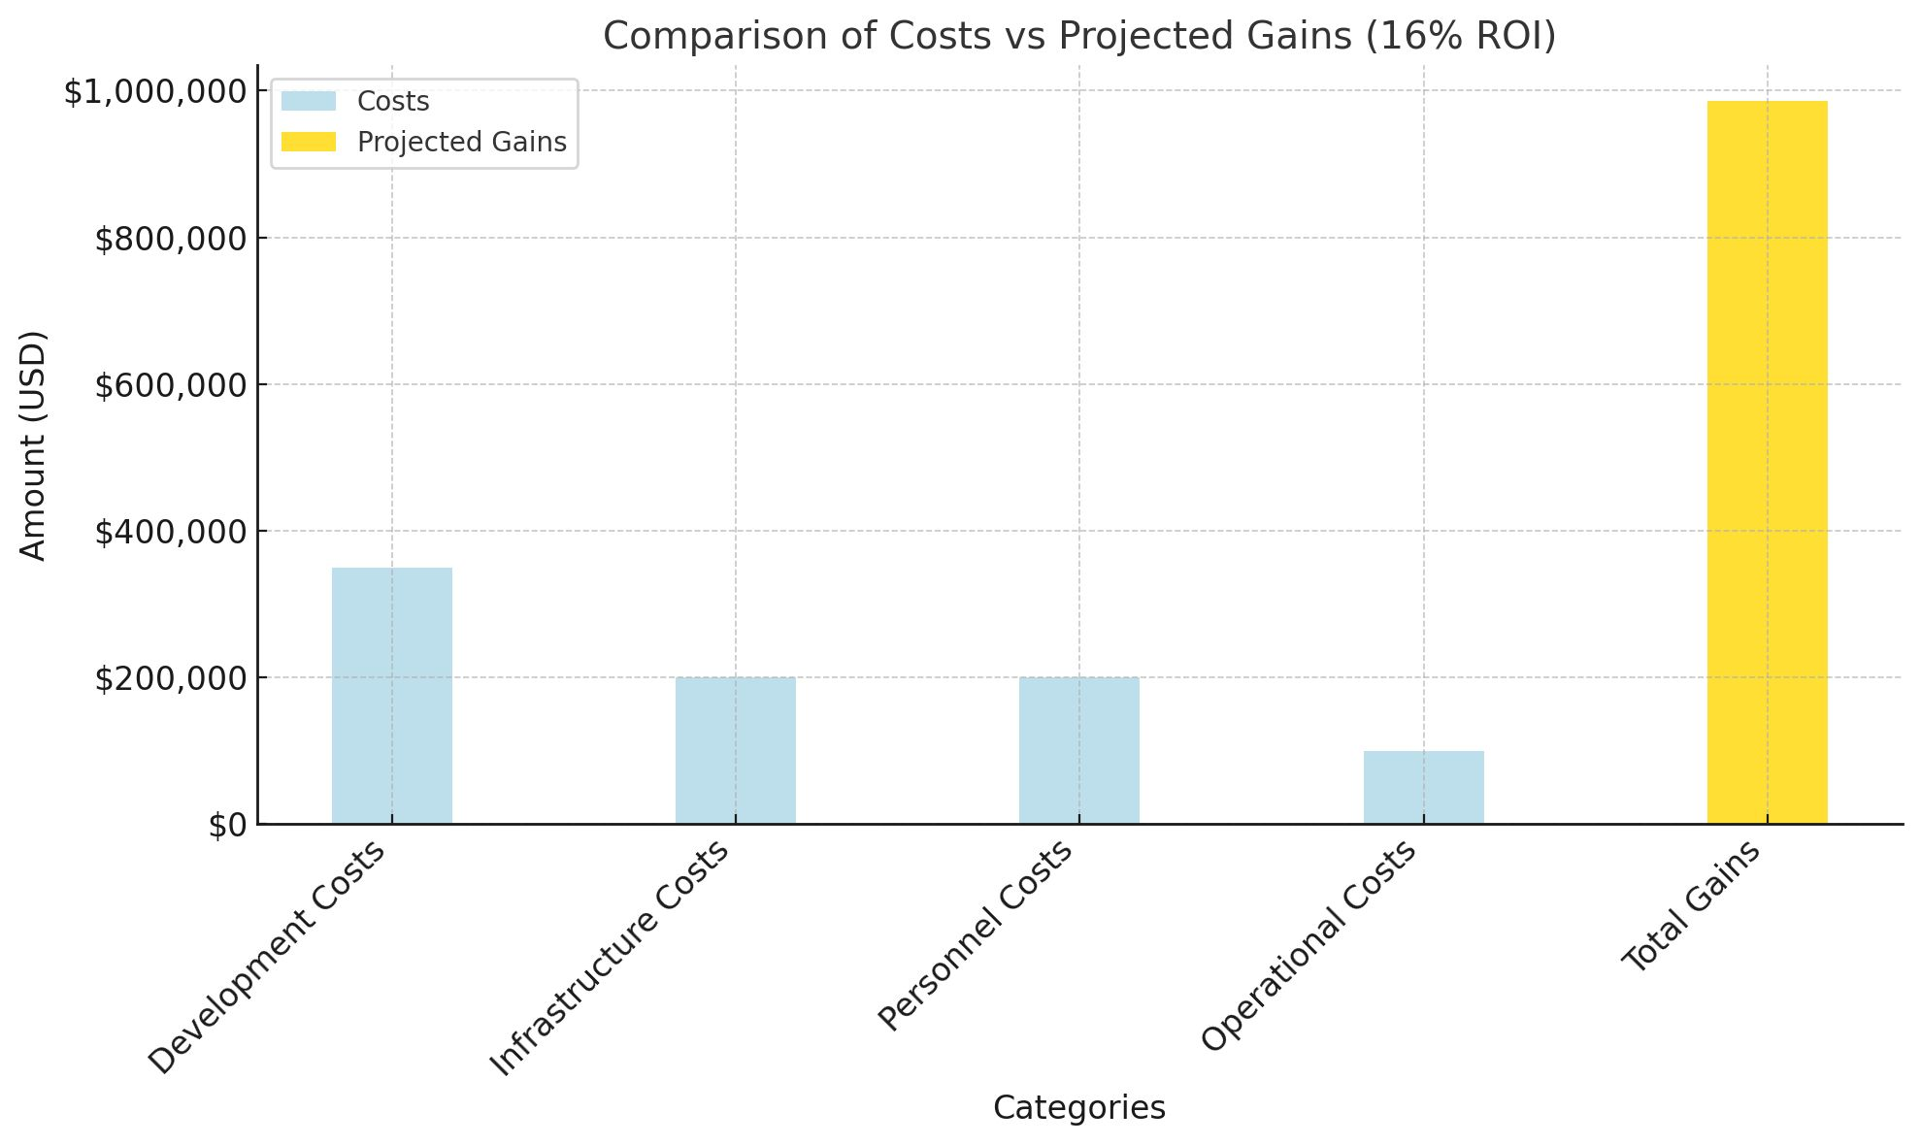
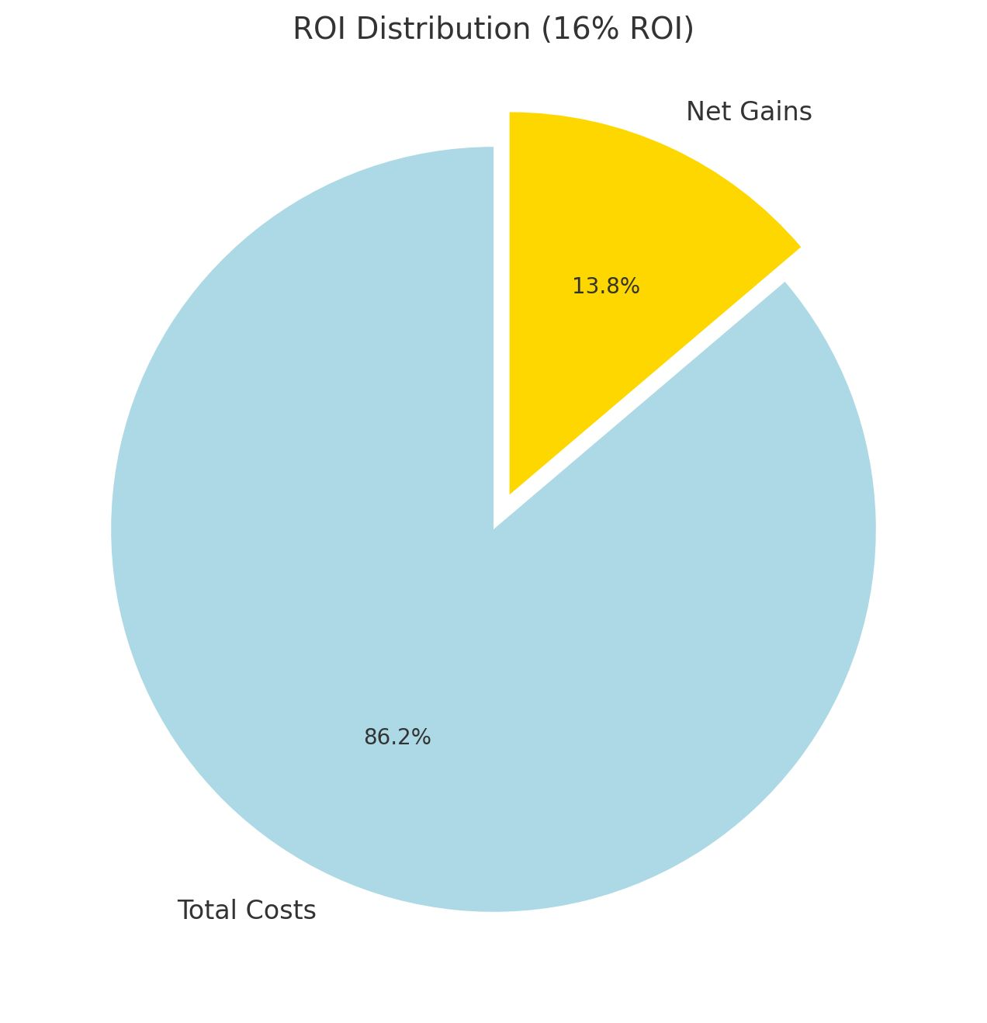
Financial Analysis:
Costs, Gains, and ROI Projection

Slide 14
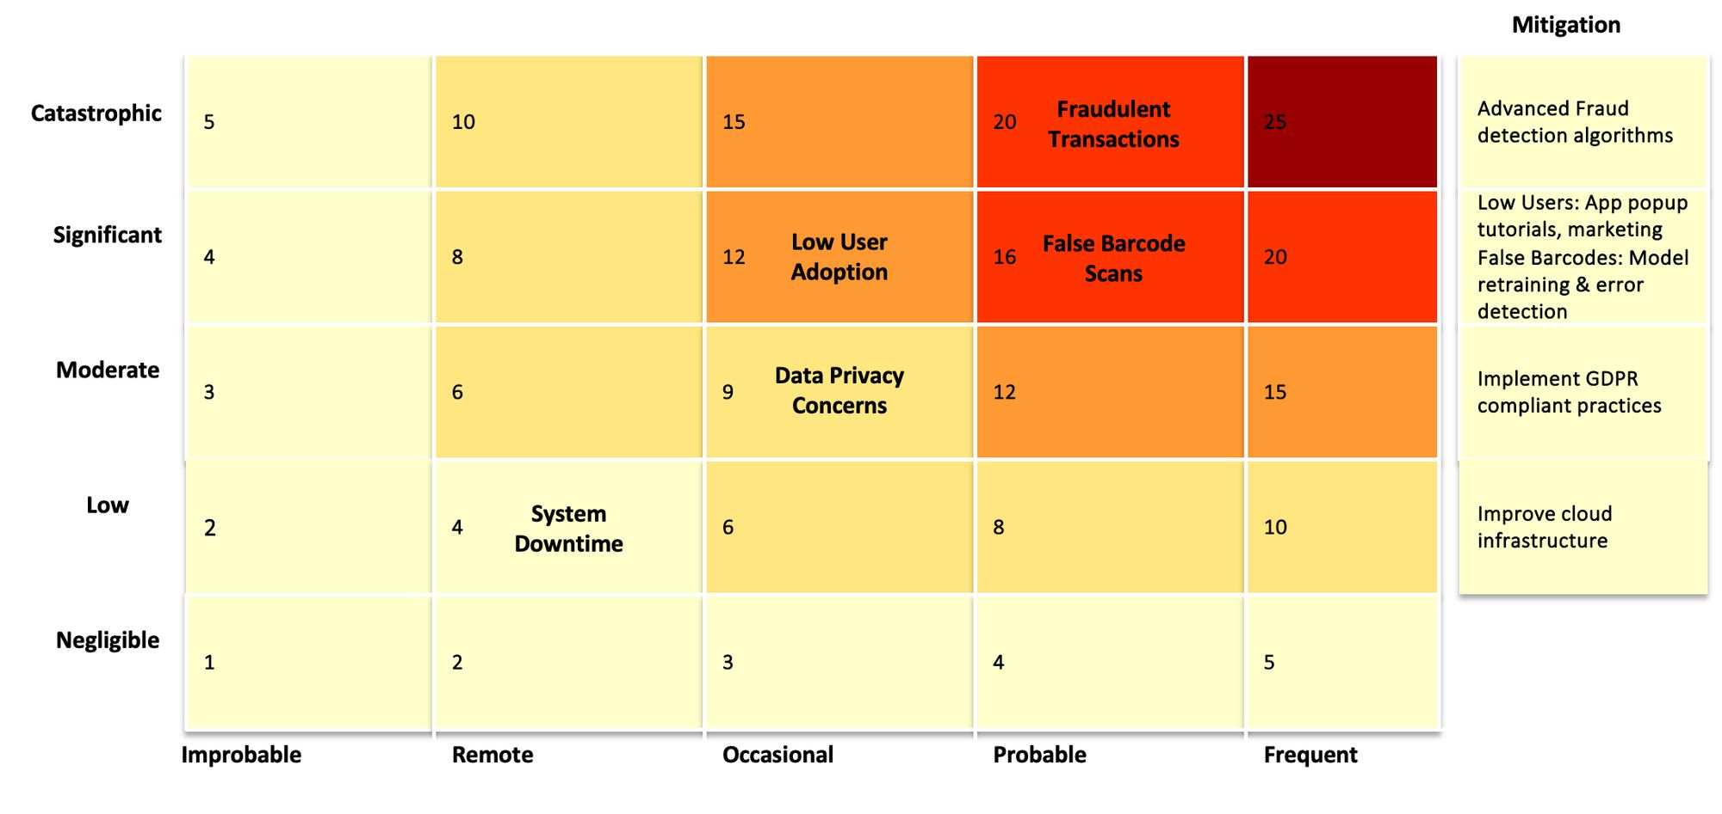
Risks and Mitigation
Impact
Likelihood

Slide 15
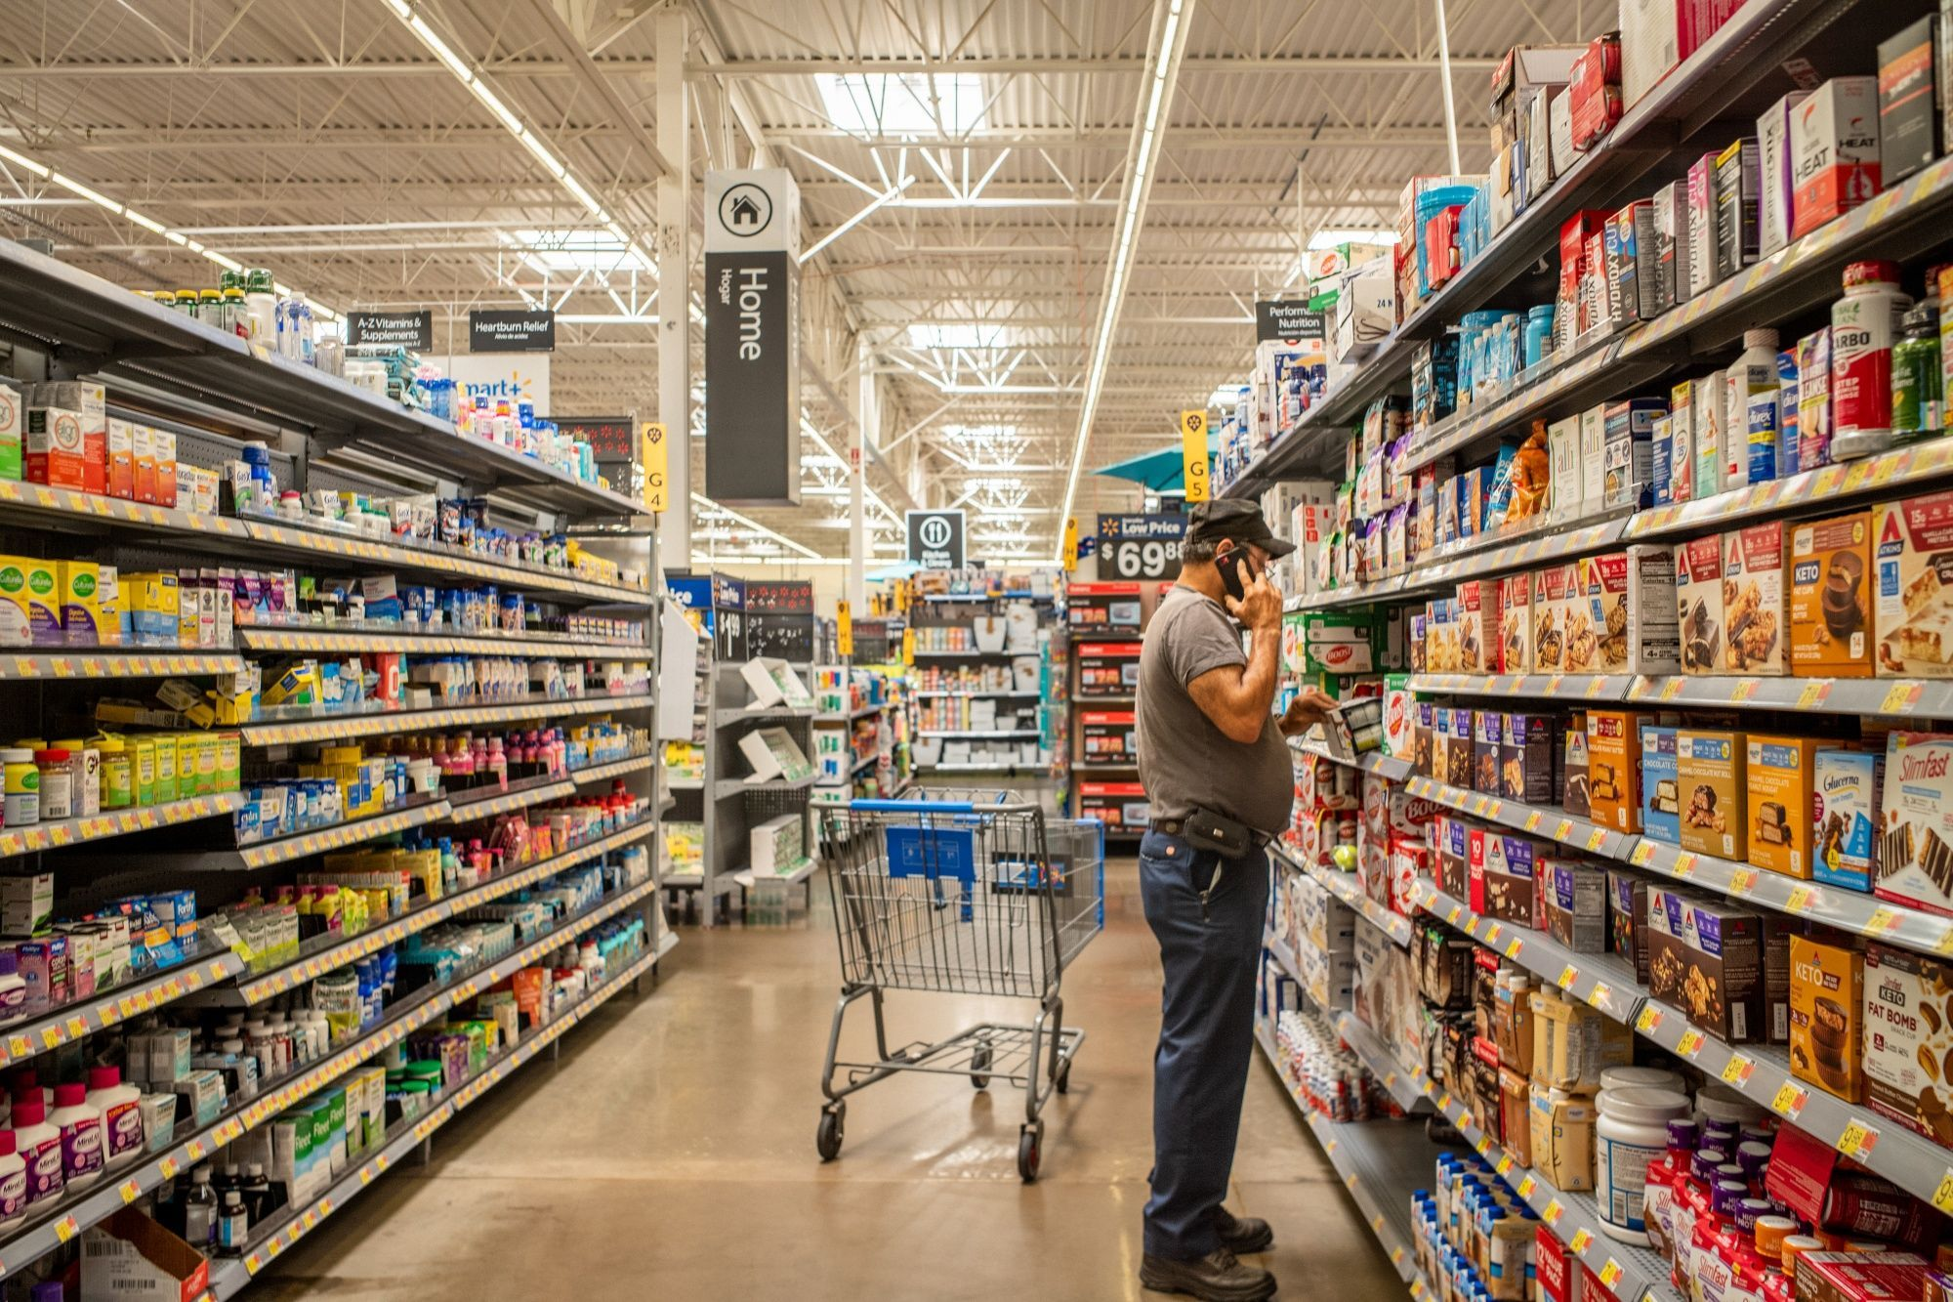
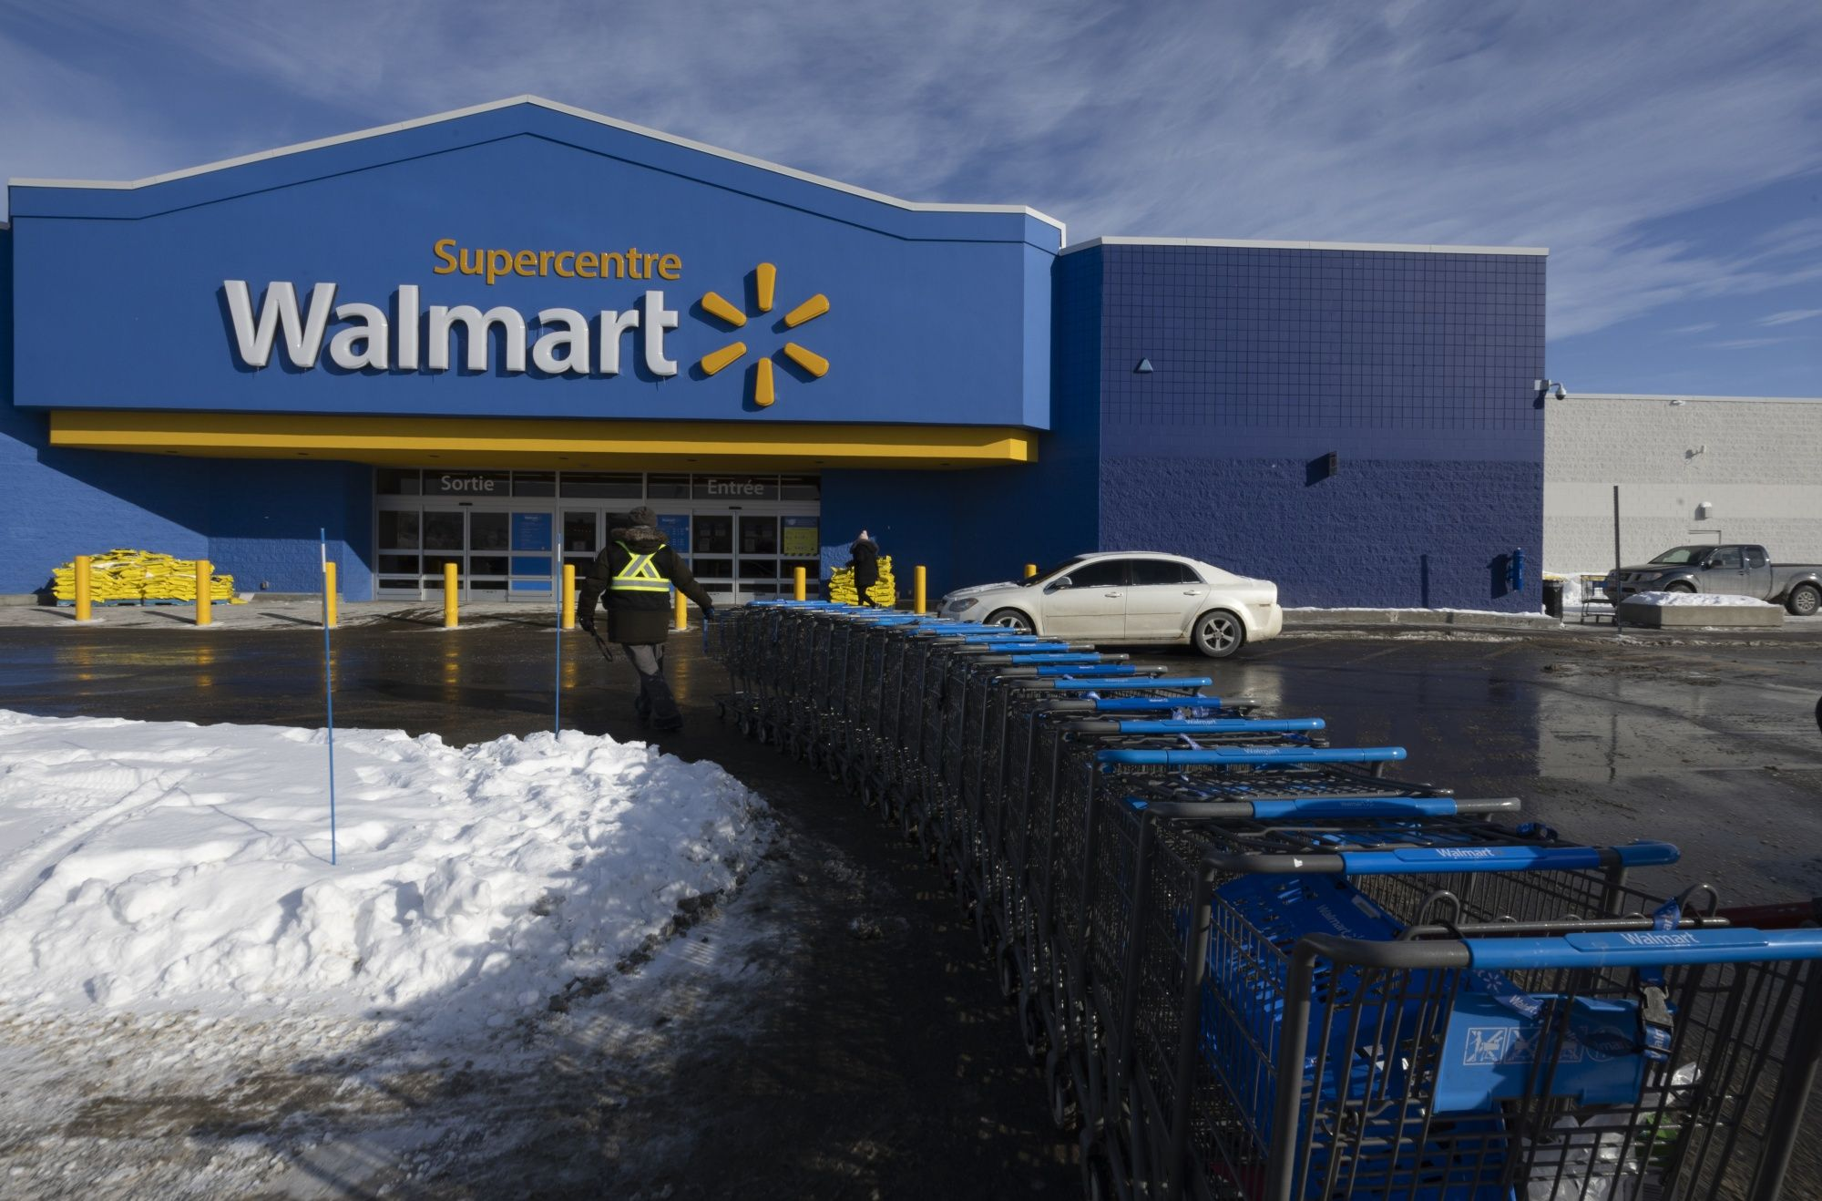
Conclusion
Revolutionizing the in-store shopping experience:
Enhanced Customer Experience
Operational Efficiency
Revenue Growth & Return on Investment

Slide 16
Your Questions, Our Vision
Q/A
Thank You !
W A L M A R T

