Slide 1

IOT MINING TRACKING AND WORKER SAFETY HELMENT
team members-
36- VEDAnT KULKARNI
54- VEDANT RAUT
56- SELVIN SALVE
59- VAISHNAVI SHENDGE
61-sOHAM VAIDYA
9.24.XX

Slide 2
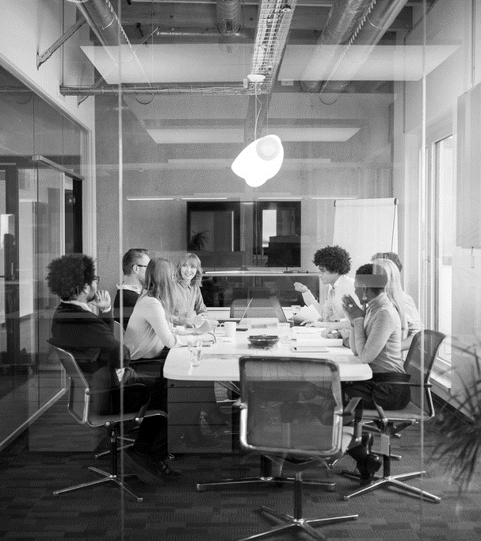
Agenda
Need of the Topic
Component
Configuration of sensors
IoT Board Information
Use case diagram
Circuit Design
Code
Simulation
Applications
Conclusion

Slide 3
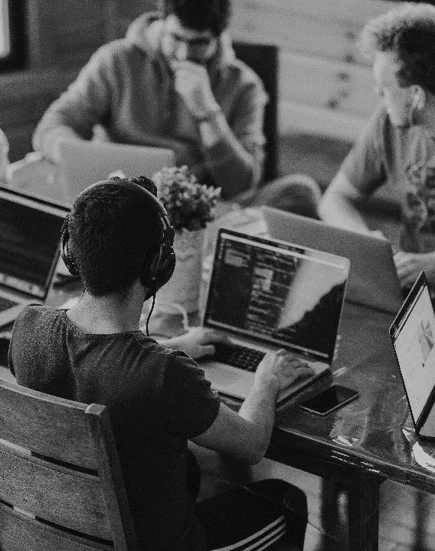
Need of topic
Safety of workers should always be of major consideration in any form of mining.
This project addresses a cost-effective, flexible solution for underground mine workers safety.
Modern mines often implement several safety procedures related with training of workers ,health and safety standards by using IOT application which will be explained in this project.

Slide 4
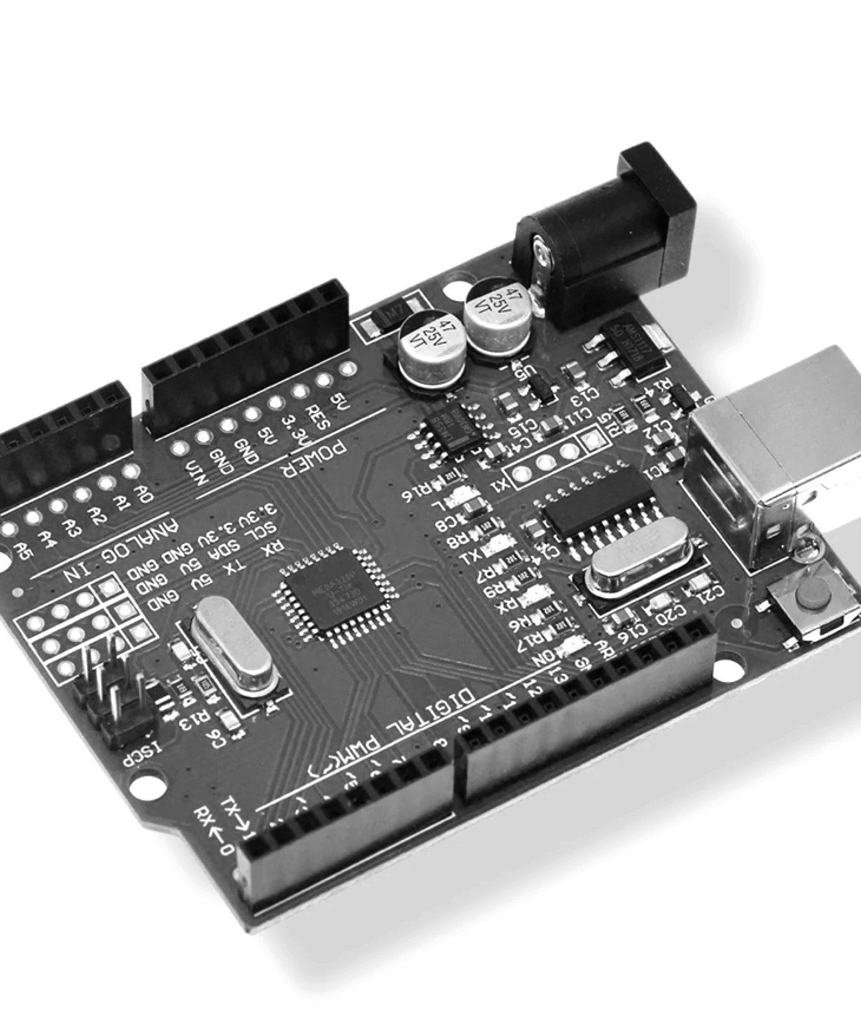
COMPONENTS
Arduino uno 3
Piezo Buzzer
LCD Display
Fall Detector
Gas Sensor
Temperature Sensor
Photo Resistor
6

Slide 5
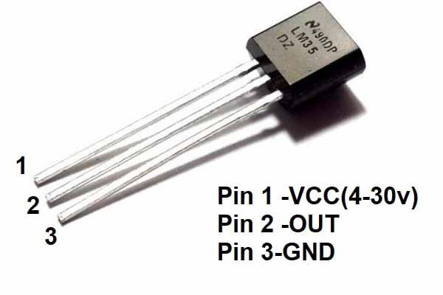
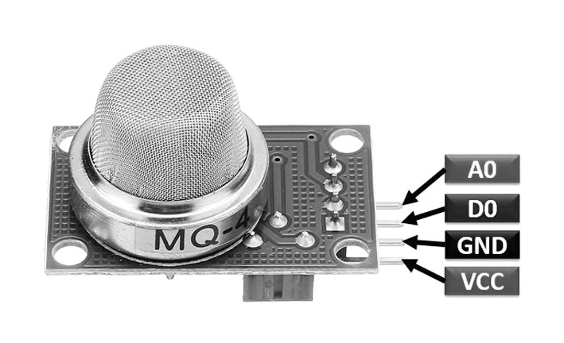
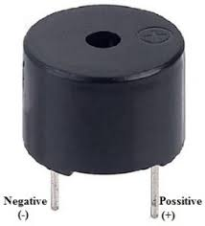
CONFIGURATION OF SENSORS
TMP 36
Gas Sensor
Piezo Buzzer

Slide 6
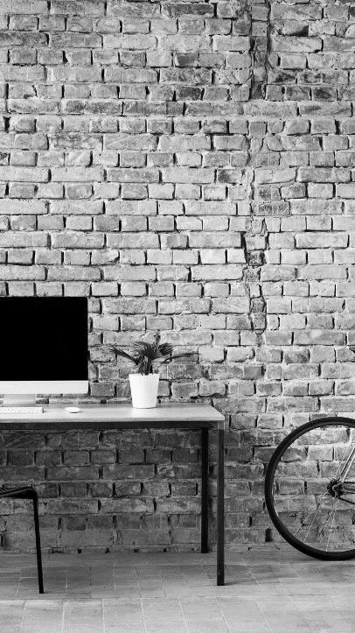
Iot board information
Open-source platform
Used for electronic projects.
This software is used to write the code and upload into the physical board through the USB cable. Arduino IDE uses the simplified version of C++.
Arduino can interact with sensors, motors, internet, smart-phone and the TV.
Arduino has varieties of boards but the UNO is one of the most popular board in the Arduino family.

Slide 7
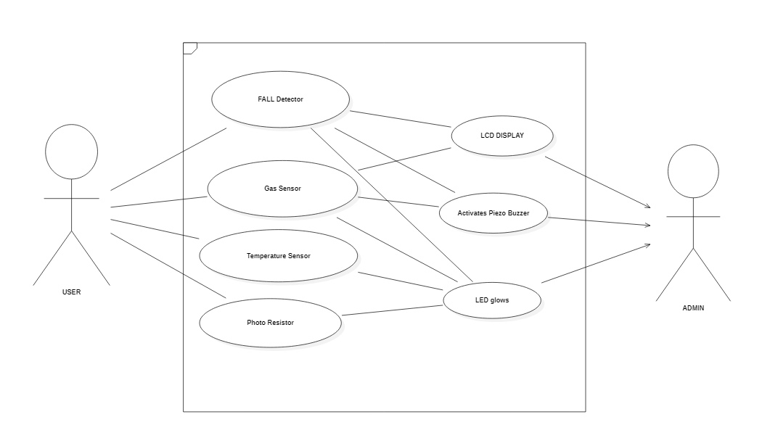
Use case diagram

Slide 8
Circuit DESIGN

Slide 9
CODE – https://www.tinkercad.com/things/hVBif9lKF6A-smart-helmet/editel

Slide 10
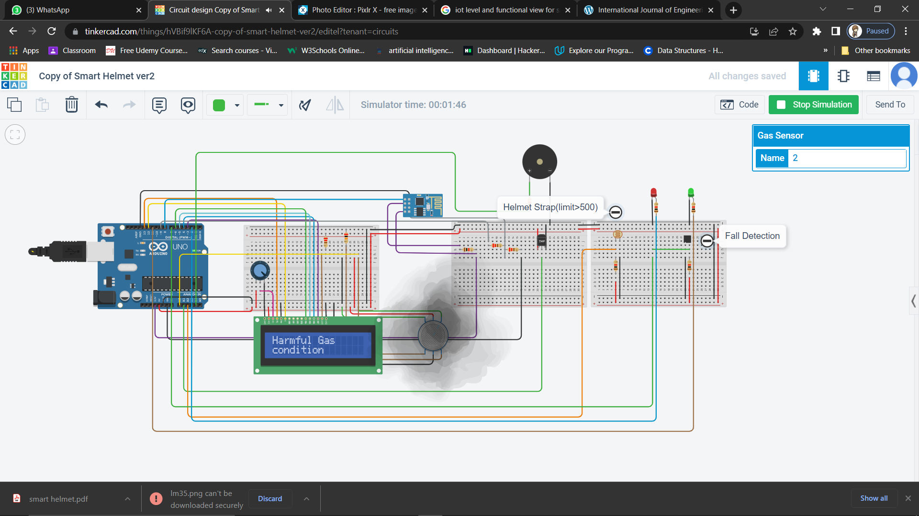
SIMULATION
GAS DETECTION :

Slide 11
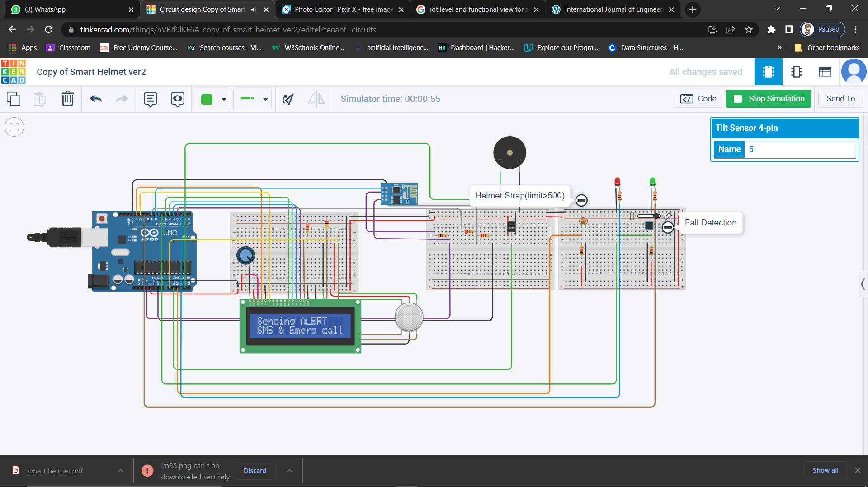
Fall detector

Slide 12
Applications
Safety of workers
Cave excavation
Monitoring mining work
0

Slide 13
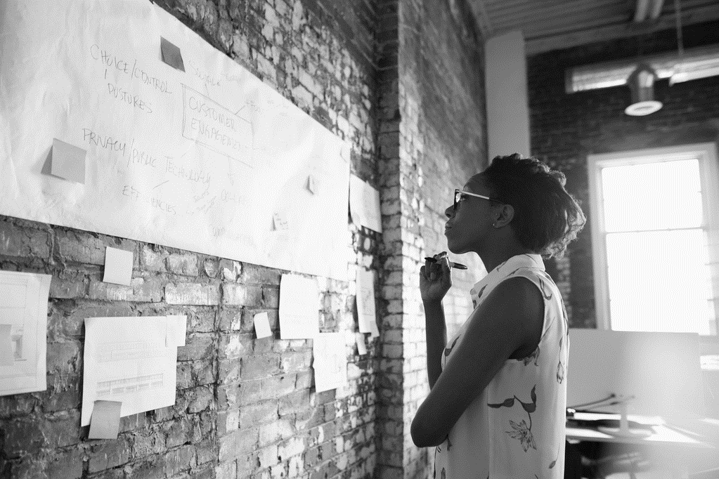
Conclusion
We have successfully enhanced the safety of workers by developing a smart helmet which includes various sensors to monitor the environmental conditions

Slide 14
SE-AI&DS
Thank you

