Slide 1
EduVox
(“Edu” for education + “Vox” meaning voice in Latin)
"Your Voice-Enabled Learning Companion"

Slide 2
Problem Statement
Why Do We Need an AI Voice Tutor?
Traditional learning methods often lack interactivity and personalization, making it difficult to cater to individual learning needs.
Students frequently struggle to understand complex topics without access to dynamic, adaptive support systems.
There is no comprehensive solution that offers real-time, voice-enabled, AI-powered assistance to enhance the learning experience.
The absence of such tools leads to a gap in providing learners with engaging, accessible, and on-demand guidance.

Slide 3
🎯 Solution Overview: What EduVox Offers
EduVox is an AI-powered voice tutor designed to transform traditional learning into an interactive, personalized experience. It leverages advanced AI, voice technology, and smart retrieval systems to support learners in real-time. 🌟 Key Features:
🎤 Voice & 💬 Text Interaction: 🤖 Personalized, Context-Aware Responses: 📝 Summarization, Simplification & Quiz Generation: 🌐 Multilingual Support:
📄 PDF Export: EduVox empowers learners with on-demand, AI-driven educational assistance — making learning more interactive, accessible, and effective.

Slide 4
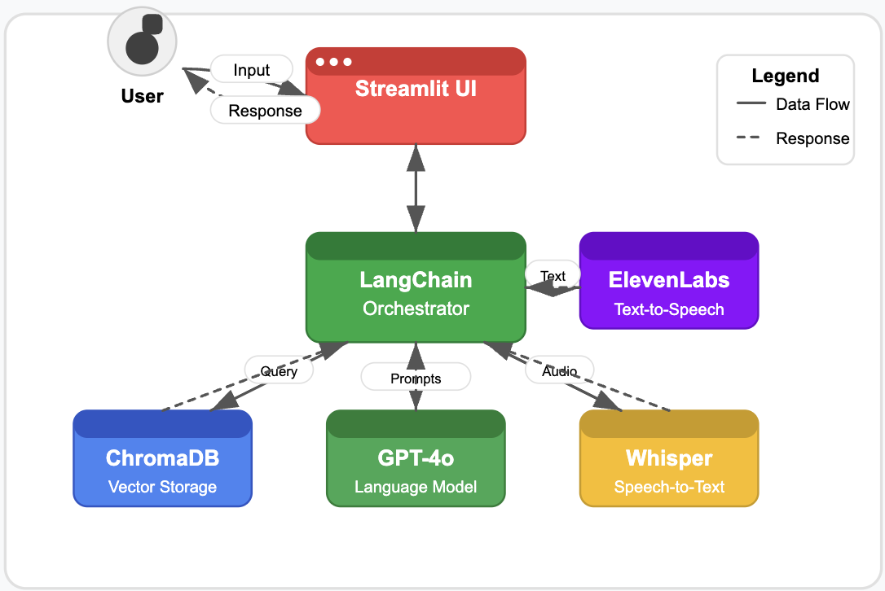
Project Architecture

Slide 5
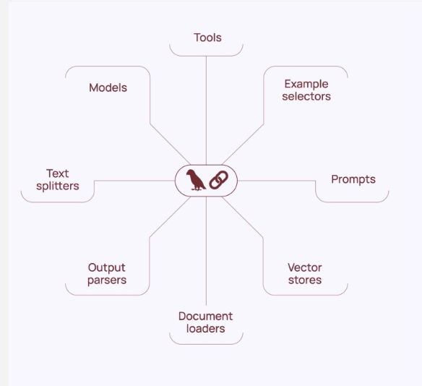
LangChain
A framework (open source) for building applications that leverage various LLMs
(Large Language Models).
Additionally - you can also use external sources of data combined with various
LLMs!

Slide 6
Key Components (LangChain)
Models
Prompts
Chains
Memory
Tools
Agents

Slide 7

Components
1. Retrievers:
Fetch relevant information from ChromaDB based on user queries.
2. Chains:
We use ConversationalRetrievalChain to link retrieval + GPT generation.
3. Memory:
ConversationBufferMemory stores chat history, making conversations contextual and human-like.
4. LLM Integration:
Seamless connection with OpenAI GPT-4o-mini.
LangChain in EduVox

Slide 8
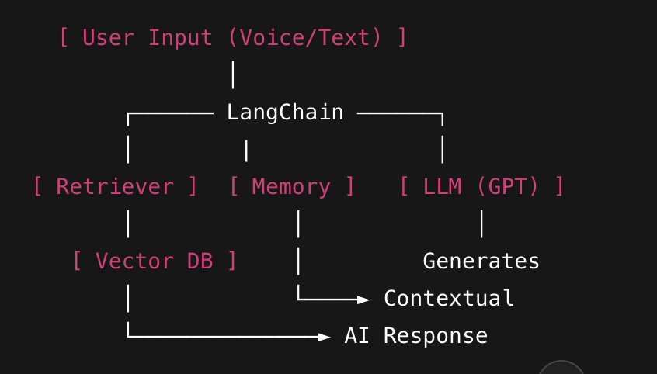
LangChain: The Glue of EduVox
Receives user input.
Uses retrievers to pull data from ChromaDB.
Passes context + data to GPT.
Manages conversation history.
Returns a smart, contextual response.

Slide 9
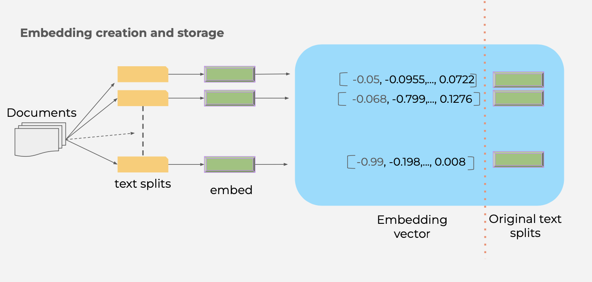
Vector database - full overview

Slide 10
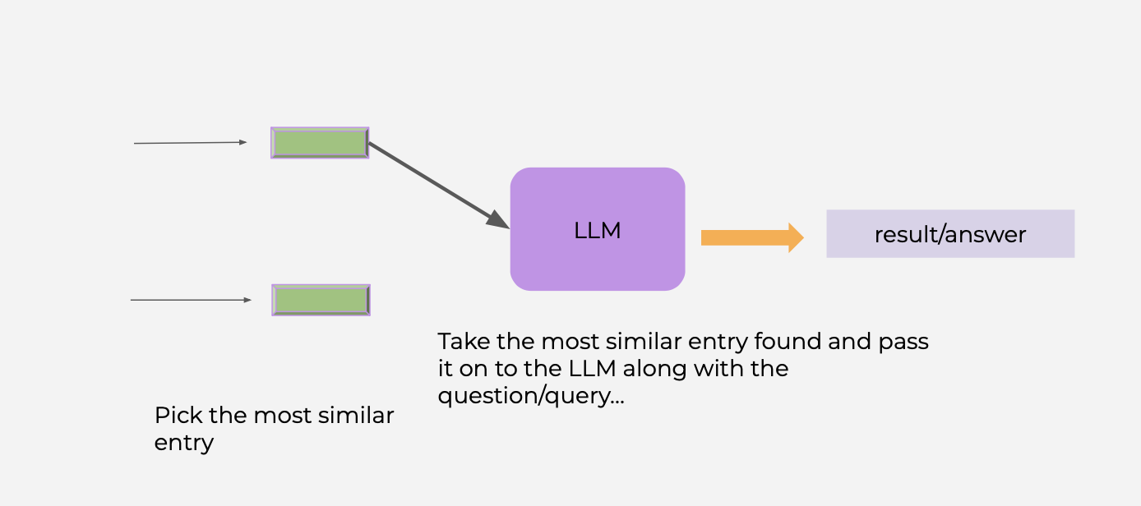
Vector Store - Processing with LLM

Slide 11
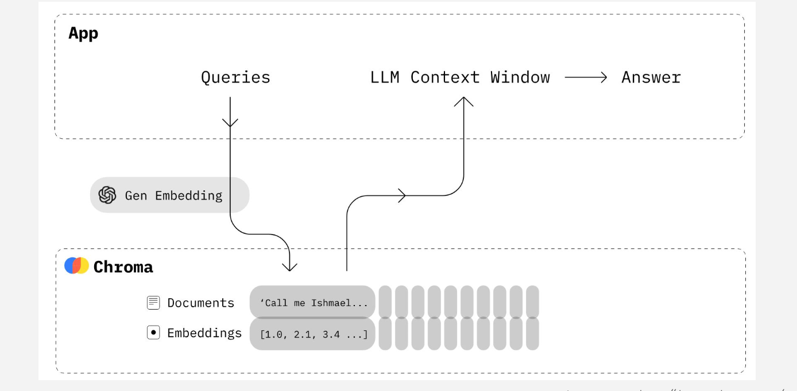
Chroma database workflow

Slide 12
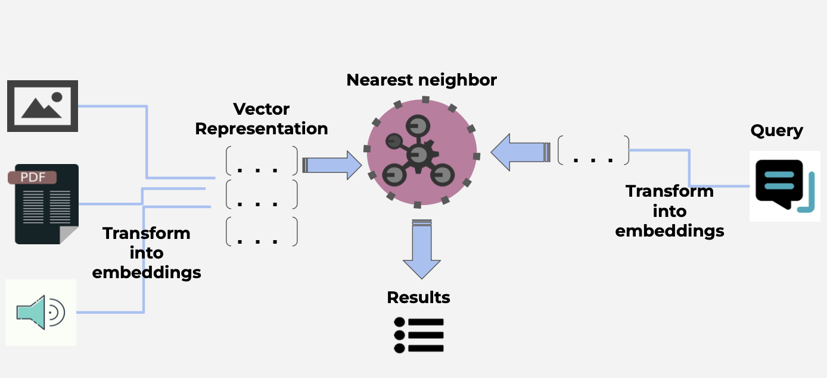
Vector Search - How Does It Work?

Slide 13
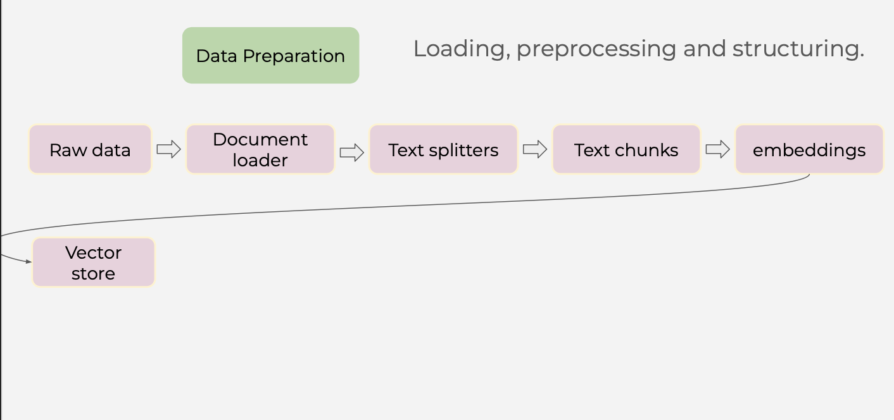
Data Preparation Process

Slide 14

What is a RAG?
A framework that combines the strengths of retrieval-based
systems and generation-based models to produce more accurate and contextual relevant response

Slide 15
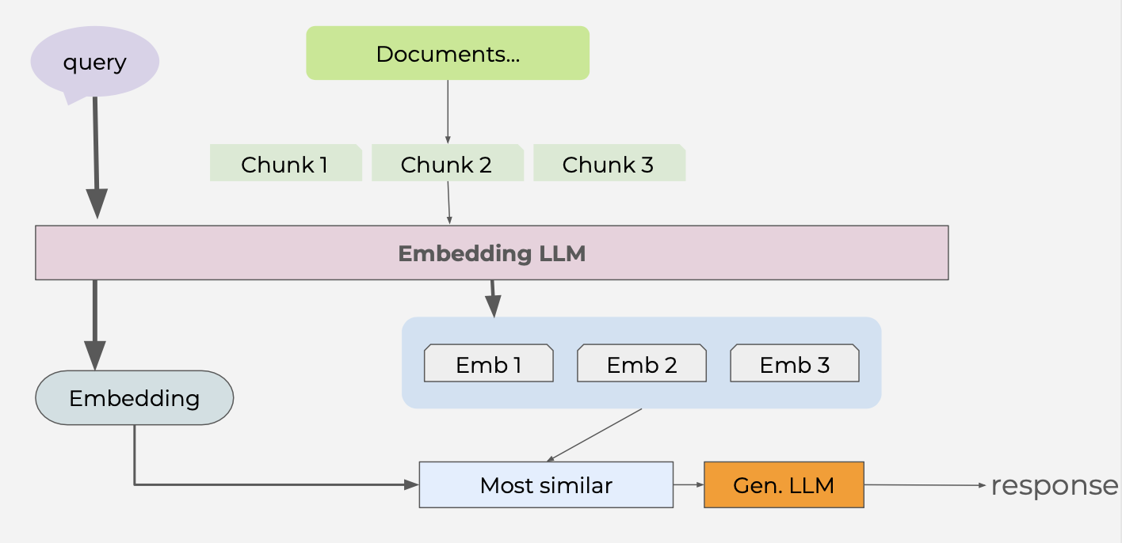
Overview

Slide 16
Benefits of Retrieval-Augmented Generation
1) Enhanced factuality: now we have up-to-date and factual information from external sources (no more solely relying on the pre-trained knowledge of the model.
2)Improved accuracy and specificity: retrieves relevant context and grounds model’s response in factual data
3) Reduced hallucination
4) Adaptability: no need for retraining the model anymore

Slide 17
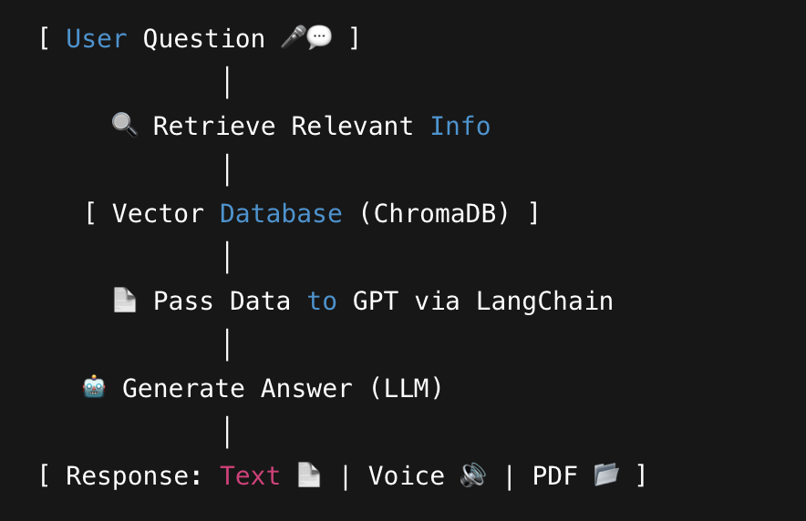
How Does RAG Work in EduVox?
Step 1: User asks a question (Voice/Text).
Step 2: System retrieves relevant document chunks from ChromaDB (Vector Search).
Step 3: Retrieved data is passed to GPT via LangChain.
Step 4: GPT generates a contextual, accurate answer.
Step 5: Response is delivered in text, voice, and PDF formats.
✅ Key Point: "AI is not guessing — it’s generating answers based on your own documents."

Slide 18
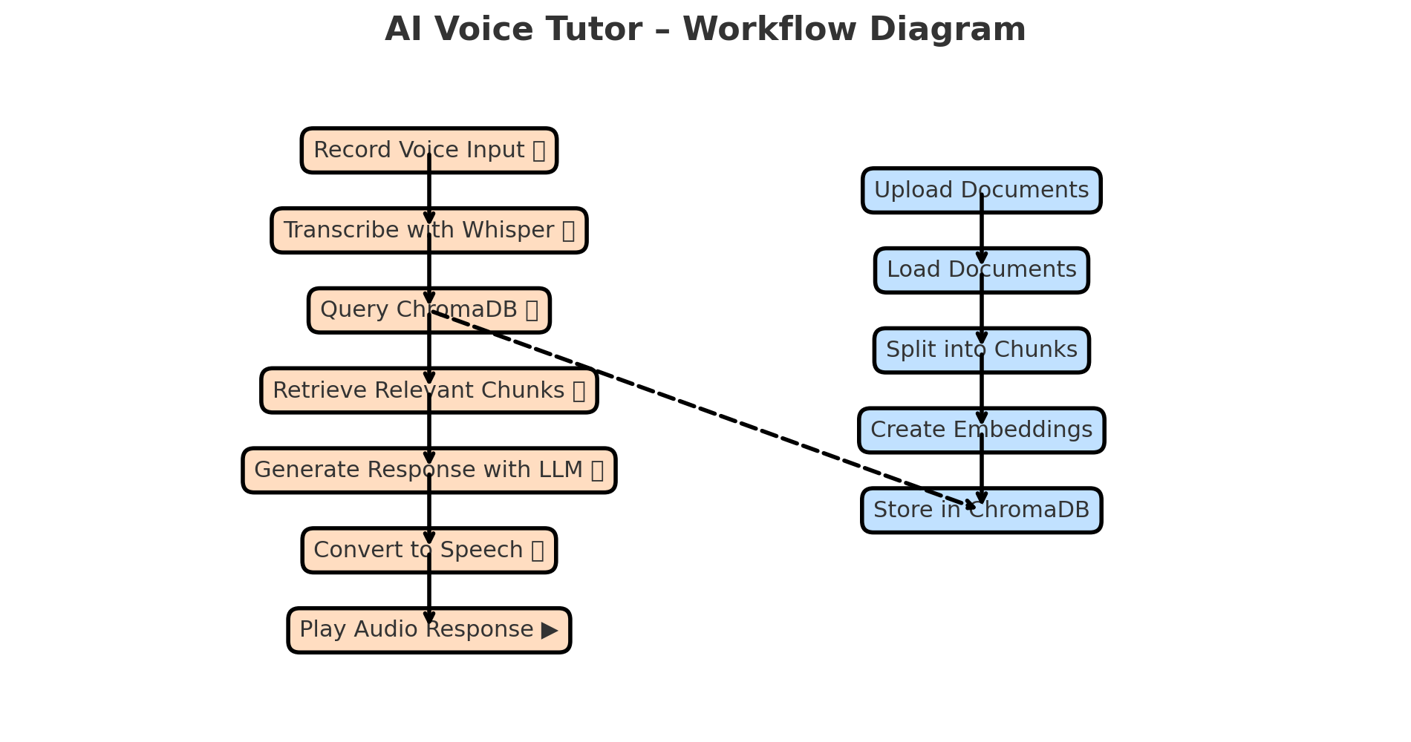

Slide 19


Voice AI Integration
Speech-to-Text (Whisper)
Converts spoken queries into precise text with OpenAI’s Whisper model.
Processes audio right from the application’s interface.
Text-to-Speech (ElevenLabs)
Generates natural voice outputs in multiple languages and voices.
Supports diverse voice options like Rachel, Domi, and Bella.

Slide 20
Challenges & Solutions
Challenge | Solution Implemented
API Rate Limits | Optimized API calls with batching techniques and implemented retries for critical requests.
Audio Processing Delays | Used efficient libraries (Whisper, sounddevice) and optimized recording durations to balance performance and accuracy.
Large Document Handling | Implemented smart chunking with LangChain's Text Splitter and leveraged ChromaDB for scalable vector storage.
Maintaining Context | Integrated ConversationBufferMemory in LangChain to ensure coherent, contextual responses across multiple queries.
Multilingual Voice Output | Utilized ElevenLabs multilingual TTS and fallback mechanisms for unsupported cases.
Temporary File Management | Automated cleanup using Python’s tempfile and os modules to manage storage efficiently.

