Slide 1

Fine-tuning hands-on (LoRA) - Open-source models
Selvin Tuscano

Slide 2

LoRA Deep Dive
A deep dive into LoRA (Low-Rank Adaptation) focuses on two key aspects
Understanding PEFT (Parameter-Efficient Fine-Tuning)
Fine-tuning LLMs with LoRA

Slide 3



What is PEFT? PEFT stands for Parameter-Efficient Fine-Tuning. It is a technique used to fine-tune only a small subset of a model’s parameters instead of the entire model. This approach significantly reduces memory and computational costs, making it more efficient and feasible, especially when working with large models or limited hardware resources.

Slide 4
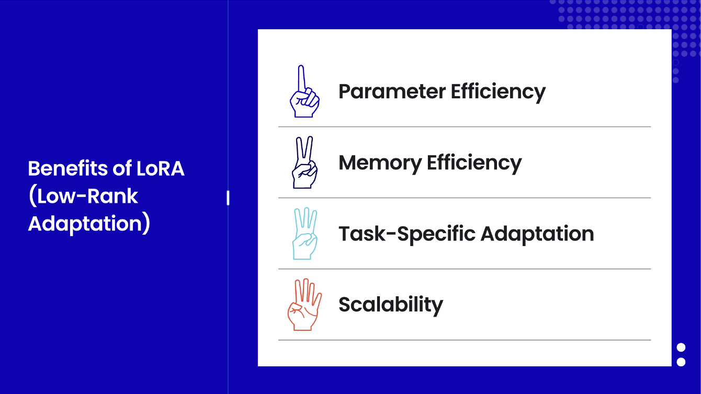

Slide 5
When to Use LoRA (Low-Rank Adaptation)
Limited Compute Resources: LoRA is ideal when you don't have access to high-end GPUs or TPUs.
Since LoRA reduces the number of trainable parameters, it allows efficient fine-tuning even on modest hardware setups, making it accessible for individuals or organizations without large-scale infrastructure.
Multi-task Learning: When there's a need to fine-tune a single model for multiple tasks without maintaining separate copies for each task.
LoRA enables efficient adaptation for various tasks by injecting lightweight, task-specific parameters, avoiding the need to duplicate large models for every new task.
Avoiding Catastrophic Forgetting: LoRA helps retain the pre-trained knowledge of a model while adapting it to new tasks.
This is crucial when fine-tuning, as it prevents the model from "forgetting" its general capabilities while learning task-specific behaviors, maintaining a balance between old and new knowledge.

Slide 6
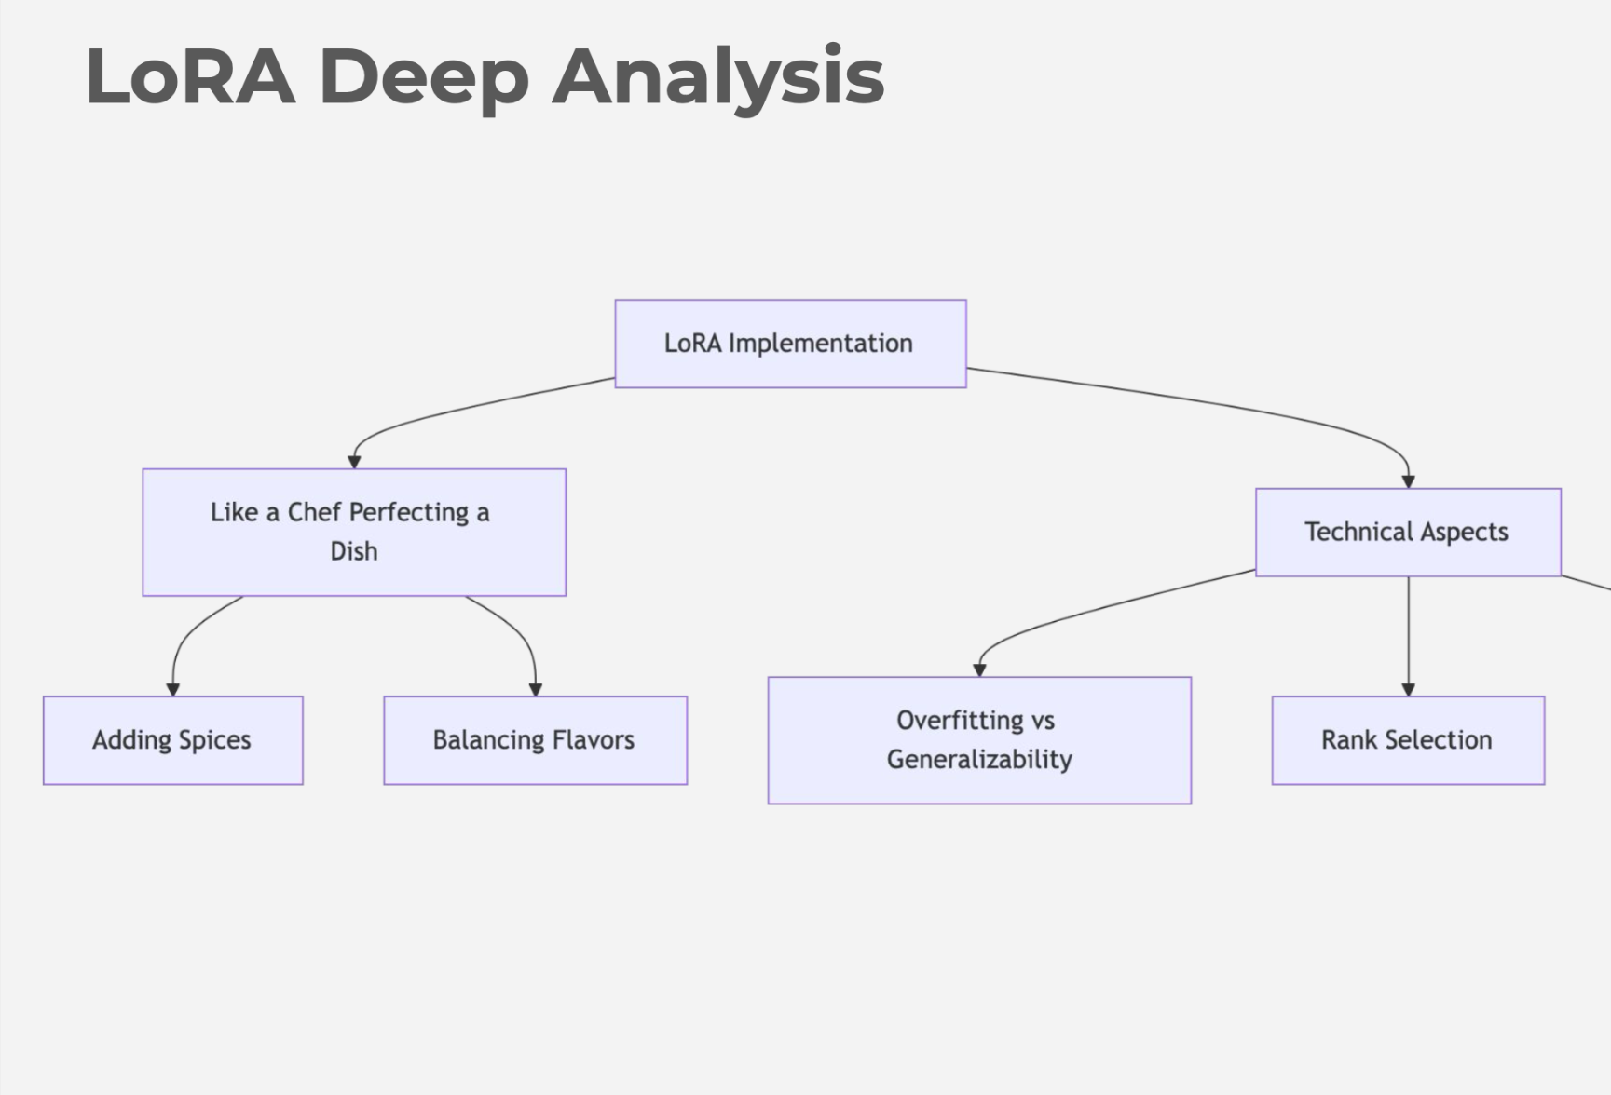

Slide 7
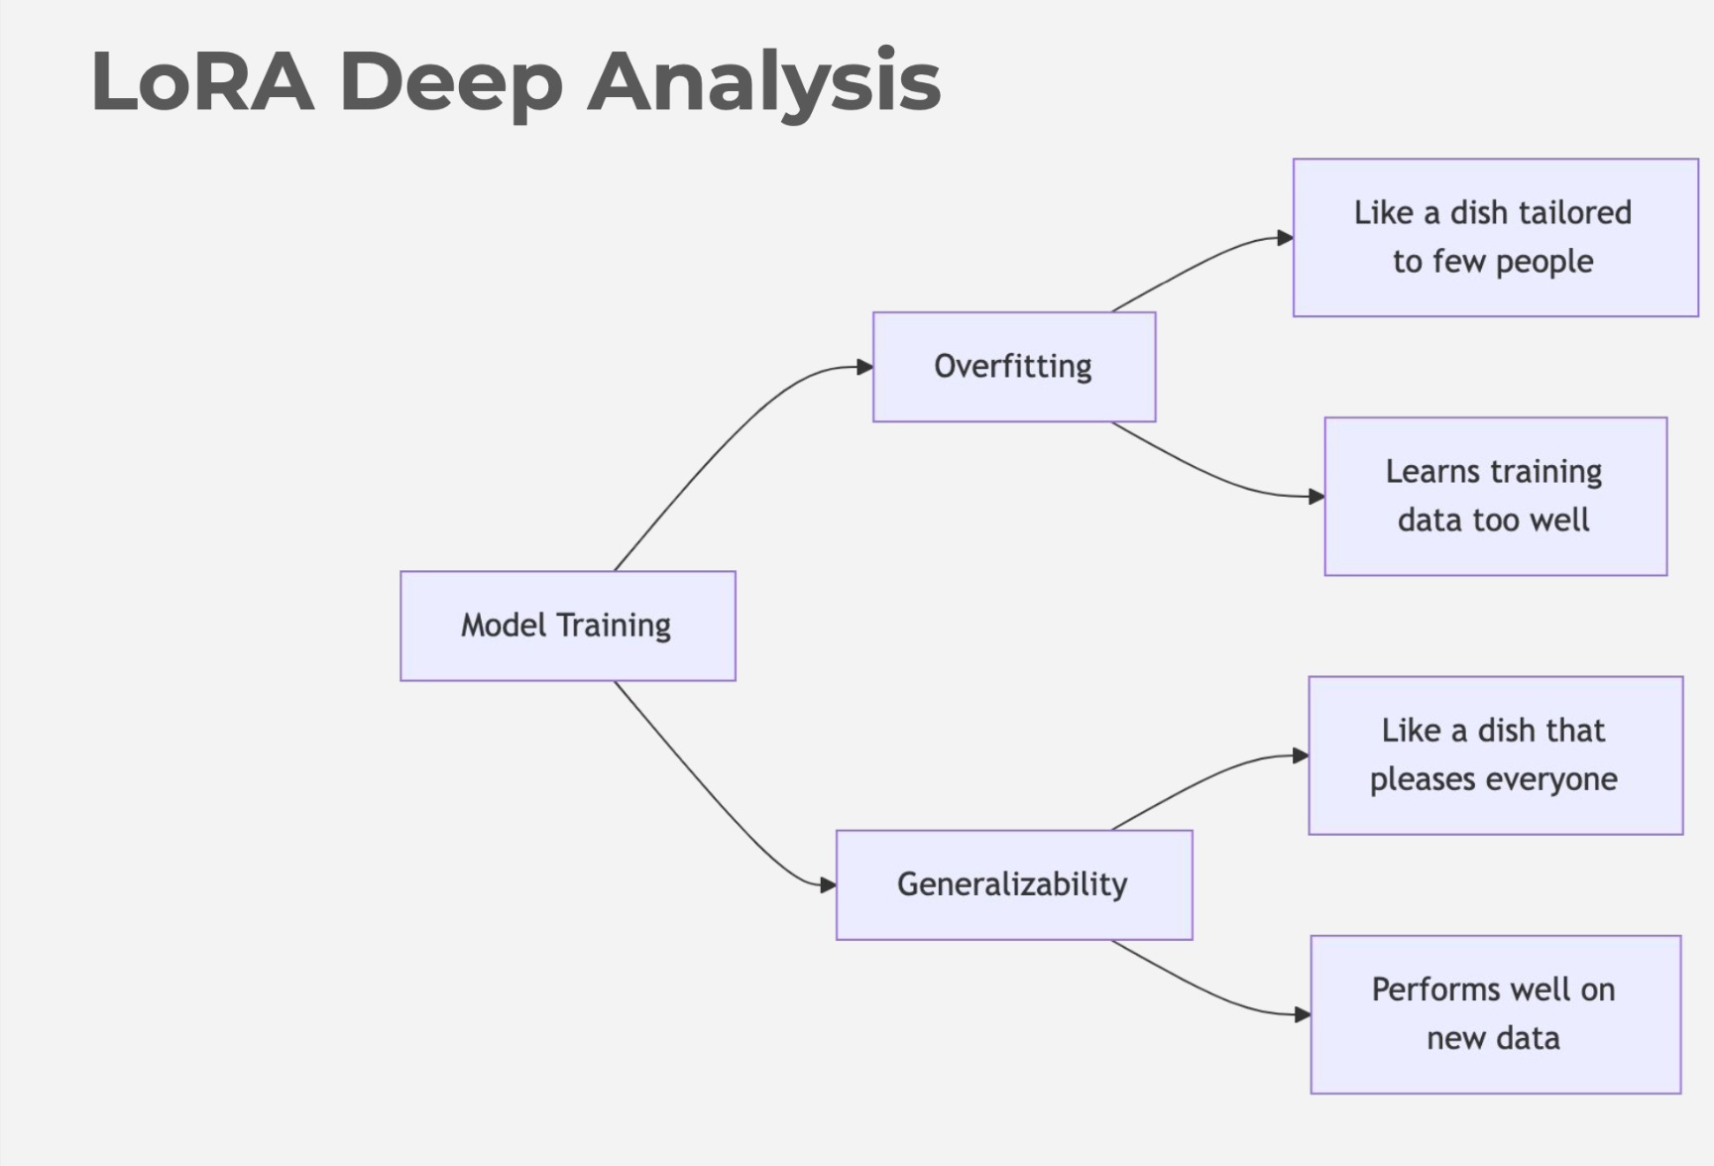

Slide 8
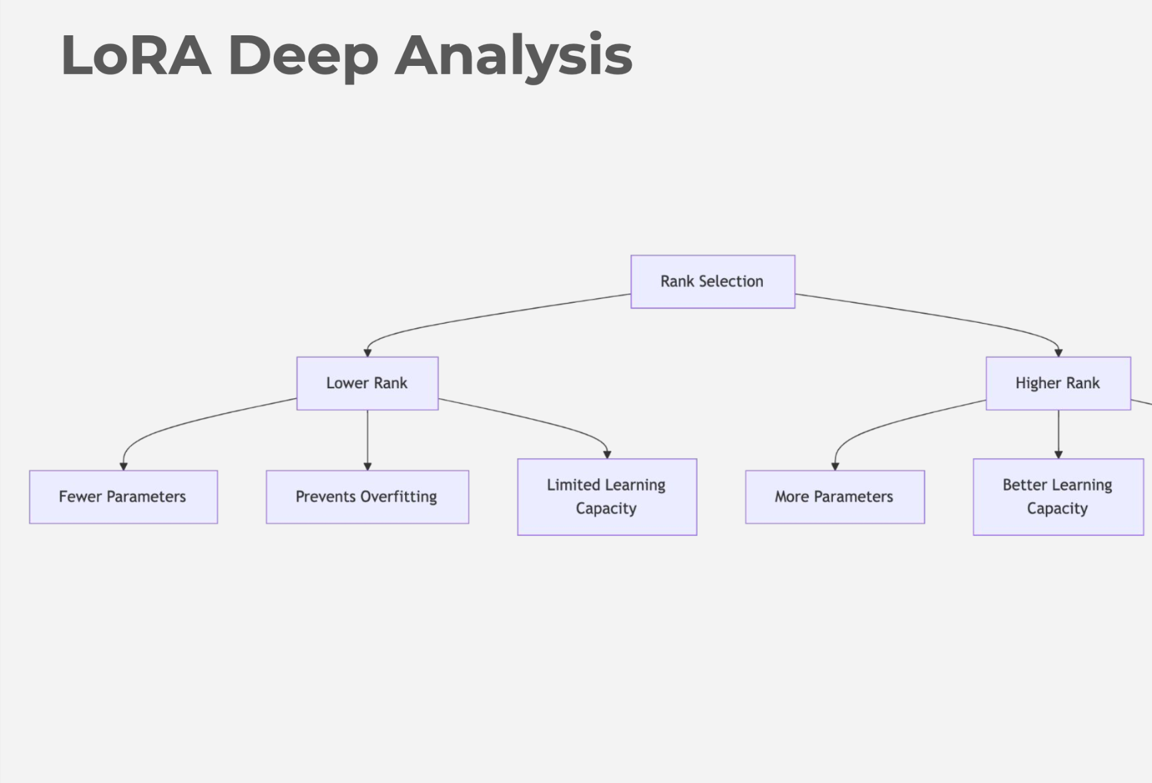

Slide 9
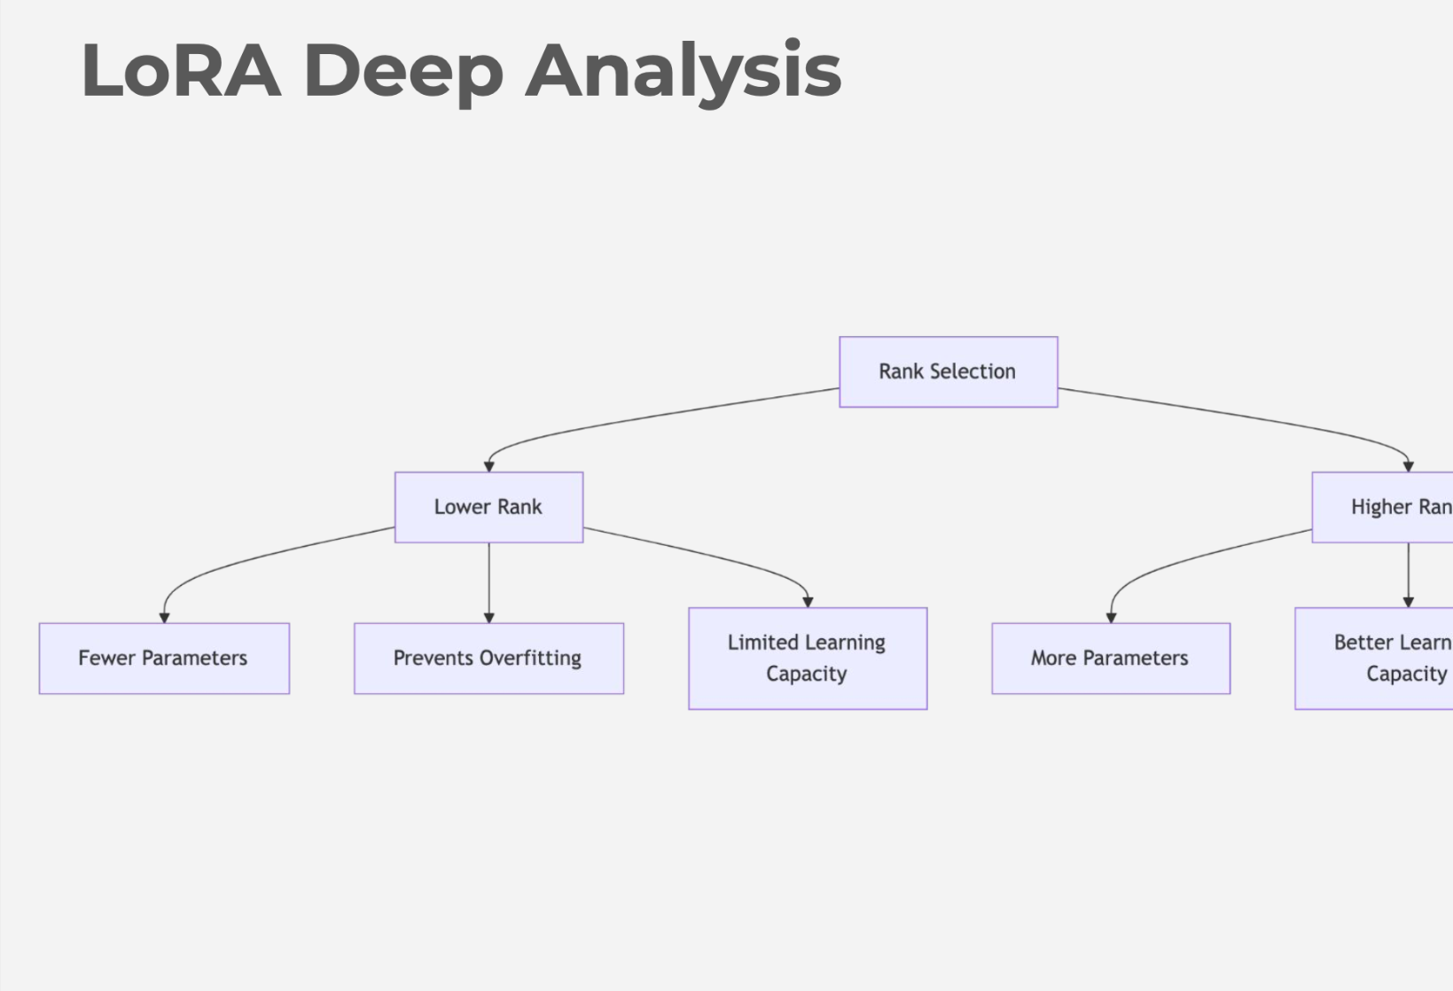

Slide 10
