Slide 1



Team no:MPI22
TITLE: USER CENTRIC E-COMMERCE PLATFORM FOR DAIRY PRODUCTS
GUIDED BY: Dr.P.VIJAYAKUMAR
Team members
MEGASHRI N (24MCR064)
MOHAN NIVASH C (24MCR067)
SELYAVARSNEE M (24MCR98)
24-Dec-24
Team_22 1

Slide 2
Table of contents
Abstract
Existing System
Proposed System
System Requirements
Module Description
Data flow diagram
Use case Diagram
Screen Shots
Conclustion
Team_22 2
24-Dec-24

Slide 3
ABSTRACT
This website offers a convenient and user-friendly platform for purchasing fresh dairy products.
This system offers a simple platform for customers and administrator to manage orders easily.
This website is easy to navigate and find what product exactly they need.
secure online payment options and timely notifications for order updates.
Fresh products, saves time and enhances the online dairy shopping experience.
24-Dec-24
Team_22 3

Slide 4
EXISTING SYSTEM
Services before are manually operated, from payment to delivery.
Many people face challenges in accessing fresh dairy products conveniently, often lacking nearby stores or time to purchase them.
Customers need to visit stores and carry dairy products home manually.
24-Dec-24
Team_22 4

Slide 5
PROPOSED SYSTEM
Customers can order dairy products through online.
Secure online payments and doorstep delivery services.
Provides convenience, time savings, efficiency for a seamless shopping experience.
24-Dec-24
Team_22 5

Slide 6
MODULE DESCRIPTION
USER MODULE:
Home Module
In this module, the user can view all the products.
Search Module
The user can search the product, select and order it.
Shop Module
The user can select products using filter by categories and filter by price.
Cart Module
The user can add the product to their cart and order it.
24-Dec-24
Team_22 6

Slide 7
ADMIN MODULE:
Home Module
Admin can view all the products.
Create Categories
Admin can create categories products.
View/Update/Delete Products
Admin can view all the products and items that are added
Admin can update or delete the existing categories or products.
24-Dec-24
Team_22 7

Slide 8
SYSTEM REQUIREMENTS
HARDWARE
1. Processor : Intel(R) Core(TM) i3-7020U CPU
2. RAM : 4.00 GB
3.Hard disk : 1 TB
4.System type : 64-bit operating system, x64-based processor
SOFTWARE
1.Operating system : Windows 11
2.Working Environment : Visual Studio Code, Chrome
Frontend : REACTJS
Backend : NODE JS, Mongodb
24-Dec-24
Team_22 8

Slide 9
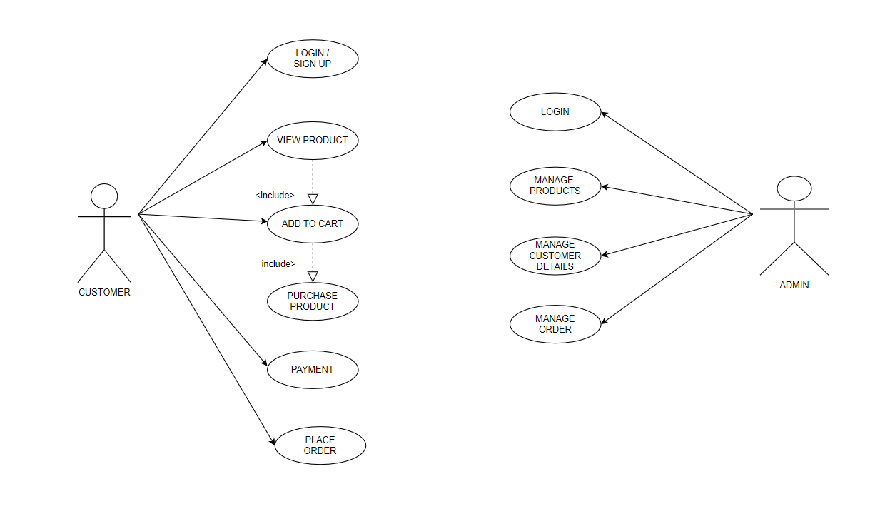
USE CASE DIAGRAM
24-Dec-24
Team_22 9

Slide 10
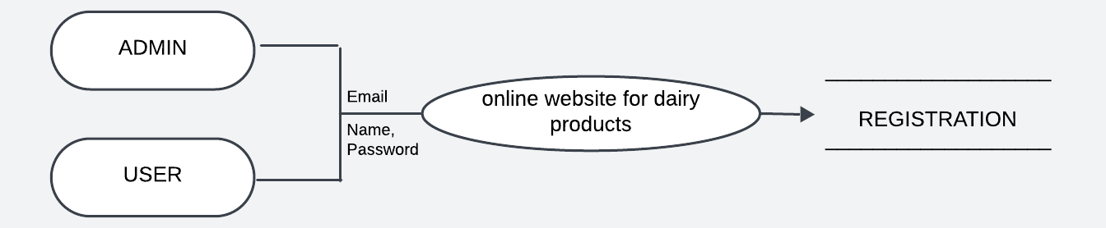
DATA FLOW DIAGRAM
Data flow diagram (level 0)
24-Dec-24
Team_22 10

Slide 11
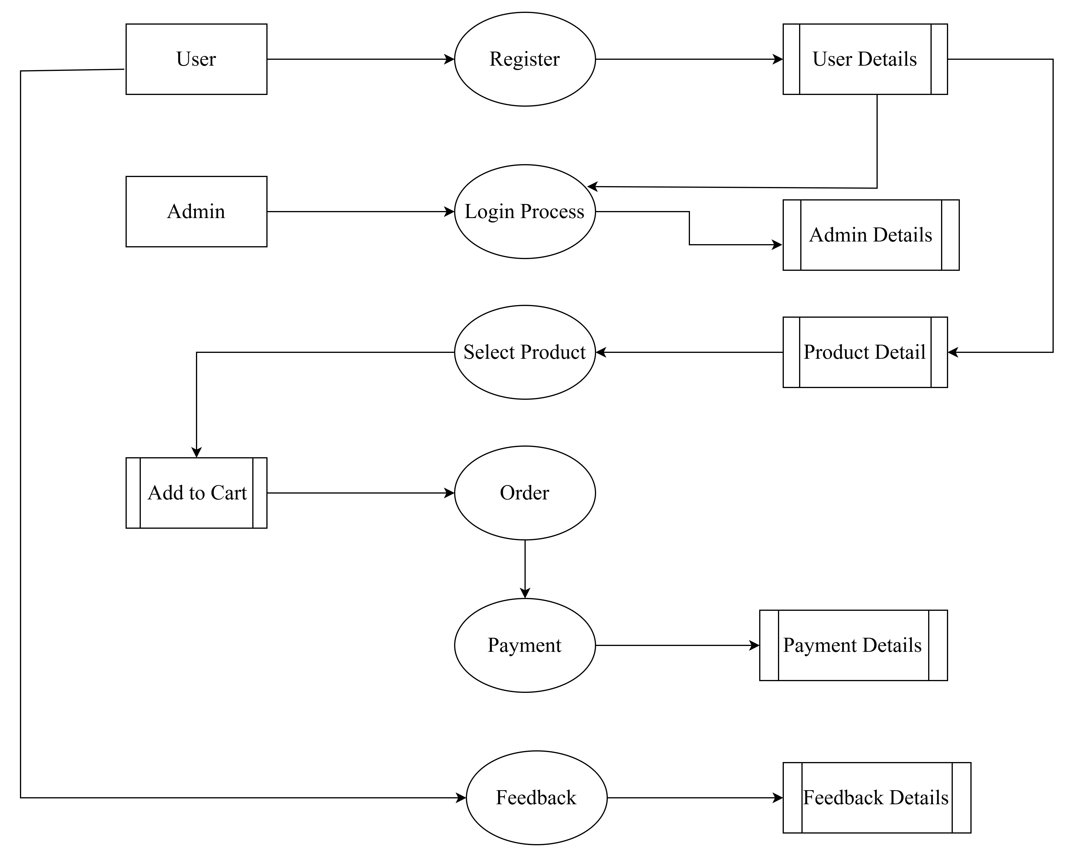
24-Dec-24
Data flow diagram (level 1)
Team_22 11

Slide 12
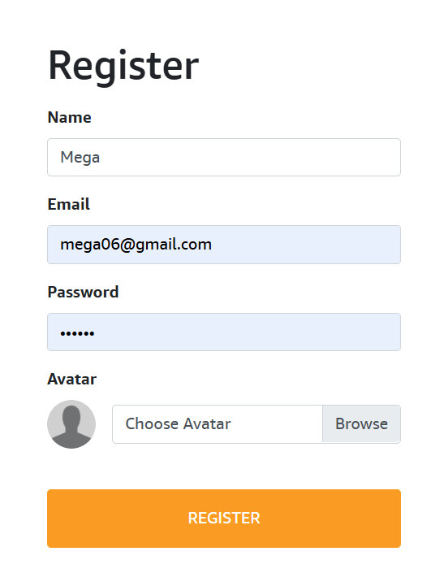
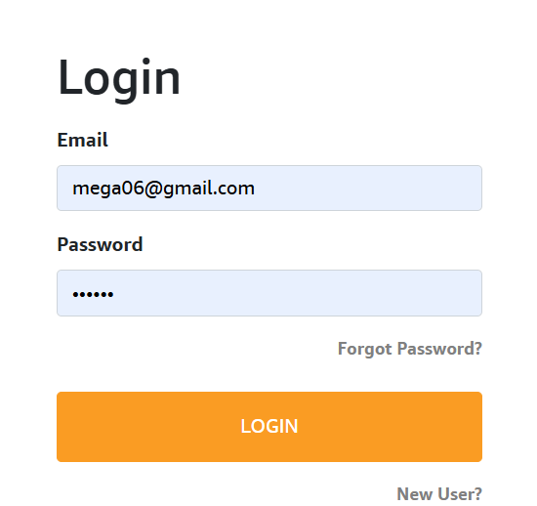
SCREEN SHOTS
User Register Page
User Login Page
24-Dec-24
Team_22 12

Slide 13
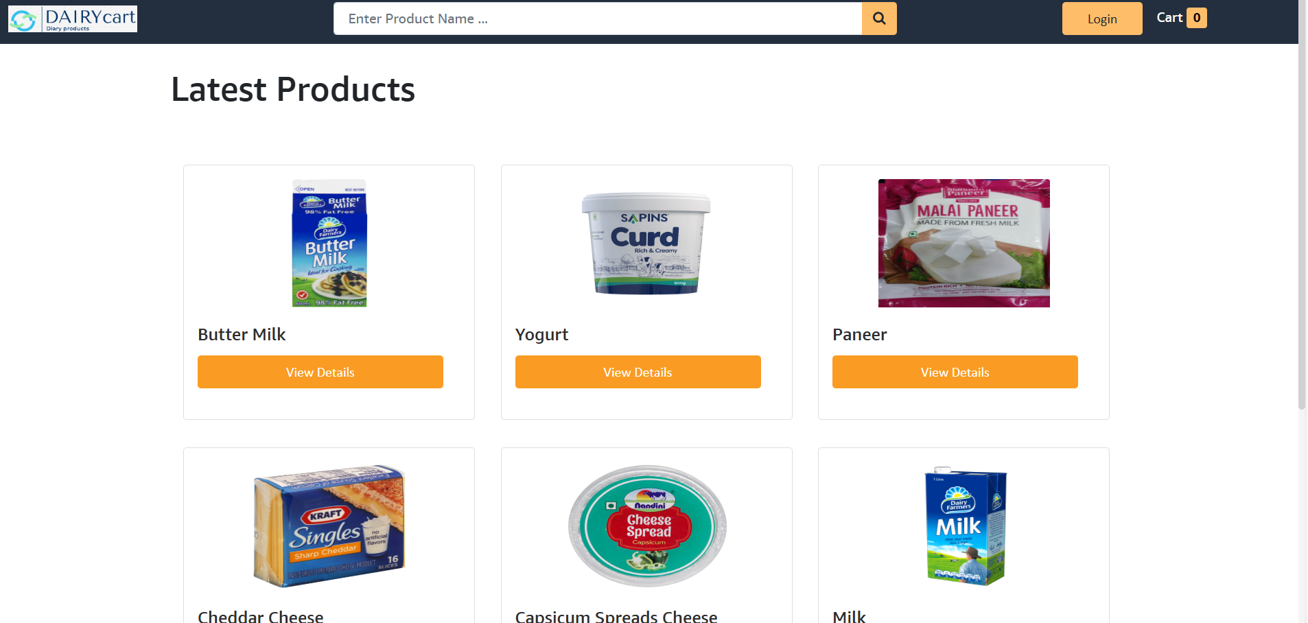
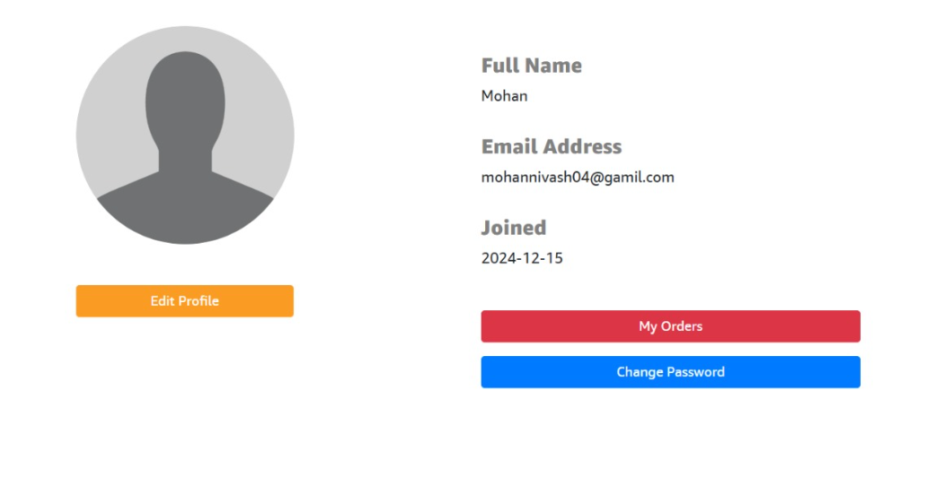
Home Page
User Profile Page
24-Dec-24
Team_22 13

Slide 14
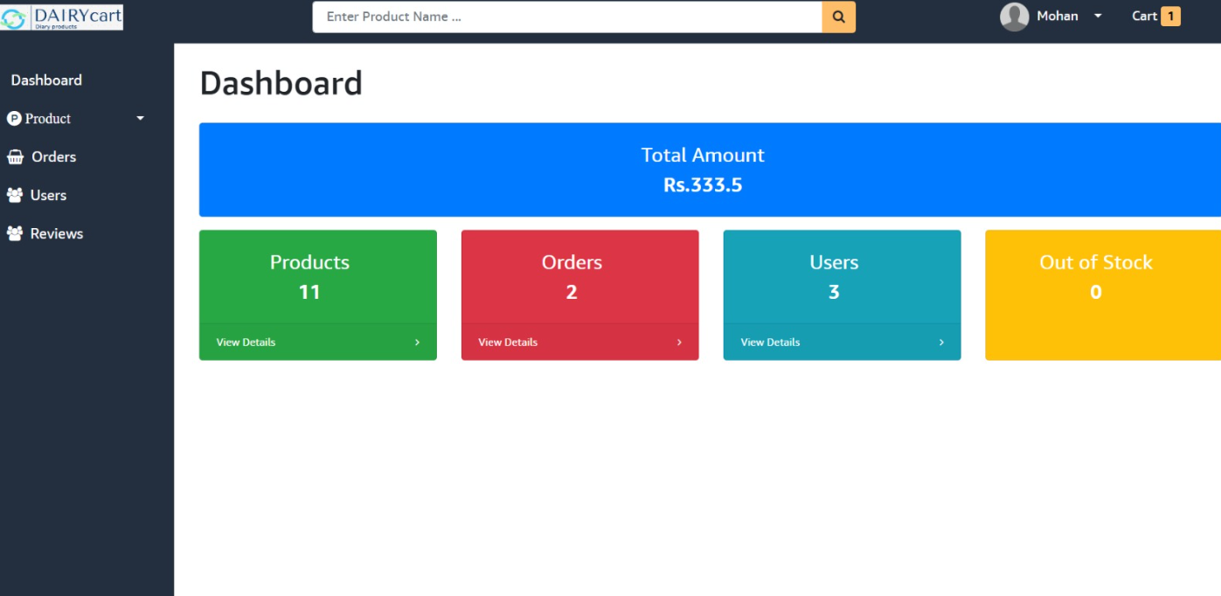
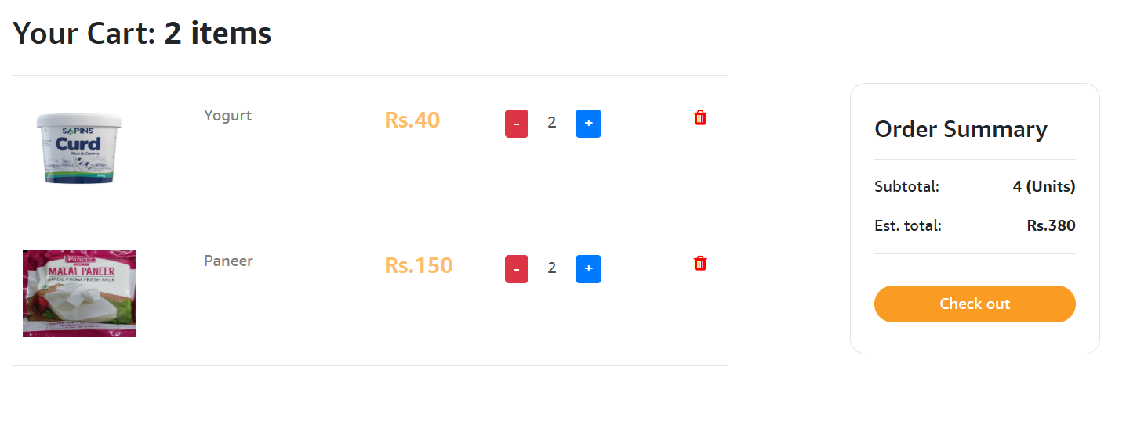
Admin Dashboard Page
Cart Page
24-Dec-24
Team_22 14

Slide 15
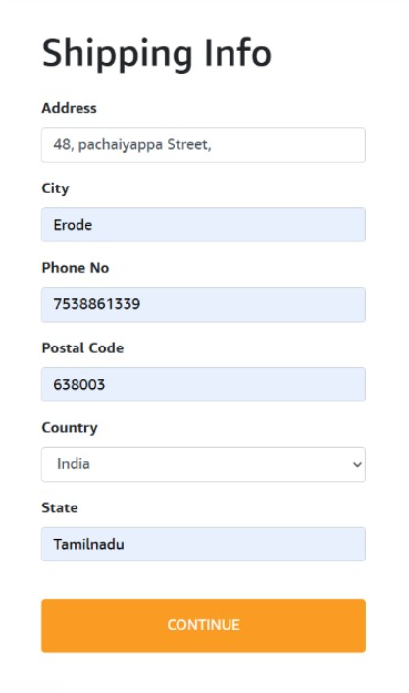
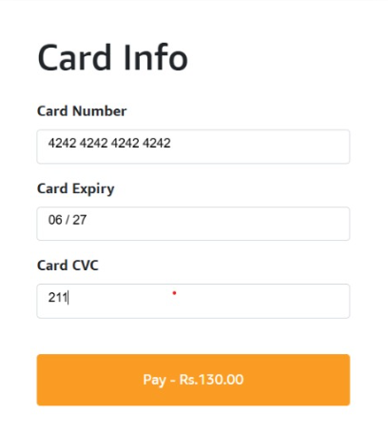
Shipping Info Page
Card Details Page
24-Dec-24
Team_22 15

Slide 16
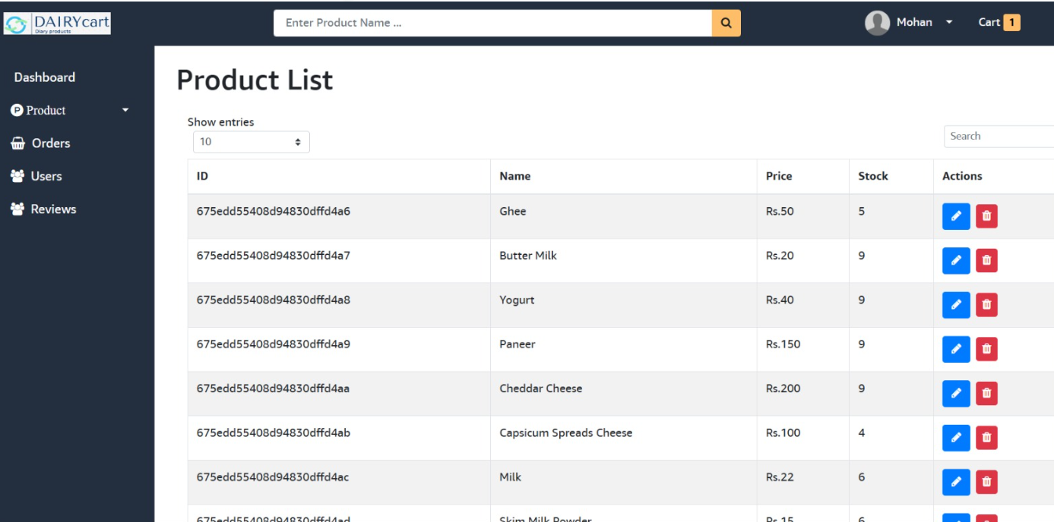
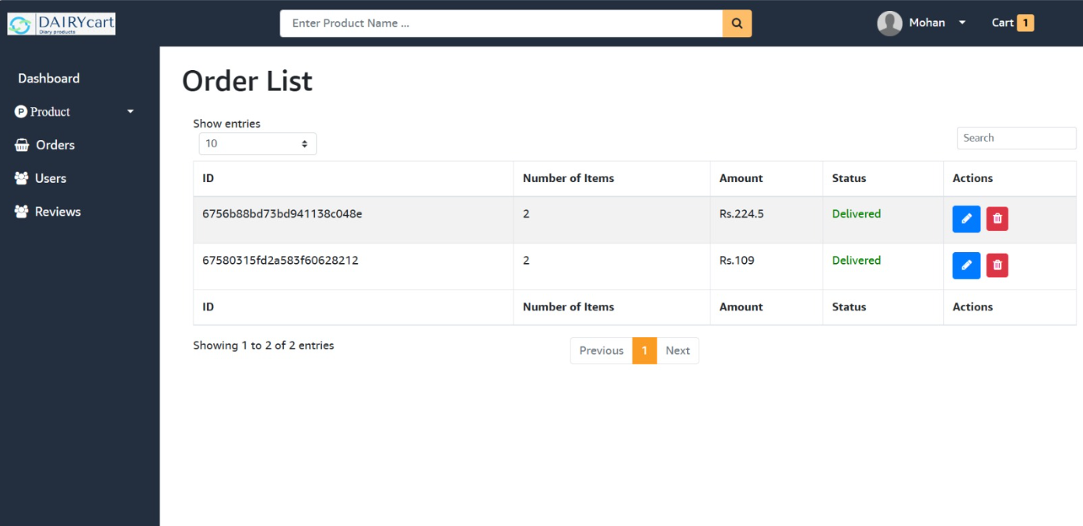
Product List Page
Order List Page
24-Dec-24
Team_22 16

Slide 17
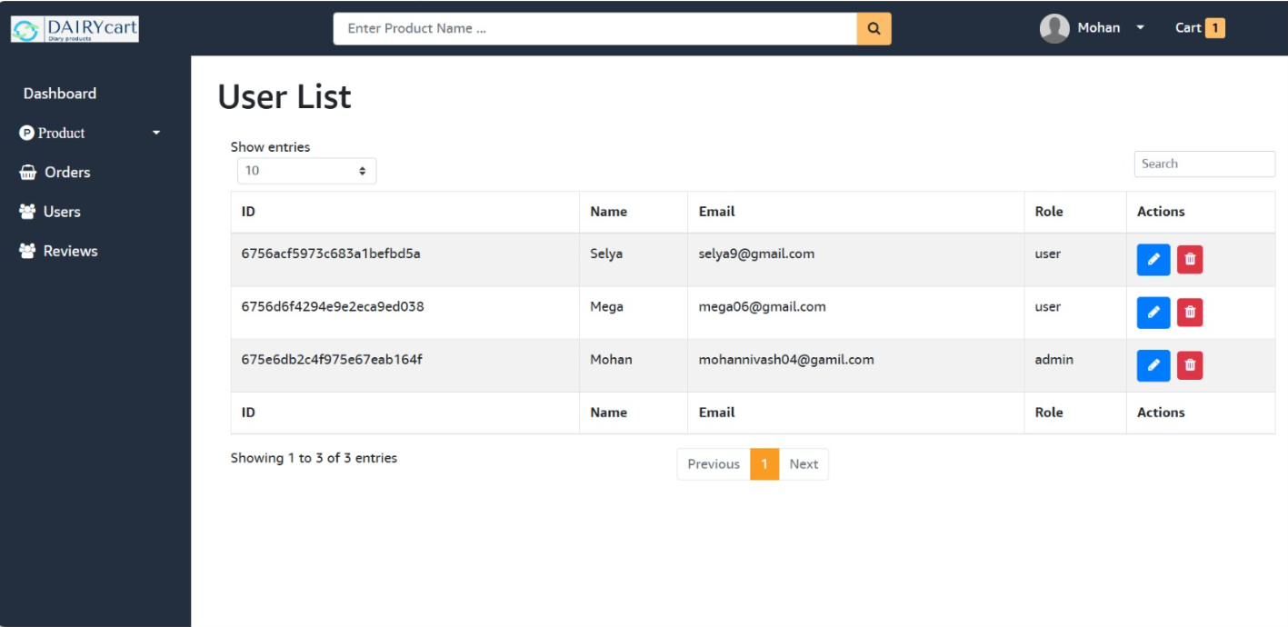
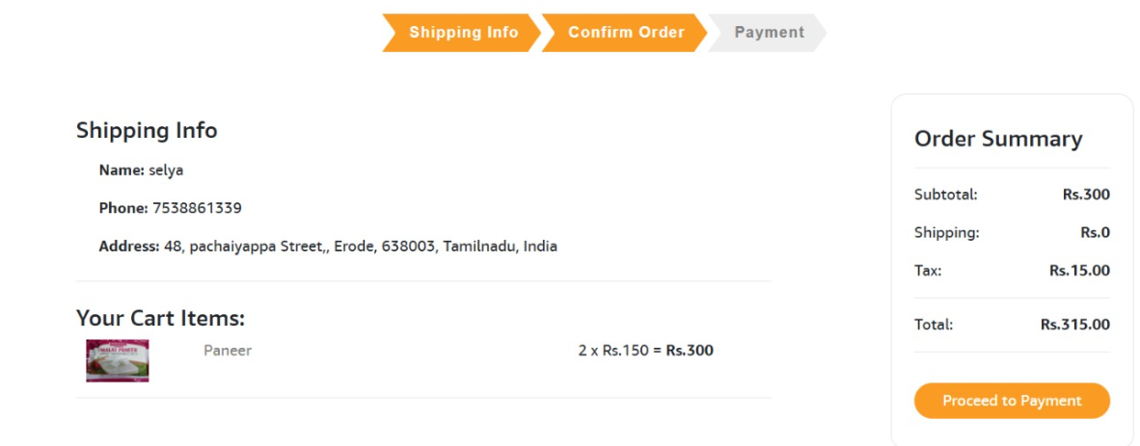
User List Page
Confirm Order Page
24-Dec-24
Team_22 17

Slide 18
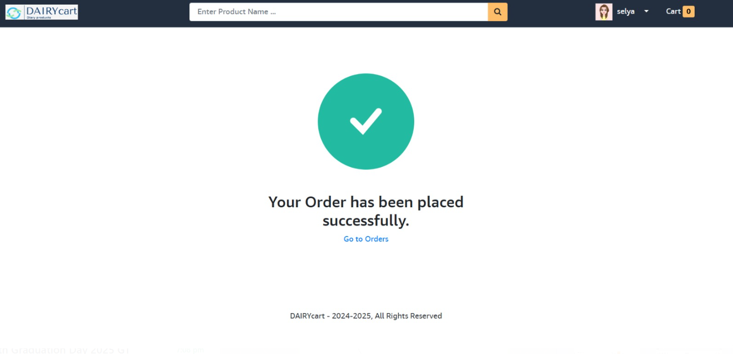
Order Placed Page
24-Dec-24
Team_22 18

Slide 19
CONCLUSTION
Combines React responsive interface with MongoDB's robust data management to create an efficient e-commerce platform for dairy products.
Ensures a seamless shopping experience for customers while supporting producers in managing operations smoothly.
Offers potential for future enhancements like personalized recommendations and faster delivery options.
24-Dec-24
Team_22 19

Slide 20


