Slide 1
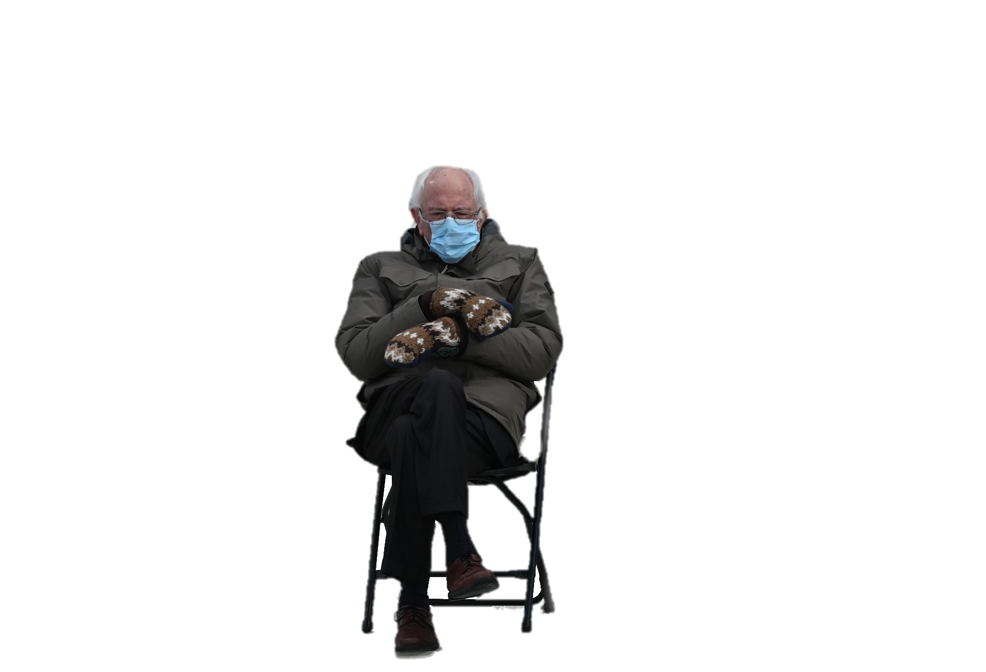
SEM
Jon
Jarrett
Figure 1: Bernie is judging your model.

Slide 2
Jim
Jarrett
SEM
Jon
Figure 1: Bernie is judging your model.

