Slide 1


PHARMACY MANAGEMENT
GROUP 2 – AP146
1
Nguyen Dinh Minh Duc
2
Nguyen Phan Duy Dang
3
Vo Van Duc

Slide 2


Overview
1
Introduce
2
3
Content
Characteristics Of Project
4
Application Interface
5
Advantages And Disadvantages
6
Further Development

Slide 3
1. Overview
Members
Supply
- Need
- Flexible
Benefit
Current System

Slide 4
3. Characteristics Of Project
1
User
2
Drug
3
Customer
4
Stock
5
Supplier
6
Bill

Slide 5
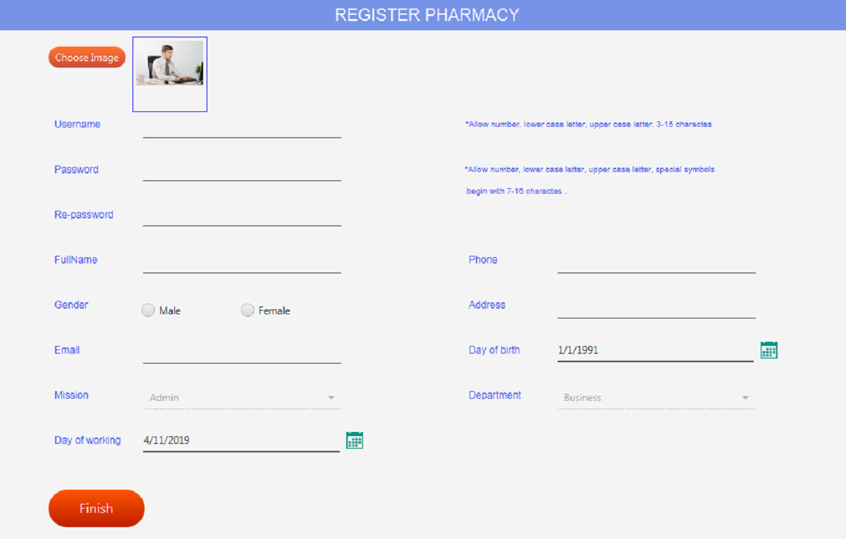
4. Application Interface
Register page

Slide 6
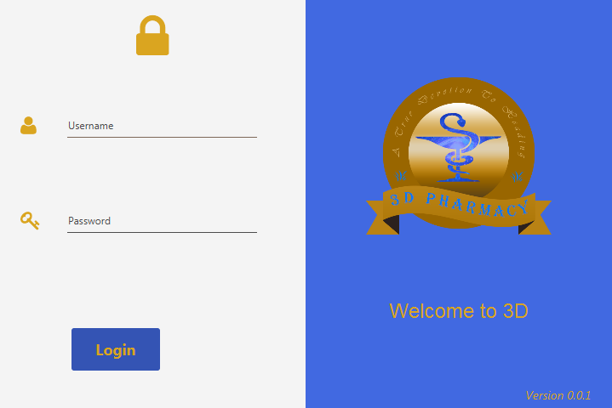
4. Application Interface
Login page

Slide 7
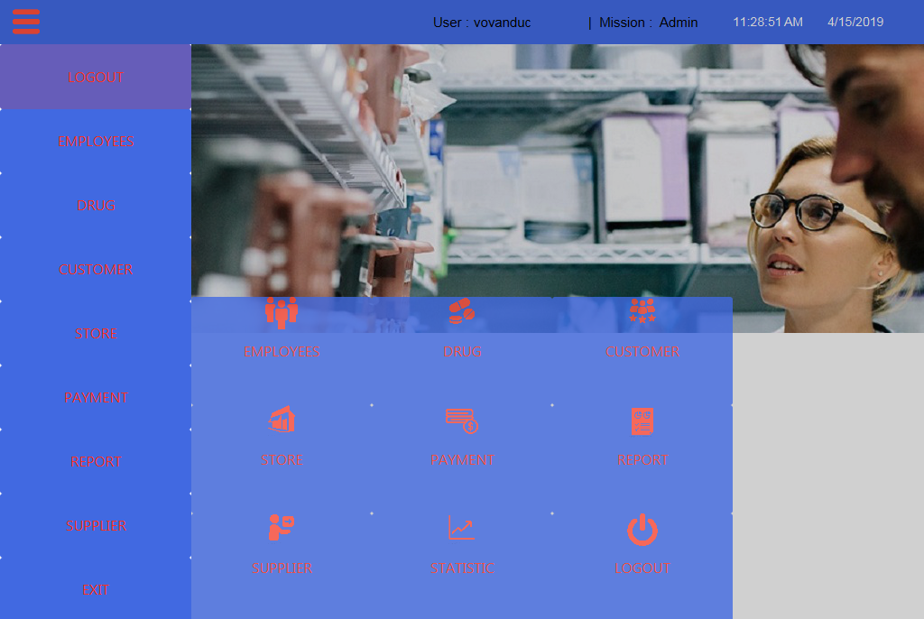
4. Application Interface
Main page

Slide 8
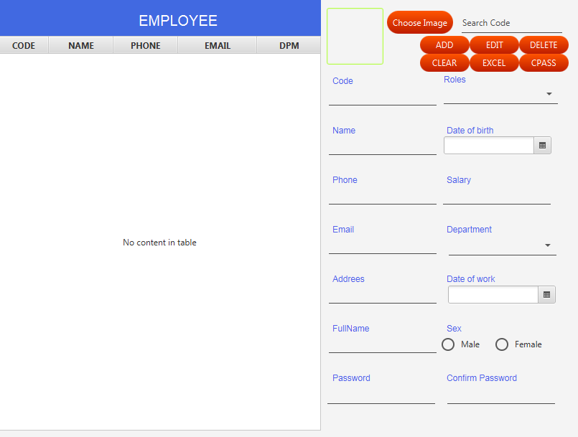
4. Application Interface
Employee page

Slide 9
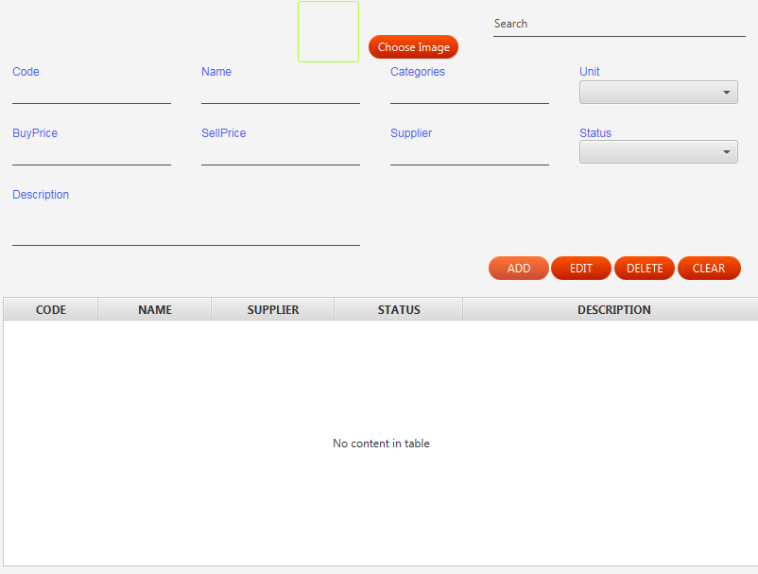
4. Application Interface
Drug page

Slide 10
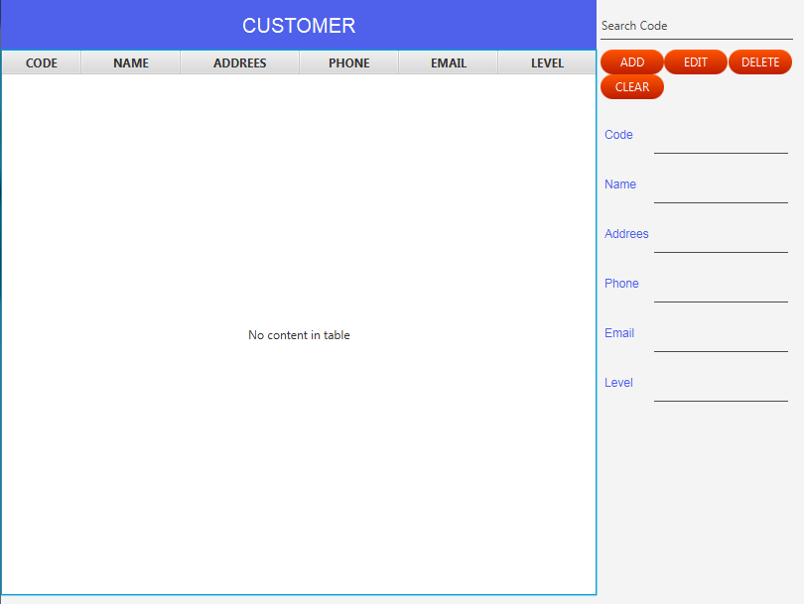
4. Application Interface
Customer page

Slide 11

4. Application Interface
Supplier page

Slide 12
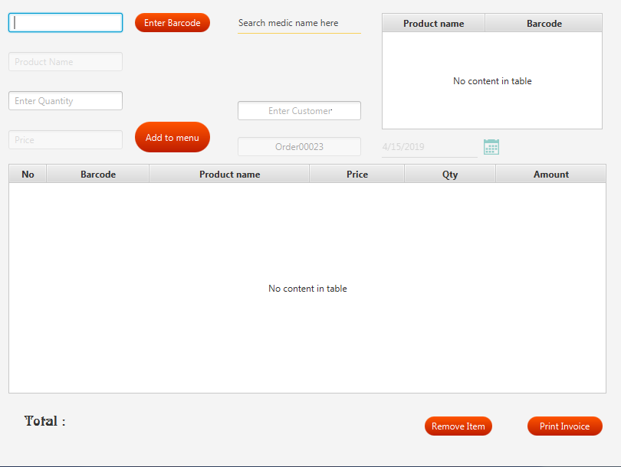
4. Application Interface
Order page

Slide 13
5. Advantages
- Application Permissions
Billing Records
Report
Statistic
Handle In Interfaces
Handle In Database
Write Data To An Excel File
Communication Between APP And Server
Performance work

Slide 14
5. Disadvantages
- Cloud Data
Security
App required using MS-SQL
ETC

Slide 15
6. Further Development
- Barcode Reader
Credit Card
Build Strong Customer Relationships
Market Research
Pharmacy Customer Service That Sizzles
Cross-Sell and Upsell
Warnings

Slide 16


