Slide 1


PHARMACY MANAGEMENT
GROUP 2 – AP146
1
Nguyen Dinh Minh Duc
2
Nguyen Phan Duy Dang
3
Vo Van Duc

Slide 2


Overview
1
Introduce
2
3
Content
Characteristics Of Project
4
Application Interface
5
Advantages And Disadvantages
6
Further Development

Slide 3
1. Overview
- Members
Need
Supply
Flexible
Benefit
Current System

Slide 4
2. Introduce
- Improve Accuracy
Enhance Safety
Scope
Providing statistics of the drug
Maintaining correct database by providing an option to update the drug in stock
Drug inventory management, etc.

Slide 5
3. Characteristics Of Project
1
User
2
Drug
3
Customer
4
Stock
5
Supplier
6
Bill

Slide 6
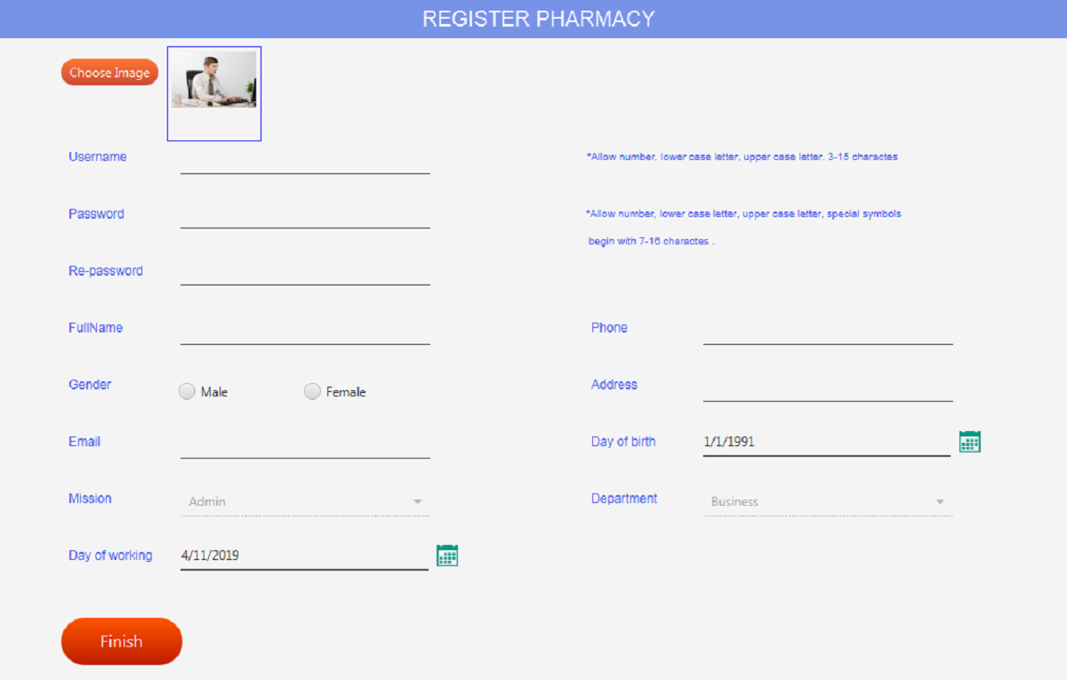
4. Application Interface
Register page

Slide 7
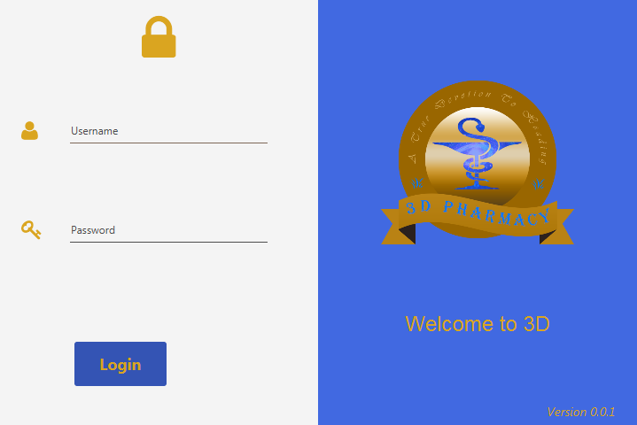
4. Application Interface
Login page

Slide 8
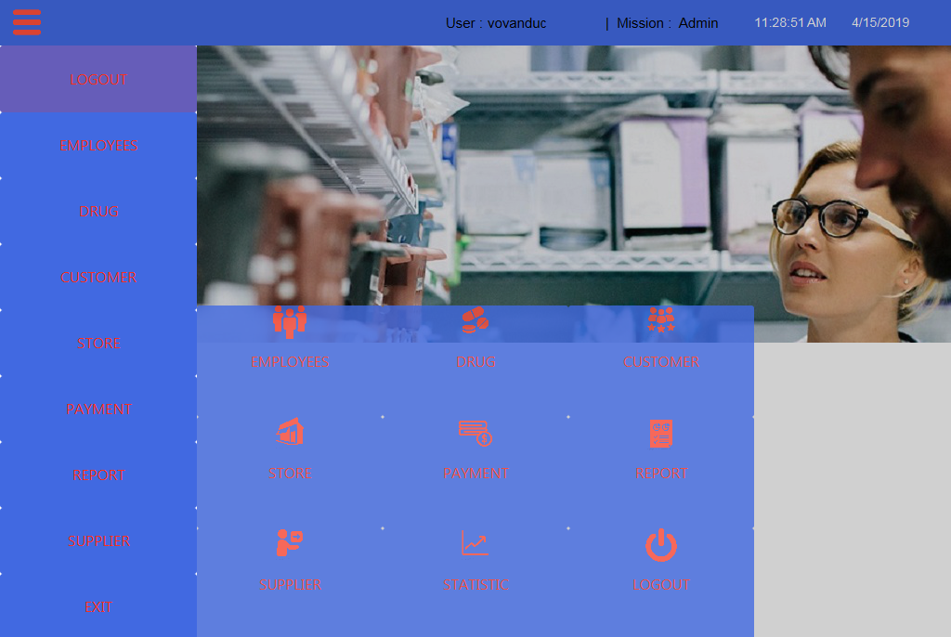
4. Application Interface
Main page

Slide 9
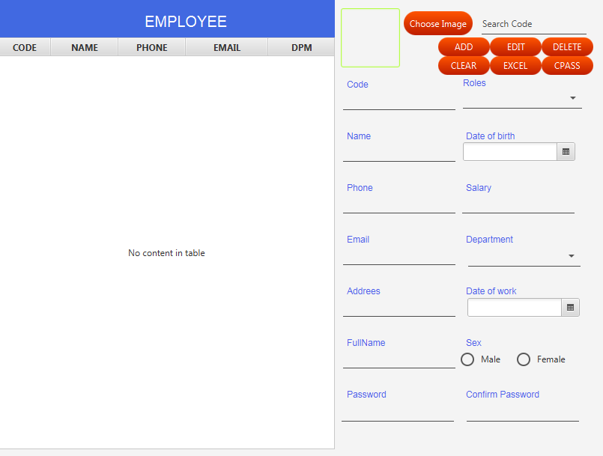
4. Application Interface
Employee page

Slide 10
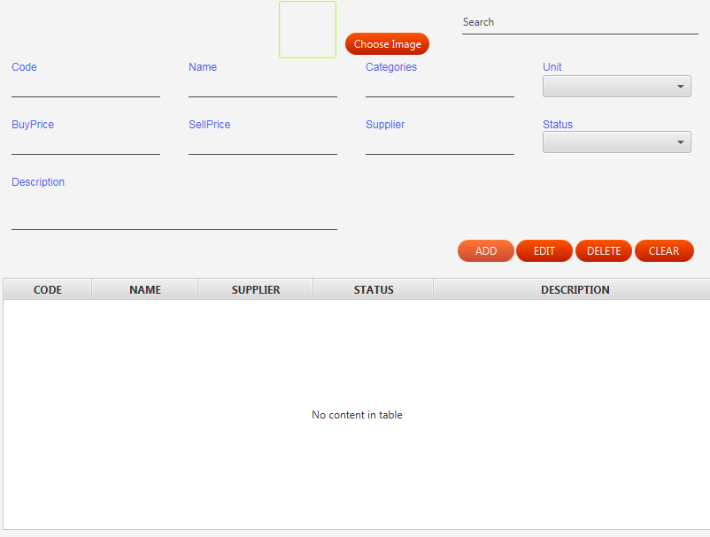
4. Application Interface
Drug page

Slide 11
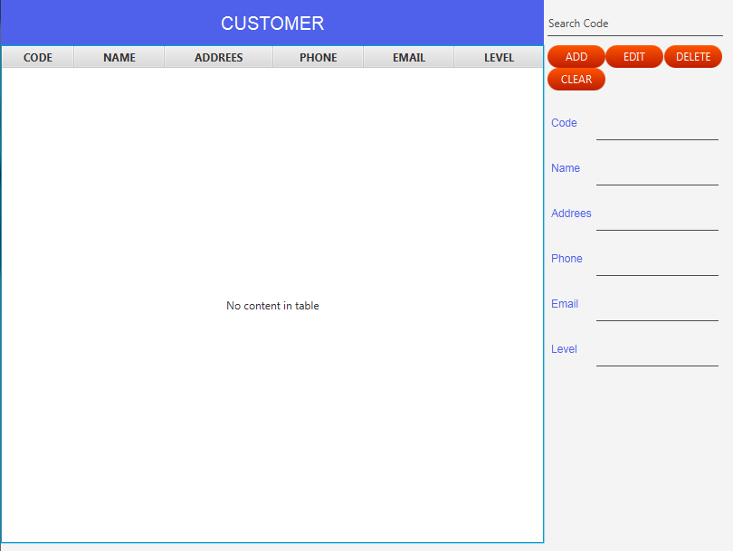
4. Application Interface
Customer page

Slide 12

4. Application Interface
Supplier page

Slide 13
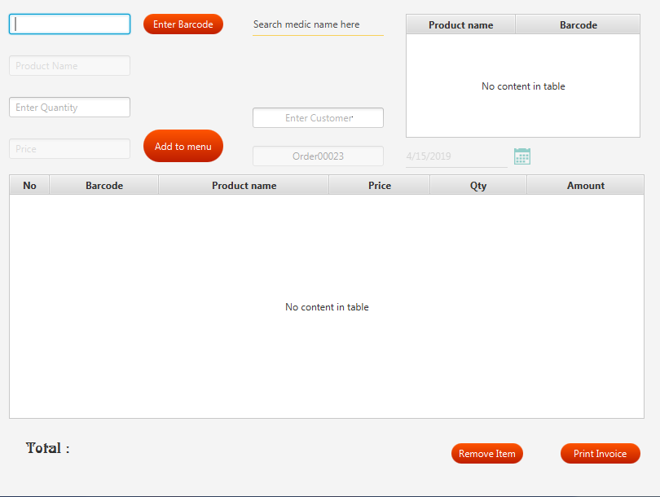
4. Application Interface
Order page

Slide 14
5. Advantages
- Application Permissions
Billing Records
Report
Statistic
Issues In Interfaces
Issues In Database
Write Data To An Excel File
Communication Between APP And Server
Team work

Slide 15
5. Disadvantages
- Cloud Data
Security
Time
Working With JavaFX
App Operability
ETC

Slide 16
6. Further Development
- Barcode Reader
Credit Card
Build Strong Customer Relationships
Market Research
Pharmacy Customer Service That Sizzles
Cross-Sell and Upsell
Warnings

Slide 17


