Slide 1

FINAL PROJECT PRESENTATION
Voice-Based Speaker Verification
Secure user authentication under spoofing and noise
Muditha Herath
Yasith Hewarathna
Herath H.M.M.P.B
Notes:
Open with the one-line pitch: a voice login that checks who you are, whether the voice is real, and whether it survives noise. (30 s)

Slide 2
01
SECTION 01
The problem
Why a voice alone is not enough to prove who you are.
Voice-Based Speaker Verification for Secure User Authentication
02
Notes:
Divider. Say one sentence and move on. (10 s)

Slide 3
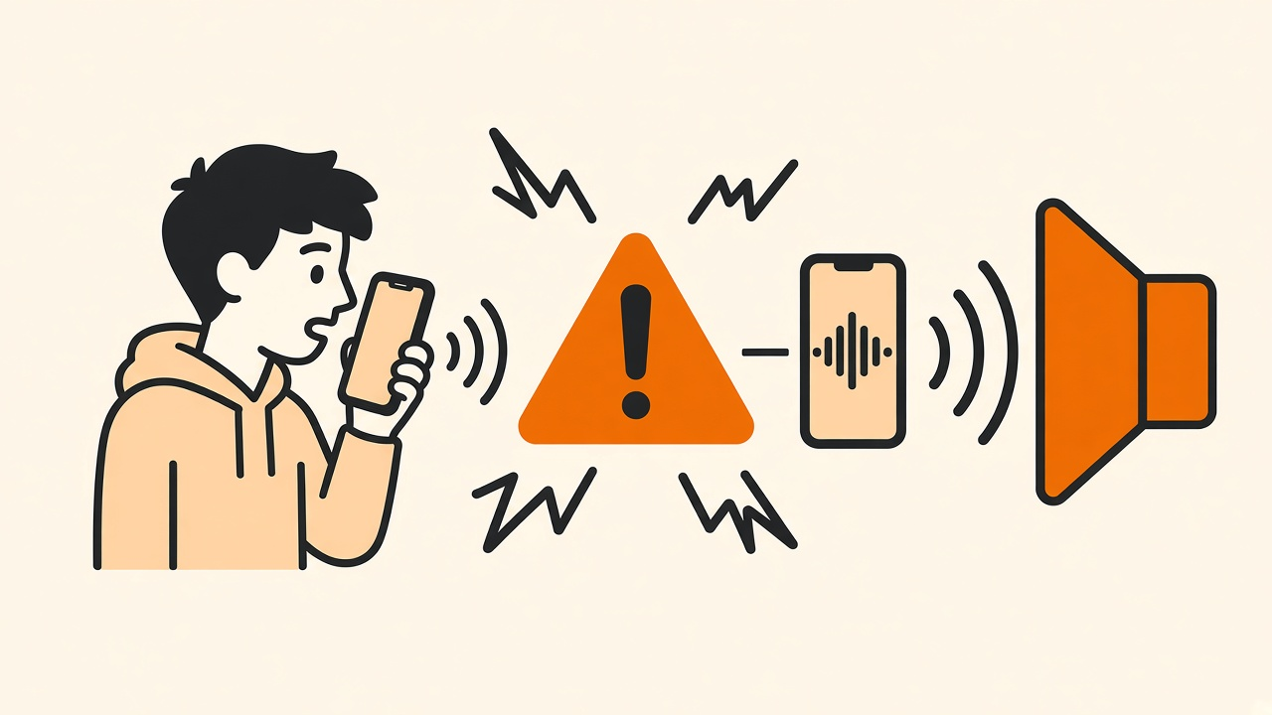
THE PROBLEM
Why voice
authentication
is hard
Voice is the most convenient credential we have. It is also the easiest one to record, and the first to break when the room gets loud.
RISK 01
Spoof and replay
An attacker plays back a recording of the real user.
RISK 02
Background noise
Street, office and babble noise break the match.
Voice-Based Speaker Verification for Secure User Authentication
03
Notes:
Frame the pain, then the two threats. This slide earns the rest of the talk. (1 min)

Slide 4

DEFINITIONS
What we
measure
SV
Is this the claimed speaker?
Compares a probe against one enrolled template.
Equal Error Rate, or EER, is the operating point where false accepts and false rejects are equal. Lower is better.
ANTI-SPOOF
Is this live speech or a fake?
Flags replayed and synthetic audio before scoring.
SASV
Both checks in a single score
Accepts only a genuine speaker speaking live.
Protocol discipline
Thresholds are tuned on the development set. The evaluation set is reported once, with no further tuning.
Voice-Based Speaker Verification for Secure User Authentication
04
Notes:
Define the vocabulary once so the numbers later land. Stress that SASV is the honest metric. (45 s)

Slide 5
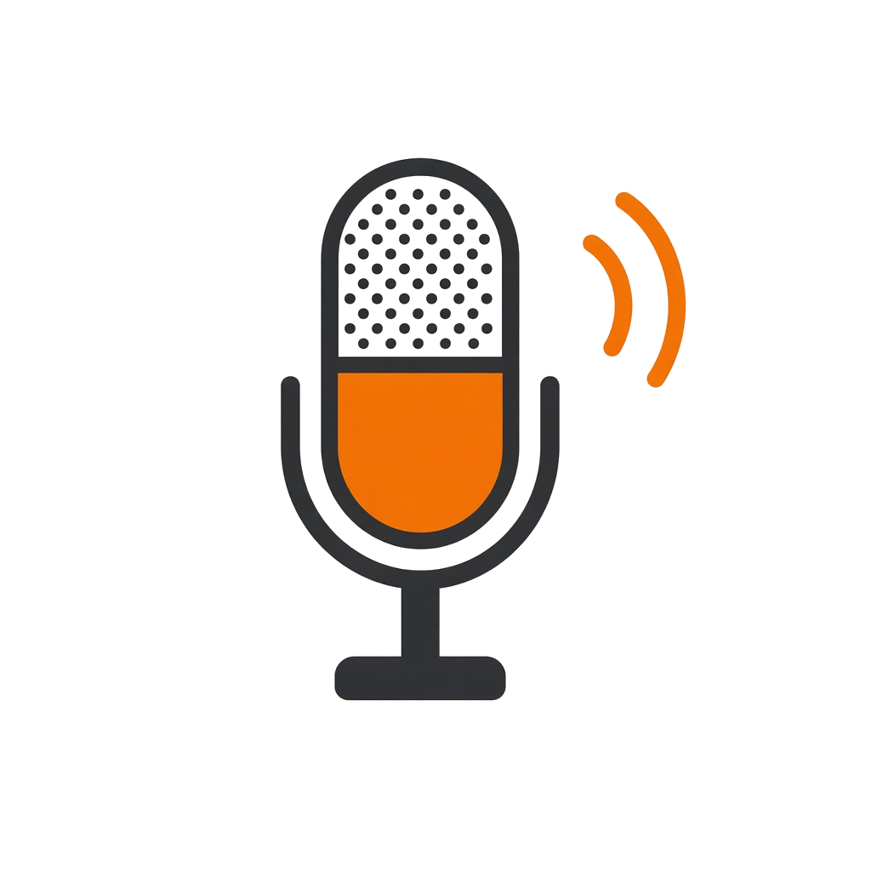

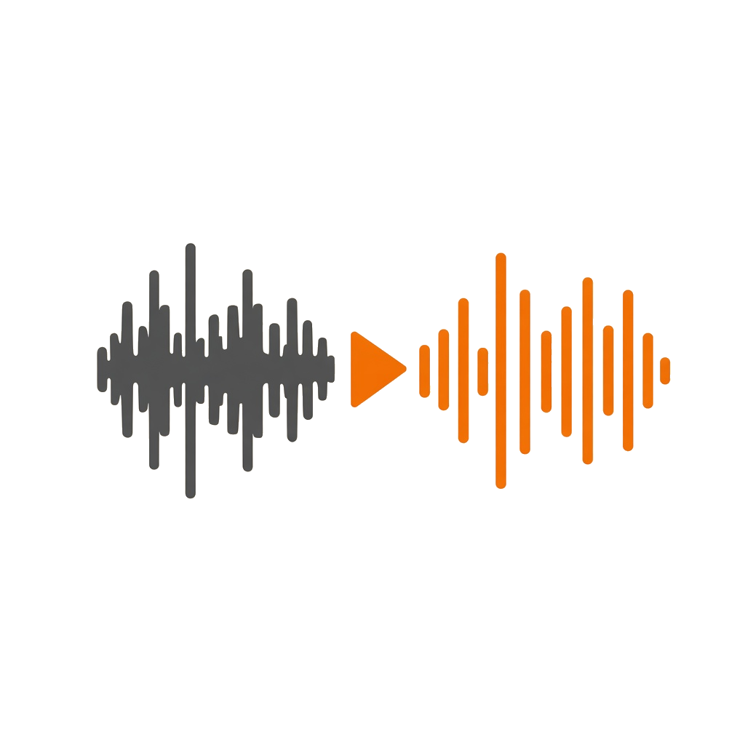

MOTIVATION
Why this matters
Four reasons this is worth building, and worth trusting.
Frictionless
No password typing and no code to wait for on repeat logins.
Spoof aware
A recorded voice is detected and rejected before any scoring.
Noise ready
Enhancement and learned fusion hold accuracy up in noise.
Deployed
A running web stack with automated build and deploy to cloud.
Fintech · call centres · access control · passwordless consumer apps
Voice-Based Speaker Verification for Secure User Authentication
05
Notes:
The value slide. One line per card, do not read them out verbatim. (1 min)

Slide 6
02
SECTION 02
The system
One architecture from the browser to the speaker model.
Voice-Based Speaker Verification for Secure User Authentication
06
Notes:
Divider. (10 s)

Slide 7
SYSTEM DESIGN
End-to-end architecture
Client · React
Record · enroll · verify · 1:N login
MUDITHA
Backend · Express
JWT auth · uploads · orchestration
MUDITHA
ML SERVER · FASTAPI
01 Silero VAD
keep speech, drop silence
02 Anti-spoof
high risk → reject early
03 Enhancement
WebRTC / Wave-U-Net
Enrollment
N clips → VAD → embed → L2-norm → average
PostgreSQL + pgvector
vector(192) templates · HNSW cosine
MUDITHA
04 ECAPA ± TitaNet
192-D speaker embedding
05 Fusion
blend raw and enhanced
06 Cosine + threshold
accept / reject + scores
DEPLOY GitHub main → build images (GHCR) → SSH deploy → docker compose pull && up on EC2
Voice-Based Speaker Verification for Secure User Authentication
07
Notes:
Walk left to right, then down, then the ML panel. Point out the spoof check happens before identity matching. (2 min)

Slide 8
HOW IT WORKS
The verification pipeline
Nine steps from a microphone to an accept or reject decision.
Capture
Browser recording or uploaded WAV
Normalise
16 kHz, mono, float32
Silero VAD
Speech only; reject silent clips
01
02
03
Anti-spoof
Replay risk → reject early
Enhancement
WebRTC or Wave-U-Net
Embedding
ECAPA-TDNN, 192 dimensions
04
05
06
Fusion
Learned blend, raw and enhanced
Cosine
Score against the template
Threshold
Accept or reject, score returned
07
08
09
ENROLLMENT several utterances → VAD → embed → L2-normalise → average → store in pgvector
Voice-Based Speaker Verification for Secure User Authentication
08
Notes:
Summarise only: capture, gate, check, embed, fuse, decide. (1 min)

Slide 9
IMPLEMENTATION
Technology stack
A conventional web stack in front of a speech model server.
Application layer | Technology
Frontend | React + Vite, MediaRecorder
Backend | Node.js / Express, JWT, Multer
Database | PostgreSQL + pgvector, HNSW
API surface | /enroll/template, /verify, /replay
Deployment | Docker Compose, GHCR, Actions
Model layer | Technology
Speech gating | Silero VAD (ONNX)
Speaker encoder | SpeechBrain ECAPA-TDNN
Second encoder | NVIDIA NeMo TitaNet-Large
Enhancement | WebRTC NS, tuned Wave-U-Net
Anti-spoof | Replay CNN, AASIST, LFCC
One contract across the whole system
Audio is always 16 kHz mono float32 and embeddings are always 192-D and L2-normalised, so the product path and the research notebooks score the same way.
Voice-Based Speaker Verification for Secure User Authentication
09
Notes:
Do not read the tables. Web stack left, speech models right, one shared contract. (45 s)

Slide 10
IMPLEMENTATION
Key design decisions
Six choices that shaped the system, and the reason behind each.
Average several enrollment clips
A single utterance overfits to one recording session.
Run VAD before scoring
Silence and room tone corrupt the embedding.
Never enhance blindly
Enhancement can hurt, so the fusion learns when to trust it.
Put the spoof gate inside the decision
Security first: reject replay before identity matching.
Two encoder slots in the database
ECAPA and TitaNet templates live side by side.
Compose deploy instead of k3s
Fits a small, low-memory cloud instance.
Voice-Based Speaker Verification for Secure User Authentication
10
Notes:
Pick two decisions, ideally 'never enhance blindly' and the spoof gate, because they set up the research. (1 min)

Slide 11
03
SECTION 03
The business
Who pays for this, and what they measure it by.
Voice-Based Speaker Verification for Secure User Authentication
11
Notes:
Divider. (10 s)

Slide 12
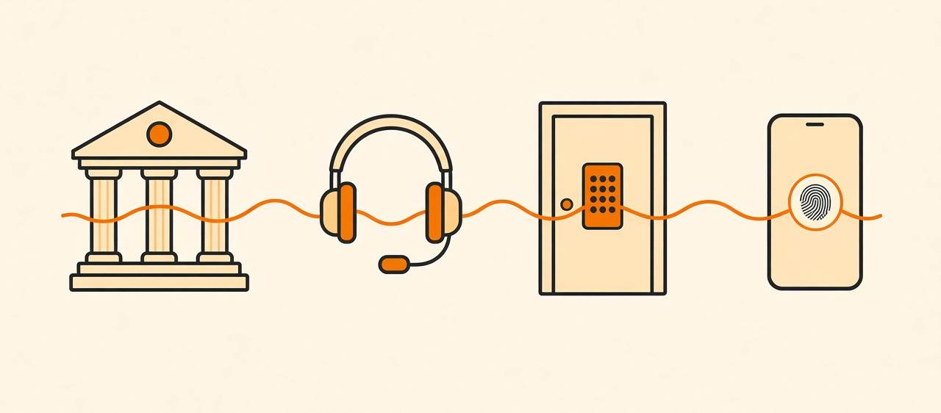
BUSINESS TRACK
Where this
creates value
The same pipeline serves a bank, a call centre and a door. What changes between them is only the risk threshold.
WHO BUYS IT
· Banks and fintech apps
· Call-centre identity
· Building and device access
· Passwordless consumer apps
WHAT THEY GET
· Fewer steps per login
· Replay-attack resistance
· Works in noisy channels
· On-premise or cloud
HOW WE SHIP IT
· Enroll, verify, identify API
· Threshold and risk dashboard
· Pilot on one workflow
· Tuned per customer
Voice-Based Speaker Verification for Secure User Authentication
12
Notes:
Switch from engineering to product. Name one concrete buyer and workflow. (1 min)

Slide 13
BUSINESS TRACK
The numbers
a customer
asks for
KPI | Why the business cares
EER / FAR / FRR | Security versus user friction
Spoof catch rate | Direct fraud prevention
Verification latency | Perceived speed of the login
Cost per verification | Unit economics at scale
Enrollment time | Onboarding drop-off
Every claim below comes from a run in this repository, including the ones that did not go our way.
EVIDENCE WE ALREADY HAVE
0.83%
SASV-EER, clean
8.79%
all-noisy SV-EER
0.54%
VoxCeleb EER
Live
cloud deployment
Responsible use
Biometric consent and a retention policy are mandatory, and high-risk transactions should still use a second factor.
Voice-Based Speaker Verification for Secure User Authentication
13
Notes:
Tie each KPI to a number we measured. End on the responsible-use card. (1 min)

Slide 14
04
SECTION 04
The research
Three tracks, three protocols, and one result we did not want.
Voice-Based Speaker Verification for Secure User Authentication
14
Notes:
Divider. (10 s)

Slide 15
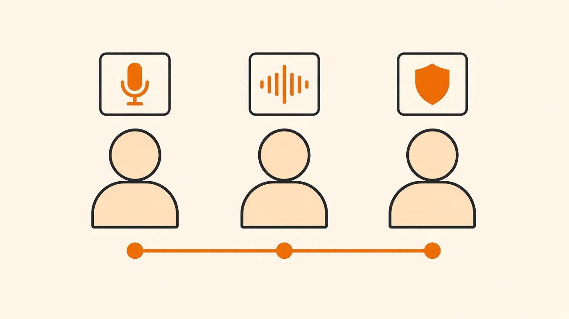
RESEARCH TRACK
Who built
what
Identity, robustness and security were developed and measured separately, then integrated into one pipeline.
Muditha Herath
Speaker models, Silero VAD, pgvector and the full app and ML integration
Yasith Hewarathna
Noise resilience, enhancer comparison, Wave-U-Net and learned fusion
The cards on the right are clickable.
Herath H.M.M.P.B
Replay and spoof detection, SASV protocol, noise-gated SASV and CI/CD
Voice-Based Speaker Verification for Secure User Authentication
15
Notes:
Introduce the three tracks. The right-hand cards are clickable if someone wants to jump. (45 s)

Slide 16


MUDITHA HERATH
Speaker core
and product
— Integrated ECAPA-TDNN and NVIDIA TitaNet-Large into the ML server, with offline checkpoint loading
— Added Silero VAD to the live inference path, including zero-speech fallback handling
— Migrated storage to PostgreSQL + pgvector with HNSW cosine indexes for 1:1 and 1:N search
— Built the Express API, the React recorder and the verification result view
— Authored the VAD, audio and schema test suites with pytest markers
The part of the project that actually runs in production: capture the voice, gate it, turn it into a vector, and search it.
Why a dual-encoder design
ECAPA is small, open and fast on CPU, which suits the deployed service. TitaNet is kept as a second template slot so a stronger encoder can be swapped in later without a schema change.
Voice-Based Speaker Verification for Secure User Authentication
16
Notes:
Muditha's scope. This is the part that actually runs in production. (1 min)

Slide 17
MUDITHA HERATH
Does removing silence help?
VoxCeleb1 test speakers, 1,120 same-speaker and 1,120 different-speaker pairs over 320 files.
0.54%
Reading the result honestly
The EER gain is small, because VoxCeleb clips are already almost all speech.
The bigger practical win is robustness: silent or empty recordings are now caught instead of producing a meaningless embedding.
The TitaNet comparison runs on the same trial list and is blocked only on the NeMo runtime install.
EER WITH SILERO VAD
down from 0.625% on raw audio, a gain of 0.09 points
92%
speech kept
320
trial files
Voice-Based Speaker Verification for Secure User Authentication
17
Notes:
Give the number first, then the honest reading: small EER gain, real robustness gain. (1.5 min)

Slide 18
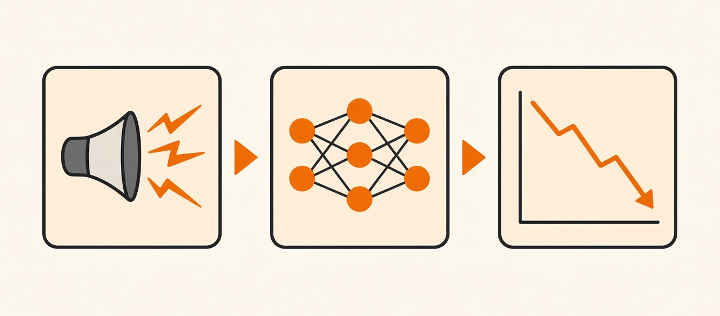
YASITH HEWARATHNA
Noise-robust
verification
Babble is the hardest condition in the whole study, and generic enhancement often makes verification worse rather than better.
The idea
Do not choose between raw and enhanced audio. Embed both with ECAPA and let a network learn how to blend them per utterance.
The final system
A Wave-U-Net enhancer fine-tuned with five speaker-aware losses, followed by self-attention fusion.
Voice-Based Speaker Verification for Secure User Authentication
18
Notes:
Yasith's core idea: do not choose between raw and enhanced, learn the blend. (1.5 min)

Slide 19
YASITH HEWARATHNA
From a fast baseline to a tuned enhancer
PHASE 01
Baselines
ECAPA beats x-vector everywhere; Sinhala is far harder than English on the same encoder.
PHASE 02
Noise study
Fourteen noise and reverb conditions. Babble at low SNR dominates the failures.
PHASE 03
Fusion MVP
WebRTC enhancement and 524k paired embeddings. Attention fusion beats both baselines.
PHASE 04
Bake-off
Eight enhancers compared end to end; only a task-tuned one helps on average.
PHASE 05
Final system
Wave-U-Net fine-tuned with five losses, plus self-attention fusion.
The negative result that shaped the design
DeepFilterNet3 enhancement helped only on babble at moderate SNR and hurt on clean, reverberant and stationary-noise audio. That is exactly why the final system learns a blend instead of always enhancing.
Voice-Based Speaker Verification for Secure User Authentication
19
Notes:
Five phases, quickly. Land on the negative result at the bottom. (1.5 min)

Slide 20
YASITH HEWARATHNA
Final results on VoxCeleb1 + MUSAN
37,611 trials, three noise types across nine SNR levels plus clean. EER in percent, lower is better.
8.79%
ALL-NOISY EER AFTER FUSION
down from 12.58% on raw ECAPA, a gain of 3.78 points
+0.03
clean EER cost
14.62%
hardest subset
The fused system wins at every SNR and every noise type, with no crossover, and gives up almost nothing on clean audio.
Voice-Based Speaker Verification for Secure User Authentication
20
Notes:
The strongest research result. All-noisy error 12.58 down to 8.79 with almost no clean cost. (1.5 min)

Slide 21
HERATH H.M.M.P.B
Detecting a replayed recording
ASVspoof 2017 V2 physical replay attacks, 1,040 held-out development files. Same CNN throughout; only the front-end changes.
4.90%
Why the front-end decides this
A Mel filterbank spends most of its resolution on low frequencies, where the speech energy is.
Inverted Mel spends it on high frequencies instead, which is exactly where a playback loudspeaker and a second microphone leave their fingerprint.
The network, the data and the training schedule were unchanged, so the gain is attributable to the front-end alone.
EER WITH AN INVERTED-MEL FRONT-END
down from 10.00% with a standard Log-Mel front-end on the identical network
0.955
replay F1
95.1%
accuracy
Voice-Based Speaker Verification for Secure User Authentication
21
Notes:
Start the security track with the literal threat: a recording played back at the microphone. The headline is that the front-end, not the network, decided this result. Inverted Mel puts resolution on high frequencies where the playback speaker and the second microphone leave artefacts, and that alone took 10.00% down to 4.90% on the same CNN. If asked: ASVspoof 2017 V2, 1,040 held-out development files, speaker-disjoint from training. (1.5 min)

Slide 22
HERATH H.M.M.P.B
Where replay detection stops working
Every row is a zero-shot run: trained on one corpus, scored on another with no retraining.
Trained on → scored on | EER
ASVspoof 2017 → 2019 PA | 50.47%
2019 PA → ASVspoof 2017 | 39.24%
2017 + PA → 2019 LA (TTS/VC) | 41.12%
AASIST off-the-shelf → 2017 | 64.32%
Fix 1 — train on the target corpus
Training the same network directly on ASVspoof 2019 PA reaches 7.96% EER over 15,434 development files, at an F1 of 0.949.
Fix 2 — mix the corpora
One corpus-balanced model holds on both instead of collapsing on the unseen one: 9.18% on 2017 and 11.00% on PA.
MIXED-CORPUS TRAINING, THREE FRONT-ENDS
Front-end | 2017 | PA 2019
Log-Mel | 21.17% | 5.99%
Inverted Mel | 10.12% | 9.66%
LFCC | 9.24% | 8.98%
The consequence — why AASIST was needed
At 41.12% on logical access, a replay detector is blind to synthesised and converted speech. A different countermeasure has to carry that attack, which is the next slide.
Voice-Based Speaker Verification for Secure User Authentication
22
Notes:
The honest boundary slide. Say it plainly: a replay detector trained on one corpus is worthless on another, 50.47% and 39.24% are both chance-level. Off-the-shelf AASIST is no better zero-shot at 64.32%, and a frozen wav2vec2 with a trained head only reached 37.32%, so a small task-trained CNN beats the big pretrained models here. Two fixes work: train on the target corpus (7.96% on PA) or mix corpora (9.18% and 11.00%). Land on the last card: 41.12% on logical access means replay detection cannot see text-to-speech, which is why the next slide brings in AASIST. (2 min)

Slide 23
HERATH H.M.M.P.B
Anti-spoofing
and the joint
SASV metric
— Evaluated on ASVspoof 2019 LA with the official SASV 2022 trial lists
— MUSAN noise added on the test side only, at clean / 15 / 10 / 5 / 0 dB
— Tuned on dev, locked the evaluation set once, with no further tuning
A recording of the real user passes speaker verification. That is the hole the countermeasure has to close.
System | What it combines
B0 | ECAPA speaker score only
B1 | ECAPA + AASIST countermeasure (α = 0.30)
P2 / P3 | SNR-gated and always-on enhancement
SV-EER
target vs non-target
SPF-EER
target vs spoof
SASV-EER
both at once
Voice-Based Speaker Verification for Secure User Authentication
23
Notes:
Set up the security track's joint metric. A recording of the real user passes speaker verification. (1 min)

Slide 24
HERATH H.M.M.P.B
One clear win, one honest failure
Locked evaluation on clean audio, then the same systems under test-side noise.
0.83%
Result 1 — the countermeasure is essential
A strong speaker encoder on its own fails against spoofed speech, at 27% spoof error. Fusing AASIST with a tuned weight closes it.
SASV-EER WITH AASIST FUSION
down from 20.67% for ECAPA alone, and better than the published 1.71% baseline
System @ 15 dB | SASV-EER
B0 raw ECAPA | 16.91%
P2 gated enhance | 16.93%
P3 always enhance | 23.11%
Result 2 — an honest negative
Gating the enhancer by estimated SNR did not beat raw ECAPA on SASV, and always enhancing was clearly worse.
Voice-Based Speaker Verification for Secure User Authentication
24
Notes:
Two results. Deliver the failure confidently: it is a finding, not a mistake. (2 min)

Slide 25
RESEARCH TRACK
How the three tracks fit together
IDENTITY
Is this the same speaker?
ECAPA and TitaNet embeddings, VAD gating and a pgvector template store.
MUDITHA
ROBUSTNESS
Can we still verify in noise?
A task-tuned Wave-U-Net plus learned fusion of raw and enhanced embeddings.
YASITH
SECURITY
Is the audio real?
A replay CNN and the AASIST countermeasure fused into a joint SASV decision.
H.M.M.P.B
Reconciling the two enhancement findings
Learned fusion improved speaker verification under MUSAN noise on VoxCeleb1, while a simple SNR-gated enhancer failed on the SASV task on ASVspoof LA. These are different protocols, different attacks and different decision rules, so both results stand: enhancement pays off only when the blend is learned for the exact task.
Voice-Based Speaker Verification for Secure User Authentication
25
Notes:
Pre-empt the obvious question about why enhancement worked once and failed once. (1 min)

Slide 26
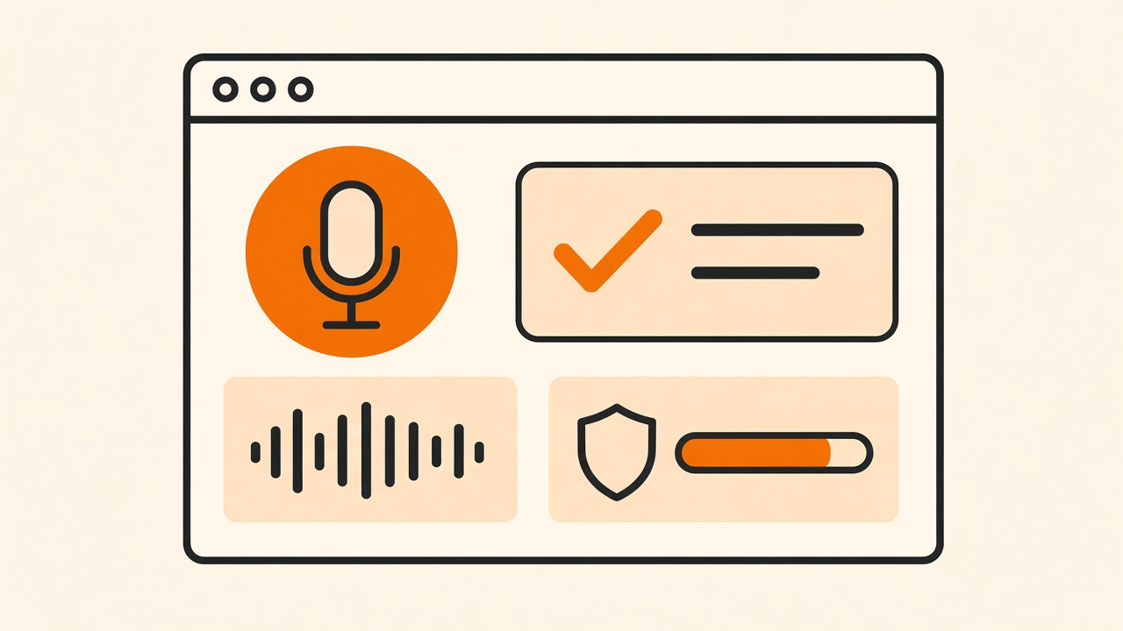
DEMONSTRATION
The system
in use
Enroll once, verify in a second, and watch a replayed recording get turned away.
— Sign in, then enroll with a few short recordings
— Verify with a fresh recording and read the score
— Replay a recording into the mic and watch it be rejected
— Push to main and see the cloud stack rebuild itself
If the room audio is bad
Play the recorded walkthrough, then show the green deployment run and the live service.
Voice-Based Speaker Verification for Secure User Authentication
26
Notes:
Run the demo. If the room audio is unreliable, go straight to the recording. (2-3 min)

Slide 27
REFLECTION
Limitations and next steps
WHAT WE WOULD NOT CLAIM
WHAT WE WOULD DO NEXT
EER values come from different protocols and are not directly comparable across tracks
Apply the learned fusion to the SASV task instead of a fixed SNR gate
Noise was applied mainly on the test side while enrollment stayed clean
Complete the countermeasure-under-noise matrix and lock it once
Replay detection does not transfer across corpora, so new microphones and rooms need their own data
Calibrate thresholds per SNR band so the decision stays stable
Parts of the noisy-SASV grid are smoke-scale rather than full runs
Finish the TitaNet comparison and collect real device recordings
REPORTING DISCIPLINE every number in this deck comes from a run we can reproduce, including the experiments that did not work.
Voice-Based Speaker Verification for Secure User Authentication
27
Notes:
Say the limitations before the panel does, each with a next step. (1 min)

Slide 28
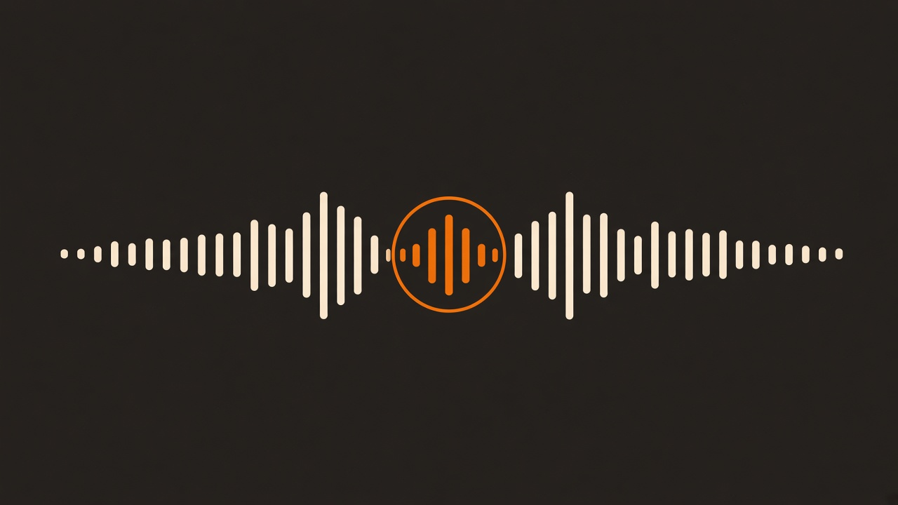
IN SUMMARY
Designed, measured, and deployed
0.83%
joint SASV error, clean audio
8.79%
speaker error across all noise
0.54%
VoxCeleb error with gating
We built the running product, measured every track on a standard protocol, reported the experiments that failed, and automated the deployment.
Thank you — questions?
Muditha Herath · Yasith Hewarathna · Herath H.M.M.P.B
Notes:
Close on the three numbers and one sentence, then stop and take questions. (45 s)

