Slide 1
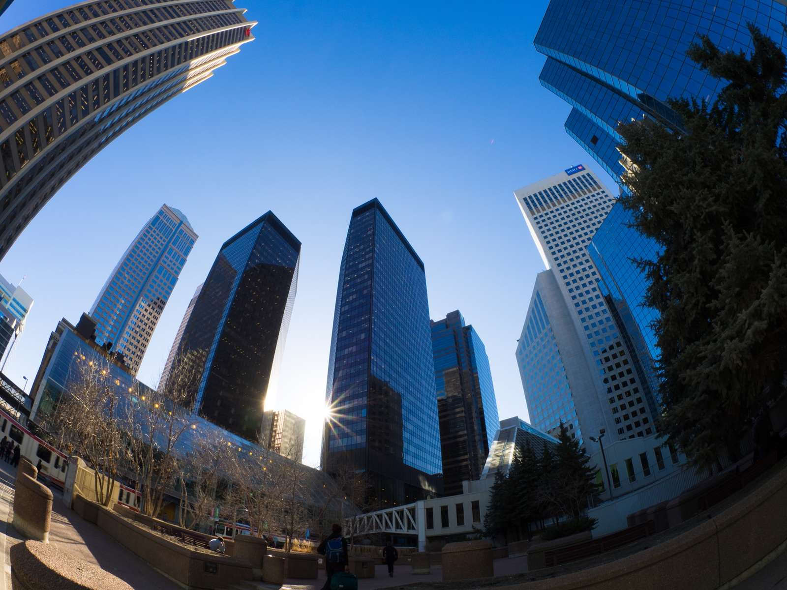
Camera calibration
Yoni Chechik
www.AIisMath.com

Slide 2
References
http://szeliski.org/Book/
http://www.cs.cornell.edu/courses/cs5670/2019sp/lectures/lectures.html
http://www.cs.cmu.edu/~16385/

Slide 3
Contents
What is camera calibration?
Camera extrinsics
Perspective projection
Camera intrinsics
Full camera matrix
Calibration methods and distortions

Slide 4
What is camera calibration
Geometric camera calibration, also referred to as camera resectioning, estimates the parameters of a lens, image sensor, position and view direction of a perspective camera.
You can use these parameters to correct for lens distortion, measure the size of an object in world units, or determine the location of the camera in the scene. These tasks are used in applications such as machine vision to detect and measure objects. They are also used in robotics, for navigation systems, and 3-D scene reconstruction.
[from: https://www.mathworks.com/help/vision/ug/camera-calibration.html]

Slide 5
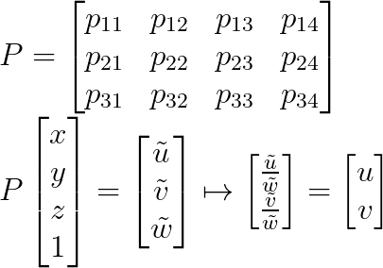
Starting from the end
The camera matrix is a full transformation from 3D objects in the scene to a 2D image with the specific camera parameters:
How many DOFs do we have?
Notes:
\\
P =
\begin{bmatrix}p_{11} & p_{12}&p_{13}&p_{14}
\\ p_{21}&p_{22} &p_{23}&p_{24}
\\p_{31}&p_{32}&p_{33}&p_{34}
\end{bmatrix}
\\
P
\begin{bmatrix}x
\\ y
\\z
\\1
\end{bmatrix}
=
\begin{bmatrix}\tilde{u}
\\ \tilde{v}
\\\tilde{w}
\end{bmatrix}
\mapsto
\begin{bmatrix}\frac{\tilde{u}}{\tilde{w}}
\\ \frac{\tilde{v}}{\tilde{w}}
\end{bmatrix}
=
\begin{bmatrix}u
\\ v
\end{bmatrix}

Slide 6
Starting from the end
The camera matrix is a full transformation from 3D objects in the scene to a 2D image with the specific camera parameters:
How many DOFs do we have?
11, because in homogenous coordinates the answer is always correct up to a scale.

Slide 7
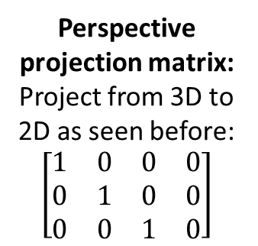
Starting from the end
Intrinsic camera matrix:
estimates the parameters of the lens and image sensor.
Perspective projection matrix:
Project from 3D to 2D as seen before:
$$\left[\begin{matrix}1 & 0 & 0 & 0 \\ 0 & 1 & 0 & 0 \\ 0 & 0 & 1 & 0\end{matrix}\right]$$
extrinsic camera matrix:
estimates the parameters of position and view direction of a camera.
Notes:
P_{3X4} = K_{3X3}[I|0]_{3X4}\Pi_{4X4}

Slide 8















Coordinate systems
There are 3 coordinate systems that are discussed in general: world, camera, and image coordinate systems.
(and also normalized image coo. System…)
This is what we need to do: $O_{world}→O_{camera}→O_{norm. image}→O_{image}$
world point
$$O_{image}$$
$$u$$
$$v$$
image point
$$x$$
$$z$$
$$O_{camera}$$
$$O_{norm. image}$$
$$z$$
$$x$$
$$y$$
$$y$$
$$y$$
$$O_{world}$$
$$x$$

Slide 9
Contents
What is camera calibration?
Camera extrinsics
Perspective projection
Camera intrinsics
Full camera matrix
Calibration methods and distortions

Slide 10

Extrinsic camera matrix
The extrinsic camera matrix is a concatenation of a rotation and translation matrix from $O_{world}$ to $O_{camera}$
We need the world coordinate system when we are talking about multiple camera setup and the relations between one another.
We are given a point in world coordinates and we transform it to the camera coordinate system: $O_{world}→O_{camera}$

Slide 11


Extrinsic camera matrix
I have a coordinate system A with a point $X_{A}$.
$$X_{A}$$
Coo. A

Slide 12
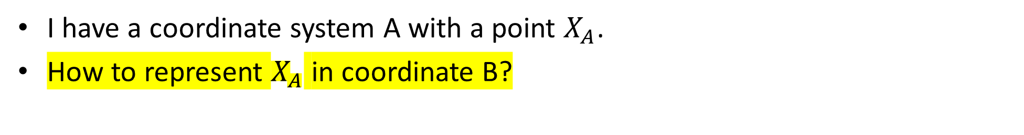
Extrinsic camera matrix
I have a coordinate system A with a point $X_{A}$.
How to represent $X_{A}$ in coordinate B?
$$X_{A}$$
Coo. B
Coo. A

Slide 13
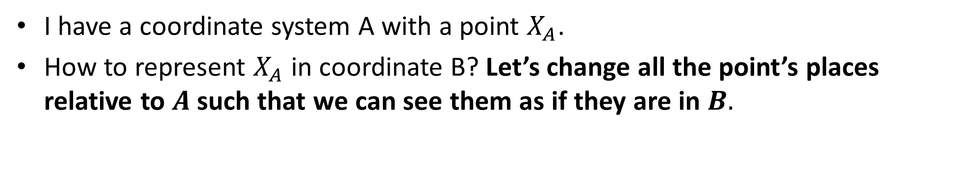
Extrinsic camera matrix
I have a coordinate system A with a point $X_{A}$.
How to represent $X_{A}$ in coordinate B? Let’s change all the point’s places relative to $A$such that we can see them as if they are in $B.$
$$X_{A}$$
Coo. B
Coo. A

Slide 14


Extrinsic camera matrix
I have a coordinate system A with a point $X_{A}$.
How to represent $X_{A}$ in coordinate B? Let’s change all the point’s places relative to $A$such that we can see them as if they are in $B.$
$$X_{A}$$
Coo. B
$$C$$
Translation vector
Coo. A

Slide 15


Extrinsic camera matrix
I have a coordinate system A with a point $X_{A}$.
How to represent $X_{A}$ in coordinate B? Let’s change all the point’s places relative to $A$such that we can see them as if they are in $B.$
$$X_{A}$$
$$−C$$
Coo. B
$$X_{A}−C$$
$$C$$
Translation vector
Coo. A

Slide 16

Extrinsic camera matrix
I have a coordinate system A with a point $X_{A}$.
How to represent $X_{A}$ in coordinate B? Let’s change all the point’s places relative to $A$such that we can see them as if they are in $B.$
$$X_{A}$$
$$−C$$
Coo. B
$$X_{A}−C$$
$$C$$
$$R$$
Translation vector
Coo. A

Slide 17


Extrinsic camera matrix
I have a coordinate system A with a point $X_{A}$.
How to represent $X_{A}$ in coordinate B? Let’s change all the point’s places relative to $A$such that we can see them as if they are in $B.$
$$X_{A}$$
$$−C$$
Coo. B
$$X_{A}−C$$
$$C$$
$$R$$
$$X_{B}=R(X_{A}−C)$$
Translation vector
Coo. A

Slide 18
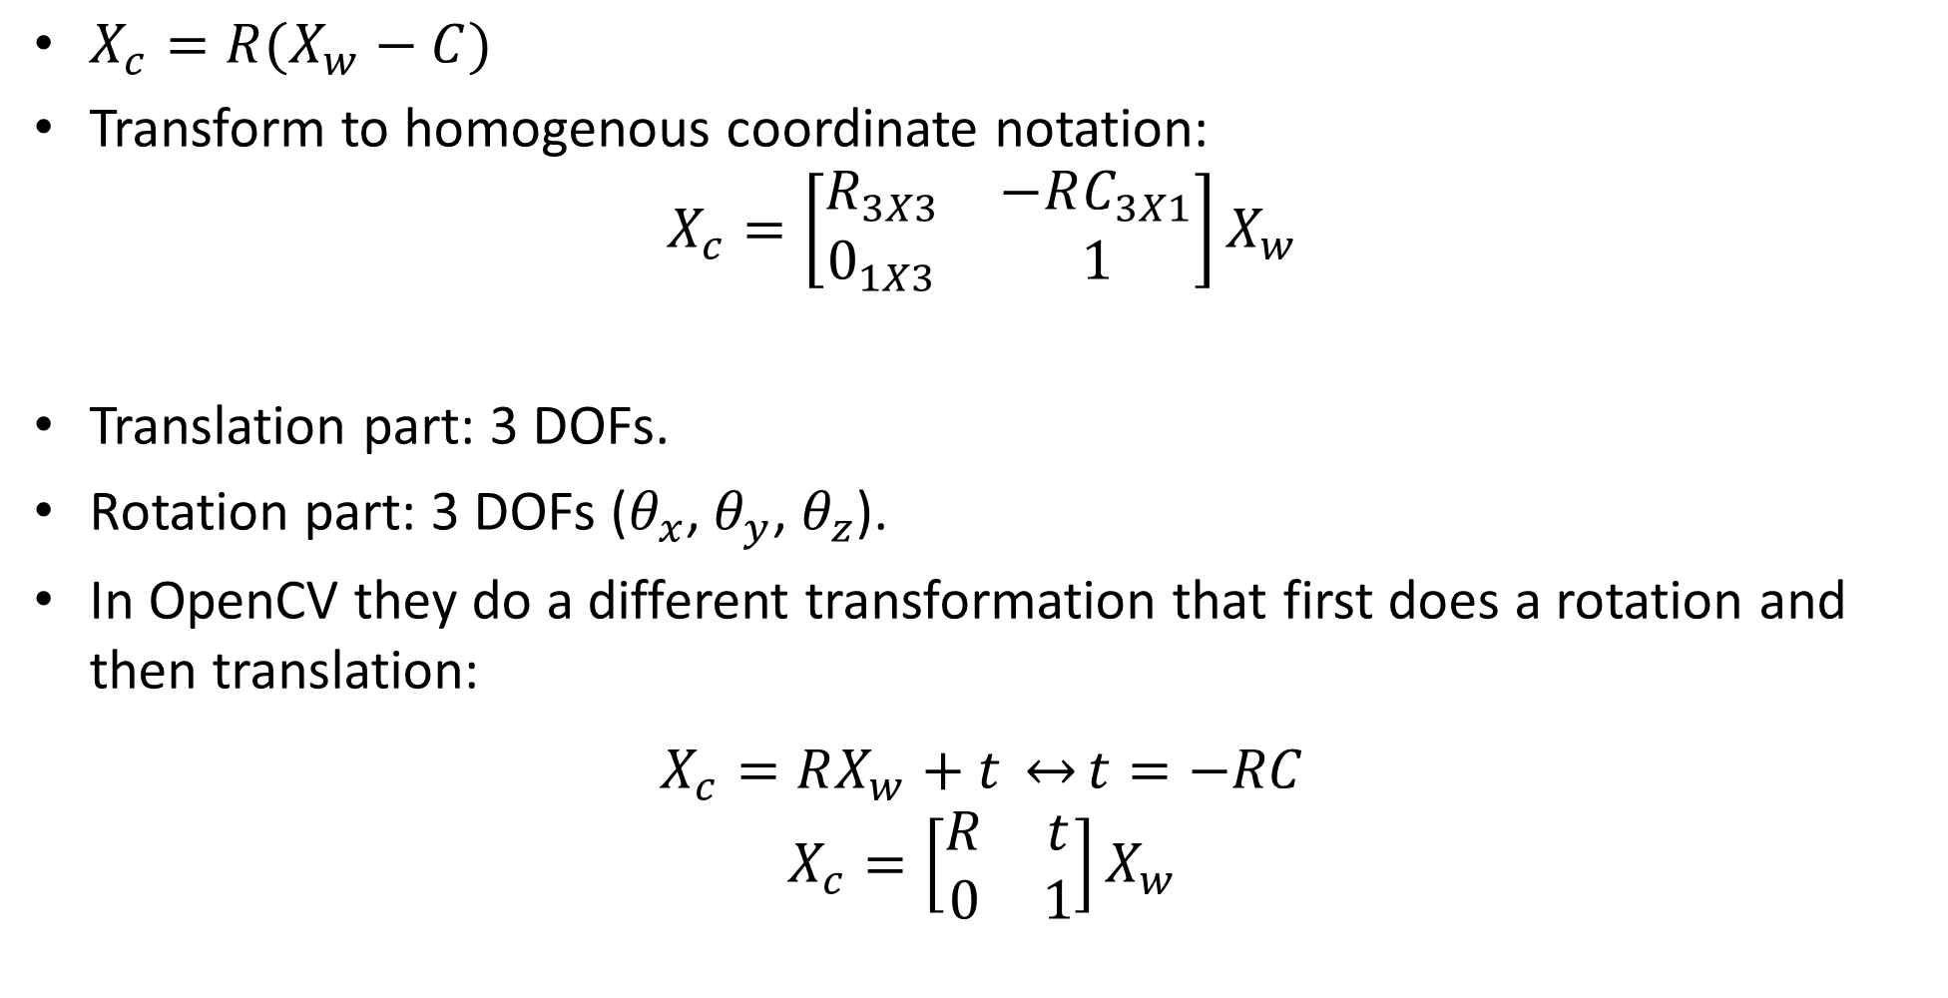
Extrinsic camera matrix
$X_{c}=R(X_{w}−C)$
Transform to homogenous coordinate notation:
$$X_{c}=\left[\begin{matrix}R_{3X3} & −RC_{3X1} \\ 0_{1X3} & 1\end{matrix}\right]X_{w}$$
Translation part: 3 DOFs.
Rotation part: 3 DOFs ($θ_{x}$, $θ_{y}$, $θ_{z}$).
In OpenCV they do a different transformation that first does a rotation and then translation:
$$X_{c}=RX_{w}+t \underset{↔}{}t=−RC$$
$$X_{c}=\left[\begin{matrix}R & t \\ 0 & 1\end{matrix}\right]X_{w}$$

Slide 19
Contents
What is camera calibration?
Camera extrinsics
Perspective projection
Camera intrinsics
Full camera matrix
Calibration methods and distortions

Slide 20

$$\text{Recap}\text{: }\text{perspective} \text{projection}$$
$O_{world}→O_{camera}$ Done.
Now: $O_{camera}→O_{norm. image}$(already saw this: 3D -> 2D perspective projection)
world point
$$O_{image}$$
$$u$$
$$v$$
image point
$$x$$
$$z$$
$$O_{camera}$$
$$O_{norm. image}$$
$$z$$
$$x$$
$$y$$
$$y$$
$$y$$
$$O_{world}$$
$$x$$

Slide 21









Recap: perspective projection
Perspective projection (also known as perspective transformation) is a linear projection where three dimensional objects are projected on the image plane.
$$\tilde{y}$$
image plane
$$\tilde{x}$$
$$\tilde{v}$$
$$\tilde{u}$$
$$\tilde{z}$$
$$O_{camera}$$
principal axis
Notes:
\begin{bmatrix}x
\\ y
\\ z
\end{bmatrix}
\begin{bmatrix}u
\\ v
\end{bmatrix}

Slide 22





Recap: perspective projection
Using triangle proportions (Thales’ theorem) we can easily conclude that:
$$\tilde{y}$$
image plane
$$y$$
$$\tilde{z}$$
$$z$$
Notes:
\begin{bmatrix}f\frac{x}{z}
\\ f\frac{y}{z}
\end{bmatrix}
=
\begin{bmatrix}u
\\ v
\end{bmatrix}

Slide 23
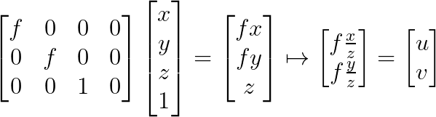

Recap: perspective projection
Let’s use the homogeneous coordinates:
Units of $[m]$
Notes:
\begin{bmatrix}f & 0&0&0
\\ 0&f &0&0
\\0&0&1&0
\end{bmatrix}
\begin{bmatrix}x
\\ y
\\z
\\1
\end{bmatrix}
=
\begin{bmatrix}fx
\\ fy
\\z
\end{bmatrix}
\mapsto
\begin{bmatrix}f\frac{x}{z}
\\ f\frac{y}{z}
\end{bmatrix}
=
\begin{bmatrix}u\\
v
\end{bmatrix}

Slide 24
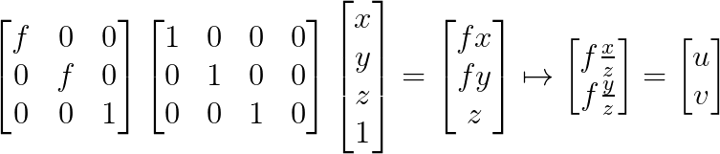
Recap: perspective projection
Let’s split into 2 matrices and use 3D->2D homogenous coordinates:
The perspective projection matrix transforms us from the camera coordinate system to the normalized image coordinate system.
The intrinsic matrix transforms us from the normalized image space to the image space.
Intrinsic camera matrix
Perspective projection matrix
Notes:
\begin{bmatrix}f & 0&0
\\ 0&f &0
\\0&0&1
\end{bmatrix}
\begin{bmatrix}1 & 0&0&0
\\ 0&1 &0&0
\\0&0&1&0
\end{bmatrix}
\begin{bmatrix}x
\\ y
\\z
\\1
\end{bmatrix}
=
\begin{bmatrix}fx
\\ fy
\\z
\end{bmatrix}
\mapsto
\begin{bmatrix}f\frac{x}{z}
\\ f\frac{y}{z}
\end{bmatrix}

Slide 25
Contents
What is camera calibration?
Camera extrinsics
Perspective projection
Camera intrinsics
Full camera matrix
Calibration methods and distortions

Slide 26

$$\text{Intrinsic} \text{camera} \text{matrix}$$
$O_{world}→O_{camera}→O_{norm. image}$ Done.
Now: $O_{norm. image}→O_{image}$
world point
$$O_{image}$$
$$u$$
$$v$$
image point
$$x$$
$$z$$
$$O_{camera}$$
$$O_{norm. image}$$
$$z$$
$$x$$
$$y$$
$$y$$
$$y$$
$$O_{world}$$
$$x$$

Slide 27
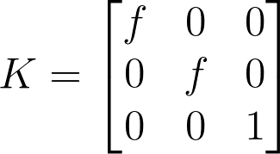
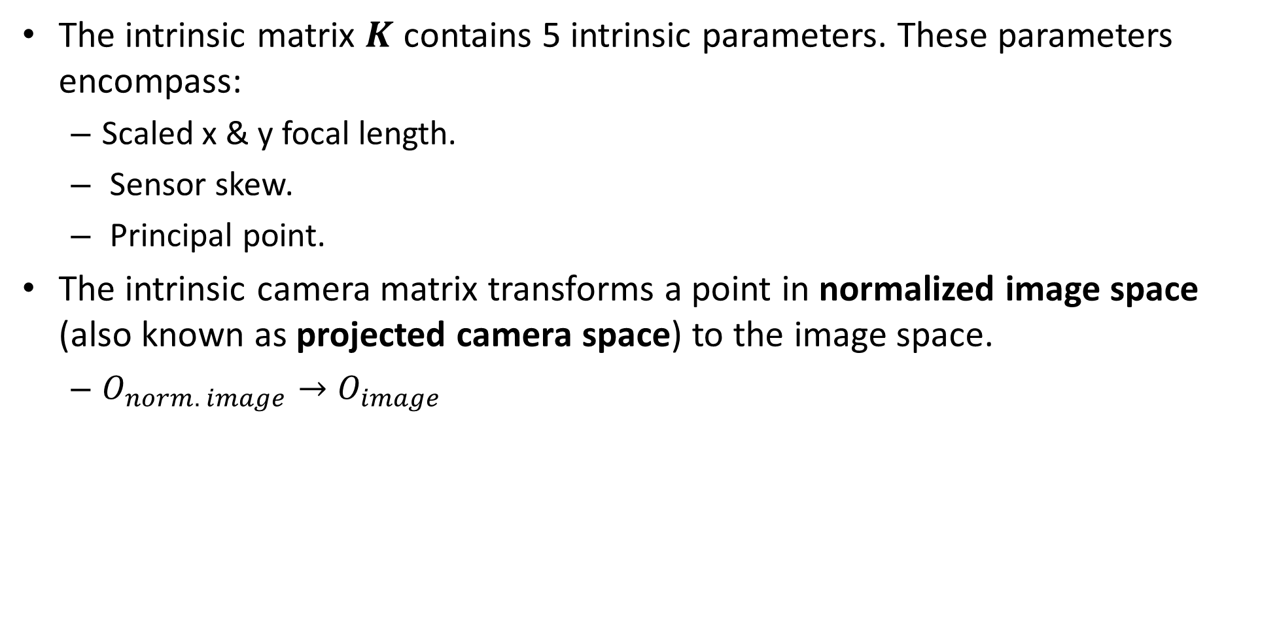
Intrinsic camera matrix
The intrinsic matrix $K$ contains 5 intrinsic parameters. These parameters encompass:
Scaled x & y focal length.
Sensor skew.
Principal point.
The intrinsic camera matrix transforms a point in normalized image space (also known as projected camera space) to the image space.
$O_{norm. image}→O_{image}$
Notes:
K =
\begin{bmatrix}f & 0&0
\\ 0&f &0
\\0&0&1
\end{bmatrix}

Slide 28
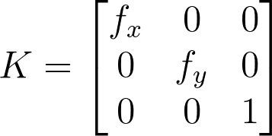

Intrinsic camera matrix
Transforming to units of pixels in image space:
$m_{x}$ is a ratio between the normalized image space to image space in pixels in x direction. ($m_{y}$ is the same…)
$$f_{x}=m_{x}f \&{ f}_{y}=m_{y}f$$
Notes:
K =
\begin{bmatrix}f_x & 0&0
\\ 0&f_y &0
\\0&0&1
\end{bmatrix}

Slide 29


Intrinsic camera matrix
Let’s add the principle point: the offset vector between the projected camera coordinates (or normalized image coo.) to the image coordinate [units of pixels].
How to add this to the intrinsic matrix?
$$O_{image}$$
$$O_{\begin{aligned}norm. \\ image\end{aligned}}$$
image plane

Slide 30
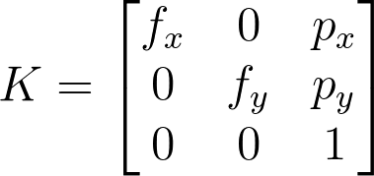

Intrinsic camera matrix
Let’s add the principle point: the offset vector between the projected camera coordinates (or normalized image coo.) to the image coordinate [units of pixels].
How to add this to the intrinsic matrix?
$$O_{image}$$
$$O_{\begin{aligned}norm. \\ image\end{aligned}}$$
image plane

Slide 31
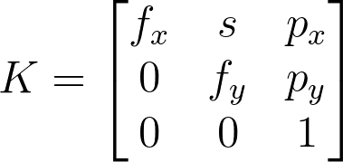
Intrinsic camera matrix
In some camera sensors exist a very small skew which makes the sensor a parallelogram.
Notes:
K =
\begin{bmatrix}f_x & s&p_x
\\ 0&f_y &p_y
\\0&0&1
\end{bmatrix}
==============================
Kx =
\begin{bmatrix}1 & 0&p_x
\\ 0&1 &p_y
\\0&0&1
\end{bmatrix}
\begin{bmatrix}1 & \frac{s}{f_y}&0
\\ 0&1 &0
\\0&0&1
\end{bmatrix}
\begin{bmatrix}f_x & 0&0
\\ 0&f_y &0
\\0&0&1
\end{bmatrix}
x

Slide 32
Contents
What is camera calibration?
Camera extrinsics
Perspective projection
Camera intrinsics
Full camera matrix
Calibration methods and distortions

Slide 33
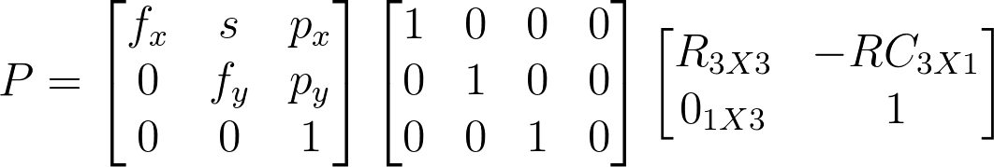
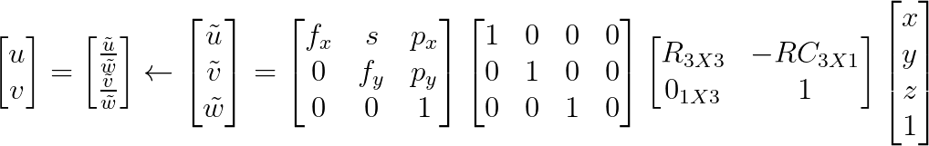
Full camera matrix
Notes:
P =
\begin{bmatrix}f_x & s&p_x
\\ 0&f_y &p_y
\\0&0&1
\end{bmatrix}
\begin{bmatrix}1 & 0&0&0
\\ 0&1 &0&0
\\0&0&1&0
\end{bmatrix}
\begin{bmatrix}R_{3X3} & -RC_{3X1}
\\ 0_{1X3}&1
\end{bmatrix}
=========================================
\begin{bmatrix}u
\\ v
\end{bmatrix}
=
\begin{bmatrix}\frac{\tilde{u}}{\tilde{w}}
\\ \frac{\tilde{v}}{\tilde{w}}
\end{bmatrix}
\leftarrow
\begin{bmatrix}\tilde{u}
\\ \tilde{v}
\\\tilde{w}
\end{bmatrix}
=
\begin{bmatrix}f_x & s&p_x
\\ 0&f_y &p_y
\\0&0&1
\end{bmatrix}
\begin{bmatrix}1 & 0&0&0
\\ 0&1 &0&0
\\0&0&1&0
\end{bmatrix}
\begin{bmatrix}R_{3X3} & -RC_{3X1}
\\ 0_{1X3}&1
\end{bmatrix}
\begin{bmatrix}x
\\ y
\\z
\\1
\end{bmatrix}

Slide 34
Contents
What is camera calibration?
Camera extrinsics
Perspective projection
Camera intrinsics
Full camera matrix
Calibration methods and distortions

Slide 35
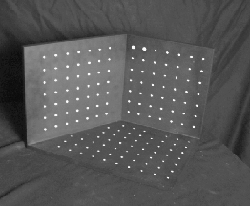
Geometric calibration
Place a known object in the scene:
identify correspondences between image and scene
compute mapping from scene to image
Issues:
must know geometry very accurately
must know 3D->2D correspondence

Slide 36
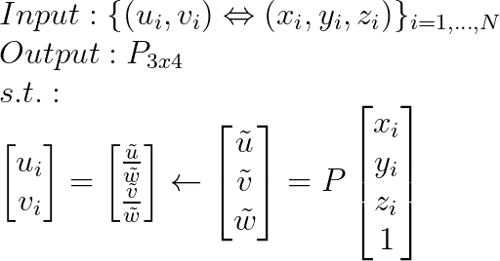
Full camera matrix
Assuming we are given an imaged points and their corresponding 3D points in the real world, camera calibration is the process to find the camera parameters.
We will return to this assumption later.
Notes:
\\
Input:
\{(u_i,v_i)\Leftrightarrow (x_i,y_i,z_i)\}_{i=1,...,N}
\\
Output: P_{3x4}
\\
s.t.:
\\
\begin{bmatrix}u_i
\\ v_i
\end{bmatrix}
=
\begin{bmatrix}\frac{\tilde{u}}{\tilde{w}}
\\ \frac{\tilde{v}}{\tilde{w}}
\end{bmatrix}
\leftarrow
\begin{bmatrix}\tilde{u}
\\ \tilde{v}
\\\tilde{w}
\end{bmatrix}
=
P
\begin{bmatrix}x_i
\\ y_i
\\z_i
\\1
\end{bmatrix}

Slide 37
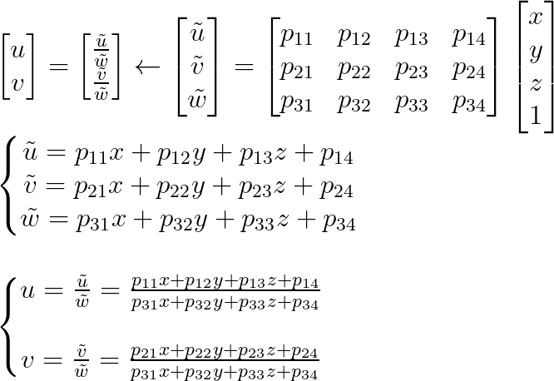
Full camera matrix
Notes:
\\
\begin{bmatrix}u
\\ v
\end{bmatrix}
=
\begin{bmatrix}\frac{\tilde{u}}{\tilde{w}}
\\ \frac{\tilde{v}}{\tilde{w}}
\end{bmatrix}
\leftarrow
\begin{bmatrix}\tilde{u}
\\ \tilde{v}
\\\tilde{w}
\end{bmatrix}
=
\begin{bmatrix}p_{11} & p_{12}&p_{13}&p_{14}
\\ p_{21}&p_{22} &p_{23}&p_{24}
\\p_{31}&p_{32}&p_{33}&p_{34}
\end{bmatrix}
\begin{bmatrix}x
\\ y
\\z
\\1
\end{bmatrix}
\\
\left\{\begin{matrix}
\tilde{u} = p_{11}x+p_{12}y+p_{13}z+p_{14}\\
\tilde{v} = p_{21}x+p_{22}y+p_{23}z+p_{24}\\
\tilde{w} = p_{31}x+p_{32}y+p_{33}z+p_{34}
\end{matrix}\right.
\\
\\
\\
\left\{\begin{matrix}
u = \frac{\tilde{u}}{\tilde{w}} = \frac{p_{11}x+p_{12}y+p_{13}z+p_{14}}{p_{31}x+p_{32}y+p_{33}z+p_{34}}\\
\\
v = \frac{\tilde{v}}{\tilde{w}} = \frac{p_{21}x+p_{22}y+p_{23}z+p_{24}}{p_{31}x+p_{32}y+p_{33}z+p_{34}}\\
\end{matrix}\right.
\\

Slide 38
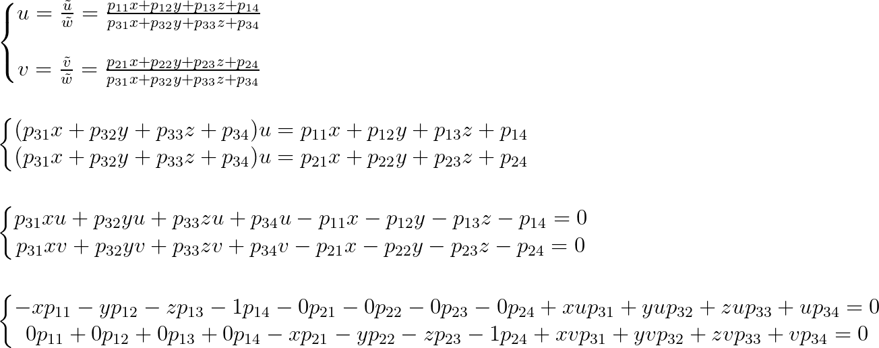
Full camera matrix
Notes:
\\
\left\{\begin{matrix}
u = \frac{\tilde{u}}{\tilde{w}} = \frac{p_{11}x+p_{12}y+p_{13}z+p_{14}}{p_{31}x+p_{32}y+p_{33}z+p_{34}}\\
\\
v = \frac{\tilde{v}}{\tilde{w}} = \frac{p_{21}x+p_{22}y+p_{23}z+p_{24}}{p_{31}x+p_{32}y+p_{33}z+p_{34}}\\
\end{matrix}\right.
\\\\\\
\left\{\begin{matrix}
(p_{31}x+p_{32}y+p_{33}z+p_{34})u = p_{11}x+p_{12}y+p_{13}z+p_{14}\\
(p_{31}x+p_{32}y+p_{33}z+p_{34})u = p_{21}x+p_{22}y+p_{23}z+p_{24}
\end{matrix}\right.
\\\\\\
\left\{\begin{matrix}
p_{31}xu+p_{32}yu+p_{33}zu+p_{34}u - p_{11}x-p_{12}y-p_{13}z-p_{14}=0\\
p_{31}xv+p_{32}yv+p_{33}zv+p_{34}v - p_{21}x-p_{22}y-p_{23}z-p_{24}=0
\end{matrix}\right.
\\\\\\
\left\{\begin{matrix}
-xp_{11}-yp_{12}-zp_{13}-1p_{14}-0p_{21}-0p_{22}-0p_{23}-0p_{24}+xup_{31}+yup_{32}+zup_{33}+up_{34}=0\\
0p_{11}+0p_{12}+0p_{13}+ 0p_{14}-xp_{21}-yp_{22}-zp_{23}-1p_{24}+xvp_{31}+yvp_{32}+zvp_{33}+vp_{34}=0
\end{matrix}\right.

Slide 39
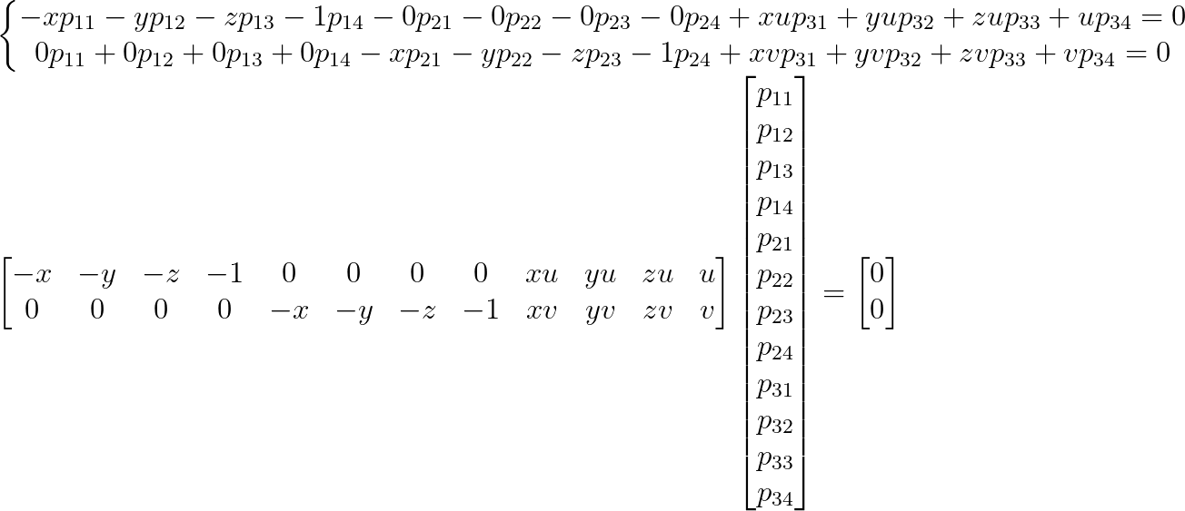
Full camera matrix
Notes:
\\
\left\{\begin{matrix}
-xp_{11}-yp_{12}-zp_{13}-1p_{14}-0p_{21}-0p_{22}-0p_{23}-0p_{24}+xup_{31}+yup_{32}+zup_{33}+up_{34}=0\\
0p_{11}+0p_{12}+0p_{13}+ 0p_{14}-xp_{21}-yp_{22}-zp_{23}-1p_{24}+xvp_{31}+yvp_{32}+zvp_{33}+vp_{34}=0
\end{matrix}\right.
\\
\begin{bmatrix}
-x & -y & -z & -1 &0&0&0&0&xu&yu&zu&u\\
0 & 0 & 0 & 0 &-x & -y & -z & -1&xv&yv&zv&v\\
\end{bmatrix}
\begin{bmatrix}
p_{11} \\
p_{12} \\
p_{13} \\
p_{14} \\
p_{21} \\
p_{22} \\
p_{23} \\
p_{24} \\
p_{31} \\
p_{32} \\
p_{33} \\
p_{34} \\
\end{bmatrix}
=
\begin{bmatrix}
0 \\
0 \\
\end{bmatrix}

Slide 40
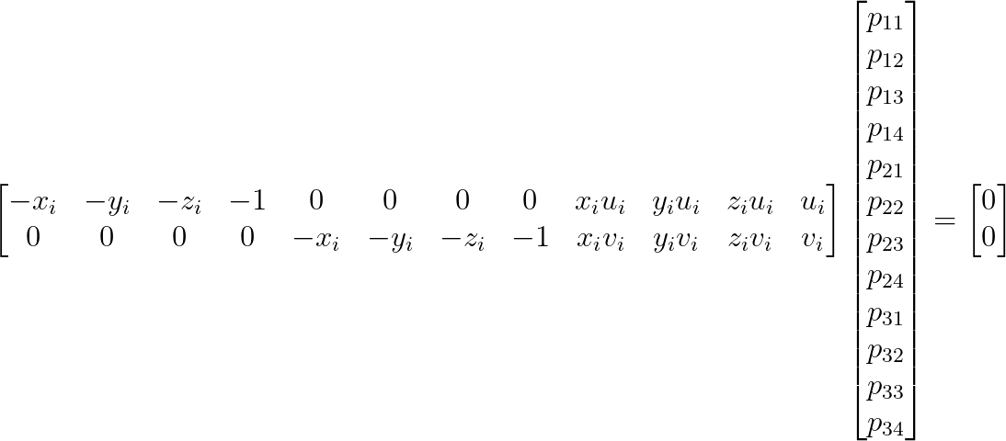
Full camera matrix
Can the above equation be solved easily? What is one possible solution that we don’t want and how do we avoid it?
Notes:
\\
\begin{bmatrix}
-x_i & -y_i & -z_i & -1 &0&0&0&0&x_iu_i&y_iu_i&z_iu_i&u_i\\
0 & 0 & 0 & 0 &-x_i & -y_i & -z_i & -1&x_iv_i&y_iv_i&z_iv_i&v_i\\
\end{bmatrix}
\begin{bmatrix}
p_{11} \\
p_{12} \\
p_{13} \\
p_{14} \\
p_{21} \\
p_{22} \\
p_{23} \\
p_{24} \\
p_{31} \\
p_{32} \\
p_{33} \\
p_{34} \\
\end{bmatrix}
=
\begin{bmatrix}
0 \\
0 \\
\end{bmatrix}

Slide 41
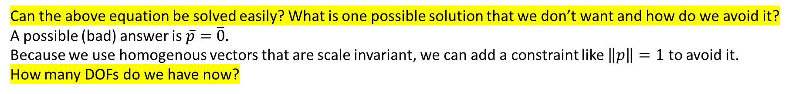
Full camera matrix
Can the above equation be solved easily? What is one possible solution that we don’t want and how do we avoid it?
A possible (bad) answer is $\overline{p}=\overline{0}.$
Because we use homogenous vectors that are scale invariant, we can add a constraint like $\left\|p\right\|=1$ to avoid it.
How many DOFs do we have now?
Notes:
\\
\begin{bmatrix}
-x_i & -y_i & -z_i & -1 &0&0&0&0&x_iu_i&y_iu_i&z_iu_i&u_i\\
0 & 0 & 0 & 0 &-x_i & -y_i & -z_i & -1&x_iv_i&y_iv_i&z_iv_i&v_i\\
\end{bmatrix}
\begin{bmatrix}
p_{11} \\
p_{12} \\
p_{13} \\
p_{14} \\
p_{21} \\
p_{22} \\
p_{23} \\
p_{24} \\
p_{31} \\
p_{32} \\
p_{33} \\
p_{34} \\
\end{bmatrix}
=
\begin{bmatrix}
0 \\
0 \\
\end{bmatrix}

Slide 42

Full camera matrix
Can the above equation be solved easily? What is one possible solution that we don’t want and how do we avoid it?
A possible (bad) answer is $\overline{p}=\overline{0}.$
Because we use homogenous vectors that are scale invariant, we can add a constraint like $\left\|p\right\|=1$ to avoid it.
How many DOFs do we have now? 11
Notes:
\\
\begin{bmatrix}
-x_i & -y_i & -z_i & -1 &0&0&0&0&x_iu_i&y_iu_i&z_iu_i&u_i\\
0 & 0 & 0 & 0 &-x_i & -y_i & -z_i & -1&x_iv_i&y_iv_i&z_iv_i&v_i\\
\end{bmatrix}
\begin{bmatrix}
p_{11} \\
p_{12} \\
p_{13} \\
p_{14} \\
p_{21} \\
p_{22} \\
p_{23} \\
p_{24} \\
p_{31} \\
p_{32} \\
p_{33} \\
p_{34} \\
\end{bmatrix}
=
\begin{bmatrix}
0 \\
0 \\
\end{bmatrix}

Slide 43
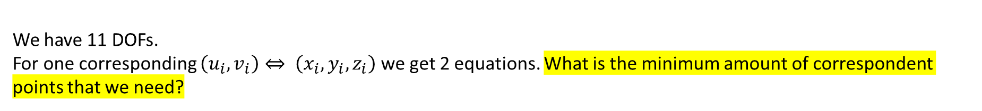
Full camera matrix
We have 11 DOFs.
For one corresponding $\left(u_{i},v_{i}\right)⇔ \left(x_{i},y_{i},z_{i}\right)$ we get 2 equations. What is the minimum amount of correspondent points that we need?
Notes:
\\
\begin{bmatrix}
-x_i & -y_i & -z_i & -1 &0&0&0&0&x_iu_i&y_iu_i&z_iu_i&u_i\\
0 & 0 & 0 & 0 &-x_i & -y_i & -z_i & -1&x_iv_i&y_iv_i&z_iv_i&v_i\\
\end{bmatrix}
\begin{bmatrix}
p_{11} \\
p_{12} \\
p_{13} \\
p_{14} \\
p_{21} \\
p_{22} \\
p_{23} \\
p_{24} \\
p_{31} \\
p_{32} \\
p_{33} \\
p_{34} \\
\end{bmatrix}
=
\begin{bmatrix}
0 \\
0 \\
\end{bmatrix}

Slide 44

Full camera matrix
We have 11 DOFs.
For one corresponding $\left(u_{i},v_{i}\right)⇔ \left(x_{i},y_{i},z_{i}\right)$ we get 2 equations. What is the minimum amount of correspondent points that we need? 6
Notes:
\\
\begin{bmatrix}
-x_i & -y_i & -z_i & -1 &0&0&0&0&x_iu_i&y_iu_i&z_iu_i&u_i\\
0 & 0 & 0 & 0 &-x_i & -y_i & -z_i & -1&x_iv_i&y_iv_i&z_iv_i&v_i\\
\end{bmatrix}
\begin{bmatrix}
p_{11} \\
p_{12} \\
p_{13} \\
p_{14} \\
p_{21} \\
p_{22} \\
p_{23} \\
p_{24} \\
p_{31} \\
p_{32} \\
p_{33} \\
p_{34} \\
\end{bmatrix}
=
\begin{bmatrix}
0 \\
0 \\
\end{bmatrix}

Slide 45
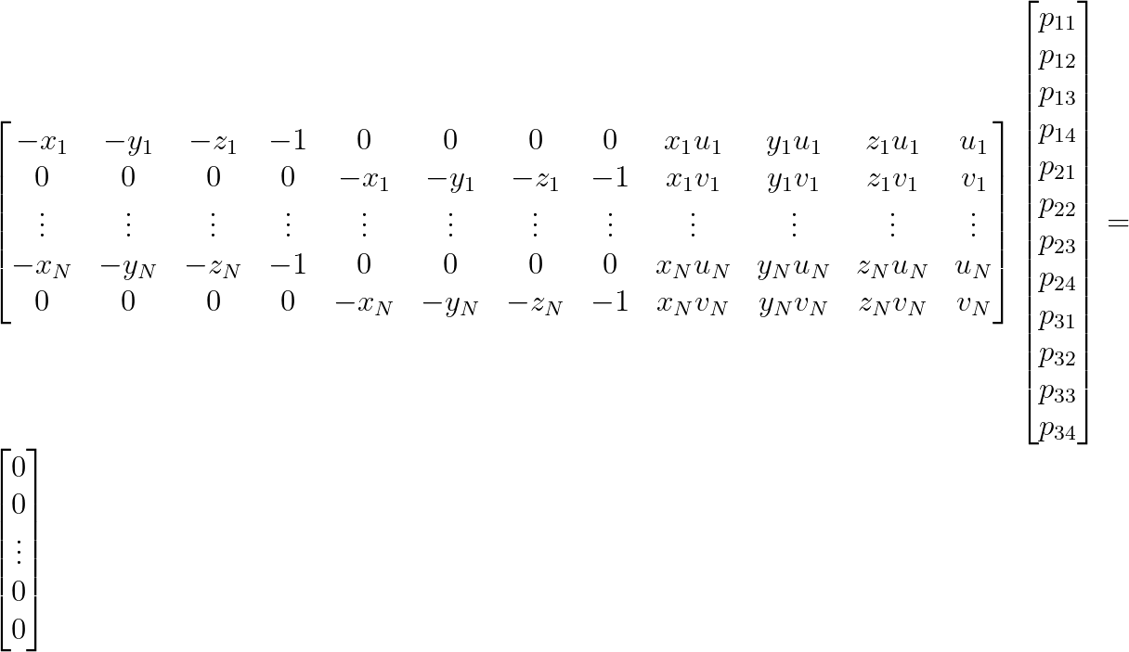

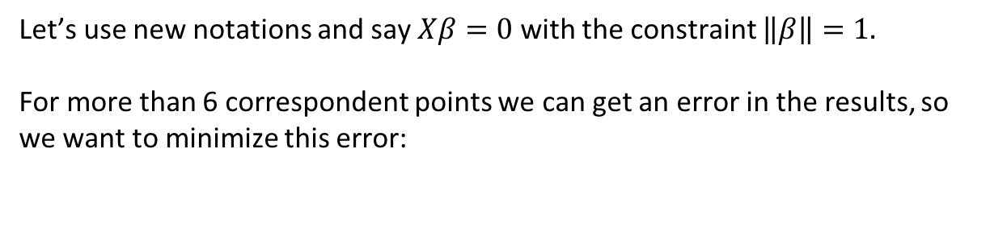
Full camera matrix
Let’s use new notations and say $Xβ=0$ with the constraint $\left\|β\right\|=1.$
For more than 6 correspondent points we can get an error in the results, so we want to minimize this error:
Notes:
\\
\begin{bmatrix}
-x_1 & -y_1 & -z_1 & -1 &0&0&0&0&x_1u_1&y_1u_1&z_1u_1&u_1\\
0 & 0 & 0 & 0 &-x_1 & -y_1 & -z_1 & -1 & x_1v_1 & y_1v_1 & z_1v_1 & v_1 \\
\vdots &\vdots &\vdots &\vdots &\vdots &\vdots &\vdots &\vdots &\vdots &\vdots &\vdots &\vdots\\
-x_N & -y_N & -z_N & -1 &0&0&0&0&x_Nu_N&y_Nu_N&z_Nu_N&u_N\\
0 & 0 & 0 & 0 &-x_N & -y_N & -z_N & -1 & x_Nv_N & y_Nv_N & z_Nv_N & v_N \\
\end{bmatrix}
\begin{bmatrix}
p_{11} \\
p_{12} \\
p_{13} \\
p_{14} \\
p_{21} \\
p_{22} \\
p_{23} \\
p_{24} \\
p_{31} \\
p_{32} \\
p_{33} \\
p_{34}
\end{bmatrix}
=
\begin{bmatrix}
0 \\
0 \\
\vdots\\
0 \\
0 \\
\end{bmatrix}
============================================
\left\{\begin{matrix}
minimize & ||X\beta||\\
s.t. &||\beta||=1
\end{matrix}\right.

Slide 46
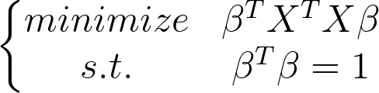
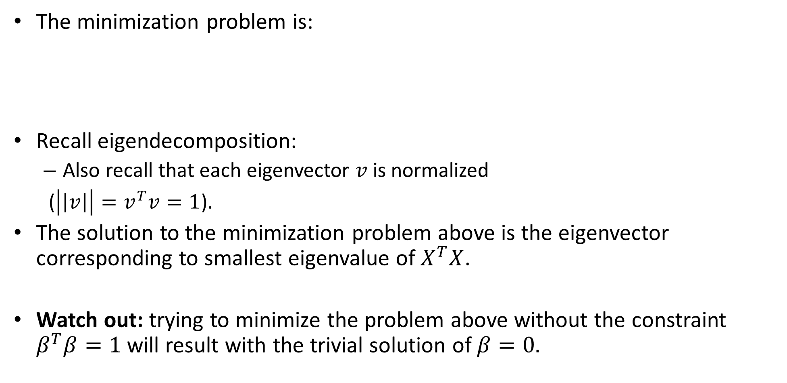
Linear TLS -the minimization problem
The minimization problem is:
Recall eigendecomposition:
Also recall that each eigenvector $v$is normalized
($\left|\left|v\right|\right|=v^{T}v=1$).
The solution to the minimization problem above is the eigenvector corresponding to smallest eigenvalue of $X^{T}X$.
Watch out: trying to minimize the problem above without the constraint $β^{T}β=1$ will result with the trivial solution of $β=0.$
Notes:
Av = \lambda v \mapsto v^TAv = \lambda

Slide 47
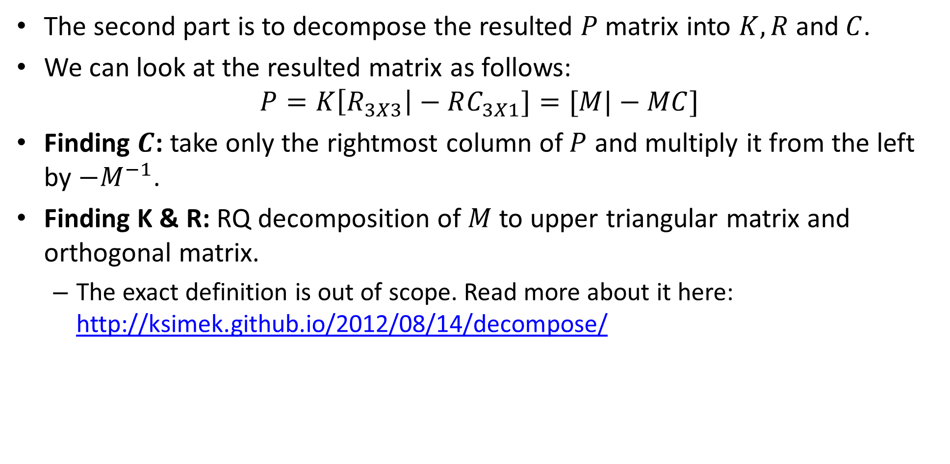
Full camera matrix
The second part is to decompose the resulted $P$matrix into $K, R$and$C$.
We can look at the resulted matrix as follows:
$$P=K\left[R_{3X3}\right|−RC_{3X1}]=[M|−MC]$$
Finding $C$: take only the rightmost column of $P$ and multiply it from the left by $−M^{−1}$.
Finding K & R: RQ decomposition of $M$ to upper triangular matrix and orthogonal matrix.
The exact definition is out of scope. Read more about it here: http://ksimek.github.io/2012/08/14/decompose/

Slide 48
Contents
What is camera calibration?
Camera extrinsics
Perspective projection
Camera intrinsics
Full camera matrix
Calibration methods and distortions

Slide 49
Geometric calibration
Advantages:
Very simple to formulate.
Analytical solution.
Disadvantages:
Doesn’t model radial/ tangential distortion.
For these reasons, nonlinear methods are preferred.
Define error function E between projected 3D points and image points.
E encompass intrinsics, extrinsics, radial distortion and tangential distortion.
Minimize E using nonlinear optimization techniques.

Slide 50
AR using markers
Compute point correspondents of known marker.
Estimate the pose of the camera.
Project 3D content to image plane using known places of camera and marker.
Examples:
https://www.youtube.com/watch?v=lIHcnwOVKng
https://developers.google.com/ar/develop/c/augmented-images

Slide 51
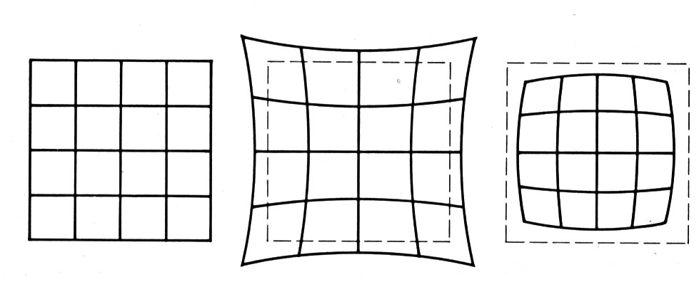
Radial distortion
No distortion
Pin cushion
Barrel
Radial distortion of the image
Caused by imperfect lenses
Deviations are most noticeable for rays that pass through the edge of the lens

Slide 52
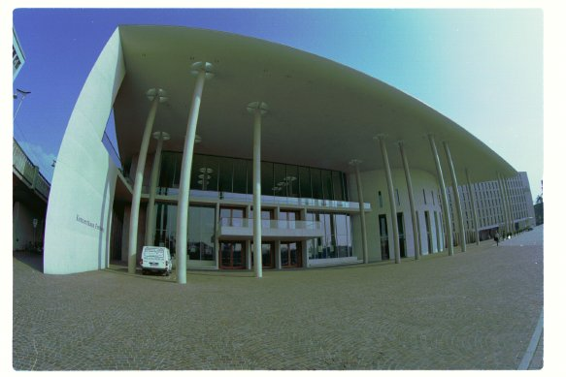
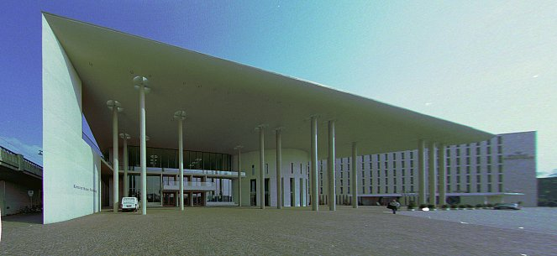
Radial distortion

Slide 53
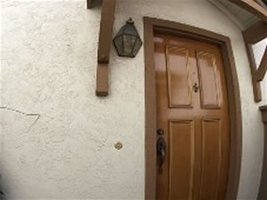
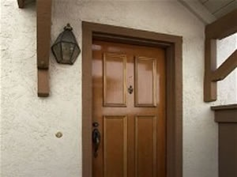
Radial distortion
before
after

Slide 54
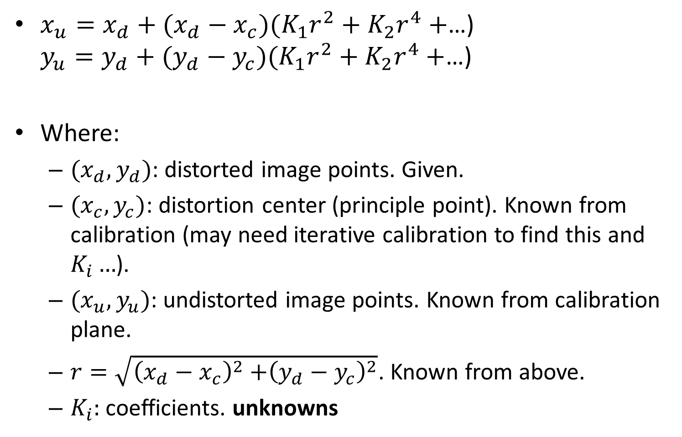
Radial distortion
$x_{u}=x_{d}+(x_{d}−x_{c})(K_{1}r^{2}+K_{2}r^{4}+$…) $y_{u}=y_{d}+(y_{d}−y_{c})(K_{1}r^{2}+K_{2}r^{4}+$…)
Where:
$(x_{d}, y_{d})$: distorted image points. Given.
$(x_{c}, y_{c})$: distortion center (principle point). Known from calibration (may need iterative calibration to find this and $K_{i}…$).
$(x_{u}, y_{u})$: undistorted image points. Known from calibration plane.
$r=\sqrt{{\left(x_{d}−x_{c}\right)}^{2}{+\left(y_{d}−y_{c}\right)}^{2}}$. Known from above.
$K_{i}:$coefficients. unknowns

Slide 55
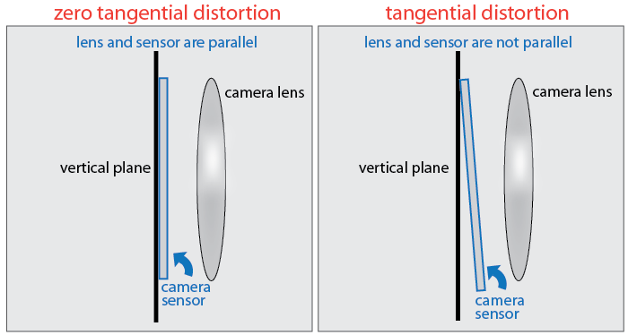
Tangential distortion
Another kind of distortion caused by the camera sensor not being completely parallel to the lens and image plane.

Slide 56
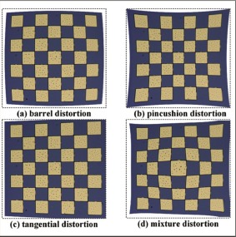
Tangential distortion

Slide 57
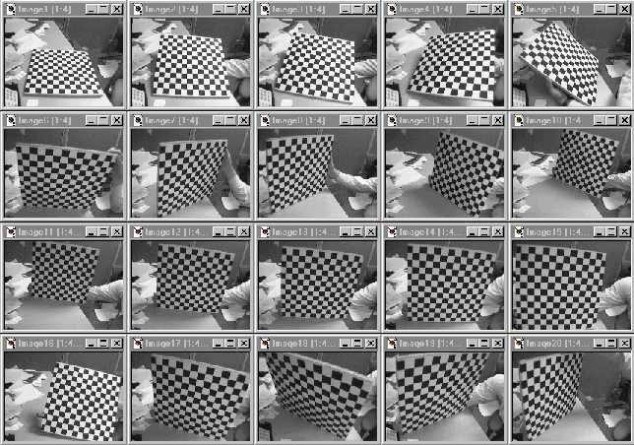
Multi plane calibration
Advantages:
Only requires a plane
Don’t have to know positions/orientations
Disadvantage:
Need to solve non-linear optimization problem.
https://www.microsoft.com/en-us/research/wp-content/uploads/2016/02/tr98-71.pdf

