Slide 1

Sharing code, figures and tables in the laboratory ...
… using GitHub
Sergio Martínez Cuesta

Slide 2
Overview
The laboratories and context
The past: Redmine
The present: GitHub
Structure
Case study: The glioblastoma project

Slide 3

Materials available at ...
https://github.com/semacu/talks
folder: 20170703_GitHubintheLab_CRUK-CI/

Slide 4
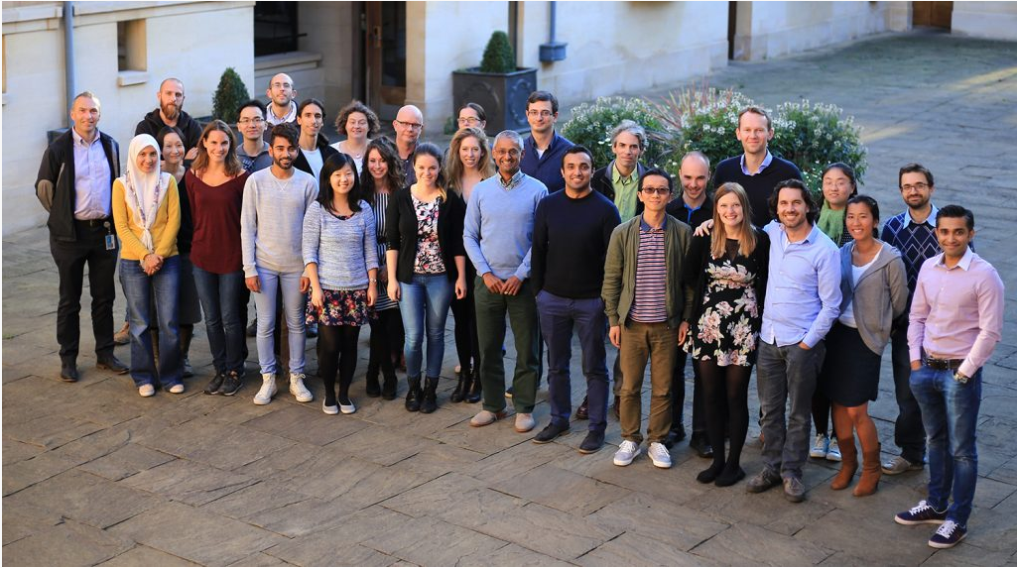
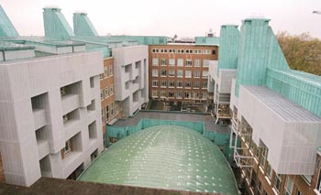
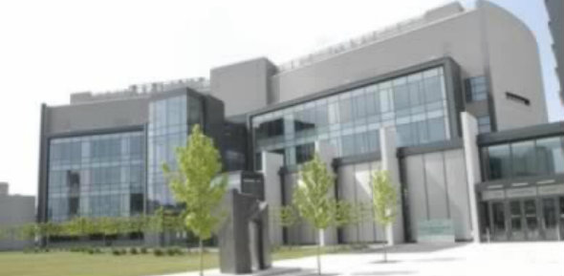
The laboratories
The Balasubramanian group

Slide 5
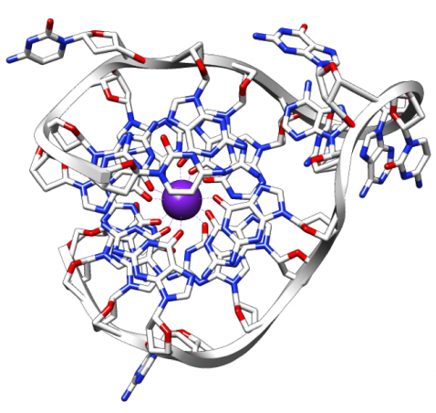
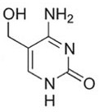
The laboratories
Nucleotide modifications
- Mapping modified bases (e.g. 5hmC and 5fC) in genomes and transcriptomes
- Quantifying abundances using mass spectrometry
- Chemical synthesis
G-quadruplexes
- Mapping in DNA and RNA
- Biophysical characterization
- Drug discovery
G4
5hmC

Slide 6




The context
Most projects have both an experimental and a computational leader
Classical ways of sharing:

Slide 7
The needs
We strive for an environment where:
Computational colleagues can ...
… share code and results
… review work
… get credit for the collaborative project work
Experimental colleagues can ...
… follow development
… access results
… learn computational methods

Slide 8
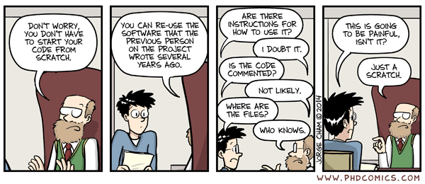
The needs
Reproducibility

Slide 9





Project timeline
Close data
Open data
Answering biological questions
Initial experiments
Method optimisation
Write up story
Ideas
Paper
Tests
First scripts
Robust analysis pipeline
Figures Tables
Document computational method
Private code
Public code

Slide 10
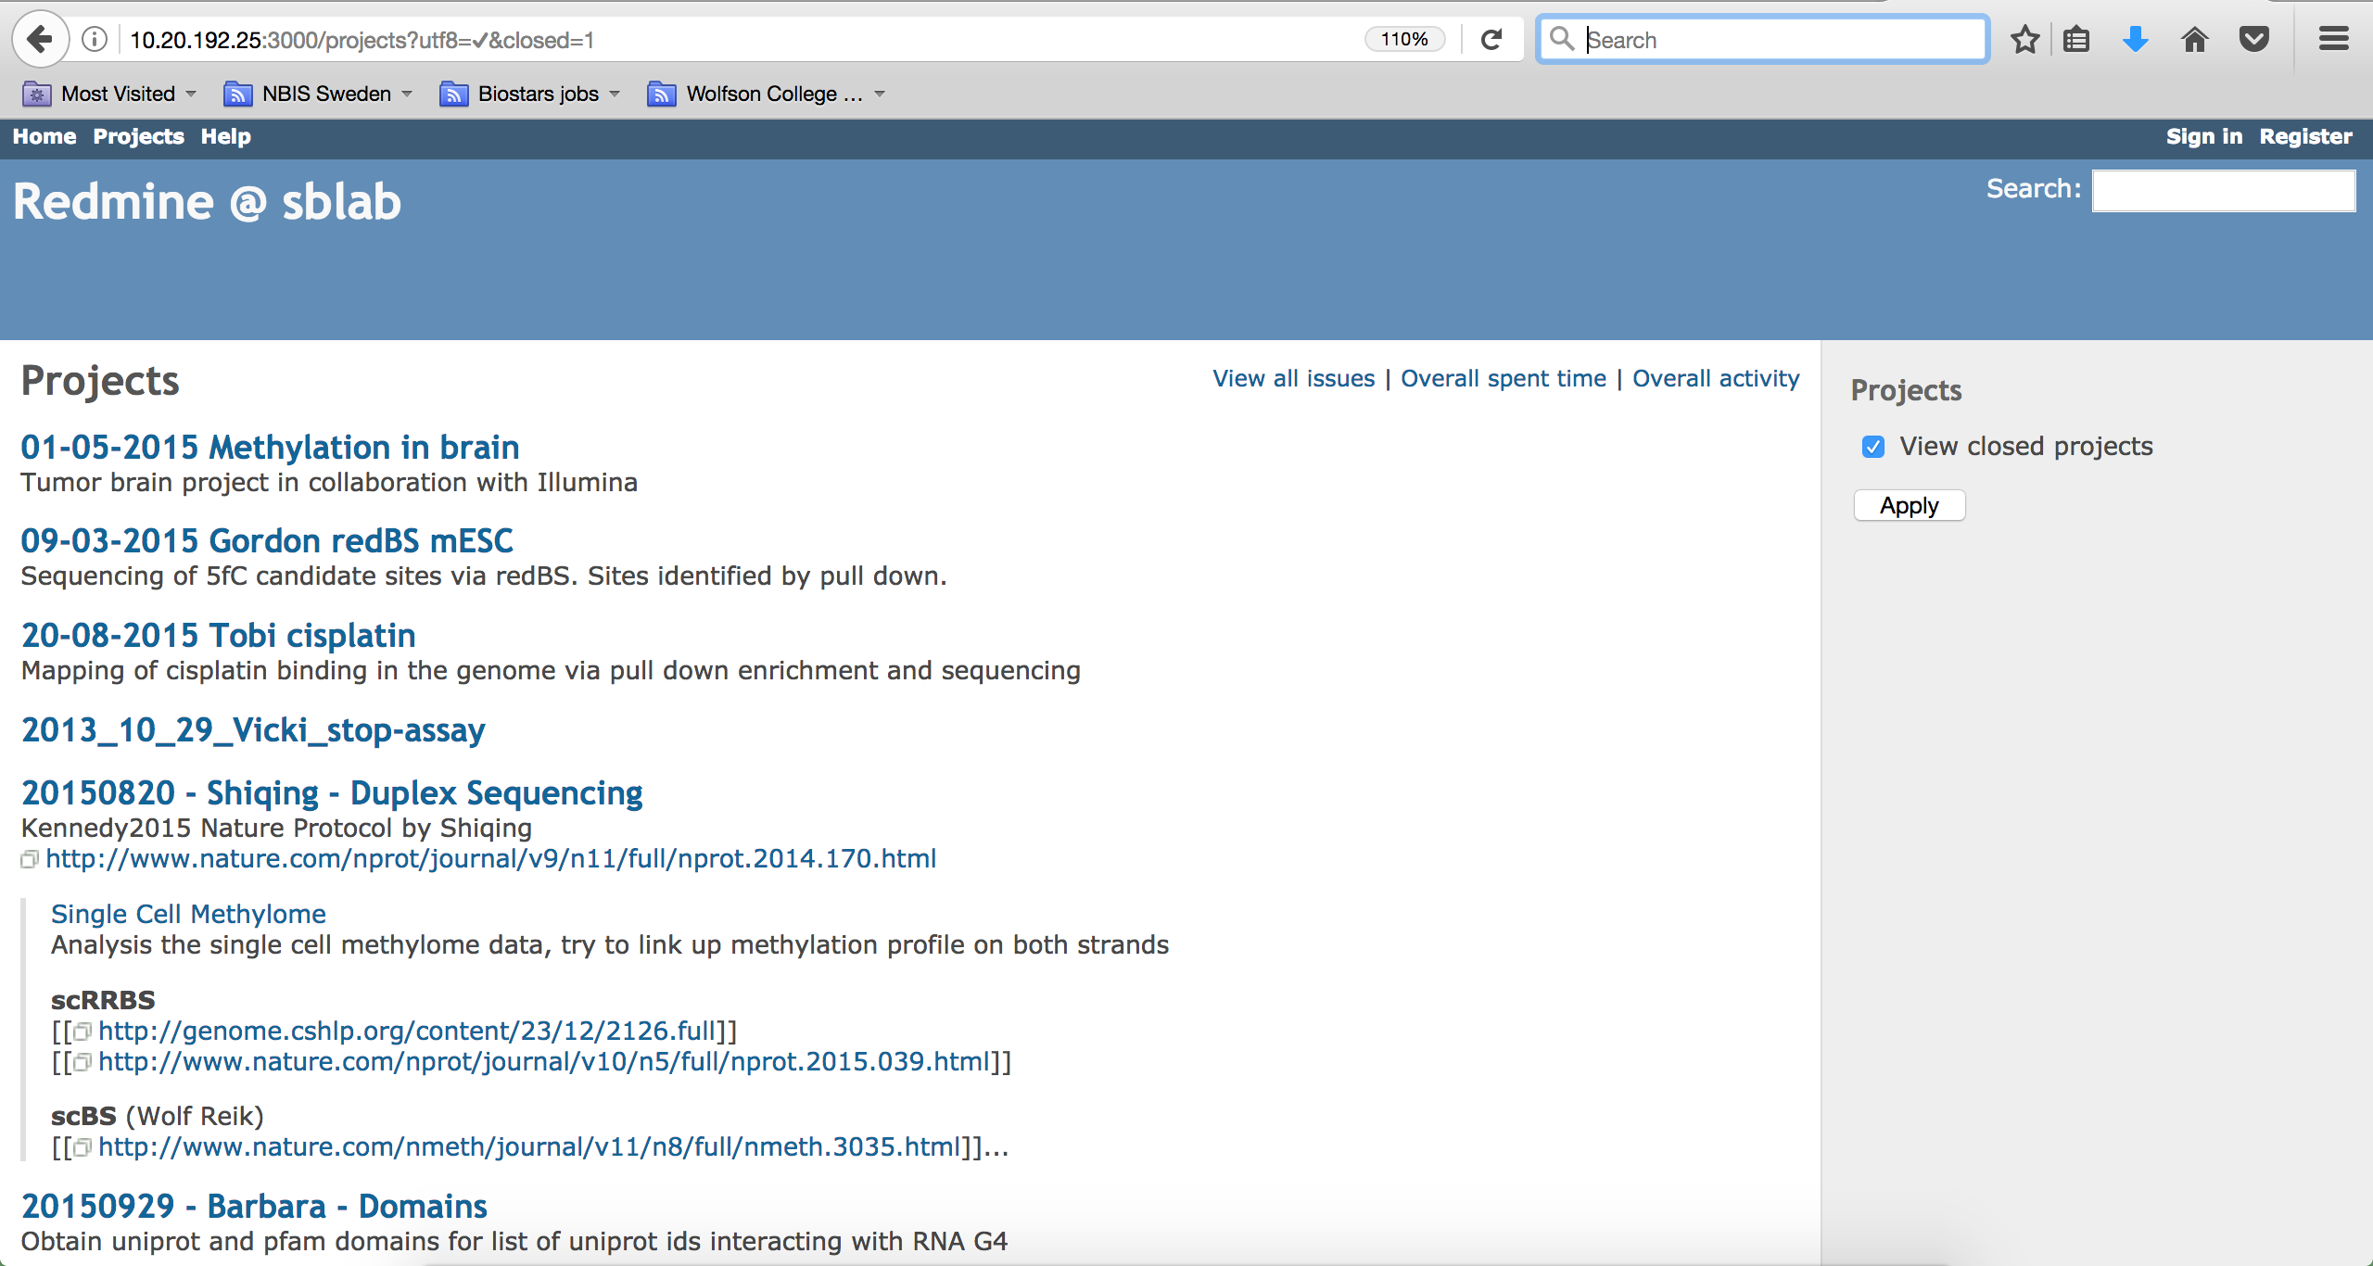
The past: Redmine

Slide 11


The past: Redmine
Open source
Accessibility
Multiple projects
Version control
Documentation
and wikis
Discontinued Feb 2015

Slide 12
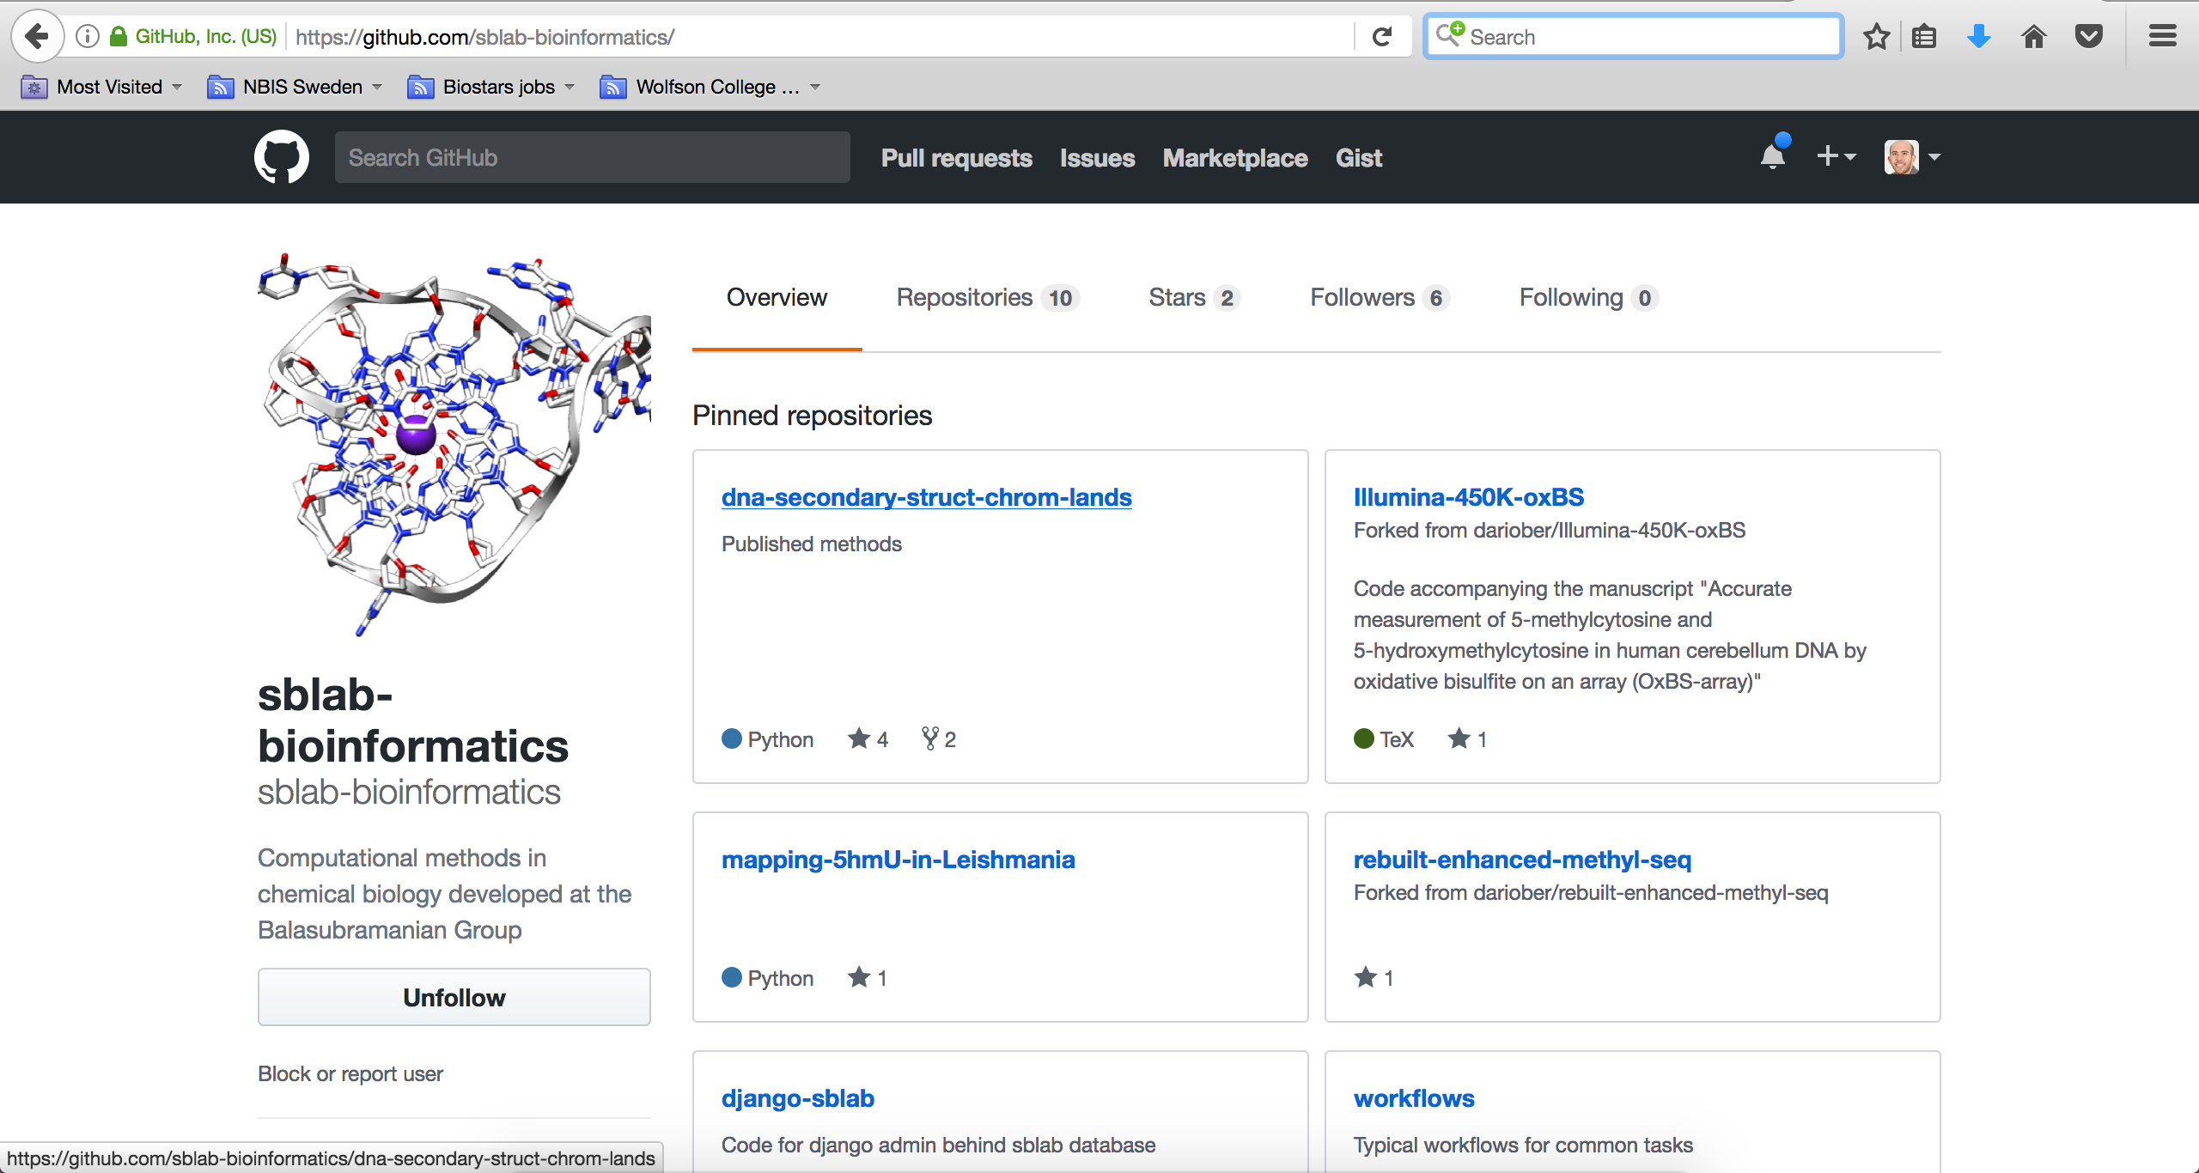
The present: GitHub

Slide 13



Structure
Private
Public
/projects/20150501_methylation_brain
/epigenetics-of-glioblastoma
/projects/FAIRE-seq_Robert
/dna-secondary-struct-chrom-lands
Early stages
Pre/post-publication stage
Documentation ...
Python
R
C
Markdown (.md)
Java
Bash

Slide 14
Structure
Contributors: computational colleagues
Collaborators: computational and experimental colleagues
Costs ...
sblab-bioinformatics developer plan
- private ($) and public (free) repositories
- USD $7 / month
https://github.com/pricing

Slide 15
Case study: The glioblastoma project
Early 2014:
- Investigate relationship between nucleotide modifications (5mC and 5hmC) and genomic variation in human glioblastoma samples
- Collaboration with neurosurgeons (Addenbrooke’s) and Illumina
2014 – 2016: development
- In projects/ private repository
Feb – Oct 2016: pre-publication
- In epigenetics-of-glioblastoma/ private repository

Slide 16
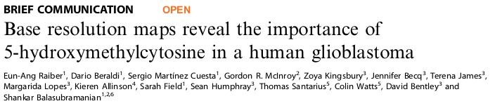
Case study: The glioblastoma project
Oct 2016: submission
- epigenetics-of-glioblastoma/ goes public
March 2017: published
2017: post-publication
- continue development of public epigenetics-of-glioblastoma/

Slide 17
Future?
Thanks!
Acknowledgements
The Balasubramanian group
Dario Beraldi

