Slide 1

Managing your research data
Sergio Martínez Cuesta

Slide 2
Overview
1. What is research data?
2. Why managing your data can be useful to you and others?
3. Challenges
4. How to organise your data well

Slide 3
What is research data?
Pieces of information that are descriptive of the research object ... or are the object itself
Necessary to validate research findings
Raw/processed data produced at a research facility
Published dataset

Slide 4


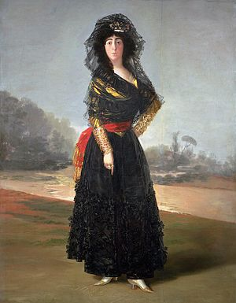

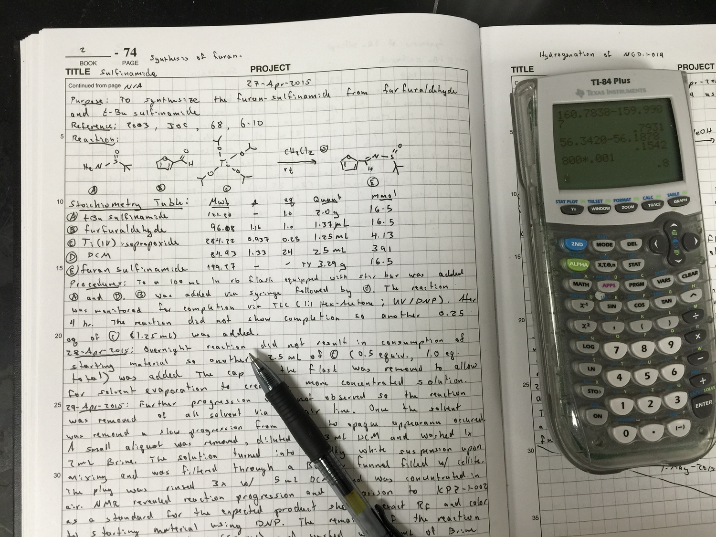
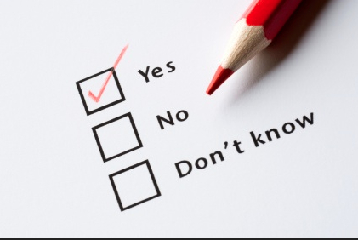



Experimental data
Images
Questionaries and surveys
Primary sources
Notebooks and diaries
Databases
Email
Audio

Slide 5
What is your research data?
5 min exchange

Slide 6
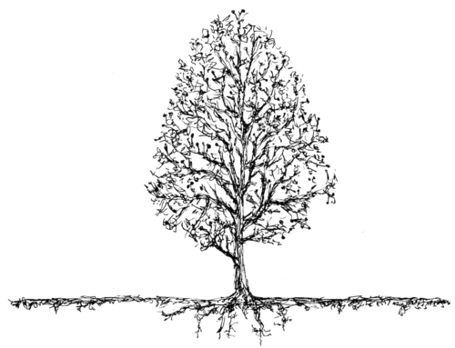
Research ...

Slide 7
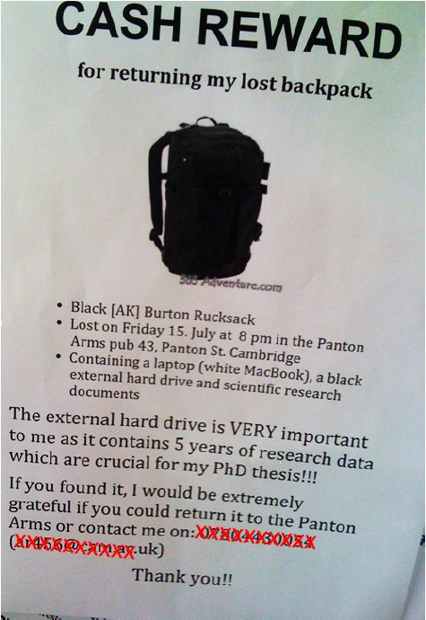
To avoid data disasters ...
What would you do if you lose your data tomorrow?

Slide 8
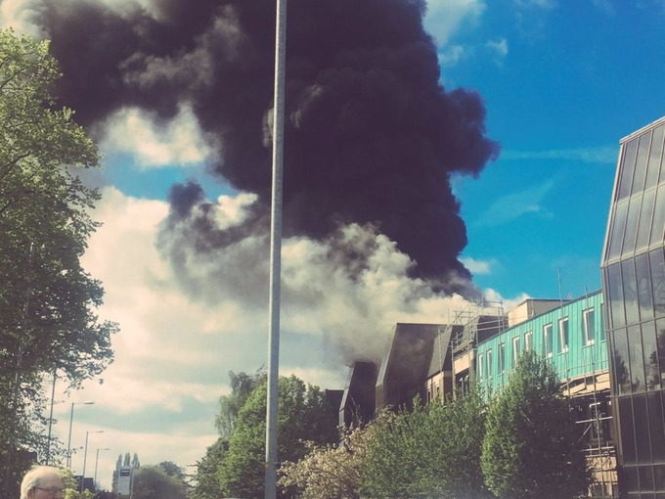
What would you do if you lose your data tomorrow?
Cancer Research UK – University of Manchester – 27 April 2017

Slide 9
To allow continuity of your work ...
Markowetz F., 2015
“I obtained the data 6 months ago. I am too busy. Of course I can’t remember all the details of all my projects after such a long time”
“My supervisor said I should continue the project of a previous student, but that student is long gone and hasn’t saved any data or documentation”

Slide 10
Makes it easier to write papers ...
Build your reputation ...
Markowetz F., 2015

Slide 11
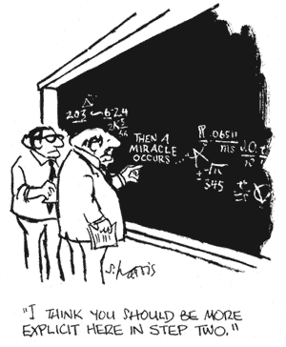

Slide 12
Markowetz F., 2015
“My data are spread over so many hard drives and directories that it would just be too much work to collect them all in one place“
“Mind you own business! I organise my data the way I want … “
“My field is very competitive and I can’t risk wasting time just like that, so I’d rather do real research than tidy up my data”
“I can always sort out all my data after submission anyway“

Slide 13
When do I need to worry about managing my data?
Markowetz F., 2015
Always!
- Before you start the project
- Before collecting the data
- While you do the analysis
- When you write/co-author a paper
- When you review a paper

Slide 14
The basics
- Keep your project organised
- Name your files and directories consistently in some informative way
- Start your data at a single backed-up location

Slide 15
How to manage research data?
Create
Organise
Access
Store
Share

