Slide 1
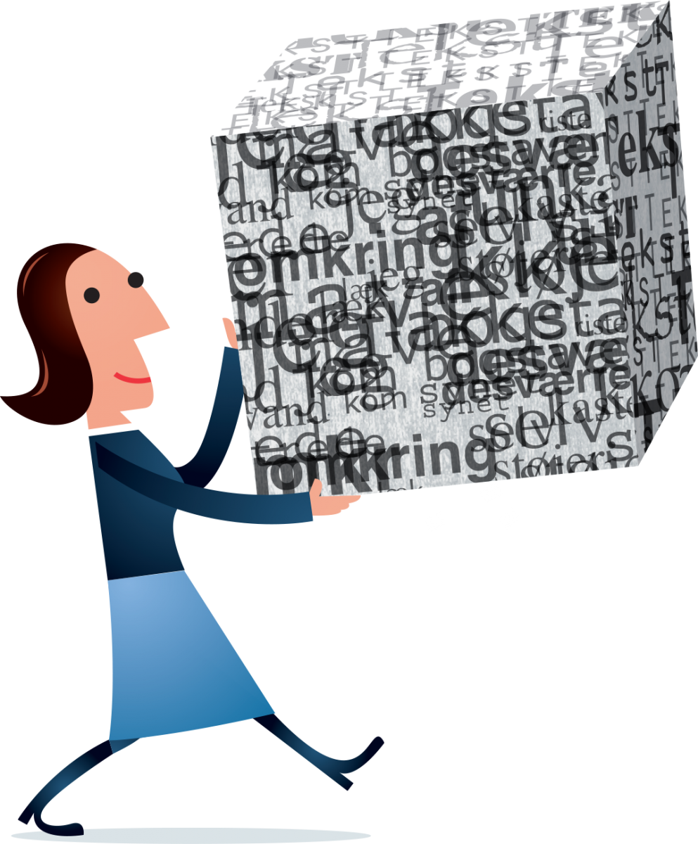
Managing your research data
Sergio Martínez Cuesta

Slide 2
Aims for today
What is research data?
Why managing your data can be useful for you and others?
Challenges
Gaining confidence to organise your data well
Existing resources and tools

Slide 3

Materials available at ...
https://github.com/semacu/training
folder: 20170601_RDM_Wolfson/

Slide 4
What is research data?
Pieces of information that are descriptive of the research object ... or are the object itself
Necessary to validate research findings
Raw/processed data produced at a research facility
Published dataset

Slide 5


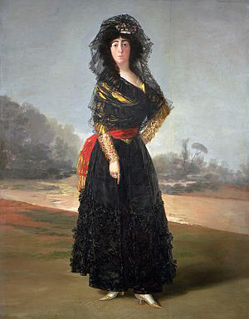

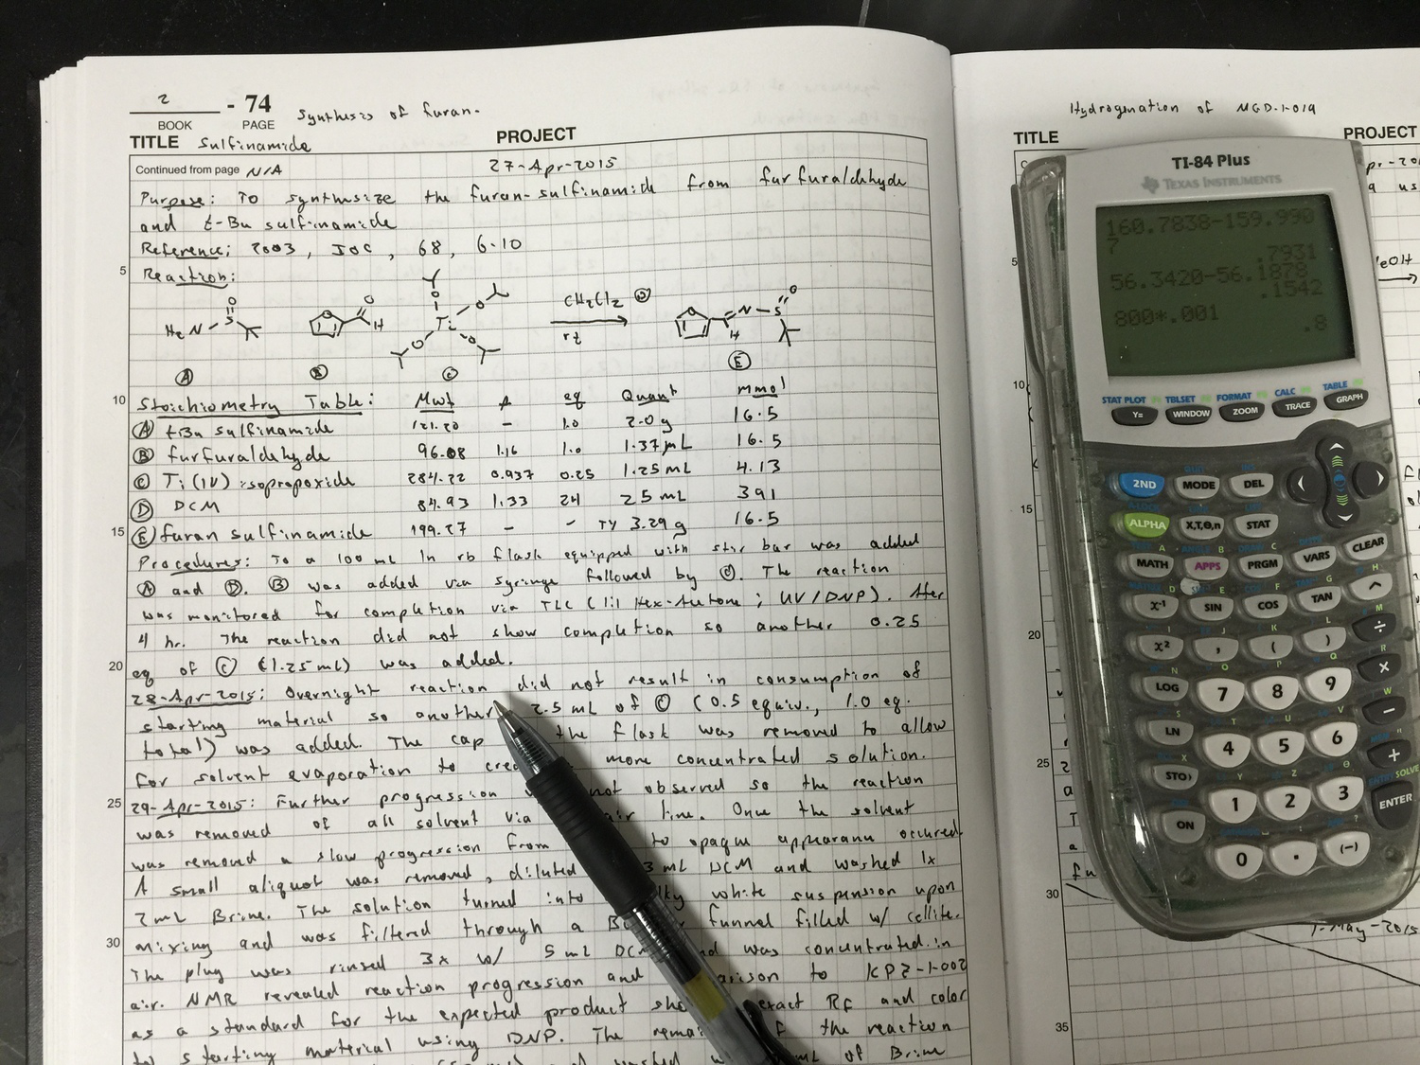
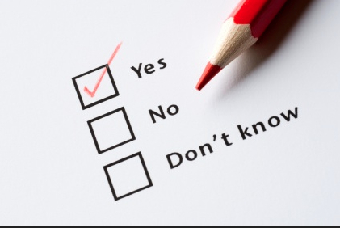



Experimental data
Images
Questionaries and surveys
Primary sources
Notebooks and diaries
… and many others ...
Databases
Email
Audio

Slide 6
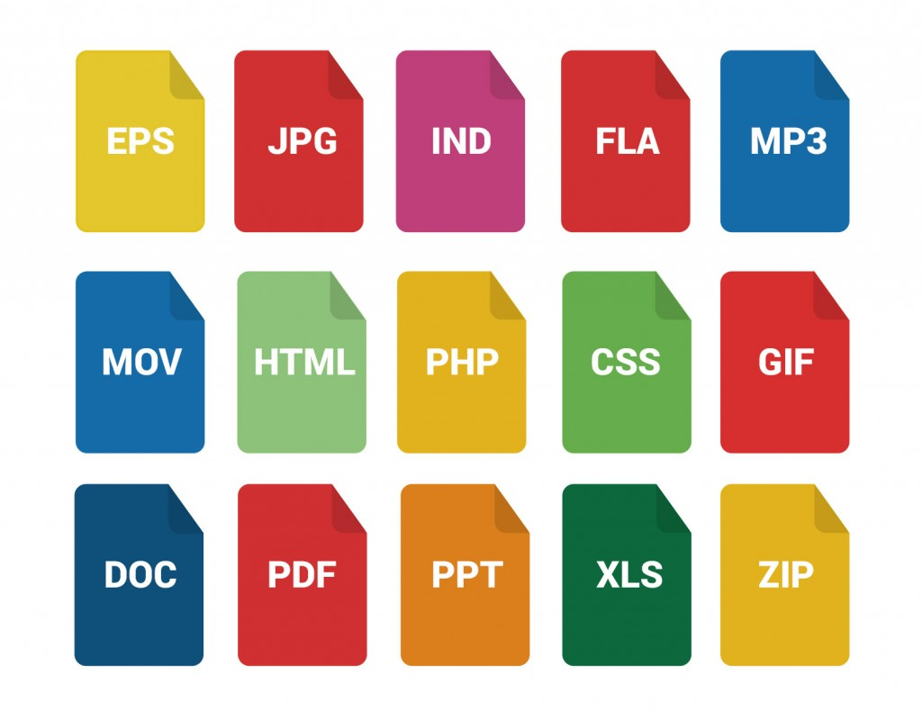
Data formats
… and more ...
http://www.designtory.net/free-psd/30-free-file-icons/

Slide 7
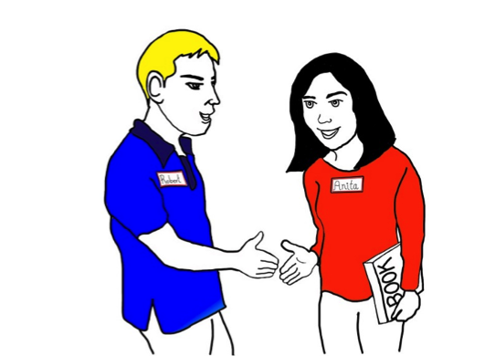
What is your research data?
Talk to the person next to you for 2 min and exchange information:
My name is … and I work at ...
What kind of research do you do?
What types of data do you collect?

Slide 8
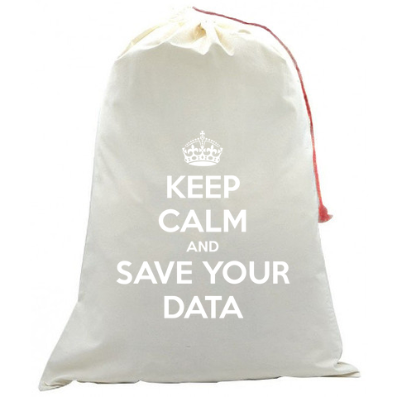
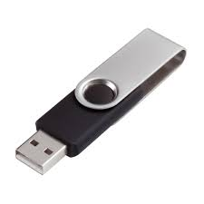
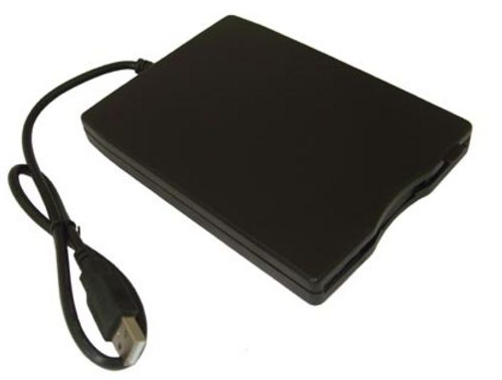
How to manage your data?
The everlasting external disks
But are they really permanent? What if …?
http://www.keepcalmandcarryon.com/

Slide 9
Why the need to manage it ?
It can be a painful process … but definitely worth long-term
Markowetz F., 2015
“My field is very competitive and I can’t just risk wasting time with all of this, so I’d rather do real research than tidy up my data”
“My data are spread over so many hard drives and directories that it would just be too much work to collect them all in one place”
“I can always sort out all my data after submission anyway”

Slide 10
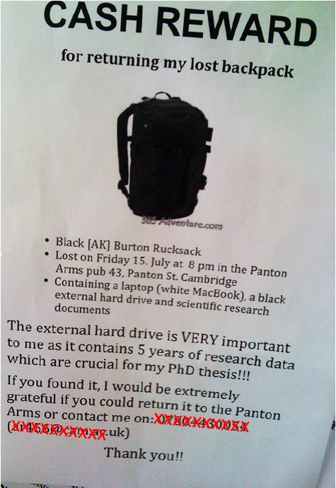
To avoid data disasters ...
What would you do if you’d lose your data tomorrow?
https://blogs.ch.cam.ac.uk/pmr/2011/08/01/why-you-need-a-data-management-plan/

Slide 11
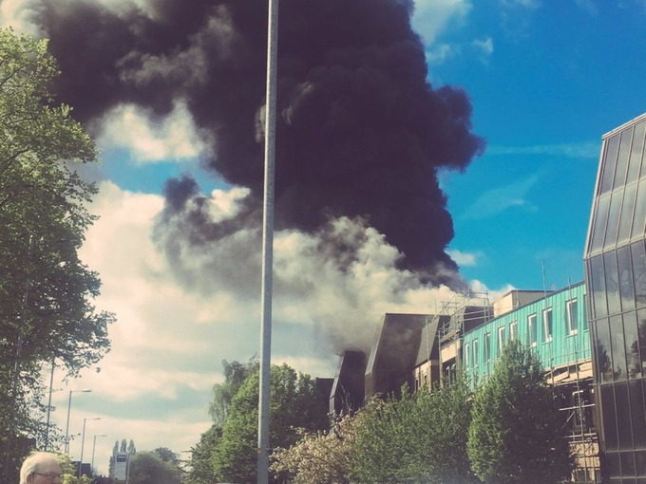
What would you do if you’d lose your data tomorrow?
Cancer Research UK – University of Manchester – 27 April 2017
http://www.itv.com/news/granada/2017-04-26/fire-breaks-out-at-manchester-christie-cancer-research-building/

Slide 12
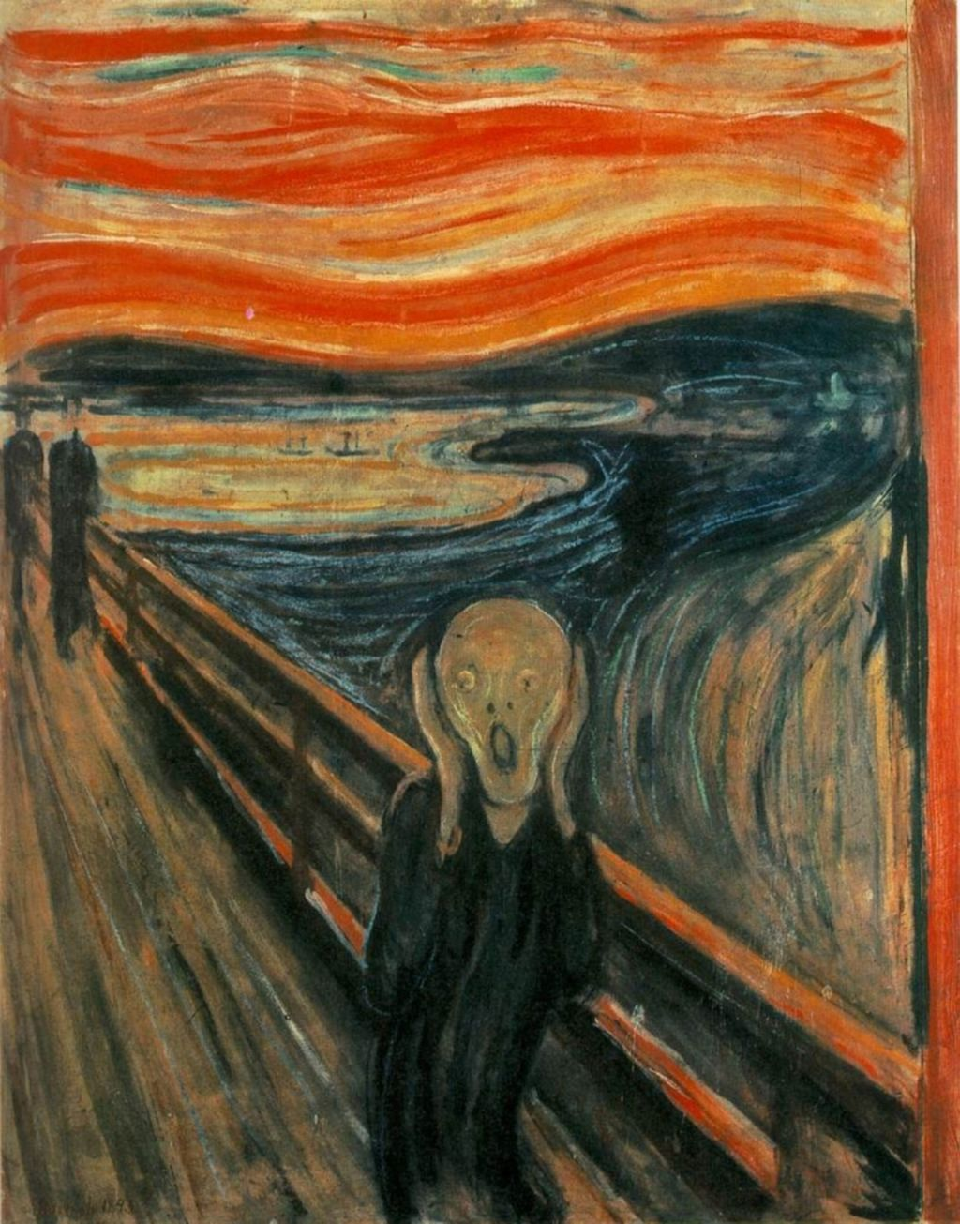
Your laptop got stolen
Your office/house burnt
Your USB stick is lost
Your portable hard disk is damaged
Data copied to Dropbox disappeared
What would you do if you’d lose your data tomorrow?
https://en.wikipedia.org/wiki/The_Scream

Slide 13
Data backup and file sharing

Slide 14
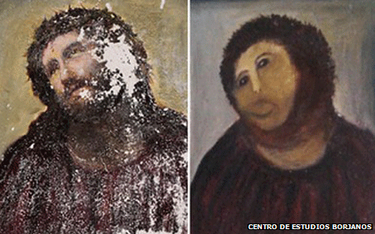
Never work directly on the raw data
http://www.inquisitr.com/309687

Slide 15
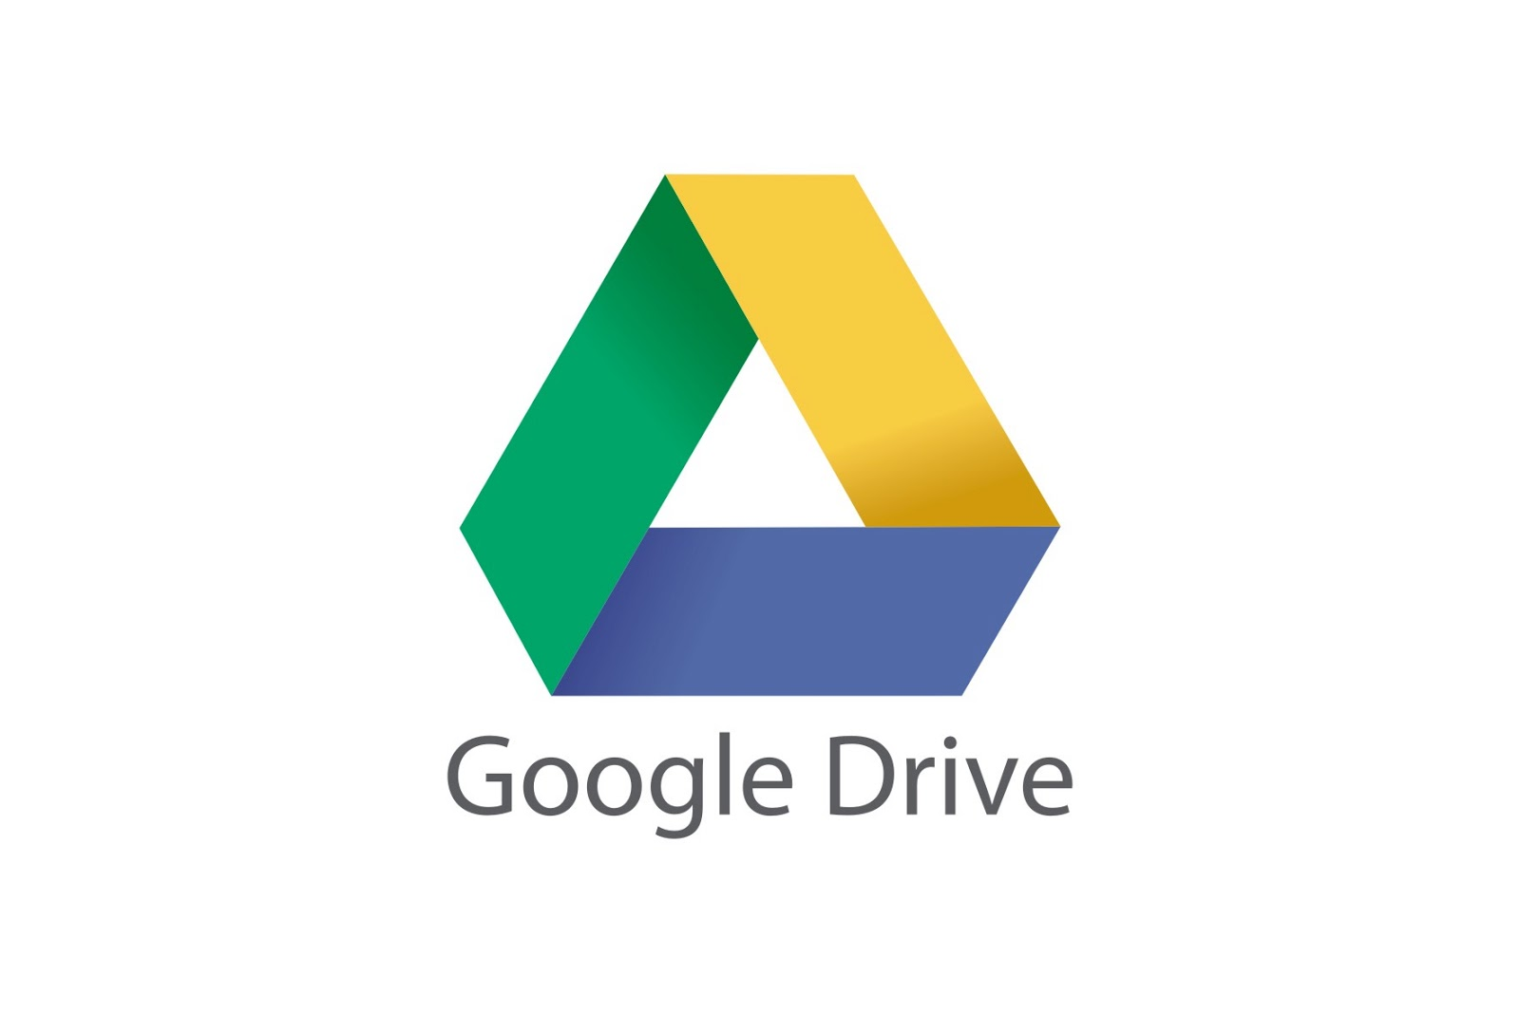
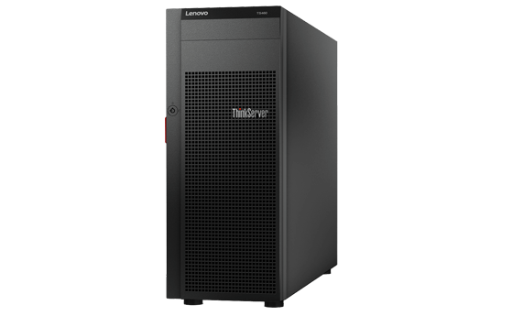




Data backup
At least 2 backups at 2 different locations
External disks
Online backup
Servers
Department
College
IT
Cheap
£10-15 / TB (1024GB)
Accessibility
Free (limit)
Managed by experts
Failure rate
1.5%/year
Personal data
Hacking
Moving between institutions

Slide 16

Data backup
Manual
Automated
Install software
e.g. Time machine (Mac users)
Copying files to relevant folders
Automatically upload files to the cloud when any changes are saved
Copying files to relevant folders

Slide 17



If manual ... how often?
How much would you be willing to lose?
1 day
1 week
1 month-year
Software allows you to set up backup time automatically

Slide 18
Data backup and file sharing
Space/price
2 GB (free)
Unlimited (£55/year)
15 GB (free)
1 TB (~£80/year)
1 TB (free)
File history and recovery
Yes, unlimited
Yes
Last 90 days
File size limit
None
5 GB
15 GB
Support
UIS
Unsupported
UIS
OS
Windows, Mac, Linux,
Android, iOS
Windows, Mac,
Android, iOS
Windows, Mac,
Android, iOS
Accessibility
Sync anywhere on any devices
Live editing
Integration with Microsoft Office

Slide 19


More … file sharing
Email
Website
FTP

Slide 20
How do you manage your research data?
Talk to the person next to you for 2 min and exchange information:
Do you do any data backup?
How often?
How do you share files/data with collaborators?

Slide 21
Data organisation and file naming

Slide 22
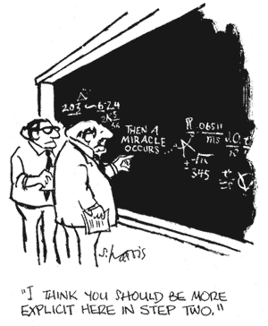
To allow continuity of your work ...
Markowetz F., 2015
“I obtained the data 6 months ago. I am too busy. Of course I can’t remember all the details of all my projects after such a long time”
“My supervisor said I should continue the project of a previous student, but that student is long gone and hasn’t saved any data or documentation”
Copyright Sidney Harris

Slide 23
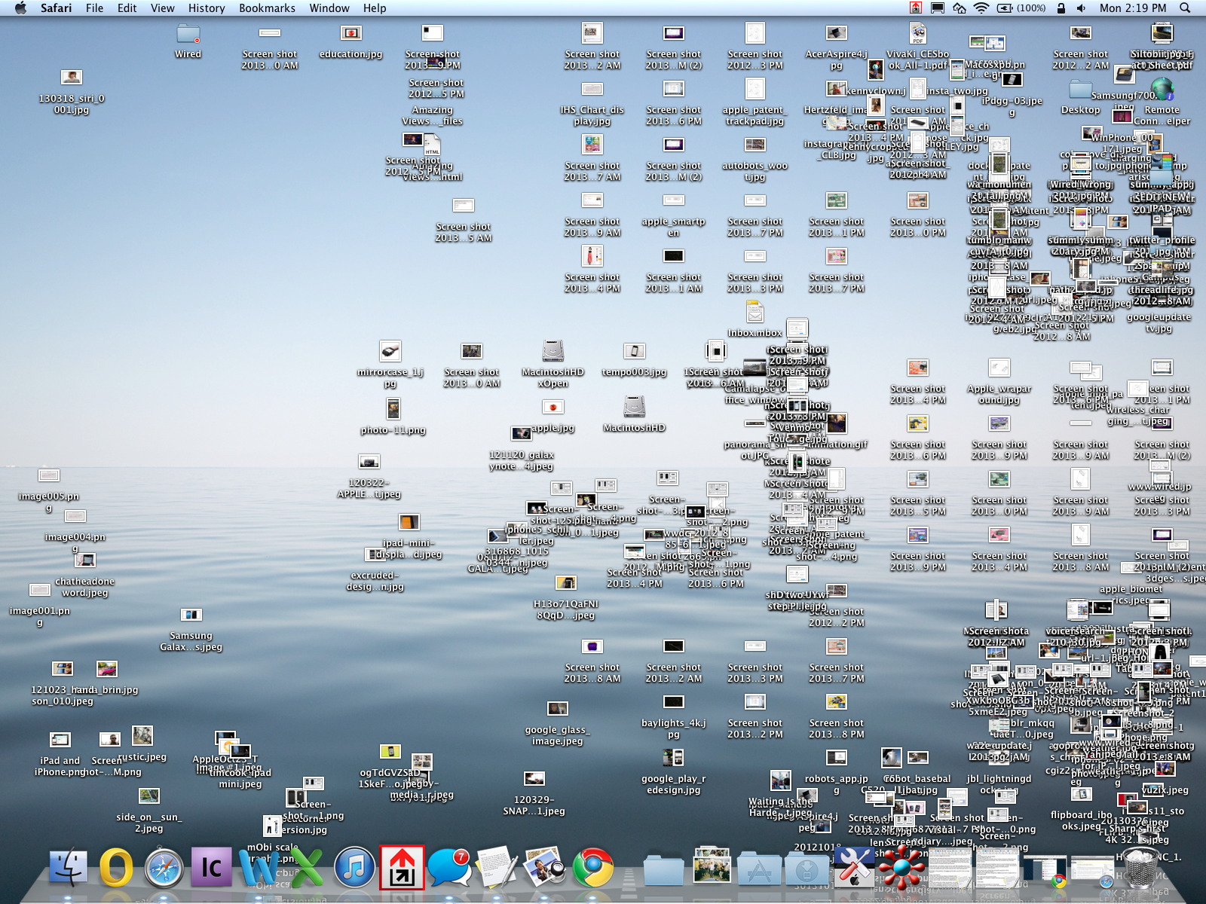
Data organisation
https://www.wired.com/2013/04/desktop-cluttered-help/

Slide 24
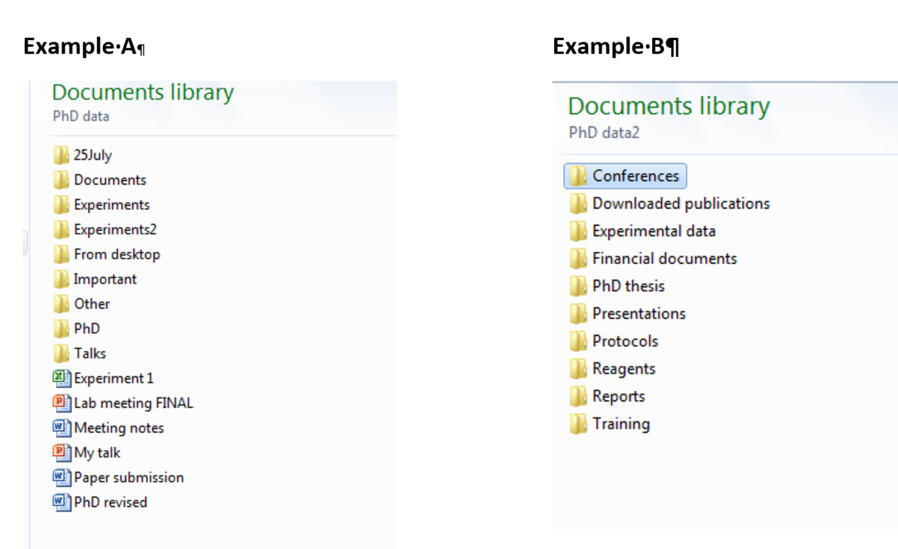
Data organisation
www.data.cam.ac.uk

Slide 25
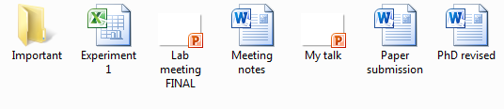
Data organisation
- Consistent and descriptive
- Meaningful to you and your colleagues
- Allow you to find files easily

Slide 26
File naming
Create a naming convention that works for you that allows to distinguish your files from one another
fk468_PCF-b2-oxhyd-1.fastq.gz
.../20170601_RDM_Wolfson/...
Collaborator: fk (Fumiko Kawasaki)
Date: 20170601
Experiment number: 468
Topic: RDM
(Research Data Management)
Life cycle stage: PCF
Batch: b2
Location: Wolfson college
Treatment: oxhyd
Replicate: 1

Slide 27
Tips
Avoid special characters ~ ! @ # $ % ^ & * ( ) ` ; < > ? , [ ] { } ' ” |
A good format for dates is YYYY-MM-DD or YYMMDD
All of your files will always stay in chronological order
Use leading zeros for clarity and to make sure files sort in sequential order
E.g. "001, 002 ... 010, 011 …" instead of "1, 2, ...10, 11 ... "

Slide 28
Tips
Do not use spaces. Some softwares do not recognize file names with spaces.
e.g. data table.xls
Other options include:
Underscores, e.g. data_table.xls
Dashes, e.g. data-table.xls
No separation, e.g. datatable.xls
Camel case, e.g. DataTable.xls

Slide 29
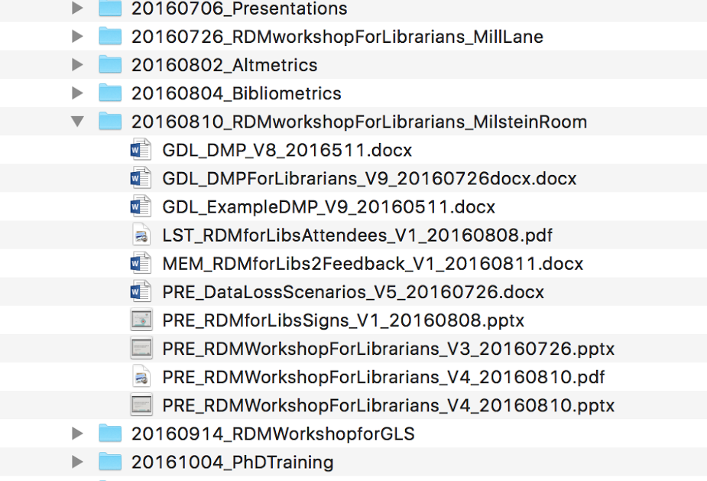
File naming
www.data.cam.ac.uk

Slide 30
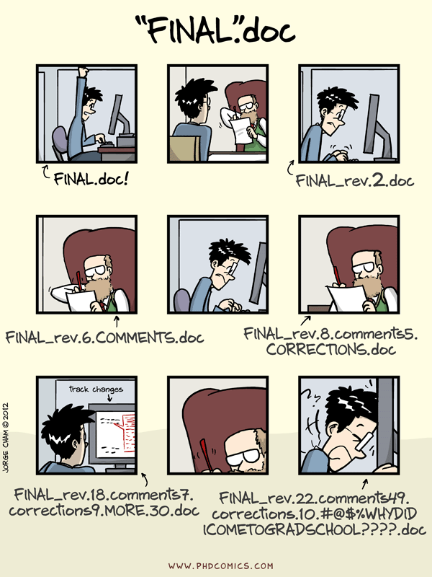
File version control

Slide 31

File version control
- Save new versions when you make significant changes
- Include a version number in the file name, e.g. v01, v02 or v02.1
- Challenging if keeping lots of versions or working with many collaborators
Manual
Software options

Slide 32
How do you organise your research data?
Talk to the person next to you for 2 min and exchange information:
How do you organise your files?
How do you name your files?

Slide 33


Easier to write papers ...
Build your reputation ...
The FAIR principles:
Findability
Accesibility
Interoperability
Reusability

Slide 34
When do I need to worry about managing my data?
Always!
Before you start the project
Before collecting the data
While you do the analysis
When writing/co-authoring your paper/thesis
When reviewing the work of others

Slide 35
Overview
Try to keep your projects organised
Name files and directories consistently using some informative way
Store your data at a single backed-up location

Slide 36
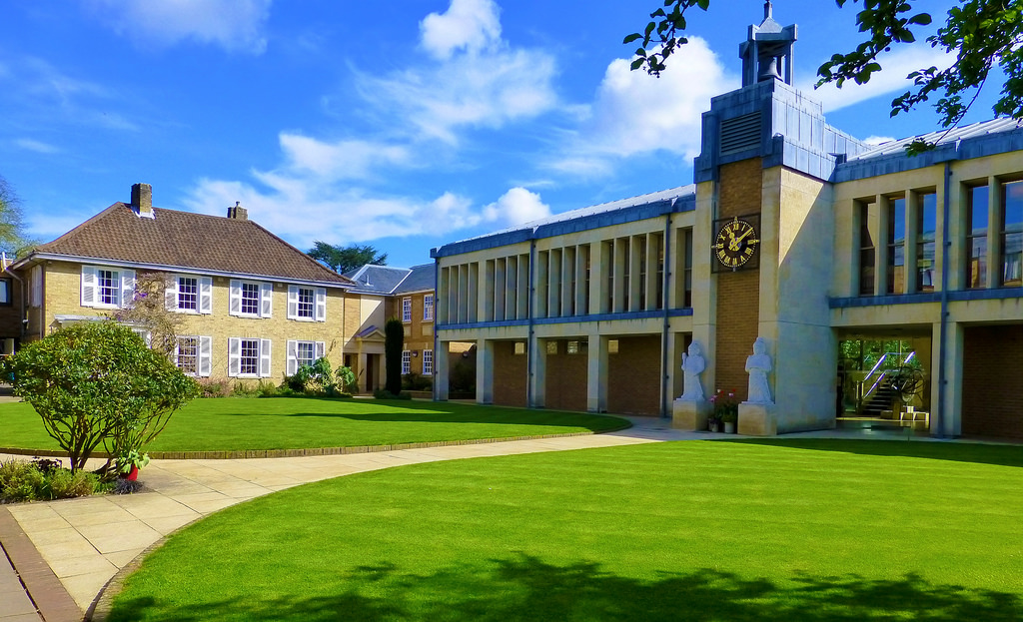
Questions?
References
sm848@cam.ac.uk
Materials and more ...
https://github.com/semacu/training
Research Data Team
http://www.data.cam.ac.uk/
Five selfish reasons to work reproducibly
https://dx.doi.org/10.1186/s13059-015-0850-7

