Slide 1
27/10/2023
Stavaza PROBE - District09
Gonna download these slides now - dont make changes anymore in this one
Ruben Delaet - ruben@ml2grow.com
Mathias Deleu – mathias@ml2grow.com Joachim van der Herten - joachim@ml2grow.com

Slide 2
PROBE: Proactive Openbaarheid van Bestuur
Besluitvorming op maat van mens en machine.

Slide 3
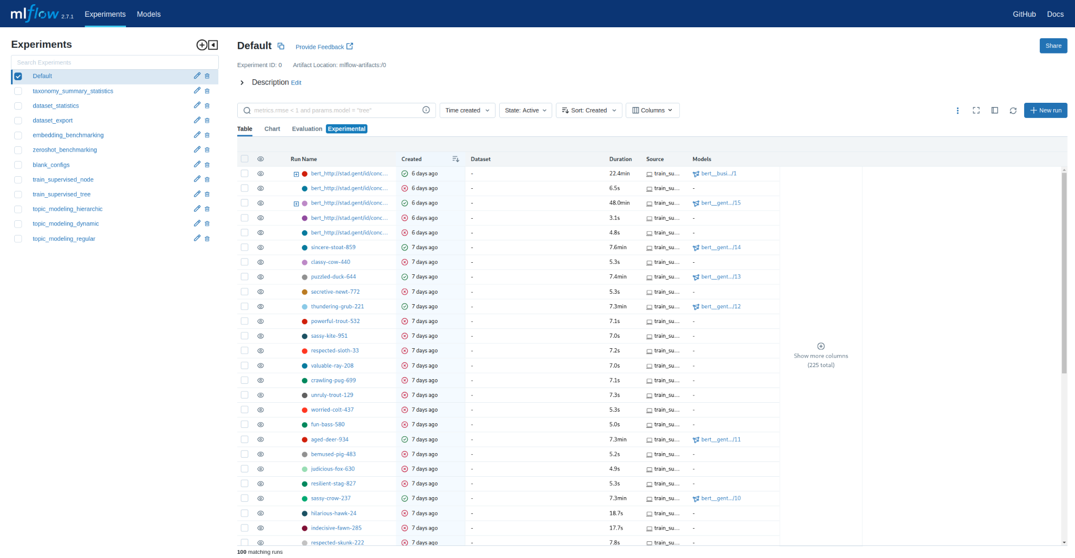
Overview of past runs for the selected experiment
Overview of experiments

Slide 4
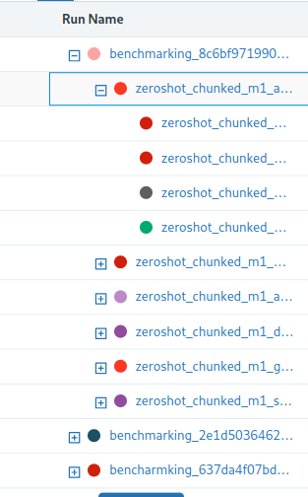
These runs are examples of nested runs
Close them by clicking the -
You can open nested runs by clicking the +

Slide 5
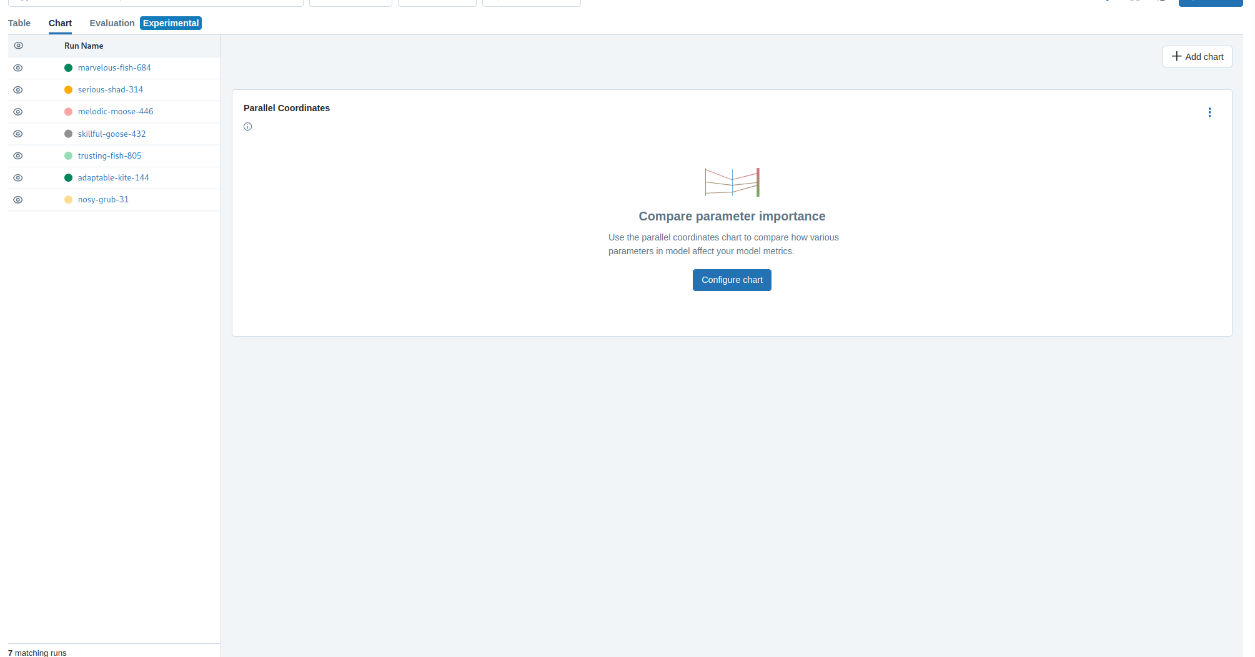
Custom line charts
Besides keeping track of artifacts, you can also easily visualize metrics from executed runs using the mlflow charts.

Slide 6
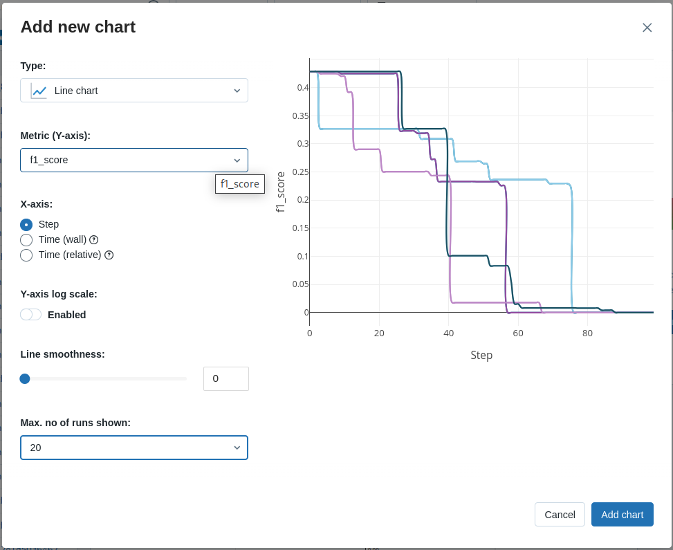
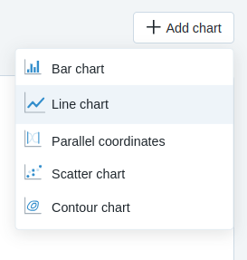
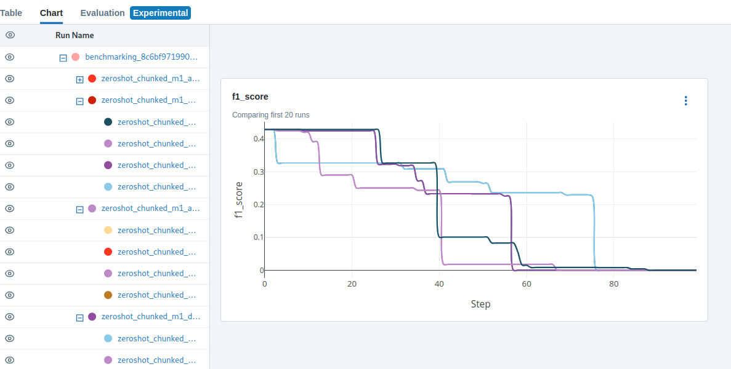
Creating custom line chart

Slide 7
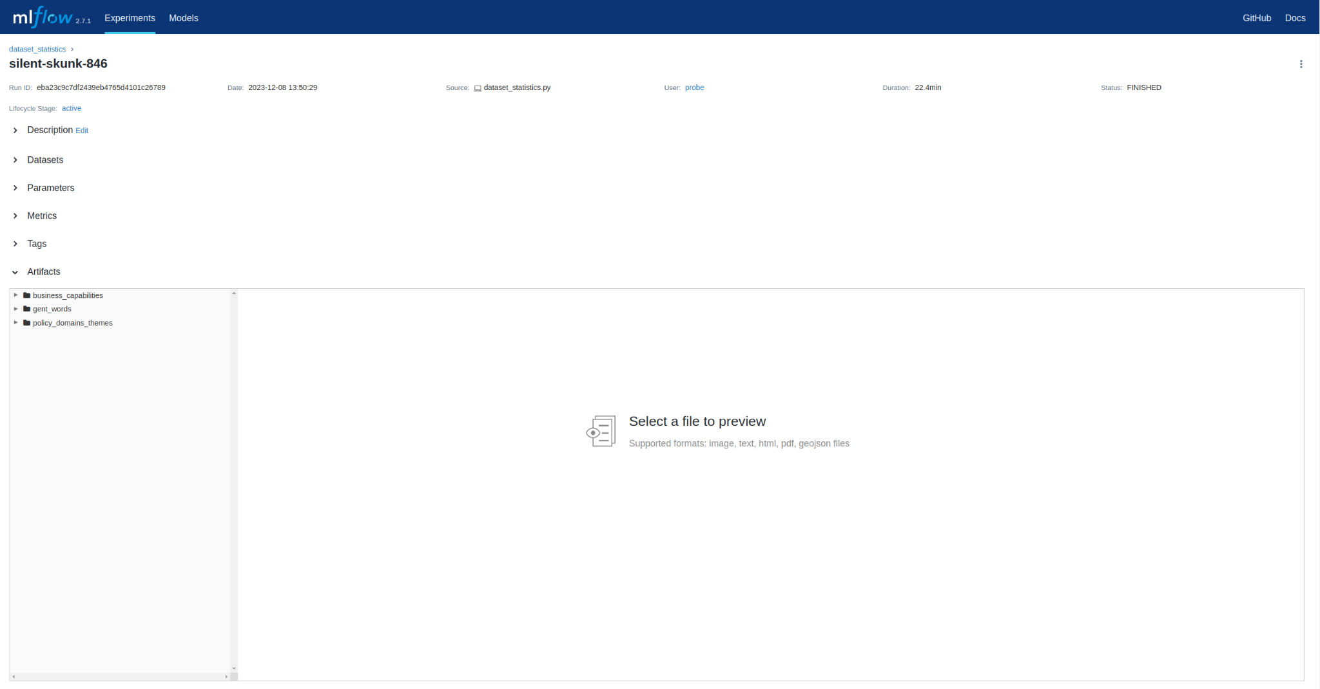
Here you can find the description (when provided)
When clicking on a specific run, you end up on the run overview page. This page contains more information that is purely related to the one experiment.
You find linked datasets, parameters, metrics, tags and artifacts here
Here you can find the datasets (when provided)
Here you can find the parameters (input variables/ configuration for the executed run)
Here you find the metrics
Here you find the tags
The artifacts are found here

Slide 8
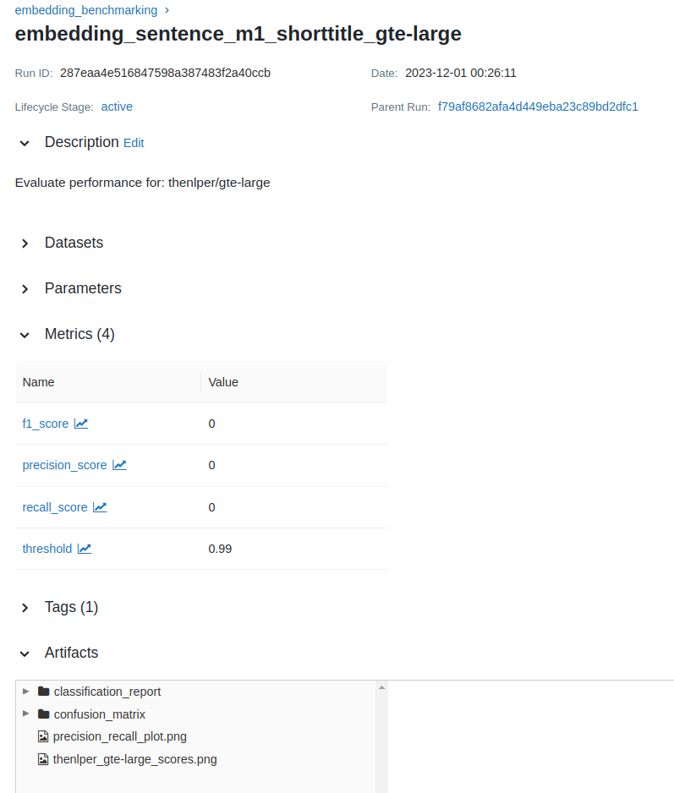
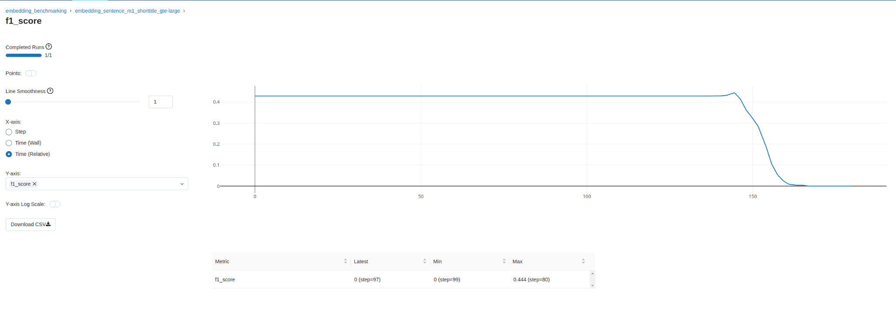
When you click on a specific metric, you navigate to the metrics overview page. Here you can customize what metrics you want to compare
Visualize data points
Select X-axis scale
Adjust smoothing
Create an export (.csv)
The plot itself
Visualize in log scale
Add or remove metrics from the plot
Table overview with basic information for the selected metrics

Slide 9
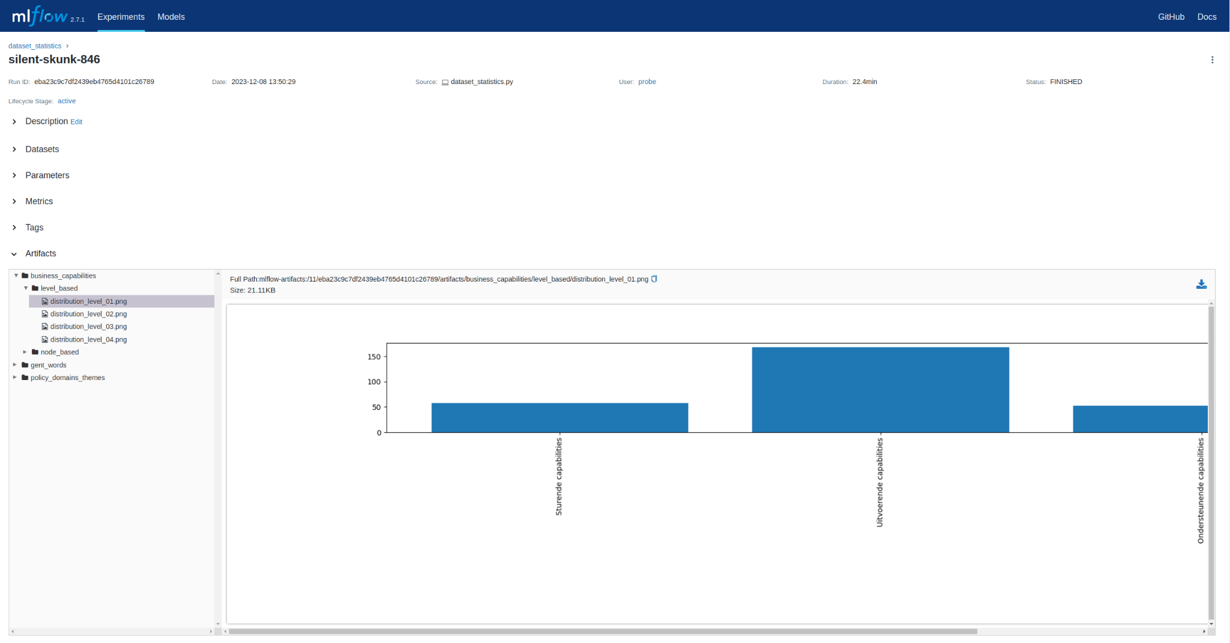
You can browse artifacts, open or download them.

Slide 10
You can browse artifacts, open or download them.

Slide 11

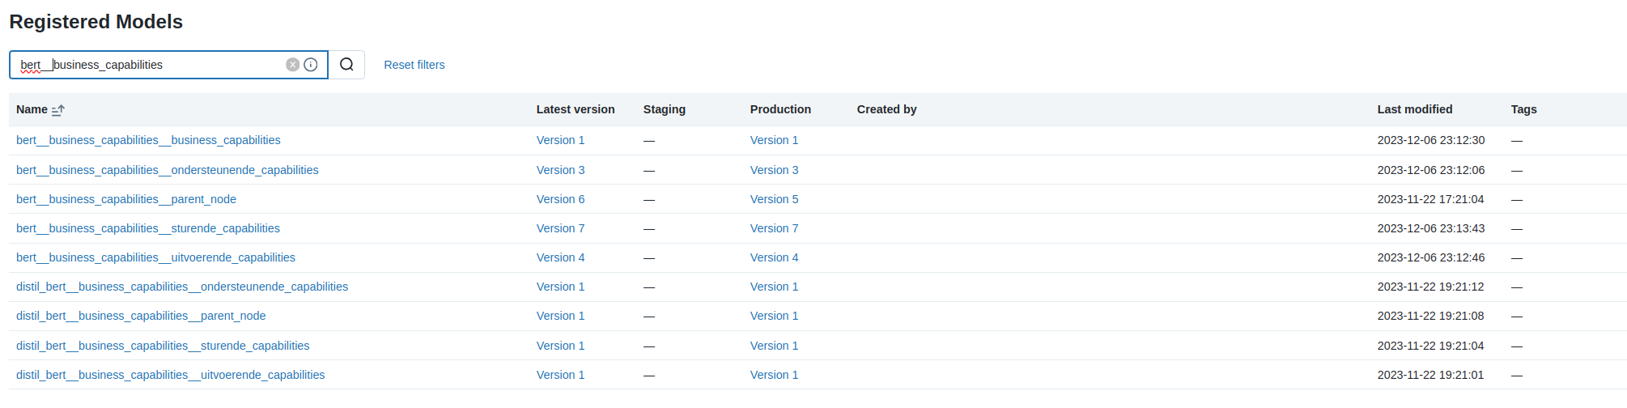
Registered models
You can find registered models by clicking on ‘Models’ in the menu.

Slide 12
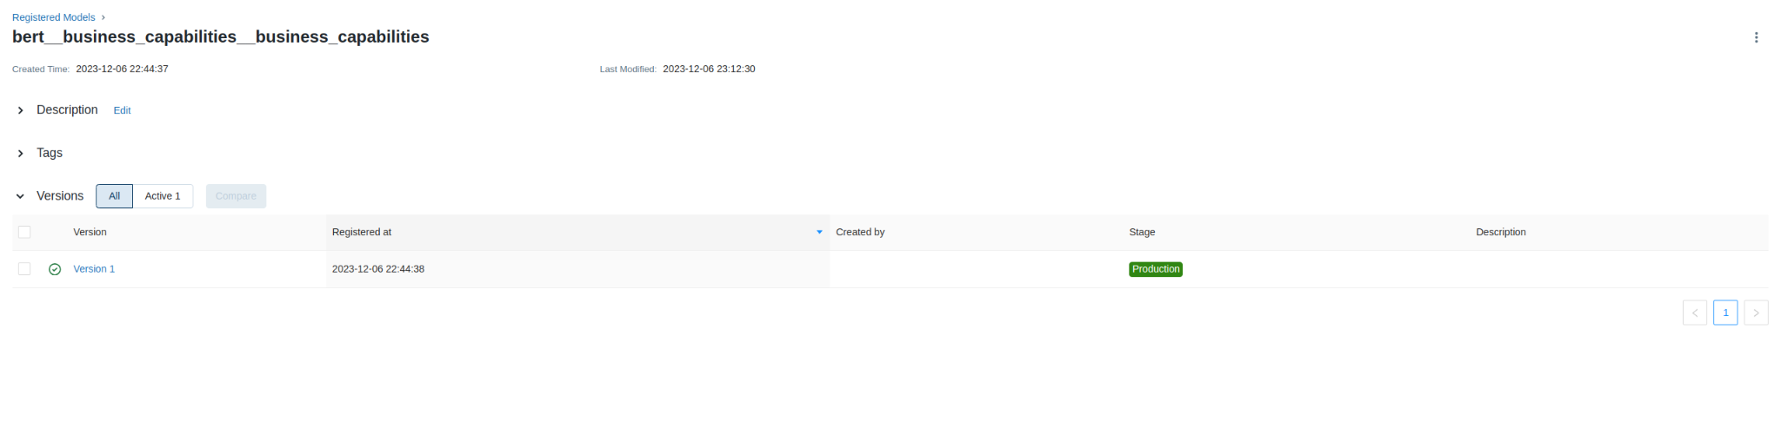
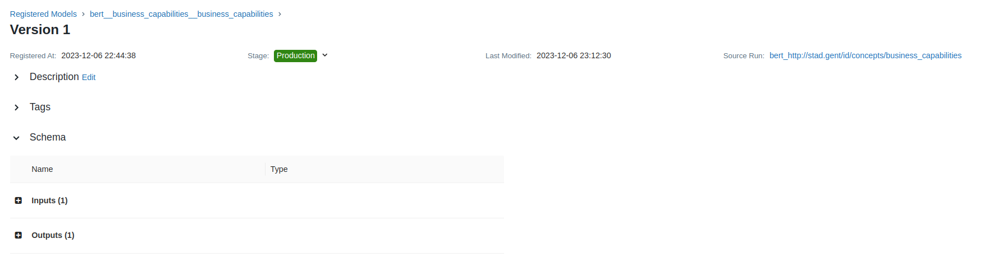
When navigating to a specific registered model, you will find at least one underlying model version.
These model version can be one of 4 stages:
Production
Staging
Archived
Nothing
By clicking on a specific version, you can look at the relevant information for that specific model instance.

Slide 13
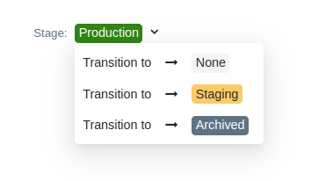
Its easy to change the model stage, you simply click the stage selector and adapt it to your needs

