Slide 1
Semantic Instrumentation and Monitoring
WP11
Silviu Bota, UTC & Softgress
Notes:
Hi, my name is Silviu Bota, I’m from the Technical University Cluj and I will present the Semantic Instrumentation and Monitoring Solution developed in WP11 by the Technical University Cluj and Softgress

Slide 2
Outline
Architecture
Instrumentation mechanism
Visualization
Relevance Feedback
Instrumented workflows and plugins
Notes:
First I will give an overview of the overal architecture of the semantic instrumentation and monitoring solution and then I will present its parts: the instrumentation mechanism, the visualization, and the relevance feedback. In the end I will present the instrumented workflows and plugins instrumented by WP11 and the amount of queries which were run in order to collect instrumentation data.

Slide 3
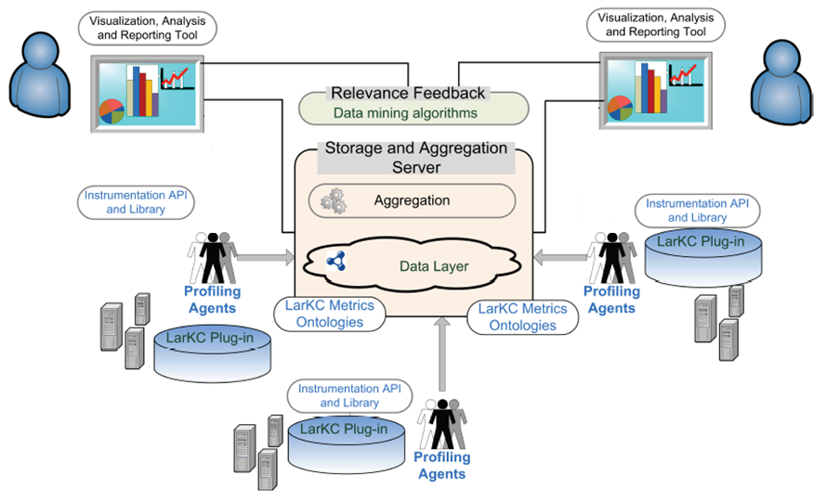
Semantic Instrumentation and Monitoring - Architecture
SIM – Semantic Instrumentation and Monitoring
Notes:
The semantic instrumentation and monitoring solution we developed consists in 5 parts, instrumentation API and library, the profiling agents, the storage and aggregation server, the visualization and the relevance feedback. The instrumentation API and Library extracts metrics from LarKC platform and plugins, together with the context in which they occurred and sends them to the profiling agents. The profiling agents reside on the same node as the LarKC platform, collect the instrumentation data and also monitor and collect data from the node on which they run. They send all this data to the Storage and Aggregation Server. The storage and aggregation server processes this data, aggragates measurements and stores them in a data layer. The visualization extracts and formats data from the data layer and presents it to the user in a visual, meaningful format. Relevance feedback uses data mining and machine learning techniques on the stored data in order to extract patterns of behaviour. It uses realtime data from the instrumentation and monitoring together with the learned behaviour to provide meaningful information about the predicted behaviour of the platform in various circumstances.

Slide 4
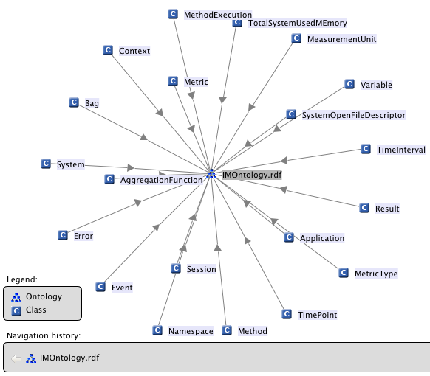
Instrumentation and monitoring ontology
An ontology of monitoring and metrics relevant for the LarKC platform and plugins
Underlying data model used by all SIM components
Generic metrics:
  Method metrics
  System metrics
LarKC specific metrics:
  Atomic or simple metrics: Query, Workflow, Plugin, Platform such as total response time, error status, etc. of a query, workflow, plugin or platform
  Compound metrics aggregation of atomic metrics
10/13/11
SIM – Semantic Instrumentation and Monitoring
Notes:
We first developed an ontology for describing measurements processes in general and LarKC speciffic processes in particular. For LarKC we identified 3 important components, Query, Workflow and Plugin with different relevant metrics. We call these atomic metrics. We also identified compound metrics, which are aggregates of the atomic metrics.

Slide 5
Instrumentation mechanism
Easy to deploy & run:
java -javaagent:aspectjweaver-1.6.9.jar -jar LarkcAssembly.jar
Easy to use & instrument:
Method instrumentation for Plugin.invoke() specified in AOP.xml file
<aspectj>
<aspects>
<concrete-aspect name="InstrumentPluginInvoke"
extends="sim.instrumentation.aop.aspectj.AbstractMethodInstrumentation">
<pointcut name="methodsToInstrument"
expression="within(eu.larkc.plugin.Plugin) AND execution(* invoke(..))"/>
</concrete-aspect>
</aspects>
</aspectj>
LarKC specific metric – Data Layer inserts
public aspect DataLayerInsertsCounter extends AbstractContextCounter {
public pointcut pointcutToIncrementCounter():
within(eu.larkc.core.data.RdfStoreConnection+)
&& execution(public * addStatement(..));
@Override
protected String getCounterName(JoinPoint jp, Context c) {
return c.getTag() + "DataLayerInserts";
}
}
10/13/11
SIM – Semantic Instrumentation and Monitoring
Notes:
For implementing the sim instrumentation component we chose to use the aspect oriented programming paradigm as and as speciffic implementation we chose AspectJ.
This allows us to easily inject instrumentation code into our target application. With this approach we get an easy to deploy solution: in case of larkc you just have to add javaagent to the command line.
If you want to instrument larkc plugins you just have to create an xml configuration file where you specify the target method, in this case the Plugin.invoke method
If you want to monitor the data layer inserts you have to write this piece of code where you specify the places where a counter should increment (addStatement()) and the counter name(“data layer inserts”);

Slide 6
Visualization, analysis and reporting tool
Enables easy interpretation of the data collected during instrumentation and monitoring
  LarKC users - visualize real-time or historical data. Furthermore they can analyze reports based on aggregated metric values.
  Platform and plugin developers - explore semantically linked instrumentation data.
Reports include:
  Overviews of the monitored metrics for given time periods.
  Aggregations of different metrics values both at the level of LarKC plug-ins and workflows.
10/13/11
WP11 – Instrumentation and Monitoring
Notes:
The visualization, analysis and reporting tool enables the easy interpretation of the data collected during instrumentation and monitoring. LarKC users visualize realtime or historic data and can analyze reports based on aggregated data. Platform and plugin developers explore semantically linked instrumentation data in order to locate useful values. The visualization can supply reports of metrics for given time periods, and aggregation of various metrics at plugin, workflow, query levels.

Slide 7
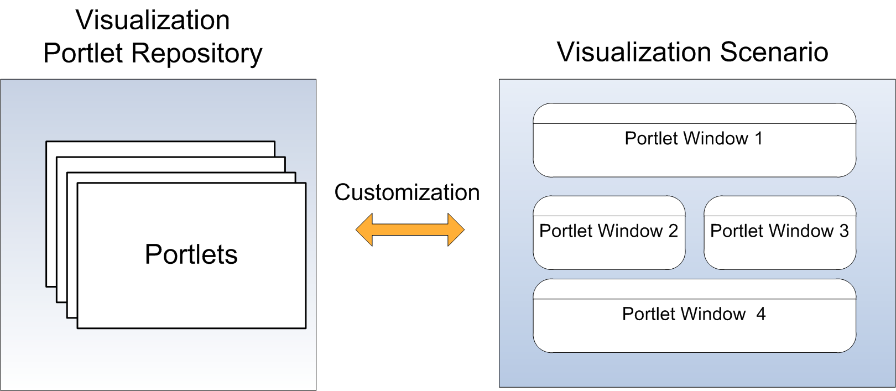
Visualization – implementation
Visualization portal containing visualization portlets.
Each portlet is easily customizable and answers different user visualization demands
The portal can be extended by 3rd party widgets (using the standard JSR 168 and JSR 286 from the portlet specification)
Using portlets as basic artifacts, various visualization scenarios can be built according to user or developer needs.
10/13/11
SIM – Semantic Instrumentation and Monitoring
Notes:
The visualization is implemented as a web application, namely a portal. A portal is a container in which portlets can be deployed. Portlets are web widgets confirming to the portlet standard. Using portlets as basic artifacts we can build various visualization scenarios that users or developers need

Slide 8
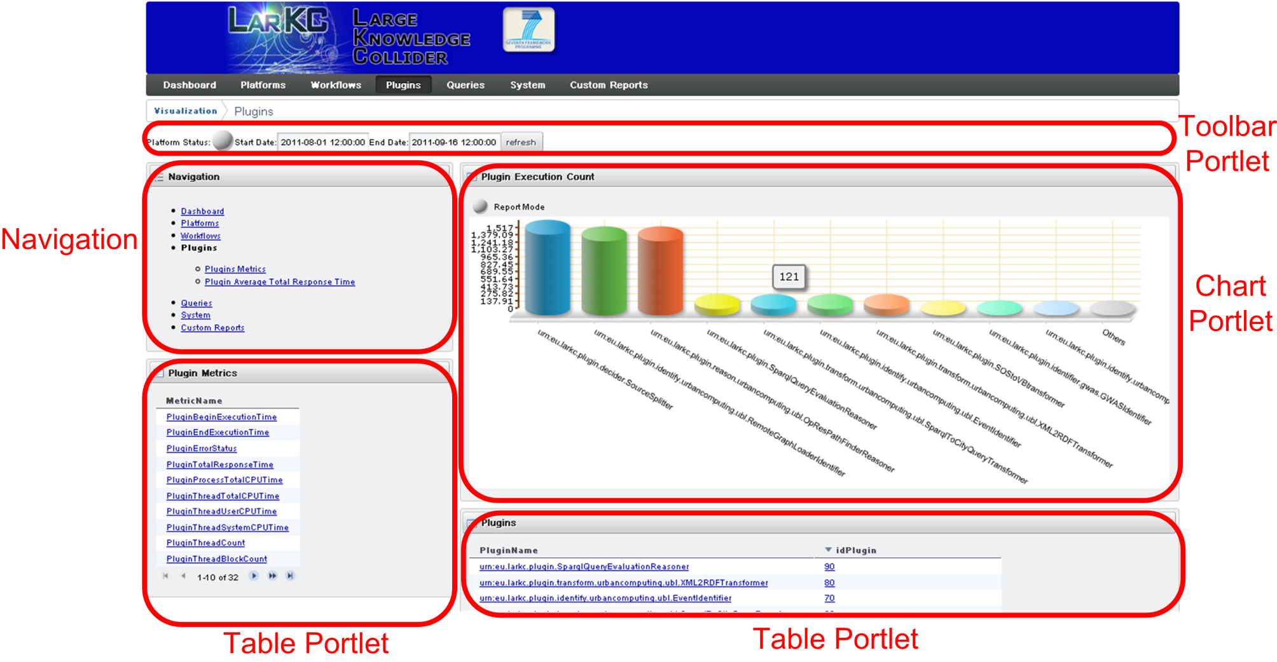
Visualization – Portal
Dashboard: Contains the most important widgets for a certain user:
10/13/11
SIM – Semantic Instrumentation and Monitoring
Notes:
Here we can see the Dashboard which contains the most important widgets for a certain users. We can see a Toolbar portlet, a Navigation portlet, two table portlets and a chart portlet

Slide 9
Visualization interface
Different visualization portlets:
  Toolbar: Allows the user to choose the global time interval during which the visualization will be done for all widgets
  Table view: Allows for displaying metrics and their context according to the required visualization level
  Chart view: Line Chart, Pie Chart, Bar Chart
  Linked data exploration portlet: visual exploration of semantically linked instrumentation data.
Refresh rate and the visualization time interval:
  report mode (historical data)
  live mode (real time visualization – last minute, hour etc.)
10/13/11
SIM – Semantic Instrumentation and Monitoring
Notes:
The toolbar portlet allows the user to choose the global time interval for which the other widgets will display results.
The table view portlet allows for displaying metrics and their context according to the required visualization level.
The chart view allows line charts, pie charts and bar charts to be displayed.
Linked data exploration portlet allows the visual exploration of semantically linked instrumentation data.
In the report mode historical data is shown. In live mode realtime, animated visualization data, for say, the last minitue is displayed.

Slide 10
Visualization features
Highly customizable visualization functions (obtained by creating portlets with desired settings)
Caching mechanism
Asynchronous (non blocking) requests.
Data aggregation: Average, Min, Max
Data interpolation.
Visualization Levels:
  System - node on which LarKC runs
  Platform – LarKC
  Plugin
  Workflow
  Query
10/13/11
SIM – Semantic Instrumentation and Monitoring
Notes:
The visualization is highly costumizable, one can configure portlets according to one’s needs. It integrates a caching mechanism for speeding up the displaying. It is asynchronous, it can aggregate data, it can interpolate data. It displays data organized on multiple levels, the system level, which refers to the node on which LarKC was run, LarKC platform Level, Query level, Workflow level and Plugin level.

Slide 11
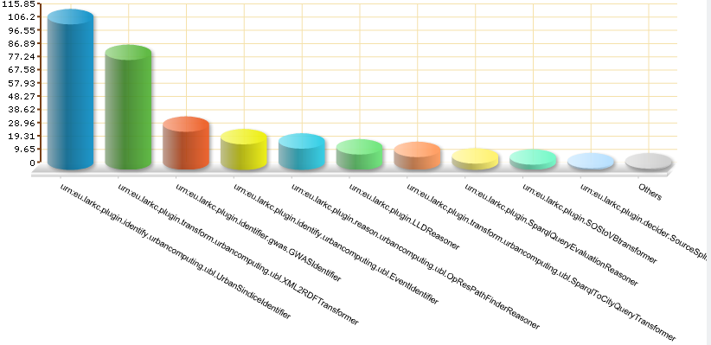
Statistics on collected data
Plugin Average Total CPU Time:
Urban Sindice Identifier
10/13/11
SIM – Semantic Instrumentation and Monitoring
Notes:
Let’s see some applications of the visualization. Here we see a bar chart showing the average cpu time spent by the instrumented plugins. We see here for example that the UrbanSindiceIdentifier plugin took an average of 116 milliseconds of cpu time.

Slide 12
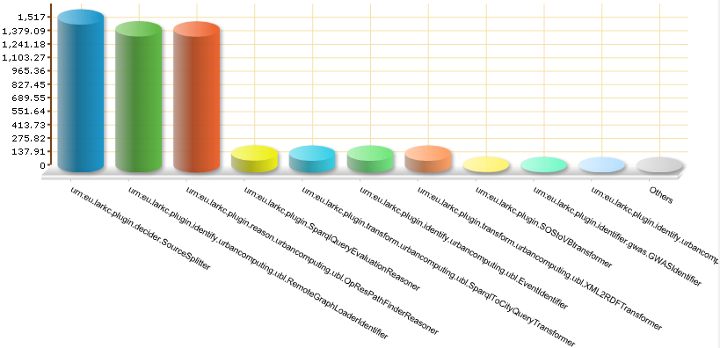
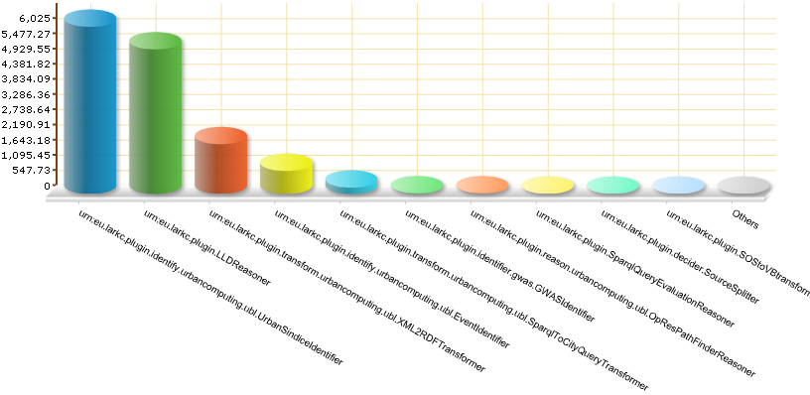
Statistics on collected data
Urban Sindice Identifier
Plugin Execution Count
Urban Sindice Identifier
Plugin Execution Time
10/13/11
SIM – Semantic Instrumentation and Monitoring
Notes:
If, for example we want to see on how many instances we performed the previous average we may look at the plugin execution count bar chart.
If we want to see the response time (total wall clock time) it took for a plugin to provide results we can look at the average plugin execution time. We see that the top plugin is again the UrbanSindiceIdentifier. It took six seconds to provide results, which is much more than the cpu time it consumed. The rest of the time was actually spent waiting for an external web service to supply the results.

Slide 13
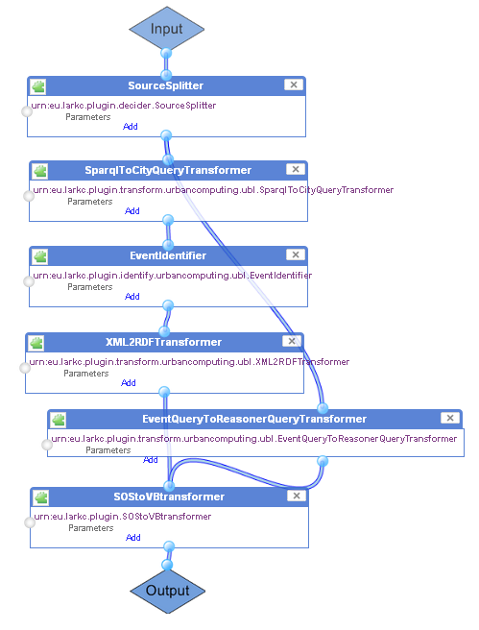
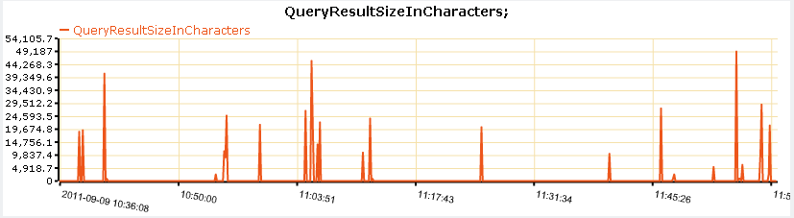
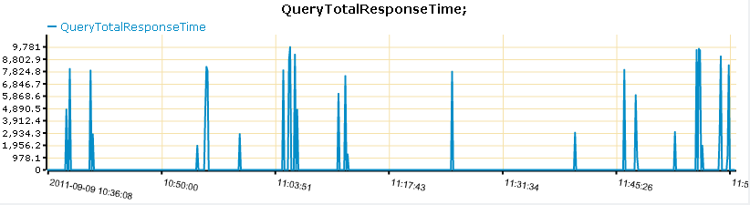
Simultaneous visualization of multiple metrics
A correlation between Query Result Size and Response Time can be observed:
Urban Event
10/13/11
SIM – Semantic Instrumentation and Monitoring
Notes:
The visualization component also allows us to see simultaneous views of multiple metrics. This can help us to identify correlations between various metrics. In this slide for example, we present the QueryResultsSize (output size) in characters versus the Query Total Response time. The measurements were done in the context of the Urban event identifier workflow. This shows a strong correlation, which can be again be explained by the fact that the workflow obtains its data from an external web service, and, if the amount of data is larger, then, of course, the time required to obtain it would also be larger.

Slide 14
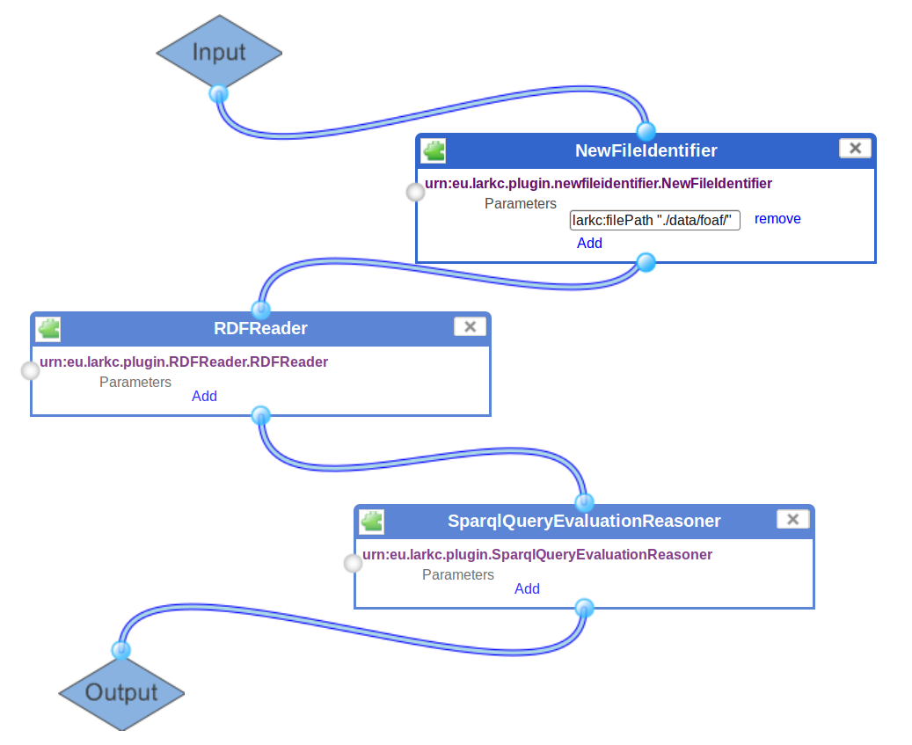
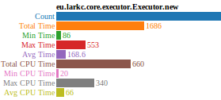
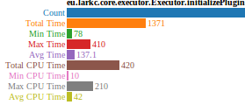
Initialization overhead visualization
Plugin initialization takes the most time for Workflow creation.
10/13/11
SIM – Semantic Instrumentation and Monitoring
Notes:
We wanted to test if Larkc can be used in a scenario which involves many workflow instantiations (for example, if a business offers Larkc as a service). For this we measured workflow creation overhead. We used a workflow built from 3 plugins. We ran the test once with just one workflow creation and then we ran the test again with 10 workflow creation. We can see that most of the time is spent on initializing plugins. Also the time is quite high for the first run 553ms , but then the average time drops to 168ms. This is explainable due to warm up of the Java VM. We also see that the vast majority of the time was spent in initializing the plugins. Maybe a caching or pooling mechanism for workflows and/or plugings could improve these times.

Slide 15
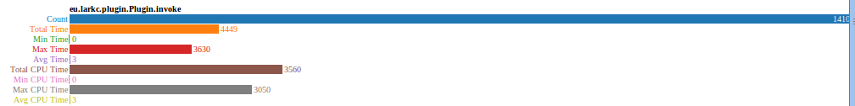
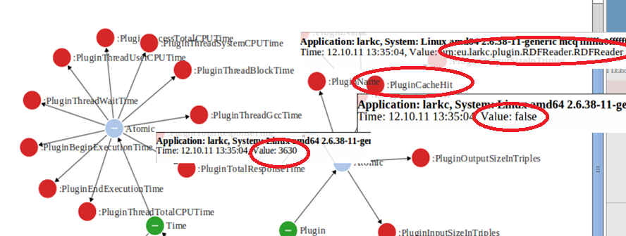
Visual analysis of LarKC caching
Even if plugin execution times take an average of 3ms there is one spike of 3500ms. SIM can identify what plugin and why.
10/13/11
SIM – Semantic Instrumentation and Monitoring
Notes:
We wanted to test the impact of Larkc plugin data exchange caching mechanism (which will be presented into the demo). For this we used the same workflow from the previous slide and we submitted 1410 queries to it. We ca see that the average time for plugin execution is 3ms but there is a spike of 3500ms. Using the linked data exploration portlet we managed to identify that RDFReader is the plugin that took that much time and the fact that there was a cache miss from Larkc plugin result caching mechanism. (the cache miss happened the first time RDFReader was executed so this is to be expected and not a problem).

Slide 16
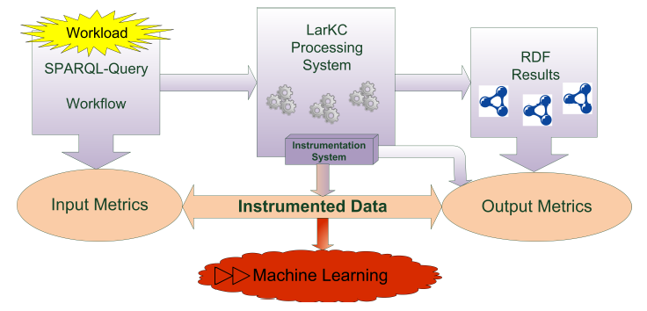
Relevance feedback
Allows the monitoring infrastructure to continuously learn and to provide suggestions
Relevance feedback uses data mining techniques and performs machine learning on top of the instrumented data
10/13/11
SIM – Semantic Instrumentation and Monitoring
Notes:
The last component of our semantic monitoring and instrumentation solution is the relevance feedback. This component allows the monitoring infrastructure to continuously learn and based on accumulated knowledge to provide suggestrions. To do this, it uses machine learning and data mining techniques on top of the instrumented data

Slide 17
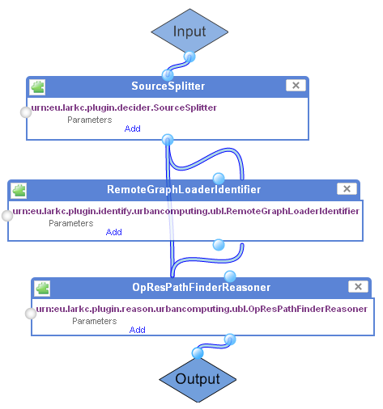
Scalability prediction
Input
  Query
    PREFIX rdf: <http://www.w3.org/1999/02/22-rdf-syntax-ns/>
    PREFIX lud: <http://www.linkingurbandata.org/onto/ama/>
    SELECT ?p ?w ?n1 ?l ?n2 WHERE {
    ?p rdf:type lud:Paths. ?p lud:pathFrom <http://seip.cefriel.it/ama/resource/nodes/node8252>.
    ?p lud:pathTo <http://seip.cefriel.it/ama/resource/nodes/node8669>.
    ?p lud:contain ?l. ?l lud:from ?n1. ?l lud:to ?n2. ?p lud:pathWeight ?w.
    }ORDER BY
  Current system and platform state
    (CPU load, memory etc.)
Output
  QueryTotalResponseTime : 26.85 ms
  QueryProcessTotalCPUTime : 22.07 ms
  QueryThreadBlockTime : 0.08 ms
  QueryThreadWaitTime : 20.89 ms
  . . .
10/13/11
SIM – Semantic Instrumentation and Monitoring
Notes:
Let’s see a concrete scenario. Given a query and the current system state, the relevance feedback can estimate what would happen in terms of the response time, cpu time and other parameters, if the given query would run on the platform in the current condition.

Slide 18
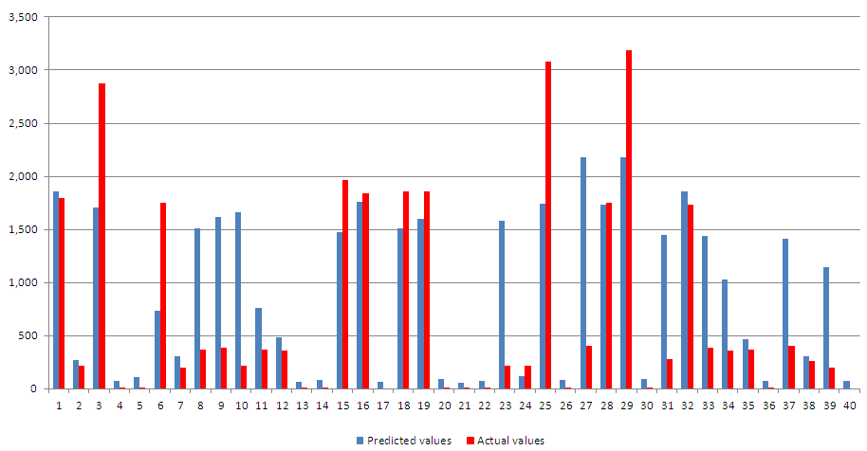
Scalability prediction evaluation
QueryTotalResponseTime (milliseconds, 40 test queries)
10/13/11
SIM – Semantic Instrumentation and Monitoring
Notes:
We can see here a comparison between predicted values (shown in blue) and actual values (shown in red). The prediction is not perfect, of course, but having more and more instrumented data can constantly improve the prediction.

Slide 19
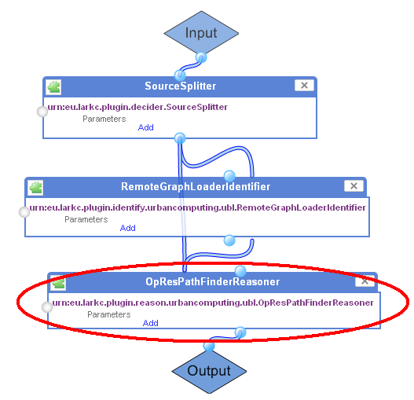
Best workflow suggestion
Best workflow:
SourceSplitter
RemoteGraphLoaderIdentifier
OpResPathFinderReasoner
Predicted QueryTotalResponseTime: 31.06 ms
SourceSplitter
RemoteGraphLoaderIdentifier
OpResPathFinderReasonerCPULoad
Predicted QueryTotalResponseTime: 25664.24 ms
10/13/11
SIM – Semantic Instrumentation and Monitoring
Notes:
Another scenario is the best workflow suggestion. Suppose we have multiple workflows which can solve the same query. Then, the relevance feedback is able to suggest the best workflow to use, in terms of some parameter. In this example we use the TotalResponseTime for the query, and the relevance feedback will suggest the fastest workflow in terms of totalresponsetime. Because we didn’t find alternative workflows to respond to the same query we generated an artificial workflow alternative to the UrbanPathfinding workflow in which we replaced one plugin with a deliberately slower version. We collected data for both workflows, and the relevance feedback was able to suggest the faster one.

Slide 20
Plugin behavior prediction
Workflow
SourceSplitter
RemoteGraphLoaderIdentifier
OpResPathFinderReasonerCPULoad
Predicted values
TotalResponseTime(SourceSplitter): 5.86 ms
TotalResponseTime(OpResPathFinderReasonerCPULoad): 25674 ms
TotalResponseTime(RemoteGraphLoaderIdentifier): 0.0 ms
Workflow
SourceSplitter
RemoteGraphLoaderIdentifier
OpResPathFinderReasoner
Predicted values
TotalResponseTime(SourceSplitter): 0.0 ms
TotalResponseTime(OpResPathFinderReasoner): 19.63 ms
TotalResponseTime(RemoteGraphLoaderIdentifier): 0.0 ms
10/13/11
SIM – Semantic Instrumentation and Monitoring
Notes:
The relevance feedback is also able to predict the behaviour of the plugin. In the same test scenario as the one presented in the previous slide, the relevance feedback was able to provide a good estimate of the plugin response time, close to the true value

Slide 21
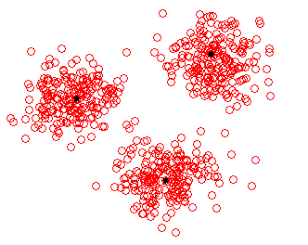
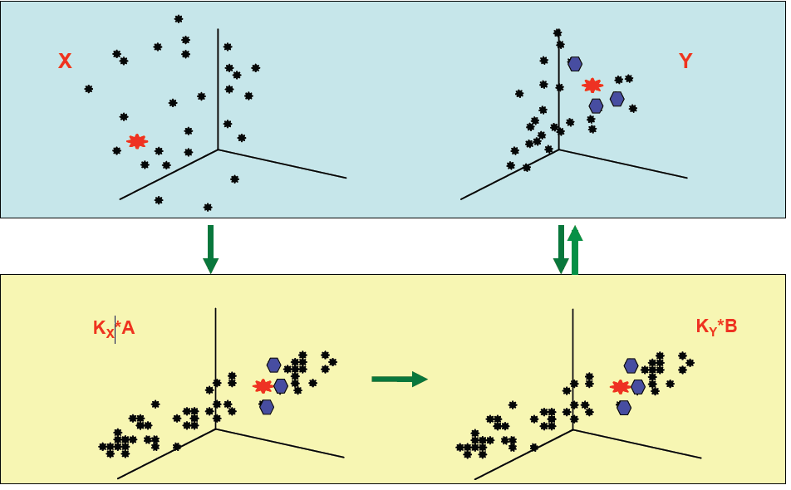
Prediction methods
Clustering & Linear Regression
Kernel Canonical Correlation Analysis
(KCCA)
More scalable
Can work incrementally
Requires more CPU and memory
  - Parallel implementation
Can predict complex distributions
10/13/11
SIM – Semantic Instrumentation and Monitoring
Notes:
So how does this prediction work? We implemented two methods, one based on clustering and linear regression and on based on kernel cannonical correlation analysis. The first method clusters first the data using the expectation maximization algorithm and the performs linear regression on each cluster. It is relatively scalable and can be updated incrementally. The second method, the KCCA, projects the input and output spaces on their principal variation components, and find correspondences between these compressed spaces. It requires more cpu and memory, we implemented an parallel version. It can predict more complex distribution but cannot easily be updated incrementally.

Slide 22
Instrumented workflows and plugins
WP6
  Instrumented workflows: UrbanEvent, UrbanMonumentFinder and UrbanPathFinder and their plugins
  Most of the queries have been run on UrbanPathFinder
  Number of queries run: 900 000
WP7a
  Instrumented workflow: LLDReasoner and its plugins
  Number of queries run: 900 000
10/13/11
SIM – Semantic Instrumentation and Monitoring
Notes:
Finally I will give an overview of what we instrumented, in terms of workflows and plugins and how many queries we ran in order to colllect data.
For WP6 we instrumented the Urban Event, Urban Path Finding and the Monument Finder workflows. We managed to run more than 100000 queries, most of them on the Path finding workflow. For workpackage WP7 we instrumented the LLD Reasoner workflow and its plugins and ran about 100000 workflows.

Slide 23
Instrumented workflows and plugins
WP7b
  Instrumented workflows: variants of GWAS and its plugins
  Number of queries run: 1000000
Example of other instrumented workflows and their plugins:
  LLDReasoner + SOStoVBtransformer,
  SPARQLDLReasonerPlugin
  PIONReasonerPlugin, SOStoVBtransformer
10/13/11
SIM – Semantic Instrumentation and Monitoring
Notes:
For workpackage seven bee weinstrumented variants of the gee doubleu a s workflow workflow. We ran about one million queries.

Slide 24
Thank You for attention
Questions
?

Slide 25
WP11 relation to WP1 work
WP1 provides a declarative approach to specify the functional and non-functional characteristics of plugins (e.g. CPU, Memory requirements)
WP11 offers tools to instrument and monitor such non-functional characteristics
Bidirectional relation between the two WPs:
  WP1->WP11: Non-functional information from the plugins can be pushed into WP11 using the instrumentation API
  WP11->WP1: LarKC plugin developers can create annotation of their plugins using WP1 terminology based on the measurements collected by WP11
10/13/11
SIM – Semantic Instrumentation and Monitoring

