Slide 1




Metadata for RDF Statements: The RDF-star Approach
Olaf Hartig Pierre-Antoine Champin
(Linköping University) (W3C/ERCIM)
@olafhartig @pchampin
LOTICO - 2021-03-25

Slide 2
Part 1
Motivation
RDF and Statement-level metadata: it’s complicated!
Notes:
RDF is a W3C standard, aimed to be a Lingua Franca for data on the Web. Semantic interoperability. Any kind of data or meta-data should be faily easy to represent in RDF. Yet...

Slide 3
Example RDF data
#alice
:workingFor
#acme
:driver
:owner
#car123
:parkedIn
geo:longitude
geo:latitude
4.86553
45.78234

Slide 4
Example RDF data + graph-level metadata
#alice
:workingFor
#acme
:driver
:owner
#pa
#car123
s:creator
:parkedIn
s:dateCreated
2021-03-11
geo:longitude
geo:latitude
4.86553
45.78234

Slide 5
Example RDF data + statement-level metadata
acme:staff.html
:contains
#alice
:workingFor
#acme
:driver
:owner
:since
#car123
2019-06-01
2019-10-03T12:34:56Z
:observedAt
:parkedIn
geo:longitude
geo:latitude
4.86553
45.78234
Notes:
Mention interoperability with PG

Slide 6
Example #2 RDF data + statement-level metadata
#alice
rdf:type
#alice
:Genius
:Genius
:source
./file.ttl
s:creator
#bob

Slide 7
Existing approaches
Standard reification
(RDF 1.0 1999)
Single-triple named graphs
(Carroll et al. 2005,
RDF 1.1 2014)
Singleton properties
(Nguyen et al. 2014)

Slide 8
Standard reification
rdf:type
#alice
:Genius
rdf:predicate
rdf:object
rdf:subject
#alice
rdf:type
:Genius
rdf:type
:source
:source
rdf:Statement
./file.ttl
./file.ttl
s:creator
s:creator
#bob
#bob

Slide 9
Querying standard reification
rdf:type
#alice
:Genius
rdf:predicate
rdf:object
rdf:subject
# Who is a genius according to whom?
PREFIX …
SELECT ?allegedGenius ?accordingTo
WHERE {
?claim rdf:type rdf:Statement .
?claim rdf:subject ?allegedGenius .
?claim rdf:predicate rdf:type .
?claim rdf:object :Genius .
?claim :source ?src .
?src s:creator ?accordingTo .
}
rdf:type
:source
rdf:Statement
./file.ttl
s:creator
#bob

Slide 10
Incomplete / overloaded reified statement
rdf:type
#alice
:Genius
rdf:predicate
rdf:object
rdf:subject
rdf:subject
rdf:type
#dan
:source
rdf:Statement
./file.ttl
s:creator
#bob

Slide 11
Single-triple named graphs
#stmt1
#alice
rdf:type
:Genius
rdf:type
(default)
#alice
:Genius
#stmt1
:source
:source
./file.ttl
./file.ttl
s:creator
s:creator
#bob
#bob

Slide 12
Querying single-triple named graphs
#stmt1
#alice
rdf:type
:Genius
(default)
# Who is a genius according to whom?
PREFIX …
SELECT ?allegedGenius ?accordingTo
WHERE {
GRAPH ?claim {
?allegedGenius rdf:type :Genius .
}
?claim :source ?src .
?src s:creator ?accordingTo .
}
#stmt1
:source
./file.ttl
s:creator
#bob

Slide 13
Singleton properties
#alice
#type1
:Genius
sp:singletonPropertyOf
#alice
rdf:type
:Genius
#type1
rdf:type
:source
:source
./file.ttl
./file.ttl
s:creator
s:creator
#bob
#bob
Nguyen et al., "Don't like RDF reification? Making statements about statements using singleton property." WWW 2014.

Slide 14
Querying singleton properties
#alice
#type1
:Genius
sp:singletonPropertyOf
# Who is a genius according to whom?
PREFIX …
SELECT ?allegedGenius ?accordingTo
WHERE {
?allegedGenius ?claim :Genius .
?claim sp:singletonPropertyOf rdf:type .
?claim :source ?src .
?src s:creator ?accordingTo .
}
#type1
rdf:type
:source
./file.ttl
s:creator
#bob
Nguyen et al., "Don't like RDF reification? Making statements about statements using singleton property." WWW 2014.

Slide 15
Existing approaches: summary
Standard reification
(RDF 1.0, 1999)
Pros:
Standard
Cons:
Verbose
Incomplete / overloaded reified statements
Single-triple named graphs
(Carroll et al. 2005,
RDF 1.1, 2014)
Pros:
Standard
Cons:
Unspecified semantics
Clutters datasets with “artificial” named graphs
Singleton properties
(Nguyen et al., 2014)
Pros:
Relatively concise
Cons:
Performance issues on many RDF systems

Slide 16
Part 2
Overview of the RDF-star approach
Why don’t we use the triple itself when talking about it?

Slide 17
Basic idea: nested triples
#alice
rdf:type
:Genius
#alice
rdf:type
:Genius
:source
:source
./file.ttl
./file.ttl
<< <#alice> a :Genius >> :source <./file.ttl> .
subject
predicate
object

Slide 18
...and nested triple patterns
SELECT ?allegedGenius ?accordingTo
WHERE {
?claim rdf:type rdf:Statement .
?claim rdf:subject ?allegedGenius .
?claim rdf:predicate rdf:type .
?claim rdf:object :Genius .
?claim :source ?src .
?src s:creator ?accordingTo .
}
SELECT ?allegedGenius ?accordingTo
WHERE {
<<?allegedGenius rdf:type :Genius>> :source ?src .
?src s:creator ?accordingTo .
}
<< <#alice> a :Genius >> :source <./file.ttl> .
subject
predicate
object

Slide 19

...and nested triple patterns
SELECT ?allegedGenius ?accordingTo
WHERE {
?claim1 rdf:type rdf:Statement .
?claim1 rdf:subject ?allegedGenius .
?claim1 rdf:predicate rdf:type .
?claim1 rdf:object :Genius .
?claim1 :source ?src1 .
?claim2 rdf:type rdf:Statement .
?claim2 rdf:subject ?allegedGenius .
?claim2 rdf:predicate rdf:type .
?claim2 rdf:object :Nerd .
?claim2 :source ?src2 .
FILTER ( ?src1 != ?src2 )
?src1 s:creator ?accordingTo .
?src2 s:creator ?accordingTo .
}

Slide 20
...and nested triple patterns
SELECT ?allegedGenius ?accordingTo
WHERE {
?claim1 rdf:type rdf:Statement .
?claim1 rdf:subject ?allegedGenius .
?claim1 rdf:predicate rdf:type .
?claim1 rdf:object :Genius .
?claim1 :source ?src1 .
?claim2 rdf:type rdf:Statement .
?claim2 rdf:subject ?allegedGenius .
?claim2 rdf:predicate rdf:type .
?claim2 rdf:object :Nerd .
?claim2 :source ?src2 .
FILTER ( ?src1 != ?src2 )
?src1 s:creator ?accordingTo .
?src2 s:creator ?accordingTo .
}
SELECT ?allegedGenius ?accordingTo
WHERE {
<<?allegedGenius rdf:type :Genius>> :source ?src1.
<<?allegedGenius rdf:type :Nerd>> :source ?src2.
FILTER ( ?src1 != ?src2 )
?src1 s:creator ?accordingTo .
?src2 s:creator ?accordingTo .
}

Slide 21
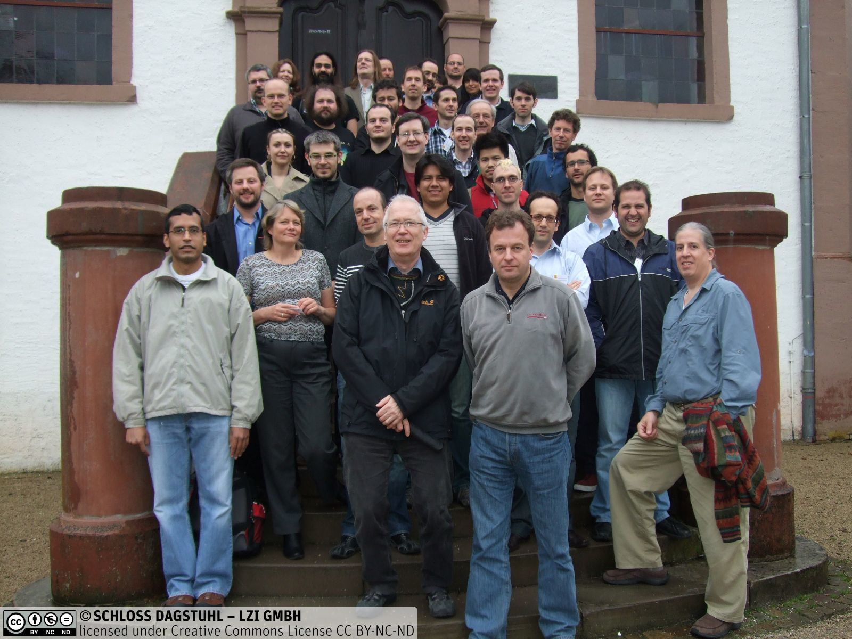
Historical perspective
Ideas of such nested triples / triple patterns in the community since many years
  Including an implementation in Blazegraph (“reification done right”)
  Dagstuhl seminar on Semantic Data Management, April 2012

Slide 22
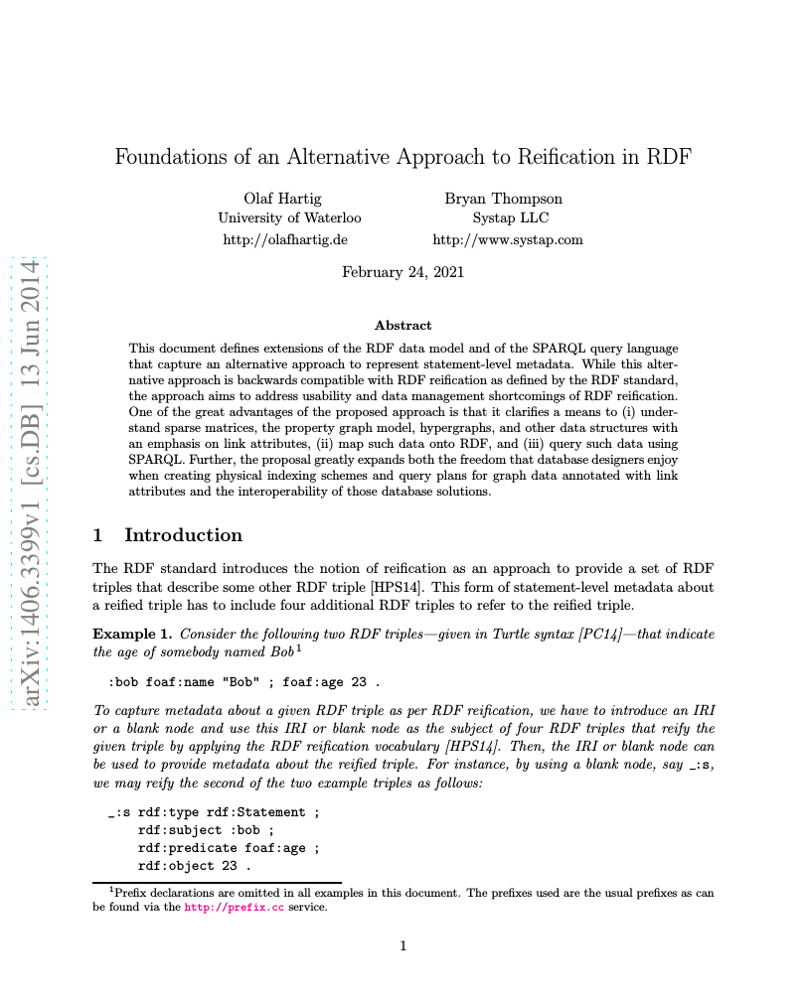
Historical perspective
Ideas of such nested triples / triple patterns in the community since many years
  Including an implementation in Blazegraph (“reification done right”)
  Dagstuhl seminar on Semantic Data Management, April 2012
Tech.report that defines the approach under the name RDF*/SPARQL*, June 2014
  RDF* abstract syntax, Turtle* format, SPARQL* syntax and evaluation semantics

Slide 23
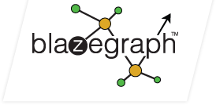









Historical perspective
Ideas of such nested triples / triple patterns in the community since many years
  Including an implementation in Blazegraph (“reification done right”)
  Dagstuhl seminar on Semantic Data Management, April 2012
Tech.report that defines the approach under the name RDF*/SPARQL*, June 2014
  RDF* abstract syntax, Turtle* format, SPARQL* syntax and evaluation semantics
Adoption
  Blazegraph, AnzoGraph, Stardog, GraphDB, Neo4j’s neosemantics
  Apache Jena, Eclipse RDF4J, RDF.rb, N3.js, EYE
  YAGO 4 knowledge graph released as a Turtle* file

Slide 24
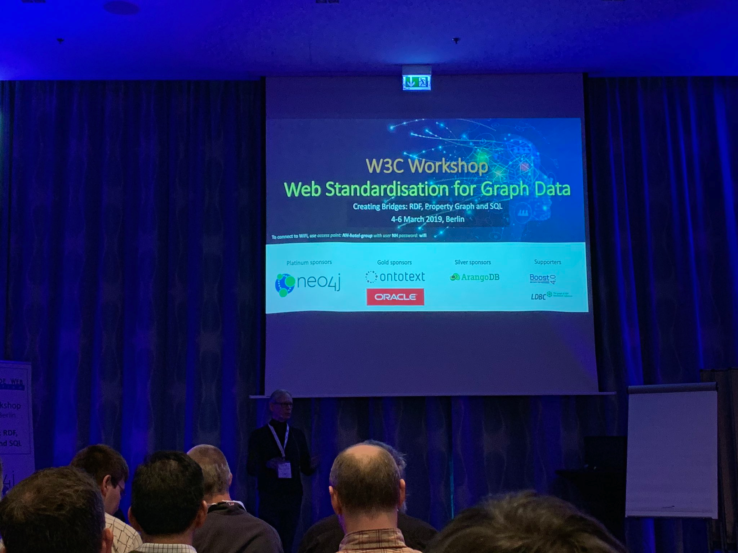
Historical perspective
Ideas of such nested triples / triple patterns in the community since many years
  Including an implementation in Blazegraph (“reification done right”)
  Dagstuhl seminar on Semantic Data Management, April 2012
Tech.report that defines the approach under the name RDF*/SPARQL*, June 2014
  RDF* abstract syntax, Turtle* format, SPARQL* syntax and evaluation semantics
Adoption
  Blazegraph, AnzoGraph, Stardog, GraphDB, Neo4j’s neosemantics
  Apache Jena, Eclipse RDF4J, RDF.rb, N3.js, EYE
  YAGO 4 knowledge graph released as a Turtle* file
W3C Workshop on Web Standardization for Graph Data, Berlin, March 2019

Slide 25
Historical perspective
Ideas of such nested triples / triple patterns in the community since many years
  Including an implementation in Blazegraph (“reification done right”)
  Dagstuhl seminar on Semantic Data Management, April 2012
Tech.report that defines the approach under the name RDF*/SPARQL*, June 2014
  RDF* abstract syntax, Turtle* format, SPARQL* syntax and evaluation semantics
Adoption
  Blazegraph, AnzoGraph, Stardog, GraphDB, Neo4j’s neosemantics
  Apache Jena, Eclipse RDF4J, RDF.rb, N3.js, EYE
  YAGO 4 knowledge graph released as a Turtle* file
W3C Workshop on Web Standardization for Graph Data, Berlin, March 2019
Community task force as part of the W3C RDF-DEV CG
  Mixture of implementers, users, and academic researchers
  Goal: create a spec that captures all aspects of the approach in the
  form of a CG report, plus a collection of corresponding test suites
  Some aspects of the approach have changed → new names: RDF-star, SPARQL-star, etc.

Slide 26
RDF and related specs
RDF-S
OWL
RDF Semantics
SPARQL
...
RDF Abstract Syntax
SHACL
RDF/XML
Turtle
JSON-LD
...
...
RDF Concrete Syntaxes
Notes:
PA takes over here

Slide 27
RDF and related specs → RDF-star
RDF-S
OWL
RDF Semantics
SPARQL
...
RDF Abstract Syntax
SHACL
RDF/XML
Turtle
JSON-LD
...
...
RDF Concrete Syntaxes
Notes:
PA takes over here

Slide 28
Part 3
From RDF to RDF-star
RDF-S
OWL
RDF Semantics
SPARQL
...
RDF Abstract Syntax
SHACL
RDF/XML
Turtle
JSON-LD
...
...
RDF Concrete Syntaxes

Slide 29
RDF-star abstract syntax
RDF-S
OWL
RDF Semantics
SPARQL
...
RDF Abstract Syntax
SHACL
RDF/XML
Turtle
JSON-LD
...
...
RDF Concrete Syntaxes
Notes:
PA takes over here

Slide 30
Part 3 : RDF-star data
Graph ::= Triple*
Triple ::= Subj Pred Obj
Subj ::= IRI | Bnode
Pred ::= IRI
Obj ::= IRI | Bnode | Literal
Dataset ::= Graph (IRI Graph)*
Graph ::= Triple*
Triple ::= Subj Pred Obj
Subj ::= IRI | Bnode | Triple
Pred ::= IRI
Obj ::= IRI | Bnode | Literal | Triple
Dataset ::= Graph (IRI Graph)*
Asserted triple
Embedded triple

Slide 31
RDF-star Concrete syntaxes
RDF-S
OWL
RDF Semantics
SPARQL
...
RDF Abstract Syntax
SHACL
RDF/XML
Turtle
JSON-LD
...
...
RDF Concrete Syntaxes
Notes:
PA takes over here

Slide 32
Turtle-star
<< <#alice> a :Genius >> :source <./file.ttl>.
<./file.ttl> s:creator <#bob>.
#alice
rdf:type
:Genius
:source
./file.ttl
s:creator
#bob

Slide 33
Turtle-star
#alice
rdf:type
:Genius
<#alice> a :Genius.
<< <#alice> a :Genius >> :source <./file.ttl>.
<./file.ttl> s:creator <#bob>.
#alice
rdf:type
:Genius
:source
./file.ttl
s:creator
#bob

Slide 34
Turtle-star: annotation syntax
#alice
rdf:type
:Genius
<#alice> a :Genius {| :source <./file.ttl> |}.
<./file.ttl> s:creator <#bob>.
:source
./file.ttl
s:creator
#bob

Slide 35
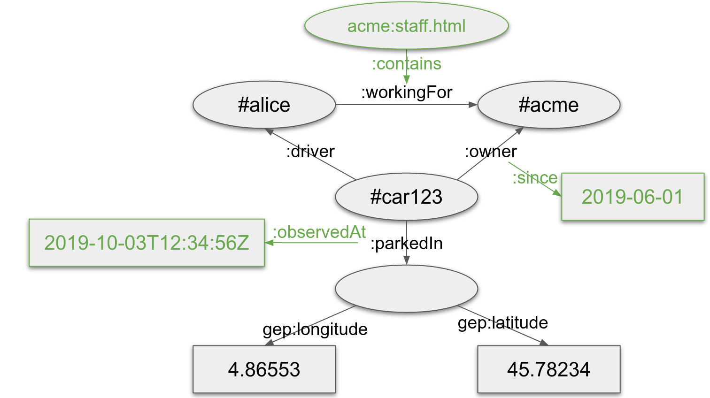
Turtle-star: a more complex example
<#alice> :workingFor <#acme>.
<#car123>
:driver <#alice>;
:owner <#acme> {| :since "2019-06-01"^^xsd:date |};
:parkedIn _:pos {| :observedAt "2019-10-03T12:34:56Z"^^xsd:dateTime |}.
_:pos
geo:longitude 4.86553;
geo:latitude 45.78234.
acme:staff.html :contains << <#alice> :workingFor <#acme> >>.

Slide 36
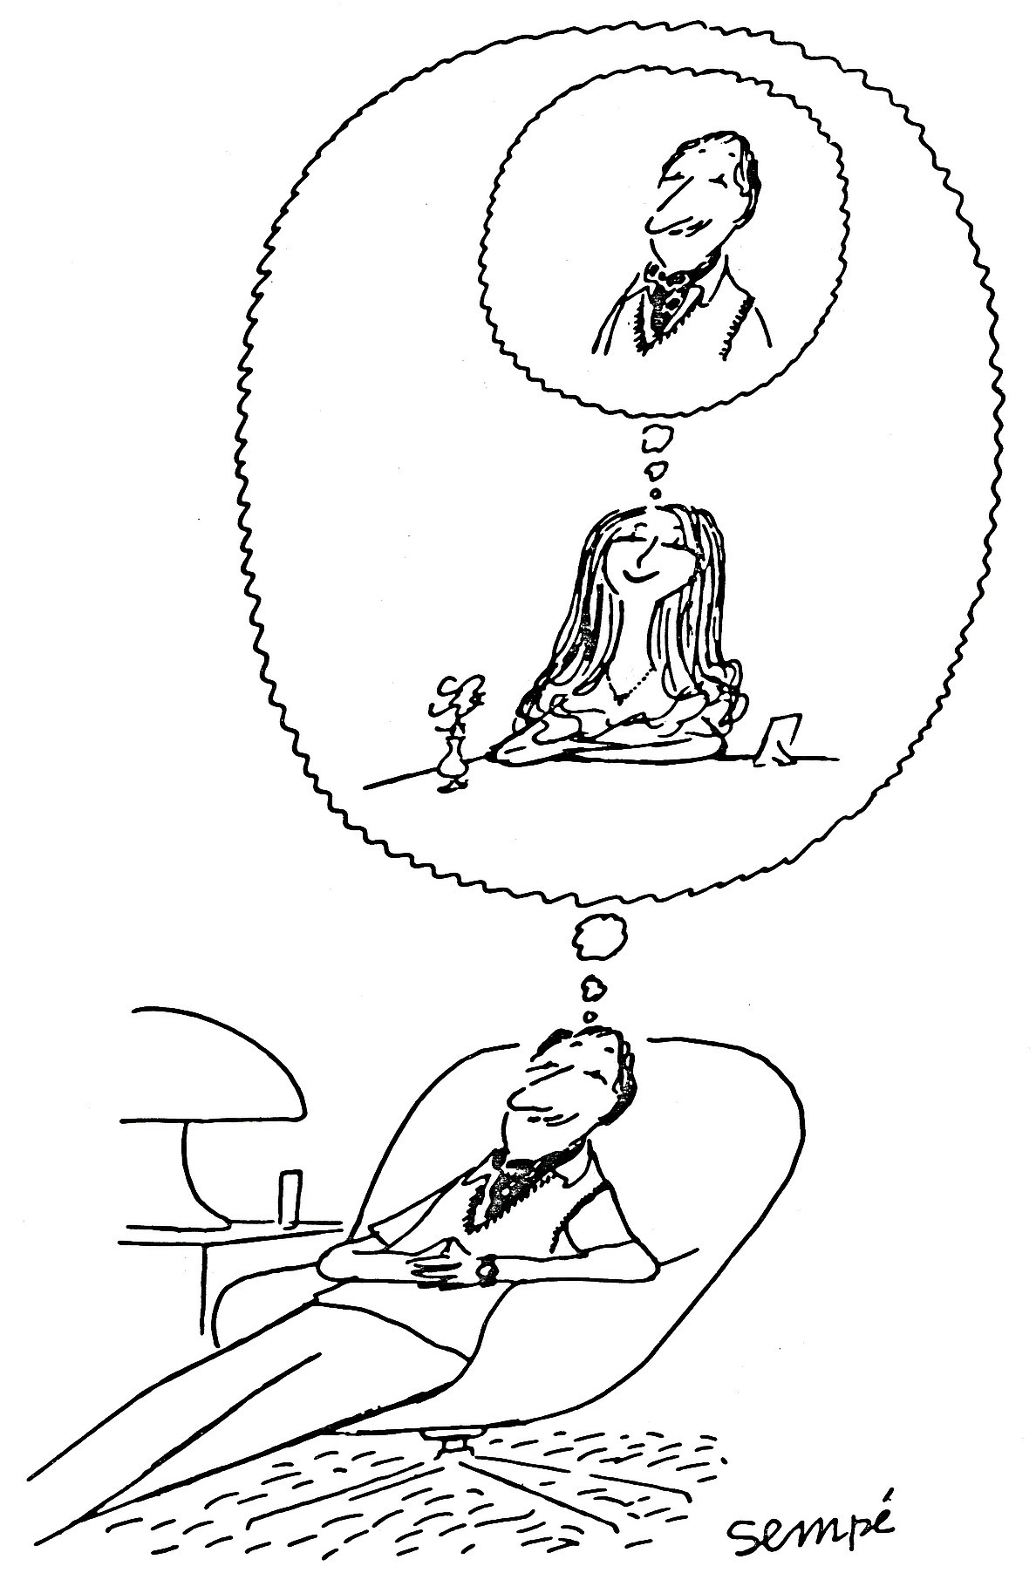
Turtle-star: deeply nested triples
<#cartoon>
:depicts <<
<#bob> :dreamingOf <<
<#alice> :dreamingOf <#bob>
>>
>>.

Slide 37
Other concrete syntaxes
N-Triples-star
  Subset of Turtle-star
  One (potentially nested) RDF-star triple per line, no annotation syntax here
N-Quads-star
  For RDF-star datasets
  N-Triples-star + optional graph name
JSON-LD-star
  https://json-ld.github.io/json-ld-star/

Slide 38
JSON-LD-star
{
“@context”: “...”,
“id”: {
“id”: “#alice”,
“type”: “Genius”
},
“source”: {
“id”: “./file.ttl”,
“creator”: “#bob”
}
}
#alice
rdf:type
:Genius
:source
./file.ttl
s:creator
#bob

Slide 39
JSON-LD-star annotation
#alice
rdf:type
:Genius
{
“@context”: “...”,
“id”: “#alice”,
“type”: {
“id”: “Genius”,
“@annotation”: {
“source”: {
“id”: “./file.ttl”,
“creator”: “#bob”
}
}
}
}
:source
./file.ttl
s:creator
#bob

Slide 40
RDF-star semantics
RDF Semantics
RDF Abstract Syntax
RDF/XML
Turtle
JSON-LD
...
RDF Concrete Syntaxes
Notes:
PA takes over here

Slide 41
RDF-star semantics relies on standard RDF semantics
Don’t reinvent the wheel
RDF-star can (in theory) be implemented on top of a standard RDF system
Semantics extensions (RDF-S, OWL…) can be directly applied to RDF-star

Slide 42
Embedded triples are not automatically asserted
Goodbye PG-mode and SA-mode
Welcome annotation syntax
<< <#alice> a :Genius >>
:source <./file.ttl>.
<#alice> a :Genius
{| :source <./file.ttl> |}.

Slide 43
Asserted triples can not be “cancelled”
Not in RDF, not in RDF-star
(monotonic semantics)
@prefix s: <http://schema.org/>.
<< <#acme> s:employee <#alice> >>
:since “2012-03-04”xsd:date;
:until “2018-09-10”xsd:date;
.
<#alice> :workingFor <#acme> {|
:since “2012-03-04”xsd:date;
:until “2018-09-10”xsd:date;
|}.
⚠

Slide 44
Triples are “unique”
They are entirely identified by their subject, predicate and object
<< :s :p :o >> is the same triple everywhere it occurs
<< <#alice> :workingFor <#acme> >>
:addedBy <#alice>;
:addedIn <./file1.ttl>.
<< <#alice> :workingFor <#acme> >>
:addedBy <#bob>;
:addedIn <./file2.ttl>.
<< <#alice> :workingFor <#acme> >>
:occurences _:occ1, _:occ2.
_:occ1 :addedBy <#alice>;
:addedIn <./file1.ttl>.
_:occ2 :addedBy <#bob>;
:addedIn <./file2.ttl>.

Slide 45
Referential opacity
Aside:
:superman owl:sameAs :clark .
:superman :can :fly .
→ :clark :can :fly .
An “explainable AI” use-case
<< :superman :can :fly >>
prov:wasDerivedFrom
( << :clark owl:sameAs :clark >>
<< :clark :can :fly >> ) .
<< :clark :can :fly >>
prov:wasDerivedFrom
( << :superman owl:sameAs :clark >>
<< :superman :can :fly >> ) .

Slide 46
Part 4
From SPARQL to SPARQL-star
RDF-S
OWL
RDF Semantics
SPARQL
...
RDF Abstract Syntax
SHACL
RDF/XML
Turtle
JSON-LD
...
...
RDF Concrete Syntaxes

Slide 47
Nested Triple Patterns
SELECT ?allegedGenius ?accordingTo
WHERE {
<<?allegedGenius rdf:type :Genius>> :source ?src .
?src s:creator ?accordingTo .
}

Slide 48
Nested Triple Patterns (cont’d)
SELECT ?allegedGenius ?accordingTo
WHERE {
<<?allegedGenius rdf:type :Genius>> :source ?src1.
<<?allegedGenius rdf:type :Nerd>> :source ?src2.
FILTER ( ?src1 != ?src2 )
?src1 s:creator ?accordingTo .
?src2 s:creator ?accordingTo .
}

Slide 49
Nested Triple Patterns (cont’d)
SELECT ?allegedGenius
WHERE {
<<?allegedGenius rdf:type :Genius>> :source ?src1 ;
:source ?src2 .
FILTER ( ?src1 != ?src2 )
?src1 s:creator ?accordingTo1 .
?src2 s:creator ?accordingTo2 .
FILTER ( ?accordingTo1 != ?accordingTo2 )
}

Slide 50
Nested Triple Patterns (cont’d)
:cartoon1 :depicts <<:bob :dreamingOf <<:alice :dreamingOf :bob>> >> .
:cartoon2 :depicts <<:bob :dreamingOf <<:alice :dreamingOf :eve>> >> .
SELECT ?cartoon ?b
WHERE {
?cartoon :depicts <<?b :dreamingOf <<?a :dreamingOf ?b>> >>
}
?cartoon | ?b
:cartoon1 | :bob

Slide 51
Results may contain triples
:cartoon1 :depicts <<:bob :dreamingOf <<:alice :dreamingOf :bob>> >> .
:cartoon2 :depicts <<:bob :dreamingOf <<:alice :dreamingOf :eve>> >> .
SELECT ?cartoon ?y
WHERE {
?cartoon :depicts <<?b :dreamingOf ?y >>
}
?cartoon | ?y
:cartoon1 | ( :alice, :dreamingOf, :bob )
:cartoon2 | ( :alice, :dreamingOf, :eve )

Slide 52
Results may contain triples
:cartoon1 :depicts <<:bob :dreamingOf <<:alice :dreamingOf :bob>> >> .
:cartoon2 :depicts <<:bob :dreamingOf <<:alice :dreamingOf :eve>> >> .
SELECT ?cartoon ?y
WHERE {
?cartoon :depicts ?y
}
?cartoon | ?y
:cartoon1 | ( :bob, :dreamingOf, (:alice, :dreamingOf, :bob) )
:cartoon2 | ( :bob, :dreamingOf, (:alice, :dreamingOf, :eve) )

Slide 53
Extension of VALUES for SPARQL-star
:cartoon1 :depicts <<:bob :dreamingOf <<:alice :dreamingOf :bob>> >> .
:cartoon2 :depicts <<:bob :dreamingOf <<:alice :dreamingOf :eve>> >> .
SELECT ?cartoon ?y
WHERE {
VALUES ?y { <<:alice :dreamingOf :bob>> <<:alice :dreamingOf :eve>> }
?cartoon :depicts << :bob :dreamingOf ?y >>
}
?cartoon | ?y
:cartoon1 | ( :alice, :dreamingOf, :bob )
:cartoon2 | ( :alice, :dreamingOf, :eve )

Slide 54
New Built-In Functions in SPARQL-star
:cartoon1 :depicts <<:bob :dreamingOf <<:alice :dreamingOf :bob>> >> .
:cartoon2 :depicts <<:bob :dreamingOf <<:alice :dreamingOf :eve>> >> .
SELECT ?cartoon ?y ?o
WHERE {
?cartoon :depicts << :bob :dreamingOf ?y >>
FILTER( isTriple(?y) )
BIND( Object(?y) AS ?o )
}
?cartoon | ?y | ?o
:cartoon1 | ( :alice, :dreamingOf, :bob ) | :bob
:cartoon2 | ( :alice, :dreamingOf, :eve ) | :eve
SELECT ?cartoon ?t
WHERE {
?cartoon :depicts << ?x :dreamingOf ?y >>
BIND( TRIPLE(?x,:state,:sleeping) AS ?t )
}
?cartoon | ?t
:cartoon1 | ( :bob, :state, :sleeping )
:cartoon2 | ( :bob, :state, :sleeping )

Slide 55
Nested Triple Patterns in GRAPH clauses
<http://example.org/graph1> {
:cartoon :depicts <<:bob :dreamingOf :alice >> .
# ...
# other triples
# ...
}
SELECT ?cartoon ?g1 ?g2
WHERE {
GRAPH ?g1 {
?cartoon :depicts <<?b :dreamingOf ?x>>
}
GRAPH ?g2 {
?cartoon :depicts <<?b :dreamingOf ?x>>
}
FILTER ( ?g1 != ?g2 )
}
<http://example.org/graph2> {
:cartoon :depicts <<:bob :dreamingOf :alice >> .
# ...
}
?cartoon | ?g1 | ?g2
:cartoon | http://example.org/graph1 | http://example.org/graph2
:cartoon | http://example.org/graph2 | http://example.org/graph1

Slide 56
Annotation Syntax in SPARQL-star
<< :alice :rdf:type :Genius >> :source <./file1.ttl> .
:alice :rdf:type :Genius .
<< :alice :rdf:type :Nerd >> :source <./file2.ttl> .
SELECT ?allegedGenius ?type ?src
WHERE {
?allegedGenius rdf:type ?type {| :source ?src |} .
}
≡
≡
:alice :rdf:type :Genius {| :source <./file1.ttl> |} .
<< :alice :rdf:type :Nerd >> :source <./file2.ttl> .
SELECT ?allegedGenius ?type ?src
WHERE {
?allegedGenius rdf:type ?type .
<< ?allegedGenius rdf:type ?type >> :source ?src .
}
?allegedGenius | ?type | ?src
:alice | :Genius | ./file1.ttl

Slide 57
CONSTRUCT Queries in SPARQL-star
:cartoon1 :depicts <<:bob :dreamingOf <<:alice :dreamingOf :bob>> >> .
:cartoon2 :depicts <<:bob :dreamingOf <<:alice :dreamingOf :eve>> >> .
CONSTRUCT {
?cartoon :depicts << ?x :state :sleeping >>
}
WHERE {
?cartoon :depicts << ?x :dreamingOf ?y >>
}
:cartoon1 :depicts << :bob :state :sleeping >> .
:cartoon2 :depicts << :bob :state :sleeping >> .

Slide 58
SPARQL-star Update
:cartoon1 :depicts <<:bob :dreamingOf <<:alice :dreamingOf :bob>> >> .
:cartoon2 :depicts <<:bob :dreamingOf <<:alice :dreamingOf :eve>> >> .
INSERT {
?cartoon :depicts << ?x :state :sleeping >>
}
WHERE {
?cartoon :depicts << ?x :dreamingOf ?y >>
}
:cartoon1 :depicts <<:bob :dreamingOf <<:alice :dreamingOf :bob>> >> .
:cartoon1 :depicts << :bob :state :sleeping >> .
:cartoon2 :depicts <<:bob :dreamingOf <<:alice :dreamingOf :eve>> >> .
:cartoon2 :depicts << :bob :state :sleeping >> .

Slide 59
Other Contributions for SPARQL-star
Extension of the SPARQL result formats (JSON and XML)
Test suites
  61 syntax tests for SPARQL-star
  29 evaluation tests

Slide 60
Part 5
Conclusion and perspectives
The specification is relatively stable now
  https://w3c.github.io/rdf-star/
  second public draft on its way
  expecting implementation reports from various implementers
  → moment of truth
What’s next
  SHACL-star ?
  moving to recommendation track ?

Slide 61


Thank you for your attention
Do you have any question?
https://w3c.github.io/rdf-star/
This project has received funding from the European Union’s Horizon 2020 research
and innovation programme under grant agreement No 825333, as well as from both
the Swedish Research Council (Vetenskapsrådet, project reg. no. 2019-05655) and
the CENIIT program at Linköping University (project no. 17.05).

Slide 62
JSON-LD-star: a more complex example
{ “@context”: “...”,
“id”: “#car123”,
“driver”: { “id”: “#alice”,
“metadata”: {
“containedBy”: “acme:staff.html”
} },
“owner”: { “id”: “#acme”,
“metadata”: {
“since”: “2019-06-01”
} },
“parkedIn”: {
“metadata”: {
“observedAt”: “2019-10-03T12:34:56Z”
},
“longitude”: 4.86553,
“latutude”: 45.78234
} } }

Slide 63
Semantic mapping
#alice
ST
SS
<http://…#alice>
rdf:type
PT
PS
<http://…#type>
:Genius
OT
OS
<http://…#Genius>
#alice
rdf:type
:Genius
:source
:source
./file.ttl
./file.ttl
s:creator
s:creator
#bob
#bob

Slide 64
Semantic mapping
ST
:value
PT
PS
<http://…#value>
OS
“x”^^<...#integer>
:value
“x”^^xsd:integer
:source
:source
./file.ttl
./file.ttl
s:creator
s:creator
#bob
#bob

Slide 65
Table of Content
Part 1: Motivation
Part 2: Overview of the RDF-star approach
Part 3: From RDF to RDF-star
Part 4: From SPARQL to SPARQL-star
Part 5: Conclusion and perspectives
Appendix

