Slide 1






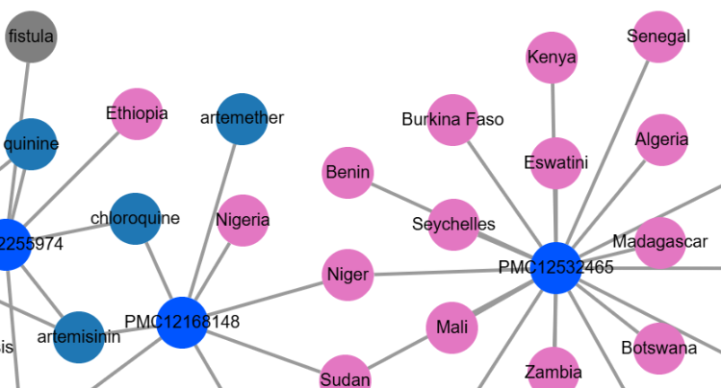

Learning by Doing!
AI for Literature Review
January 16, 2026
Renu Kumari
Program Manager: #semanticClimate

Slide 2
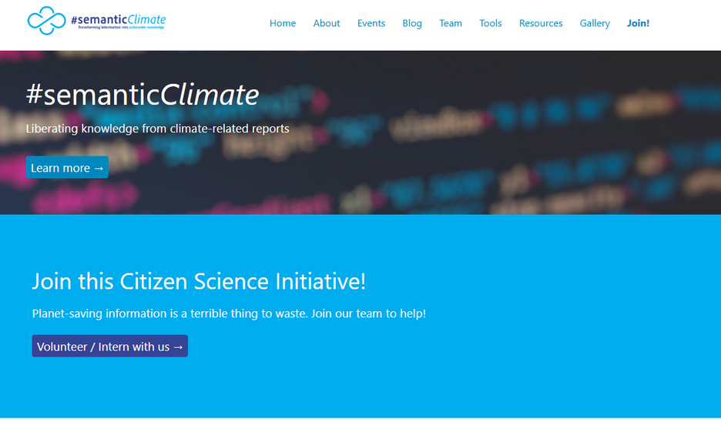

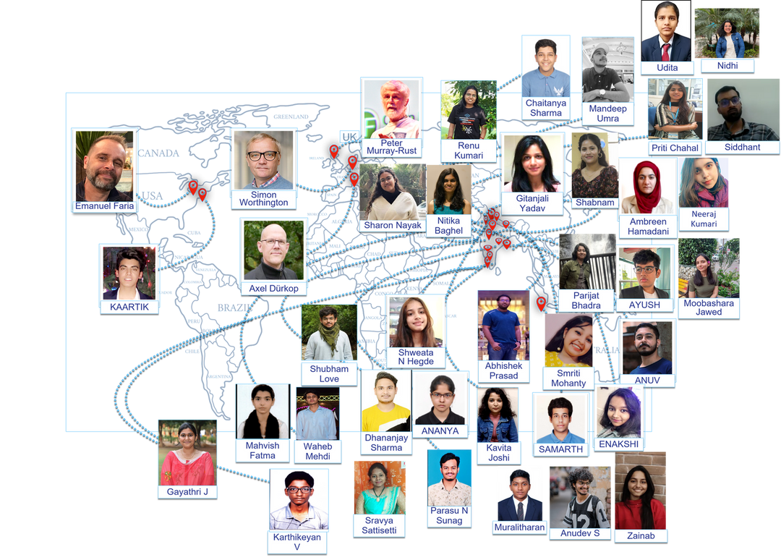
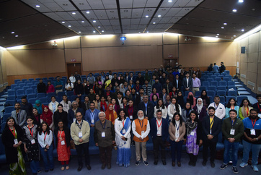
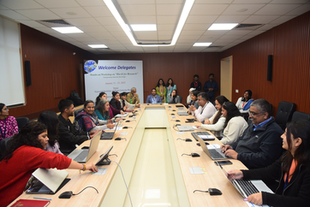
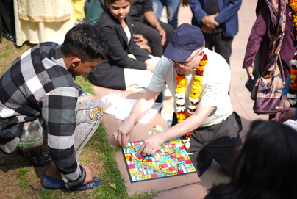
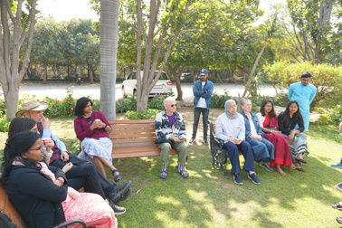
5 years old organization
We are the team of interns (Online and offline).
Work by creating, distributing and using software.
Youth Knowledge Champions
It's committed to making public knowledge available in a frictionless form for everybody.
https://semanticclimate.github.io/p/en/

Slide 3
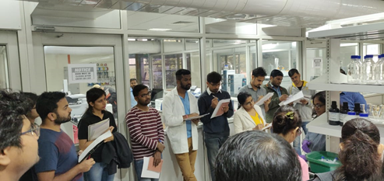

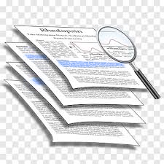
WHY WE NEED ALR?
Exponential growth of publications
Difficult to keep up with the latest developments
Literature exists in various formats: mainly PDFs
Not machine-readable or structured formats
Limited Access to the repositories and journals
No single platform for getting access to all research outputs
Bulk downloading is often restricted
Technical Barriers to automate article retrieval for people with no coding

Slide 4
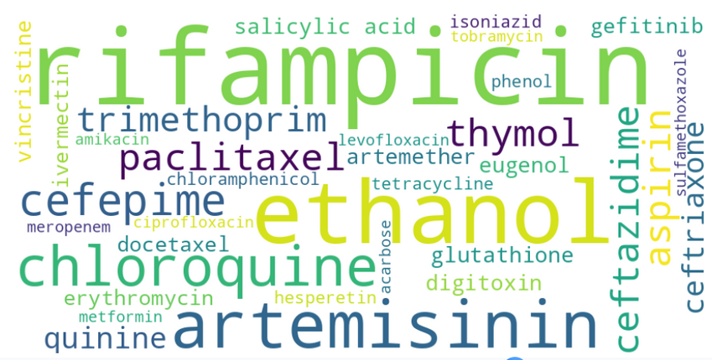
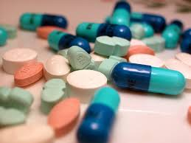



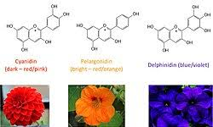
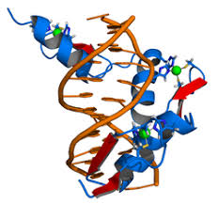
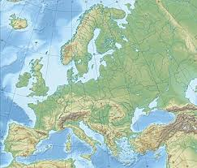
APPLICATIONS OF ALR : NAMED ENTITY RECOGNITION (NER)
Drugs
Species
Phytochemicals
Scholarly publications
Genes
Location

Slide 5

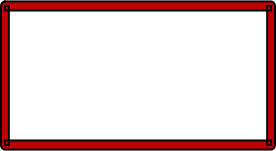
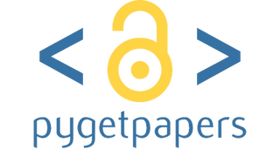







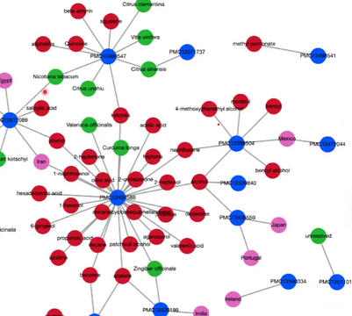

OVERVIEW OF THE PRESENTATION
Add query term
1
pygetpapers
Input
Introduction about corpus and their applications
pygetpapers
About the tool (pygetpapers, amilib, docanalysis)
Open access repository (ex: Europe PMC)
2
amilib
Creates datatables for the corpus
Workflow of the tool
Give papers in XML/HTML format
Output
download PDF files
docanalysis/NER
3
NER (Species, Drug, Diseases etc.)

Slide 6
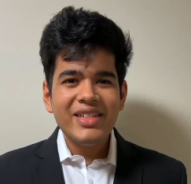
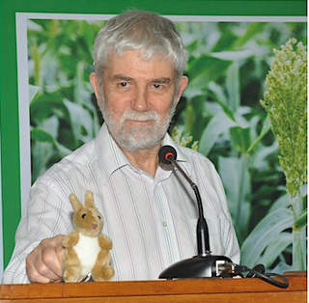
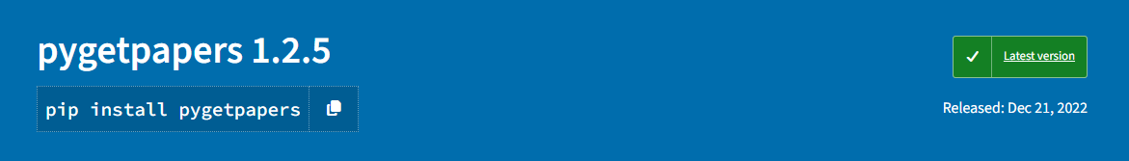
PYGETPAPERS : CORPUS BUILDER
developed by:
Automated Download of Research Papers from various scientific repositories
Ayush Garg and Peter Murray-Rust
GitHub repo: https://github.com/petermr/pygetpapers

Slide 7




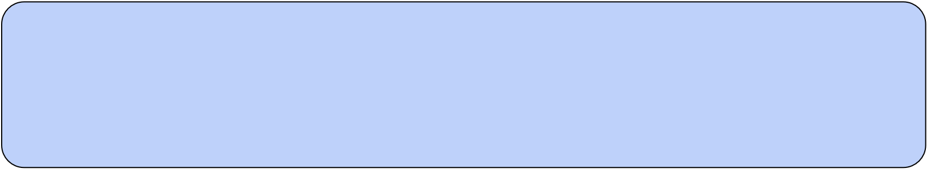

ADVANCED FEATURES : PYGETPAPERS
Advanced Features
Output Formats
1
Date Range Queries
Search papers published between dates
1
JSON Metadata
--startdate 2023-01-01 --enddate 2023-12-31
2
CSV Output
2
Term-based Queries
3
HTML Tables
terms.txt with comma-separated terms
4
Full text PDF
drug, natural products, deep learning

Slide 8
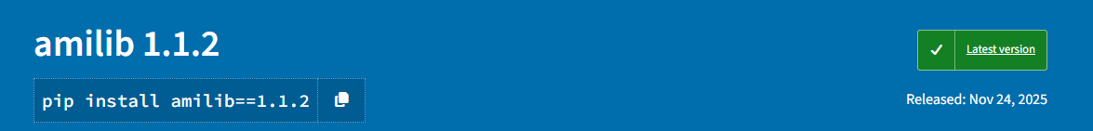
AMILIB
developed by:
Library to support downloading and analysis of documents, mainly from Open Access repositories, from published scholarly articles, or from authoritative sites such as UN IPCC or UNFCCC.
Peter Murray-Rust
Professor Emeritus, Cambridge University
and Co-Founder #semanticClimate
Used for semantic indexing of the corpus: Datatable
https://github.com/petermr/amilib

Slide 9
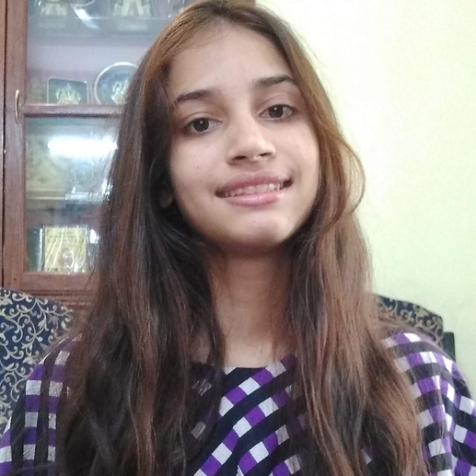
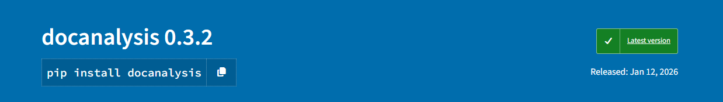
DOCANALYSIS
developed by:
docanalysis is a Command Line Tool that ingests corpora (CProjects) and carries out text-analysis of documents, including
sectioning
NLP/text-mining
dictionary generation
Shweata N Hegde and Peter Murray-Rust
Used for named entity recognition (NER)
https://github.com/petermr/docanalysis

Slide 10
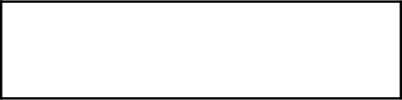
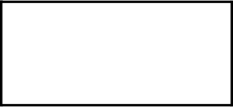
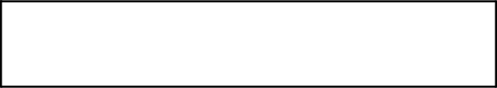
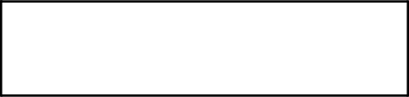
QUERYING PYGETPAPERS IN COLAB NOTEBOOK
Search query
XML
Number of papers
!pygetpapers --query '"drug discovery" AND "medicinal plants"' --xml --limit 50 --startdate "2010-01-01" --enddate "2025-10-31" --output drug_discovery --save_query
timeframe
Output folder

Slide 11
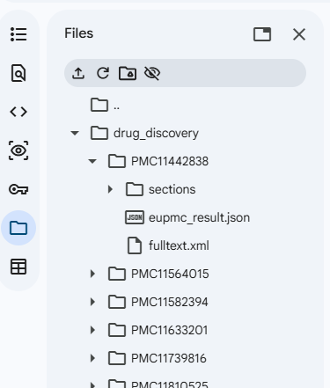
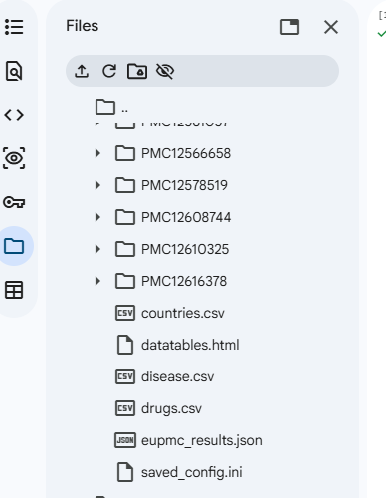




RESULTS : SEMANTIC CORPUS FOR THE QUERY
Query:
"drug discovery" AND "medicinal plants"
Output :
drug_discovery
Summary table
(Semantic Index)

Slide 12
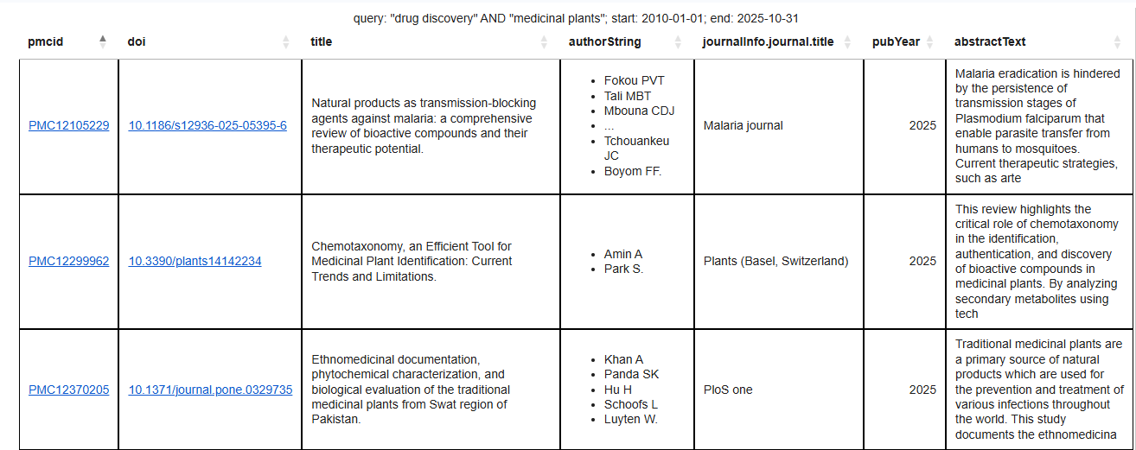
SEMANTIC INDEX OF THE CORPUS
PMCID (for Europe PMC)
DOI,
Title,
Authors,
Journal name etc...............
Datatable

Slide 13
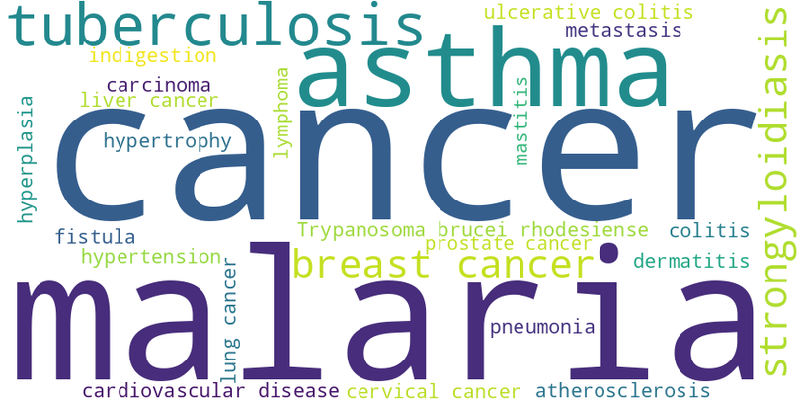
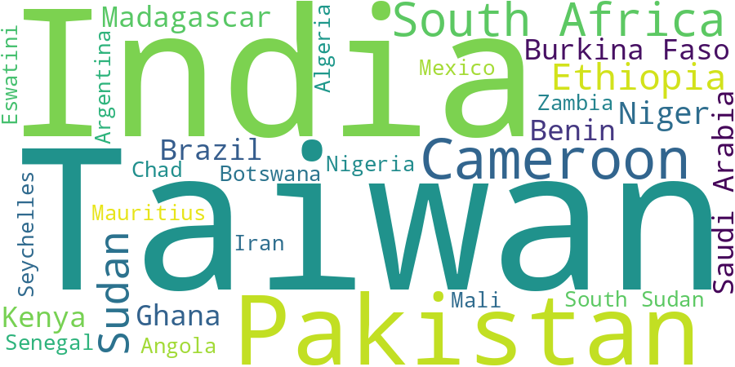
EXTRACTED ENTITIES FROM THE LITERATURE
Drugs
Diseases
Location

Slide 14


Platform to run the tool
Google Colab Notebook

Slide 15

IMPORTANCE OF GOOGLE COLAB NOTEBOOK
Open Jupyter E-Notebook environment
No pain with setups, versions
Human Machine friendly
Supports interactive programming
Easy learn and explore new tools
Notes:
1.7.2013
1.7.2013
14
‹#›
‹#›

Slide 16


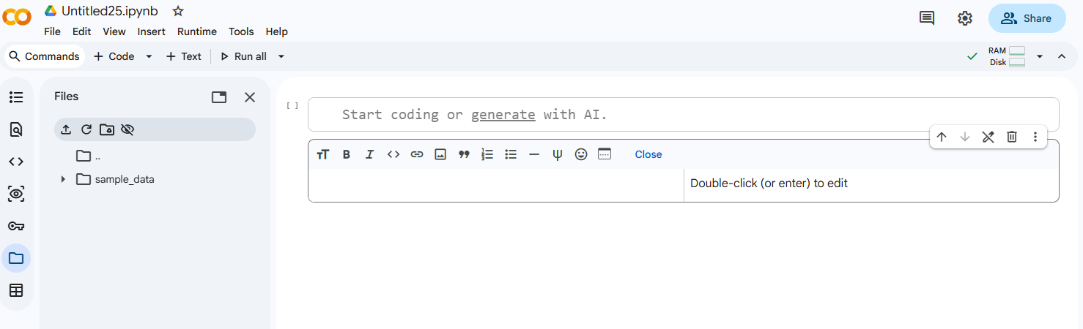


GOOGLE COLAB (COLLABORATORY)
free, cloud-based platform to write and execute python-based codes
share the notebook
Upload files/folders
Title of the colab notebook
Click here to run code
Code Cell: for writing code
Files: content folder for the output and all files of the
colab notebook
Text Cell: for adding documentation
Need Google account to get started!

Slide 17

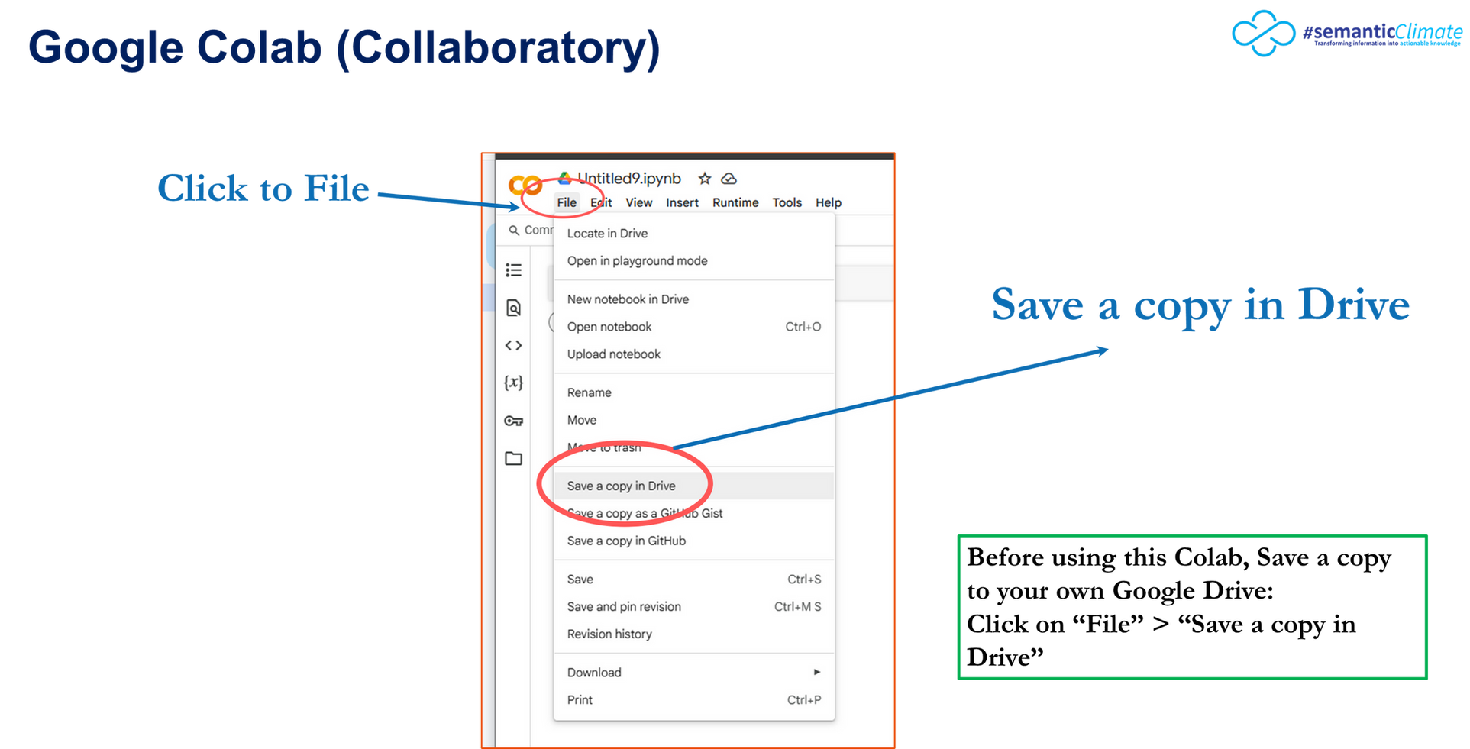
GOOGLE COLAB (COLLABORATORY)
Notes:
1.7.2013
1.7.2013
‹#›
‹#›

Slide 18
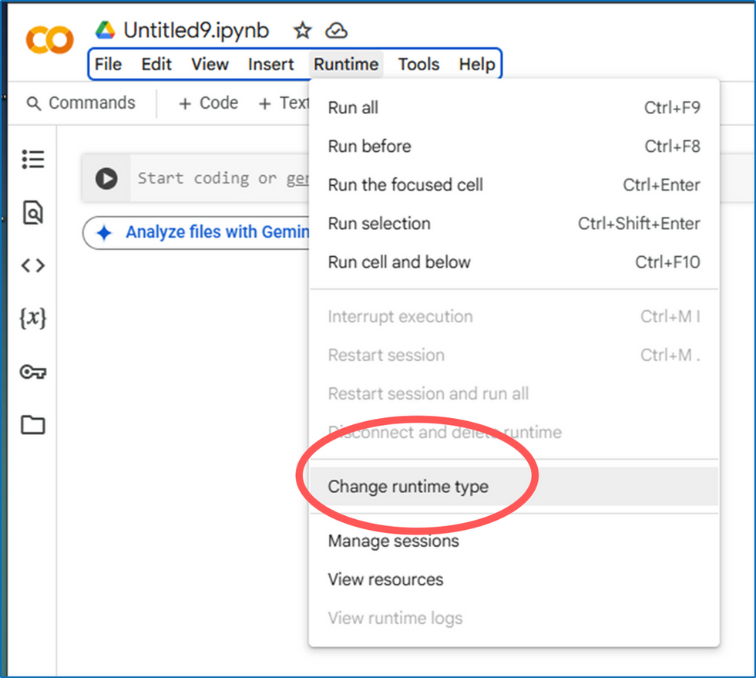
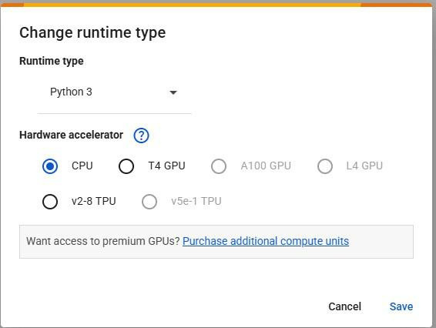

CHANGE RUNTIME FOR MORE MEMORY REQUIREMENT
T4 GPU
Notes:
1.7.2013
1.7.2013
‹#›
‹#›

Slide 19
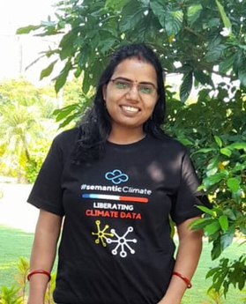
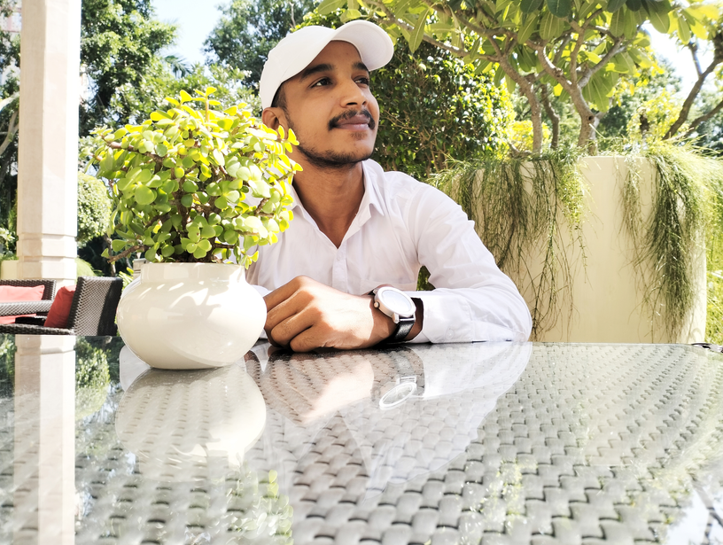
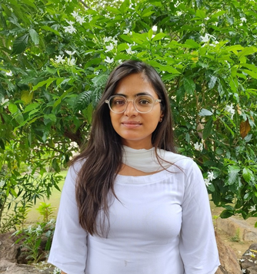
Hands-on Session
Instructors
Dr. Renu Kumari (Program Manager, semanticClimate)
Mr. Mandeep
(Ph.D. Student, NIPGR)
Ms. Priti
(Ph.D. Student, NIPGR)
Link to Colab Notebook
https://colab.research.google.com/drive/1acnaYZ-aAhNYiRDK0pGfMCLCpvNPjoAb?usp=sharing

Slide 20

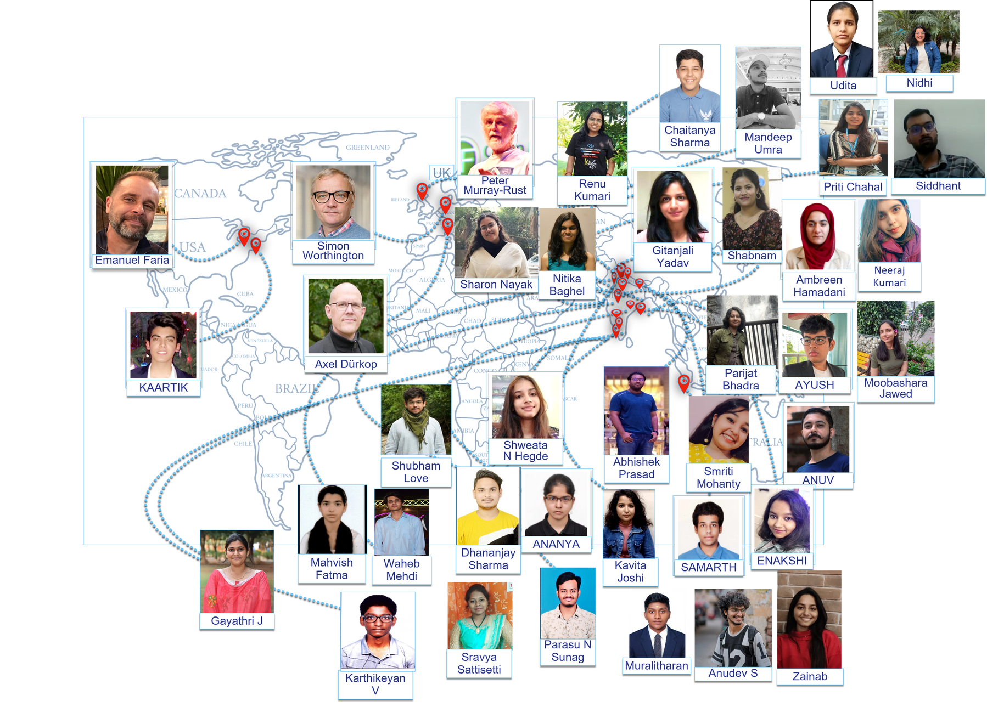

“From Papers to Knowledge Graphs”
—THANK YOU FOR LEARNING WITH US!
Team
BIOINFORMATICS INFRASTRUCTURE FACILITY (BIF-DBT SPONSORED)
E-mail
semanticclimate@gmail.com
Website
https://semanticclimate.github.io/p/en/
GitHub
https://github.com/semanticClimate
X (Formerly Twitter)
#semanticClimate

