Slide 1






An AI chatbot based on UN IPCC reports and Europe PMC research papers.

Slide 2

D A T A S O U R C E S
IPCC AR6 SYR Longer Report
Grounded in IPCC AR6 report. Authoritative facts on global climate trends.
Europe PubMed Central Reports on Ocean heatwaves
12 papers open-access semantic corpus

Slide 3
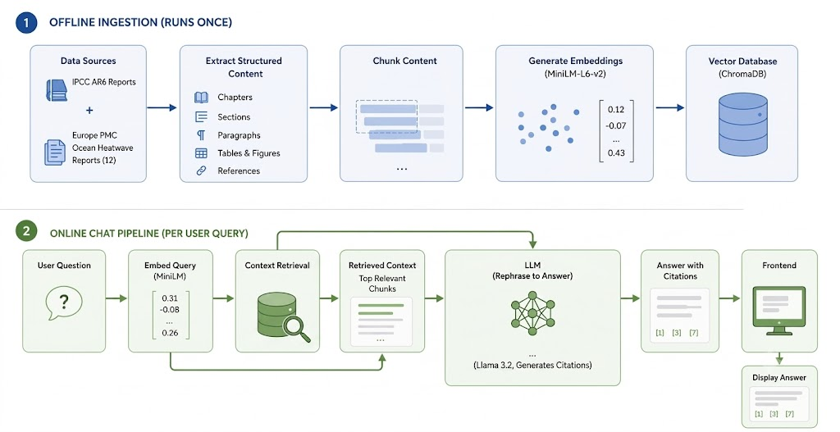
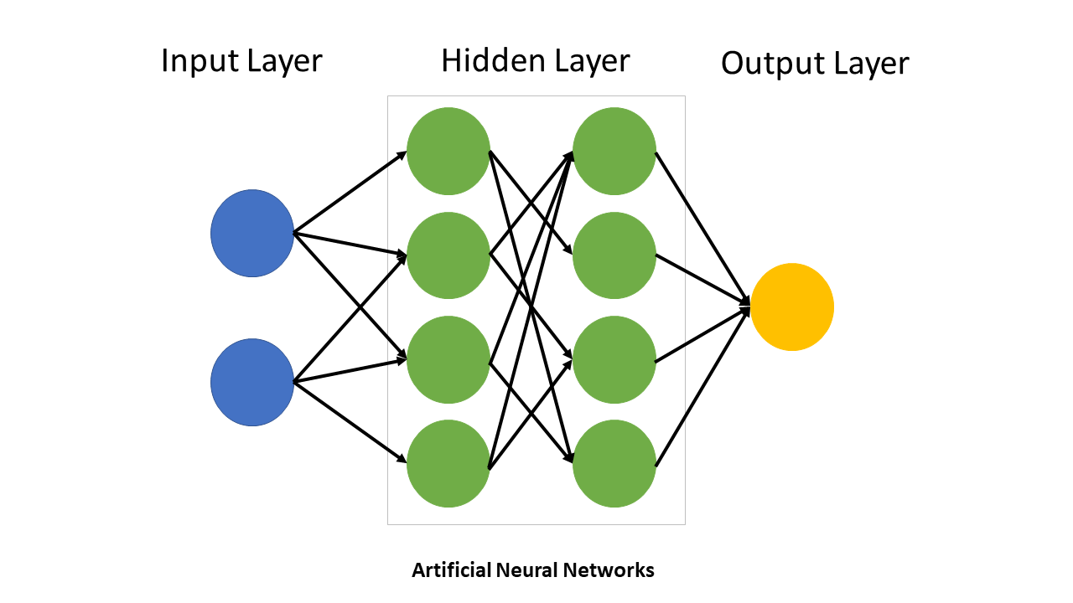
C H A T B O T B A C K E N D

Slide 4


P R O T O T Y P E C H A T B O T S
Code and Documentation on semanticClimate GitHub
(Note: These Chatbots are under active development. We're looking for collaborators, testers, and contributors. Join semanticClimate if you'd like to participate!)
ClimateInsight Chatbot
Based On
IPCC AR6 Report and
Europe PMC Papers
Climate Academy Chatbot (CABot)
Based On
Climate Academy Book

Slide 5
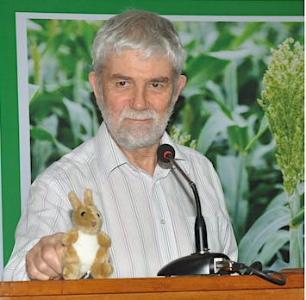
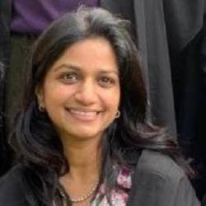


T H A N K S T O
NIPGR
Open Knowledge Foundation
Climate Academy
SPECIAL THANKS TO
Dr. Peter Murray-Rust
Dr. Gitanjali Yadav
Dr. Renu Kumari
Ms. Udita Agarwal
Alpha Testers:
Ms. Akalya S. · Ms. Ilakkya S. · Ms. Shreya S. Bhat · Ms. Subhangi Panigrahi · Ms. Vrinda Sharma

