Slide 1
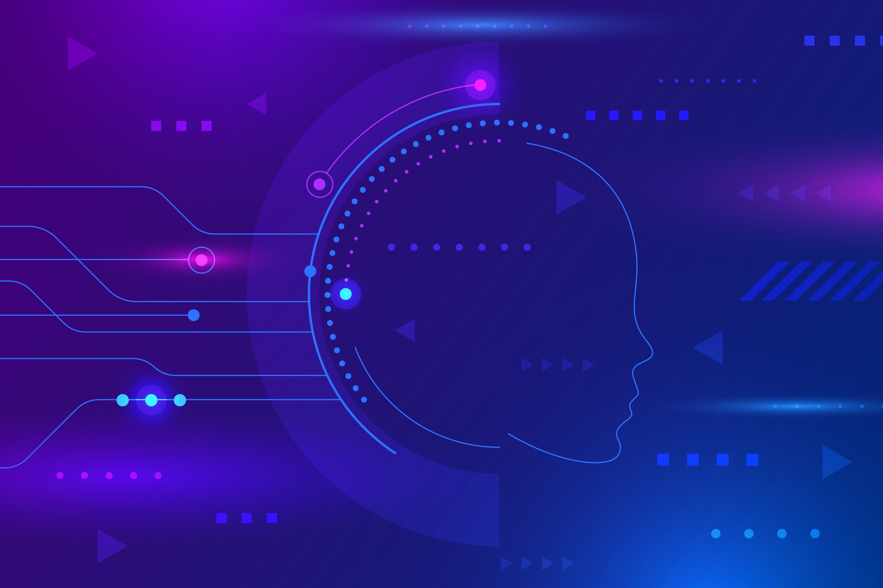



Query Search with RAG/LLM
Presenter: Shabnam Barbhuiya

Slide 2
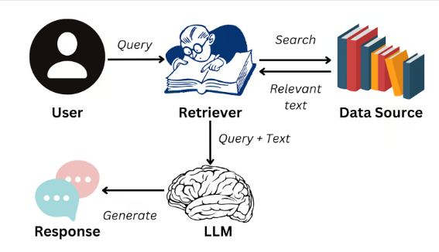
From Summarization to Smart Querying with RAG
RAG combines a retriever (to fetch relevant text) with a generator (to answer questions or summarize) for better contextual understanding.
RAG (Retrieval-Augmented Generation) allows users to:
Ask questions in natural language
Retrieve relevant chunks from downloaded PDFs
How it works?
User asks a question
RAG retrieves relevant text chunks from the papers
The generator model forms a natural, concise answer

Slide 3
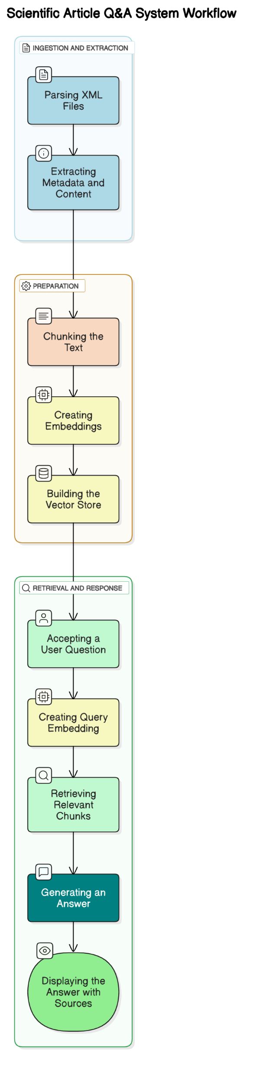
Query Search / RAG Workflow
The query pipeline uses vector search and large language models to return semantic, source-based answers to research questions.
Library Used:
Sentence-BERT – Converts text and queries into semantic vectors
FAISS – Fast Approximate Nearest Neighbor Search
Markdown Conversion – XML → Markdown before embedding
LLaMA 3 via Groq – Generates the final answer
LangChain – Orchestrates the end-to-end workflow

Slide 4
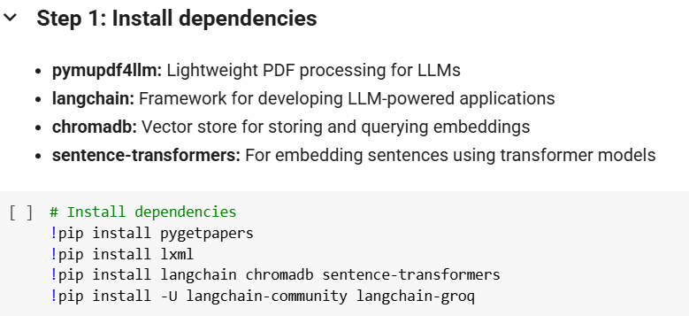
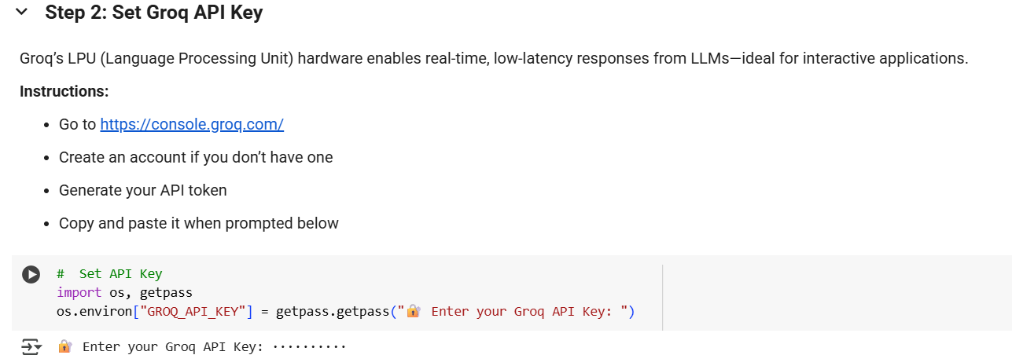
Query Search Colab Overview(DIY)

Slide 5
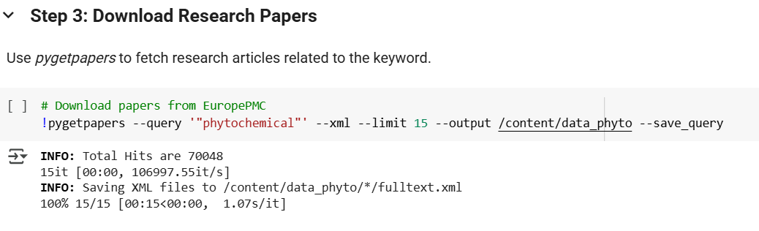
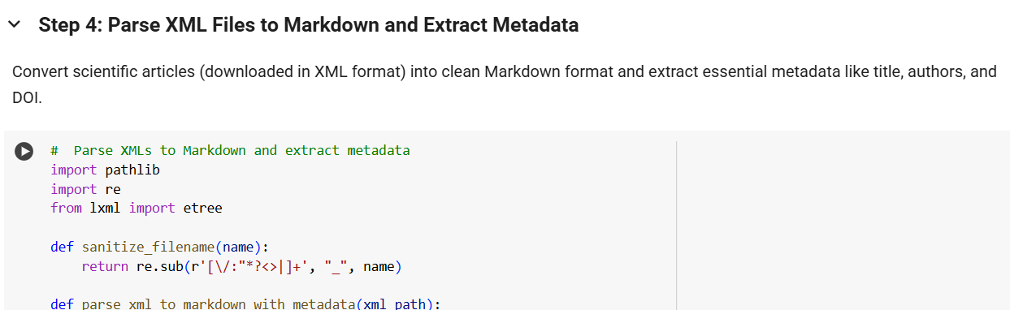
Query Search Colab Overview(DIY)

Slide 6
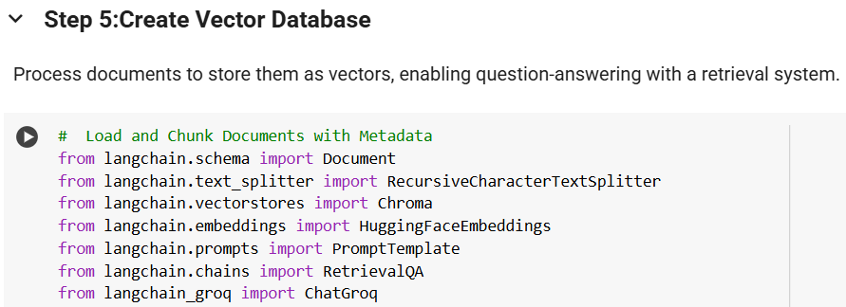
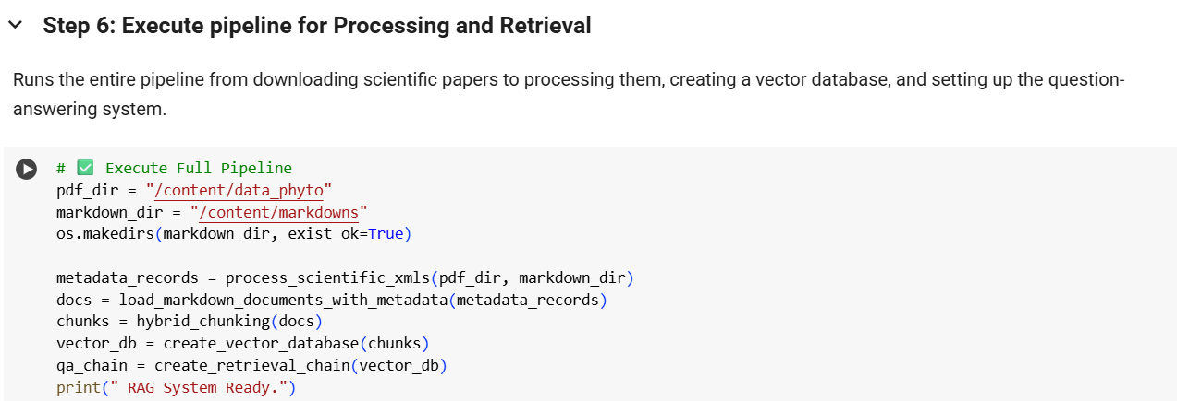
Query Search Colab Overview(DIY)
USER QUERY

Slide 7
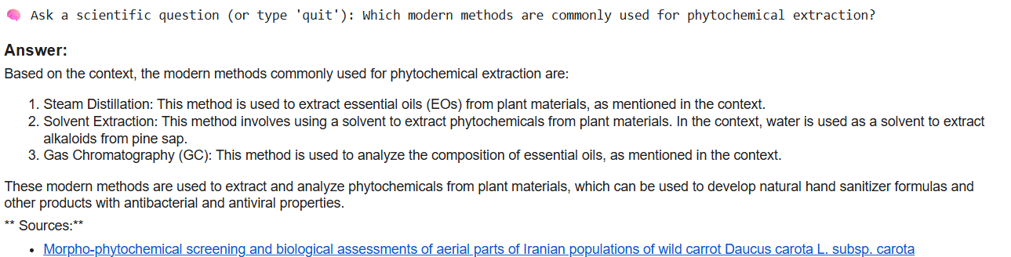
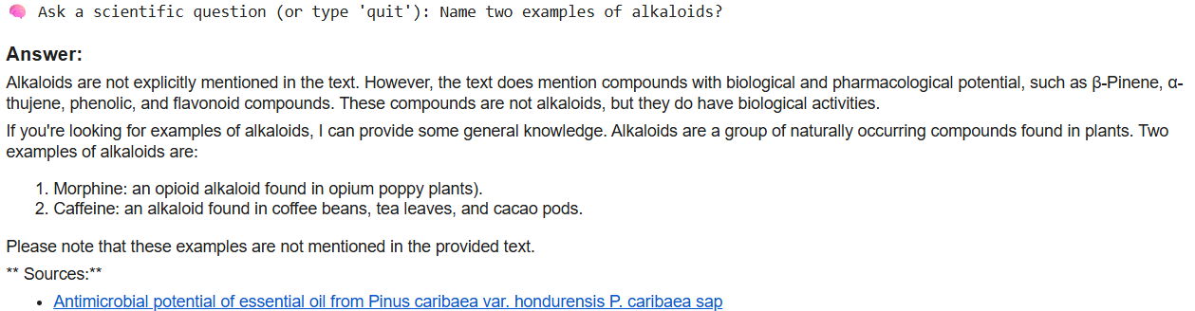
Query Search: Output

