Slide 1


FSCI 2025
Corpus creation: Open Access repository retrieval and analysis
22 July, 2025
Presented by: Dr. Renu Kumari
Project Scientist, NIPGR
Program manager, #semanticClimate

Slide 2
Contents of the presentation
Introduction
- Scientific literature corpus
- pygetpapers
Colab notebook
DIY (Hands-on)
- pygetpapers

Slide 3
What is Scientific Literature corpus?

Slide 4
It is a structured collection of scholarly articles and research papers that can be used for further analysis.

Slide 5
Why there is a need of Scientific Literature corpus?

Slide 6
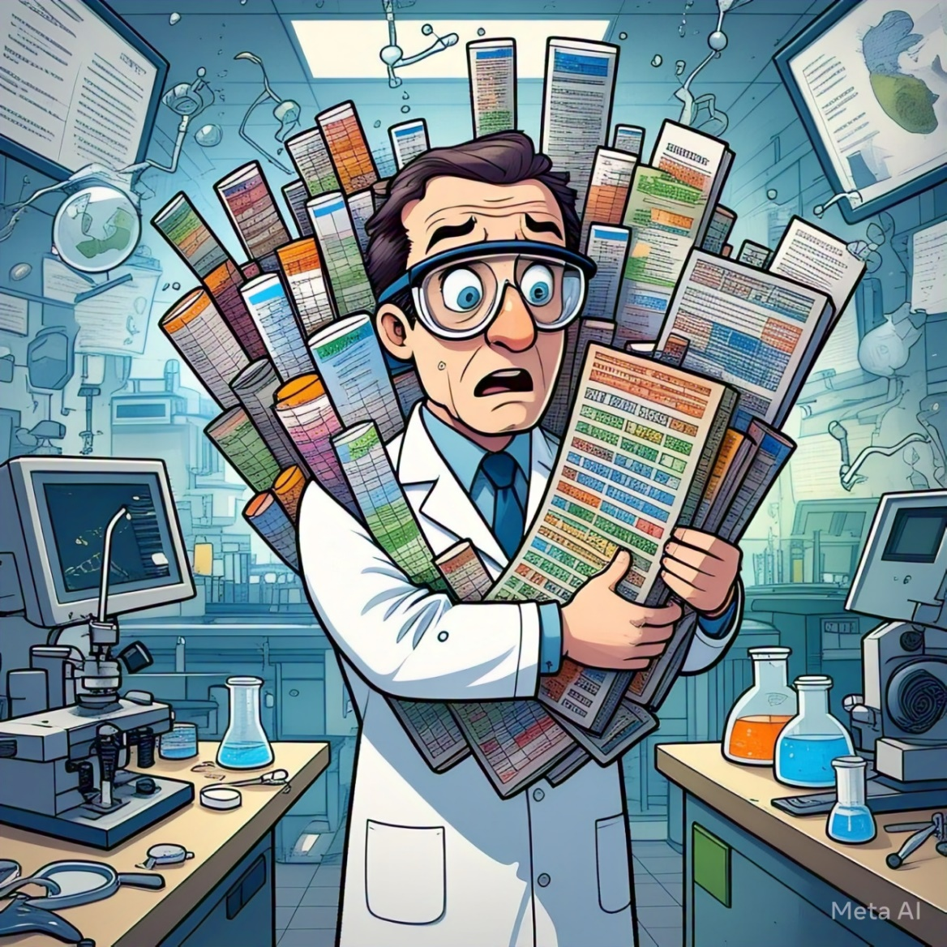
Challenges with Scientific literatures and analysis
Exponential growth of publications
Difficult to keep up with the latest developments
Literature exists in various formats: mainly PDFs
Not machine-readable or structured formats
Limited Access to the repositories and journals
No single platform for getting access to all research outputs
Bulk downloading is often restricted
Technical Barriers to automate article retrieval for people with no coding

Slide 7
Applications of Scientific Literature corpus?

Slide 8
To train Natural Language Processing (NLP) models for the following:
Named Entity Recognition (NER)
Automated summarization
Facilitate literature reviews:
identifying gaps
formulating hypotheses

Slide 9
So, we need a tool which can create curated corpus in a machine readable format………………..

Slide 10

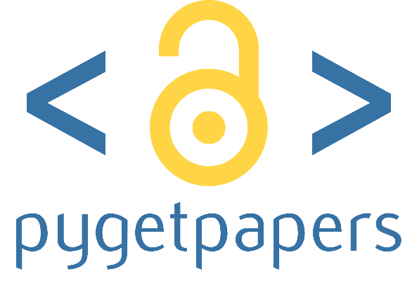
#semanticClimate tool used to create corpus
pygetpapers
pygetpapers is a tool to assist text miners.
Developed by: Ayush Garg and Peter Murray-Rust
GitHub repo: https://github.com/petermr/pygetpapers

Slide 11
Workflow
Add query term
Input
pygetpapers
Creates datatables for the corpus
download PDF files
Give papers in XML/HTML format
Output

Slide 12


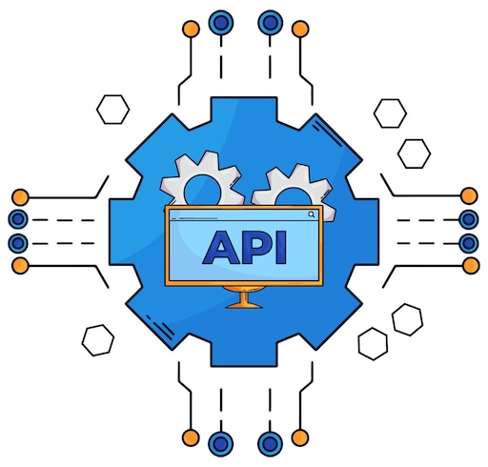




Query Builder and API support
Europe PMC
OpenAlex
Create Query:
Search within a date range
Query with terms in text file
Compound Queries (AND, OR, NOT)
Crossref
bioRxiv
arXiv
medRxiv
Different API

Slide 13
Platform to run the tool
Google Colab Notebook

Slide 14

Importance of Google Colab Notebook
Open Jupyter E-Notebook environment
No pain with setups, versions
Human Machine friendly
Supports interactive programming
Easy learn and explore new tools

Slide 15
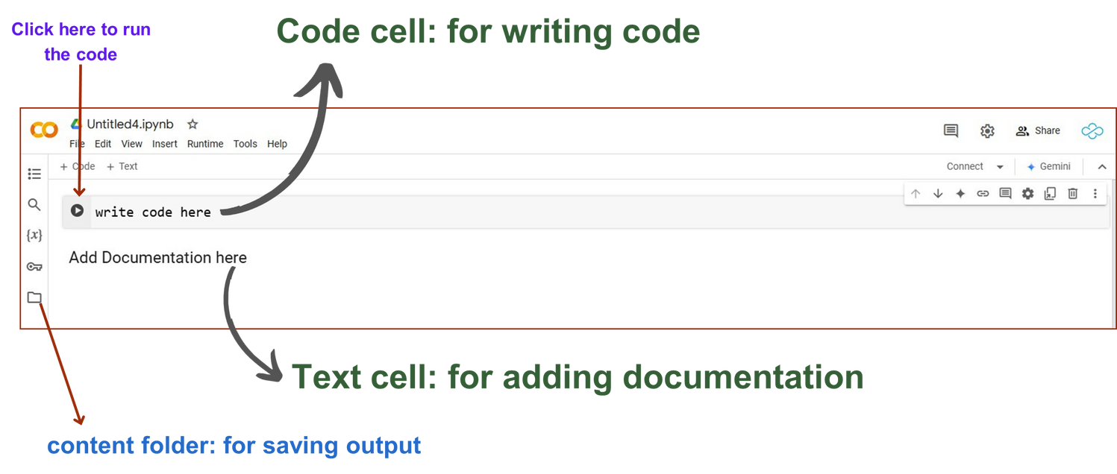

Google Colab (Collaboratory)
free, cloud-based platform to write and execute python-based codes
share the notebook
Need Google account to get started!

Slide 16
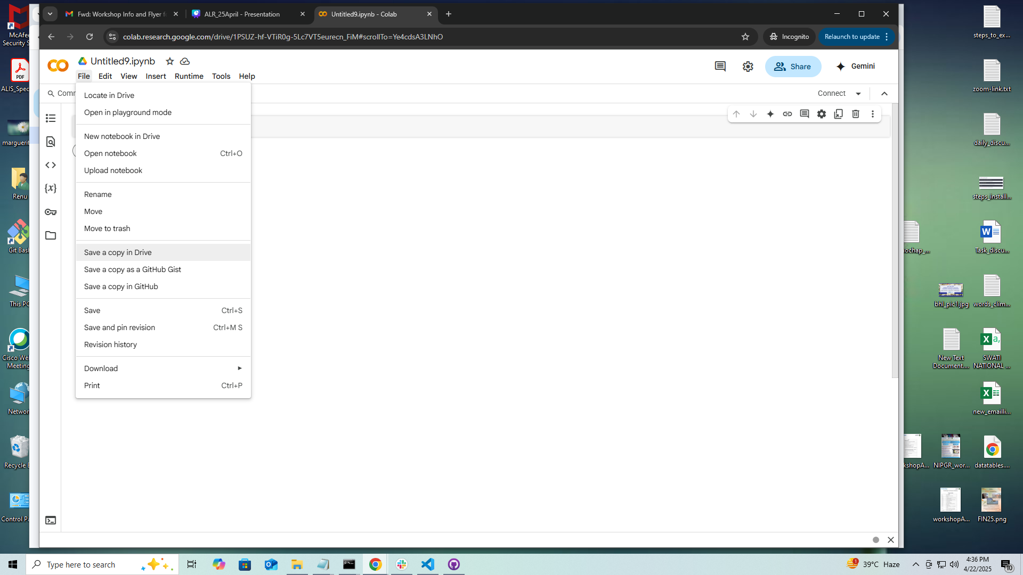

Google Colab (Collaboratory)
Click to File
Save a copy in Drive
Before using this Colab, Save a copy to your own Google Drive:
Click on “File” > “Save a copy in Drive”

Slide 17
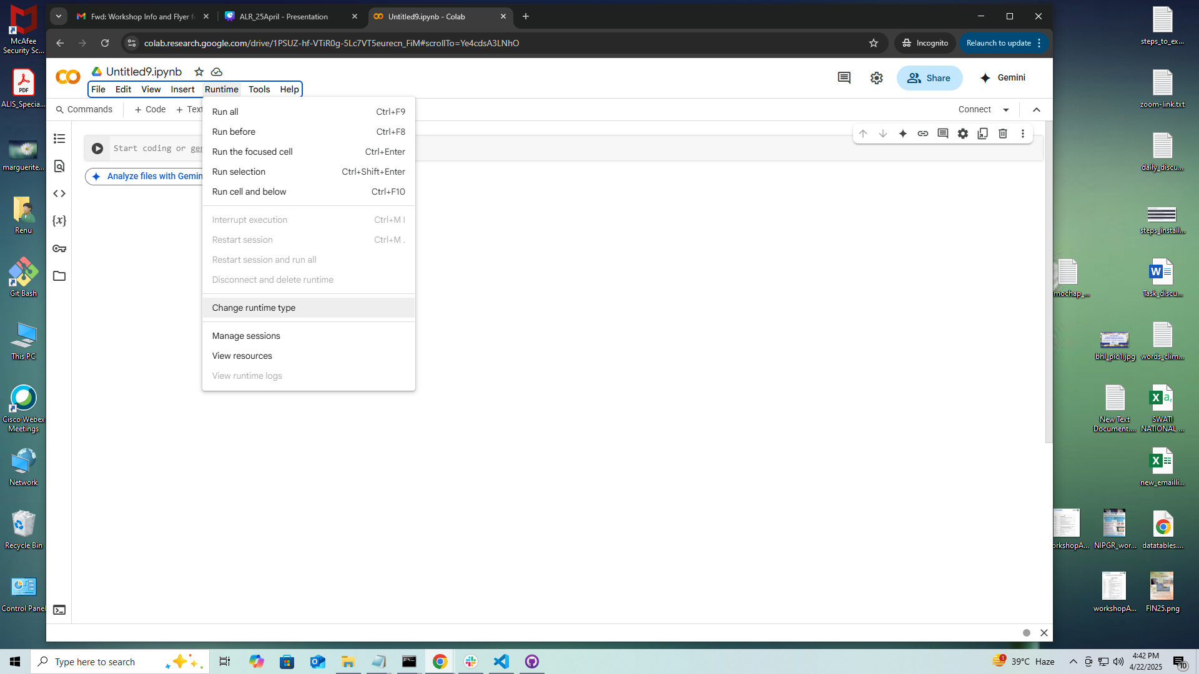
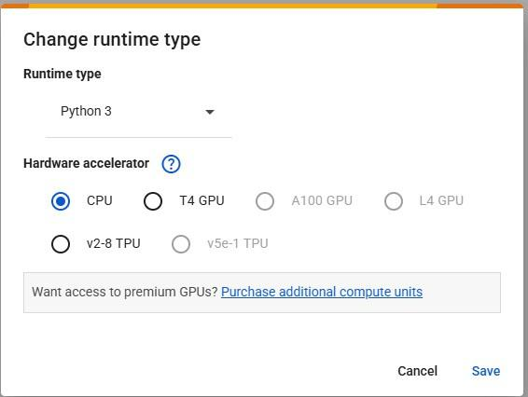
Change Runtime
T4 GPU

Slide 18
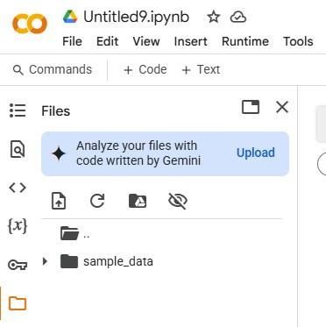


Input and Output files
Upload the files
For all the results and input files

Slide 19
Using pygetpapers in colab notebook

Slide 20
Querying pygetpapers
Search query
Output folder
Summary table
pygetpapers -q "Ocean heat" -k 20 -o Ocean_Heat2 -x --datatables
Number of papers
XML
Link to colab notenook
https://colab.research.google.com/drive/1stqd9YxRda2SmSR-r40LBAGhabJi0vkq?usp=sharing

Slide 21
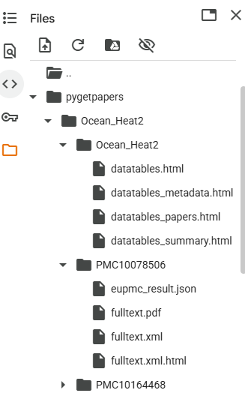
Output:

Slide 22
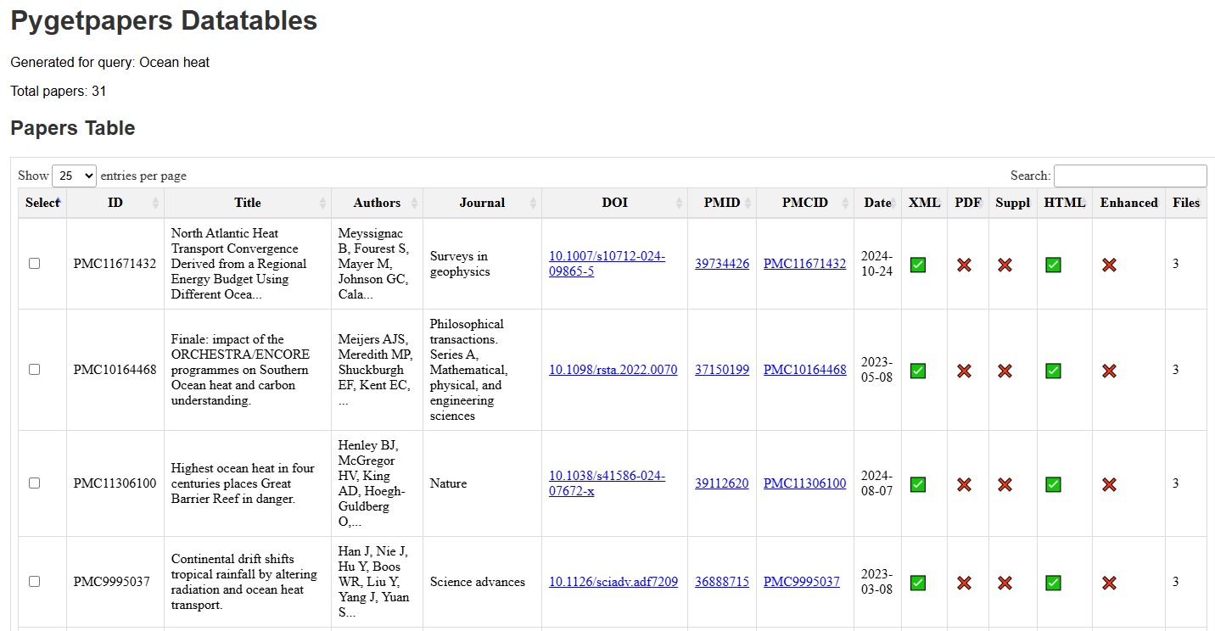
Datatables
Link to the output:
https://github.com/semanticClimate/ai-automated-literature-review/tree/main/Output_pygetpapers

Slide 23
DEMO SESSION
How to use pygetpapers?

Slide 24

Link to colab notebook
https://colab.research.google.com/drive/1stqd9YxRda2SmSR-r40LBAGhabJi0vkq?usp=sharing
QR for colab notebook

Slide 25
THANK YOU

