Slide 1

#semanticClimate
Project Overview

Slide 2
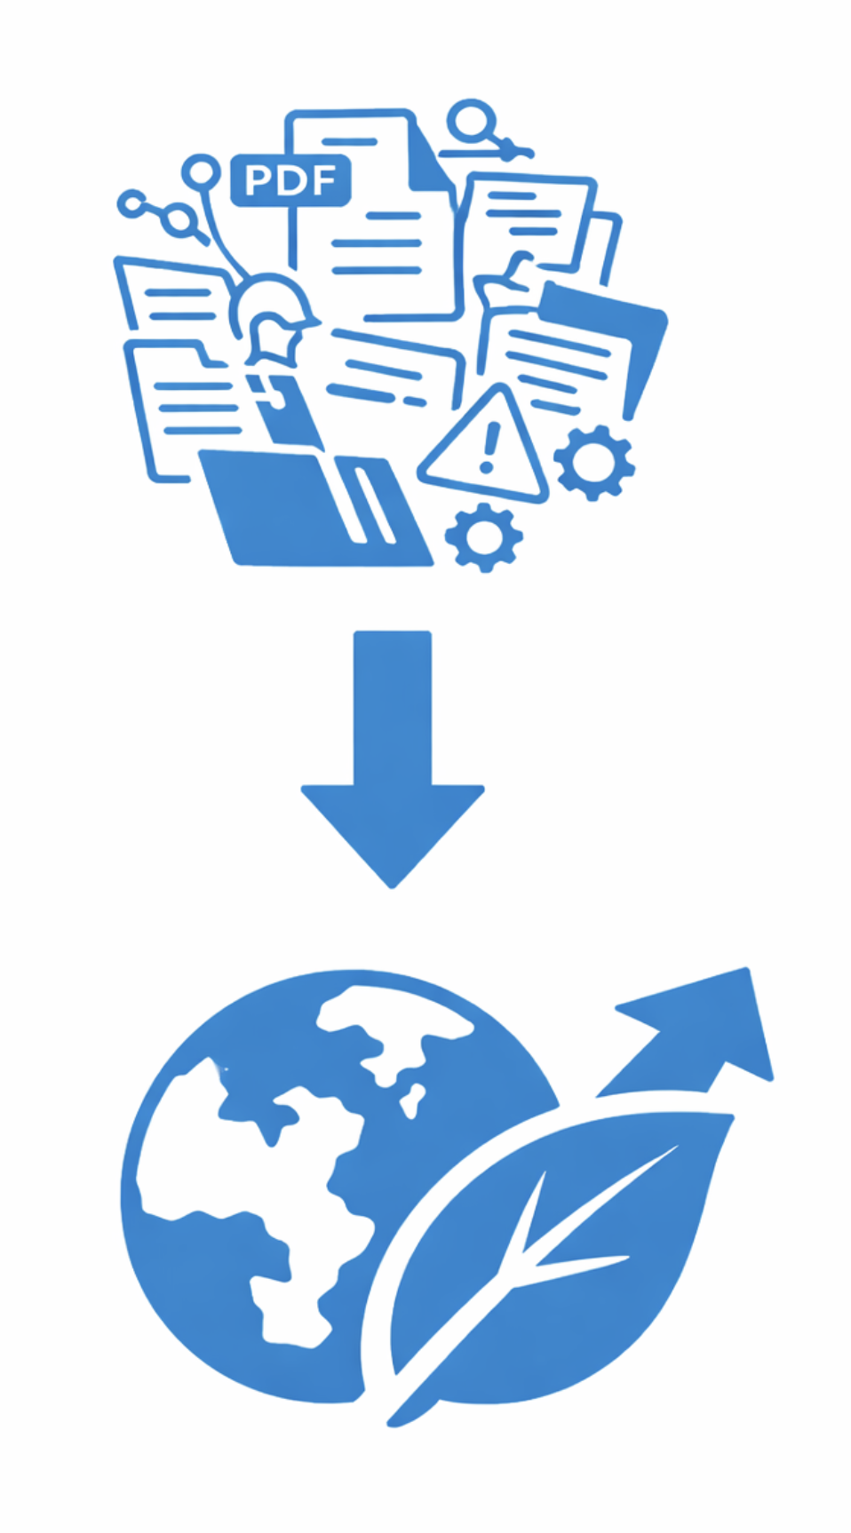
From Data Deluge to Climate Action
The Problem
Massive data deluge makes information overwhelming and often useless
Data management challenges faced by students, researchers, scientists, and open-source developers
Most research exists in unstructured formats such as PDFs
PDFs are not inherently machine readable
Critical global climate data remains inaccessible and difficult to navigate
Young people especially lack structured access to climate knowledge

Slide 3
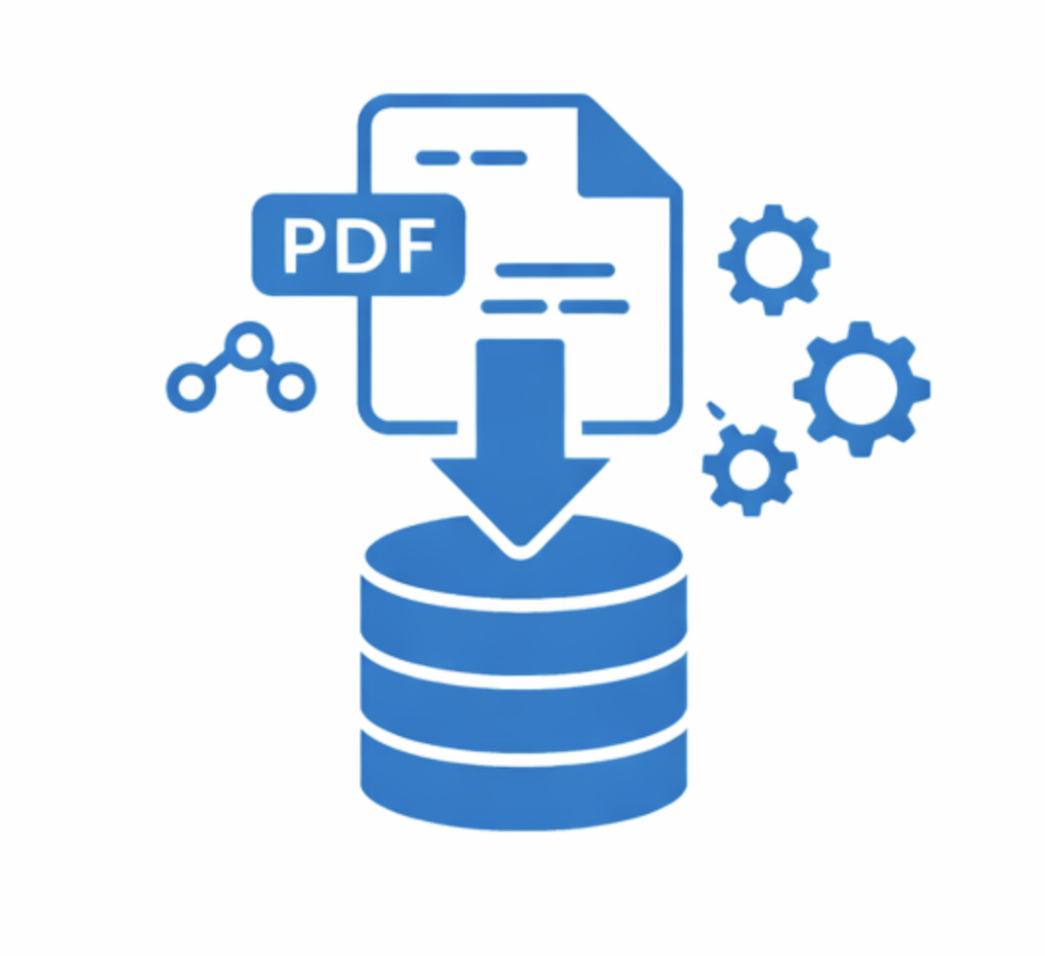
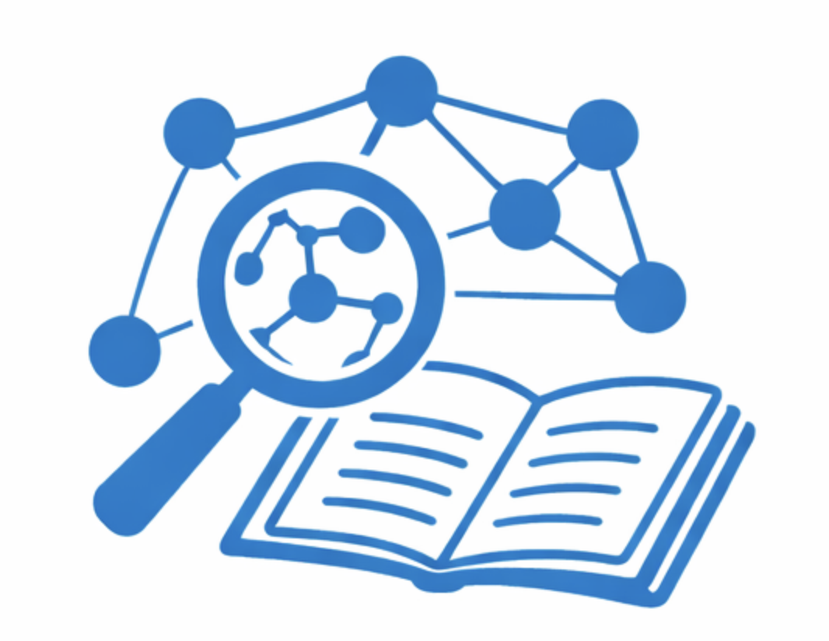
Why It Matters
Climate information must be accessible and understandable
Structured knowledge empowers informed decision making
Educated youth can become “Youth Knowledge Champions”
Climate action requires knowledge that reaches every citizen

Slide 4
The #semanticClimate Vision
#semanticClimate focuses on semantifying climate data and resources to make climate knowledge open, machine readable, and actionable.
Our goal is to help scientists, policymakers, and communities respond more effectively to climate change.
More importantly, we aim to create Youth Knowledge Champions who can carry climate action forward globally.

Slide 5

Powered by Interns from Diverse Backgrounds
A fully online team driven by rotating intern cohorts every 2 to 6 months
Interns join from different academic, technical, and disciplinary backgrounds
Some start with no Python experience, others bring strong technical expertise
A collaborative, communal learning culture where members actively support one another
Regular Zoom sessions, Slack coordination, and daily GitHub commits
Work openly under the ONS philosophy: commit immediately, no insider knowledge
What Drives Us
Make climate knowledge accessible to as many people as possible
Demonstrate how the semantic approach works in practice

Slide 6
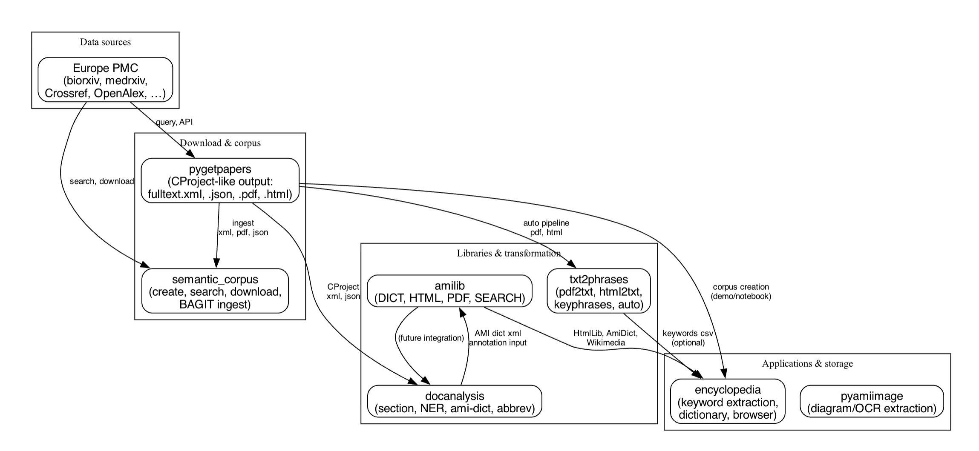
Project Workflow

Slide 7

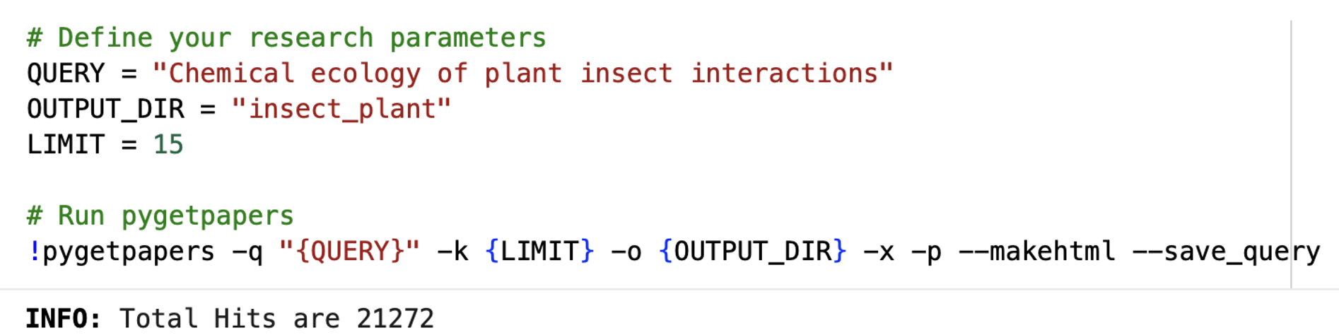
pygetpapers
Managed by: Vaishnavi Sharma
pygetpapers is a Python based literature mining tool for automated search and download of research papers. In our workflow, it serves as the entry point for retrieving structured research data from multiple open access sources.
How our team utilizes pygetpapers:
Querying APIs such as Europe PMC and related repositories
Automating large scale literature search and download
Creating structured CProject outputs including XML, JSON, PDF, and HTML
Feeding downloaded documents into the semantic corpus layer

Slide 8

semantic_corpus
Managed by: Gulam Ajdhani & team
Semantic corpus is a structured document management layer that organizes research content into searchable and analyzable collections. In our workflow, it prepares ingested documents for systematic semantic processing.
How our team utilizes semantic_corpus:
Ingesting XML, PDF, and JSON outputs from pygetpapers
Creating and managing searchable corpora
Structuring documents for downstream transformation
Enabling consistent corpus level operations and version control

Slide 9

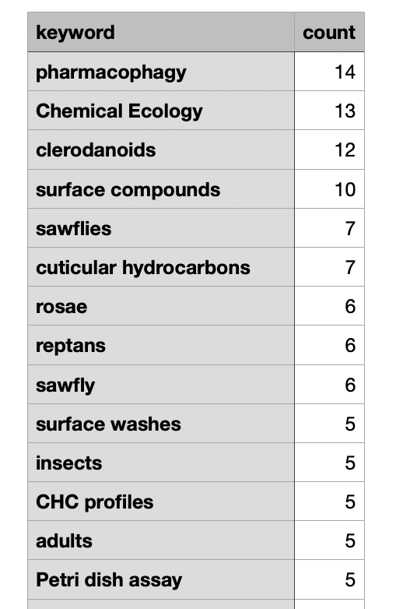
txt2phrases
Managed by: Sakshi Gupta
txt2phrases is a text processing tool that extracts meaningful key phrases and terms from research papers. In our workflow, it converts raw textual content into structured keyword level outputs.
How our team utilizes it:
Processing PDF and HTML documents automatically
Extracting keywords and domain specific phrases
Generating structured phrase outputs for further analysis
Supports keyword CSV exports
Providing structured inputs & term frequencies for encyclopedia building

Slide 10

encyclopedia
Managed by: Taiba Shamim & team
The Encyclopedia Project is a comprehensive toolset for extracting and analyzing keywords from scientific documents, with a focus on climate change research and IPCC reports.
Subprojects within the Encyclopedia Project:
Keyword_extraction - AI-powered keyword extraction from text documents
Dictionary - Structured storage and analysis of extracted keywords and document content
Encyclopedia Browser - Web-based browser for searching and exploring encyclopedia entries. Supports up to 5,000 entries with advanced search capabilities

Slide 11
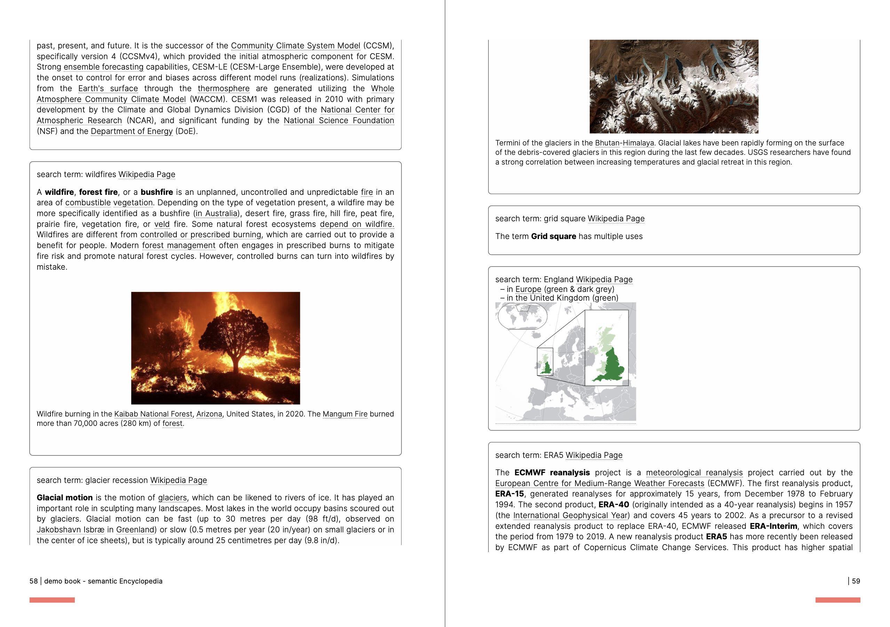
Encyclopedia Example

Slide 12


Knowledge Graph
Managed by: Vipparla Pushpa valli, and Saniya
A structured network of interconnected concepts. In our workflow, the keywords curated in the encyclopedia become nodes, which are connected based on semantic relationships derived from Wikipedia pages.
How our team utilizes it:
Identifying relationships between concepts using Wikipedia context
Creating edges based on semantic and topical connections
Structuring interconnected knowledge instead of isolated terms
Enabling visual exploration and discovery of concept clusters
Supporting deeper insight into how research themes relate to one another

Slide 13
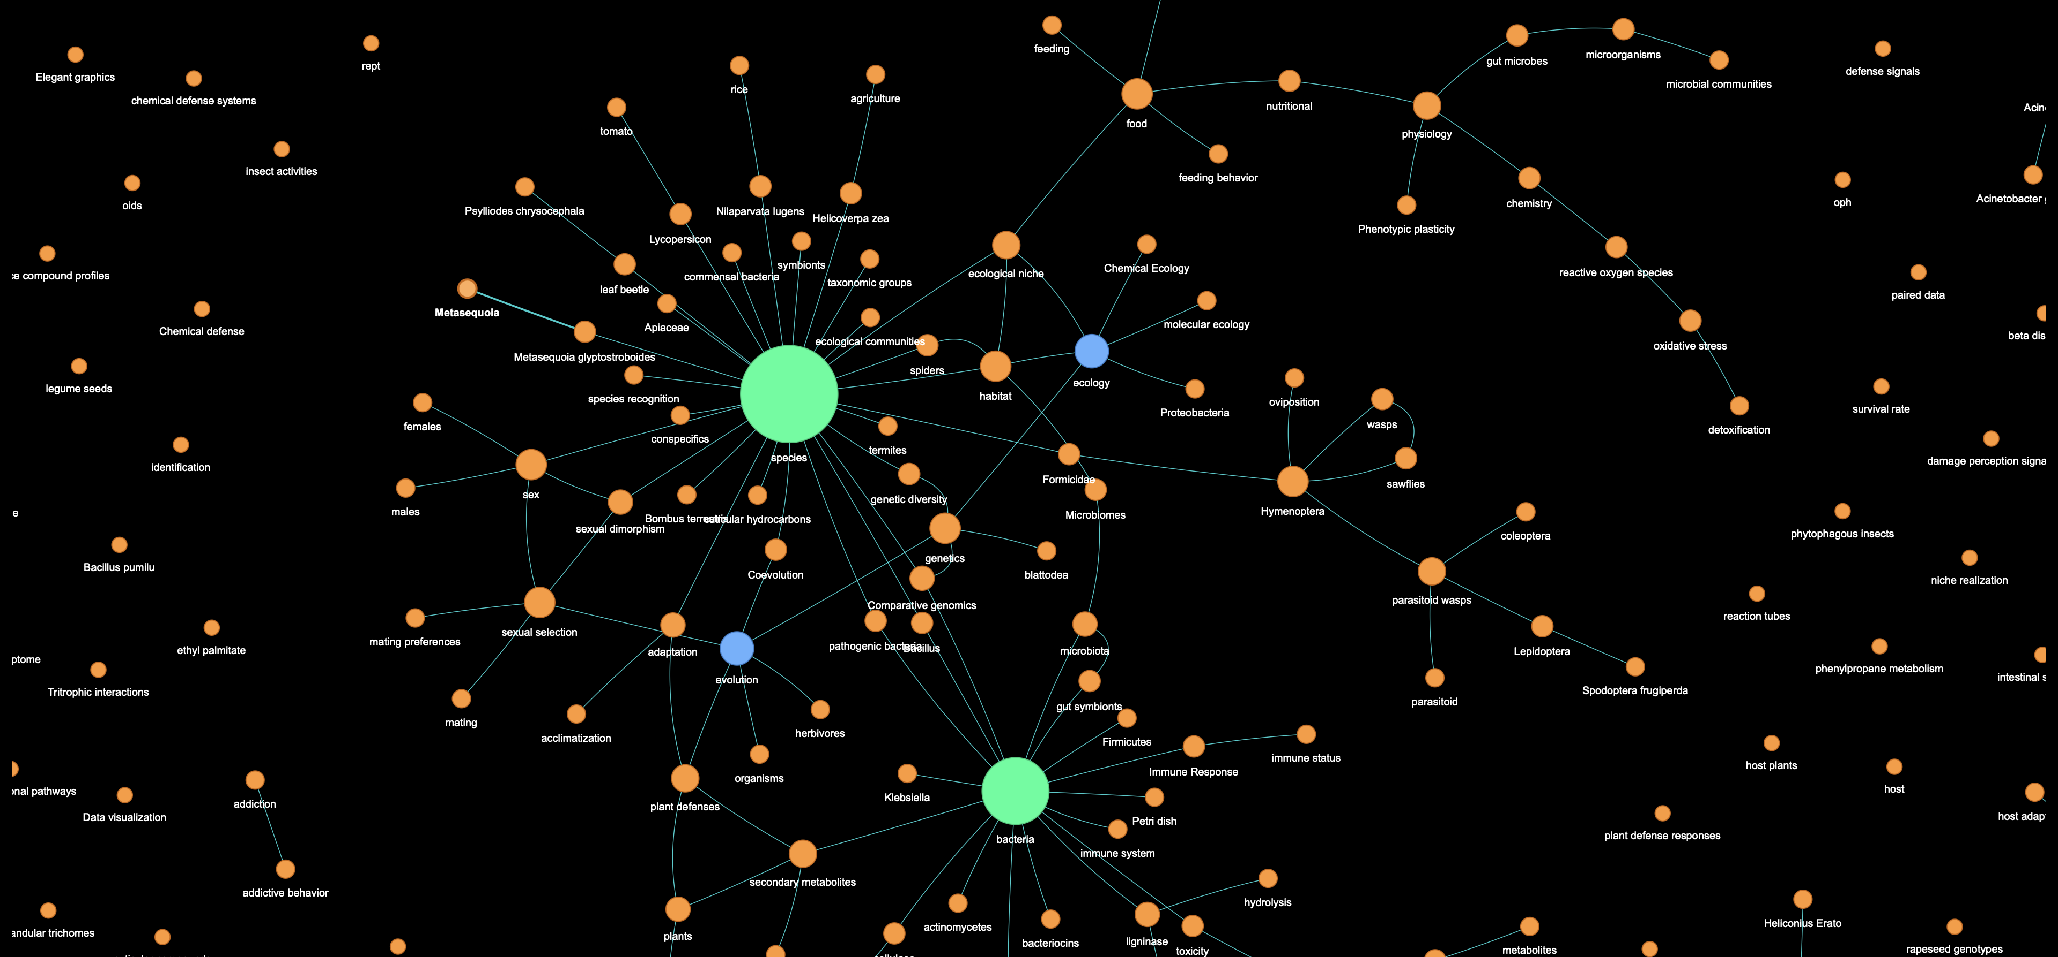
In our graph, each keyword acts as a node, and links are formed when concepts share contextual or relational overlap through their associated Wikipedia content, resulting in a structured and navigable semantic network

Slide 14
Other Tools Utilized by Our Team
amilib: Python library designed for finding, cleaning, converting, searching, and republishing legacy documents (PDFs, PNGs, etc.)
docanalysis: A command-line tool that processes document collections (CProjects) and performs text analysis
pyamiimage: A set of tools to extract semantic information from scientific diagrams. The output of pyamiimage is an image with annotations of substrate, products & enzymes.

Slide 15
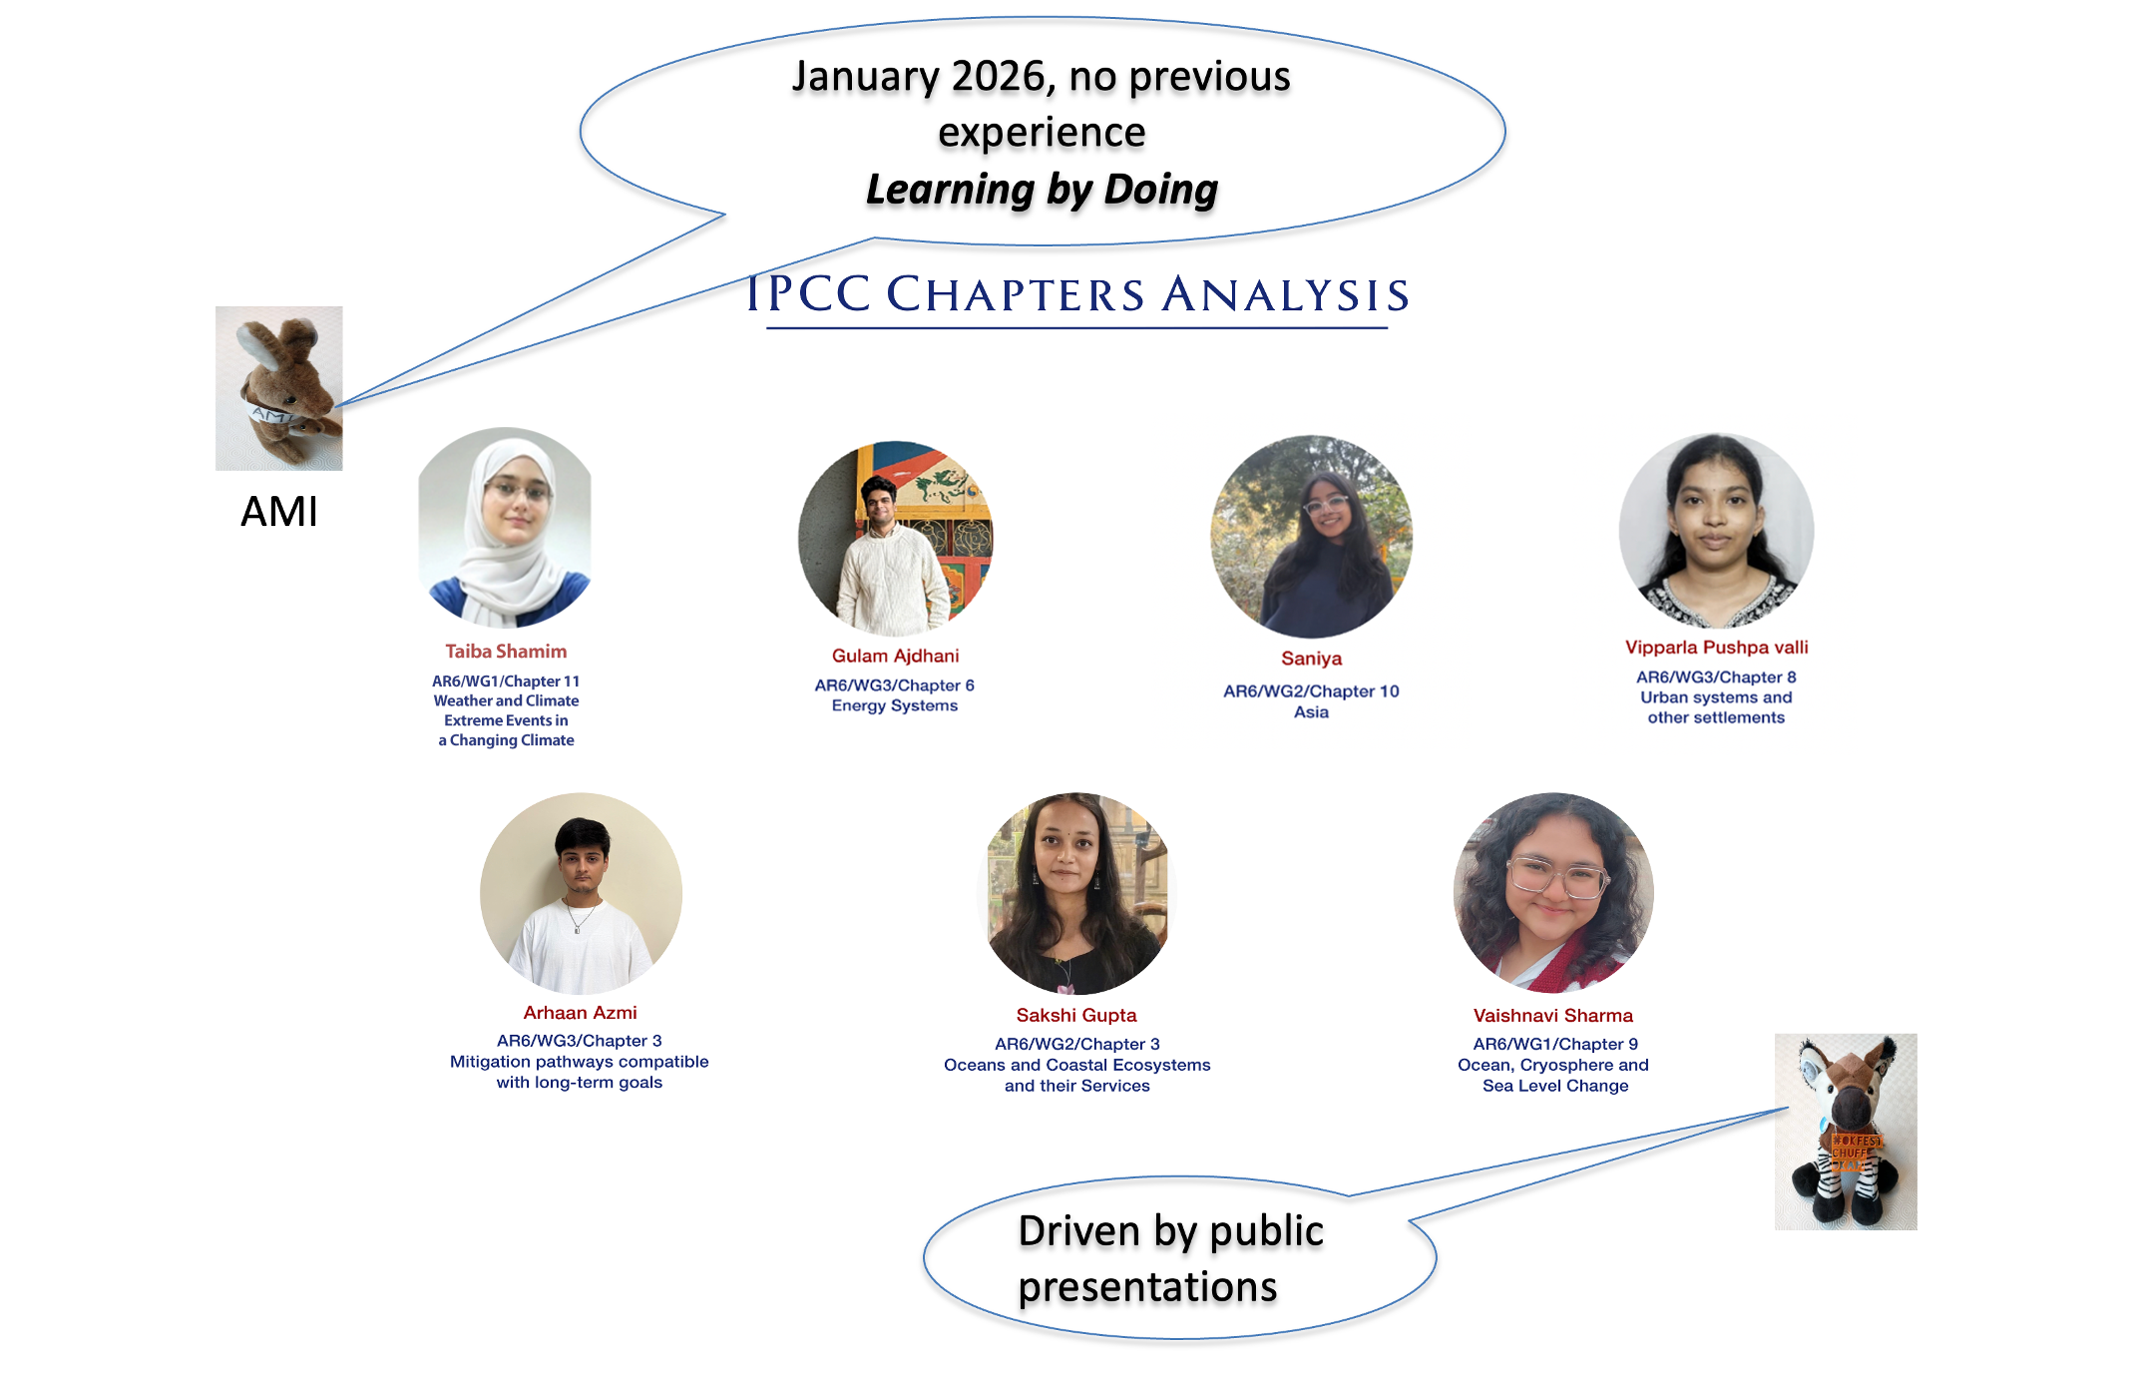

Slide 16
Long Term Goals
Prepare a Knowledge Graph for The Intergovernmental Panel on Climate Change (IPCC) Assessment Reports
A Knowledge Graph for OT-ViRARe & assessment for scientific research, starting with plant science in India

Slide 17
Thank You!

