Slide 1

Encyclopedia
NAME : Pushpa valli TOPIC : India’s Net – zero carbon emissons by 2070

Slide 2

Semantic Climate is an open-source initiative focused on extracting, structuring, and linking climate knowledge from scientific literature. It uses automated text-mining and semantic technologies to transform unstructured research papers into organized, machine-readable knowledge resources such as encyclopedias and knowledge graphs, enabling easier discovery and reuse of climate information.
Why Semantic Climate? Climate research is vast and scattered across publications, making knowledge hard to access and integrate. Semantic Climate automatically extracts and structures key concepts and relationships, creating searchable knowledge that supports interdisciplinary research and evidence-based decisions.
🌍Contribution to the World Semantic Climate democratizes climate knowledge by making scientific insights openly accessible and connected. It enables researchers, educators, and policymakers to use structured climate intelligence for better collaboration and informed global climate action.

Slide 3
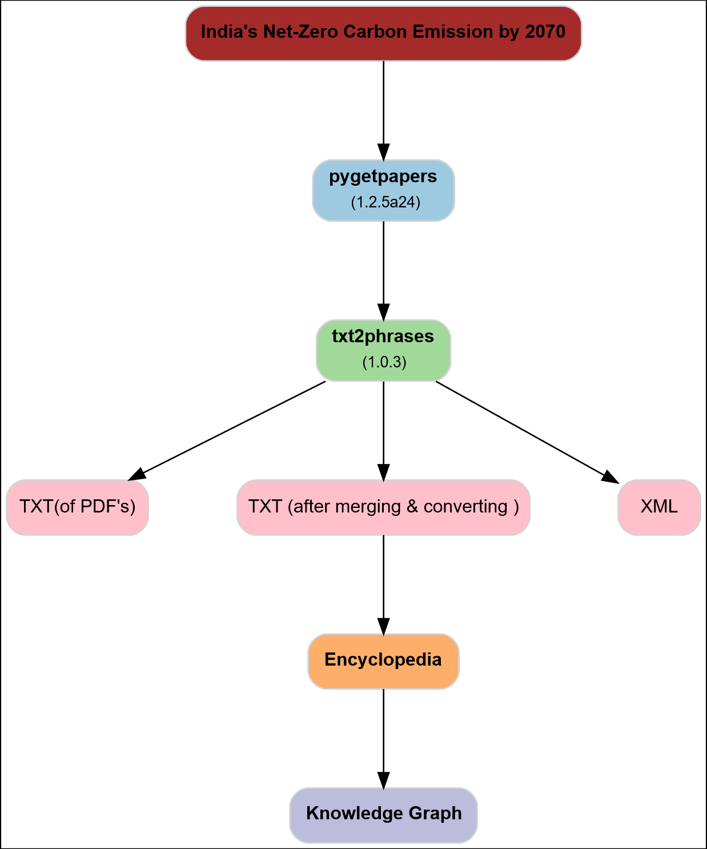
Grapviz work flow

Slide 4



pygetpapers
pygetpapers is an open-source literature retrieval tool that automatically searches and downloads scientific articles and metadata from PubMed Central based on user-defined research queries.
Enables rapid, large-scale collection of relevant research papers with PMC IDs for reproducible text-mining workflows.

Slide 5


txt2phrases
Extracts meaningful keyphrases and concepts from large collections of text documents (e.g., research papers) and converts them into structured outputs such as CSV and XML for downstream knowledge processing.
Identifies unique domain-specific key concepts from literature, enabling automated knowledge extraction and encyclopedia creation.

Slide 6
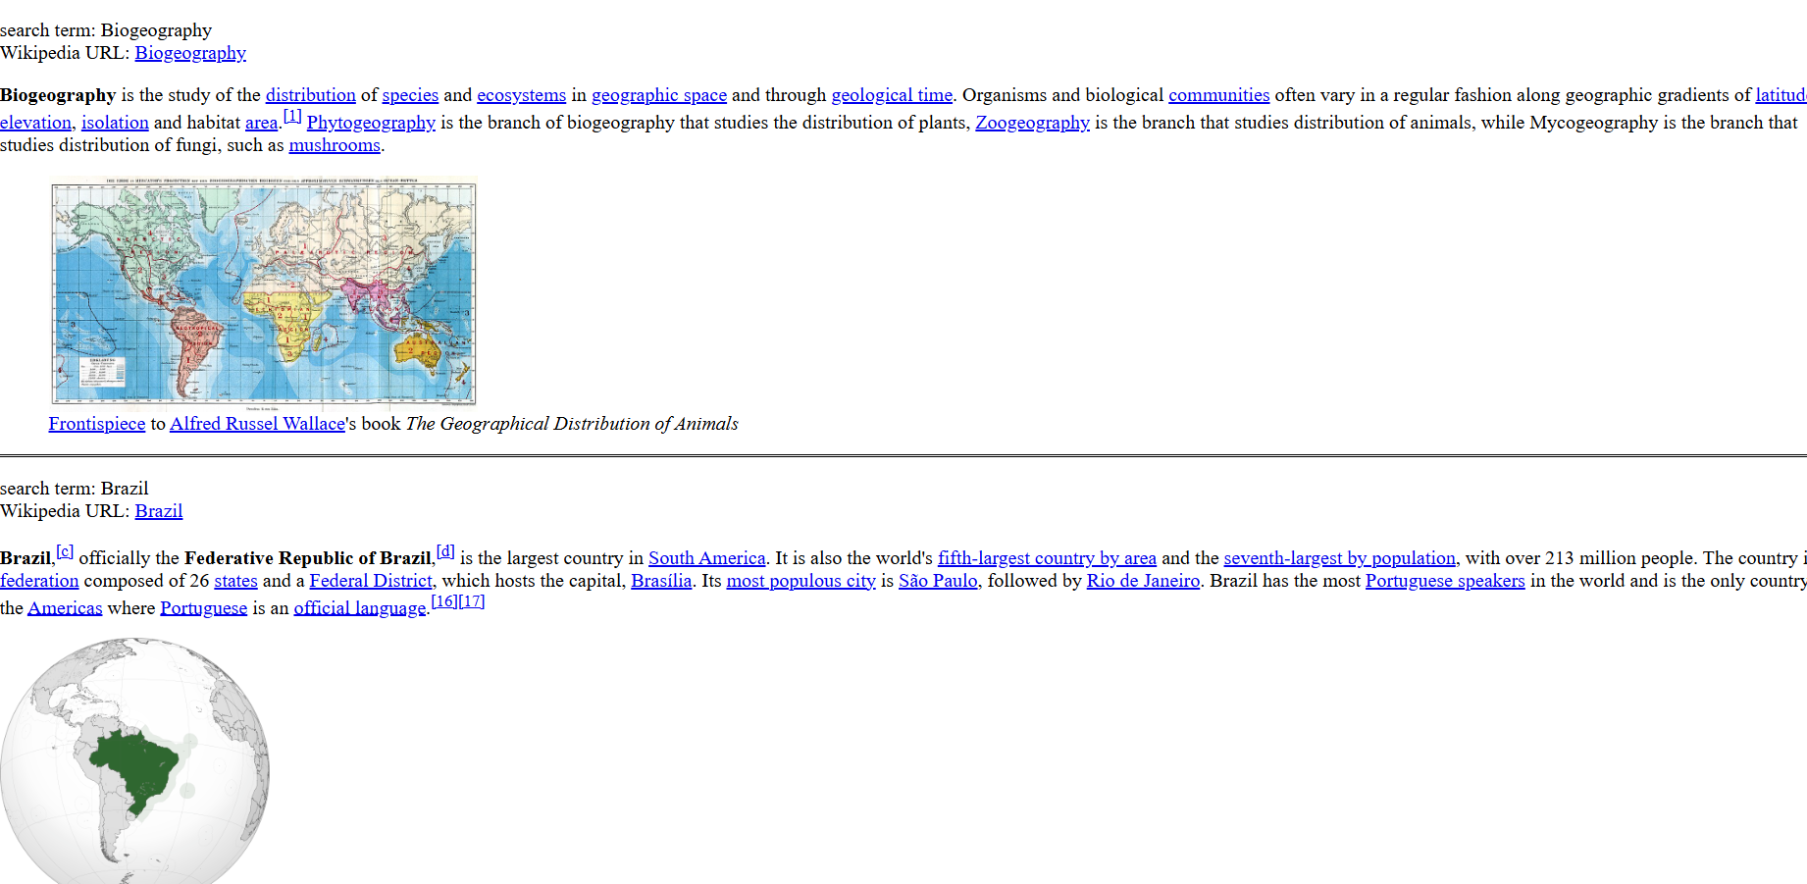
Encyclopedia

Slide 7
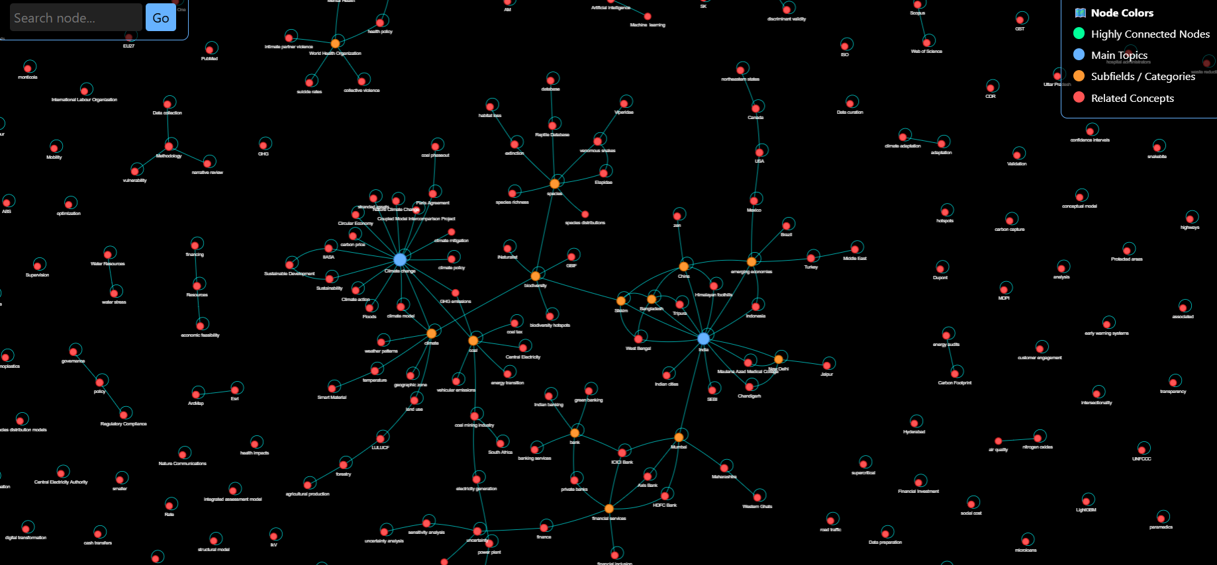
Knowledge graph

Slide 8
Thank you

