Slide 1
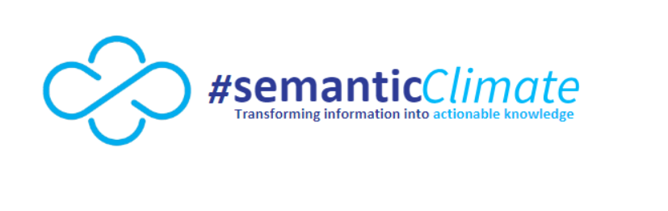
Project – SemanticCorpus

Slide 2
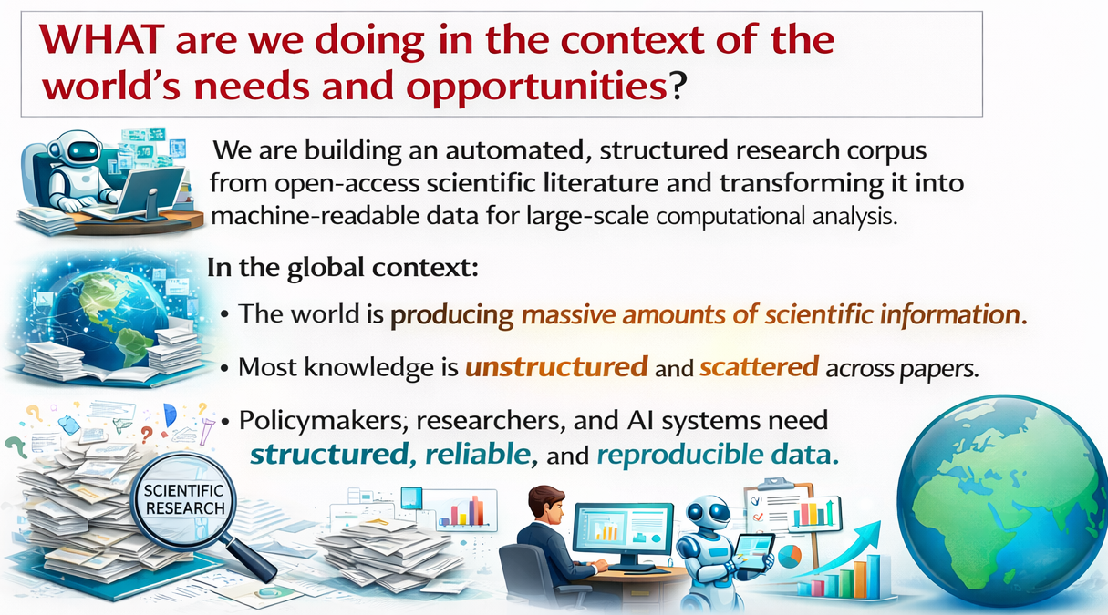

Slide 3
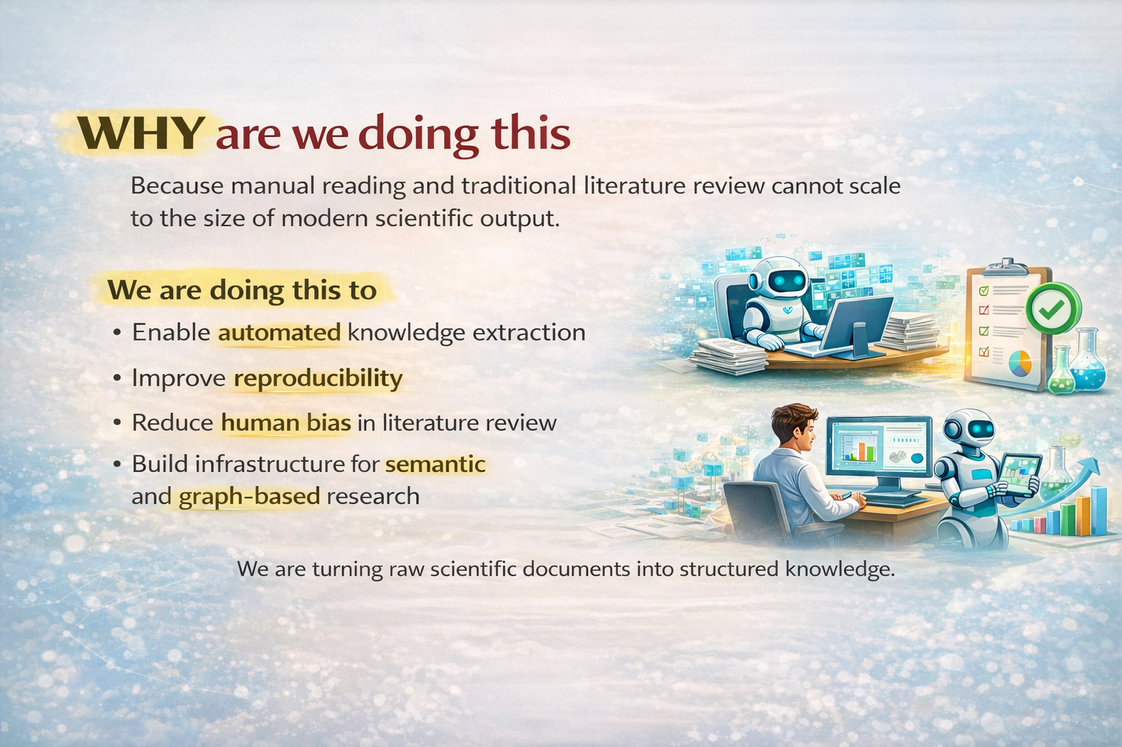

Slide 4

WHAT are we doing in the context of the world’s needs and opportunities?
We are building an automated, structured research corpus from open-access scientific literature and transforming it into machine-readable data for large-scale computational analysis.
In the global context:
The world is producing massive amounts of scientific information.
Most knowledge is unstructured and scattered across papers.
Policymakers, researchers, and AI systems need structured, reliable, and reproducible data.

Slide 5
WHY are we doing this
Because manual reading and traditional literature review cannot scale to the size of modern scientific output.
We are doing this to
Enable automated knowledge extraction
Improve reproducibility
Reduce human bias in literature review
Build infrastructure for semantic and graph-based research
We are turning raw scientific documents into structured knowledge.

Slide 6
Demonstration: Corpus Retrieval and Structuring
Using pygetpapers for automated literature collection and DataTables for structured analysis.

Slide 7
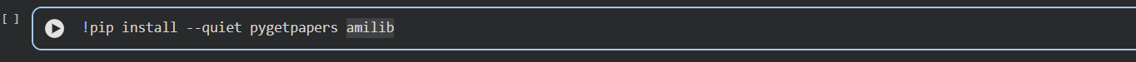
Step 1: Install Dependencies
pygetpapers is a command-line tool developed as part of the ContentMine project
version = 1.2.3

Slide 8
Why Do We Use pygetpapers?
A large number of relevant research papers
Structured metadata (title, authors, DOI, abstract)
Machine-readable full text
Organized folders for further processing
One command downloads many papers at once

Slide 9
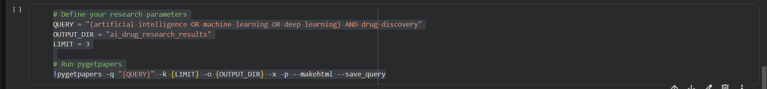
Step 2: Search and Download Scientific Literature
-q → search query
-k → number of papers
-o → output folder

Slide 10
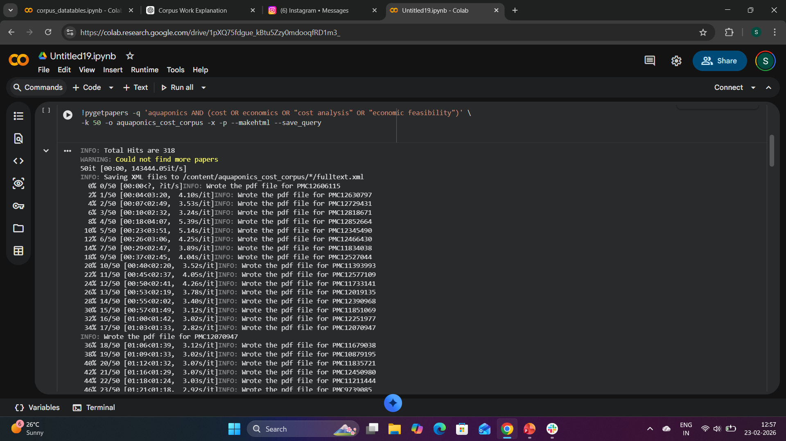
Retrieving open-access research articles on aquaponics cost and economic feasibility using structured query commands.
.

Slide 11
Why We Used datatables ?
Organize extracted corpus data
Enable filtering and comparison
Prepare data for further computational processing
Integration Friendly

Slide 12
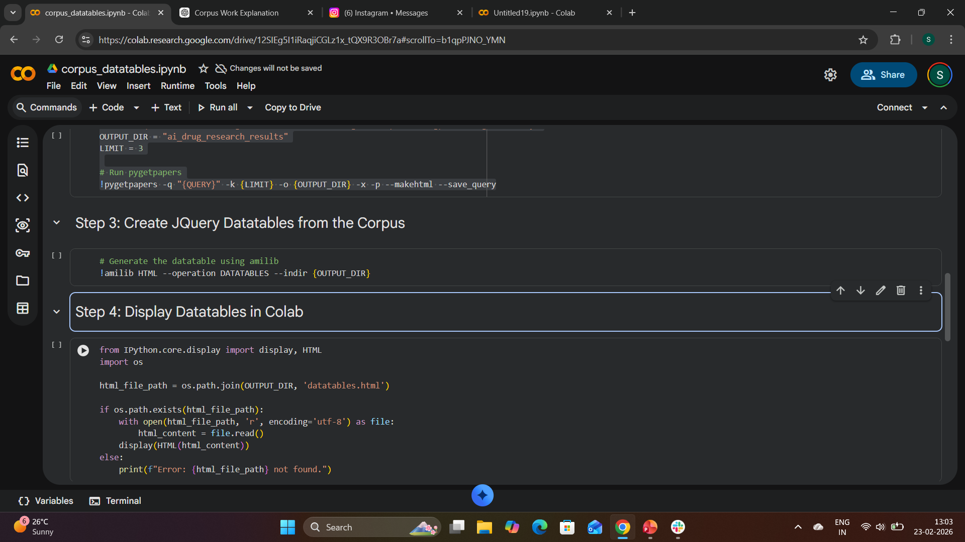
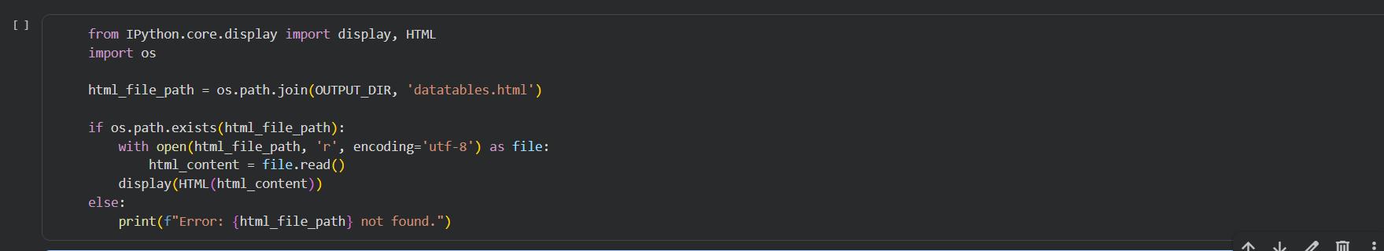
Step 3: Create JQuery Datatables from the Corpus
Step 4: Display Datatables in Colab

Slide 13
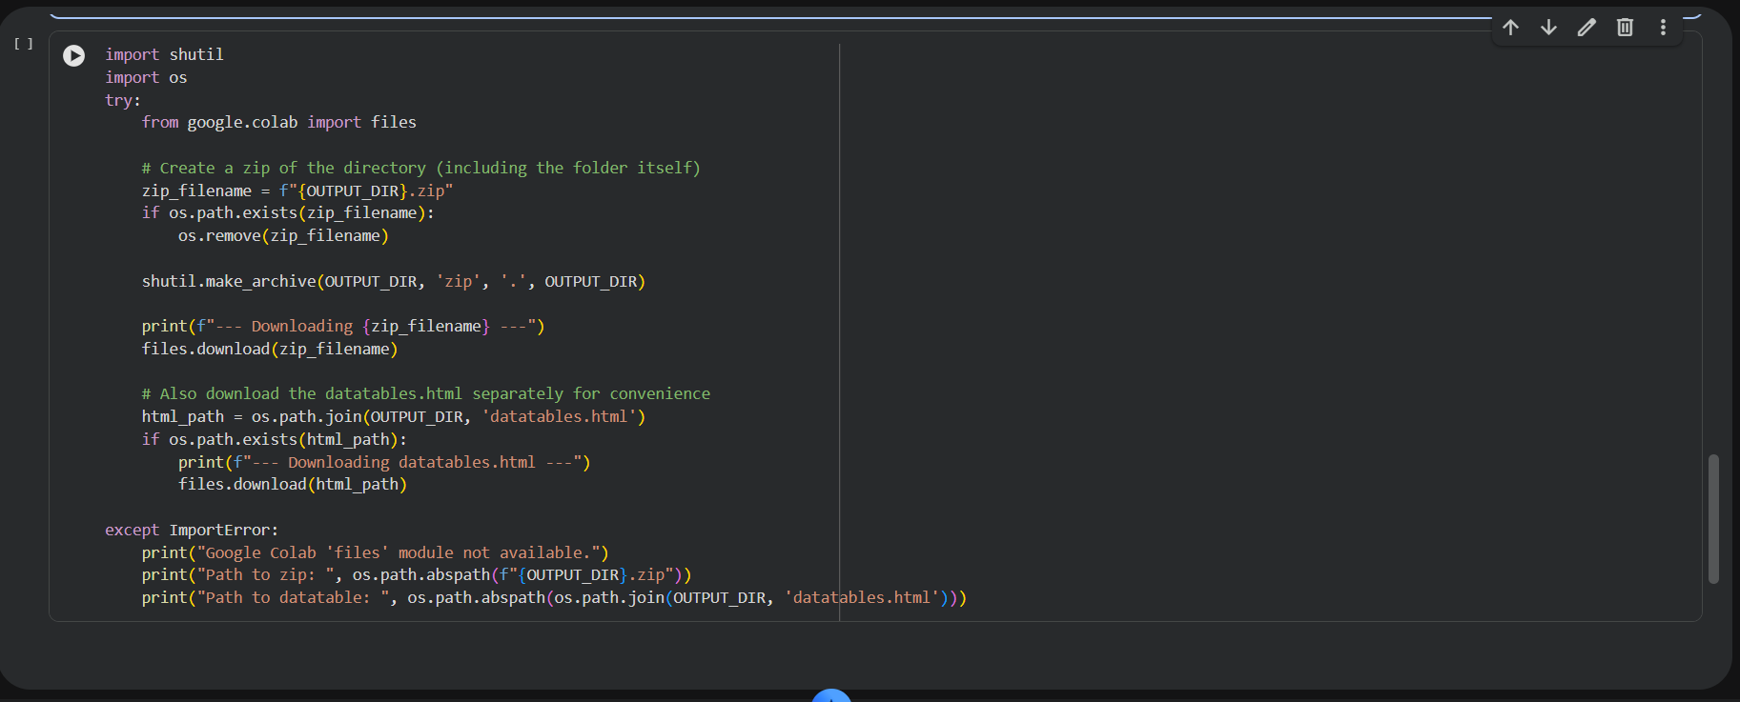
Step 5: Zip and Download the Results

Slide 14
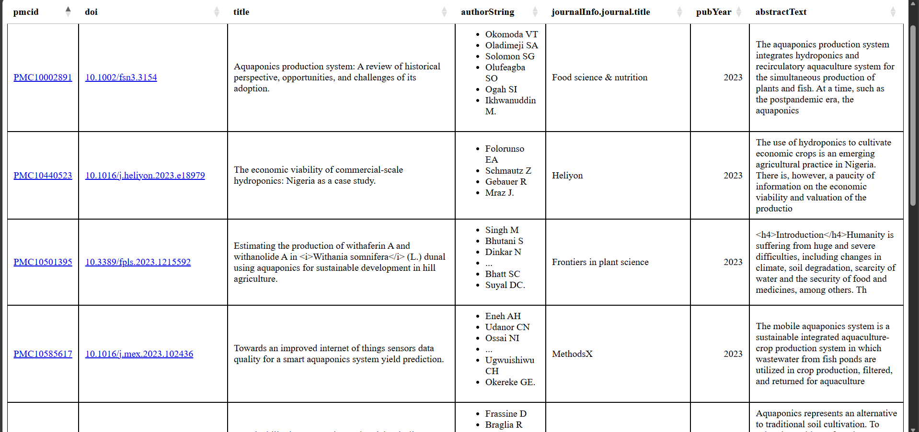
DataTable Output from pygetpapers Retrieval

