Slide 1

#semanticClimate
Encyclopedia & Knowledge Graph Creation by Arhaan Azmi
Topic: Chemical ecology of plant insect interactions

Slide 2
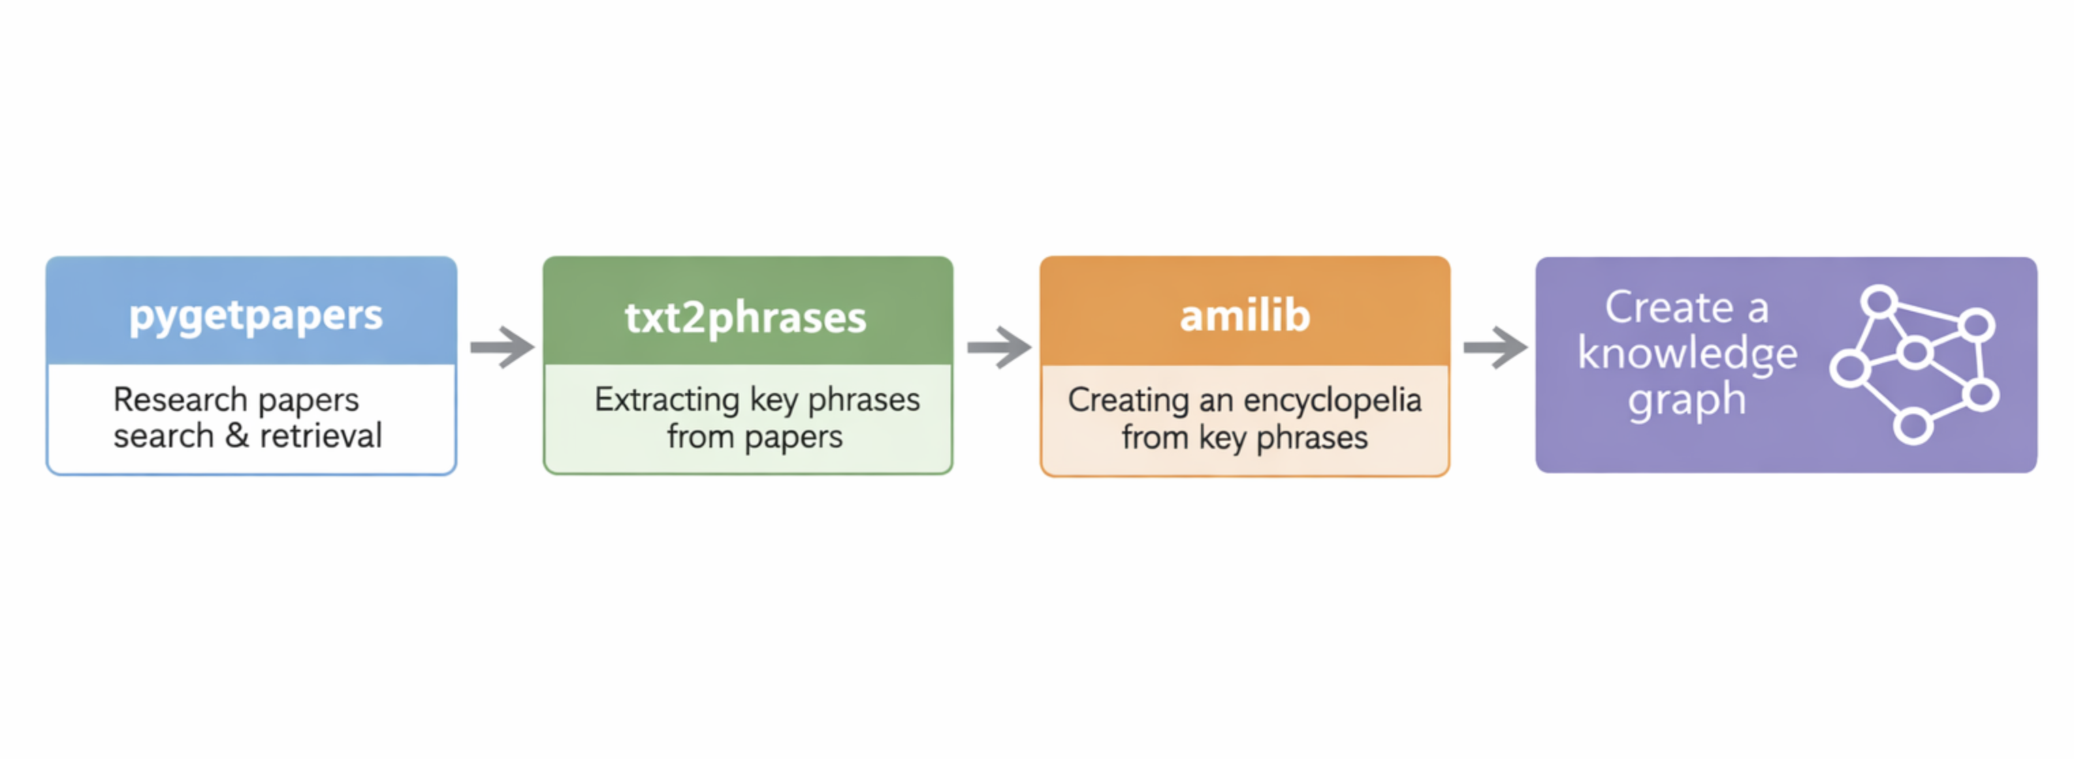
Current Pipeline

Slide 3
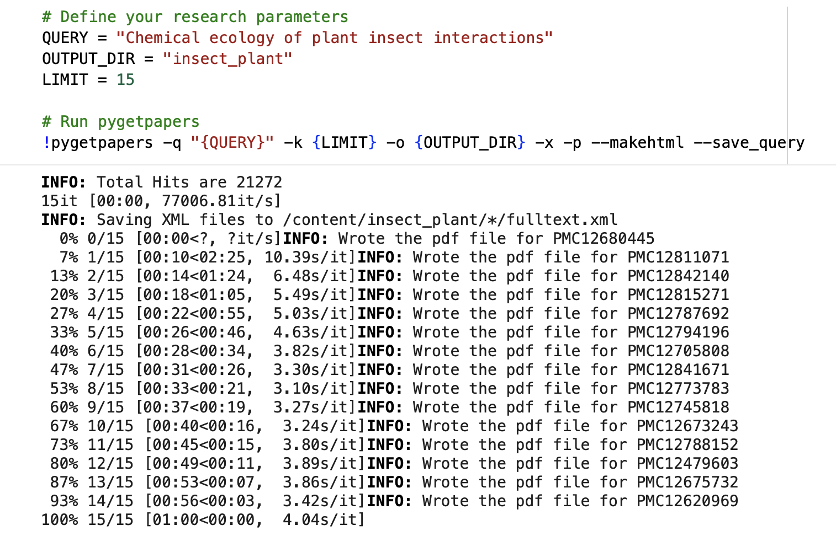
Step 1: Search & retrieve scientific papers from EU PMC using pygetpapers 1.2.3

Slide 4
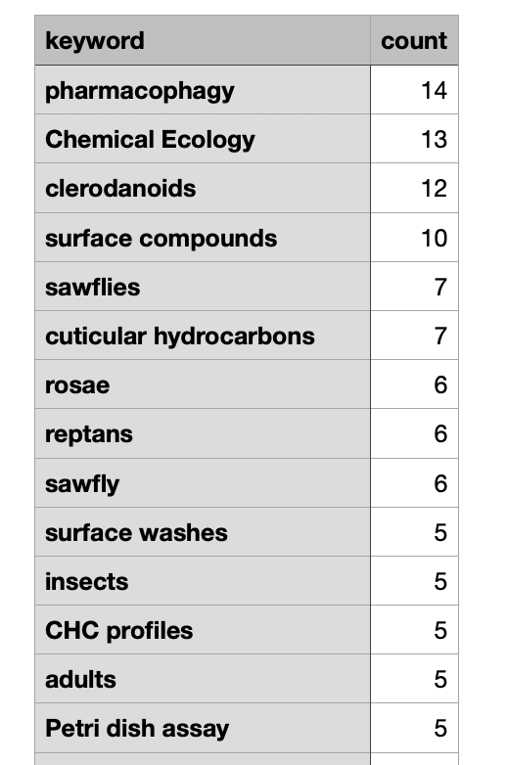
Step 2: Use txt2phrases to convert the retrieved PDFs into TXT files and extract key phrases from them.

Slide 5
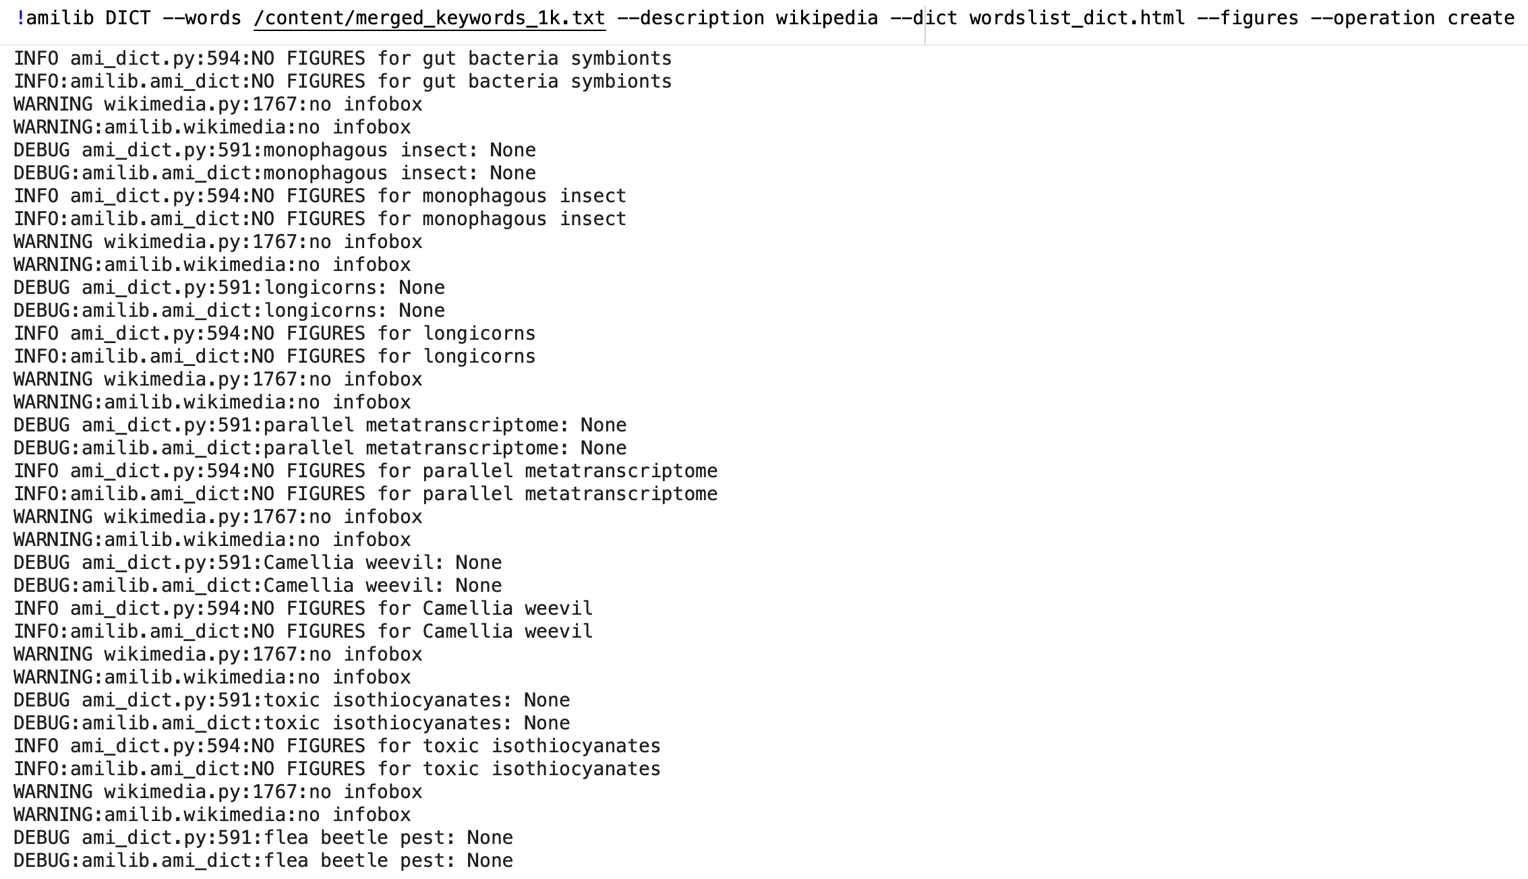
Step 3: Create an Encyclopedia from the extracted key phrases using amilib 1.1.2

Slide 6
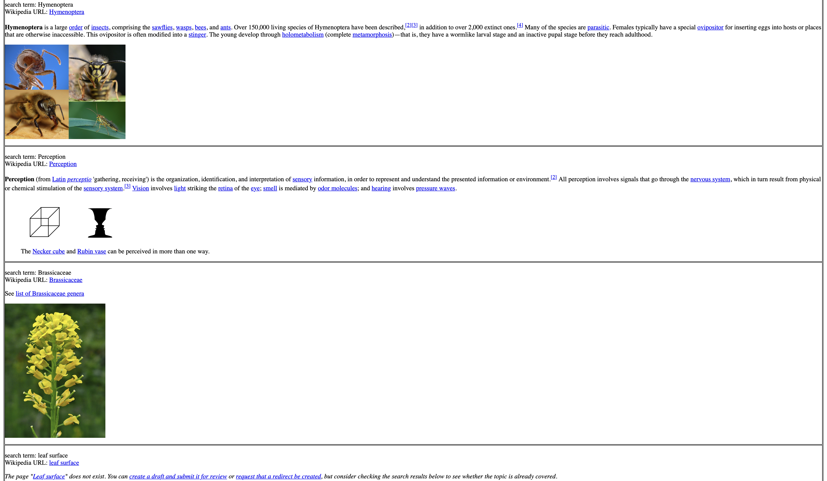
Encyclopedia on Chemical ecology of plant insect interactions

Slide 7
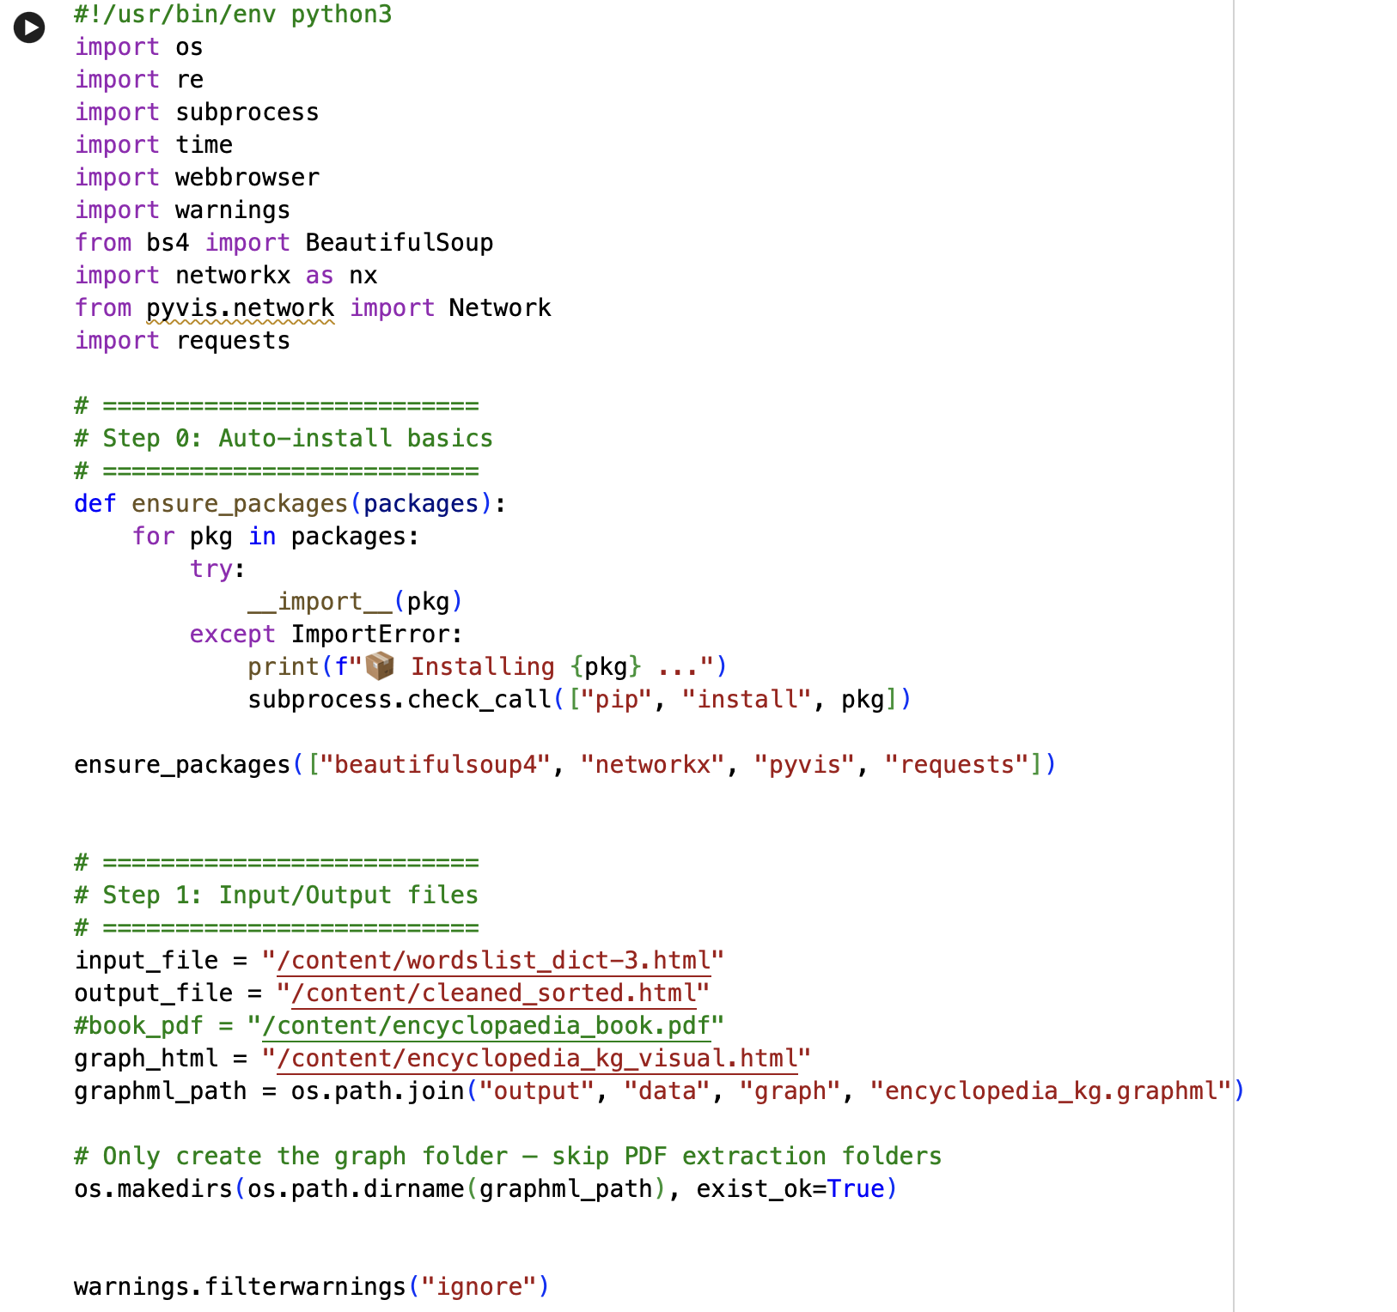
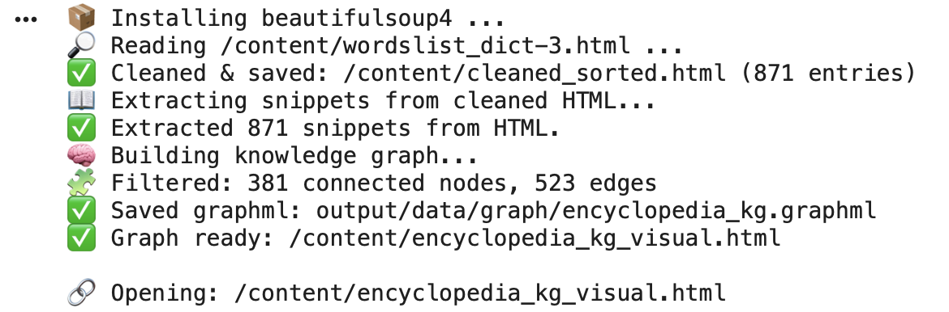
Step 4: Use the generated encyclopedia as input to a standalone script to create a knowledge graph.

Slide 8
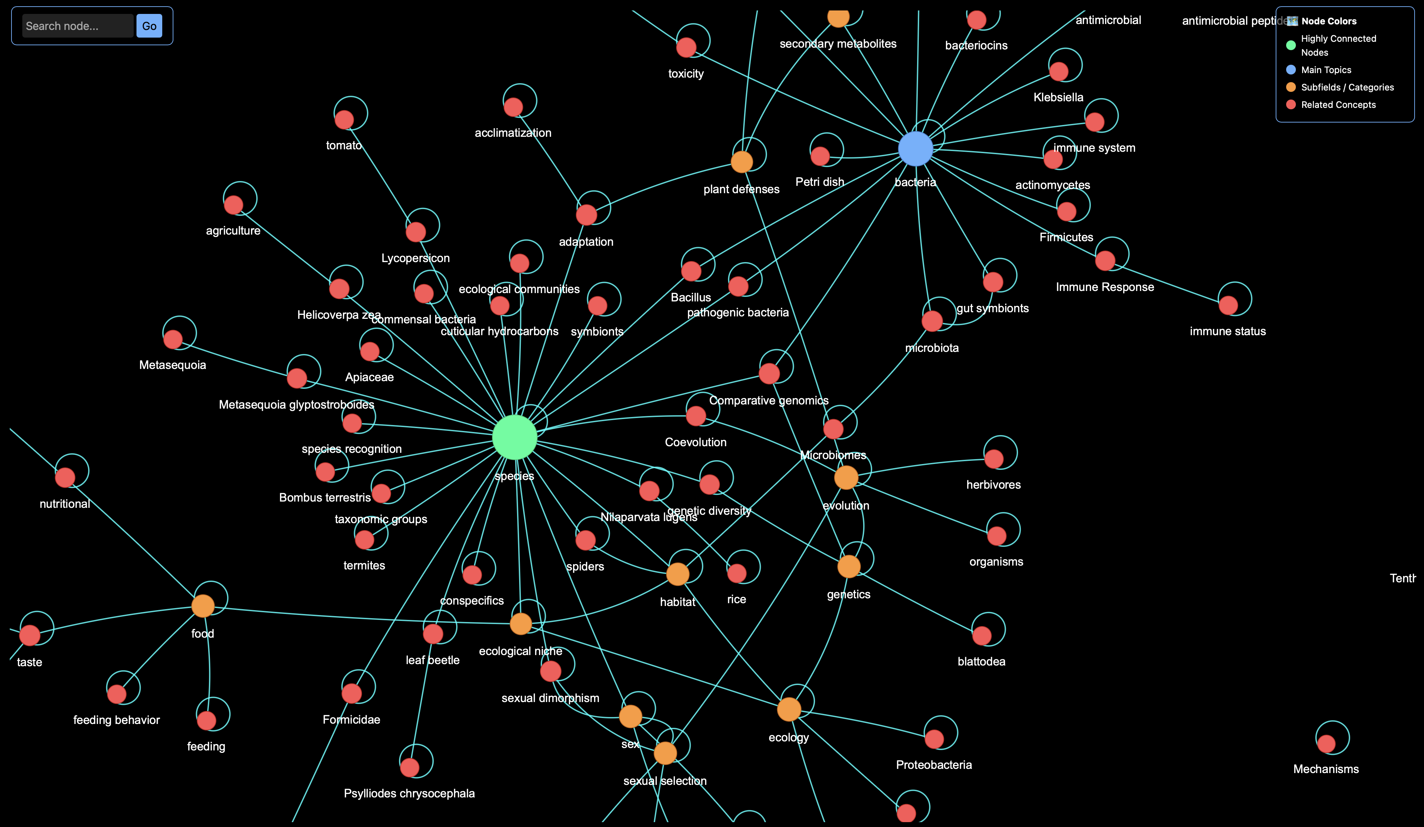
Knowledge Graph on Chemical ecology of plant insect interactions

Slide 9
Thank You!

