Slide 1
Presentation: Keyphrases Extraction Workflow
This presentation outlines the automated pipeline for extracting and aggregating keyphrases from the annual reports of 10 Indian plant research institutions.
By-Sakshi gupta

Slide 2
Goal
We are building a system that converts unstructured scientific documents — annual reports of plant research institutions — into structured, computable knowledge.
By using txt2phrases to extract key research concepts and organizing them into a keyphrase × institution matrix, we created the foundation of a knowledge graph that reveals who is working on what, how research themes are distributed, and where overlaps or gaps exist across organisations.

Slide 3
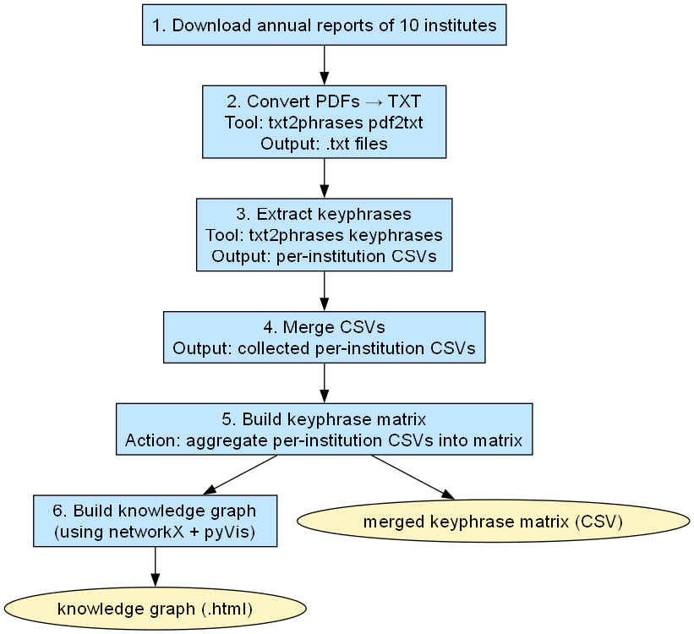

Slide 4
Commands
# Install dependencies
pip install -e .
# Run full pipeline (Convert -> Extract -> Merge)
python scripts/extract_keywords_from_reports.py --merge
# Generate Matrix and HTML reports
python scripts/build_keyphrase_table.py

Slide 5
Deliverables & Outputs
keyphrase_matrix.csv: A matrix of keyphrases × institutions, including "Total" and "N_institutions" counts.
https://github.com/semanticClimate/txt2phrases/blob/reports/Examples/otvirare/india_plant_reports/keyphrase_matrix.csv
keyphrase_datatables.html: An interactive, searchable, and paginated table using the jQuery DataTables library.
https://github.com/semanticClimate/txt2phrases/blob/reports/Examples/otvirare/india_plant_reports/keyphrase_datatables.html
keyphrase_table.html: A lightweight, static HTML version of the matrix for accessibility without JavaScript.
https://github.com/semanticClimate/txt2phrases/blob/reports/Examples/otvirare/india_plant_reports/keyphrase_table.html

Slide 6
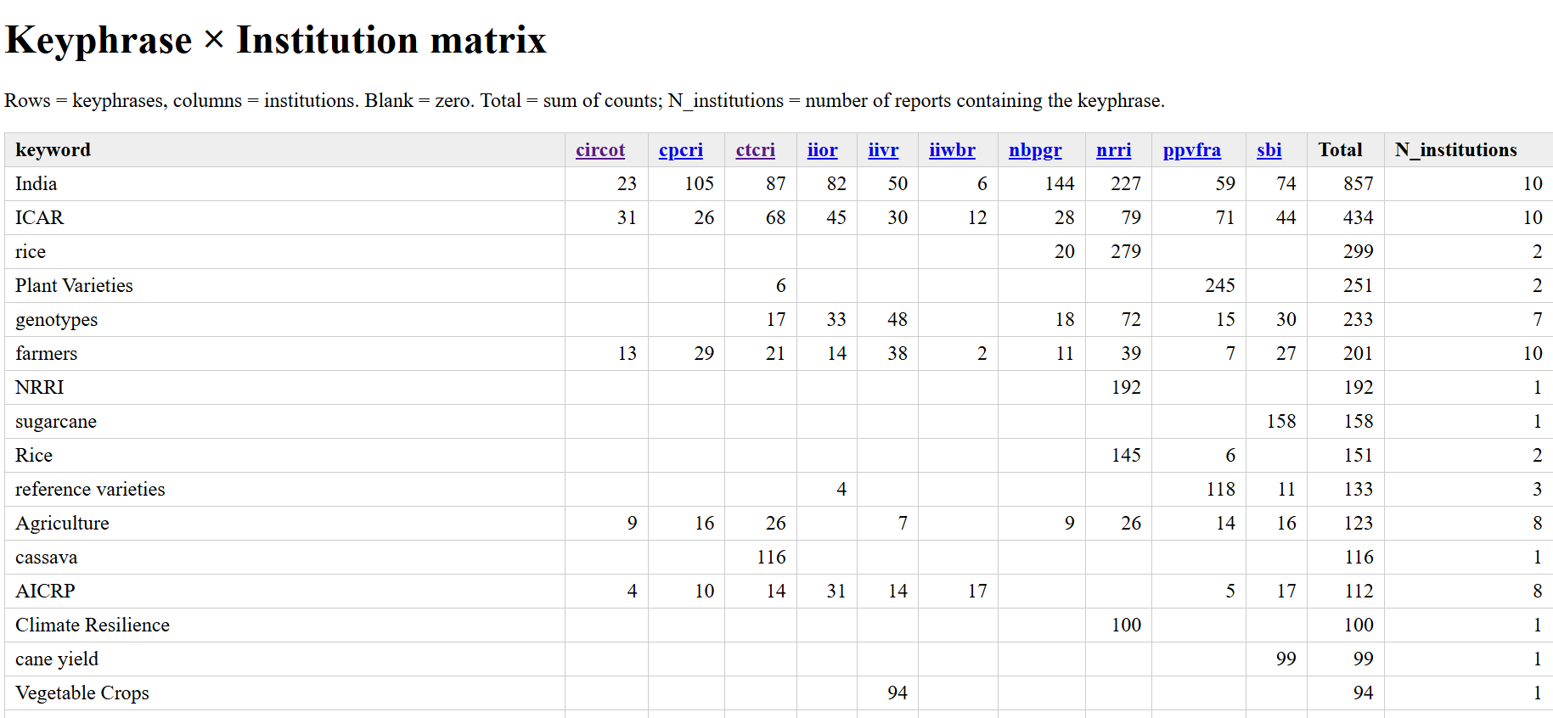

Slide 7
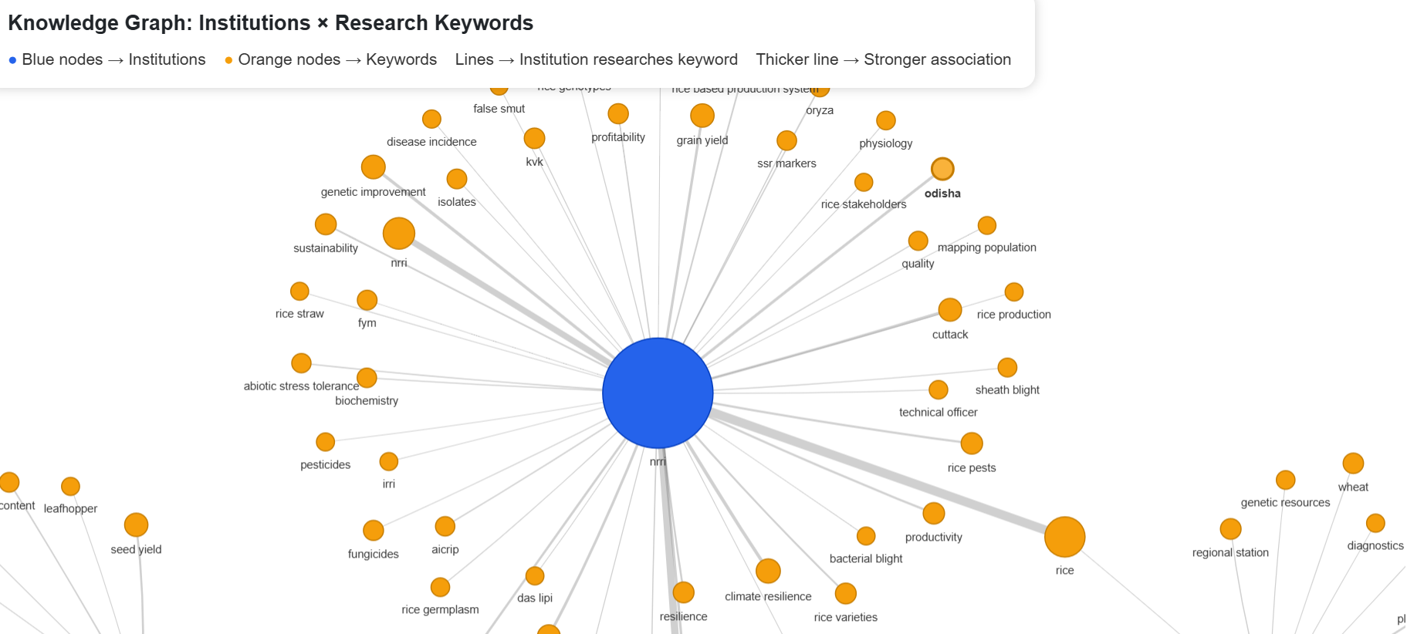
https://github.com/semanticClimate/internship_sC/blob/sakshi-gupta/txt2phrases/knowledge_graph.html

Slide 8
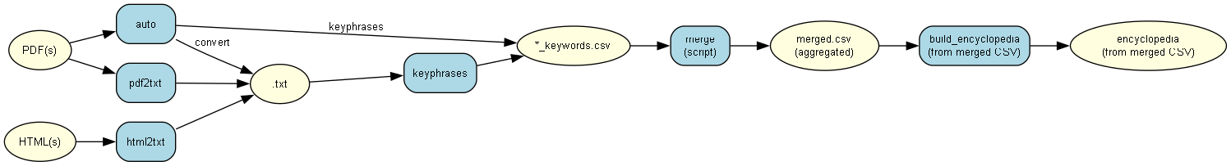
txt2phrases

Slide 9
Outputs
Encyclopedia
https://github.com/semanticClimate/internship_sC/blob/sakshi-gupta/txt2phrases/wordslist_dict%20(3).html
Knowledge graph
https://github.com/semanticClimate/internship_sC/blob/sakshi-gupta/txt2phrases/encyclopedia_kg_visual%20(2).html
https://github.com/semanticClimate/txt2phrases/blob/reports/Examples/otvirare/india_plant_reports/merged_keywords.csv

Slide 10
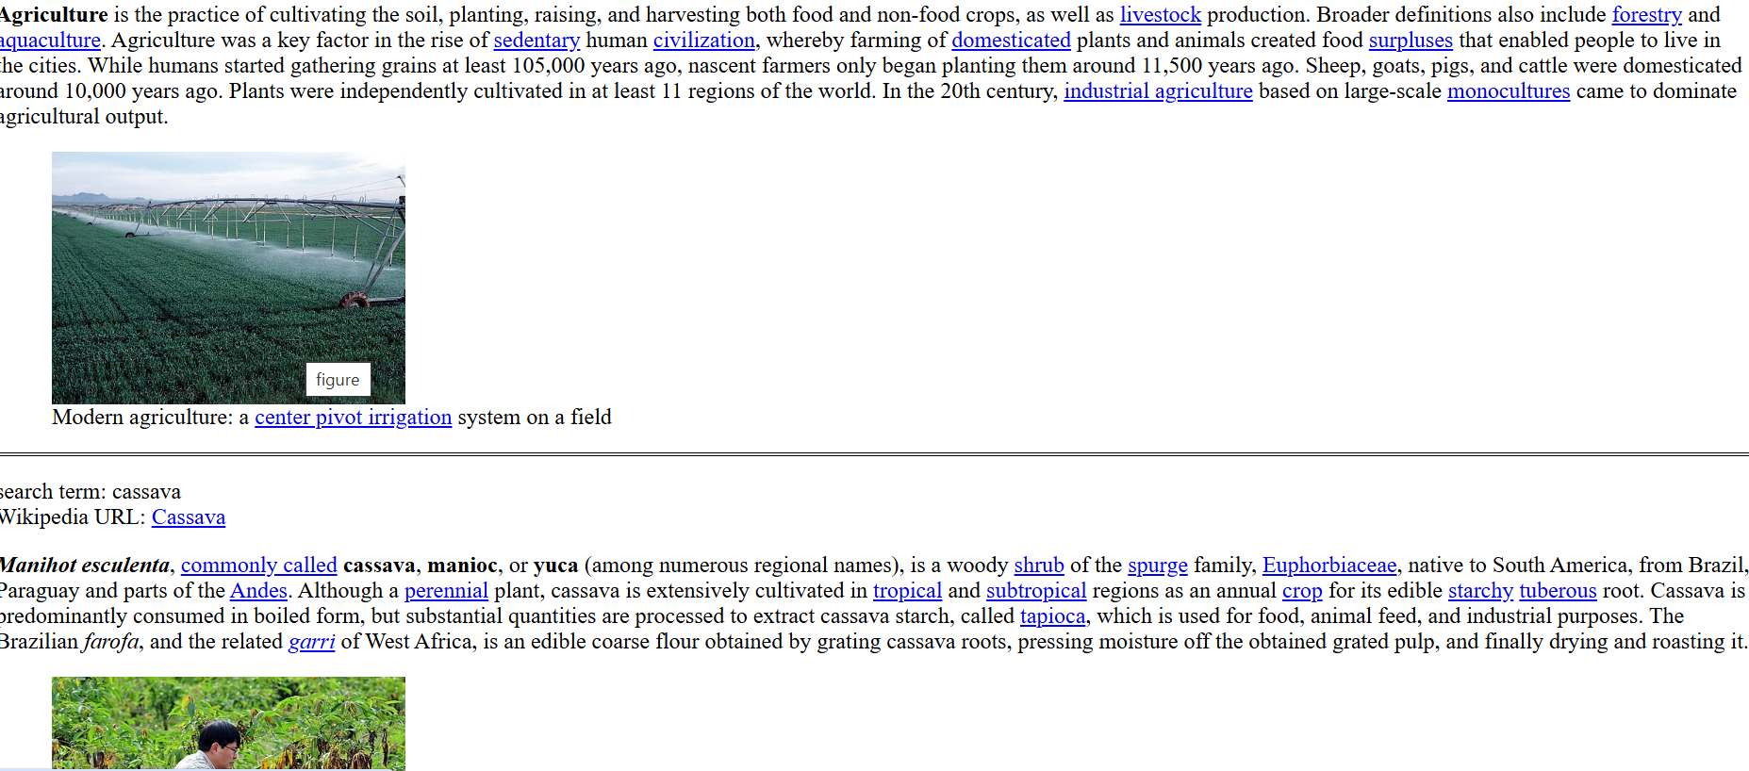

Slide 11
