Slide 1
txt2phrases
txt2phrases is a Python library and CLI tool designed for processing and analizing text data.
It provides a streamlined pipeline for converting documents (HTML, PDF) into plain text, extracting keywords using models (keyBERT), and classifying keywords into specific and general categories using TF-IDF (term frequency-inverse document frequency)

Slide 2
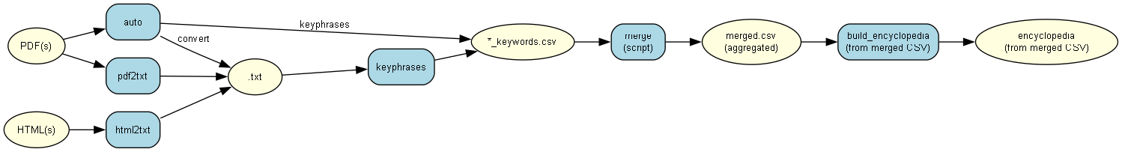

Slide 3
Features:
1. PDF to Text Conversion
Extract plain text from PDF files for further processing.
2. HTML to Text Conversion
Convert HTML documents into clean, plain text.
3. AI-Powered Keyword Extraction
Use advanced NLP models to extract and rank the most important keywords from text files.
4. Automated Pipeline
Run the entire pipeline (PDF/HTML → TXT → Keywords) with a single command.
5. Batch Processing
Process single files or entire directories efficiently.

Slide 4
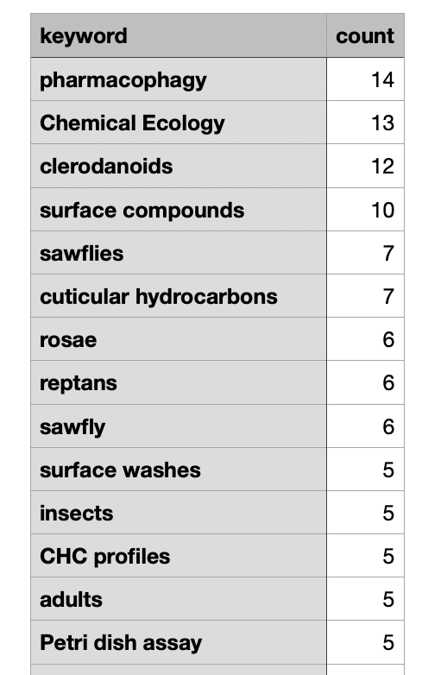
Installation
Install txt2phrases directly from PyPI:
pip install txt2phrases

Slide 5
Commands
# Convert PDF to text
txt2phrases pdf2txt -i document.pdf -o output_folder
# Convert HTML to text
txt2phrases html2txt -i webpage.html -o output_folder
# Extract keywords from text files
txt2phrases keyphrases -i text_files/ -o keywords/ -n 500
# Run complete pipeline
txt2phrases auto -i pygetpapers_output/ -o results/ -n 100

Slide 6
To merge CSVs
# Defaults
python scripts/run_merge_sample.py
# Custom directory
python scripts/run_merge_sample.py -i test/fixtures/merge_sample -o merged.csv
# Explicit files
python scripts/run_merge_sample.py -i file1.csv file2.csv -o merged.csv
# Limit to top 20 keywords
python scripts/run_merge_sample.py -i my_keywords/ -o top20.csv --top-n 20

Slide 7
What to do next.
CLI Integration: Add merge subcommand to cli.py
txt2phrases merge -i keywords_folder/ -o merged_keywords.csv
txt2phrases merge -i file1.csv file2.csv file3.csv -o merged_keywords.csv
txt2phrases merge -i keywords_folder/ -o merged_keywords.csv --top-n 500
Update README.md with merge command examples

Slide 8
Future aspects we can work on
scripts/build_keyphrase_table.py
Input: All *_keywords.csv under query subdirs (multiple CSVs per query are summed per keyphrase).
Outputs:
(a) CSV: keyphrase_matrix.csv – rows = keyphrases, columns = query(IPCC, Institution); cell = count or blank if zero; extra columns Total (sum of counts) and N_query (number of non-zero cells in that row).
(b) DataTables HTML: keyphrase_datatables.html – normal HTML <table> with <thead>, <tbody>, <tr>, <th>, <td>; DataTables is initialised on that table (DOM-sourced data per DataTables docs). Search, sort, pagination; default sort by Total descending.
(c) Plain HTML table: keyphrase_table.html – same <table> markup with no JavaScript.

Slide 9
# Install
pip install -e .
# Full pipeline: convert PDFs → extract keyphrases → merge
python scripts/extract_keywords_from_reports.py –merge
# Build keyphrase × query matrix (CSV + DataTables HTML)
python scripts/build_keyphrase_table.py

Slide 10
Thank you

