Slide 1

CRYPTC
2x vision Insights
Dr Sabiha Imran
Srinivas Patil Nilesh Barat

Slide 2
Solutions Masquerading as Problems?
Composting, a source of GHG emissions?
Can afforestation lead to land degradation/water table depletion?
Is the idea of recycling encouraging the consumption of plastic?
Solution ∝ Problem
Solution (s) ≥ Problem
s = situational awareness

Slide 3
CRYPTC
A tool that correlates the interfaces of requirements, scalability, and IPCC goals and generates metadata aiding in the decisive aspects of composting, afforestation, and plastic recycling.
IoV – index of variables
Industrial establishments (Public and Private) ,Urban Planners, CSR data

Slide 4
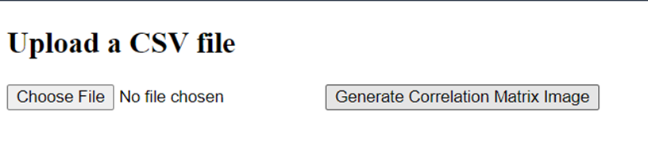
Interface 1 –CSV file
*PS-sorry for no interactive UI

Slide 5
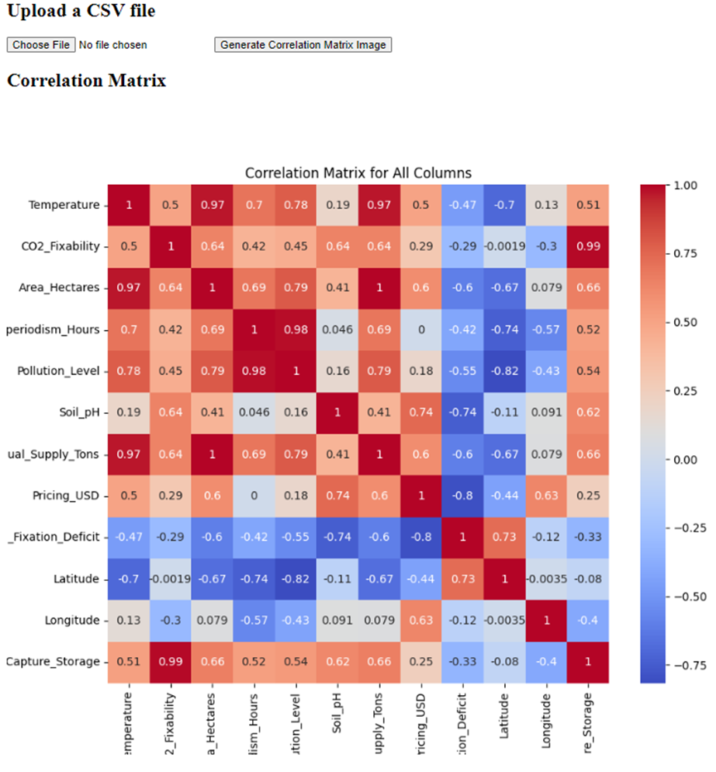
Interface 2 -output

Slide 6
Community Goals for climate change
Build enterprises around solutions
Not to speak but to get heard
Incremental problems to incentivized problems
We can do what we want but we can’t want what we want – (not my line) eclipsed reality

Slide 7
IPCC AR6 WGIII Hits and References
https://docs.google.com/presentation/d/1hqRKjWul1Ff2z6VX-ZJksW_jY__MK_sH/edit?usp=drive_link&ouid=118115722208893126028&rtpof=true&sd=true

