Slide 1
Open Climate Knowledge #OCK – 100% OA for Climate Change
Coffee Lecture
https://github.com/petermr/climate
Simon Worthington - Twitter @mrchristian99, Open Science Lab, TIB
SLIDES
http://linkme2.net/1wr

Slide 2
Open Climate Knowledge
#OCK
100% open collaborative research for climate change knowledge
Peter Murray-Rust, ContentMine
Simon Worthington, TIB
Join us!
https://github.com/petermr/climate

Slide 3
Motivation
Knowledge liberation. Currently Open Access rates for climate change research publishing are possibly less than 30%. (Tai and Robinson 2018. We aim to change that!
Reference: Tai, Travis C., and James P. W. Robinson. ‘Enhancing Climate Change Research With Open Science’. Frontiers in Environmental Science 6 (2018). https://doi.org/10/gf64mq.

Slide 4
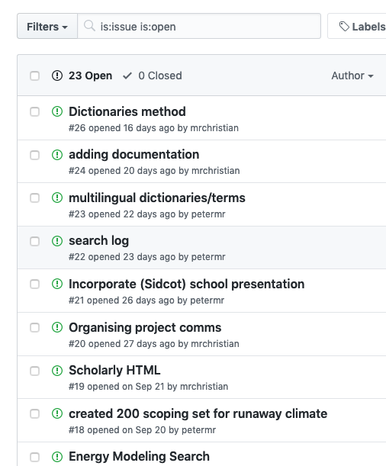
Open Research Project. #OCK
We have a powerful software that can search open repositories using linked data dictionaries based on WikiData. We can then retrieve metadata and documents and apply analysis for entity recognition with Machine Learning, manually and automatically annotate, create collections and repositories, develop Knowledge Graphs, and more.
It's all open and you can use the tools as well. https://github.com/petermr/climate
GitHub Issues Daily PUBLIC log of all activity
SLIDES
http://linkme2.net/1wr
SLIDES

Slide 5
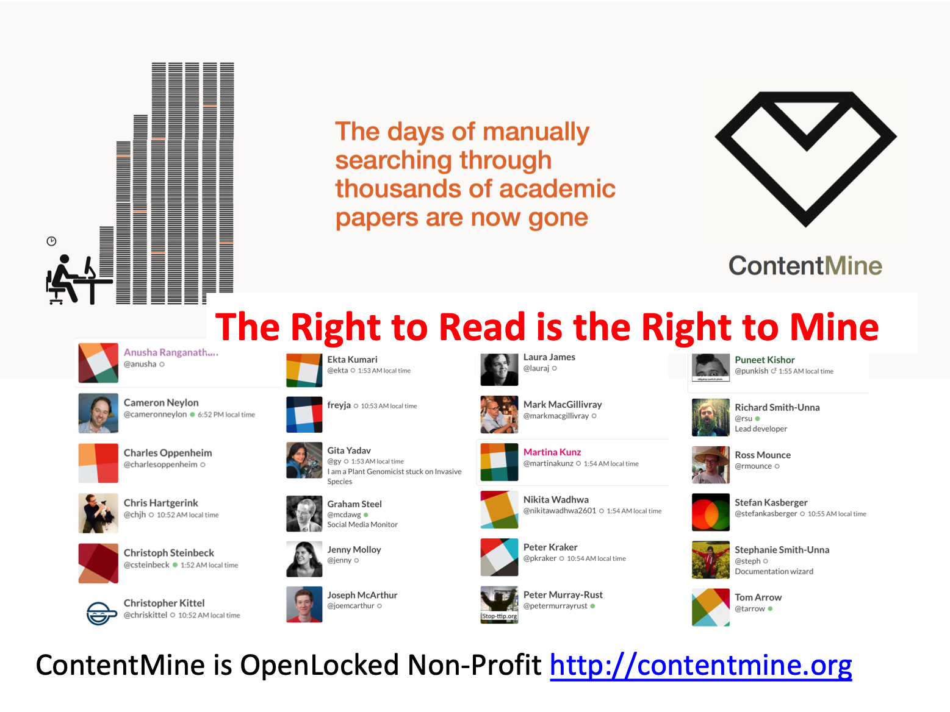
ContentMine
ALSO
Other technology frameworks...
Chem 4 Word
Hypothesis - W3C Annotation
WikiDate
...
http://linkme2.net/1wr
SLIDES
http://linkme2.net/1wr
SLIDES

Slide 6
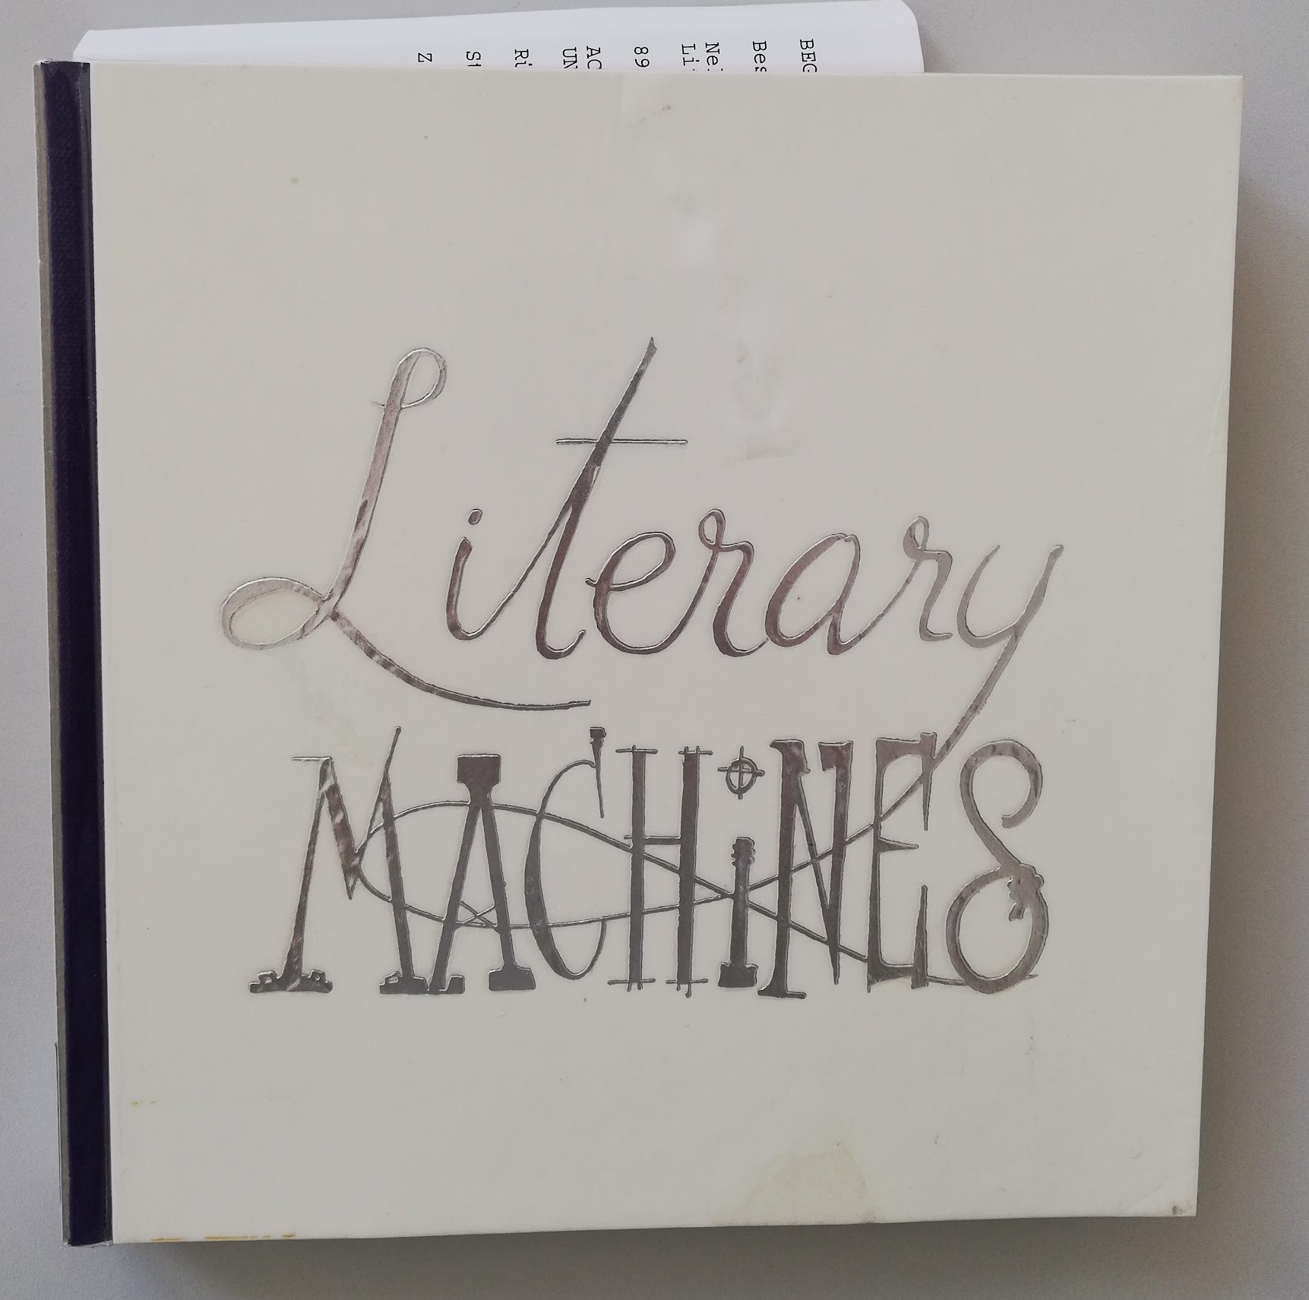
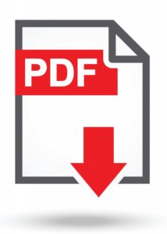
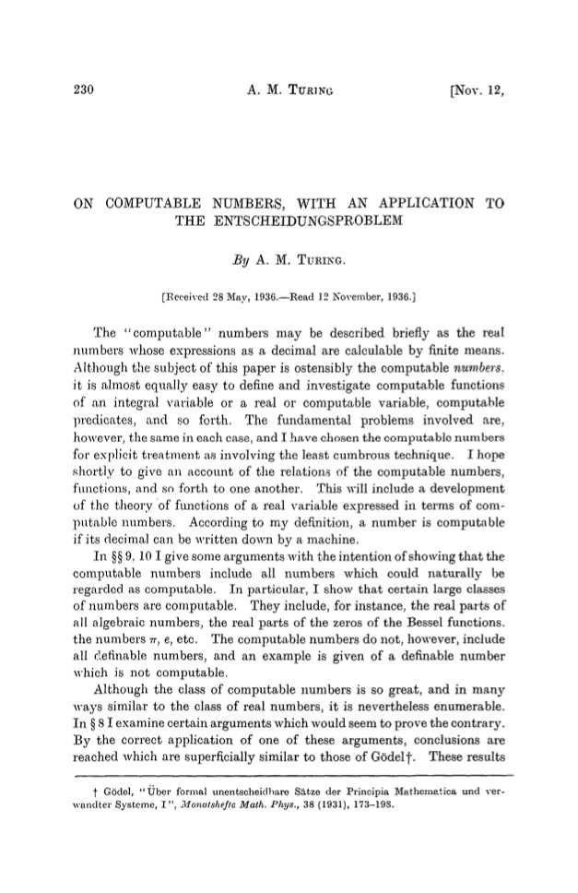

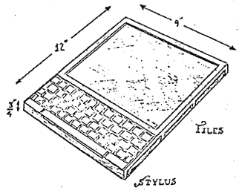
Semantic Open Access
It’s as if we haven’t been able to write computationally for the short history of modern computing (80+ years)
Turing Machine (1936)
PDF
Dynabook (1968)
Jupyter Notebook like (the future daughters of Jupyter Notebooks)
Literary Machines - Ted Nelson 1981, Edition 87.1 May 1987 ISBN 0-89347-055-4
SLIDES
http://linkme2.net/1wr
SLIDES

Slide 7
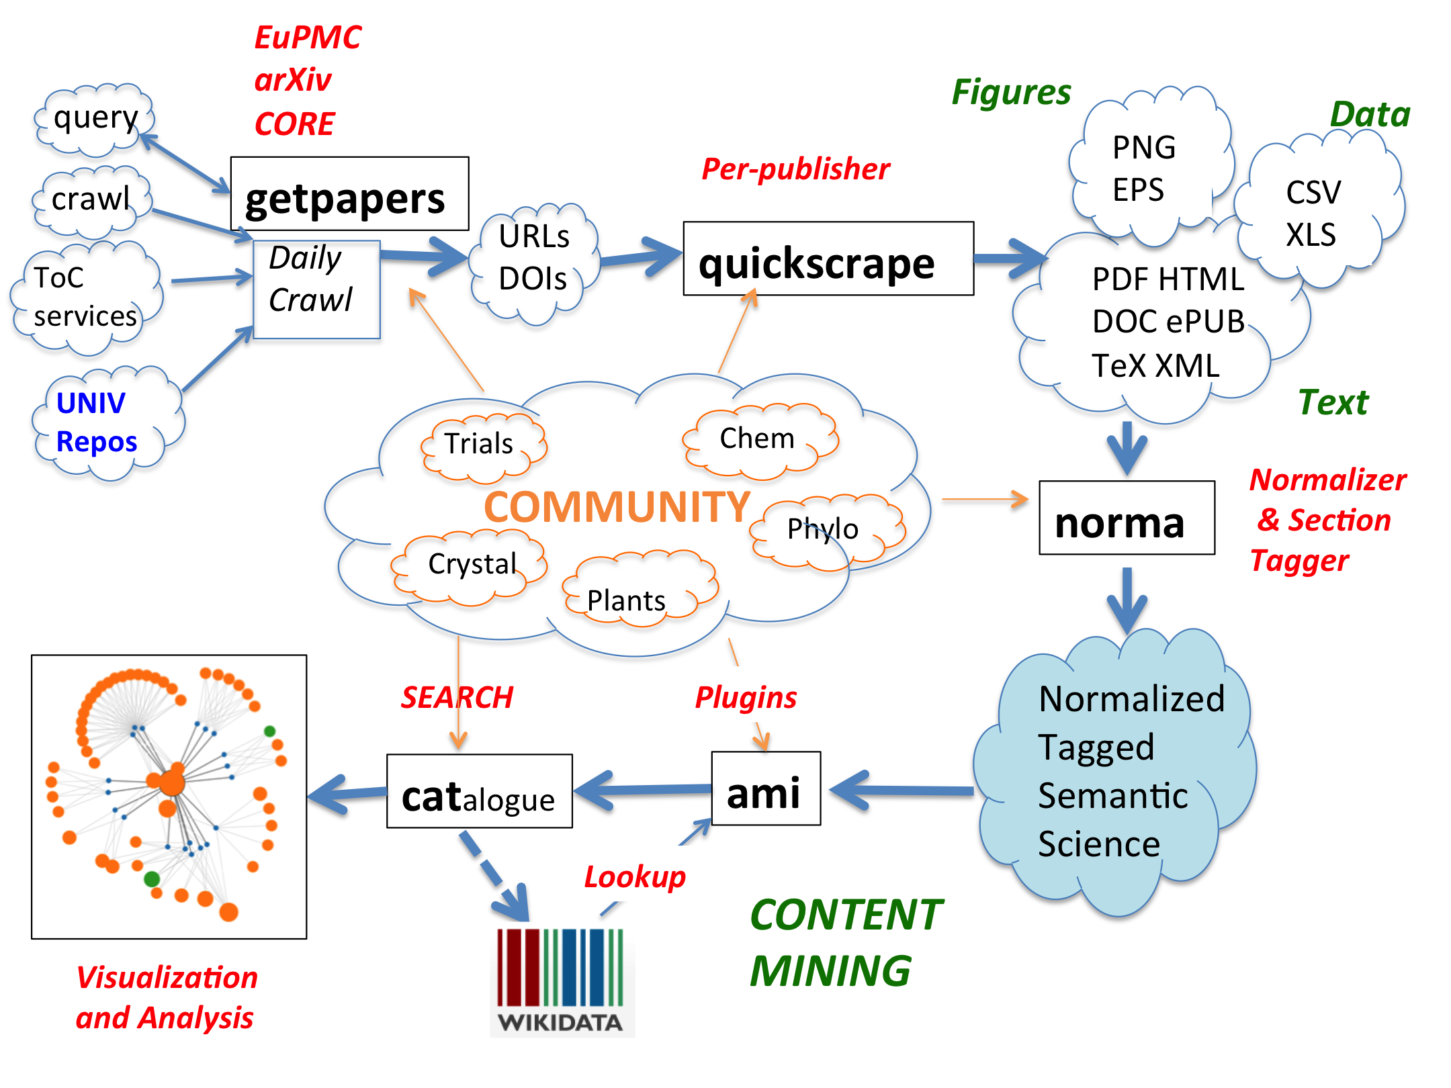

Assembling knowledge
DISCOVER
RETRIEVE
CLEAN / SEMANTIFY

Slide 8
Assembling knowledge
DISCOVER
DOWNLOAD
CLEAN
DISCOVER
RETRIEVE
CLEAN / SEMANTIFY
DICTIONARIES
NORMALIZE
REPUBLISH
SEMANTIFY
ANNOTATE

Slide 9
ContentMining with dictionaries
DEMO TIME https://github.com/petermr/climate
ami-search -p climate --dictionary
species country funders //built in
dictionaries/climate.xml // bespoke
// dictionaries linked to Wikidata or Wikipedia
SLIDES
http://linkme2.net/1wr
SLIDES

Slide 10
Understanding how to
make change
We are doing the following:
Get up-to-date statistics for open content
Make a plan for a transition to 100% open
Forming a working group with Force11
Create a public repository of all open climate change research publishing
Create an open climate change research knowledge graph
CMIP6 (Climate Model Intercomparison Project Phase 6) Dictionary building
SLIDES
http://linkme2.net/1wr
SLIDES

Slide 11
Help needed!
We are looking for expertise, advice, support with the following:
Climate Change specialists as advisors on use of Content Mine
OA experts to help on informing OCK on existing research on OA rates, stats and how OCK can deal with speeding up OA in Climate Change
Knowledge graph expertise
Content curation and repository building
Data science software developers: users to carry out searches, experiments
Wikidata wranglers; WikiData term stemming for multilingual purposes; WikiData entries
RDMP
Community development and open project strategy implementation
Software support documentation
Members to join a Force11 working group for OCK, contribute on research, papers, WG duties, OA stats, contribute to plans for transition to open research/OA
SLIDES
http://linkme2.net/1wr
SLIDES

Slide 12
Thank you!
Contact details:
Simon Worthington Simon.Worthington@tib.eu @mrchristian99
SLIDES
http://linkme2.net/1wr
SLIDES

