Slide 1
Data Conversion for Units of Measure
Phil Blackwood
June 2024

Slide 2
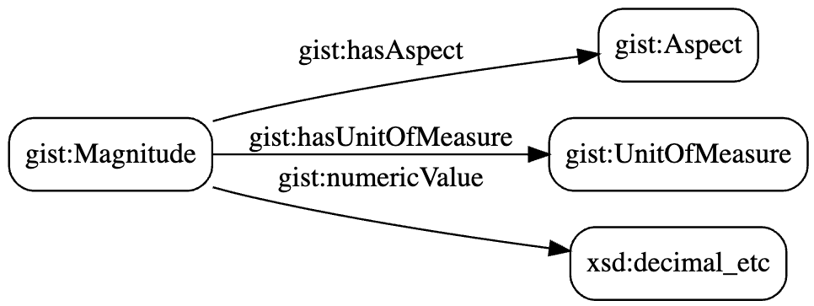
In a nutshell
The main objective is to use the new pattern for magnitudes, with standardized units of measure.
example:
gistd:_Aspect_area
gistd:_UnitOfMeasure_square_foot
“144”^^xsd:decimal
An aspect is a measurable characteristic such as height, weight, cycle time, cost, etc.
gistd is the prefix for gist reference data.

Slide 3
Summary of data conversion process
Identify the impact on the client data and artifacts (queries, forms, etc.)
Install new version of gist and new Unit of Measure reference data
Update client data and artifacts
Remove things no longer needed
Note: this deck shows the “all-in” approach to data conversion. It can be customized as needed.

Slide 4
Steps of Unit of Measure Data Conversion
Identify existing units and aspects
findUnits
findAspects1 through findAspects5
checkAspects
Identify impacts to reads, writes, etc.
SPARQL queries, APIs, Forms, documentation, code, etc.
Get Semantic Arts reference data
provide Semantic Arts with a list of existing aspects and units
Semantic Arts will return a list of standard aspects and units
Copy reference data into client graph
replace gist12 with gist13
add namespace for unit of measure reference data
copy the reference data to its own named graph
Replace old units of measure
replaceUnits and update reads, writes, etc.
Insert new aspects
insertAspects1 through insertAspects5 and update reads, writes, etc.
findMagnitudesWithNoAspect
Flatten numerator/denominator data
multiplierDivisor1 through multiplierDivisor3
Remove things no longer needed
useHasMagnitude and putMagnitudesInClass
removeOldAspects1 and removeOldAspects2
removeOldProperties
update ontologies and taxonomies to remove entries no longer needed

Slide 5
Customization
Some of the queries used during data conversion are generic and others must be customized for the individual client.
If a conversion query has “template” in the filename, copy it to a query with the client name in the filename.
For example: copy findAspects1-template.rq to findAspects1-sa.rq for Semantic Arts internal data.
Be sure to review the header of each query for more information.

Slide 6
Identify units of measure and aspects used by client
Identify existing units and aspects
Existing Client Data
Aspect (implicit or explicit)
Unit of Measure
Query the client data for existing units of measure and aspects.
Run findUnits
Run the five queries findAspects[1-5]
Cross-check the results using checkAspects
See the next few slides for diagrams of the queries.

Slide 7
Examples of Aspects in client data
Identify existing units and aspects
Aspect represented as a class
Aspect represented as a category
Aspect represented as a property
144
144
:_patio
:_magnitude
:_patio
:_magnitude
sq. ft.
sq. ft.
type
isCategorizedBy
Area
:_area
hasArea
144
144
:_patio
:_magnitude
:_patio
:_magnitude
sq. ft.
sq. ft.
hasAspect
:_Aspect_area

Slide 8
More examples:
Identify existing units and aspects
144
(the string “area” might also be found in the IRI of the Magnitude)
:_patio_area
:_magnitude
sq. ft.
144
:_patio
:_magnitude
sq. ft.
:_area
144
:_patio
:_x
:_magnitude
sq. ft.
:_area
144
:_patio
:_magnitude
(area is an implied Aspect)
sq. ft.

Slide 9
Variables used in queries:
Identify existing units and aspects
?thingToMagnitudeProperty
gist:hasUnitOfMeasure
?thing
?magnitude
?unit
?thingProperty
?magnitudeProperty
?thingPropertyValue
?magnitudePropertyValue
gist:isAspectOf
?aspect
?thing or ?magnitude

Slide 10
Where the queries look:
Identify existing units and aspects
3
5
5
?thingToMagnitudeProperty
gist:hasUnitOfMeasure
?thing
?magnitude
?unit
2
?thingProperty
1
?magnitudeProperty
?thingPropertyValue
?magnitudePropertyValue
4
gist:isAspectOf
?aspect
?thing or ?magnitude

Slide 11
Sample query instructions:
Identify existing units and aspects
?magnitude
# find existing Aspects that are represented as either:
#
# - a property of a Magnitude
# - or the value of a property of a Magnitude
#
# use this query iteratively as follows:
#
# - run the query
# - pick a few lines of output
# - update the upper section of the query with properties or values that do NOT involve an Aspect
# - update the lower section of the query (filter not exists) with properties and values that DO represent Aspects
# - repeat
#
# this iterative process accounts for every property and value associated with a Magnitude
# when the query returns no results, every row of the original output has been accounted for
# the aspects identified are used in other queries later in the process
1
?magnitudeProperty
?magnitudePropertyValue

Slide 12
Identify artifacts that refer to aspects and units
Identify impacts to reads, writes, etc.
Identify all client artifacts that refer to aspects and units.
These artifacts may include:
SPARQL queries
Data ingestion scripts (tarql, etc.)
APIs
Forms
Documentation
Code
etc.

Slide 13
Augment Semantic Arts UoM reference data
Get Semantic Arts reference data
Existing Client Data
Aspect (implicit or explicit)
Unit of Measure
provide Semantic Arts with a list of existing aspects and units
Semantic Arts will return a list of standard aspects and units
Semantic Arts
Unit of Measure
Reference Data
Aspect
UnitGroup
Unit of Measure
Discipline

Slide 14
Map client values to reference data
Copy reference data into client graph
Existing Client Data
Existing Aspect
Existing Unit of Measure
Semantic Arts
Unit of Measure
Reference Data
New Aspect
New Unit of Measure
Include this mapping in the queries replaceUnits and insertAspects[1-5].

Slide 15
Replace old version of gist with new version of gist
Copy reference data into client graph
Existing Client Data
gist12.1.0
gist13
Add prefix gistd: <https://w3id.org/semanticarts/ns/data/gist/>

Slide 16
Prepare the client reference data
Copy reference data into client graph
Customize the query prepareClientReferenceData-[client].rq with new units and aspects the client will use.
Run the query on the Semantic Arts reference data.
Download as Turtle.
Make sure the namespaces in the ttl header line up with namespaces used by the client (e.g. for gist).
Semantic Arts
Unit of Measure
Reference Data
Aspect
Unit of Measure
Unit Group
Discipline

Slide 17
Populate the client reference data
Copy reference data into client graph
Existing Client Data
Client Unit of Measure
Reference Data
Aspect
UnitGroup
Unit of Measure
Discipline
Use a separate named graph.
Semantic Arts
Unit of Measure
Reference Data
Aspect
UnitGroup
Unit of Measure
Discipline

Slide 18
Replace old client units with new ones
Replace old units of measure
Existing Client Data
Uses previously-documented data mapping.
Unit of Measure
gist:_USDollar
gist:_bit
gist:_kilogram
gist:_meter
gist:_minute
gist:_second
client:_example
gistd:_UnitOfMeasure_US_dollar
gistd:_UnitOfMeasure_bit
gistd:_UnitOfMeasure_kilogram
gistd:_UnitOfMeasure_meter
gistd:_UnitOfMeasure_minute
gistd:_UnitOfMeasure_second
gistd:_UnitOfMeasure_example
Client Unit of Measure
Reference Data
Unit of Measure
replaceUnits-[client].rq
Verify the results by re-running findUnits-[client].rq
Modify client artifacts to use the new units in place of the old units.

Slide 19
Add new Aspects to Magnitudes
Insert new aspects
before:
144
:_patio
:_magnitude
sq. ft.
after:
144
:_patio
:_magnitude
sq. ft.
gist:hasAspect
gistd:_Aspect_area

Slide 20
Add new Aspects to Magnitudes
Insert new aspects
Existing Client Data
Magnitude
insertAspects[1-5]-[client].rq
Customize the five scripts with values from previous steps.
Run findMagnitudesWithNoAspect.rq to check results.
See if magnitudes with no aspect have a reasonable default,
e.g. square feet might always have the same Aspect.
Client Unit of Measure
Reference Data
Aspect
Modify client artifacts to use the new aspects.
Tip: do not include Monetary or MonetaryPerDuration in the first pass (a more specific value may be present).

Slide 21
Use hasMultiplier and hasDivisor
Flatten numerator/denominator data
multiplierDivisor1.rq
multiplierDivisor2.rq (run repeatedly until it no longer makes changes)
multiplierDivisor3.rq
Add this conversion to the end of the client data ingestion pipeline, or update transformations upstream.
Modify client artifacts that use these properties.
gist:hasMultiplicand
gist:hasNumerator
gist:hasDenominator
gist:hasMultiplier
gist:hasDivisor
Modify client artifacts to use hasMultiplier and hasDivisor,
and stop using hasMultiplican, hasNumerator, and hasDenominator.

Slide 22
First add two things
Remove things no longer needed
Run useHasMagnitude.rq to add gist:hasMagnitude wherever it is missing to relate a thing to a magnitude.
Run putMagnitudesInClass.rq to put every magnitude in the Magnitude class (if not already in it).
Modify client artifacts so things are explicitly related to magnitudes using hasMagnitude, and every magnitude is in the Magnitude class (or RequiredMagnitude).

Slide 23
Remove old aspects
Remove things no longer needed
Edit and run removeOldAspects1 and removeOldAspects2.
Modify client artifacts that create or use these old aspects.

Slide 24

Remove other properties no longer needed
Remove things no longer needed
Remove triples that use properties no longer needed.
gist:hasBaseUnit
gist:hasStandardUnit
gist:isAspectOf
etc.
removeOldProperties.rq
Modify artifacts that use these properties (data ingestion, data queries, etc.)

Slide 25
Update related ontologies and taxonomies
Remove things no longer needed
Update ontologies or taxonomies to remove entries that are no longer needed, e.g.
subclasses of Magnitude used to represent aspects
subclasses of UnitOfMeasure
properties that are aspect-specific
categories that are used as aspects

