Slide 1
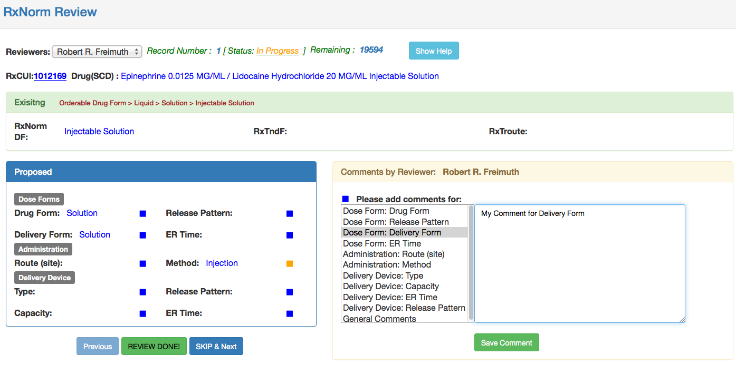
Current reviewer name, you can change it while staying on the same record. It does not reset the record you are reviewing or the comments you have typed so far.
Sequence number, shows which record you are on.
Shows how many more left to review. This includes records with “Incomplete” status. It does not include other record, which are being reviewed by other reviewers concurrently at this review time.
Toggles Help content display.
Breadcrumb text shows the path in the hierarchy or terms
Comment Text goes here

Slide 2
Alternate way to select “General Comments” – to type comments for this drug as a whole.
Click one of these square icons to select the property to comment on.
Blue color shows that there is no comment for this property so far (for the selected drug)
Orange color shows that there is a comment for this property already.
Click on it to edit/update/remove the existing comment.
You can select multiple properties to comment on.
Clicking on “SKIP & Next” button (or “Previous” button) will skip this record for now from the review process. You can come back to it later and review/add your comments, as long as you stay in the same browser session and session is alive.
Saves the comment text “in memory”, for the selected properties (for current RxCUI). These comments are not persisted to the database, unless review is completed (by clicking “REVIEW DONE!” button and “Save & Next” button is pressed).
If you reload the page or close the browser, your comments for not “Completed” RxCUIs, will not be saved for next review session.

Slide 3
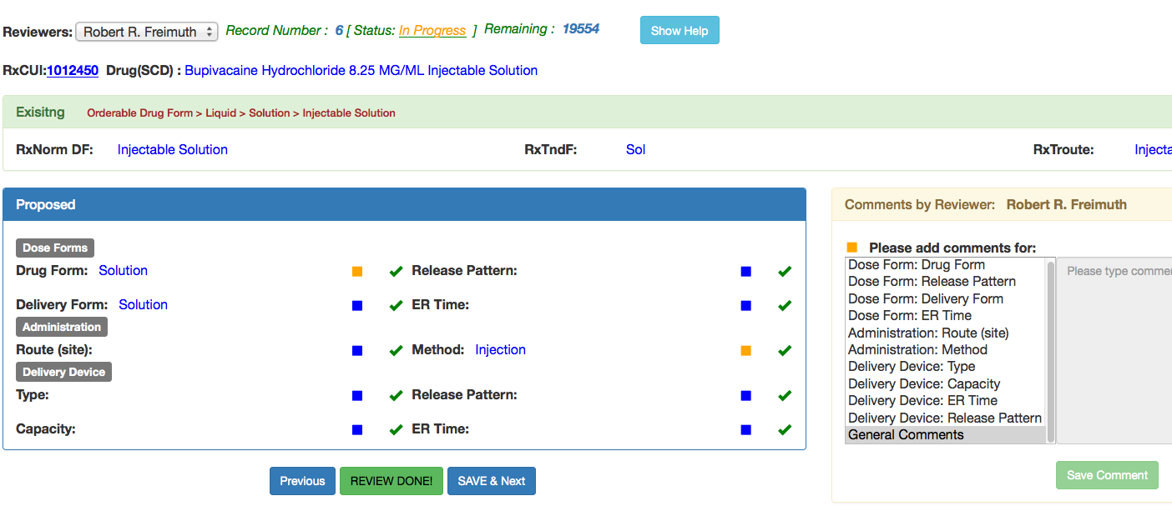
Check marks indicates that this record has been reviewed and comments are ready to be saved in database.
Click this to complete review of this drug. To save the comments to database, click on “Save & Next” Button. Clicking on “Previous” will take you to the previous drug to review and leaving the comments for this drug ‘in memory’ (not the database), you can come back to it and review your comments again, as long as you stay in this session and session is alive.
You can select multiple properties to comment on.

