Slide 1
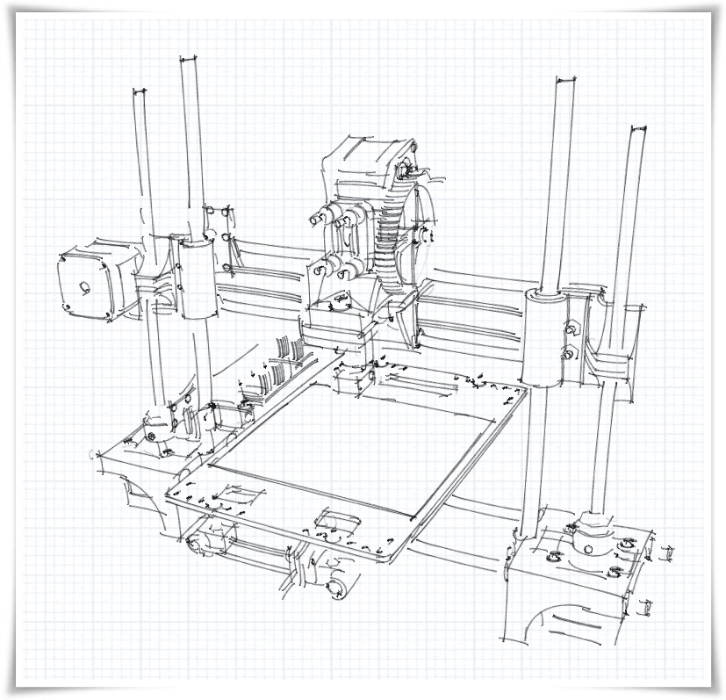





Portabee
Portable 3D Printer
Assembly Instructions
V1.0 (10 Jul 2012)

Slide 2
Introduction
Document Version & Date: V1.0 (10 Jul 2012)
Goal: Provide a visual guide of the steps needed to construct a Portabee Portable 3D Printer.
Original Authors:
Md Noh – design of the Portabee
Special Mention:
The design of the Portabee has been made possible by ideas, concepts, designs and good work by:
Brook Drumm (Printrbot)
Whosa whatsis (RepRap Wallace)
Jean-Marc Giacalone (Emaker Huxley)
Author of this Document:
Md Noh
Mendel STL Model Files:
https://github.com/romscraj/Portabee
Sketchup Model Credits:
Below are the Credits for the Sketchup models from 3D Warehouse
(sketchup.google.com/3dwarehouse/), modified for use in this documentation where necessary, and are
used in accordance to the Google 3D Warehouse - Terms of Service as of June 2012 under
Section 11.1, Subsection (c):
- 'stepper motor - nema 17' by russ_anderson
http://sketchup.google.com/3dwarehouse/detailsmid=7b5ee9e35f85c343757b961dad12f52
- 'Straight dashed line and arrow, ground' by Google
http://sketchup.google.com/3dwarehouse/details?mid=f352190b5a788ecff788b21b3d1cd437
- 'Spirit Level' by COL 1
http://sketchup.google.com/3dwarehouse/details?mid=2b43e78280d32d13c9de7b195ccfa970
- 'Wrench' by Xaltix
http://sketchup.google.com/3dwarehouse/details?mid=8a5eecc4ddf07cfcb847e83cc7b5598
- 'sledge hammer' by Paul
http://sketchup.google.com/3dwarehouse/details?mid=25f6f2002f9287ff6c142f9dd7073357
Licensing:
Portabee: GPL (http://reprap.org/wiki/GPL)
This Document: GFDL (http://www.gnu.org/licenses/fdl.html)
The source files for this document are available at:
https://github.com/romscraj/Portabee/downloads (.odp OpenDocument master)
Issues with this document can be submitted to:
romscraj@orangeknob.com
Note on Mr Bu character:
Mr Bu character designed and drawn by Md Noh, using Windows® Paint Version 5.1. Inspiration taken from the notorious Ikea® man (or perhaps woman), with that signature distinctive groovy zoot suit cum loon pants cum palazzo pants inspired jumpsuit. Mr Bu has absolutely no hair and truly has no skin colour – he is transparent. His aerodynamic, wind-tunnel-efficient head was inspired from (one half of) the RepRap logo. Due to his addiction to coffee (consuming 170 cups a day on average), he has since given up on bringing around with him numerous Thermos® flasks filled with brewed coffee (28 of them, totalling approximately 34 litres of coffee) and has switched to carrying packets of instant coffee sachets which he keeps in numerous specially tailored, internally accessible pockets within his jumpsuit.

Slide 3
Changelog
V0.9 (14 Jun 2012)
- Draft document. Not finalised and may contain errors.
V1.0 (10 Jul 2012)
- Initial release.

Slide 4
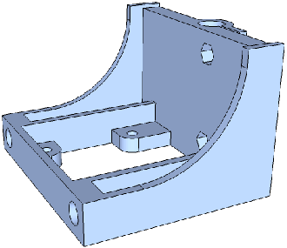
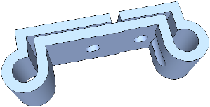
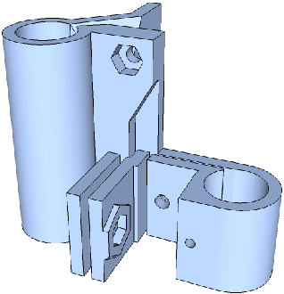
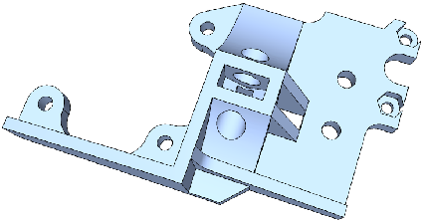
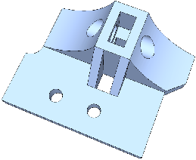
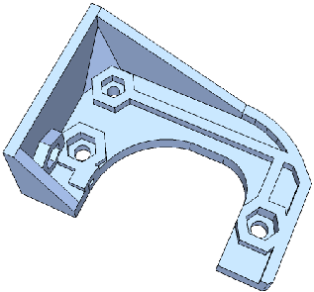
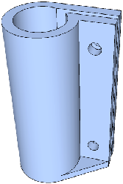
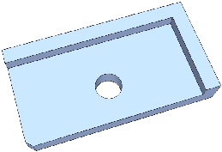
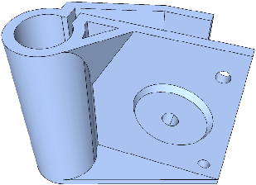
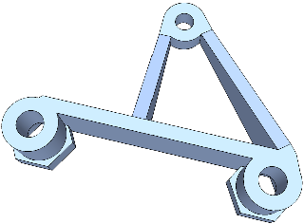
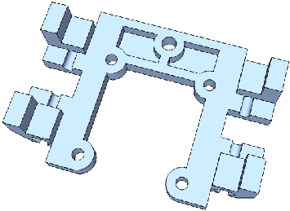
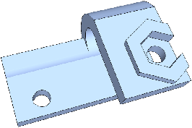
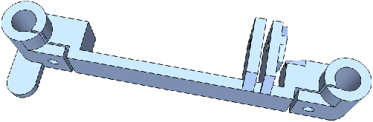
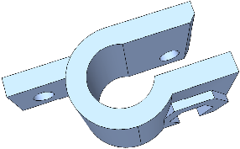
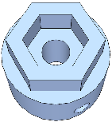

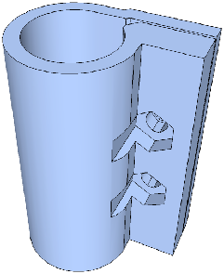
Bill of Materials (1/3)
Printed Parts
Note: Extruder parts are not included in this BOM. Part drawings not shown to scale.
2x base |  | 2x x-rod-clamp
1x x-end-motor |  | 1x x-carriage
1x x-end-idler |  | 1x extruder-plate
1x y-bearing-holder |  | 1x extruder-spacer
1x y-bearing-idler |  | 1x electronics-holder
1x y-block |  | 1x y-endstop-holder
2x y-end |  | 1x z-endstop-holder
2x z-shaft-coupling |  | 2x lock-clip
2x z-bearing-holder

Slide 5
Bill of Materials (2/3)
Non-Printed Parts
Note: Extruder parts are not included in this BOM.
It is recommended to procure extra quantities of common parts to be on the safe side.
Quantity | Item Description | Remarks
2 | Ø 8mm smooth rod, 290mm | Z axis smooth rods. Hardened linear rods recommended.
2 | Ø 6mm smooth rod, 235mm | Y axis smooth rods. Hardened linear rods recommended.
2 | Ø 6mm smooth rod, 250mm | X axis smooth rods. Hardened linear rods recommended.
2 | M6 threaded rod, 210mm | Z leadscrews
2 | M6 threaded rod, 350mm | Base frame rods
25 | M6 hex nut
15 | M6 flat washer
10 | M4 hex nut
15 | M4 flat washer
4 | M4 nylon large washer | 4mm ID x 18mm OD x 2mm
45 | M3 hex nut
1 | M3 wing nut | For mounting electronics when using romscraj's modified z motor (refer to Part 6, Step 6.6)
45 | M3 flat washer
25 | M3 nylon flat washer
2 | M4x35 bolt | Socket cap head recommended
5 | M4x25 bolt | Socket cap head recommended
2 | M3x40 bolt | Socket cap head recommended
4 | M3x30 bolt | Socket cap head recommended
12 | M3x16 bolt | Socket cap head recommended
25 | M3x10 bolt | Socket cap head recommended
2 | M3x8 set screw
2 | M3x5 set screw | For use on motor pulleys from romscraj. Requirement may differ if other pulleys are used.
2 | 624 ball bearing | Typically 624ZZ
7 | LM6 linear bearing | Typically LM6UU
4 | LM8 linear bearing | Typically LM8UU
2 | Manufactured belt pulleys | For X and Y axes. Typically T2.5 or 2GT profile.
1 | 350mm belt | For X axis. Belt teeth profile to match pulley (T2.5 or 2GT)
1 | 650mm belt | For Y axis. Belt teeth profile to match pulley (T2.5 or 2GT)
1 set | Electronics + Endstops + associated connecting cables + compatible power supply | Portabee kits shipped with Gen6.d and set of 3 PCB-mounted mechanical endstops. Power supply: 12V 10A
4 | NEMA 17 bipolar stepper motor with cable | Note that extruder motor is not included in qty

Slide 6
Bill of Materials (3/3)
Non-Printed Parts (continued)
Note: Extruder parts are not included in this BOM.
It is recommended to procure extra quantities of common parts to be on the safe side.
Quantity | Description | Remarks
1 | Printbed (heated platform) | Provided with the Portabee kit. If a non-heated platform is desired, refer to 'printbed-simple.png' dimension drawing: https://github.com/romscraj/Portabee
1 | Kapton (polyimide) tape | For covering the printbed print surface. 50mm width recommended (and provided with Portabee kits). If non-heated platform is used (i.e. not using the printbed), use blue painter's tape or masking tape.
2m | Spiral cable coil | Used to organize wires and cables
10 | Ziptie | Used to organize and affix wires and cables
1 | Extruder, complete with motor and hot end | The Portabee is designed to work only with the Wade V3 extruder at the moment. Other extruders may be used with modifications likely required.
1 | Spirit level | 15cm length or shorter would be ideal – must have bubble windows for both horizontal as well as vertical alignment
2 | 10mm combination wrench | Very highly recommended for ease of assembly – for use with M6 nuts. Small adjustable wrenches may also be used
1 | 2mm hex wrench (allen key) | For use with M3 set screws
1 | 2.5mm hex wrench (allen key) | For use with M3 socket cap head
1 | 3mm hex wrench (allen key) | For use with M4 socket cap head
1 | Steel rule / measuring tape | 15cm/6” steel rule with zero at the edge is recommended
1 | Hand drill with 3mm, 4mm, 5m, 6mm and 8mm drill bits | For reaming / cleaning out holes on printed parts. Powered (ideally cordless) with speed control highly recommended.
1 | Needle nose pliers
1 | Small wire cutter / diagonal pliers | Sharp blades for trimming belts, zipties etc.
2 | File | Round / rat-tail, and flat bastard files. A set of assorted needle files may also come in handy.
1 | Small mallet or hammer | May be required for gently tapping in metal rods into plastic parts during the assembly. Sledgehammer not recommended.
1 | Safety eyewear | Eyeballs are delicate, soft, precious, well, balls. Eye injuries usually aren't much fun at all.
Recommended Essential Tools

Slide 7
Part 1
Assembling the base

Slide 8
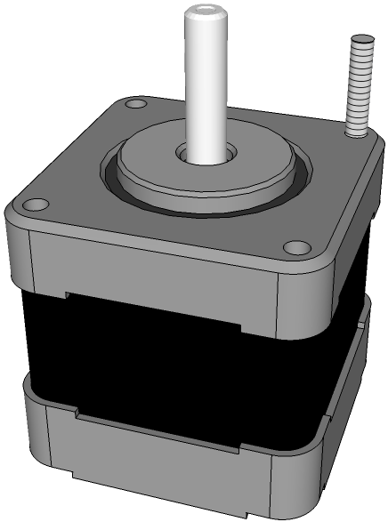
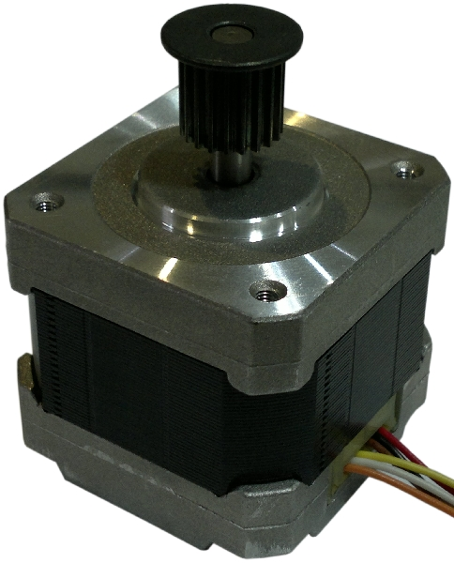
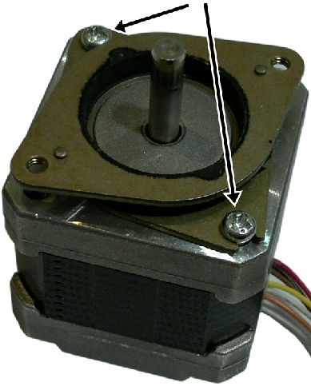
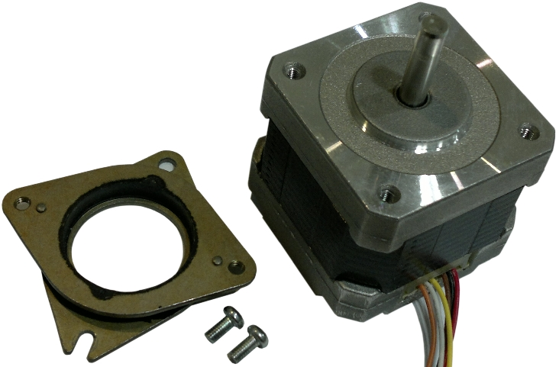
Note for Portabee kits: Almost all the RP printed parts that came in the kit are unreamed and uncleaned. Most times they may require cleaning up before assembly, especially for the holes. A hand drill running slowly with the proper size drill bit is recommended for cleaning out holes, and files may also be required to clean out certain parts.
Below are the drill bit sizes that are needed to clean out / ream out holes to the corrrect size:
Drill bit size: | For use on:
3mm | holes for M3 bolts
4mm | holes for M4 bolts
5mm | holes on pulleys for mounting onto motor shaft
6mm | holes for M6 rods
8mm | holes for M8 rods
Note on identifying motors in the kit:
There are a total of 5 motors in the Portabee complete kit – one X motor, one Y motor, two Z motors (left and right), and one Extruder motor.
Look for the motor with a protruding M3 screw thread at one corner – this is the left Z motor.
Inspect all the remaining motors in your kit. If there are two motors with a black pulley attached onto the motor shaft, these are the X and Y motors. Note that some kits may not have such motors included.
The remainder of the motors (without protruding screw thread, and without attached motor pulley) may be used for any of the remaining positions.
Left Z motor:
Note protruding M3 screw thread
Motor with attached black pulley – your kit may or
may not have this included. If included, these are to
be used as the X and Y motors.
If your motors came with a vibration-damping mount attached, this needs to be removed.
This applies to all the motors in the kit.
Unscrew these two mounting screws
to remove vibration-damping mount

Slide 9
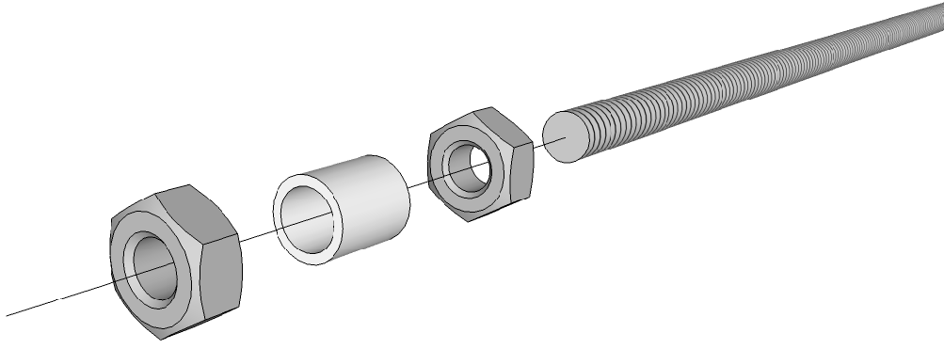
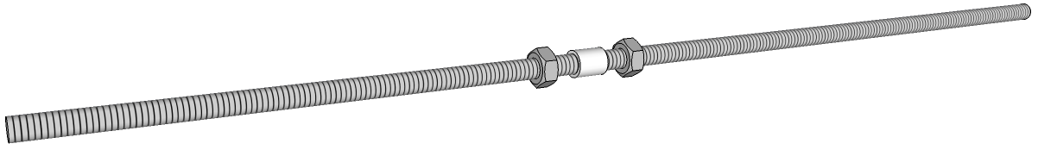
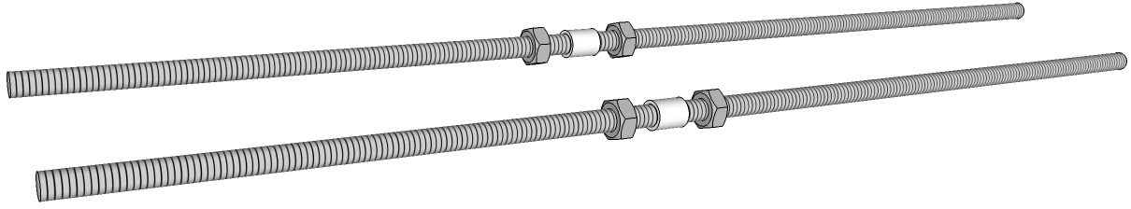
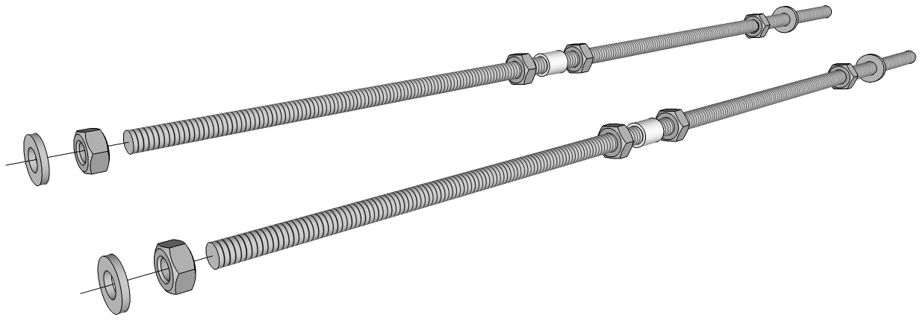
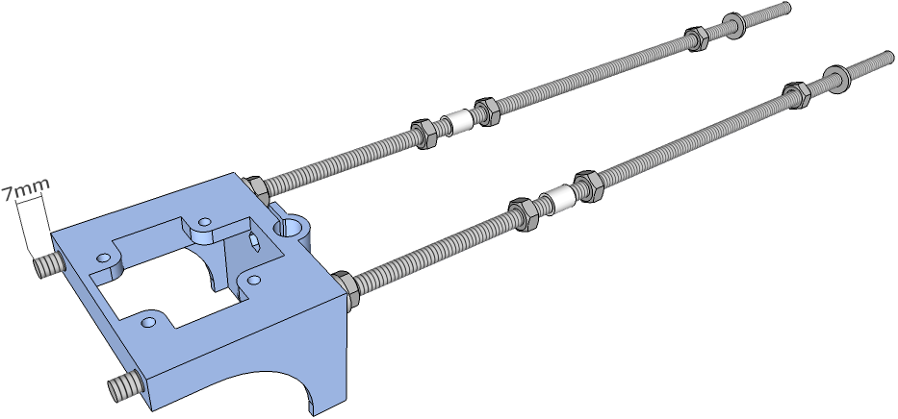
1.1
Insert the following into one of the 350mm M6 threaded rods:
M6 nut – 6mm ID x 8mm OD x 10mm LG PTFE tubing – M6 nut
Position them to approximately the middle of the rod. Do not tighten the nuts.
1.2
Repeat the previous step for the other 350mm M6 threaded rod.
1.3
Insert a nut followed by a washer into each end of both 350mm threaded rods. Insert the rods into one base part and leave approximately 7mm protruding out – adjust the position of the nut and washer on each rod to achieve this.

Slide 10
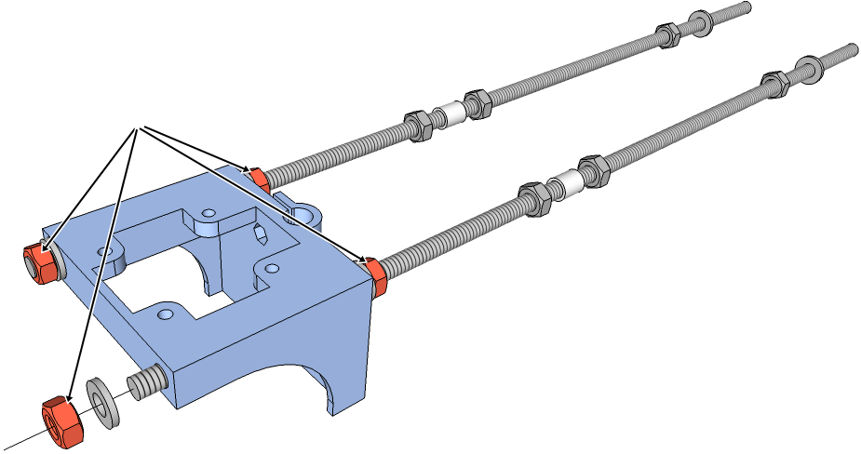
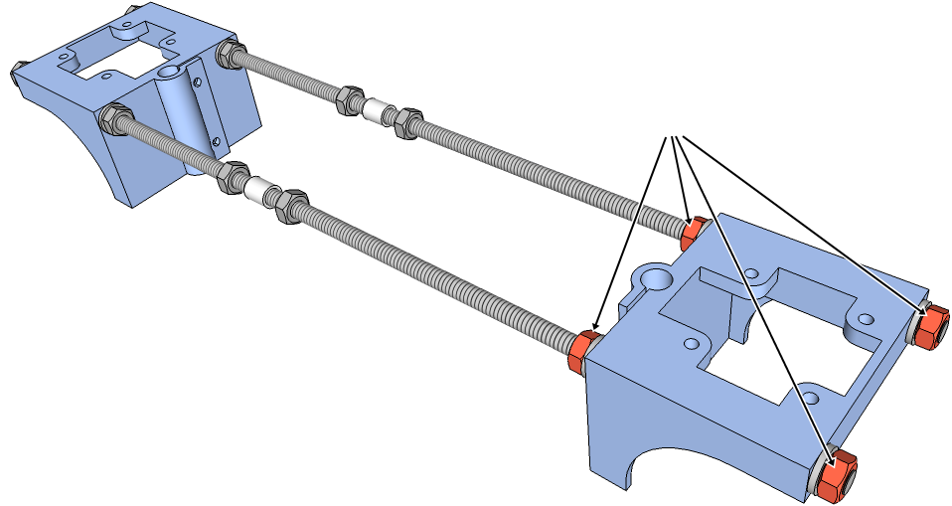
1.4
Insert a washer followed by a nut into the open end of each threaded rod against the base part. Tighten the nuts only by hand against the base for now (do not use tools).
Tighten these nuts by hand only
(without the use of tools)
Note: Actual nuts are not red in colour, and are highlighted so for illustrative purposes.
More of such highlighting can be found as you proceed through this document.
1.5
Insert the other base part into the opposite end of the threaded rods. Add a washer followed by a nut to the open end of the threaded rod. Tighten the nuts by hand for now (do not use tools).
Tighten these nuts by hand only
(without the use of tools)

Slide 11
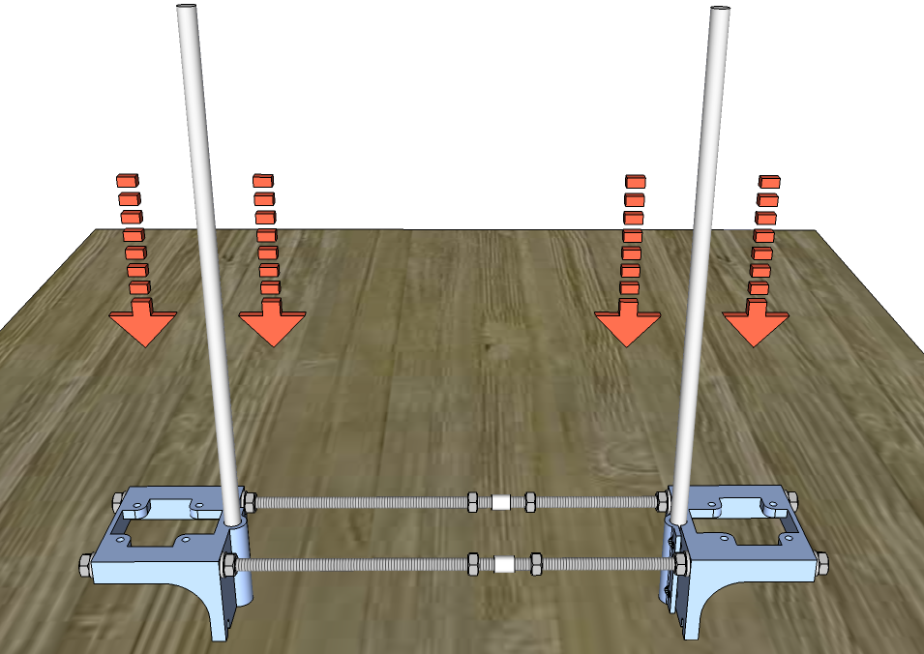
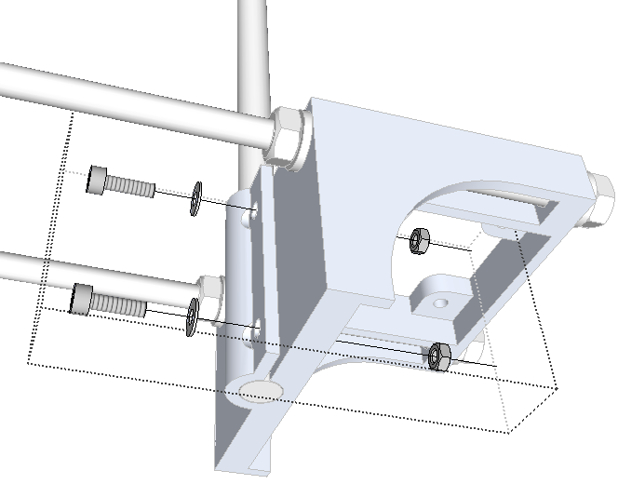
1.6
Insert one 290mm Ø 8mm smooth rod (the z smooth rod) into one of the base parts. You may find it easier to do this by placing the parts on a table, and pressing the rod down into the hole with a twisting motion. You may want to protect the tabletop surface from damage by doing this on a hard, flat material eg. a cutting mat, coaster or an old faulty compact disc (or perhaps a working condition music CD from an artist that you do not like).
Ensure that the rod does not protrude out of the underside of the base part – it should be flush with or slightly recessed into the bottom of the base. Repeat with the other z smooth rod and base part.
Put a washer on each of two M3x10 bolts and insert them through the two rod clamp holes on the base. Insert an M3 nut to the end of both bolts, into the nut traps on the inside face of the base part. Tighten the M3x10 bolts.

Slide 12
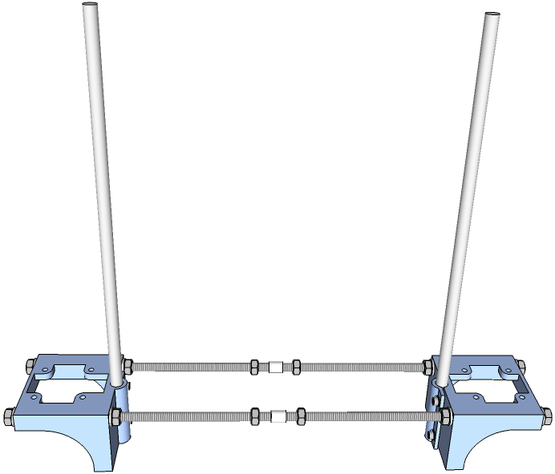
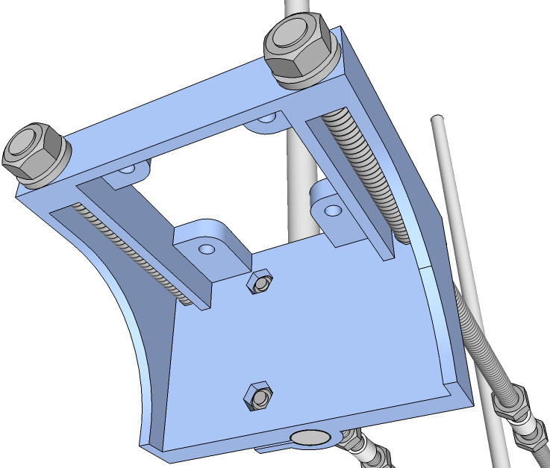
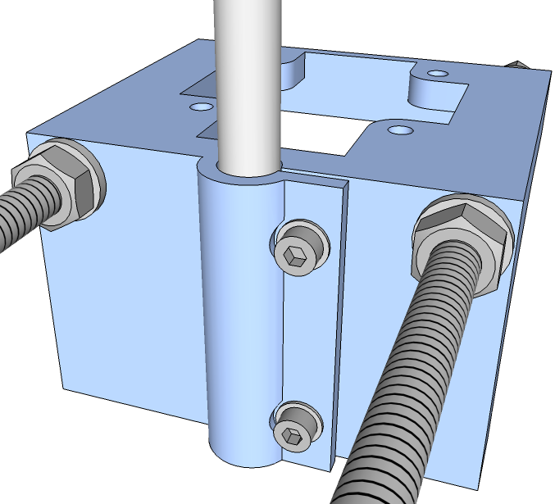
1.7
Repeat the previous step on the other base part.
Refer to the pictures below and verify that your build is correct.

Slide 13
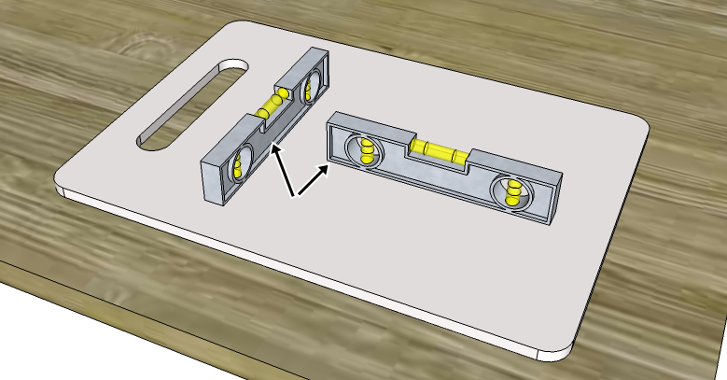
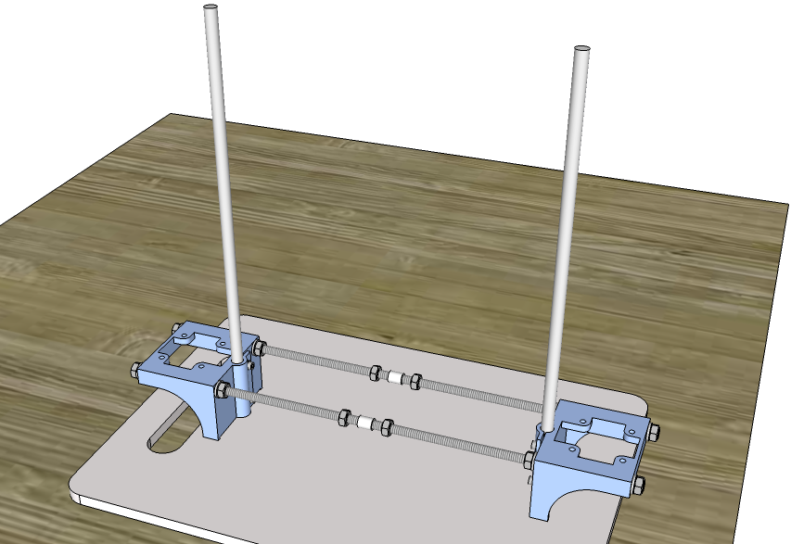
1.8
Perform an initial levelling of the base.
Find a suitable perfectly flat, stiff object of at least 25cm x 7cm in size. Examples would be a plastic chopping board, an MDF board or a large smooth tile.
Place the flat object on a table and use the spirit level to check if the surface is absolutely level. If not, stack bits of paper under the four corners of the object until this is so.
Once leveled, place the base assembly onto the object.
Check that object is perfectly level
by placing spirit level in the two
positions shown

Slide 14
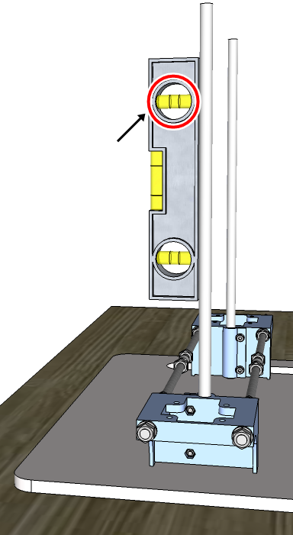


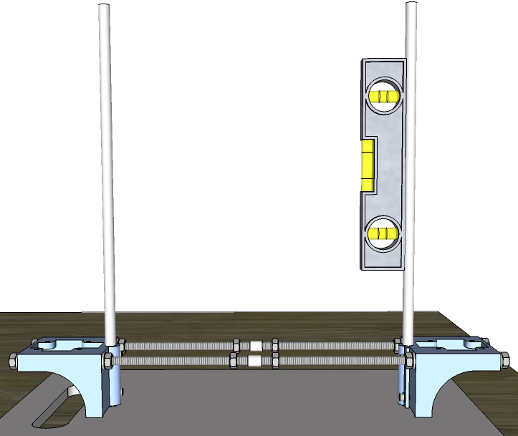
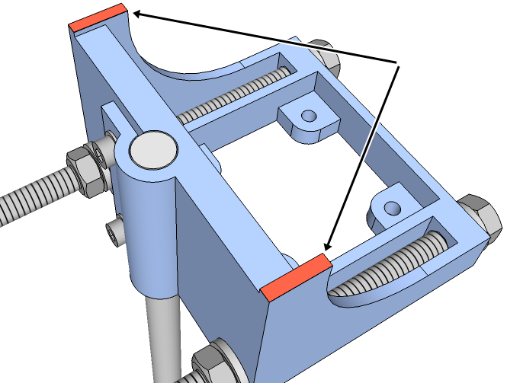
Place the spirit level vertically onto one of the z smooth rods as shown in the picture with the green tick. Check that the rod is perfectly perpendicular to the table surface, if not, file down only one of the two tabs on the underside of the base part in small amounts until this is so.
Repeat with the other z smooth rod on the other base part. Note that you may need to twist the base parts slightly with respect to each other to ensure that they sit flat on the surface as you are reading off the spirit level.
Refer to this bubble
to check if rod is
perfectly vertical
Wrong placement
of spirit level
(side view of table)
(underside of base part)
File down small amounts
at a time from only one of
these tabs to make the
z smooth rod perfectly
vertical
(End of Part 1)

Slide 15
Part 2
Assembling the x axis

Slide 16
2.1
Insert three LM6UU bearings into the bearing channels on the x-carriage. You may find it easier to do this by placing the bearing on end ('standing up') on a table, and pressing the x-carriage down onto the bearing. Take care not to injure your fingers underneath the part when pressing down. If the bearings feel loose when inserted, wrap a few rounds of tape (masking tape or sticky tape) around the body of the bearing to improve the fit.
You may want to protect the table surface from damage.

Slide 17
2.2
Insert the two 250mm 6mm smooth rods (one at a time) into one of the x-rods-clamp part. Note carefully the orientation of the part in the pictures below. You may find it easier to do this by placing the x-rods-clamp part on a table, and pushing the rods down into the holes with a twisting motion.
You may want to protect the tabletop surface from damage.

Slide 18
2.3
Carefully insert the x-carriage into the open end of the two smooth rods from the previous step, sliding the LM6UU bearings onto the rods. Note carefully the orientation of the parts in the pictures below.
Slide the carriage along the rods and check that it can do so smoothly. If this is not the case, lightly file (using a round / rat-tail file) the inside surface of the long bearing holder on the x-carriage, especially near the ends.
2.4
Insert the open end of the smooth rods into the other x-rods-clamp part. Only if necessary, lightly tap the rods in with a small mallet or other suitable tool - be sure to tap the metal rod ends and not the plastic part.
Refer to the pictures on the following page.

Slide 19


Slide 20
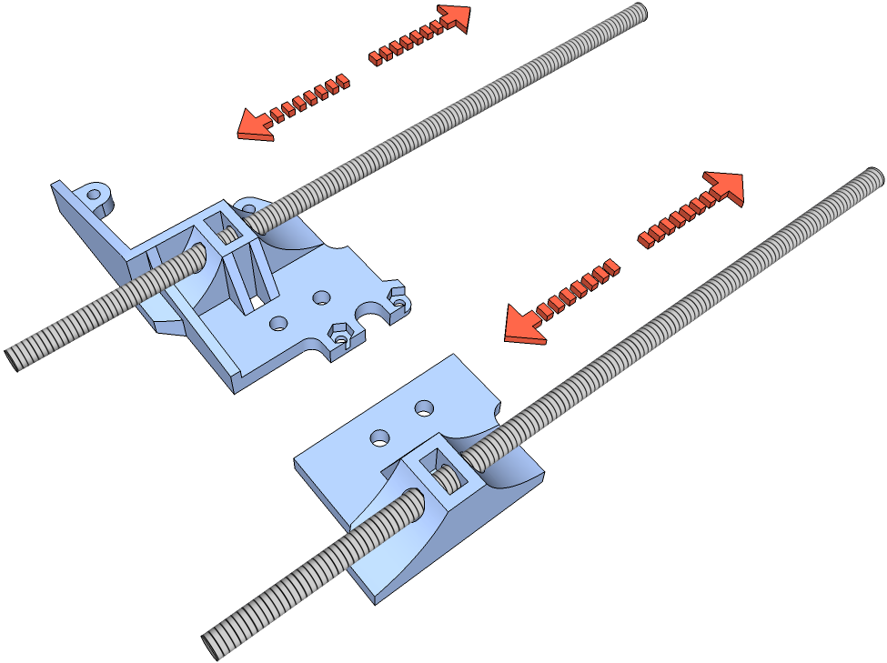
Verify your build so far by referring to the pictures below. Especially note the orientation of the holes on both x-rods-clamp parts.
2.5
Run an M6 threaded rod through the z leadscrew channel on both the x-end-motor and x-end idler as shown in the pictures below. The rod must be able to slide in and out smoothly without any resistance. If this is not the case, run the rod in and out of the hole until it is smooth, or carefully widen the hole by filing or drilling it out until this has been achieved.

Slide 21
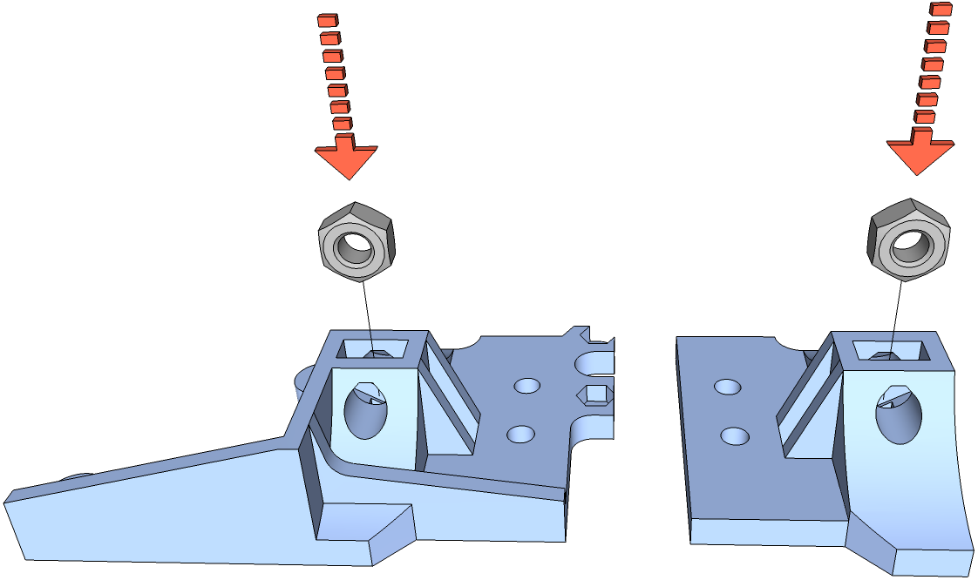
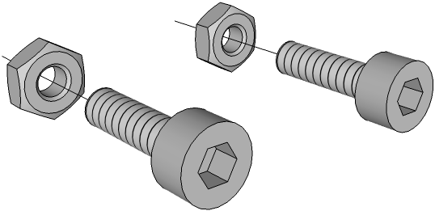
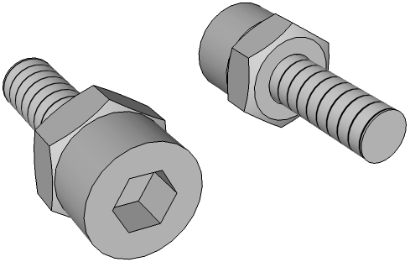
2.6
Insert an M6 nut each into the nut slot on the x-end-motor and x-end-idler. The nut should fit snugly – you may need to file the inside corners and/or faces if it is too tight to fit in. Ensure that the hole in the M6 nut aligns with the z leadscrew channel on each part.
2.7
Thread in an M3 nut onto each of two M3x10 bolts, all the way in.

Slide 22
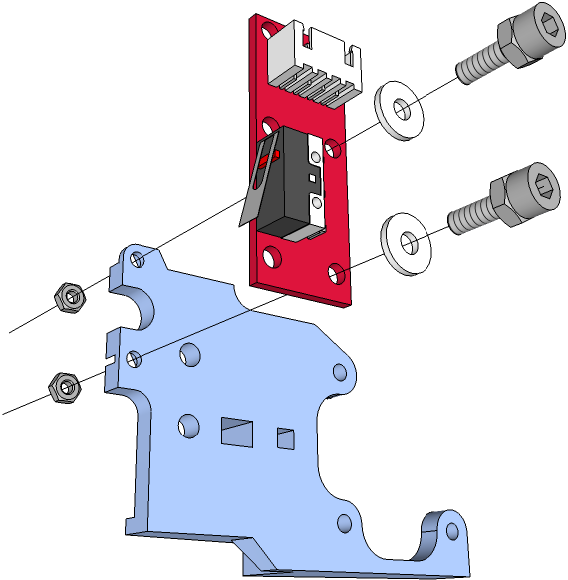
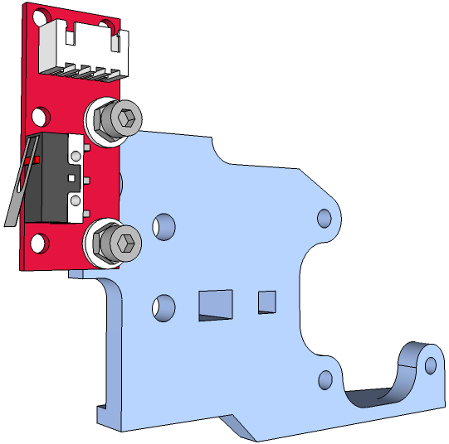
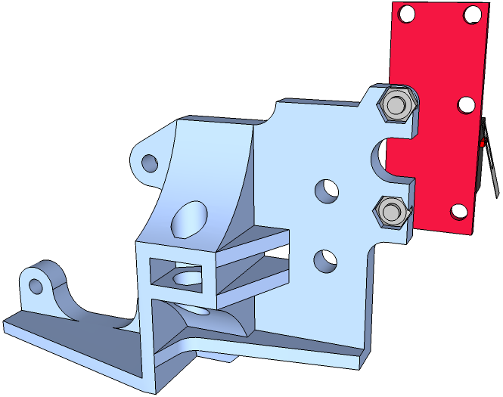
2.8
Insert an M3 nut each into both endstop nut traps on the x-end-motor part. Insert an M3 nylon washer into each of both M3x10 bolts from the previous step, and fasten an endstop onto the x-end-motor part.

Slide 23
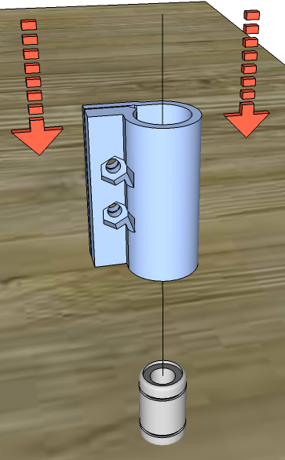
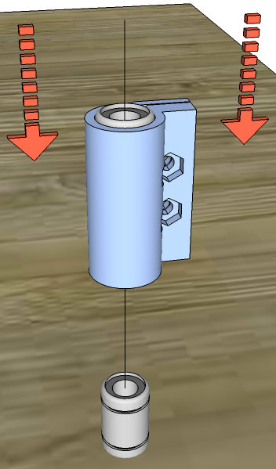
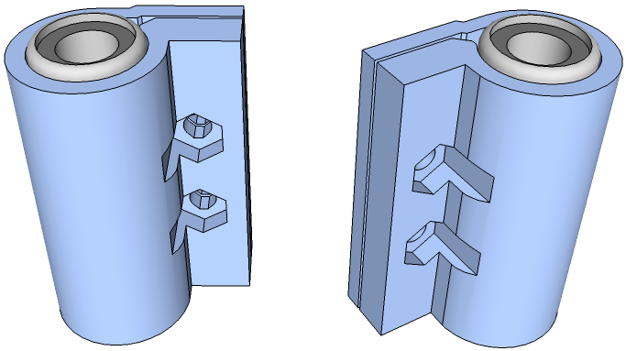
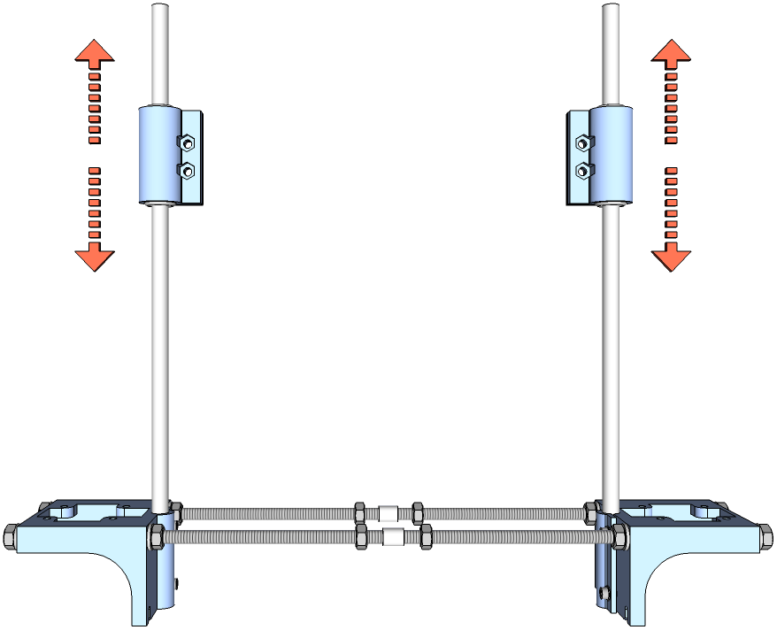
2.9
Insert two LM8UU bearings into one z-bearing-holder part. If the bearings feel loose when inserted, wrap a few rounds of tape (masking tape or sticky tape) around the body of the bearing to improve the fit. If too tight, lightly file the insides of the bearing holders. Note that each bearing will protrude out of the part slightly on both ends. Repeat with the other z-bearing-holder.
Insert the parts above into the z smooth rods. They should be able to slide smoothly up and down the rods. If this is not the case, remove the bearings and lightly file the insides of the bearing holders (especially near the ends). Once you are satisfied, remove the bearing holders from the smooth rods.
2.10
Insert an M4 nut into the each of the two nut traps on one of the z-bearing-holders. Align the two holes on the x-rods-clamp part, x-end-motor and z-bearing holder and fasten them together with two M4x25 bolts, with an M4 washer on each bolt. Tighten the parts together, but be careful not to overtighten.
Take your time to carefully study the pictures on the following page, and observe the orientation and positioning of the parts.

Slide 24
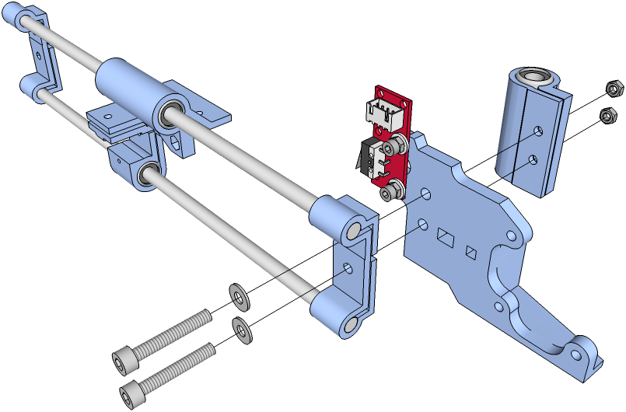




Slide 25



2.11
Insert the following into an M4x35 bolt:
M4 washer – M4 nylon large washer – M4 washer – 624 bearing – M4 washer – M4 nylon large washer – M4 washer
2.12
Insert an M4 nut into the each of the two nut traps on the remaining z-bearing-holder. Align the two holes on the x-rods-clamp part, x-end-idler and z-bearing holder. Fasten the parts together using the M4x35 bolt with inserted parts from the previous step, and an M4x25 bolt with an M4 washer. Tighten the parts together, but be careful not to overtighten.
Take your time to carefully study the pictures below and on the following page, and observe the orientation and positioning of the parts.

Slide 26




Slide 27



Verify your build so far by referring to the pictures below.
2.13
Place the assembled base from Part 1 on a flat surface. It is important that the surface is flat. Most tabletops are suitable, except for certain raw wood tops that have an undulating/bumpy surface (unless if it had been factory sanded flat).
Loosen the M6 nuts from the insides of both base-block parts such that they are able to move along the base M6 threaded rods by about 5mm or so.
Loosen these nuts

Slide 28


2.14
Carefully insert the x axis assembly into the z smooth rods though the LM8UU bearings. Slide both base parts along the base M6 threaded rods such that the z smooth rods align with the position of the LM8UU bearings and allow the x axis assembly to slide up and down the rods smoothly. Once this is done, tighten the M6 nuts on the base by hand. Remove the x axis assembly for now.
2.15
Tighten the M6 nuts on both base-block parts using proper tools. As you tighten, ensure that the base sits flat on the work surface (tabletop). If this is not the case, the base may end up being 'twisted' and will not be stable.
After tightening the base parts, insert the x axis and slide it up and down the z smooth rods to re-confirm that the alignment is correct. Remove the x axis assembly for now.
(End of Part 2)

Slide 29
Part 3
Assembling the y axis

Slide 30




3.1
Insert the two lock-clips into the channels on the y-block part. File the inside edges of the y-block part if it is too tight to fit.
3.2
Insert an M3 nut into the nut trap on the side of the y-block part. Add a washer onto an M3x40 bolt and insert it into the y-block part, through the lock-clip and fasten it onto the M3 nut. Do not over-tighten – the lock clip should be able to swivel on the bolt shaft with slight resistance. Repeat for the other lock clip.
Note the orientation of the parts in the pictures below (lock-clips highlighted in red for visual clarity)

Slide 31




3.3
Insert two LM6UU bearings each into the y-bearing-holder and y-bearing-idler parts. If the bearings feel loose when inserted, wrap a few rounds of tape (masking tape or sticky tape) around the body of the bearing to improve the fit.
'X-ray' view
3.4
Insert the two 235mm 6mm smooth rods (the y smooth rods) into one y-end part. Important – observe the orientation of the parts in the picture below.

Slide 32




3.5
Slide the y-bearing-holder and y-bearing-idler into the y smooth rods from the previous step. Important – note the orientation of the parts below.
The parts you have inserted should be able to slide smoothly along the rods. If this is not the case, remove the bearings and lightly file the insides of the bearing holders (especially near the ends).
3.6
Insert the open end of the smooth rods from the previous step into the other y-end part. You may find it easier to place the y-end part on the table and pressing the rods down into the holes. Only if necessary, lightly tap the rods in with a mallet or other suitable tool - be sure to tap the metal rod ends and not the plastic part. Refer to the pictures below and on the following page.

Slide 33





3.7
Insert the following into an M4x35 bolt:
M4 washer – M4 nylon large washer – M4 washer – 624 bearing – M4 washer - M4 nylon large washer
3.8
Slide the y-block into the opening of the y-bearing idler – align the big centre (4mm) hole on both parts. Add an M4 nut into the nut trap on the y-bearing-idler. Fasten the parts together using the M4x35 bolt with inserted parts from the previous step. Tighten by hand for now.

Slide 34




3.9
If your y motor came with a black pulley attached, skip this step (refer to the notes at the beginning of Part 1).
Insert a pulley onto the shaft of the y axis motor – leave a gap of approximately 5mm from the bottom of the pulley and the motor body. Insert an M3x5 grub screw into the pulley rim and temporarily tighten it onto the motor shaft.

Slide 35



3.10
Thread in an M3 nut onto each of two M3x16 bolts, all the way in.
3.11
Insert an M3 nylon washer into each bolts from the previous step. Insert the bolts through the holes on the y-bearing-idler, all the way through the y-block.
Insert an M3 nylon washer into each of two M3x16 bolts. Insert the bolts through the holes on the y-bearing-holder, all the way through the y-block.
M3x16 bolts with M3 nut
inserted from previous step

Slide 36





3.12
Add an M3 nylon washer to the open end of each of the bolts you have inserted in the previous step. Affix the bolts onto the y-axis motor – you may find it easier to do this by placing the y-axis motor on a table and screwing the bolt down onto it. Important – note the orientation of the motor cable in the pictures below.

Slide 37




3.13
Verify that the holes on the y-end parts (highlighted in red in the first picture below) are 212mm apart from each other. Insert an M3 nut into each of the two nut traps on one y-end. Add an M3 washer each onto two M3x30 bolts and insert them into the holes on the y-end part (into the opposite end of the nut trap) and tighten them. Tighten well to prevent the y-end parts from moving along the rods, but be careful not to over-tighten Repeat for the other y-end part.
As you are tightening, ensure that the y smooth rods are parallel to each other. After tightening, verify again that the holes on the y-end parts are 212mm apart (refer to the first part of this step).
Attempt to twist the rods and verify that they are tight against the y-end parts (the rods should not be able to twist). If this is not the case, remove the rods and carefully wrap some kapton tape neatly around the end of the rods to improve the fit, insert them again and re-tighten.
view from side to check that rods are parallel to each other

Slide 38


3.14
Slide the y smooth rods from end to end and confirm that they are able to do so smoothly. If this is not the case, loosen (do not remove) the two M3x16 bolts on the y-bearing-holder and y-bearing-idler, slide the rods from end to end a few times and re-tighten them again.
Once done, tighten the M4x35 bolt on the y-bearing-idler fully.
3.15
Position two of the nuts on the base threaded rods to be 90mm away from the inside edge of one of the base parts.
Using a set square, or a credit card or similar card, check that the two nuts you have positioned are perfectly perpendicular to the threaded rods. Refer to the pictures below and on the following page.

Slide 39



Align this edge with threaded rod
Ensure highlighted nuts are
aligned to this edge. If not,
move the nut which is away
from the edge towards the edge.
3.16
Slide the two PTFE tubing parts to the nuts that you have repositioned from the previous step. Tighten the two remaining M6 nuts against the PTFE tubings by hand only (do not use tools). Stop tightening once the parts feel reasonably secure (and cannot come loose easily). Do not over-tighten or you will deform the PTFE tubings, especially if you have strong fingers. Do not use teeth to tighten the nuts.
Important - be careful not to move the two M6 nuts that you have positioned from the previous step.
Remember the side of the base part that you have referenced your measurement from the previous step – this is the left of the printer. You may want to make a small mark either with a marker pen or a small sticker pasted on the left base part to make it easier to identify the left side of the printer as we move on with the assembly.
Tighten these nuts against the
PTFE tubings by hand only
REAR
LEFT
RIGHT
FRONT

Slide 40


3.17
Place the y-axis assembly (from Step 3.14) onto the base threaded rods – position the y-block such that the lock clips align with the PTFE tubings. The lock-clips will need to be rotated upwards in order for the y-block to sit onto its proper position on the base threaded rods.
Important – carefully study the drawings below and on the following page and compare them to your build before proceeding or you may risk breaking the lock clips.
Once you are sure that the y-block has been seated correctly on the threaded rods, test the locking mechanism by rotating the lock-clips down and securing it onto the PTFE tubings. The y-axis assembly should now be secure on the threaded rods.
REAR
LEFT
RIGHT
Rotate lock clips
upwards before
attaching y-axis
assembly to base
FRONT
(viewed from underside)
M6 nuts must be
seated within the
recess portion of
y-block part on
both sides

Slide 41


Threaded rod must be in contact with
both inside surfaces as highlighted,
on all four corners of the y-block part
3.18
Remove the y-axis assembly from the base.
Position the y-endstop-holder to be 14mm apart from the left-most M6 nut on the front base threaded rod, and slide it onto the threaded rod.
Insert a nylon washer each onto an M3x16 bolt and an M3x10 bolt. Affix a PCB-mounted endstop onto the y-endstop-holder using these bolts – add an M3 nut to the open end of the M3x16 bolt (into the nut trap on the y-endstop-holder), and an M3 washer followed by a nut to the open end of the M3x10 bolt. Be careful not to over-tighten the M3x16 bolt or you may break the y-endstop-holder.
REAR
FRONT
LEFT

Slide 42



M3 nylon washers
(End of Part 3)

Slide 43
Part 4
Assembling the z axis

Slide 44






4.1
Thread in two M6 nuts into a 210mm M6 threaded rod. Position the outermost nut to be flush with the end of the threaded rod. Tighten the two nuts against each other tightly (using proper tools). Repeat with the other 210mm M6 threaded rod. Going forward, these will be referred to as the z leadscrews.
position outermost nut to be
flush with end of threaded rod
Z leadscrews
4.2
Ensure that the hole in the centre of the two z-shaft-coupling parts matches the motor shaft – it should slide on and fit very snugly. If it is too tight, carefully drill or file the hole. Once done, remove the z-shaft-coupling part from the motor.

Slide 45






4.3
Insert an M3 nut into the rectangular slot on the underside of the z-shaft-coupling. The fit should be fairly tight. If it is too tight, you may need to widen the slot slightly. Make sure that the centre of the nut is aligned with the channel in the pulley that goes to the centre hole.
Insert an M3x8 set screw into the channel on the rim of the hub. Screw it through the M3 just nut enough to hold it in place (one or two full turns will do).
Repeat the above with the other z-shaft-coupling.
4.4
Place one of the z-shaft-coupling part on a flat surface (eg tabletop) – you may want to protect the surface from damage. Take one of the z leadscrews from Step 4.1 and push down the end with the M6 nut into the z-shaft-coupling – align the M6 nut with the hex recess on the part.
The fit should be fairly tight. Repeat with the other z leadscrew and z-shaft-coupling part.
Align M6 nut
to hex recess

Slide 46



4.5
There are two z motors, one for the left and the other for the right side of the printer. Identify the left z motor – this is the one with an M3 screw thread protruding out at one corner of the top (refer to the notes at the beginning of Part 1).
Insert the z-shaft-coupling (which has been attached to the z leadscrew) onto the motor shaft. Push down well to ensure that the motor shaft is inserted as far as it can go into the z-shaft-coupling, then tighten the M3x8 grub screw Do this for both z motors.
Note protruding
M3 screw thread
on left z motor
4.6
Insert the left z motor into the left base part from underneath. Position the protruding M3 screw thread on the inside-rear hole on the left base part. Fasten the motor onto the left base part with three M3x10 bolts with an M3 washer on each bolt (we will address the protruding M3 screw thread later on). Refer to the pictures below and on the following page.
Note location of protruding
M3 screw thread
LEFT

Slide 47




Fasten motor with
three M3x10 bolts
with an M3 washer
on each bolt
4.7
Repeat the previous step with the right z motor – this time use four M3x10 bolts, with an M3 washer on each bolt, to fasten the motor onto the right base part. It is recommended to fasten the motor in such a way that the cable exit is facing inwards. Refer to the pictures below.
RIGHT
RIGHT
(viewed from underside)

Slide 48





4.8
Insert a nylon washer each onto an M3x16 bolt and an M3x10 bolt. Affix a PCB-mounted endstop onto the z-endstop-holder using these bolts – add an M3 nut to the open end of the M3x16 bolt (into the nut trap on the z-endstop-holder), and an M3 washer followed by a nut to the open end of the M3x10 bolt. Tighten the M3x10 bolt to fasten the endstop, but leave the M3x16 bolt untightened for now.
M3 nylon
washers
4.9
Take the z endstop holder and insert the circular inside of the 'U' through the top of the left z smooth rod (290mm Ø 8mm smooth rod). Slide it down the smooth rod until it is approximately 20mm above the left base part. You do not need to tighten the M3x16 bolt at this point. Note the orientation of the endstop in the pictures below.
LEFT

Slide 49


4.10
Take the x-axis assembly (that you have assembled in Part 2) and insert it into the top of the z smooth rods – the x-end-motor is to be on the left. Guide the z leadscrews into the channels on the x-end and x-idler parts, and thread them into the M6 nuts. Thread in both z leadscrews by the same amount, i.e. give each the same number of turns, to ensure that the x axis remains level as it is lowered down.
Stop turning the z leadscrews once the x axis has been lowered to approximately 1/3 of the length of the z smooth rods.
Turn z leadscrews
counter-clockwise
to lower x-axis
(End of Part 4)

Slide 50
Part 5
Mounting the extruder and belts

Slide 51




5.1
At this point, assemble the extruder and hot end before proceeding. The assembly instructions can be found in the “Romscraj Extruder Assembly Instructions”, which can be downloaded from here:
https://github.com/romscraj/romscraj-extruder/downloads
(Download the PDF version, available in two resolutions – low and high)
5.2
Add an M3 washer into an M3x16 bolt. Insert the bolt into the hole in the x-carriage as pictured below and add an M3 nut into the nut trap on the other side. Tighten everything together.

Slide 52



5.3
Add an M3 washer into another M3x16 bolt. Insert the bolt into the hole in the x-carriage and through the extruder-plate part as pictured below. and add an M3 nut into the nut trap on the extruder-plate. Fasten the parts together but do not fully tighten yet.

Slide 53



5.4
Add an M3 washer into another M3x16 bolt. Insert the bolt into the hole in the x-carriage and through the extruder-plate part as pictured below. and add an M3 nut into the nut trap on the extruder-plate. Fasten the parts together but do not fully tighten yet.

Slide 54





5.5
Place the extruder-spacer onto the front top edge of the extruder-plate. Note the raised edge on the bottom side of the extruder-spacer.
Top
Bottom
Note raised edge
on bottom side
5.6
Mount the extruder on the extruder-plate using two M4x25 bolts with an M4 washer on each bolt. Add an M4 nut to the end of each bolt, into the nut traps on the underside of the extruder-plate. Note the orientation - the extruder motor should face the rear of the printer. Tighten the bolts, as well as all the other bolts on the x-carriage and extruder-plate.

Slide 55

5.7
If your x motor came with a black pulley attached, skip this step (refer to the notes at the beginning of Part 1).
Insert a pulley onto the shaft of the x axis motor – leave a gap of approximately 5mm from the bottom of the pulley and the motor body. Insert an M3x5 grub screw into the pulley rim and tighten it onto the motor shaft.
5.8
Fasten the motor onto the x-end-motor using 3 M3x10 bolts. The cable exit on the motor should be on the bottom. Put an M3 nylon washer between each bolt and the x-end-motor, as well as between the x-end-motor and the motor. Note the orientation: the motor body is on the front and the pulley points towards the rear. Tighten the bolts.
Use a total of 6 nylon
washers – 3 on each side
of the x-end-motor part

Slide 56



5.9
Take the 650mm belt and make a small loop on one end, with the teeth on the inside of the loop. Use a zip tie to hold the loop in place but do not tighten it fully yet. Refer to the picture below.
5.10
Insert the looped end of the belt all the way in onto the bolt on the rear of the x-carriage from Step 5.2. The toothed side of the belt is to face downwards. Slide the zip tie towards the bolt to tighten the belt. Fully tighten the zip tie and trim the excess length.
Slide zip tie towards
bolt, then tighten

Slide 57



5.11
Run the open end of the belt around the pulley on the x motor, around the idler bearing on the x-end-idler part and back to the x-carriage. Slide the into the belt clamp on the x-carriage.
Insert an M3x10 bolt with an M3 washer into the belt clamp and and a nut into the nut trap on the other side. Pull the the belt tight and tighten the belt clamp.
Trim the open end of the belt but leave about 15mm of excess length.
5.12
Slide in one end of the 350mm belt into one of the y-end parts, with the toothed side of the belt facing inwards. The belt should be inserted all the way down into the belt clamp on the y-end part.
Insert an M3x10 bolt with an M3 washer into the belt clamp and and a nut into the nut trap on the other side. Tighten the belt clamp.
Refer to the pictures on the following page.

Slide 58




5.13
Run the open length of the belt around the pulley on the y motor and the idler bearing, and slide the belt into the belt clamp on the other y-end part. Note: you may need to adjust the position of the pulley on the y motor such that it is at the same level as the idler bearing – this does not apply if your motor has an attached black pulley. Verify that your have inserted the belt correctly – the teeth on the belt should mesh with the motor pulley, and the smooth side of the belt should be on the idler bearing.
Insert an M3x10 bolt with an M3 washer into the belt clamp and and a nut into the nut trap on the other side. Pull the the belt tight and tighten the belt clamp.
Trim the open end of the belt but leave about 15mm of excess length.

Slide 59



5.14
Check that your belt tension is correct by turning the pulley on the x motor and y motor – the x carriage and the y-ends respectively should move immediately, but should not feel tight.
(End of Part 5)

Slide 60
Part 6
Mounting the printbed and electronics board

Slide 61













6.1
Prepare the printbed to be mounted onto the printer by referring to the steps below:
There are two 50cm long red PTFE wires included in the kit – these are the wires for the printbed heater connector. Strip approximately 8mm off one end of both wires.
Identify the top side as well as the front edge of the printbed. The top side of the printbed has text on it, eg. 'mee siam mai hum'. Insert the wires from the underside into the two outermost through-hole pads near the front edge of the printbed.
REAR
LEFT
(Top side)
RIGHT
(underside of printbed)
FRONT
Turn the printbed over and solder the wire leads to the pads. Trim the excess leads with a wire cutter. If you are not using a solder that specifies its flux as being 'no clean', you will need to remove the flux with a flux remover (or a swab soaked with denatured alcohol).
Strip approximately 6mm from the open end of the wires. Insert them into the terminal block connector provided (the green coloured connector), and screw tight. This is the printbed heater connector.
Printbed heater connector

Slide 62












Strip approximately 8mm off the wire ends of the printbed thermistor cable – this is the cable with a connector attached to two 50cm long black PTFE wires.
Cut the provided heat shrink tubing into two equal lengths and insert each into the two wires of the printbed thermistor cable.
Bend the thermistor leads to be parallel to each other as shown in the picture below. Solder the printbed thermistor cable wires to the thermistor legs, and insulate the solder joint and the thermistor leads with the heat shrink tubing.
Position the thermistor on the centre of the underside of the printbed with the wires leading to the front edge. Cut approximately an 8cm length of the provided kapton tape and fasten the thermistor to the underside of the printbed.
Plan carefully beforehand as this step cannot be reversed without damaging the cork sheet. Stick the five adhesive transfer strips onto one side of the cork sheet as shown below. Apply pressure on the adhesive strips to ensure that they stick well. Note that one side of the cork sheet measures 130mm (13cm) – this fits the width of the printbed. Align the longer edge to the large rectangular hole at the back of the printbed. Once you are confident of the placement, remove the adhesive backing and attach the cork sheet to the underside of the printbed, covering the thermistor.

Slide 63





Cut approximately 45cm of the provided spiral cable coil. Wrap it around the wires of the printbed heater and printbed thermistor cables.
Use two zipties to attach the wrapped wires to the left underside edge of the printbed as shown in the photo below.
zipties
6.2
Thread an M3 nut into each M3x30 bolt on the two y-end parts. Leave 8mm of the bolt above each nut. Add an M3 washer onto each bolt.

Slide 64



6.3
Place the printbed onto the four M3x30 bolts. Note the orientation – the right side of the printbed corresponds to the side of the y assembly where the idler bearing is.
Note the holes used to mount the printbed in the pictures below.
REAR
REAR
'X-ray' view showing
idler bearing on right side
underneath printbed
FRONT
FRONT
6.4
Add an M3 washer followed by an M3 nut onto each M3x30 bolt above the printbed. Tighten by hand for now.

Slide 65




6.5
Insert an M3 nylon washer into each of two M3x16 bolts. Insert the bolts through the two standoff holes on the left on the electronics board as shown in the picture below.
Insert an M3 nut into each of the two nut traps on the underside of the electronics-holder part. Insert the bolts into the electronics-holder part through the top, and tighten them onto the M3 nuts.
6.6
Insert the electronics holder into the protruding M3 screw thread on the left z motor. Insert an M3 washer followed by the M3 wing nut. Tighten the wing nut to secure the parts.

Slide 66


Mount the y assembly onto the base. Be sure to refer to Part 3, Step 3.17 and ensure the y assembly has been seated properly before locking down.
Refer to the pictures below to verify your build so far.
REAR
LEFT
RIGHT
FRONT
FRONT
LEFT
RIGHT
REAR
(End of Part 6)

Slide 67
Part 7
Wiring the electronics
&
Axes movement testing

Slide 68





This section will cover electronics setup based on the Gen6.d electronics board, which is shipped with Portabee kits.
The connections for the Gen6.d electronics configuration are shown below:
7.1
7.2
Identify the X, Y an Z motor cables by measuring their lengths.
Study carefully the pictures below and on the following page and take note of the two possible connections for the motor cable – A and B.
Motor connector
Motor-side connector
of motor cable
Connect motor-side
connector of motor
cable to PH-6 connector
provided

Slide 69






Motor connection
Motor connection
Refer to the table below and connect the motor cables to their respective motors:
Motor Cable | Length | Motor Connection
X | 25cm
Y | 25cm
Z (Left) | 20cm
Z (Right) | 35cm
Extruder | 50cm

Slide 70



7.3
The Z-motor extension board splits the single z-motor connector on the Gen6.d electronics board to enable the two z motors (left and right) to be connected.
Mount the Z-motor extension board onto the Z-motor connector on the Gen6.d electronics board as shown below.
Z-motor extension board
7.4
Connect the motor cables to the Gen6.d electronics board (refer to Step 7.1 for the motor cable connection points on the Gen6.d).
Refer to the pictures for the recommended wire routing.
X motor cable
(viewed from rear of printer)

Slide 71


Y motor cable
Printbed removed for visual clarity
Y motor cable
Ensure that the
Y motor cable
is above the base
threaded rod
(viewed from rear of printer)
Printbed removed for visual clarity

Slide 72



Connect the two
Z motor cables
to the Z motor
extension board
Z motor cables
(left & right)
(viewed from rear of printer)
Printbed removed for visual clarity
7.5
Connect the three endstop cables to each endstop, and to their respective connections on the Gen6.d electronics board (refer back to Step 7.1 for the endstop connection points on the Gen6.d).
Refer to the pictures for the recommended wire routing.
X endstop cable
ziptie
Affix X endstop cable with ziptie as
shown above to prevent it from being
rubbed against the X axis belt
(viewed from rear of printer)

Slide 73


Y endstop cable
(viewed from rear of printer)
Z endstop cable
(viewed from rear of printer)

Slide 74


7.6
Connect the hot end cable to the extruder hot end.
Route the extruder motor cable, hot end cable and extruder fan cable to the electronics board. Refer to the picture for the recommended routing.
Extruder motor, hot end
and extruder fan cables
Extruder motor, hot end
and extruder fan cables
(viewed from rear of printer)

Slide 75


7.7
Move the x and y axes all the way in each direction, and check that no wires interfere with movement before starting the axes movement test.
Slide the x-carriage and printbed to approximately the centre of the printer. Move the z axis to approximately the halfway point between its upper and lower extremes.
Download and install daid's Cura from: https://github.com/daid/Cura/wiki which contains our highly recommended host controller software bundled within – kliment's PrintRun.
(Alternatively, you may choose to use another host controller software of your choice).
Power up your printer and connect the electronics to your computer via USB. Identify the port name the your printer is connected to, eg. COM38.
Run 'printrun.bat' from the Cura program folder (for Windows® users, you can click on 'PrintRun' in the Cura folder from the programs list in Start Menu).
From the pull down menu, set the port name your printer is connected to. If it is not in the list, type it in, eg. COM38.
Set the baud rate to 250000 from the pull down menu. Click .
Important: The hotend (or at least the extruder thermistor) must be connected to the electronics board for the printer to be connected in pronterface and allow axis testing to be performed. This should have already been done in Step 7.6.

Slide 76



Once connected, pronterface will show “Printer is online.” on the status bar.
In the “XY: mm/min” box, enter a value of 1500. In the “Z: mm/min box, enter a value of 120.
Click once on the “+x 10” button. Verify that the x axis moves to the right. Click once on the “-x 10” button. Verify that the x axis moves to the left.

Slide 77



Gently depress and hold down the x endstop switch. Verify that the LED on the endstop PCB lights up. While keeping the switch depressed, click once on the “-x 10” button. Verify that the x axis does not move. Release the endstop switch and click on “home x” button. Verify that the x-carriage moves all the way to the left and stops once it reaches the x endstop.
Click once on the “+y 10” button. Verify that the y axis moves forward (towards the front). Click once on the “-y 10” button. Verify that the y axis moves rearwards (towards the back).

Slide 78



Gently depress and hold down the y endstop switch. Verify that the LED on the endstop PCB lights up. While keeping the switch depressed, click once on the “-y 10” button. Verify that the y axis does not move. Release the endstop switch and click on “home y” button. Verify that the print-bottom-plate moves all the way to the rear and stops once it reaches the y endstop.
Click once on the “+z 10” button. Verify that the z axis moves upwards. Click once on the “-z 10” button. Verify that the z axis moves downwards.

Slide 79


Important: Ensure that the Z endstop is positioned higher than the printbed before proceeding. Also ensure that the Z endstop is positioned such that the switch is triggered when the x-end-motor part moves downwards and reaches the endstop.
Gently depress and hold down the z endstop switch. Verify that the LED on the endstop PCB lights up. While keeping the switch depressed, click once on the “-z 10” button. Verify that the z axis does not move. Release the endstop switch and click on “home z” button. Verify that the z axis moves downwards and stops once it reaches the z endstop.
Should any of the above 10 substeps above not yield the correct results, recheck the wiring of the cables, and that you have connected the cables from the electronics board to their respective endstop/motor correctly. Refer back to Step 7.1 for the Gen6.d drawing with labels, as well as the remainder of the steps in Part 7 which detail on the connections.
(End of Part 7)

Slide 80
Part 8
Levelling the printbed
&
Finalising the assembly

Slide 81

8.1
Find a suitable perfectly flat, stiff object of at least 25cm x 7cm in size. Examples would be a plastic chopping board, an MDF board or a large smooth tile.
Place the flat object on a table and use the spirit level to check if the surface is absolutely level. If not, stack bits of paper under the four corners of the object until this is so.
Once leveled, place the printer onto the object.
Check that object is perfectly level
by placing spirit level in the two
positions shown

Slide 82


8.2
Place a spirit level on top of the bed and adjust the nuts that hold the printbed on each M3x30 bolt until the spirit level shows that the bed is level. You will need to place the spirit level near all four edges of the printbed (one edge at a time), adjusting the nuts in small amounts until the bed is level.
Do not screw the nuts in too far – leveling should be accomplished using a combination of screwing and unscrewing the four nuts above, as well as the four nuts below the printbed. Once you are satisfied that the bed is level, tighten all eight M3 nuts against the printbed.
❷
❶
❸
❹

Slide 83


8.3
Turn both z leadscrews simultaneously to lower the nozzle until it almost touches the printbed. Slowly slide the x carriage to the left and right and observe the height of the nozzle with respect to the printbed surface. Take care not to scratch the printbed surface with the nozzle. Turn each z leadscrew until the nozzle height is equal along the entire x-carriage travel from end to end.
Once this is done, adjust the position of the z endstop such that the switch is triggered when the nozzle just touches the printbed surface, then tighten the nut on the endstop to secure its position.
Slide x-carriage all the way to the left
and observe distance of nozzle
from printbed
Slide x-carriage all the way to the
right and adjust z leadscrews to
position nozzle to same distance
from printbed as above picture.

Slide 84

The printbed surface may be slightly less than perfectly flat. This should not be a major problem under normal use.
However, if you find that this causes problems (for example when printing large parts, and/or with a first layer height lower than 0.25mm), we recommend purchasing a pane of glass measuring 130mm x 130mm x 3mm thick and attaching it to the printbed at the corners of the glass using small fold-back bulldog clips. Usually two clips placed diagonally at two corners is sufficient. The clips may or may not reduce the print area (just at the corners where they are placed), so this needs to be taken into consideration if you are printing parts near the corners of the print area.
As a note, romscraj does not ship glass in our kits due to the high cases of breakage, and due to the fact that glass is cheaply and easily sourced locally in almost all regions. Do consider purchasing more than one pane, since glass as we know breaks fairly easily from even minor careless handling (as well as bad home karaoke singing through a splendid sound system with the volume turned up).
8.4
Carefully cover the build surface (the glass pane, or the printbed surface if you are not using glass) with the supplied kapton tape. Ensure that there are no air bubbles or creases on the tape as this may affect printing. This is important, take as much time as you need.
8.5
Use the supplied spiral cable wrap to organize the cables neatly (refer to the photo example in Part 6, Step 6.1, substep 9). At the very least, the extruder motor, hot end and fan cables are to be wrapped together – this is highly recommended (we would think crucial) to prevent the individual wires from interfering with printing.
8.5
8.6
Your Portabee 3D printer assembly is now complete. Enjoy a cup of (instant) coffee on us.
(End of Part 8)

