Slide 1



PARADYME MANAGEMENT: ACCOUNTING FOR TIME
VS
VS

Slide 2


DELTEK TIME AND EXPENSE
Services
16,000 organizations and 2 million users in over 80 countries
Revered for its simplicity
One easily-adaptable, integrated system
Easy-to-use interface
Greater visibility into opportunities
Mobile app (Deltek Touch Time and Expense)
Case Studies
Raytheon and Hill & ENGEO

Slide 3


DELTEK TRAINING SYSTEM
Deltek University
Learning Portals
24/7 access to hundreds of short, topic-specific videos
Classroom instructor-led training
provides students with hands-on experience to match their unique role requirements. These courses are held at one of our learning facilities worldwide.
Live, online learning
same experience that you would get in one of our in-person courses without the travel costs or being out of the office
cover the same curriculum accessible from your office, home, or on the road.

Slide 4
DELTEK PRICING
Primary System |  | Back Up System
Requirements | Capital Investment | Annual Cost | Capital Investment | Annual Cost
Initial License Fee | $63
Back End Software Oracle/SQL Server - SSL Certificates | $12,000 | $2,400 | $12,000 | 2,400
SOX Independent Audit Sport - SSAE16-SOC2 Type II Audit @MA 201 Compliance | $35,000 | $35,000 | $0 | $0
Primary & 3 Backup Servers - Time & Expense X3 | $15,000 | $3,000 | $15,000 | $3,000
Security & Backup Appliances Firewall - Nightly Backups | $5,000 | $1,000 | $5,000 | $1,000
Maintenance Hardware - Software | $4,400 | $4,400 | $4,400 | $4,400
Secured Facility @5k/mo | $60,000 | $60,000 | $60,000 | $60,000
Personnel A-Mid. IT/DBA $65K@25% B-Fringe@35% of A C-Overhead@40% of AB D-G&A@10% of ABC | $ 16,250 $ 5,668 $ 8,775 $ 3,071 | $0 | $0 | $0
Totoal System and Operating Costs | $131,400 | $139,564 | $96,400 | $70,800
Total | $1,650 | $4,250 | $9,000

Slide 5

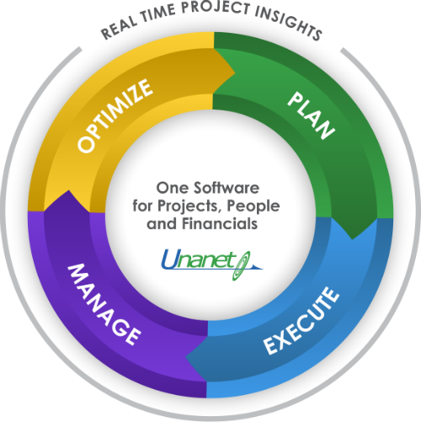

UNANET TIME SHEET AND EXPENSE
Services
Unanet™ Professional Services Automation (PSA)
helps organizations that need to reliably plan, track and manage projects, people and financials.
provides resource management, opportunity / project management, timesheets, expense reports, workforce collaboration, invoicing, general ledger, accounts payable, accounts receivable, and cost pool calculations in a single software application

Slide 6


UNANET TRAINING SYSTEM
Unanet University
Traditional Individual Training:
hands-on exercises individually using a Unanet with access to workstation he Unanet training site.
Team Training:
Complete all hands-on activities during class using one Unanet workstation and share ideas to implement the features within your Organization. Both participants will receive all course materials and will be eligible to receive CPE credit.

Slide 7
UNANET PRICING
 | Starter Edition | Standard Edition | Advanced Edition
Initial Purchase | $100/month | $2,000 | $3,000
 | Free | $750 | $1,750
 |  | $750 | $1,750
 |  |  | $1,000
Annual renewal |  | $750 | $1,500
Total

Slide 8


ICAT TIMESHEET AND EXPENSE
Services
installs easily and works with QuickBooks
ICAT gives contractors added functionality for compliance, business development, contract management and reporting.
loads the chart of accounts and configures indirect cost pools and bases for computing rates
cost pools and bases can be easily configured to work with your existing chart of accounts.
enables contractors to continue using their QuickBooks accounting system rather than implementing more costly systems.

Slide 9
ICAT PRICING
Fees | Starter Edition | Standard Edition | Advanced Edition
Initial Purchase | $1,250 | $2,000 | $3,000
Upgrade from ICAT 1.0 | Free | $750 | $1,750
Upgrade from ICAT 2.0 Starter Edition | None | $750 | $1,750
Upgrade from ICAT 2.0 Standard Edition | None | None | $1,000
Annual renewal | $400 | $750 | $1,500
Total | $1,650 | $4,250 | $9,000

Slide 10


ICAT SYSTEMS TRAINING
Two Methods of Training Support
Online Video Training
Fundamentals of Federal Cost Contracting Accounting
ICAT Training Videos
Live Training
Budget Development and Provisional Indirect Rates Workshops
Configuring QuickBooks to be DCAA Compliant
Fundamentals of Federal Contract Cost Accounting
Incurred Cost Report Workshop
Contractors subject to the "Allowable Cost and Payment"

Slide 11
System Compatibility
Qualities | Deltek | UNANET | ICAT
DCAA Compliant | Yes | Yes | Yes
Trial Period | Yes | Yes | Yes
Browsers | Internet Explorer, Chrome, Firefox and Safari | Internet Explorer, Chrome, Firefox and Safari
System Compatibility | Windows, Mac, Linux and Solaris | Windows and Linux | QuickBooks 2011 – Present Windows
Databases | MS SQL Server and Oracle | MS SQL SERVER and Oracle
Mobile App | Yes | No | No
Hacking History | Yes | No | No
Training Support | Yes (24/7) | Yes | Yes
Minimum Price | $1,650 | $4,250 | $9,000

