Slide 1

CardioRisk ML
Cardiovascular Risk Prediction
End-to-end ML pipeline for binary classification of cardiovascular risk
in a synthetic clinical dataset of 10,000 adult patients
Python 3.10+
Scikit-learn
XGBoost
SMOTE
Pandas
Emerson Antonio da Silva · github.com/emersonantoniods

Slide 2



Project Overview
CardioRisk ML
Three clinical questions drive the project:
1. Which factors drive cardiovascular risk?
Feature importance analysis across six ML models to identify the top clinical and lifestyle predictors.
2. Can ML reliably identify at-risk patients?
Binary classification on 10,000 synthetic patients calibrated against Framingham Heart Study & NHANES.
3. What threshold maximises clinical utility?
Threshold analysis optimised to maximise Recall — minimising missed high-risk cases in preventive screening.

Slide 3
Dataset — Synthetic Clinical Records
CardioRisk ML
10,000
~35%
37
42
Patient Records
High-Risk Class
Features (incl. 8 engineered)
Random Seed (reproducible)
Variable Groups
Clinical Grounding
Demographics
Glycaemic
Age (30–80 yrs), sex, race
Fasting glucose, HbA1c
Vitals
Lifestyle
Systolic/diastolic BP, BMI, resting HR, height, weight, waist circumference
Physical activity, smoking, alcohol use, diet quality, sleep, stress level
Lipid Panel
Comorbidities
LDL, HDL, triglycerides, total cholesterol
Diabetes, hypertension, family CVD history, CV medication
📋 Calibrated against the Framingham Heart Study & NHANES — correlations follow established clinical relationships.

Slide 4



Five-Notebook Pipeline
CardioRisk ML
01
02
03
04
05
›
›
›
›
Data
Generation
Exploratory
Analysis
Preprocessing
& Engineering
Modelling
& Comparison
Storytelling
& Conclusions
10,000 patients
seeded generation
Distributions,
correlations,
class balance
Encoding, SMOTE,
StandardScaler,
8 new features
6 algorithms,
5-fold CV,
composite scoring
Threshold analysis,
before/after,
exec. summary

Slide 5
Feature Engineering — 8 Derived Clinical Indices
CardioRisk ML
Raw lipid values alone miss synergistic effects. Eight features encode established clinical indices:
ldl_hdl_ratio
tg_hdl_ratio
Atherogenic index — LDL/HDL. More informative than isolated lipid values (ideal < 3.0)
Triglyceride/HDL ratio — insulin resistance proxy. Ideal < 2.0
pulse_pressure
metabolic_score
Systolic − Diastolic BP — arterial stiffness marker. >60 mmHg signals elevated risk
Composite of BMI, fasting glucose and blood pressure — captures metabolic syndrome signal
lifestyle_score
bmi_age_interaction
Physical activity × smoking interaction — captures compound lifestyle risk
BMI × age — amplifies obesity risk as patients age; captures delayed metabolic damage
glucose_diabetes
bp_hypertension
Fasting glucose × diabetes flag — flags uncontrolled glycaemia in confirmed diabetics
Systolic BP × hypertension flag — isolates drug-resistant or severe hypertension signal

Slide 6
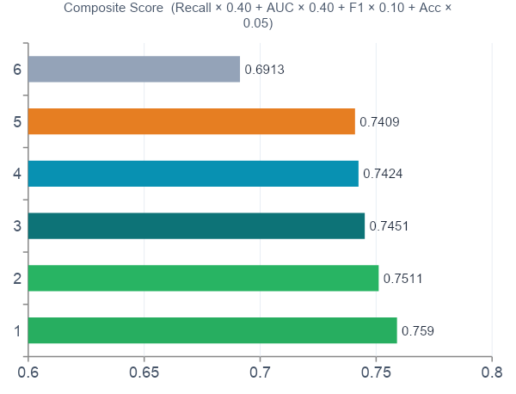

Model Comparison — 6 Algorithms
CardioRisk ML
Champion Selection Logic
Metric | Weight | Rationale
Recall | 40% | Miss = clinical risk
AUC | 40% | Class separability
F1 | 10% | Precision balance
Accuracy | 5% | Overall correctness
CV-AUC | 5%* | Generalisation (NB04 only)
* CV-AUC included in NB04 only; redistributed in NB05.
🏆 Champion Model
Logistic Regression
Score 0.7590 · AUC 0.866 · Recall 0.747
Feature engineering + SMOTE beat all complex ensembles.

Slide 7
Full Results — All 6 Models
CardioRisk ML
Evaluated on 2,000 held-out patients at natural class distribution (no SMOTE applied to test set)
Model | Accuracy | Precision | Recall | F1 | AUC | Score
⭐ Logistic Regression | 0.792 | 0.740 | 0.747 | 0.743 | 0.866 | 0.7590
SVM | 0.792 | 0.743 | 0.738 | 0.741 | 0.856 | 0.7511
Gradient Boosting | 0.786 | 0.741 | 0.719 | 0.730 | 0.863 | 0.7451
Random Forest | 0.780 | 0.729 | 0.723 | 0.726 | 0.854 | 0.7424
XGBoost | 0.792 | 0.760 | 0.706 | 0.732 | 0.865 | 0.7409
Decision Tree | 0.750 | 0.697 | 0.672 | 0.684 | 0.791 | 0.6913
💡 Key insight: Logistic Regression beat all ensembles. Feature engineering + SMOTE extracted the signal — the algorithm mattered less than the preprocessing.

Slide 8
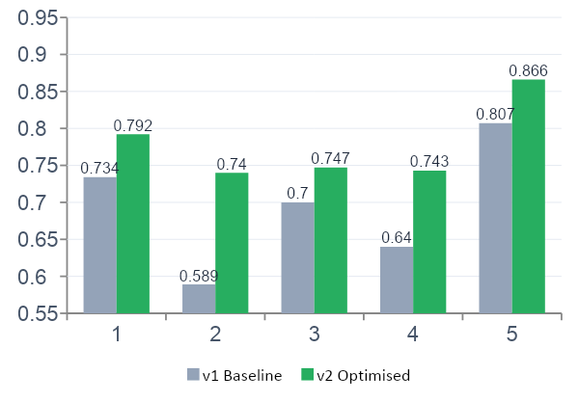
Optimisation Impact & Threshold Analysis
CardioRisk ML
v1 → v2 Improvement
Threshold Calibration for Screening
t = 0.50 (Default)
Recall 0.747 Precision 0.742 F1 0.744
Misses 1 in 4 high-risk patients.
t = 0.35 ← Recommended for Screening
Recall 0.863 Precision 0.650 F1 0.742
Catches ~9 in 10 high-risk patients.
~2 in 3 flagged = true positive (Precision 65%).
Unnecessary follow-up costs far less than a missed event.
v1 = Logistic Regression, no engineering, no SMOTE, default threshold

Slide 9




Key Findings
CardioRisk ML
Glycaemic markers dominate
Fasting glucose & HbA1c ranked #1 across all tree-based models — reflecting the strong causal link between insulin resistance and cardiovascular disease.
Engineered lipid ratios outperform raw values
LDL/HDL ratio consistently ranked above isolated LDL or HDL, validating established clinical atherogenic indices from the cardiology literature.
Smoking: disproportionate risk premium
Current smokers show ~2× the high-risk prevalence of non-smokers — the single largest individual-factor effect in the entire dataset.
Sedentary behaviour is strongly discriminating
Sedentary patients carry ~45 percentage points higher risk than those with intense activity — the most impactful modifiable lifestyle factor after smoking.
Diabetes + hypertension = highest-risk group
The concurrent comorbidity drove roughly double the prevalence of either condition in isolation — far exceeding additive risk expectations.

Slide 10

Conclusions
End-to-end ML pipeline validated on 10,000 synthetic clinical records with full reproducibility (seed = 42).
Feature engineering delivered the biggest lift: Precision +25.6% over baseline — outweighing algorithm choice.
Champion model (Logistic Regression, AUC = 0.866) proves that interpretable models can compete with complex ensembles when the preprocessing is rigorous.
At t = 0.35, the model catches 9 in 10 at-risk patients — clinically viable for preventive screening programmes.
Next step: validate on real-world data (e.g. UCI Heart Disease or Framingham public dataset) to assess generalisability.
Emerson Antonio da Silva · github.com/emersonantoniods · Madrid, Spain

