Slide 1
Blockchain Network
Blockchain Node
XDS Transaction Interpreter
Document Register Function
Document Query Function
XDS Document Registry Actor
XDS Document Repository Actor
XDS Document Consumer Actor

Slide 2
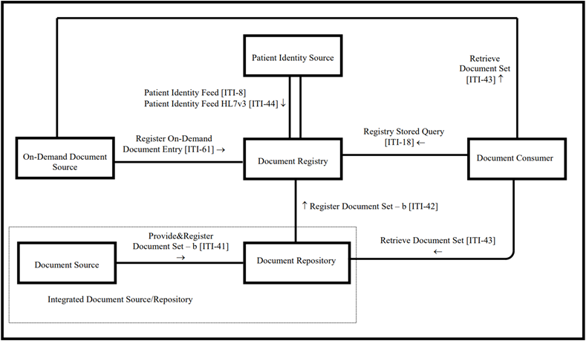

Slide 3
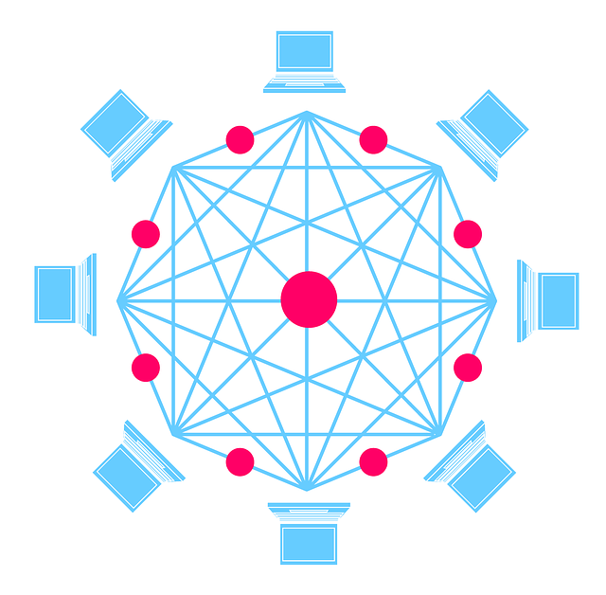






Slide 4

Hospital A
Hospital B
XDS Registry Actor
Registry Query
[ITI-18]
Smart Contract
Interpreter
Add
Hospital C
Read
Responder
Search
Query Response [ITI-18]
Ethereum Blockchain Ledger
Interpreter & Simplifier
Hospital D
Register Document Set-b [ITI-42]
XDS Affinity Domain Blockchain Network

Slide 5
Register Stored Query [ITI – 18]
XDS Document Registry Actor (XDS Registry Blockchain)
XDS Document Consumer Actor
Register Document Set – b [ITI – 42]
XDS Document Repository Actor
Retrieve Document Set [ITI – 43]

Slide 7



Document Repository
Document Registry Blockchain
Document Consumer
User Input Search Keywords
Actual Health Document
ITI – 18 Transaction
ITI – 42 Transaction
Metadata Attributes
Query Result
Query Result Display for User

Slide 8
Document Register
Document Registry Blockchain
Document Search
User Input Search Keywords
Actual Health Document
ITI – 18 Transaction
ITI – 42 Transaction
Metadata Attributes
Query Result
Query Result Display for User

