Slide 1

Implementing Cross-Enterprise Document Sharing (XDS) based on Blockchain Technology
Petnathean Julled
Module 1, 2019

Slide 2
Design Overview
The system group into 4 major parts
Interpreter program that create JSON object from received ITI-42 transaction which included META-Data attributes of each Document.
Interface program that register JSON object into Blockchain.
Search program that look upon all available ETH Address representing each document registry.
Agent program that communicate with XDS Document Consumer, receive search request and return set of matched registry.

Slide 3



Design Overview
XDS Blockchain
Registry Query [ITI-18]
Search
Smart
Contract
Interpreter
Add
Responder
Query Result
Read
Ethereum
Blockchain Ledger
Interpreter
& Simplifier
Register Document Set-b [ITI-42]

Slide 4
Interpreter program
Receive ITI-42 transaction
Interpret ITI-42 transaction
Sort META-Data attributes within received ITI-42 transaction and store these values into simpler JSON object
Pass resulting JSON object to Blockchain interface program

Slide 5
Design Overview
XDS Blockchain
Registry Query [ITI-18]
Search
Smart
Contract
Interpreter
Add
Responder
Query Result
Read
Ethereum
Blockchain Ledger
Interpreter
& Simplifier
Register Document Set-b [ITI-42]

Slide 6
Sample ITI-42 transaction

Slide 7
Simplified form of metadata attributes retrieved from ITI-42

Slide 8
Interpreter & Simplifier javascript code

Slide 9

Design Overview
XDS Blockchain
Registry Query [ITI-18]
Search
Smart
Contract
Interpreter
Add
Responder
Query Result
Read
Ethereum
Blockchain Ledger
Interpreter
& Simplifier
Register Document Set-b [ITI-42]

Slide 10
Blockchain Interface Program – Remix IDE
Empty pre-made smartcontract created with Remix IDE which given “ABI Code” and “Byte Code” to be used with Web3js Javascript module which allow Javascript program to interact with Ethereum Blockchain

Slide 11
Explain Current Implementation Steps
Design Overview
XDS Blockchain
Registry Query [ITI-18]
Search
Smart
Contract
Interpreter
Add
Responder
Query Result
Read
Ethereum
Blockchain Ledger
Interpreter
& Simplifier
Register Document Set-b [ITI-42]

Slide 12

Remix IDE for Ethereum Solidity

Slide 13

Remix Interface
Area for Solidity code
Compiler/Validator
Console

Slide 14

Solidity Code
Declare suitable version of compiler (“pragma”)
Declare smartcontract name
Declare initial value of variable saySomething
Declare function
This function return value of variable saySomething to contract issuer
This function replace value of saySomething with issuer specified value

Slide 15
Compiler/Validator
Environment for compiling
-Javascript VM -> Web based compiler with no actual Blockchain
(Simulated Blockchain Environment)
- Web3js -> Web3js instance created by local blockchain
Issuer account on specified environment
Gas Limit which prevent infinity loop error
Wei value represent cost to execute contract
Executed contract
Value specified by issuer to replace value of variable saySomething
using function ‘transact’
Returned value after execute function ‘speak’

Slide 16
Flow chart of this example contract
No
Return “Hello World!”
Function “speak”
Any input?
saySomething = “Hello World!”
Function “transact”
saySomething = <input>
Return <input>
Yes

Slide 17
Flow chart of our initial smart contract will be like this
saySomething
= metadata attributes + ITI-42 transaction
Return value of saySomething =
metadata attributes + ITI-42 transaction
Our initial smartcontract will just store received value in Blockchain without any change
- value of saySomething will inherit from our Javascript interpreter (JSON object)
- The returned value of this contract will be process by our other Javascript to form ITI-18 transaction

Slide 18
Blockchain Interface Program – Solidity and smartcontract
Empty pre-made smartcontract created to store value from JSON object
META-Data attributes value sort into smartcontract which allow discoverability by Search program

Slide 19
Explain Current Implementation Steps
Design Overview
XDS Blockchain
Registry Query [ITI-18]
Search
Smart
Contract
Interpreter
Add
Responder
Query Result
Read
Ethereum
Blockchain Ledger
Interpreter
& Simplifier
Register Document Set-b [ITI-42]

Slide 20
Smart Contract - Add
Smart Contract
Solidity ‘Struct’
JSON
Publish
To
Blockchain
Add
Assign unique ‘ETH’ Address
Ex. 0xef8ty5h4f5g9f7d4vdfd36g
Each XDS Document will have its unique
ETH Address on Blockchain
XDS META-Data Attributes
Read
Search

Slide 21
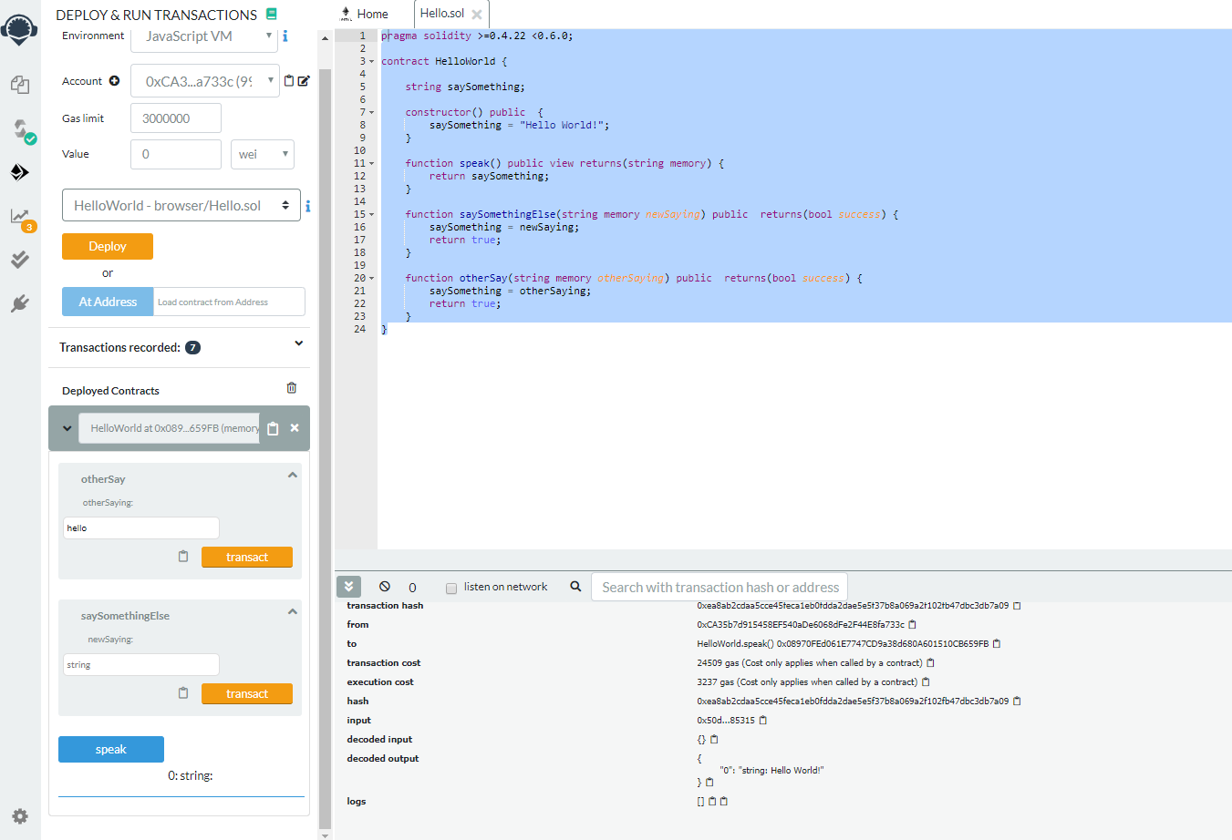
Smart Contract – Add – Coding in Remix IDE
Deploy and Run Transaction Controller
Solidity Code
Console
Smartcontract Simple UI

Slide 22
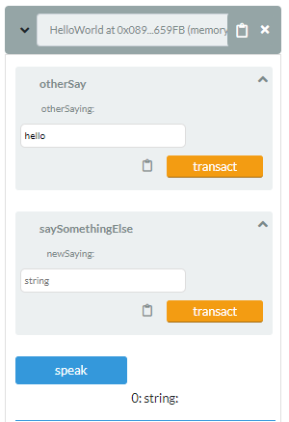
Smart Contract – Add – Coding in Remix IDE
Input Function
Return Function

Slide 23
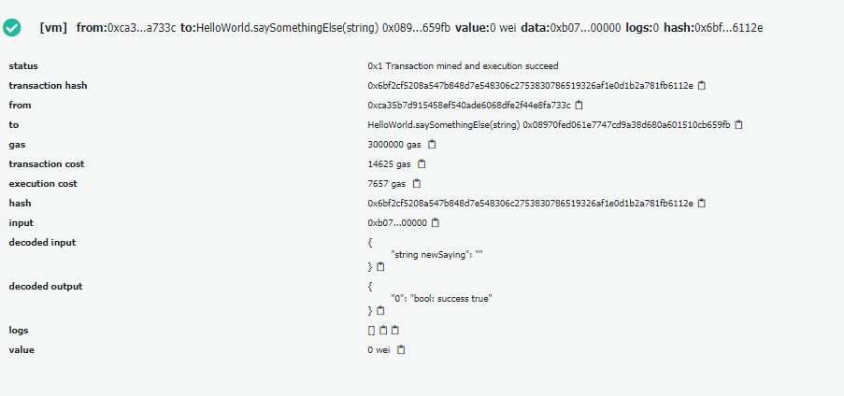
Smart Contract – Add – Coding in Remix IDE
Input Function
Input Value
Each XDS document have its own unique ETH Address

Slide 24
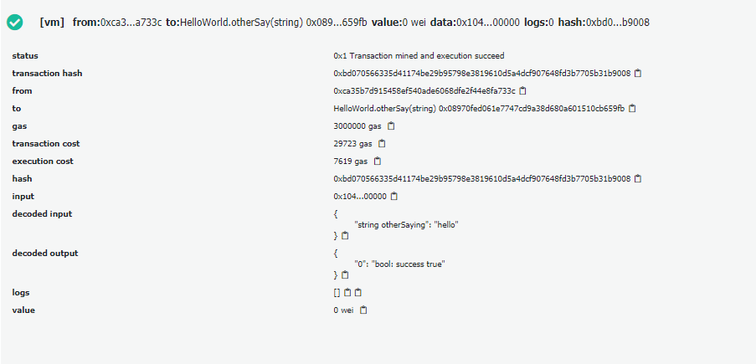
Smart Contract – Add – Coding in Remix IDE
Input Function
Input Value
Each XDS document have its own unique ETH Address
These ETH Address will be remembered by local search program which allow them to be discoverable in Blockchain

Slide 25
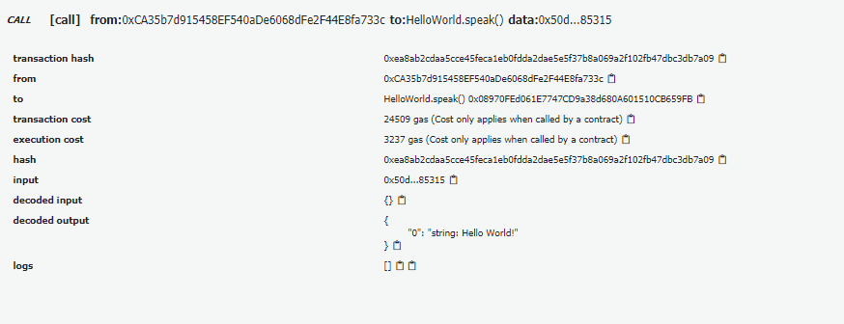
Smart Contract – Add – Coding in Remix IDE
Return Function
Return Value
Each XDS document have its own unique ETH Address
That mean, search program will look into each ETH Address to find for XDS META-Data attributes with matching value to the one provided by search requirement

Slide 26
Smart Contract – Search and Read
Smart Contract
Search
Solidity ‘Struct’
JSON
Search
Requirement
Input
Return All
Matched
Result
Read
Search
Result
Search all ETH Address for matching XDS META-Data Attributes

Slide 27
Blockchain Interface Program – Web3js
Web3js Javascript module act as interface API between Javascript program and Ethereum Blockchain

Slide 28
Web3js
An API interface that allow Javascript program to interact with Ethereum Smartcontract
Deploy (Add)
Javascript
(NodeJS)
Web3js
Smartcontract
Interface
Transact
(Update)
Call (Read)

Slide 29
Deploy Smartcontract with Web3js
Solidity
Code
Remix IDE
Web3js
(in NodeJS)
Smartcontract
(on Blockchain)
Contract
Byte Code
Deploy

Slide 30
Transact & Call Smartcontract with Web3js
Transact (Update)
Javascript
(NodeJS)
Web3js
Smartcontract
(on Blockchain)
ETH Address
& Operation
Call (Read)

Slide 31
Design Overview
Web3js is in here!
XDS Blockchain
Registry Query [ITI-18]
Search
Smart
Contract
Interpreter
Add
Responder
Query Result
Read
Ethereum
Blockchain Ledger
Interpreter
& Simplifier
Register Document Set-b [ITI-42]

Slide 32
Smartcontract and Search Program
Once smartcontract deployed into Ethereum Blockchain, it will be given unique ETH Address which essential for access its content within Ethereum Blockchain
There will be Record program that remember all relationship between each document registry and its assigned ETH Address
Search program will look into all available ETH Address, seek for all ETH Address that contain matching META-Data attributes value
Then Agent program return all matched results to XDS Document Consumer using ITI-18 transaction format

Slide 33
XDS Registry on Blockchain Workflow
Deploy Contract – 1st time register of document
Record
Program
(NodeJS)
Return
ETH Address
Intepreter Program
(NodeJS)
Register Program
(NodeJS)
ITI-42
Transaction
JSON
Deploy
Smartcontract
(On Blockchain)
(Pre – made Empty Contract)
Byte Code
ABI Code
Remix IDE
(Solidity Code)

Slide 34
XDS Registry on Blockchain Workflow
Transact – Update META-Data value of registered document
Record
Program
(NodeJS)
Feed
ETH Address List
(On ETH Address)
Transact
Intepreter Program
(NodeJS)
Register Program
(NodeJS)
ITI-42
Transaction
JSON
Smartcontract
(On Blockchain)
ABI Code
Remix IDE
(Solidity Code)

Slide 35
XDS Registry on Blockchain Workflow
Call – Read META-Data Value of registered document
Record
Program
(NodeJS)
Feed
ETH Address List
(On ETH Address)
Call
XDS Consumer
Request
For document
Search
Program
(NodeJS)
Smartcontract
(On Blockchain)
Known META-Data Attribute values of the document
Return
(META-Data values)
Byte Code
ABI Code
(Pre – made Empty Contract)
Remix IDE
(Solidity Code)

Slide 36
XDS Registry on Blockchain Workflow
Call on all available ETH Address until match – Search
Record
Program
(NodeJS)
Feed
ETH Address List
Repeat on all ETH Address
(On ETH Address)
Call
XDS Consumer
Request
For document
Search
Program
(NodeJS)
Smartcontract
(On Blockchain)
Known META-Data Attribute values of the document
Return
(META-Data values)
Byte Code
ABI Code
(Pre – made Empty Contract)
Remix IDE
(Solidity Code)

Slide 37
XDS Registry on Blockchain Workflow
Call on all available ETH Address until match – Search
Repeat on all ETH Address
(On ETH Address)
Call
XDS Consumer
Search
Program
(NodeJS)
Return
Smartcontract
(On Blockchain)
Set of registry
With matched META-Data values
Return
(META-Data values)

Slide 38
XDS META-Data attributes which may contain sensitive information
There will be a method to provide basic security and confidentiality for these META-Data attributes
Better than leave these attributes as plain text on Blockchain
However, this can be further improve by other research for future work

Slide 39
XDS META-Data Attributes with Sensitive Information
For 1st stage, rely on permission system came along with Smartcontract
For 2nd stage, Encrypted or Hashed Value
The vital point is key distribution and management amongst Blockchain nodes
This require some more study on KMS
  Ref.1: https://www.helpnetsecurity.com/2019/11/07/encryption-key-management-system/
  Ref.2: https://nvlpubs.nist.gov/nistpubs/SpecialPublications/NIST.SP.800-130.pdf
  Ref3: https://en.wikipedia.org/wiki/Key_management#Management_and_compliance_systems
  And more
This also heavily depend on relationship and policy between nodes
In our prototype, assume that all nodes have received key through secured method.
Will provide suggestion that best fit with Blockchain environment

Slide 40
Task list and Timeline
Expected to finish system prototype within January 2020

Slide 41
Task List
Create Javascript program which receive and interpret ITI-42 transaction by convert it into JSON
Create Smartcontract to store XDS META-Data attributes of each document withim Blockchain
Create Web3js program which programmatically deploy and transact Smartcontract with Javascript code
Setup remote server for Smartcontract deployment test
Create Javascript/Web3js search program which look into all ETH Addresses to seek for matching XDS Document within Blockchain
Create Javascript program which allow XDS Registry to communicate with XDS Consumer (Comply to the standard, ITI-18)
Create simple UI for XDS Consumer to demonstrate the query concept

Slide 42
Expected Timeline
Action | 31 Dec | 7 Jan | 14 Jan | 21 Jan | 28 Jan | 4 Feb
1. Blockchain interface program with Web3js
2. Search program
3. Connect with XDS Document Consumer
4. Create UI for XDS Document Consumer
5. Test deploy and improve

