Slide 1
Our contribution
Design Blockchain environment that focus on allow health document sharing between different enterprises through compliance of IHE XDS.b profile
Design and integrate Blockchain into IHE XDS.b process flow
Define usage and benefit of Blockchain in IHE XDS.b as a middle for health information document exchange between enterprises.
Study and choose Blockchain environment that best suit the scenario where different hospitals share patients information document with each others (Result as permissioned/consortium Blockchain being chosen)
Study and choose available Blockchain consensus that best suit the scenario. (Result as PBFT being chosen)
Based on efficiency, resource consumption, and compatibility with workload
Proof of concept implementation
Design software that act as a middle between XDS.b profile process and Blockchain
Design Blockchain smart contract that integrate Blockchain into XDS.b profile process flow
Design search algorithm for document registry published on Blockchain
Propose additional smart contract function as audit trail for exchanged health document

Slide 2
Design Analysis Overview
Problem Statement
To allow sharing of healthcare document between different healthcare organizations which require maintain of its confidentiality while mitigate emerging cyber-threats on healthcare domain that tamper with integrity and availability of data, there need document registry that have distributed, decentralized, persistent, and immutable characteristics.
Digitization of healthcare information drive hospitals to develop their IT infrastructure, however, there came along with emerging cyber-security threats
The Profile facilitates the registration, distribution and access across health enterprises of patient electronic health records.
Cross-Enterprise Document Sharing is focused on providing a standards-based specification for managing the sharing of documents between any healthcare enterprise, ranging from a private physician office to a clinic to an acute care in-patient facility.
* The XDS.b Integration Profile assumes that these enterprises belong to one or more XDS Affinity Domains.
* An XDS Affinity Domain is a group of healthcare enterprises that have agreed to work together using a common set of policies and share a common infrastructure.

Slide 3
Existing Standard
Integrating Healthcare Enterprise (IHE)
As respond to Health Information Sharing issue and Interoperability, there found initiative to standardize health informatics.
IHE is one of well-known initiative who provide materials for healthcare organization for developing their system to meet requirement in healthcare operation.
Cross-Enterprise Document Sharing (XDS.b) Profile
XDS.b Profile define actors scheme and transaction format that needed for enable health document sharing between different healthcare organizations.
The profile ensure that any organization implement their system following the profile can systemically exchange document and communicate with each other.
However, XDS.b profile have its limits
It require confident amount of trust between each parties to share their information asset with each other
Its security characteristics rely mainly on trust and policy between XDS Affinity Domain members
There are open issue regard security of shared data.
Notes:
What’s the matter? Independent from trust

Slide 4
Design Analysis Overview
Cross-Enterprise Document Sharing (XDS.b) Profile
Scope or type of sharing document is not restricted by the Profile
Security of XDS Affinity Domain depend on…
Audit Trail and Node Authentication Profile (ATNA)
Each members must have their own Audit Repository Actor
Policies of each XDS Affinity Domain
Trust between each members within XDS Affinity Domain
Confidentiality, Integrity, and Accessibility of Document Registry actor depend on members of XDS Affinity Domain
Benefit gained from Blockchain implemented
By replace traditional database of Document Registry actor with Blockchain ledger, XDS Affinity Domain then lessen required trust between each members. As none of any members can freely temper with anything existing on the Blockchain.
Blockchain ensure integrity of Document Registry. With additional mechanism of Blockchain, it also help reduce risk against confidentiality and accessibility of Document Registry.
Blockchain give additional audit system, as everything published on it cannot be modified or deleted. This is addition to ATNA.
This reduce friction for each healthcare enterprise to joint cooperation and share their data with each other which allow better patient care.

Slide 5
Design Analysis Core
Replacing Document Registry’s traditional database with Blockchain
Convert from centralized database to Decentralized ledger
Eliminate need of trusted 3rd party to host Document Registry
Lessen required trust between member of XDS Affinity Domain
Passively enforce agreed policies within Blockchain
How to
XDS Affinity Domain need machine that have access to Ethereum Node
All Ethereum Node from each member of XDS Affinity Domain have access to the same Blockchain ledger that act as Document Registry actor
Replace related transaction that would be need to communicate with normal Document Registry with Smartcontract.
Smartcontract also need to provide additional function that give more capability to what Document Registry can do.

Slide 6
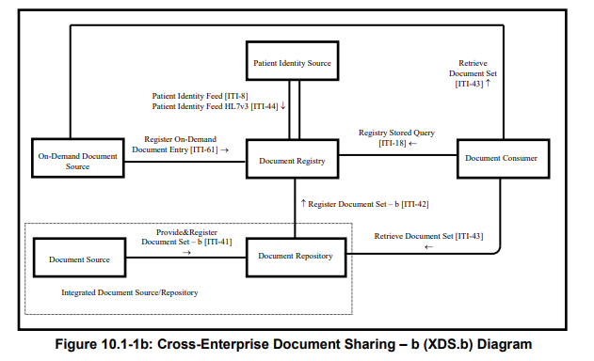
Cross-Enterprise Document Sharing – b (XDS.b)
Notes:
There should be some kind of header that specify type of transaction

Slide 7
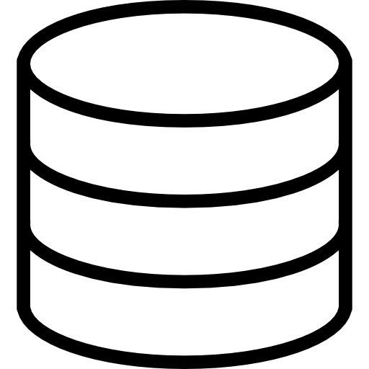


Design Overview
XDS Blockchain
Registry Query [ITI-18]
Search
Smart Contract
Interpreter
Add
Responder
Query Result
Read
Ethereum Blockchain Ledger
Interpreter & Simplifier
Register Document Set-b [ITI-42]

Slide 8
Design Overview
XDS Blockchain
Registry Query [ITI-18]
Search
Smart Contract
Interpreter
Add
Responder
Query Result
Read
Ethereum Blockchain Ledger
Interpreter & Simplifier
Register Document Set-b [ITI-42]

Slide 9
Sample ITI-42 transaction

Slide 10
Simplified form of metadata attributes retrieved from ITI-42

Slide 11
Interpreter & Simplifier javascript code

Slide 12

Design Overview
XDS Blockchain
Registry Query [ITI-18]
Search
Smart Contract
Interpreter
Add
Responder
Query Result
Read
Ethereum Blockchain Ledger
Interpreter & Simplifier
Register Document Set-b [ITI-42]

Slide 13
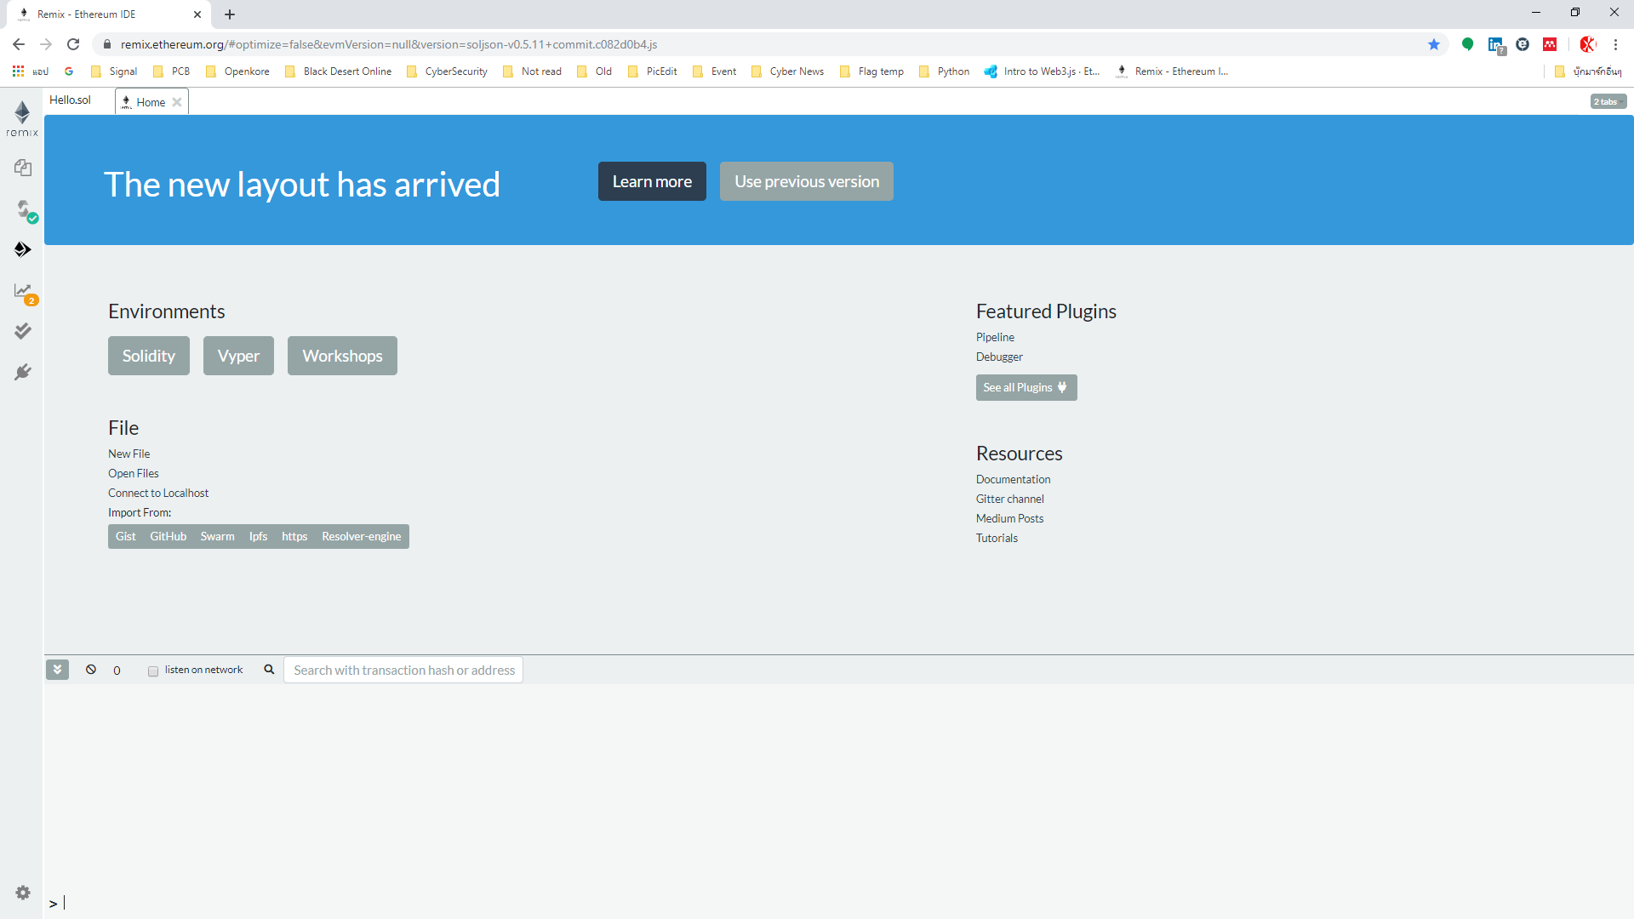
Remix IDE for Ethereum Solidity

Slide 14
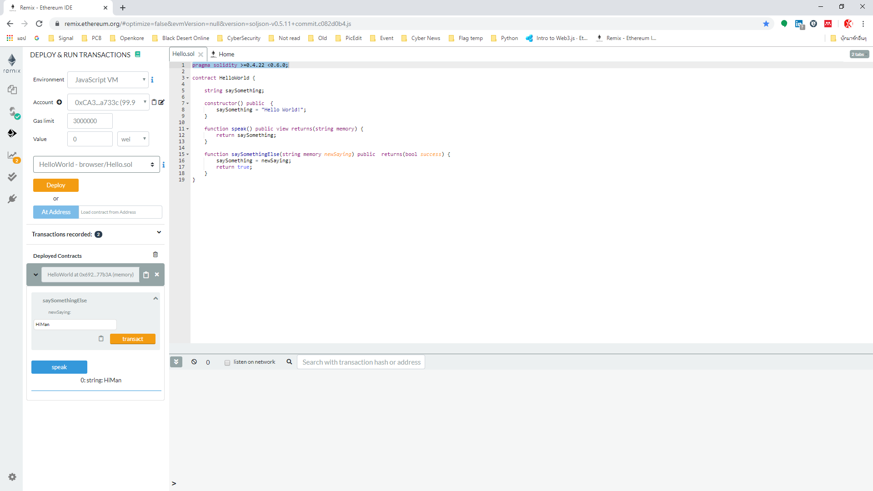
Remix Interface
Area for Solidity code
Compiler/Validator
Console

Slide 15
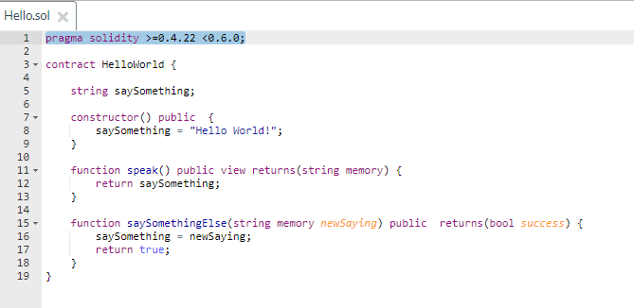
Solidity Code
Declare suitable version of compiler (“pragma”)
Declare smartcontract name
Declare initial value of variable saySomething
Declare function
This function return value of variable saySomething to contract issuer
This function replace value of saySomething with issuer specified value

Slide 16
Compiler/Validator
Environment for compiling -Javascript VM -> Web based compiler with no actual Blockchain (Simulated Blockchain Environment) - Web3js -> Web3js instance created by local blockchain
Issuer account on specified environment
Gas Limit which prevent infinity loop error
Wei value represent cost to execute contract
Executed contract
Value specified by issuer to replace value of variable saySomething using function ‘transact’
Returned value after execute function ‘speak’

Slide 17
Flow chart of this example contract
No
Return “Hello World!”
Function “speak” Any input?
saySomething = “Hello World!”
Function “transact”
saySomething = <input>
Return <input>
Yes

Slide 18
Flow chart of our initial smart contract will be like this
saySomething = metadata attributes + ITI-42 transaction
Return value of saySomething = metadata attributes + ITI-42 transaction
Our initial smartcontract will just store received value in Blockchain without any change - value of saySomething will inherit from our Javascript interpreter (JSON object)
- The returned value of this contract will be process by our other Javascript to form ITI-18 transaction

Slide 19
Explain Current Implementation Steps Design Overview
XDS Blockchain
Registry Query [ITI-18]
Search
Smart Contract
Interpreter
Add
Responder
Query Result
Read
Ethereum Blockchain Ledger
Interpreter & Simplifier
Register Document Set-b [ITI-42]

Slide 20
Smart Contract
Search
Smart Contract
Interpreter
Add
Responder
Read
Interpreter & Simplifier

Slide 21
Smart Contract - Add
Smart Contract
Solidity ‘Struct’
JSON
Publish
To
Blockchain
Add
Assign unique ‘ETH’ Address
Ex. 0xef8ty5h4f5g9f7d4vdfd36g
Each XDS Document will have its unique ETH Address on Blockchain
XDS META-Data Attributes
Read
Search

Slide 22
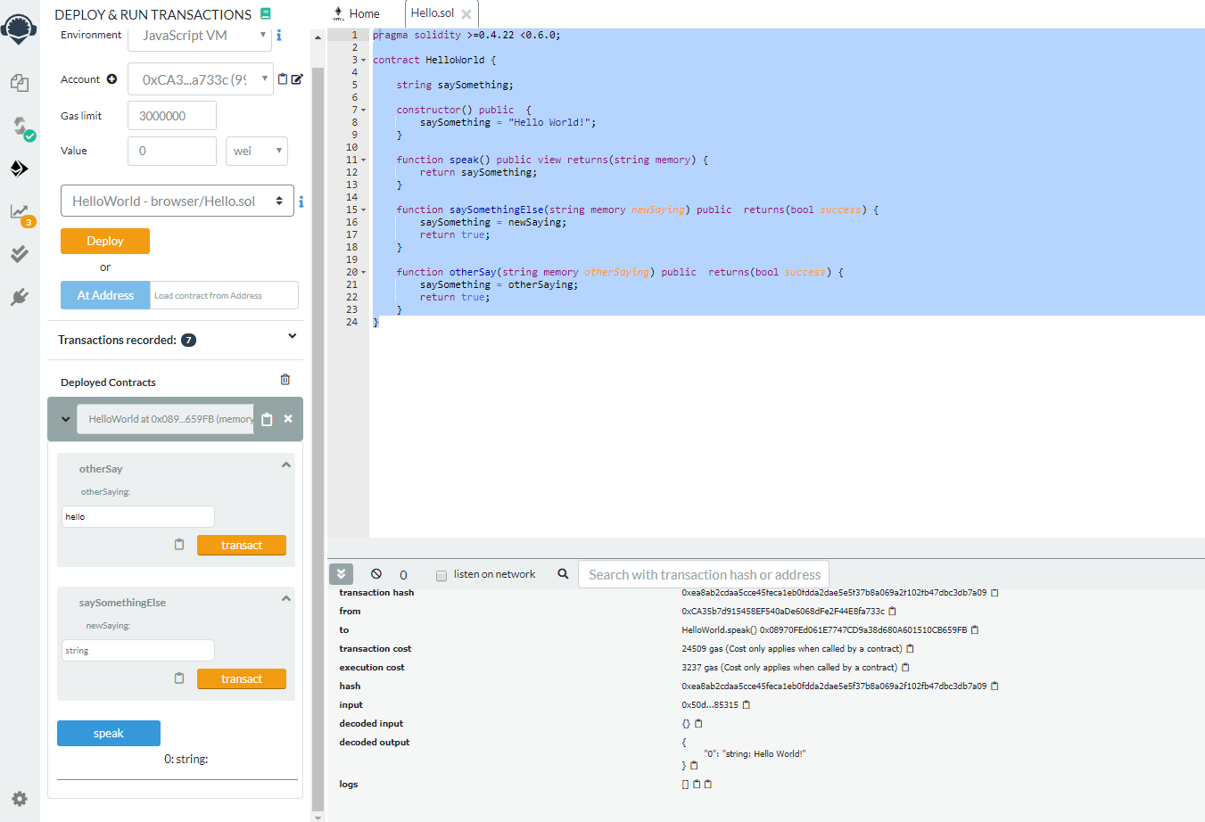
Smart Contract – Add – Coding in Remix IDE
Deploy and Run Transaction Controller
Solidity Code
Console
Smartcontract Simple UI

Slide 23
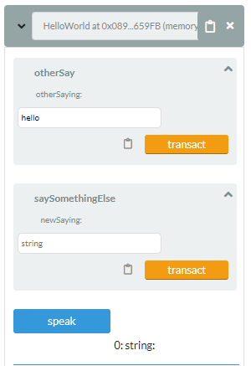
Smart Contract – Add – Coding in Remix IDE
Input Function
Return Function

Slide 24
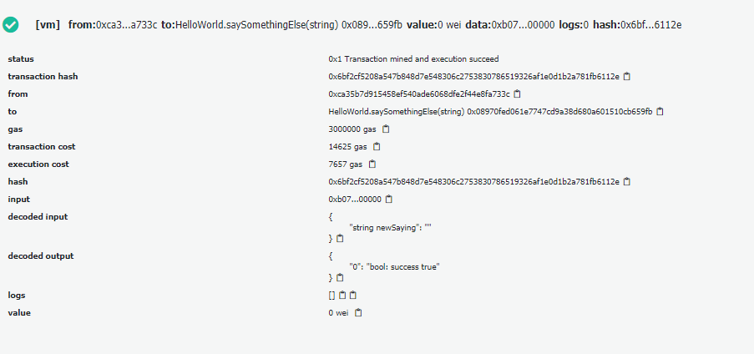
Smart Contract – Add – Coding in Remix IDE
Input Function
Input Value
Each XDS document have its own unique ETH Address

Slide 25
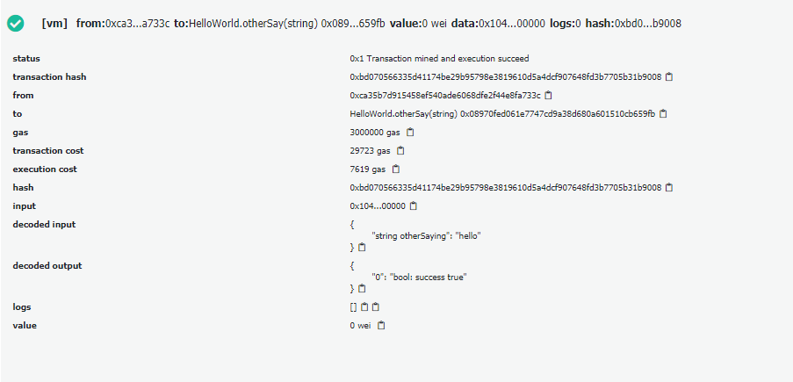
Smart Contract – Add – Coding in Remix IDE
Input Function
Input Value
Each XDS document have its own unique ETH Address
These ETH Address will be remembered by local search program which allow them to be discoverable in Blockchain

Slide 26
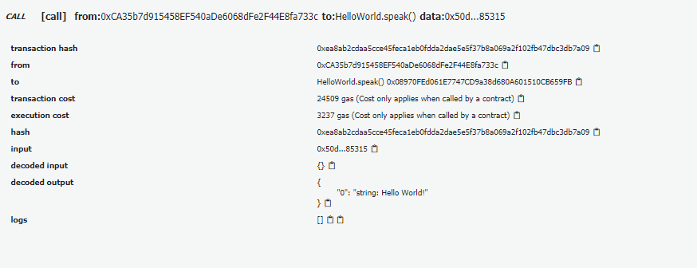
Smart Contract – Add – Coding in Remix IDE
Return Function
Return Value
Each XDS document have its own unique ETH Address
That mean, search program will look into each ETH Address to find for XDS META-Data attributes with matching value to the one provided by search requirement

Slide 27
Smart Contract – Search and Read
Smart Contract
Search
Solidity ‘Struct’
JSON
Search
Requirement
Input
Return All
Matched
Result
Read
Search
Result
Search all ETH Address for matching XDS META-Data Attributes

Slide 28
Web3js
An API interface that allow Javascript program to interact with Ethereum Smartcontract
Deploy (Add)
Javascript
(NodeJS)
Web3js
Smartcontract
Interface
Transact (Update)
Call (Read)

Slide 29
Deploy Smartcontract with Web3js
Solidity
Code
Remix IDE
Web3js
(in NodeJS)
Smartcontract
(on Blockchain)
Contract Byte Code
Deploy

Slide 30
Transact & Call Smartcontract with Web3js
Transact (Update)
Javascript
(NodeJS)
Web3js
Smartcontract
(on Blockchain)
ETH Address
& Operation
Call (Read)

Slide 31
Design Overview
Web3js is in here!
XDS Blockchain
Registry Query [ITI-18]
Search
Smart Contract
Interpreter
Add
Responder
Query Result
Read
Ethereum Blockchain Ledger
Interpreter & Simplifier
Register Document Set-b [ITI-42]

Slide 32
XDS Registry on Blockchain Workflow Deploy Contract – 1st time register of document
Record
Program
(NodeJS)
Return
ETH Address
Intepreter Program
(NodeJS)
Register Program
(NodeJS)
ITI-42
Transaction
JSON
Deploy
Smartcontract
(On Blockchain)
(Pre – made Empty Contract)
Byte Code
ABI Code
Remix IDE
(Solidity Code)

Slide 33
XDS Registry on Blockchain Workflow Transact – Update META-Data value of registered document
Record
Program
(NodeJS)
Feed
ETH Address List
(On ETH Address)
Transact
Intepreter Program
(NodeJS)
Register Program
(NodeJS)
ITI-42
Transaction
JSON
Smartcontract
(On Blockchain)
ABI Code
Remix IDE
(Solidity Code)

Slide 34
XDS Registry on Blockchain Workflow Call – Read META-Data Value of registered document
Record
Program
(NodeJS)
Feed
ETH Address List
(On ETH Address)
Call
XDS Consumer
Request
For document
Search
Program
(NodeJS)
Smartcontract
(On Blockchain)
Known META-Data Attribute values of the document
Return
(META-Data values)
Byte Code
ABI Code
(Pre – made Empty Contract)
Remix IDE
(Solidity Code)

Slide 35
XDS Registry on Blockchain Workflow Call on all available ETH Address until match – Search
Record
Program
(NodeJS)
Feed
ETH Address List
Repeat on all ETH Address
(On ETH Address)
Call
XDS Consumer
Request
For document
Search
Program
(NodeJS)
Smartcontract
(On Blockchain)
Known META-Data Attribute values of the document
Return
(META-Data values)
Byte Code
ABI Code
(Pre – made Empty Contract)
Remix IDE
(Solidity Code)

Slide 36
XDS Registry on Blockchain Workflow Call on all available ETH Address until match – Search
Repeat on all ETH Address
(On ETH Address)
Call
XDS Consumer
Search
Program
(NodeJS)
Return
Smartcontract
(On Blockchain)
Set of registry
With matched META-Data values
Return
(META-Data values)

Slide 37
XDS META-Data Attributes with Sensitive Information
For 1st stage, rely on permission system came along with Smartcontract
For 2nd stage, Encrypted or Hashed Value
The vital point is key distribution and management amongst Blockchain nodes
This require some more study on KMS
Ref.1: https://www.helpnetsecurity.com/2019/11/07/encryption-key-management-system/
Ref.2: https://nvlpubs.nist.gov/nistpubs/SpecialPublications/NIST.SP.800-130.pdf
Ref3: https://en.wikipedia.org/wiki/Key_management#Management_and_compliance_systems
And more
This also heavily depend on relationship and policy between nodes
In our prototype, assume that all nodes have received key through secured method.
Will provide suggestion that best fit with Blockchain environment

