Slide 1

Implementing Cross-Enterprise Document Sharing (XDS) based on Blockchain Technology
Petnathean Julled
Defense Exam Presentation

Slide 2
Background & Motivation

Slide 3
Literature review – IHE > ITI Framework > IHE Profile > XDS.b
Note: For IHE Profile, a machine/server/ or system are all called “actors”. This allows an organization to use just a single machine or the whole system as each IHE Profile actor, not limited to just a specific type of platform.

Slide 4
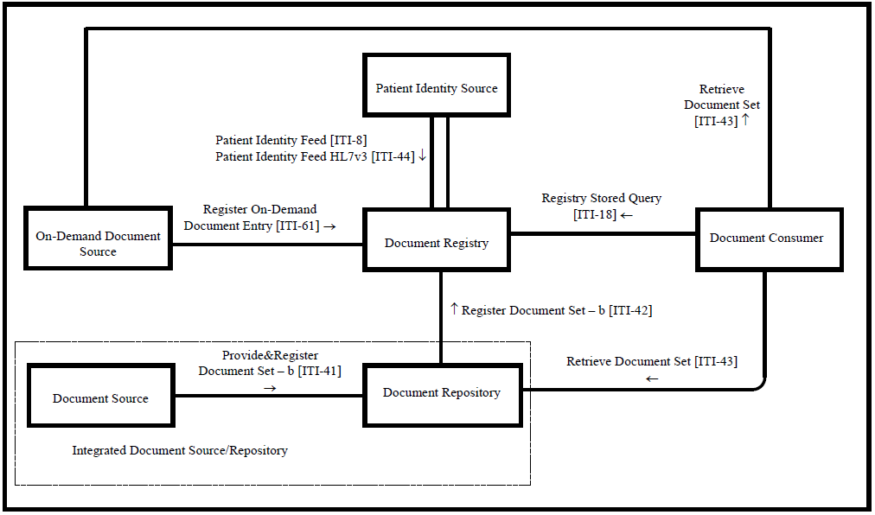
Literature review – IHE > ITI Framework > IHE Profile > XDS.b
Cross-Enterprise Document Sharing – b (actors) Diagram

Slide 5
Literature review - Blockchain
Definition
Benefit

Slide 6
Literature review - Blockchain
Blockchain Characteristics

Slide 7
Literature review - Blockchain
Blockchain Types

Slide 8
Literature review - Blockchain
Blockchain Components
  Transaction and ‘Block’
  Cryptographically hashed ‘Chain’
  Distributed network of participate ‘Node’

Slide 9
Literature review - Blockchain
Blockchain Components
  Consensus
    Competition-based consensus
    Randomness-based consensus
    Majority-based consensus

Slide 10
Literature review – Ethereum Blockchain
Smartcontract

Slide 11
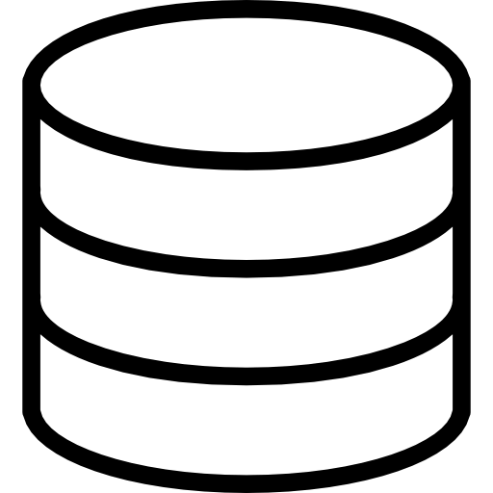

Literature review – Ethereum Blockchain

Slide 12
Literature review – Ethereum Blockchain
Quorum

Slide 13
Literature review – Related Work
A Blockchain-Based Approach to Health Information Exchange Networks (Mayo Clinic)

Slide 14
Literature review – Related Work
A Case Study for Blockchain in Healthcare: “MedRec” prototype for electronic health records and medical research data (MIT)

Slide 15
Literature review – Related Work
Blockchain-Based Data Preservation System for Medical Data

Slide 16
Literature review – Related Work
Blockchain-based electronic healthcare record system for healthcare 4.0 applications

Slide 17
Method
Implement Blockchain into the IHE XDS.b Profile
  Replace traditional database of XDS Document Registry Actor with Blockchain
Register Stored Query [ITI – 18]
XDS Document Registry Actor
(XDS Registry Blockchain)
XDS Document Consumer Actor
Register Document Set – b [ITI – 42]
XDS Document Repository Actor
Retrieve Document Set [ITI – 43]

Slide 18
Method
Approach (Different from related work)
  Not put health document directly into Blockchain
  Enhancing existing standard
Benefit
  Reduce the friction that prevent formation of health document sharing network due to “trust” issue
  Enhancing the XDS.b Profile with Blockchain characteristics
    Ensure availability of XDS Document Registry Actor
    Ensure integrity of health document metadata for access
  Encourage health information sharing using Blockchain as the medium
  Further encourage sharing of information as shared document becoming peer backup for the source

Slide 19
Method
Design

Slide 20

Method
XDS Registry Blockchain
Design
Hospital A
Registry Query
[ITI-18]
Smart
Contract
Interpreter
Add
Read
Responder
Search
Query Response [ITI-18]
Ethereum
Blockchain Ledger
Interpreter
& Simplifier
Register Document Set-b [ITI-42]
XDS Affinity Domain
Blockchain Network

Slide 21
Method
Flowchart to Pseudocode?

Slide 22
Implementation
Step-by-Step?

Slide 23
Result

