Slide 1

Implementing Cross-Enterprise Document Sharing (XDS) based on Blockchain Technology
Petnathean Julled
Defense Exam Presentation

Slide 2
Agenda
Introduction
  Motivation
Related Work
Propose
Background Knowledge
  IHE, Cross-Enterprise Document Sharing (XDS.b) Profile
  Blockchain
  Ethereum
Proposed Method
Implementation & Result
Discussion
Conclusion

Slide 3
Introduction
Healthcare Information
Sharing
&
Healthcare Operation Interoperability
Cyber-Security
In Healthcare Industry

Slide 4
Introduction
Healthcare Information
Sharing
&
Healthcare Operation Interoperability
Cyber-Security
In Healthcare Industry

Slide 5
Introduction
Follow the digital transformation, the healthcare industry is undergoing the change to improve performance and develop efficient healthcare services
Healthcare information sharing and interoperability between healthcare organizations are one of major solutions to improve healthcare service quality.
  Patient’s health document data are scattered across the industry
  Healthcare providers unable to access a full history of patient health condition cause redundancy in healthcare services
  Healthcare organizations not yet have the right solution to help them share healthcare information
So, there is a demand for the solution to solve the issue regarding healthcare information sharing and healthcare organizations interoperability

Slide 6
Introduction
Healthcare Information
Sharing
&
Healthcare Operation Interoperability
Cyber-Security
In Healthcare Industry

Slide 7
Introduction
Emerging of cyber-attack threatening the continuity of healthcare operation
  Ransomware incident disrupt the availability of healthcare information, interrupting healthcare operation
  A data breach or unauthorized access to healthcare information can cause damage to the individual scale
Healthcare information systems are centralized system at their foundation
  Each organization have their own method of developing healthcare information system
  When hit by cyber-incidents, they become a single point of failure, interrupting the continuity of the whole system
So, there is a demand for the solution to mitigate emerging cyber-attack and apply decentralization to avoid a single point of failure problem

Slide 8
Introduction
Healthcare Information
Sharing
&
Healthcare Operation Interoperability
Cyber-Security
In Healthcare Industry

Slide 9
Introduction
The “trust” issue is one of the major factor preventing sharing of healthcare information between different organizations
  Each organization cannot be sure that healthcare information shared with others will be kept properly
  A bad actor may gain an opportunity to perform malicious activity on shared information
The benefit gained from health information sharing may not worth the risk
  Sharing information with other also risking provide an opportunity for business-competitor
  Data leakage from shared information cause by others may also affect customer trust in the source
So, there is a need for a solution to address the “trust” issue and provide additional benefit from healthcare information sharing

Slide 10
Agenda
Introduction
  Motivation
Related Work
Propose
Background Knowledge
  IHE, Cross-Enterprise Document Sharing (XDS.b) Profile
  Blockchain
  Ethereum
Proposed Method
Implementation & Result
Discussion
Conclusion

Slide 11
Motivation
The solution to solve the issue regarding healthcare information sharing and healthcare organizations interoperability
  Many initiatives started proposed standardized method to address the issue
  Integrating Healthcare Enterprise (IHE) is one of them
The solution to mitigate emerging cyber-attack and apply decentralization to avoid a single point of failure problem
  The Blockchain technology can mitigate the threat and apply decentralization
A need for a solution to address the “trust” issue and provide additional benefit from healthcare information sharing
  The Blockchain network can be designed to address the “trust” issue
  Blockchain Smartcontract can be designed to further provide additional benefit

Slide 12
Agenda
Introduction
  Motivation
Related Work
Propose
Background Knowledge
  IHE, Cross-Enterprise Document Sharing (XDS.b) Profile
  Blockchain
  Ethereum
Proposed Method
Implementation & Result
Discussion
Conclusion

Slide 13
Related Work
A Blockchain-Based Approach to Health Information Exchange Networks (Mayo Clinic)
  Use Blockchain as health information exchange medium
    Blockchain record audit trail of health information exchange
  Proposed using FHIR URL and FHIR Profile to allow health information sharing via Blockchain
    Avoid put healthcare data directly into the Blockchain ledger,
    Put its access point instead
  Actual health information stored within “Health Information Pool” outside the Blockchain ledger
  Proposed “Proof of Interoperability”
    Avoid wasting computational resources solely on consensus mechanism
Notes:
Shorten to the point

Slide 14
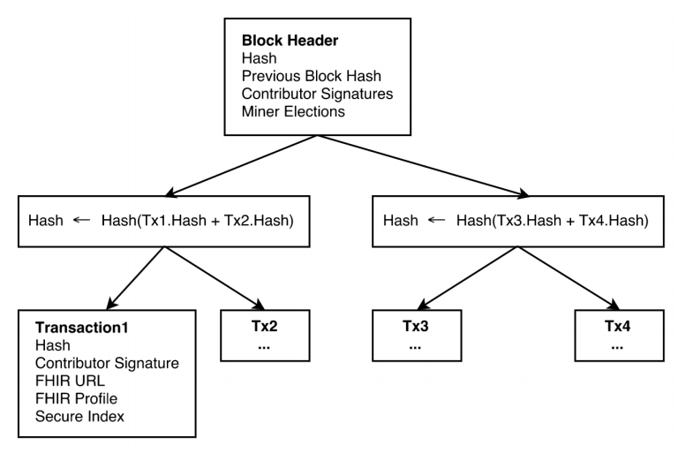
Related Work
A Blockchain-Based Approach to Health Information Exchange Networks (Mayo Clinic)
A healthcare blockchain block containing entries into the patient record
Notes:
Shorten to the point

Slide 15
Related Work
A Case Study for Blockchain in Healthcare: “MedRec” prototype for electronic health records and medical research data (MIT)
  Use Ethereum Smartcontract to record activity related to Electronic Health Record
  Allow micro-management of healthcare information sharing
  Improve patient control over their own data
  Propose a de-anonymized data as consensus reward for validator nodes
    De-anonymized data are data that have some part reduced to the point that its owner can no longer be identified
    Validator nodes spend their resources to maintain the Blockchain network

Slide 16
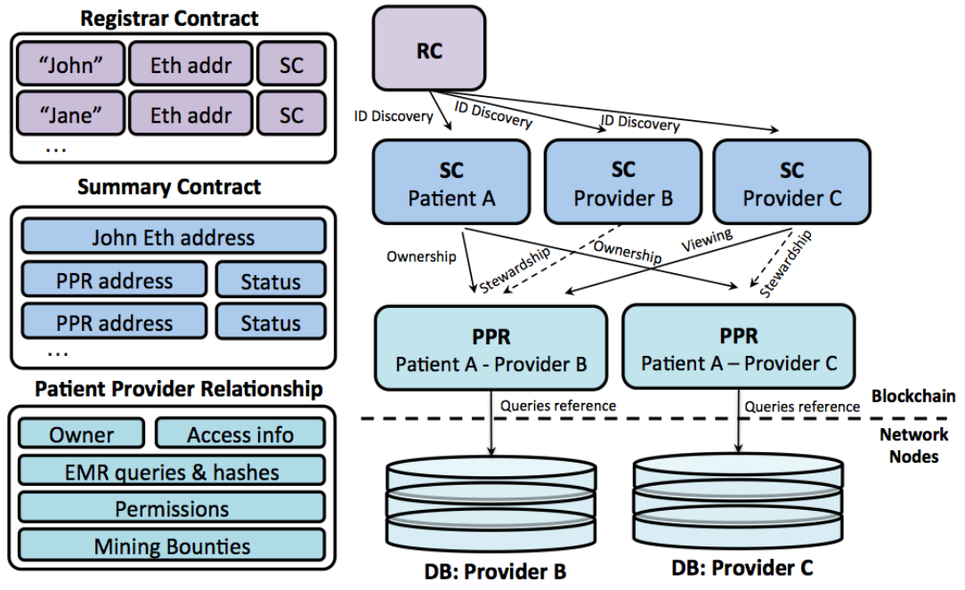
Related Work
A Case Study for Blockchain in Healthcare: “MedRec” prototype for electronic health records and medical research data (MIT)
MedRec smart contracts on the left, showing data content for each contract type.
Sample relationship graph between contracts and network nodes on the right

Slide 17
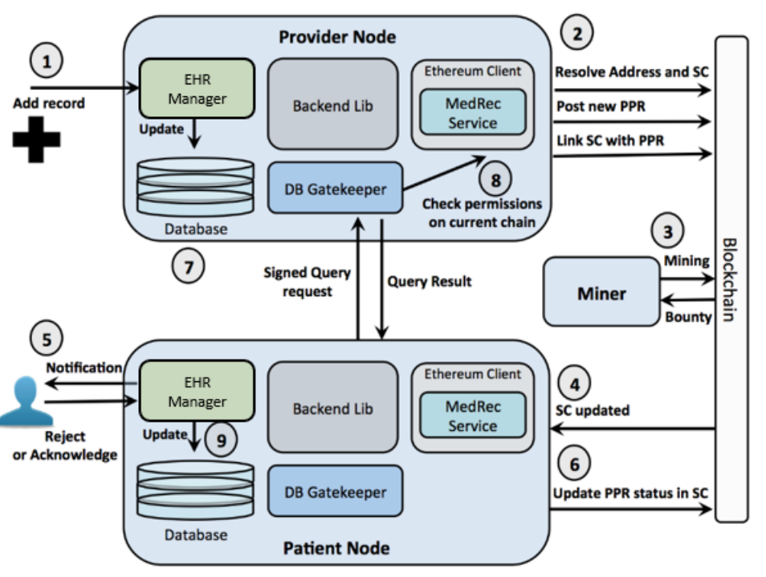
Related Work
A Case Study for Blockchain in Healthcare: “MedRec” prototype for electronic health records and medical research data (MIT)
System orchestration example: provider adds a record for new patient

Slide 18
Related Work
Blockchain-Based Data Preservation System for Medical Data
  Store Medical Data directly into Blockchain
  Use Blockchain address to secure user privacy
    Use Blockchain address as patient identifier excluding personal information

Slide 19
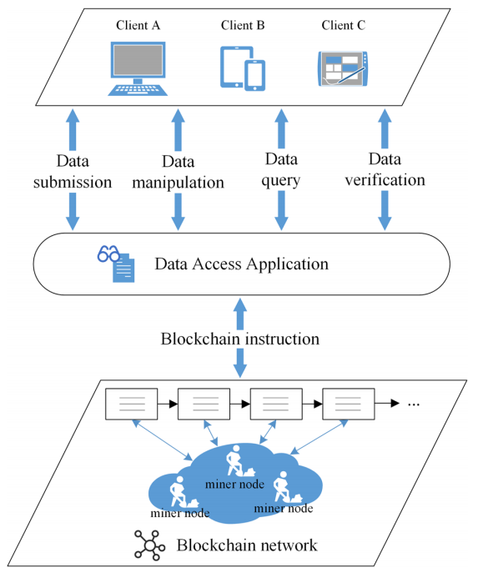
Related Work
Blockchain-Based Data Preservation System for Medical Data
Structure of preservation and blockchain interaction

Slide 20
Related Work
Blockchain-based Electronic Healthcare Record (EHR) system for healthcare 4.0 applications
  Recent work summarize all proposed EHR Blockchain from year 2016 to 2019
  Use Blockchain as EHR ledger recording patient’s data
  Blockchain ledger act as distributed database that everyone can access
    Limited access to only healthcare personals and employees
    Allow patient control over their own data
    Propose an Access Control Policy Algorithm for improving data accessibility between healthcare providers

Slide 21
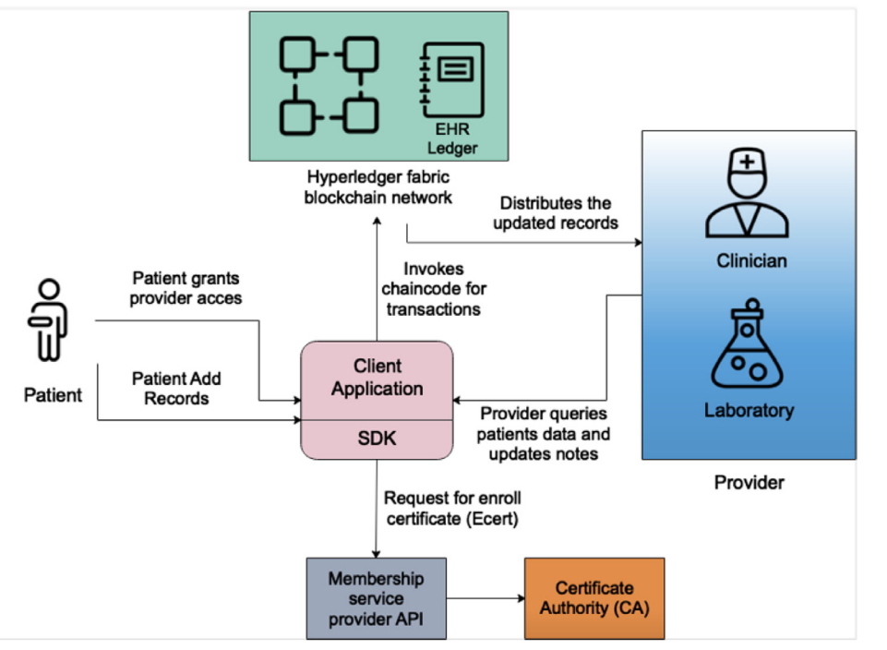
Related Work
Blockchain-based Electronic Healthcare Record (EHR) system for healthcare 4.0 applications
System architecture

Slide 22
Related Work
However,
None of the related work utilize existing healthcare information sharing standard
  Not emphasize on enable health information sharing and interoperability between different organizations
  Put healthcare information directly into a persistent Blockchain ledger is risky
  The proposed concept may not be compatible with the existing system
None of the related work directly address the mitigation of emerging cyber-attack
None of the related work directly address the “trust” issue between organizations

Slide 23
Agenda
Introduction
  Motivation
Related Work
Propose
Background Knowledge
  IHE, Cross-Enterprise Document Sharing (XDS.b) Profile
  Blockchain
  Ethereum
Proposed Method
Implementation & Result
Discussion
Conclusion

Slide 24
Propose
Implementing Cross-Enterprise Document Sharing (XDS) Profile which is the existing standard for healthcare information sharing between different organizations provided by IHE based on Blockchain Technology

Slide 25
Agenda
Introduction
  Motivation
Related Work
Propose
Background Knowledge
  IHE, Cross-Enterprise Document Sharing (XDS.b) Profile
  Blockchain
  Ethereum
Proposed Method
Implementation & Result
Discussion
Conclusion

Slide 26
IHE
IHE is an initiative founded by RSNA and HIMSS working closely with the healthcare industry to improve the way computer systems in healthcare integrate and share their information.
The initiative brings together users and developers of healthcare information technology in an annually recurring process to address interoperability in a variety of clinical domains.
They have worked in various areas including
  Cardiology, Dental, Devices, Endoscopy, Eye Care, Surgery, Pathology and Laboratory Medicine, Patient Care Coordination, Pharmacy, Quality, Research, Public Health, Radiation Oncology, Radiology,
  and Information Technology Infrastructure (ITI), which is the center of this work.
Resulting in an implementation guideline/standard called “IHE Profiles”
IHE Profiles in the same area published together in the same IHE Framework

Slide 27
IHE ITI Framework & IHE Profiles
IHE IT Infrastructure
  IHE Profiles published within the framework is all about Information Technology Infrastructure
  There is a total of 37 Profiles published in the framework included the deprecated profiles and reserved section for the profiles to be published in the future
The Cross-Enterprise Document Sharing (XDS.b) Profile is one of profile published in the framework
Note:
  Originally published Trial Implementation on August 15, 2004, which simply called “XDS” at the time
  “XDS.b” published Trial Implementation August 15, 2007 (Original “XDS” got renamed to “XDS.a”)

Slide 28
Cross-Enterprise Document Sharing (XDS.b) Profile
The profile facilitates the registration, distribution and access across health enterprises of patient electronic health records.
The profile is focused on providing a standards-based specification for managing the sharing of documents between any healthcare enterprises, ranging from a private physician office to a clinic to an acute care in-patient facility.
In IHE Profile, a machine/server/ or system are all called “actors”. This allows an organization to use just a single machine or the whole system as each IHE Profile actor, not limited to just a specific type of platform.
In XDS.b, metadata attributes of health document are used to represent the actual document, especially, specify access information for the document.

Slide 29
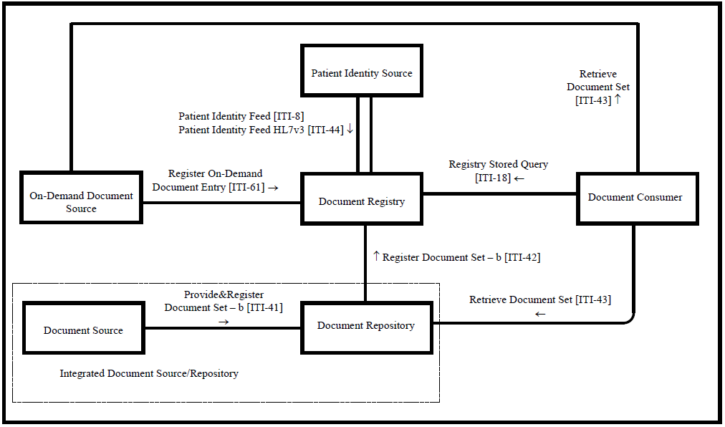
Cross-Enterprise Document Sharing (XDS.b) Profile
Cross-Enterprise Document Sharing Profile Diagram

Slide 30
Agenda
Introduction
  Motivation
Related Work
Propose
Background Knowledge
  IHE, Cross-Enterprise Document Sharing (XDS.b) Profile
  Blockchain
  Ethereum
Proposed Method
Implementation & Result
Discussion
Conclusion

Slide 31
Blockchain
Blockchain is a list of records, or “blocks”, that are linked to one another and cryptographically secured
Blockchain allows data to be stored and exchanged on a peer-to-peer basis
Structurally, Blockchain data can be consulted, shared and secured thanks to consensus-based algorithms
Blockchain is a sequence of blocks, which holds a complete list of transaction records like conventional public ledger

Slide 32
Blockchain Characteristics
Decentralized
The Blockchain ledger was kept as almost infinite copies throughout the Blockchain network and always synchronized with each other
  Even any of node went down, the Blockchain ledger will always survive,
  if there are at least one node survived
  Opposite to the centralized system, no one in the Blockchain network have authority over other
  Opposite to the centralized system, no one in the Blockchain network has absolute authority or control over its data

Slide 33
Blockchain Characteristics
Immutable
Data published on the Blockchain ledger are permanently bound by the cryptographically hashed “chain” and its decentralized nature
  Any attempt to change the content of the data published in the Blockchain must be done by changing all the value of the hash chain on each block and all decentralized nodes at once to succeed, otherwise, the change will immediately be rejected by the network
  This was proven to be impossible with existing computational power

Slide 34
Blockchain Characteristics
Transparent
All activity that happened on the Blockchain will be monitored and recorded by everyone in the network
  This makes it impossible for any secret malicious activity on Blockchain

Slide 35
Blockchain Characteristics
Distributed
The decentralized nature of the Blockchain ledger come together with the distribution of data
  Everyone in the Blockchain network has access to its data
  However, the right to access each data can be further regulated by manipulation of Blockchain address and Smartcontract

Slide 36
Blockchain Characteristics
Trusted
With all components and other characteristics of Blockchain combined, made it difficult for any actor to attempt malicious activity on Blockchain without the network notice
  This passively provide systematically “trust” between each participants of the Blockchain network
  Member of the network do not need to known and voluntarily “trust” another member to publish their data into the Blockchain ledger

Slide 37
Blockchain Types
There are three major types of Blockchain categorized by the scope of participants who can participate in a specific Blockchain network
  Public Chain
  Private Chain
  Permissioned Chain

Slide 38
Blockchain Types
Public Chain
  Public Blockchain is the type that allows anyone to participate in the network either participating as client/user node or miner/validator node
  This type of Blockchain mostly has no specific rule, policy, or agreement for participants to enter the network
  The type is suited best with the network environment where its data is not required to be kept confidential from the public

Slide 39
Blockchain Types
Private Chain
  Private Blockchain is the type that allows only a limited number of members to participate
  This type was invented to be more compatible with the environment that participant nodes are members of a specific organization or community where the Blockchain ledger may record confidential information limited only to participants

Slide 40
Blockchain Types
Permissioned Chain (also known as Consortium Blockchain)
  Permissioned Blockchain is the type that allows only selected members of a specific community or affinity domain to participate
  The permission chain may further extend its member to a larger group of members via policy or agreement accepted by original participants
  The permission chain will not allow anyone to participate in the network as the Blockchain ledger may contain confidential information limited to the accepted group of participants

Slide 41
Blockchain Components
Transaction and ‘Block’
  …
Cryptographically hashed ‘Chain’
  …
Distributed network of participate ‘Node’
  …

Slide 42
Blockchain Components
<Picture explaining components>

Slide 43
Blockchain
Blockchain Components
  Consensus
    Competition-based consensus
    Randomness-based consensus
    Majority-based consensus

Slide 44
Agenda
Introduction
  Motivation
Related Work
Propose
Background Knowledge
  IHE, Cross-Enterprise Document Sharing (XDS.b) Profile
  Blockchain
  Ethereum
Proposed Method
Implementation & Result
Discussion
Conclusion

Slide 45


Ethereum Blockchain
Ethereum is one of the well-known open-source Blockchain platforms
The platform initially invented by the developer named Vitalik Buterin and further develop and maintain by the Ethereum community
The main approach of Ethereum Blockchain is about the use of Blockchain technology for applications other than cryptocurrency
The platform was the first to propose the concept of
a ‘smart contract’ that enables programming
over Blockchain technology

Slide 46
Ethereum Blockchain
Smartcontracts is a programming script define what behavior the contract will do when open/view by user
In Ethereum, smart contract code is written with Solidity programming language and
rely on Ethereum Virtual-Machine (EVM) which allow host machine of Ethereum client to be able to execute smart contract Solidity code
EVM was designed to allow portability of Ethereum platform
and always packed with Ethereum client

Slide 47
Ethereum Blockchain
Solidity is Javascript-like programming language that is specifically designed to use with Ethereum smart contract
The main purpose of the programming language is to act as the middle between human-understandable language and computer language
It reduces difficulty for developer to design behavior
of their smart contract on Ethereum Blockchain
The language is update and maintain by
Ethereum community

Slide 48
Ethereum Blockchain
Quorum (also known as go-Quorum)
  is an Ethereum-based distributed ledger protocol forked of go-Ethereum enabled for transaction/contract privacy and a wider range of majority-based consensus mechanisms compatibility
  Quorum enables the usage of PBFT by inventing a PBFT-inspired consensus algorithm called Istanbul BFT (IBFT) which was adapted to be compatible with the Ethereum Blockchain environment
  The platform also offers the “7-Nodes Example” for developers to invent and test their Blockchain concept which is useful for the development with the limited computational resources available.

Slide 49
Agenda
Introduction
  Motivation
Related Work
Propose
Background Knowledge
  IHE, Cross-Enterprise Document Sharing (XDS.b) Profile
  Blockchain
  Ethereum
Proposed Method
Implementation & Result
Discussion
Conclusion

Slide 50
Proposed Method
Scenario, Content + Pic

Slide 51
Proposed Method
Cross-Enterprise Document Sharing Profile Diagram

Slide 52
Proposed Method
Implement Blockchain into the IHE XDS.b Profile
  Replace traditional database of XDS Document Registry Actor with Blockchain
  Extend the usage of the Profile by allow shared document to act as alternative access for the source.
Register Stored Query [ITI – 18]
XDS Document Registry Actor
(XDS Registry Blockchain)
XDS Document Consumer Actor
Register Document Set – b [ITI – 42]
XDS Document Repository Actor
Retrieve Document Set [ITI – 43]

Slide 53
Proposed Method
Design
  Replace the position for traditional database in XDS Document Registry Actor with Blockchain ledger
  Smartcontract help the XDS Document Registry Actor program interact with Blockchain ledger
  Smartcontract store value of metadata attributes set and keep track of published set
  As the databased was replaced with Blockchain, the special search algorithm was created to take the role.
  The search program perform sequential search on each published Smartcontract one-by-one until the matching result was found.
  XDS Registry Actor Blockchain able to communicate with original XDS Document Repository Actor and
  XDS Document Consumer Actor
  The Blockchain network use IBFT as its consensus mechanism and participating nodes are XDS Affinity Domain members

Slide 54

Proposed Method
XDS Registry Blockchain
Design
Hospital A
Registry Query
[ITI-18]
Smart
Contract
Interpreter
Add
Read
Responder
Search
Query Response [ITI-18]
Ethereum
Blockchain Ledger
Interpreter
& Simplifier
Register Document Set-b [ITI-42]
XDS Affinity Domain
Blockchain Network

Slide 55
Blockchain
XDS

Slide 56
Implementation – Blockchain setup
Machine specification
  The main machine was the best machine available for the implementation and compatible workflow which will be used for the coding process, which is a laptop Alienware 17 R5, Intel(R) Core (TM) i9-8950HK CPU@2.90GHz, 32 GB installed RAM, running on Windows 10 operating system version Home Single Language (20H2) 64-bit, x64-based processor
  A test machine is a virtual machine established within the main machine using Oracle VM running on
  Linux Ubuntu (64-bit) version 18.10 with 8 GB RAM and 100 GB storage dynamically shared from the host main machine

Slide 57
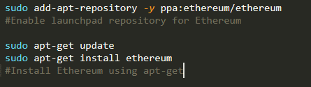
Implementation – Blockchain setup
Go-Ethereum
Installation command-line for Go-Ethereum on Ubuntu

Slide 58
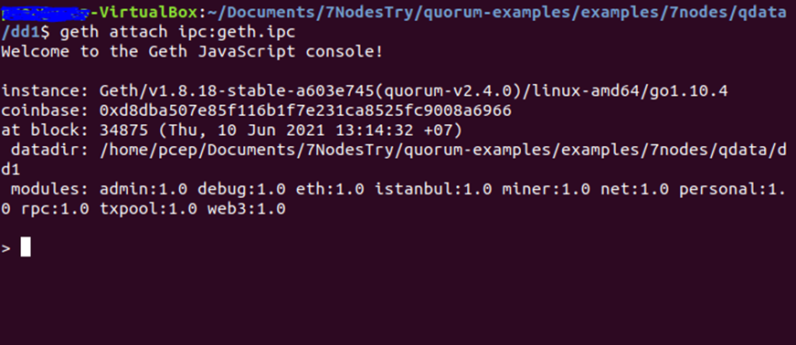
Implementation – Blockchain setup
Go-Ethereum
Geth interface running on Ubuntu

Slide 59
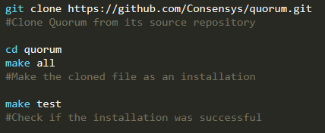
Implementation – Blockchain setup
Quorum Installation
Installation command-line for Quorum on Ubuntu

Slide 60
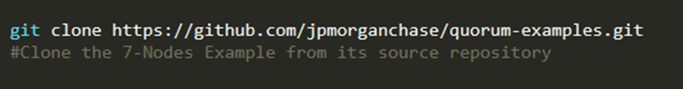
Implementation – Blockchain setup
7-Nodes Example Installation
Installation command-line for 7-Nodes Example on Ubuntu

Slide 61
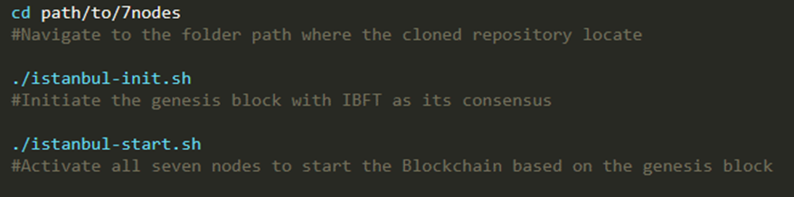
Implementation – Blockchain setup
7-Nodes Example Installation
Installation command-line for 7-Nodes Example on Ubuntu

Slide 62
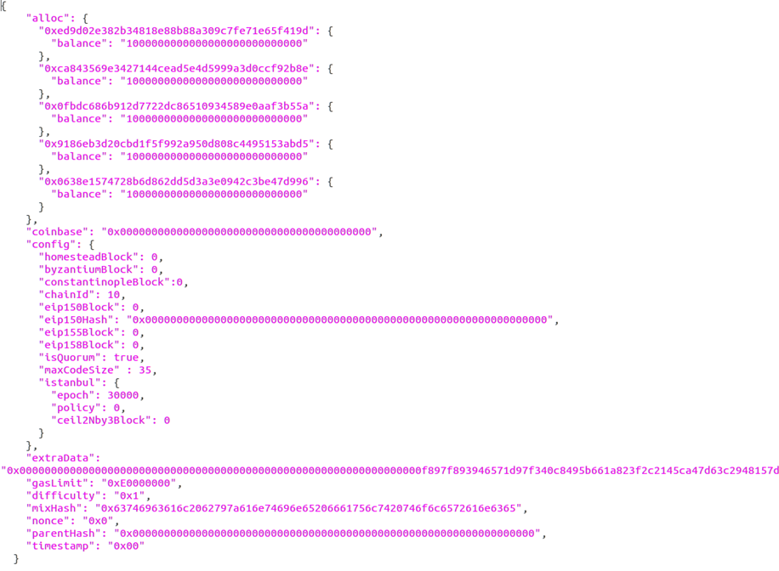
Implementation – Blockchain setup
7-Nodes Example Installation
Content of "istanbul - genesis.json" file

Slide 63

Implementation – Blockchain setup
7-Nodes Example Installation
IBFT 7-Nodes Blockchain activation script

Slide 64
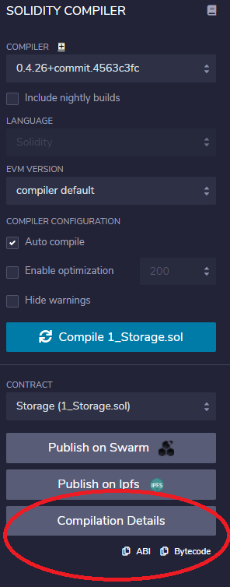
Implementation – Blockchain setup
Compile and deploy Smartcontract Solidity code
ABI Code and Byte code generated can be copied and passed directly
(From red circle) into Web3js code

Slide 65
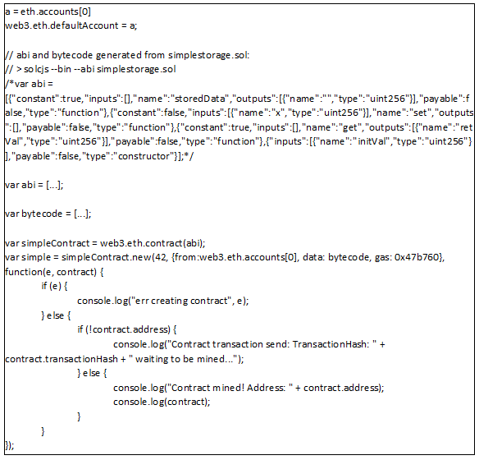
Implementation – Blockchain setup
Deploy Smartcontract into Blockchain
The Web3js script for Smartcontract deploy

Slide 66
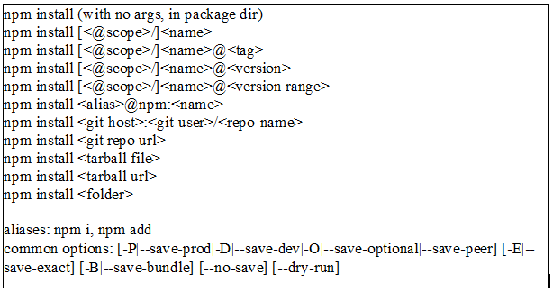
Implementation – Blockchain setup
Prepare NodeJS Coding Environment
  The coding of program for native side of XDS Actor require node module name "Web3" (Web3js) ,
  "xml2js" , "fs" , "net" , "util" , "moment" , and "cryptr" which can be installed using the command-line
"npm install" command-line

Slide 67
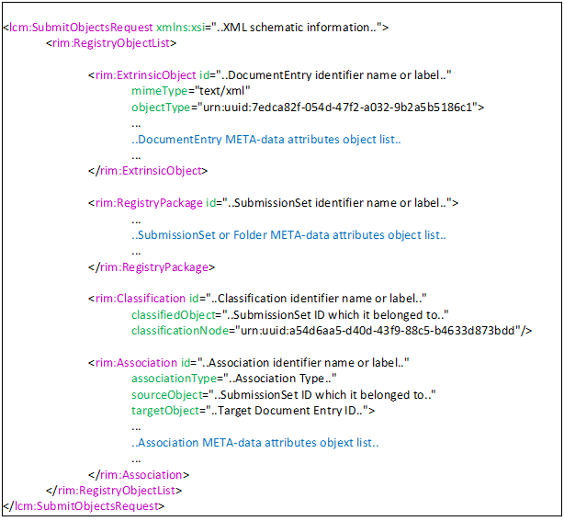
Implementation – XDS Actors
XDS Document Repository Actor
Pseudocode represents general format of Register Document Set-b [ITI-42]

Slide 68
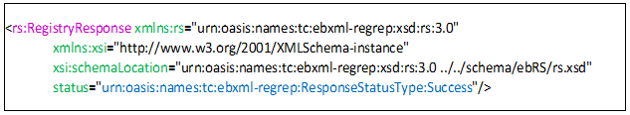
Implementation – XDS Actors
XDS Document Repository Actor
XML Code snippet of Registry Document Set-b Response transaction sample

Slide 69
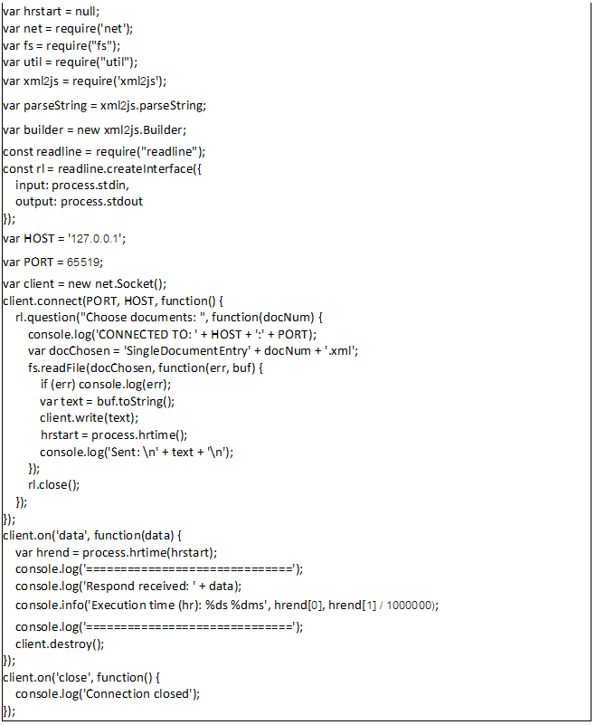
Implementation – XDS Actors
XDS Document Repository Actor
XDS Document Repository Actor simulating program

Slide 70
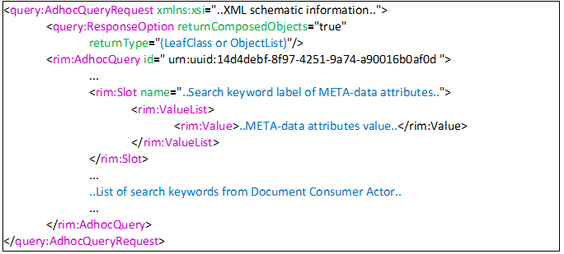
Implementation – XDS Actors
XDS Document Consumer Actor
Pseudocode represents general format of Registry Stored Query Request [ITI - 18]

Slide 71
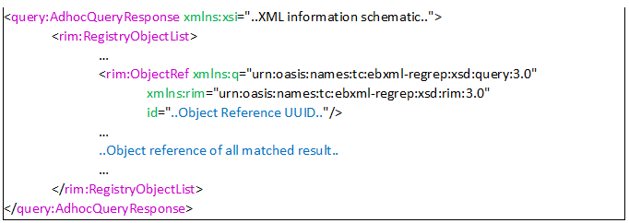
Implementation – XDS Actors
XDS Document Consumer Actor
Pseudocode represents general format of Query Response
included “Object Reference” of search results

Slide 72
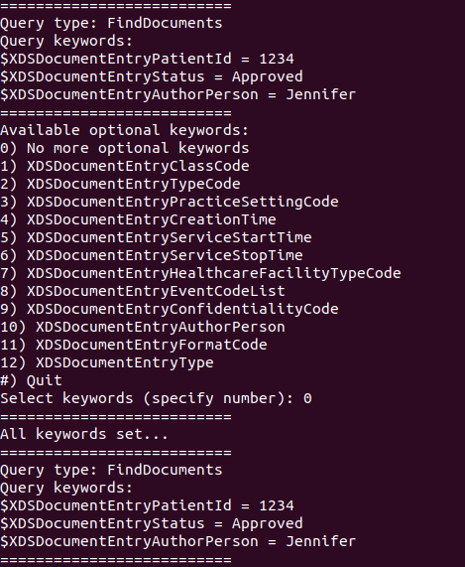
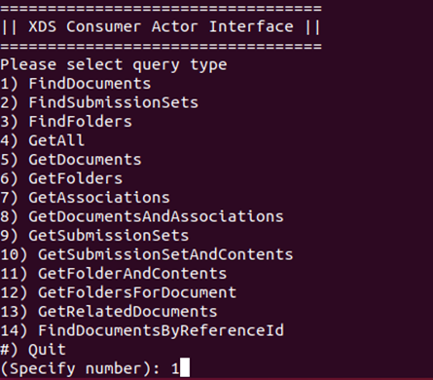
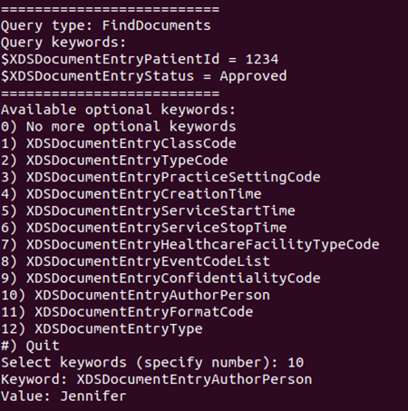

Implementation – XDS Actors
XDS Document Consumer Actor
XDS Document Consumer Actor simulating program

Slide 73
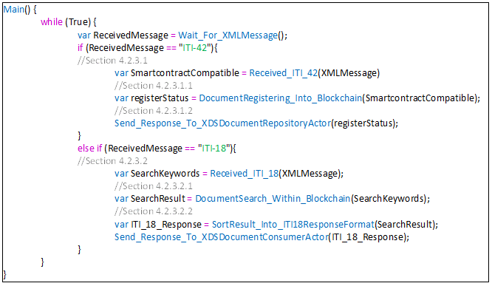
Implementation – XDS Actors
XDS Document Registry Actor
Pseudocode showing the process flow of the XDS Document Registry Actor

Slide 74
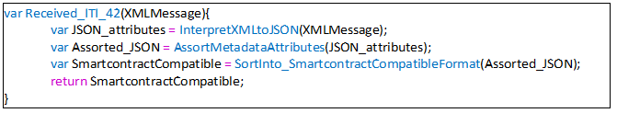
Implementation – XDS Actors
XDS Document Registry Actor – ITI 42
The pseudocode showing the process flow of XDS Document Registry Actor for Document Registering Function

Slide 75
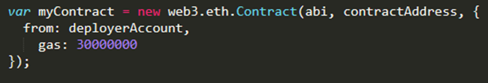
Implementation – XDS Actors
XDS Document Registry Actor – Smartcontract for ITI-42
Specified gas value supplying Ethereum Smartcontract execution

Slide 76
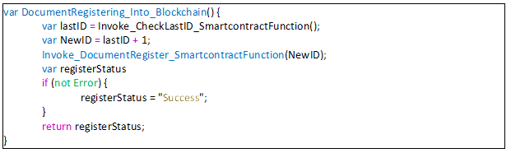
Implementation – XDS Actors
XDS Document Registry Actor – Smartcontract for ITI-42
The pseudocode showing the process flow of Document Register Smartcontract

Slide 77
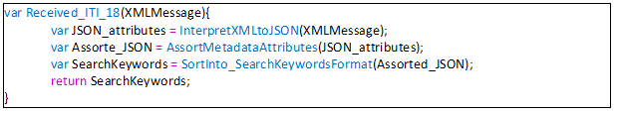
Implementation – XDS Actors
XDS Document Registry Actor – ITI-18
The process flow for the native-side Javascript program
related Document Search Function

Slide 78
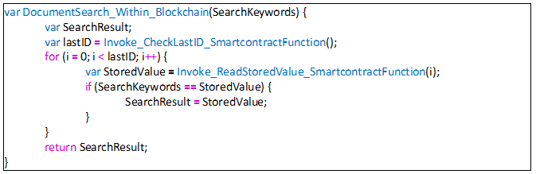
Implementation – XDS Actors
XDS Document Registry Actor – Smartcontract for ITI-18
The pseudocode showing the process flow of Smartcontract function related to Document Search

Slide 79
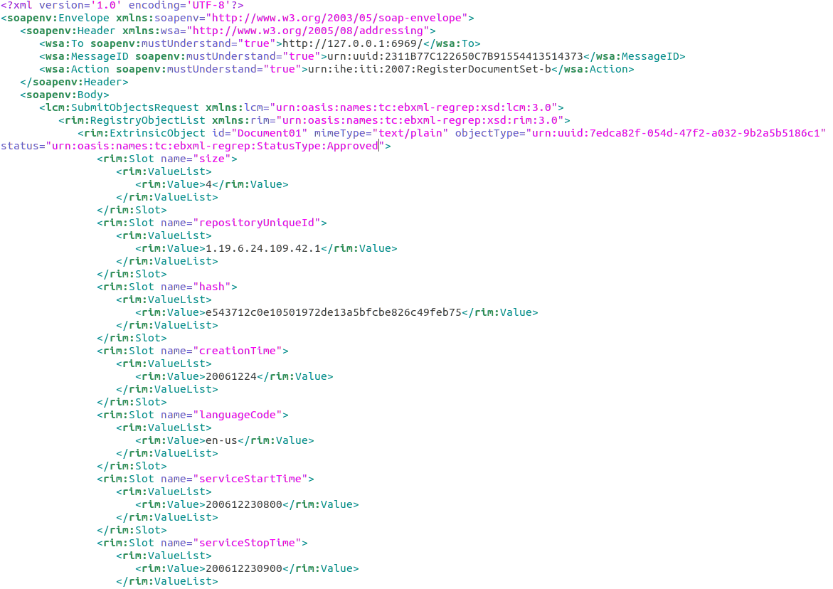
Implementation
Experimental Setup
Content of mockup transaction example
Notes:
Picture not clear

Slide 80
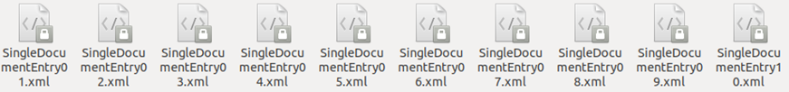
Implementation
Experimental Setup
Ten of mockup transactions generated for the experiment
Notes:
How each file differ
In Thesis, include all files content

Slide 81
Result
<Demonstration>

Slide 82
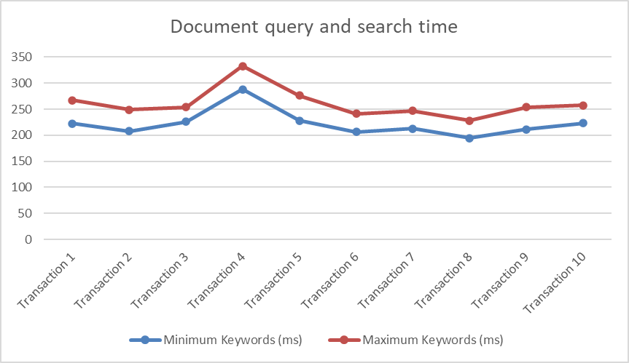
Result
Chart comparing document query and search time
between minimum keywords and maximum keywords
Notes:
Axis legend
Add average value too

Slide 83
Agenda
Introduction
  Motivation
Related Work
Propose
Background Knowledge
  IHE, Cross-Enterprise Document Sharing (XDS.b) Profile
  Blockchain
  Ethereum
Proposed Method
Implementation & Result
Discussion
Conclusion

Slide 84
Discussion
The XDS On-Demand Document Repository would enhance the benefit of the XDS Blockchain as it provides On-Demand health document type which gave flexibility and a wider range of usability of shared health document to healthcare operation
The Patient Identity Feed Actor may even further integrate into the Smartcontract and eliminate the need for centralized identity feed in the network
We try to focus only on using the Blockchain technology to act as an exchange medium for health document metadata because the idea of putting health documents directly into the persistent Blockchain ledger still has a high risk of exposing the data to the unintentional actor who would cause harm to the industry
The IHE IT Infrastructure is providing much more profiles and various tools for use in achieving healthcare interoperability
As Blockchain technology still has a long way of development and research path to go through, the concept proposed in this work also could be further developed into a more advanced version for actual adoption in the future

Slide 85
Agenda
Introduction
  Motivation
Related Work
Propose
Background Knowledge
  IHE, Cross-Enterprise Document Sharing (XDS.b) Profile
  Blockchain
  Ethereum
Proposed Method
Implementation & Result
Discussion
Conclusion

Slide 86
Conclusion
Write

Slide 87
Q&A

