Slide 1

Cross-Enterprise Document Sharing (XDS) Implementation based on Blockchain Technology
Petnathean Julled

Slide 2
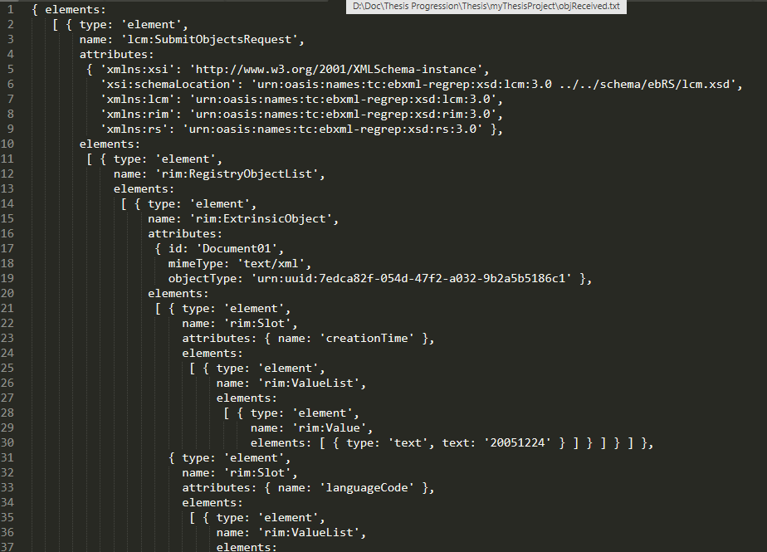
RetrievedObject

Slide 3
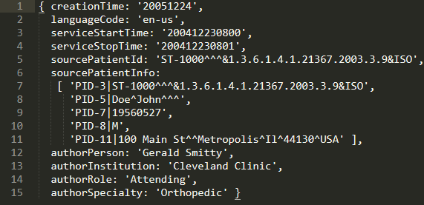
AssortedObject

