Slide 1

DATABASE PROJECT
PROJECT NAME:
Database System Project
PROJECT DESCRIPTION:
This project includes a system design that will enable a company to track personnel information, job assignments, compensation, experience and document management in an integrated manner, covering both its own personnel and external personnel. In addition, social elements such as family information of in-house personnel and gift processes on special occasions will also be evaluated within the scope of the system.
ADVISOR:
Prof.Dr. İLHAMİ MUHARREM ORAK
ORGANISATION:
Karabük University

Slide 2
Subject of the Project
In this project, a personnel management system will be developed that covers both a company's own employees and external employees (hired from other companies). Basic information about all employees (name, surname, phone number, date of birth) will be stored in the system.
The company's own employees receive monthly salaries and bonuses. Spouse and child information about these employees is also kept in the system. In addition, various gifts are given to employees' spouses and unmarried children at the ages of 10, 25 and 50. E-mail addresses are defined for employees who request it.
External employees work for hourly wages and must present a diploma or certificate in order to be registered in the system. The name of the company these employees are affiliated with, their contact information and the sector they operate in are also included in the system.
The system tracks how much salary or wage all employees receive each month. Each employee is matched to only one task in the system and each task requires a certain number of years of experience. In addition, each task has a responsible supervisor.
Thanks to this system, personnel information, task assignments, wage management and external company information can be managed in a centralized structure; The company's human resources process will become more organized and efficient.

Slide 3
Entity Definitions
Certificate: It represents the certificate or diploma that externally hired employees must have. At least one document must be assigned to each hired employee.
Company: Contains information about external companies to which leased employees are affiliated. Company name, contact information and sector information are kept.
Contract Employee: They represent employees who are hired from other companies to work temporarily. They work for an hourly wage and must have a certificate or diploma in order to work.
Dependent: They are the spouses and children of their own employees. Gifts are given to single children and spouses on special days (10, 25, 50 years old). It is related to the employee.

Slide 4
Entity Definitions
Employee : It represents all employees within the company. Basic information such as name, surname, telephone, date of birth are kept here. Own employees and hired employees are separated through this entity.
Gift: It refers to gifts given to employees' spouses and single children at certain ages (10, 25, 50). It is tracked according to age and person.
Own Employee: Represents employees belonging to the company. They receive monthly salaries and bonuses. Email addresses are provided to those who request them. Spouse and child information is associated with this entity.

Slide 5
Entity Definitions
Prim: It refers to the monthly premiums given only to its own employees. The amount of premium received by each employee in each month is kept in this asset.
Salary Record: It is the entity where the salaries of own employees and the wages calculated according to working hours for hired employees are recorded on a monthly basis.
Supervisor: He/she is the person who takes responsibility for the tasks and guides the employees. Every task is subordinate to a superior.

Slide 6
Creating Tables and Created Tables
Certificate
Company
Contract employee
Depent
Employee
Gift
Own employee
Prim
Salary record
Supervisor

Slide 7
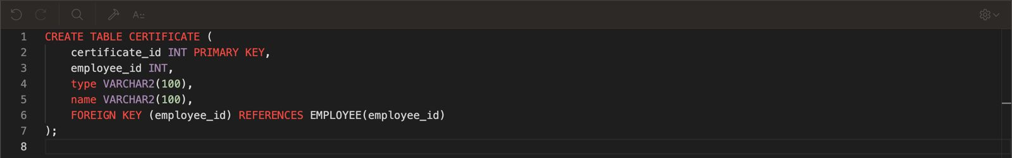
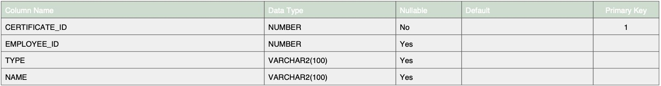
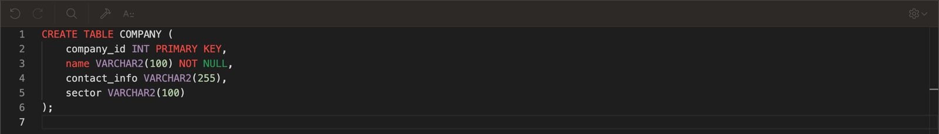
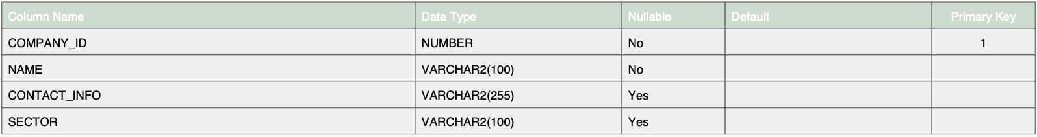

Slide 8
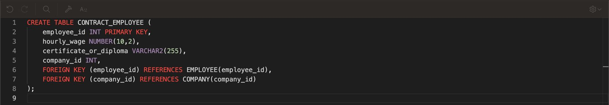
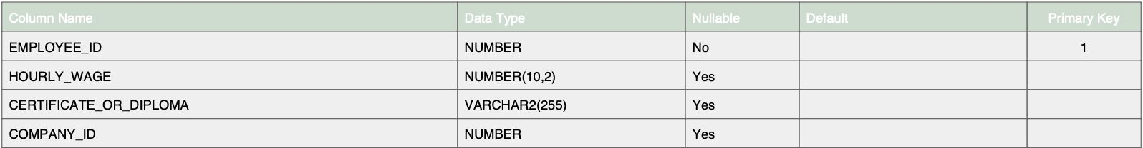
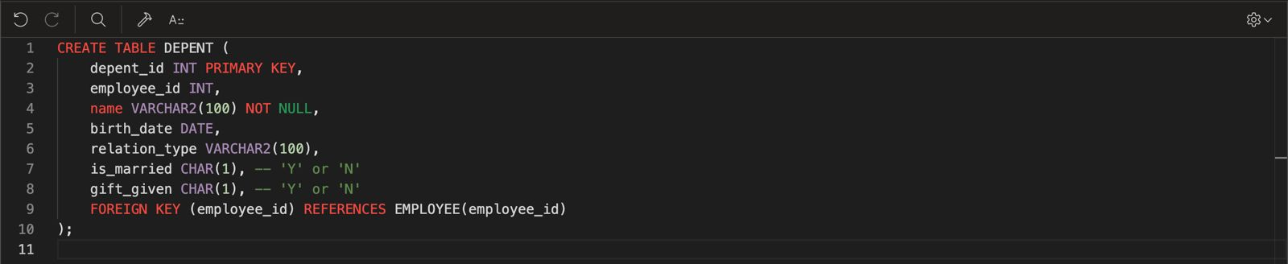
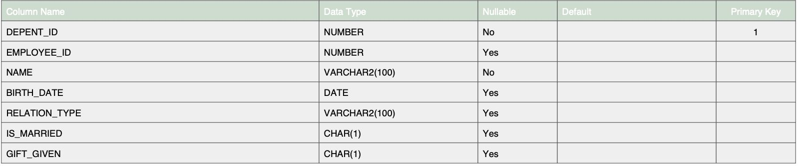

Slide 9
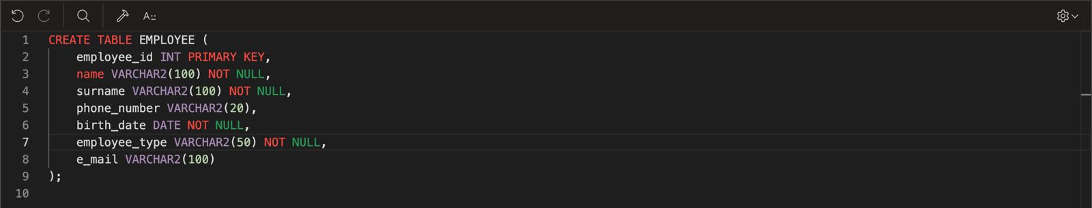
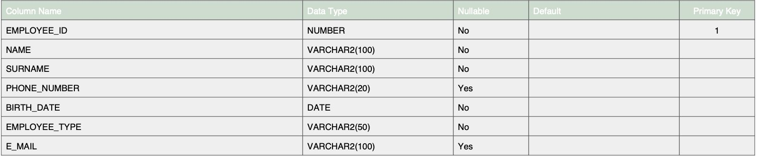
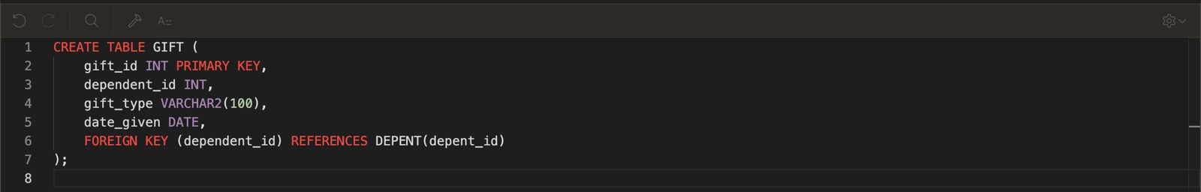
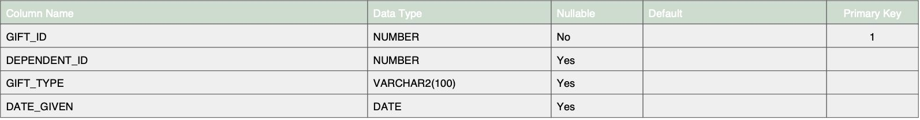

Slide 10
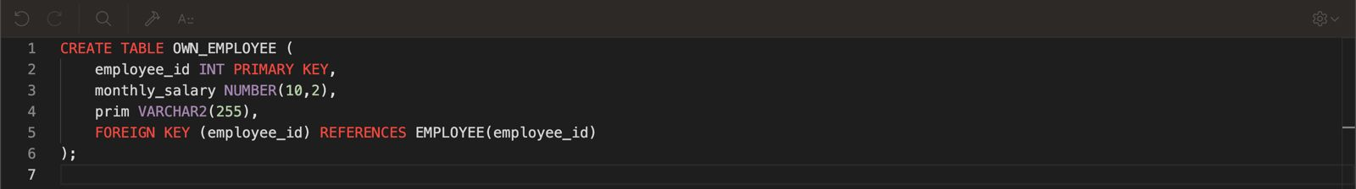
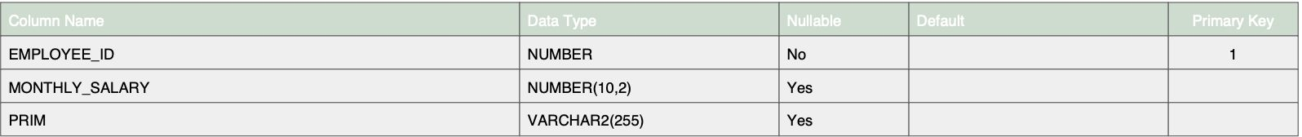
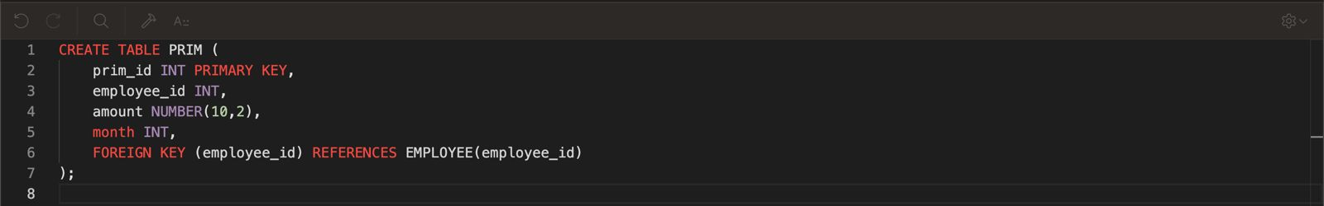
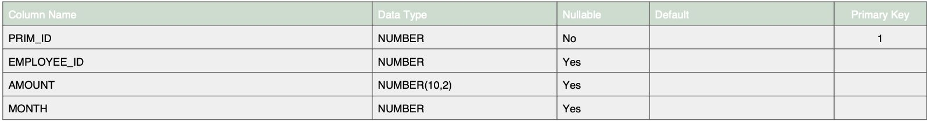

Slide 11
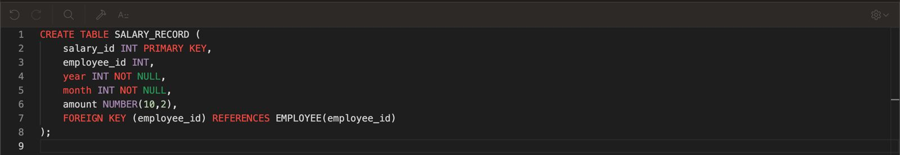
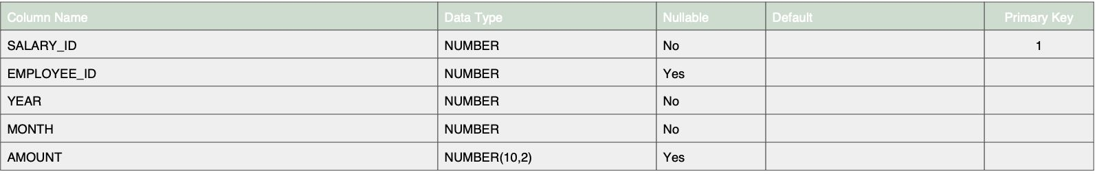
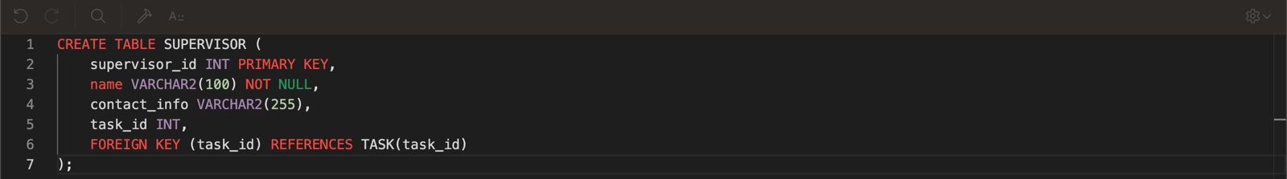
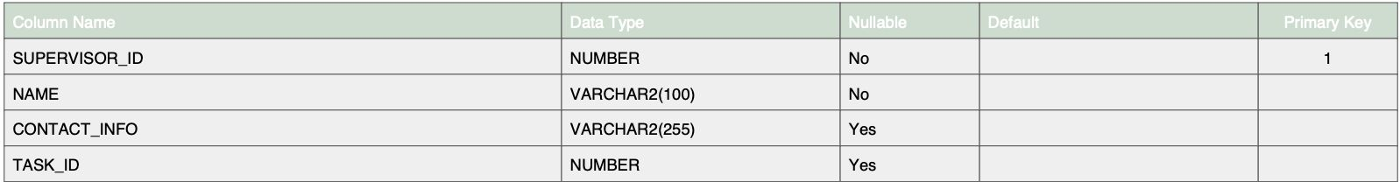

Slide 12
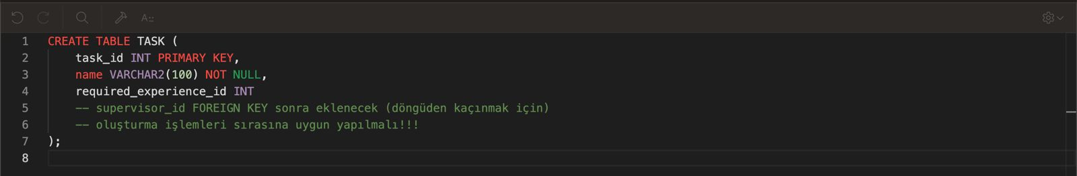
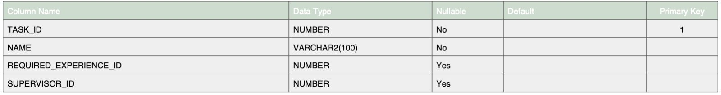

Slide 13
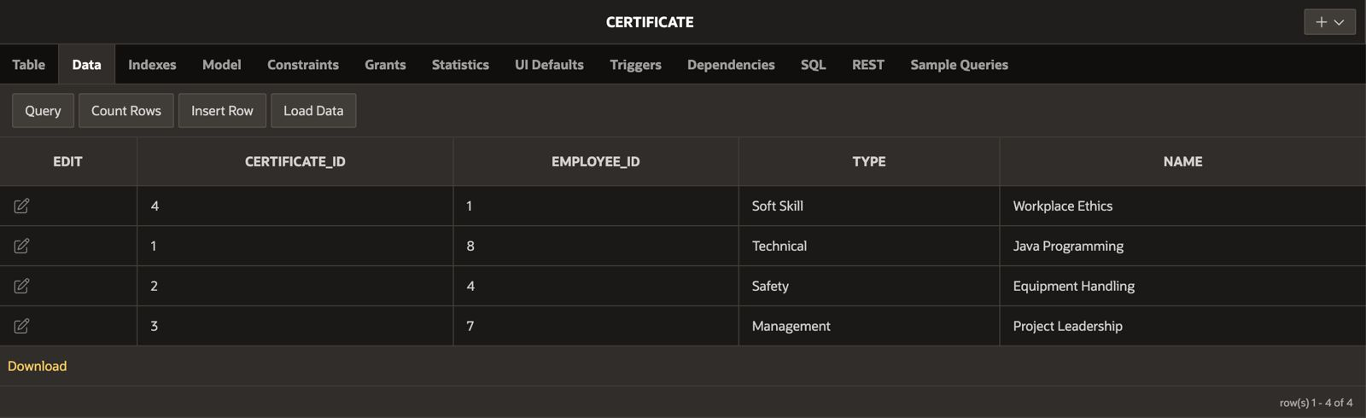

Slide 14
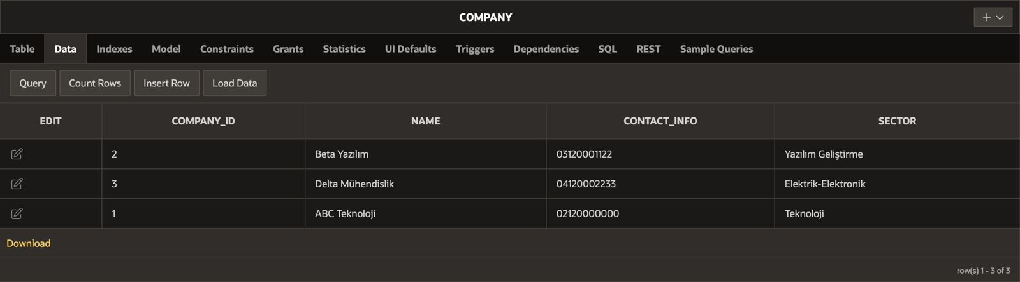

Slide 15
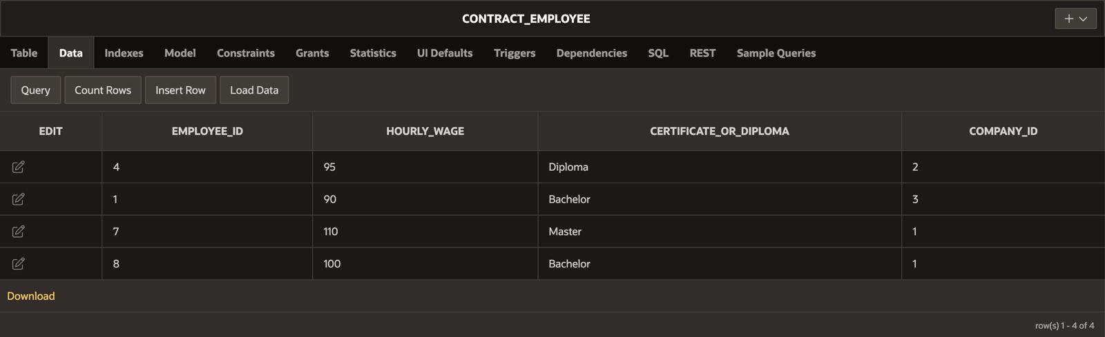

Slide 16
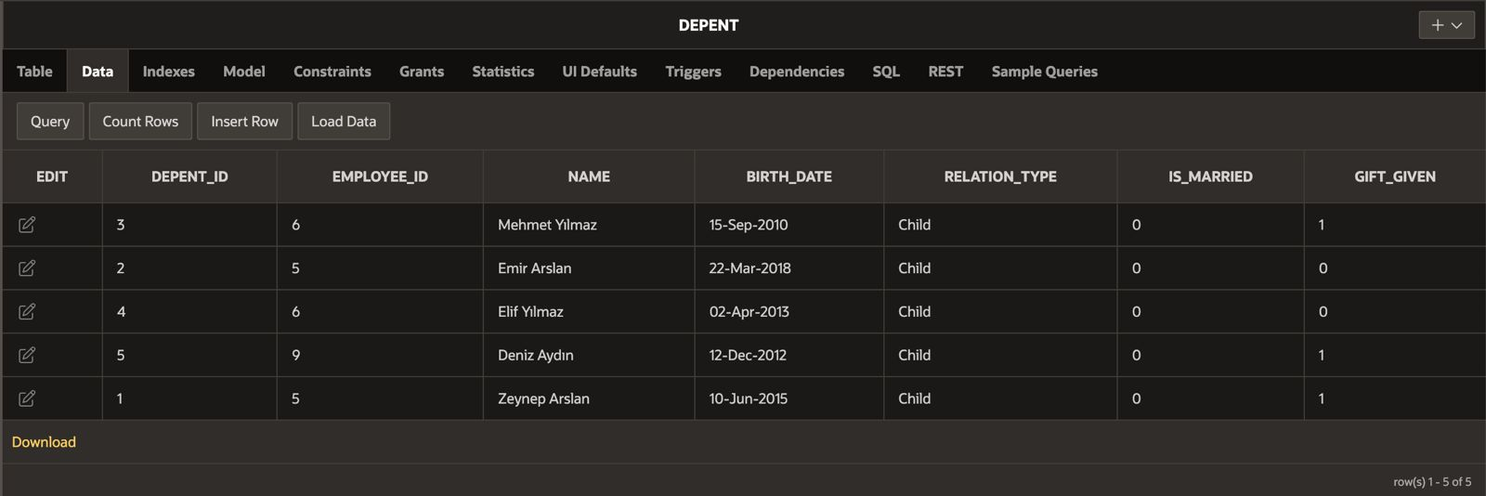
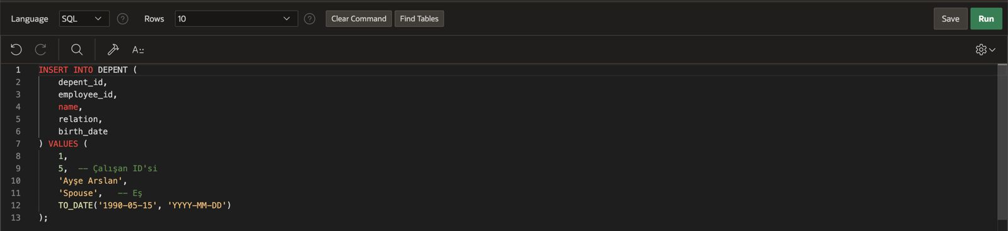

Slide 17
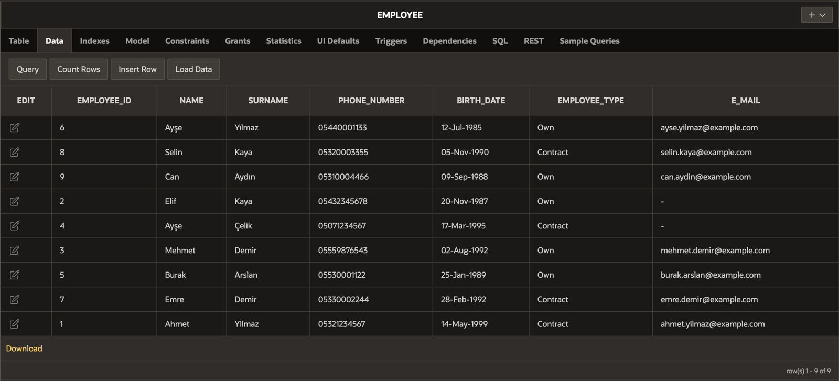
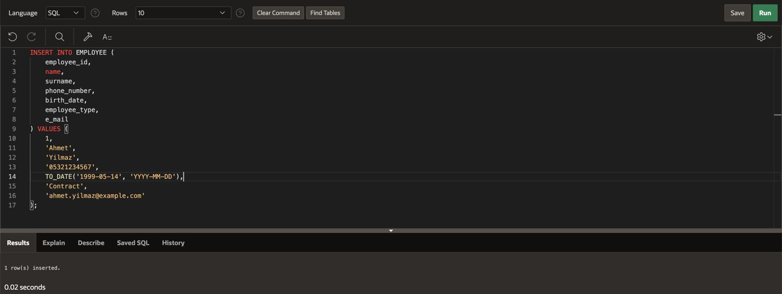

Slide 18
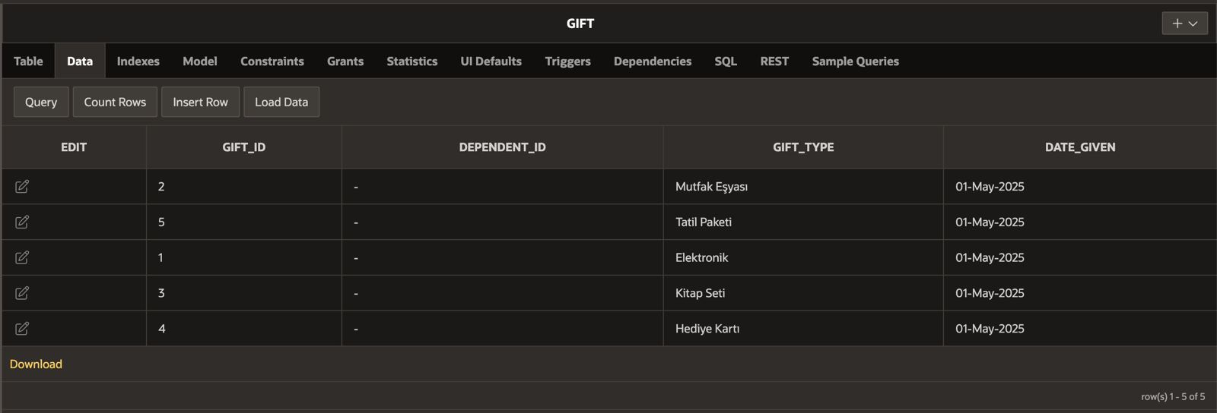

Slide 19
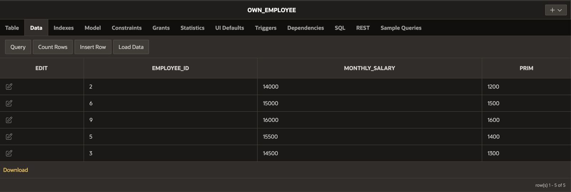

Slide 20
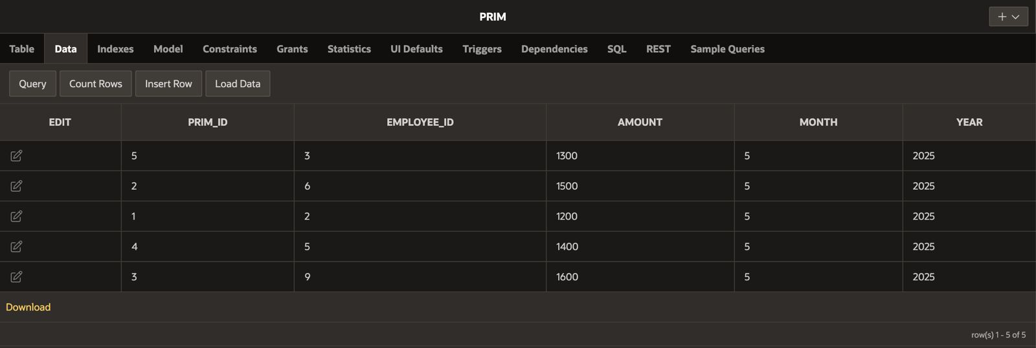

Slide 21
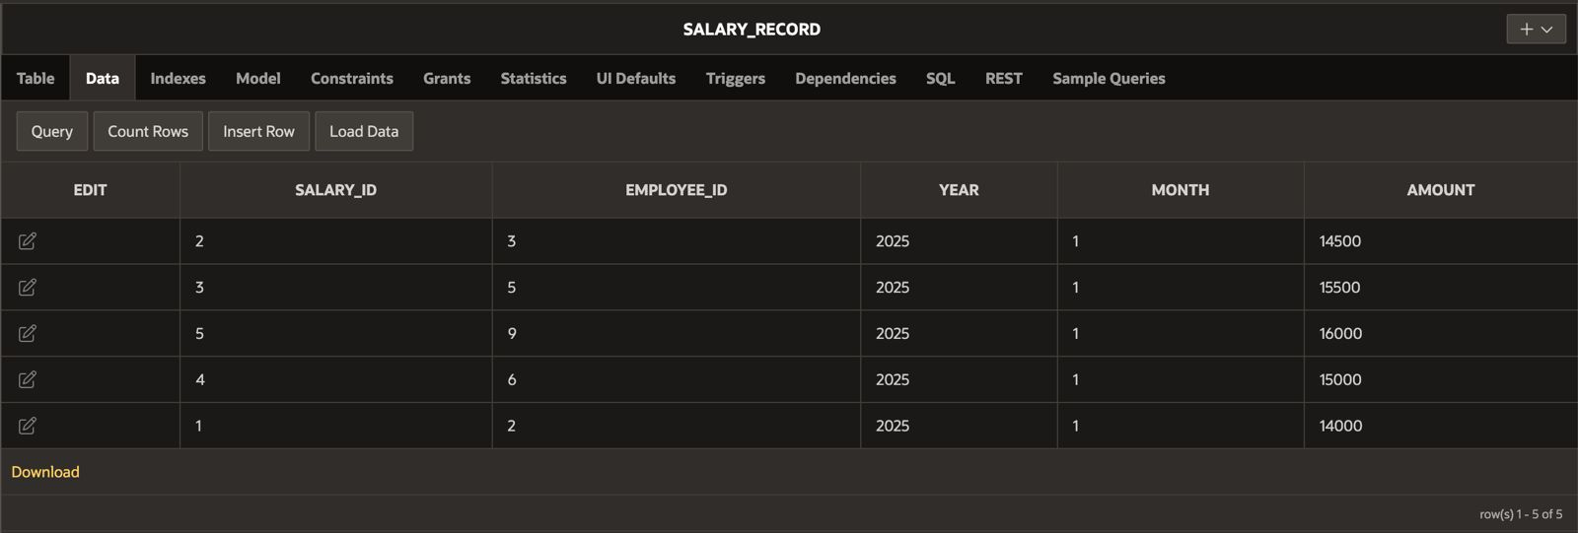

Slide 22
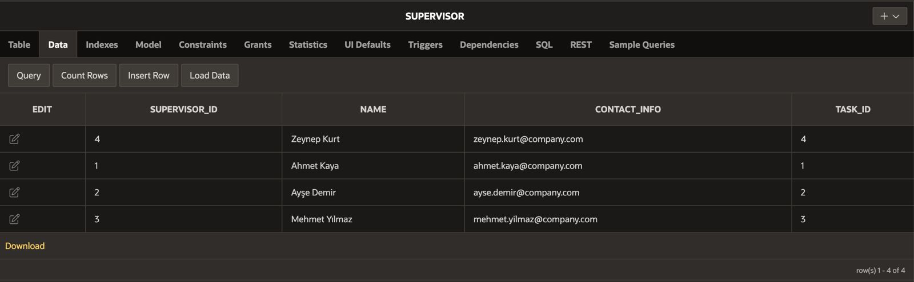

Slide 23
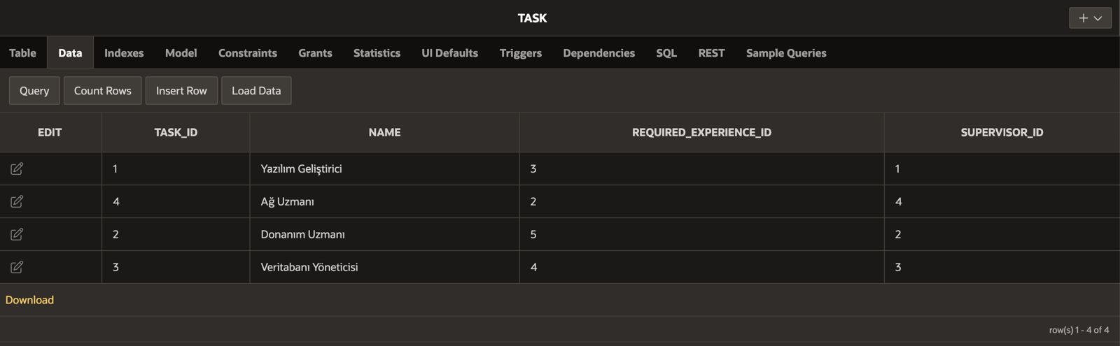

Slide 24
Writing SQL DML Statements to reach information
One statement including Subquery
One statement including Join
One statement including Group By
One statement including Date function
One statement including Character function
One statement including Update
One statement including Alter Table

Slide 25
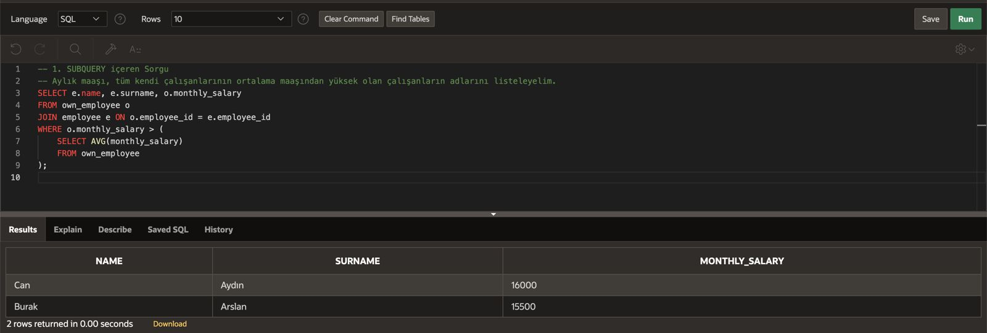

Slide 26
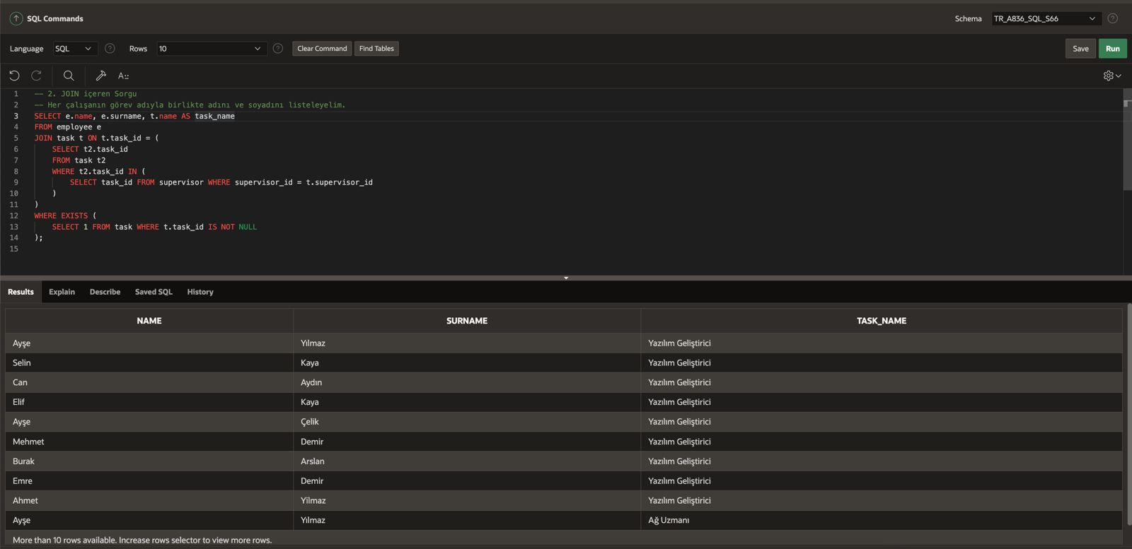

Slide 27
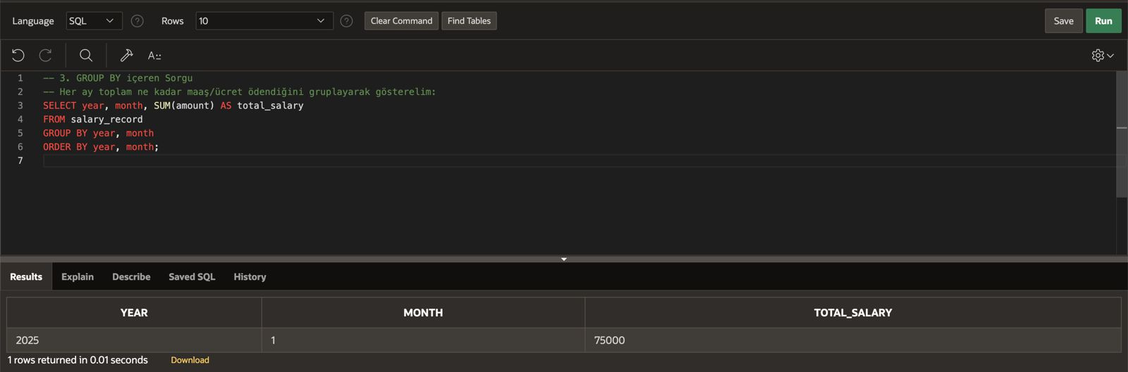

Slide 28
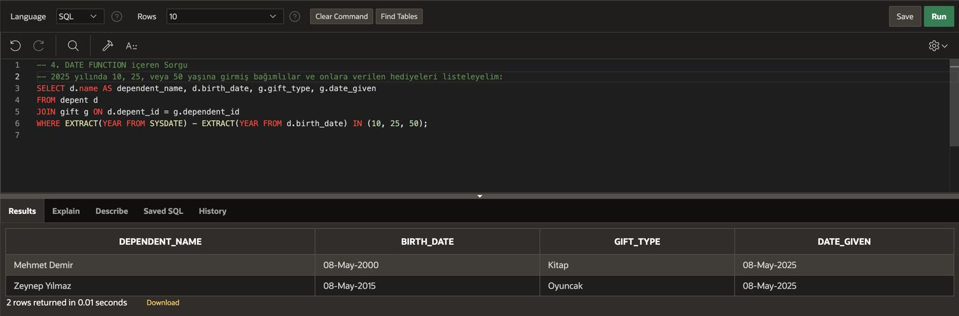

Slide 29
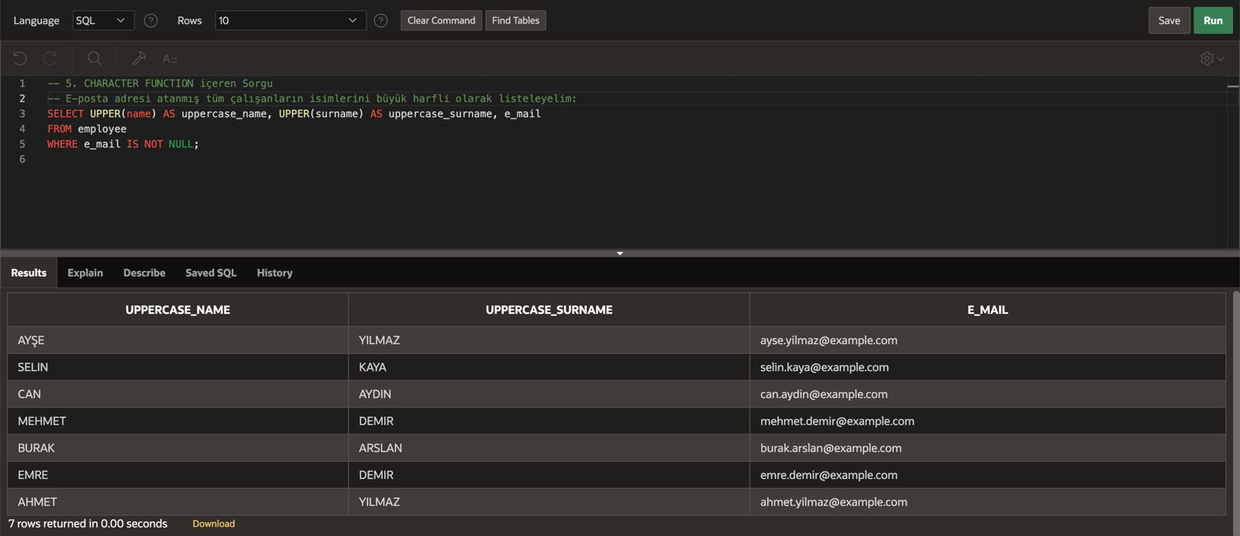

Slide 30
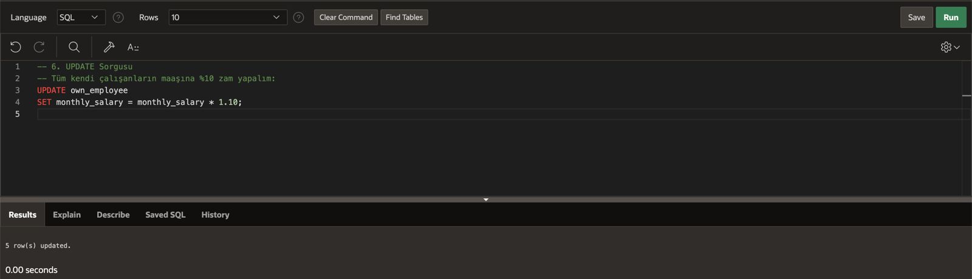

Slide 31
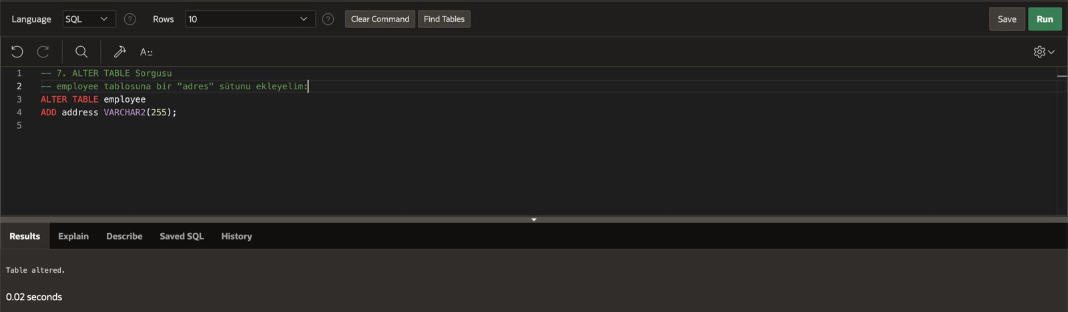

Slide 32
Developing ERD
Defining at least 7 entity
Defining attributes
Defining all necessary relationships
If possible Superype-subtype, arc and hierarchical structures

Slide 33
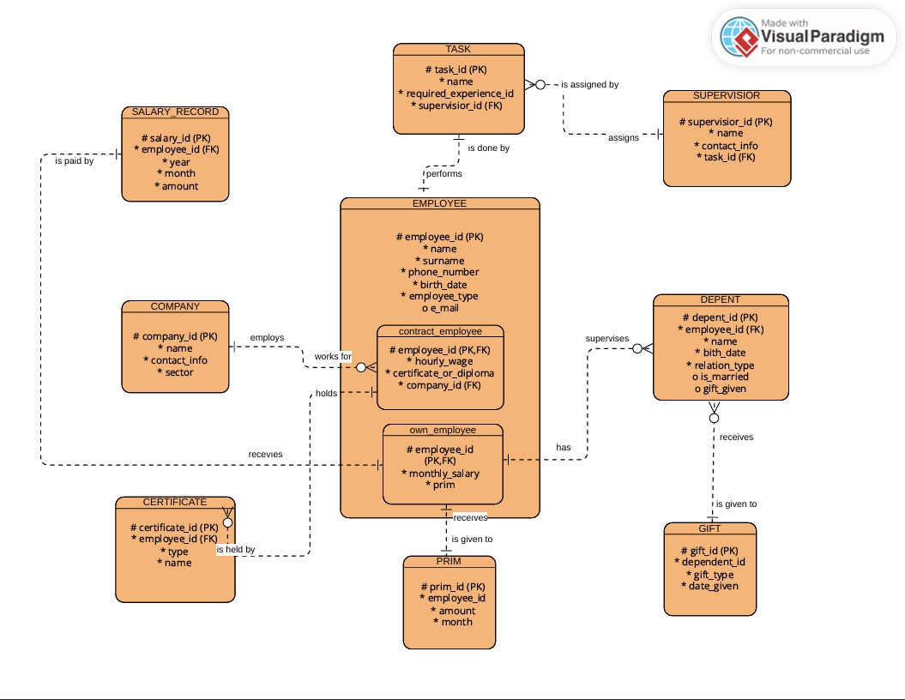

Slide 34
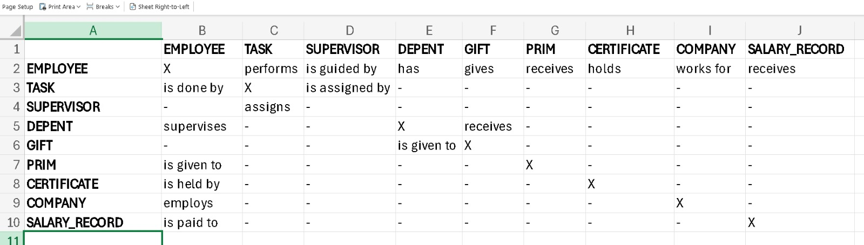

Slide 35
Those Who Prepared
Semih Nebi TOKALAK
Hamza KALAYCI
Sudenaz SÜZGEN
Batuhan ÇİNE

