Slide 1
Decision Trees
Dr Panagiotis Chountas

Slide 2
Overview
What is a Decision Tree
Sample Decision Trees
How to Construct a Decision Tree
Problems with Decision Trees
Summary

Slide 3
What is a Decision Tree?
An inductive learning task
Use particular facts to make more generalized conclusions
A predictive model based on a branching series of Boolean tests
These smaller Boolean tests are less complex than a one-stage classifier
Let’s look at a sample decision tree…

Slide 4
Sample Experience Table
Example | Attributes |  |  |  | Target
 | Hour | Weather | Accident | Stall | Commute
D1 | 8 AM | Sunny | No | No | Long
D2 | 8 AM | Cloudy | No | Yes | Long
D3 | 10 AM | Sunny | No | No | Short
D4 | 9 AM | Rainy | Yes | No | Long
D5 | 9 AM | Sunny | Yes | Yes | Long
D6 | 10 AM | Sunny | No | No | Short
D7 | 10 AM | Cloudy | No | No | Short
D8 | 9 AM | Rainy | No | No | Medium
D9 | 9 AM | Sunny | Yes | No | Long
D10 | 10 AM | Cloudy | Yes | Yes | Long
D11 | 10 AM | Rainy | No | No | Short
D12 | 8 AM | Cloudy | Yes | No | Long
D13 | 9 AM | Sunny | No | No | Medium

Slide 5
Predicting Commute Time
Leave At
If we leave at 10 AM and there are no cars stalled on the road, what will our commute time be?
10 AM
9 AM
8 AM
Stall?
Accident?
No
Yes
Long
No
Yes
Short
Long
Medium
Long

Slide 6
Inductive Learning
In this decision tree, we made a series of Boolean decisions and followed the corresponding branch
Did we leave at 10 AM?
Did a car stall on the road?
Is there an accident on the road?
By answering each of these yes/no questions, we then came to a conclusion on how long our commute might take

Slide 7
Decision Tree as a Rule Set
if hour == 8am
commute time = long
else if hour == 9am
if accident == yes
commute time = long
else
commute time = medium
else if hour == 10am
if stall == yes
commute time = long
else
commute time = short
Notice that all attributes to not have to be used in each path of the decision.
As we will see, all attributes may not even appear in the tree.

Slide 8
How to Create a Decision Tree
We first make a list of attributes that we can measure
These attributes (for now) must be discrete
We then choose a target attribute that we want to predict
Then create an experience table that lists what we have seen in the past

Slide 9
Choosing Attributes
The previous experience decision table showed 4 attributes: hour, weather, accident and stall
But the decision tree only showed 3 attributes: hour, accident and stall
Why is that?

Slide 10
Choosing Attributes
Methods for selecting attributes (which will be described later) show that weather is not a discriminating attribute
We use the principle of Occam’s Razor: Given a number of competing hypotheses, the simplest one is preferable

Slide 11
Choosing Attributes
The basic structure of creating a decision tree is the same for most decision tree algorithms
The difference lies in how we select the attributes for the tree
We will focus on the ID3 algorithm developed by Ross Quinlan as part of this presentation

Slide 12
Decision Tree Algorithms
The basic idea behind any decision tree algorithm is as follows:
Choose the best attribute(s) to split the remaining instances and make that attribute a decision node
Repeat this process for recursively for each child
Stop when:
All the instances have the same target attribute value
There are no more attributes
There are no more instances

Slide 14
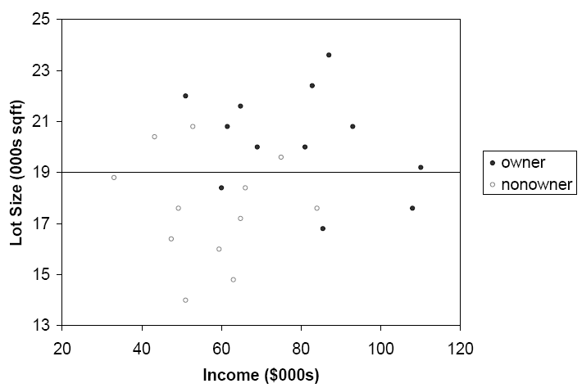
The first split: Lot Size = 19,000

Slide 15
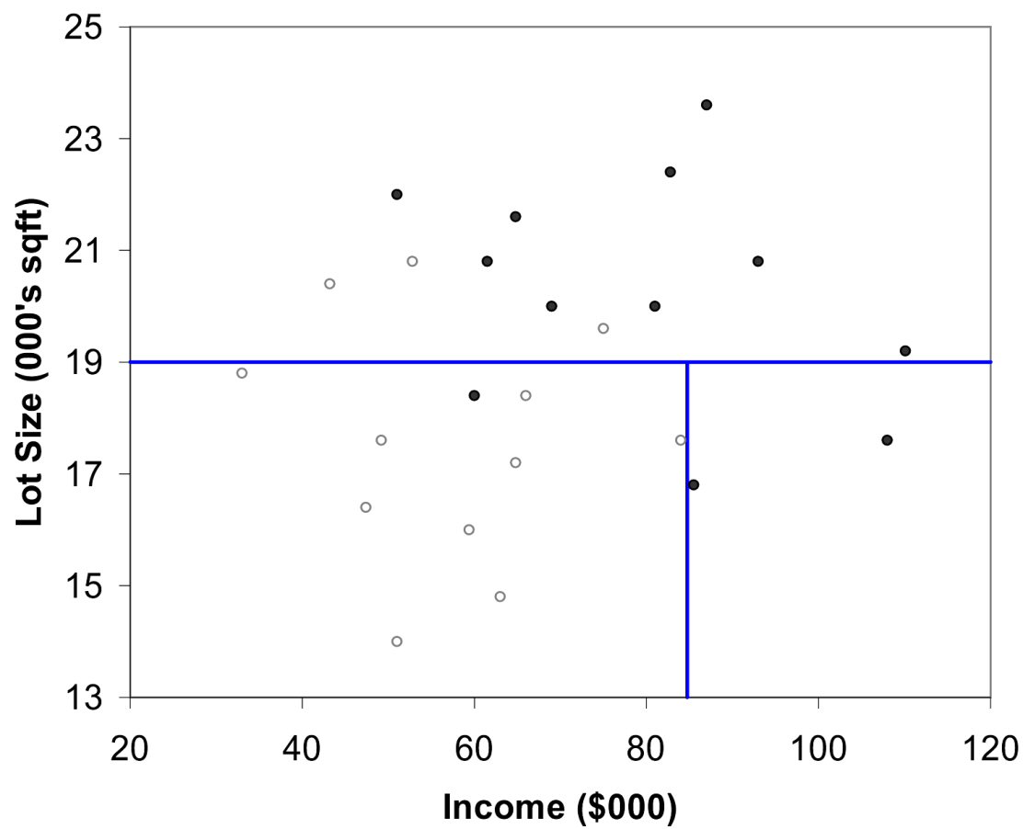
Second Split: Income = $84,000

Slide 16
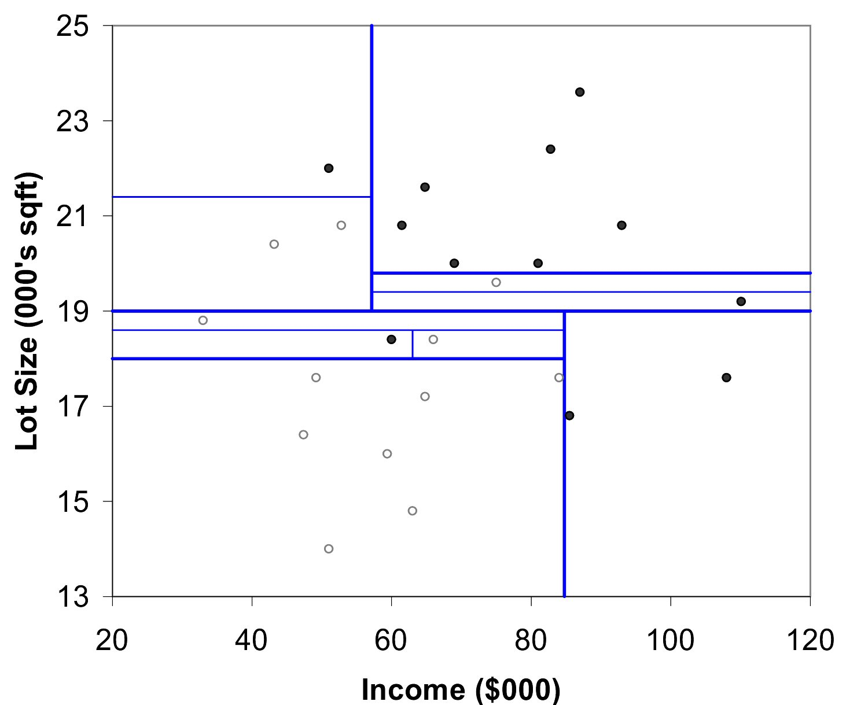
After All Splits

Slide 17
Gini Index
Gini Index for rectangle A containing m records
p = proportion of cases in rectangle A that belong to class k
I(A) = 0 when all cases belong to same class
Max value when all classes are equally represented (= 0.50 in binary case)
Note: XLMiner uses a variant called “delta splitting rule”

Slide 18
Entropy
p = proportion of cases (out of m) in rectangle A that belong to class k
Entropy ranges between 0 (most pure) and log₂(m) (equal representation of classes)

Slide 19
Entropy
Entropy is minimized when all values of the target attribute are the same.
If we know that commute time will always be short, then entropy = 0
Entropy is maximized when there is an equal chance of all values for the target attribute (i.e. the result is random)
If commute time = short in 3 instances, medium in 3 instances and long in 3 instances, entropy is maximized

Slide 20
Identifying the Best Attributes
Refer back to our original decision tree
Leave At
10 AM
9 AM
8 AM
Stall?
Accident?
Long
No
Yes
No
Yes
Short
Long
Medium
Long
How did we know to split on leave at and then on stall and accident and not weather?

Slide 21
ID3
Given our commute time sample set, we can calculate the entropy of each attribute at the root node
Attribute | Expected Entropy | Information Gain
Hour | 0.6511 | 0.768449
Weather | 1.28884 | 0.130719
Accident | 0.92307 | 0.496479
Stall | 1.17071 | 0.248842

Slide 22
Entropy
Expected Entropy
Information Gain

Slide 23
Pruning Trees
There is another technique for reducing the number of attributes used in a tree - pruning
Two types of pruning:
Pre-pruning (forward pruning)
Post-pruning (backward pruning)

Slide 24
Prepruning
In prepruning, we decide during the building process when to stop adding attributes (possibly based on their information gain)
However, this may be problematic – Why?
Sometimes attributes individually do not contribute much to a decision, but combined, they may have a significant impact

Slide 25
Postpruning
Postpruning waits until the full decision tree has built and then prunes the attributes
Two techniques:
Subtree Replacement
Subtree Raising

Slide 26
Subtree Replacement
Entire subtree is replaced by a single leaf node
A
B
C
4
5
1
2
3

Slide 27
Subtree Replacement
Node 6 replaced the subtree
Generalizes tree a little more, but may increase accuracy
A
B
6
4
5

Slide 28
Problems with ID3
ID3 is not optimal
Uses expected entropy reduction, not actual reduction
Must use discrete (or discretized) attributes
What if we left for work at 9:30 AM?
We could break down the attributes into smaller values…

Slide 29
Problems with Decision Trees
While decision trees classify quickly, the time for building a tree may be higher than another type of classifier
Decision trees suffer from a problem of errors propagating throughout a tree
A very serious problem as the number of classes increases

Slide 30
The Overfitting Problem

Slide 31
Stopping Tree Growth
Natural end of process is 100% purity in each leaf
This overfits the data, which end up fitting noise in the data
Overfitting leads to low predictive accuracy of new data
Past a certain point, the error rate for the validation data starts to increase

Slide 32
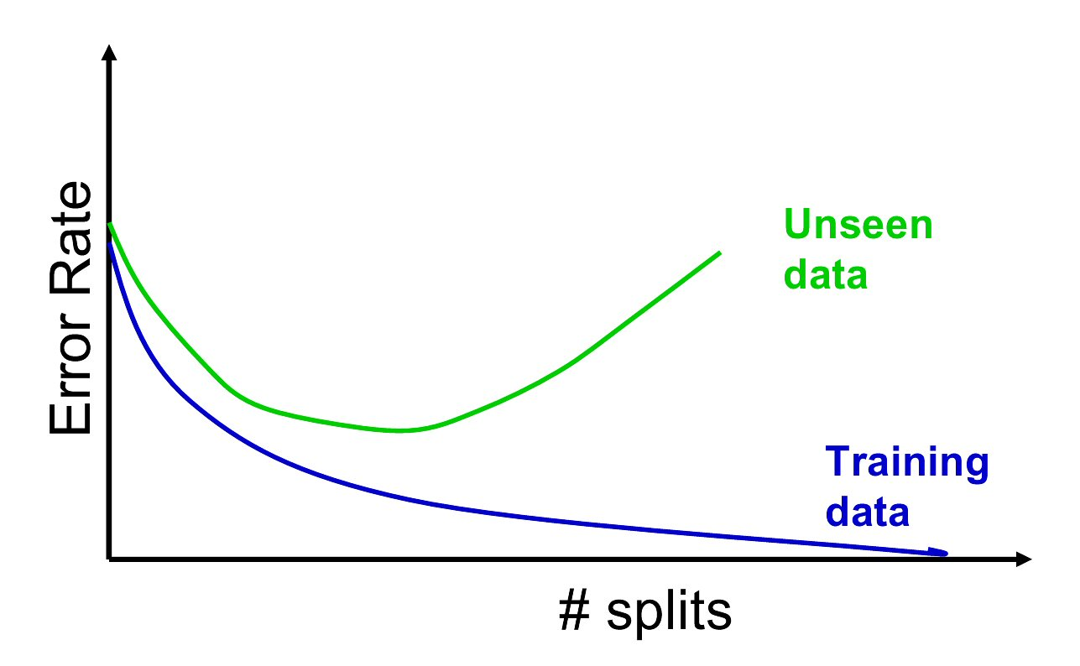
Full Tree Error Rate

Slide 33
CHAID
CHAID, older than CART, uses chi-square statistical test to limit tree growth
Splitting stops when purity improvement is not statistically significant

Slide 34
CART
CART lets tree grow to full extent, then prunes it back
Idea is to find that point at which the validation error begins to rise
Generate successively smaller trees by pruning leaves
At each pruning stage, multiple trees are possible
Use cost complexity to choose the best tree at that stage

Slide 35
Cost Complexity
CC(T) = Err(T) + α L(T)
CC(T) = cost complexity of a tree
Err(T) = proportion of misclassified records
α = penalty factor attached to tree size (set by user)
Among trees of given size, choose the one with lowest CC
Do this for each size of tree

Slide 36
Using Validation Error to Prune
Pruning process yields a set of trees of different sizes and associated error rates
Two trees of interest:
Minimum error tree
Has lowest error rate on validation data
Best pruned tree
Smallest tree within one std. error of min. error
This adds a bonus for simplicity

Slide 37
Summary
Decision trees can be used to help predict the future
The trees are easy to understand
Decision trees work more efficiently with discrete attributes
The trees may suffer from error propagation

Slide 38
Summary
Classification and Regression Trees are an easily understandable and transparent method for predicting or classifying new records.
A tree is a graphical representation of a set of rules
Trees must be pruned to avoid over-fitting of the training data
As trees do not make any assumptions about the data structure, they usually require large samples

