Slide 1
SPHE6010
DVB-S/S2 Tuner
Jacky Wu

Slide 2
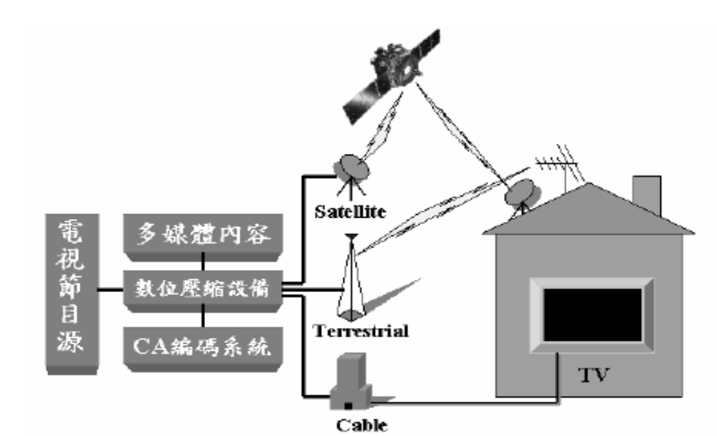
TV Broadcasting

Slide 3
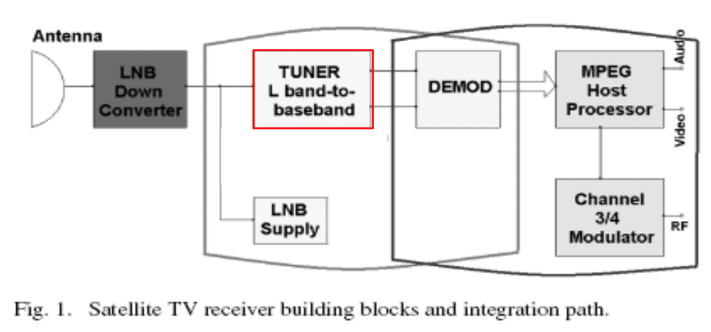
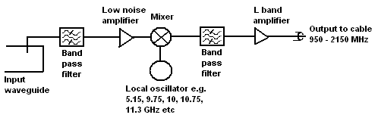
Satellite TV Receiver

Slide 4
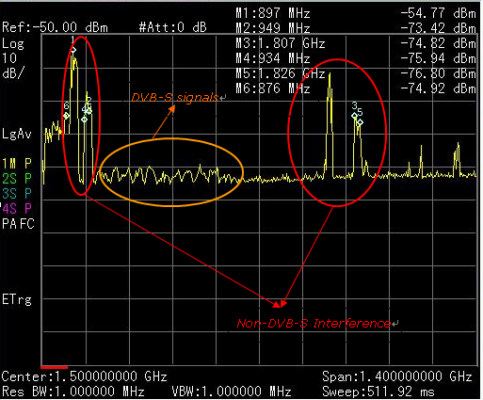
The Real TV RF Signals

Slide 5
Features of DVB-S/S2
Input frequency range : 950MHz ~ 2150MHz
Direct conversion tuner for quadrature down conversion from L-band to zero IF
On-chip loop-through path
Symbol rate : 1~45MSps
Independent RF AGC and baseband gain control
Fully integrated alignment-free low phase noise fractional-N frequency synthesizer with DVB-S2 requirements
Integrated loop filter
Integrated DC offset cancellation
Auto Optimization at ACI condition
32-pin QFN package
5th order Chebychev baseband filter with bandwidth adjustable from 5~40MHz
DC couple to demodulation (for SIP)

Slide 6
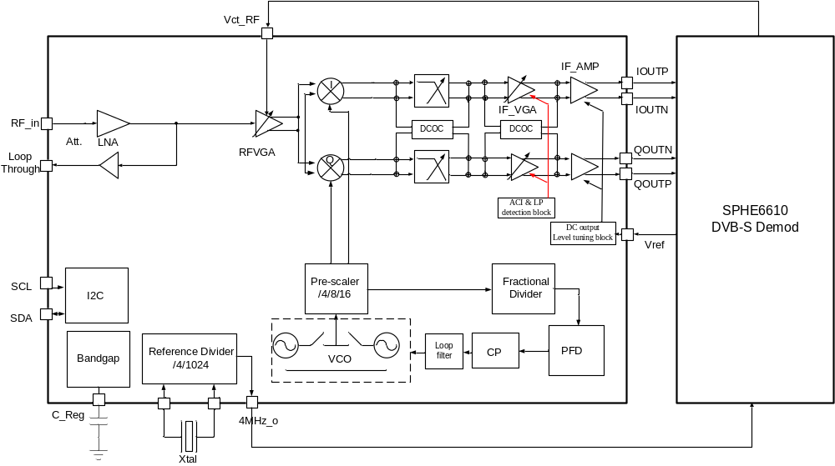
Block diagram

Slide 7
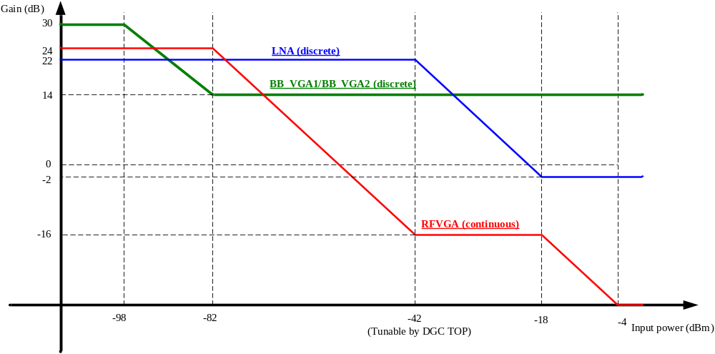
Gain vs. input power

Slide 8
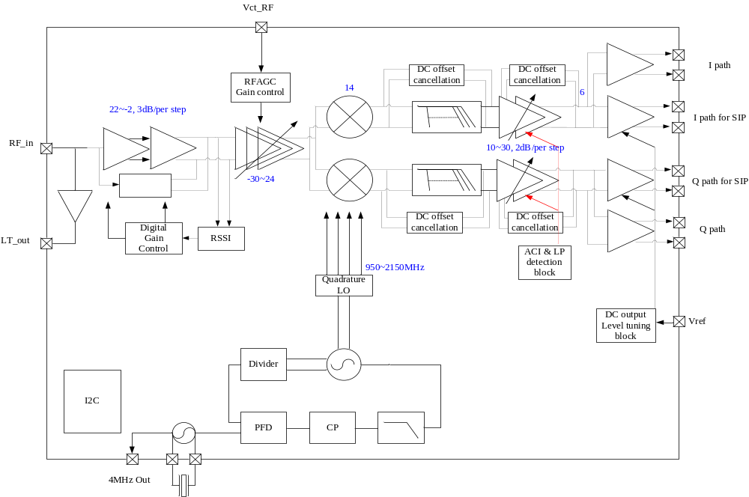
ACI Detection

Slide 9
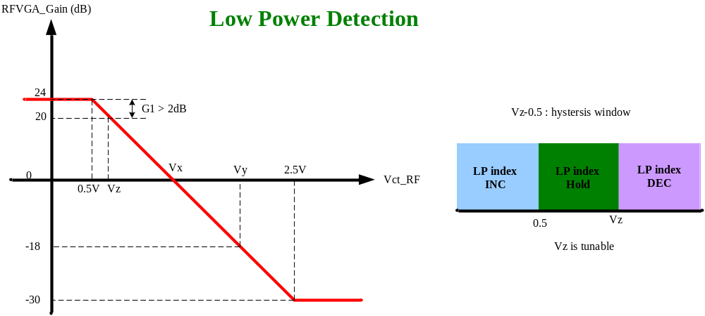
Low power detection

Slide 10
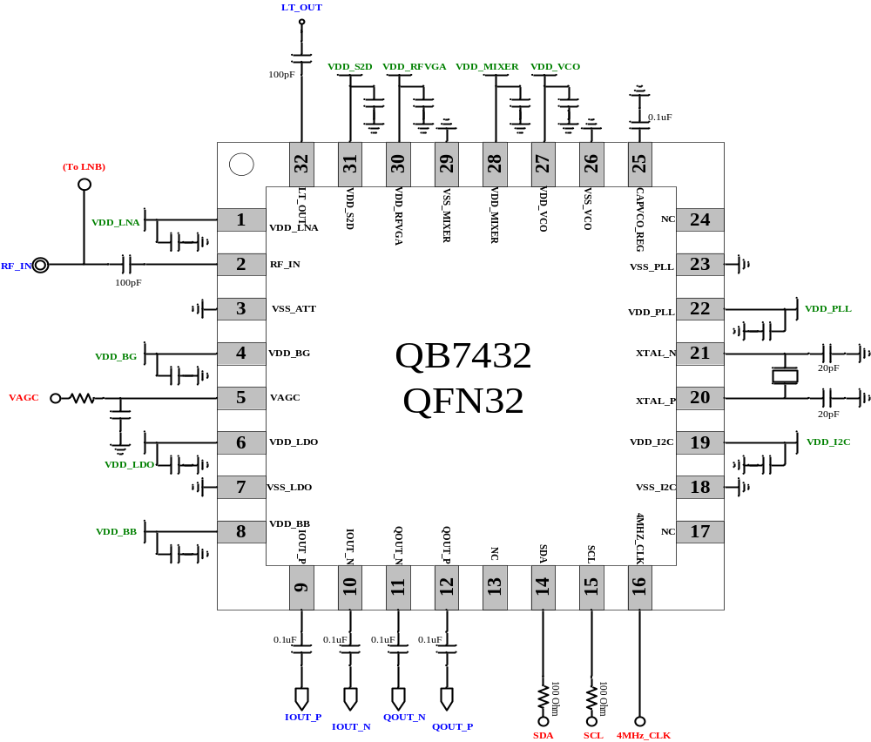
Typical application circuit

Slide 11
Performance Summary

Slide 12
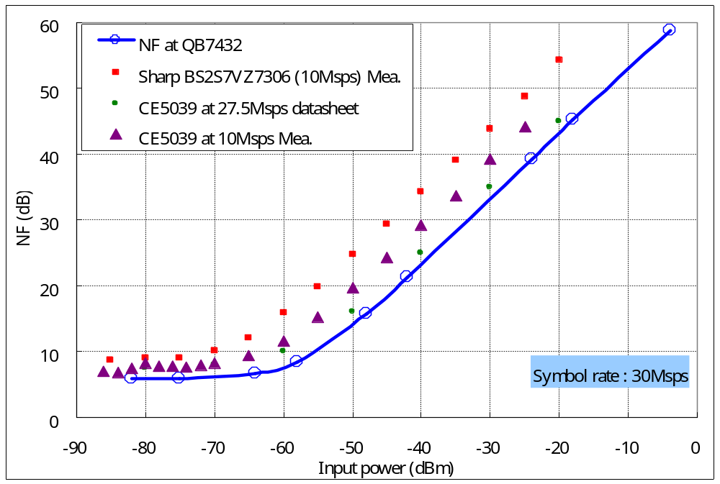
NF vs. Input power

Slide 13
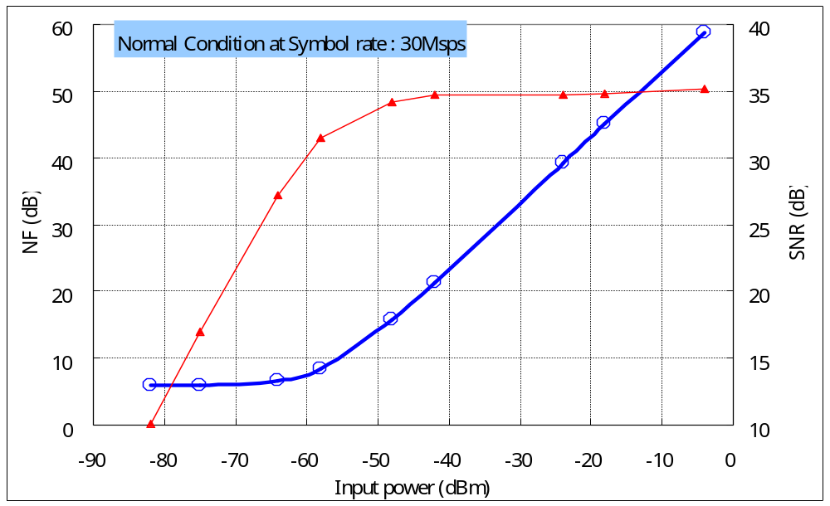
NF & SNR vs. Input power

Slide 14
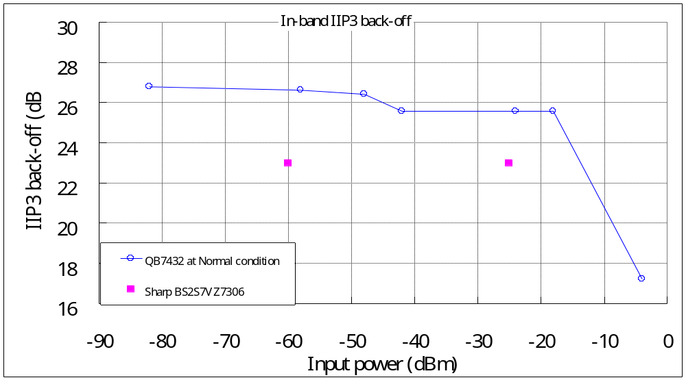
In-Band IIP3 back-off

Slide 15
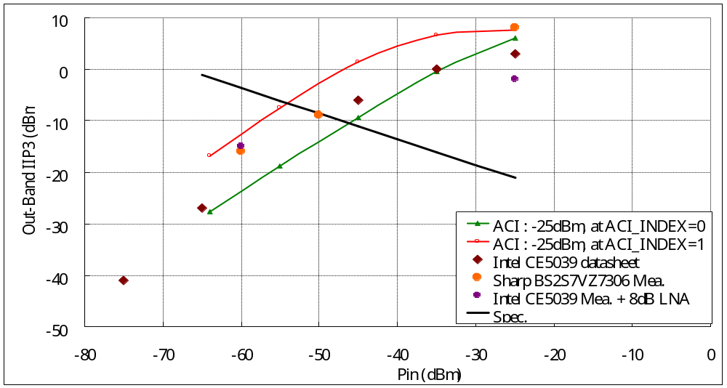
Out-Band IIP3 at ACI = -25dBm

Slide 16
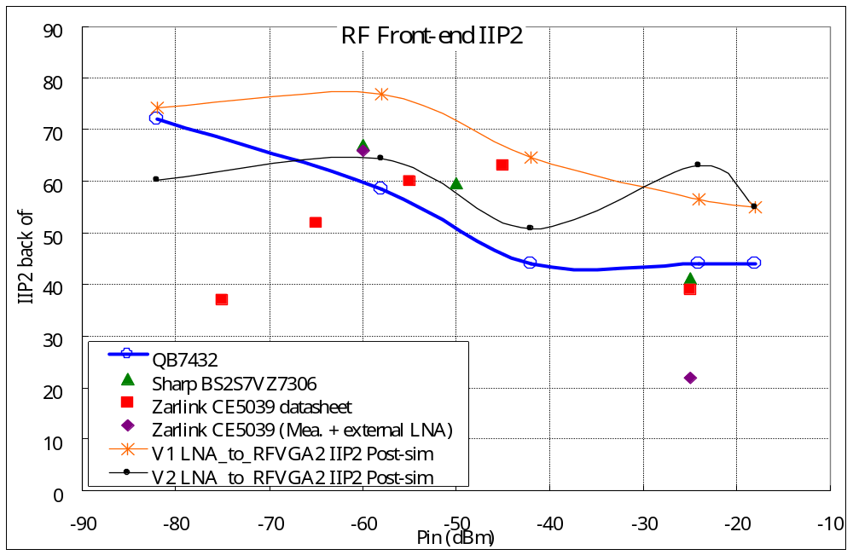
IIP2 back-off

Slide 17
Sensitivity

Slide 18
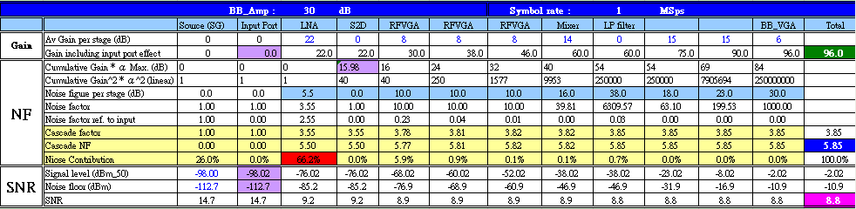
Sensitivity
Code rate : 1/2 => SNR > 2.9dB
Code rate : 7/8 => SNR > 7.8dB
DVB-S
Symbol rate : 1MSps
Sensitivity > -98dBm

Slide 19

Sensitivity
Code rate : 1/2 => SNR > 2.9dB
Code rate : 7/8 => SNR > 7.8dB
DVB-S
Symbol rate : 45MSps
Sensitivity : -82dBm

Slide 20
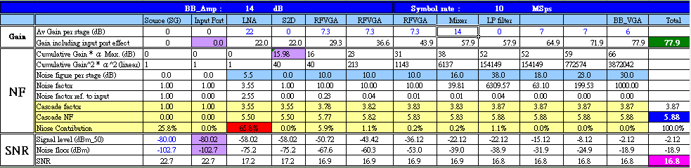
Sensitivity
8PSK, Code rate : 9/10 => SNR > 12dB
32APSK, Code rate : 9/10 => SNR > 17.05dB
DVB-S2
Symbol rate : 10MSps
Sensitivity : -80dBm

Slide 21
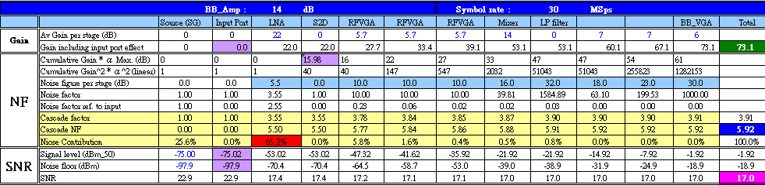
Sensitivity
8PSK, Code rate : 9/10 => SNR > 12dB
32APSK, Code rate : 9/10 => SNR > 17.05dB
DVB-S2
Symbol rate : 30MSps
Sensitivity : -75dBm

Slide 22
ACI performance summary
At enable ACI detected function

Slide 23
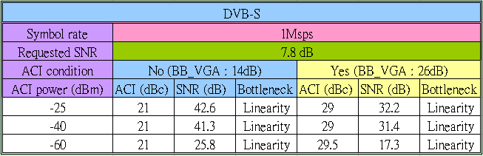
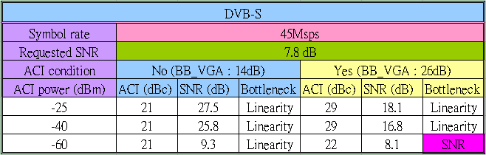
DVB-S

Slide 24
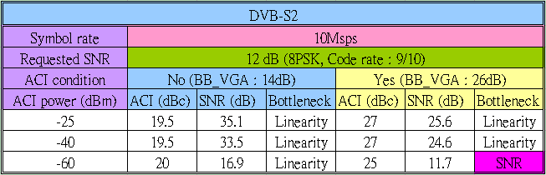
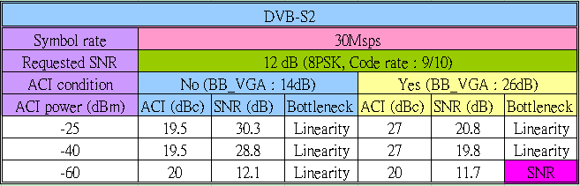
DVB-S2 – 8PSK

Slide 25
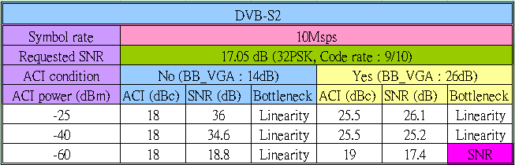
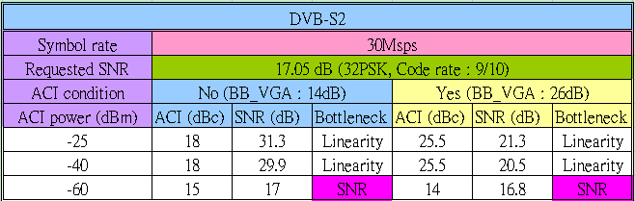
DVB-S2 – 32APSK

Slide 26
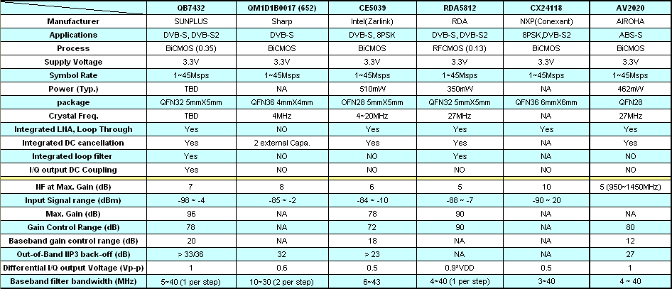
Compared table

Slide 27
Thanks for your attention

