Slide 1
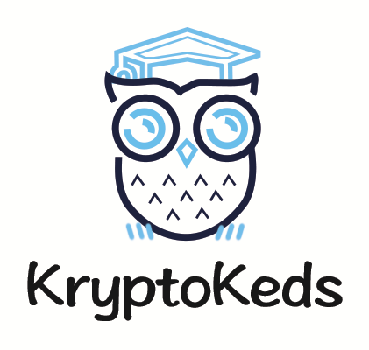
KryptoKeds
Make Learning Fun and Rewarding

Slide 2
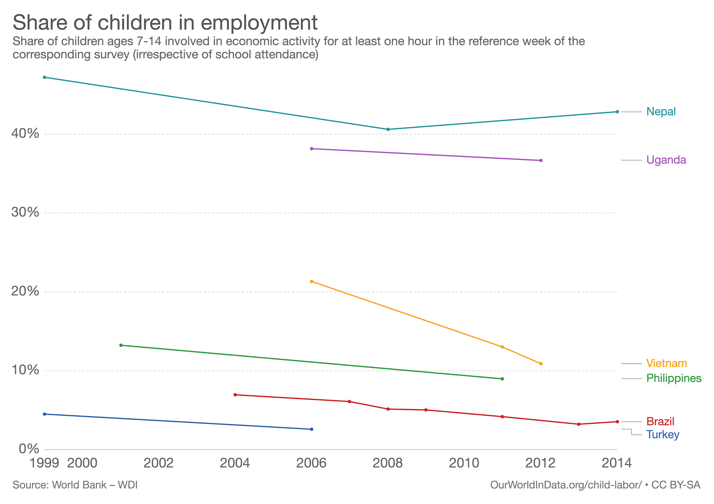
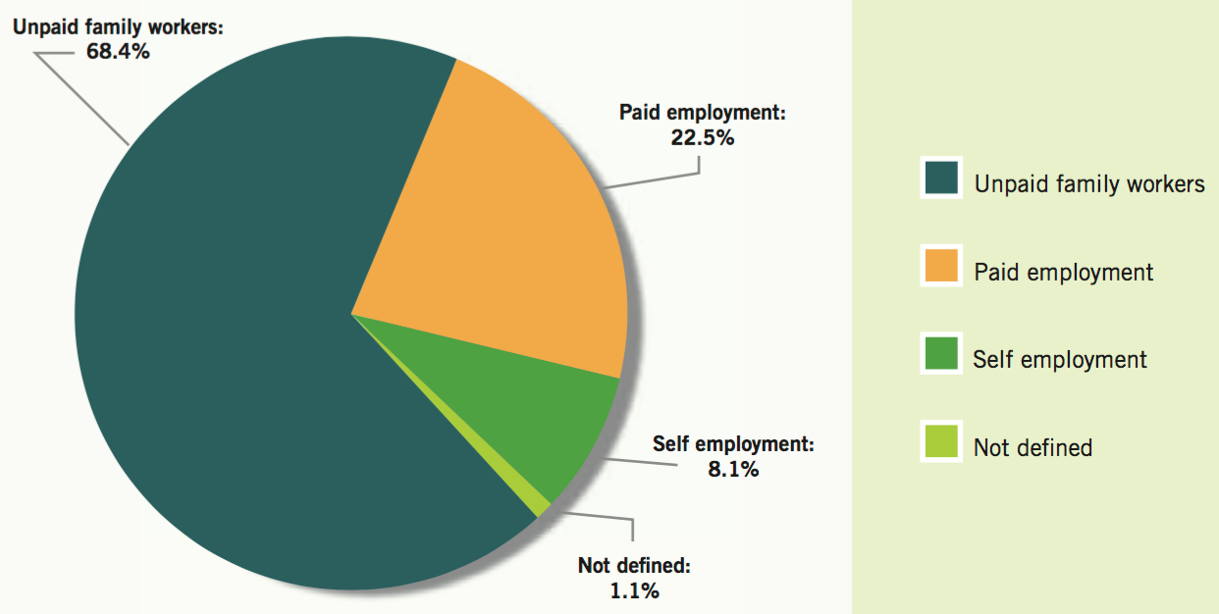
Problem
Kids from low income families have limited resources and a constricted environment that is not conducive for learning which puts them on a negative trajectory for their future careers.

Slide 3
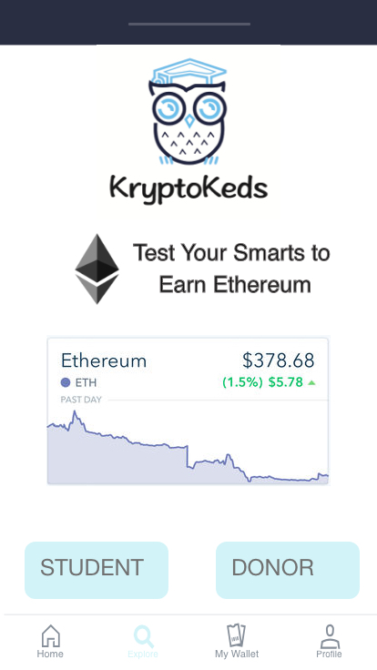
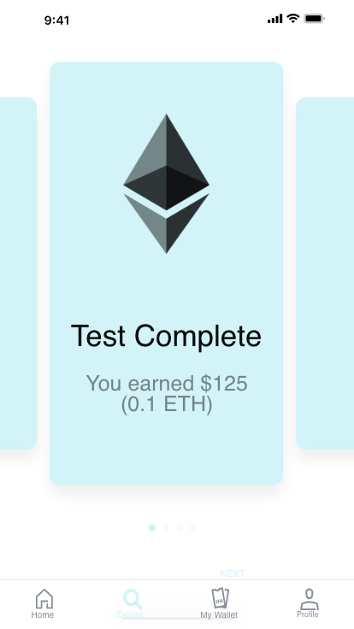
Solution
A platform for students from low income communities to learn and earn using decentralized charity

Slide 4


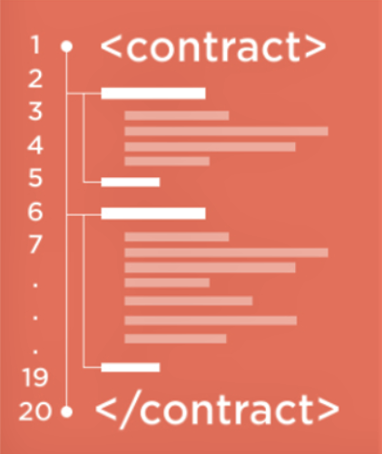

Smart Contract
Donor Donates
Student Passes Test
Student Gets Paid
Pass Test
Pay

Slide 5
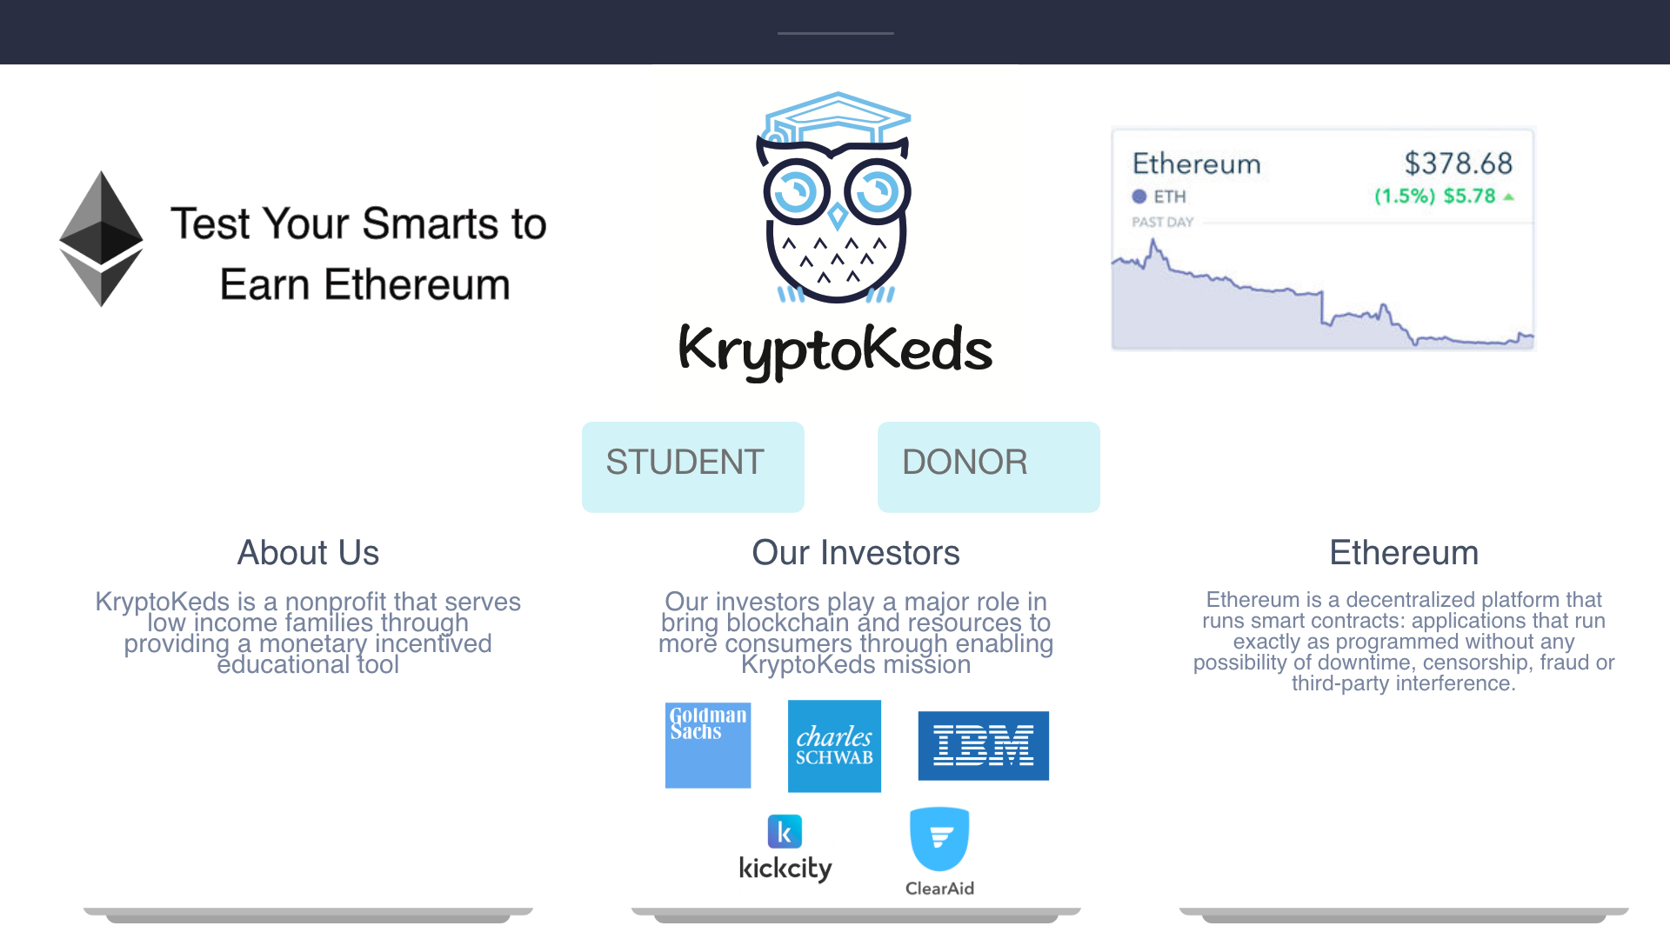
Milestones
Enterprise and Beyond
December 2018
June 2019
Dec 2021
June 2019
Dec 2020
Multiple Donors and Students. Extend to Content Providers Like Khan Academy
Extend to Universities and Educational Institutions
Cohort of Users Transform into Donors for next Generation
Dec | Mar | June | Dec | Mar | June | Dec | Mar | June | Dec | Mar | June
Scholarships Issued Based on Quantitative Results
Enterprises to Reward Employees for Internal Training

Slide 6
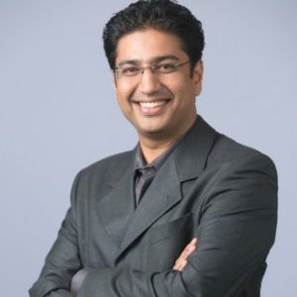
The team
Blockchain Enthusiasts
Del Davaasambuu
Amy
Zhu
YuxuanSherry Du
Anand
Vallamsetla
Semirah Dolan
Harish Gowda
Engineer Entrepreneur
Engineer
Designer
Architect Entrepreneur
Engineer & Designer
Engineer

