Slide 1
AI Watermarking
Questions raised by new tech

Slide 2
AI Malicious & Misleading uses
Phishing for private information
Manipulating images/video without people’s consent (deepfakes)
Song generation
Use of training data without permission
Incorrect information form customer support
Access to information to create harm
Specific examples:
Selling products (Tom Hanks dental insurance)
Misleading voters (Biden fake speech)

Slide 3
Watermarking
Visible to humans vs Invisible to humans
Added during creation (needs access to model) vs Added after content is produced

Slide 4
Image Watermarking
Visible Watermark (Dall-E 2)
color blocks added to the image
Data Poisoning (Glaze)
protect against style mimicry
Signing (C2PA)
provenance and history digitally signed and verifiable
stored in metadata together with image
based on public key encryption infrastructure
edits made without C2PA - missing/incomplete message shows up

Slide 5
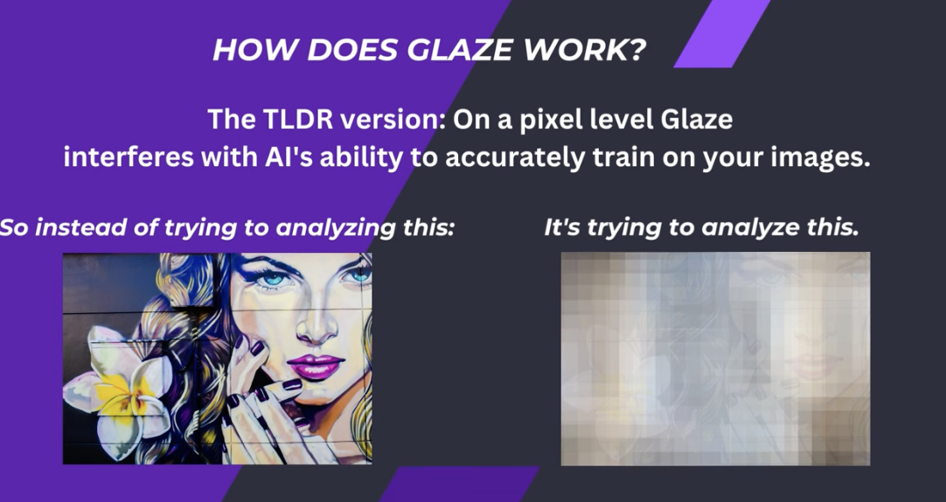

Slide 6
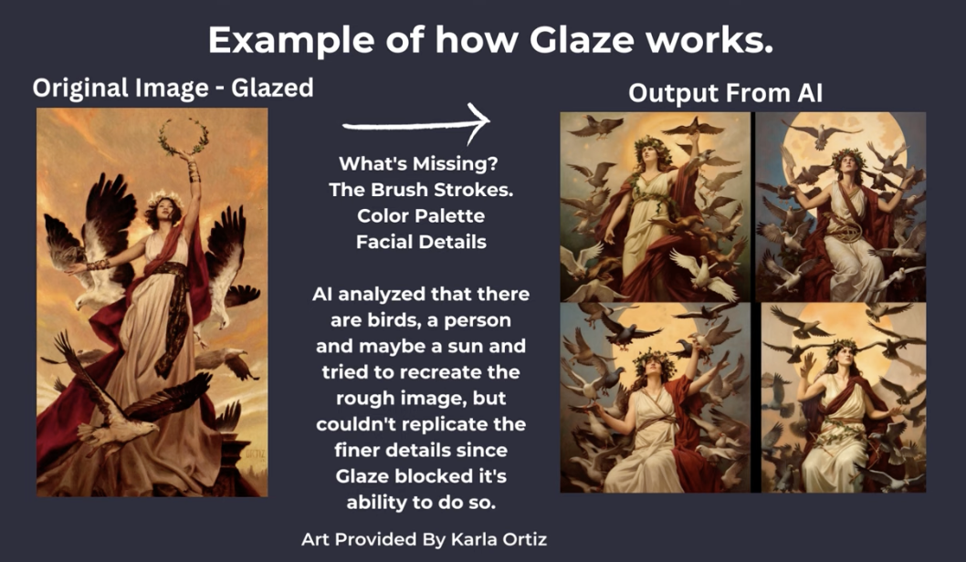

Slide 7
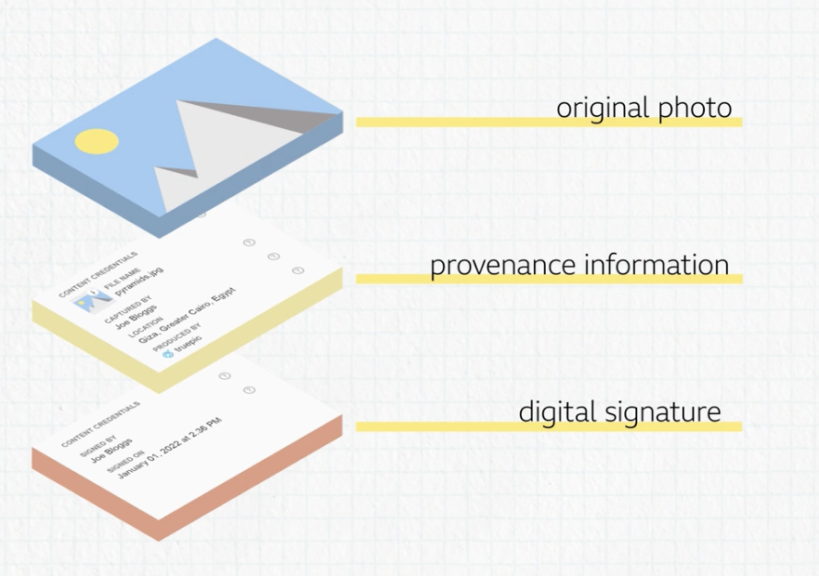

Slide 8
Text Generation basics
How does LLMs work?
they predict a very likely next words
How do they do that?
generate probability estimates for whole vocabulary
P(next token | given context)
sampling from outputs
can be greedy/stochastic, temperature/top-k

Slide 9
Text Watermarking
Visualizing word/token probabilities (GLTR)
Calculated using gpt2
Promoting sub-vocabularies
red & green candidate groups
promote green & restrict red
Hard watermark - disallow red
Soft watermark - increase green probability
~ Similar to Benford’s law

Slide 10
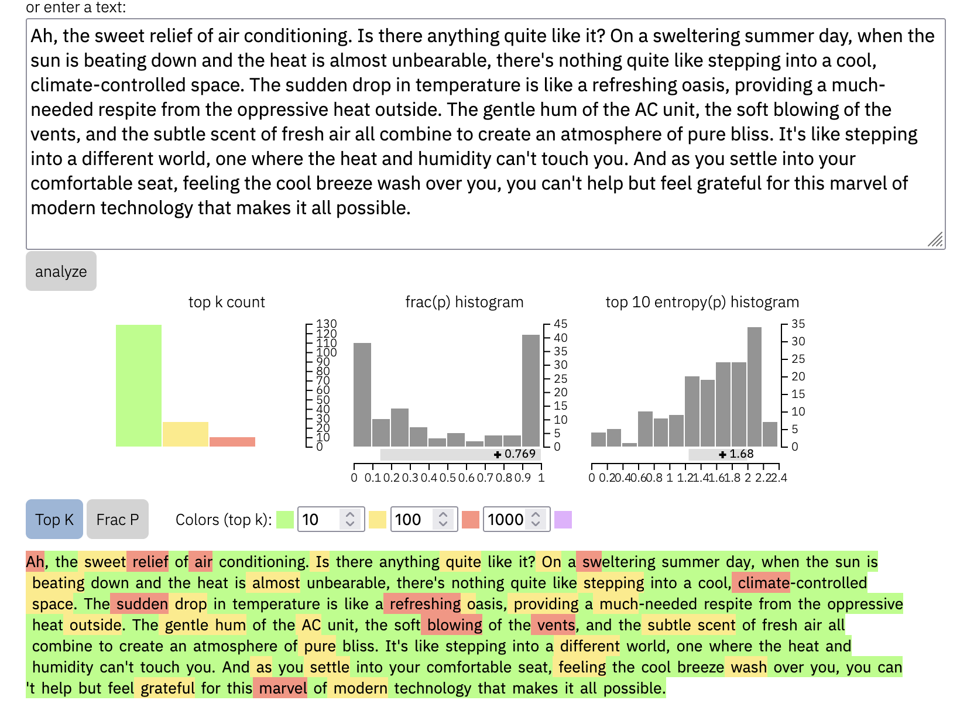

Slide 11
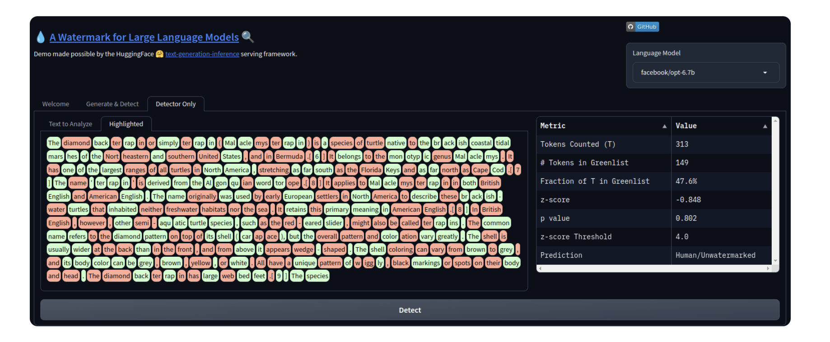

Slide 12
Text Watermark - Risks and Limitations
Longer text, more probability to detect
Generic approach, might not work for all models
Model specific approach, needs access to model
False positives (incorrect labeling) can have bad consequences

Slide 13
Audio Watermarking
inject metadata regarding provenance (AudioSeal)
con frequencies that are imperceptible to human ears
below ~20 or above ~20,000 Hz

Slide 14
Conclusion
Watermarking goal: identify AI generated content
Not a foolproof method, but can be a powerful tool to fight against malicious and misleading uses of AI

Slide 15
References
https://huggingface.co/blog/watermarking

