Slide 1
Karpenter
cluster scaling

Slide 2
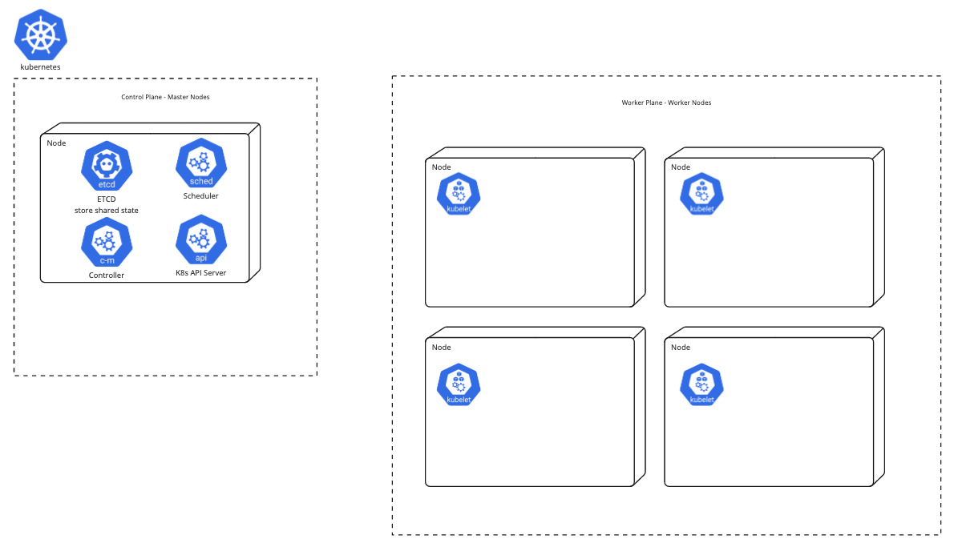

Slide 3
EKS

Slide 4
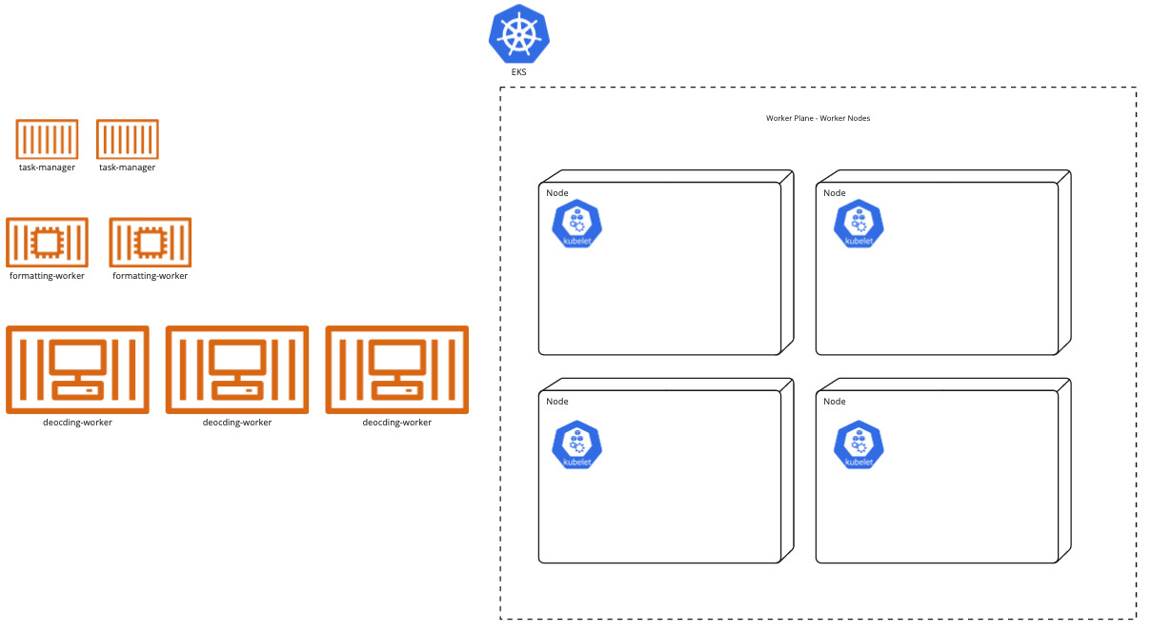

Slide 5
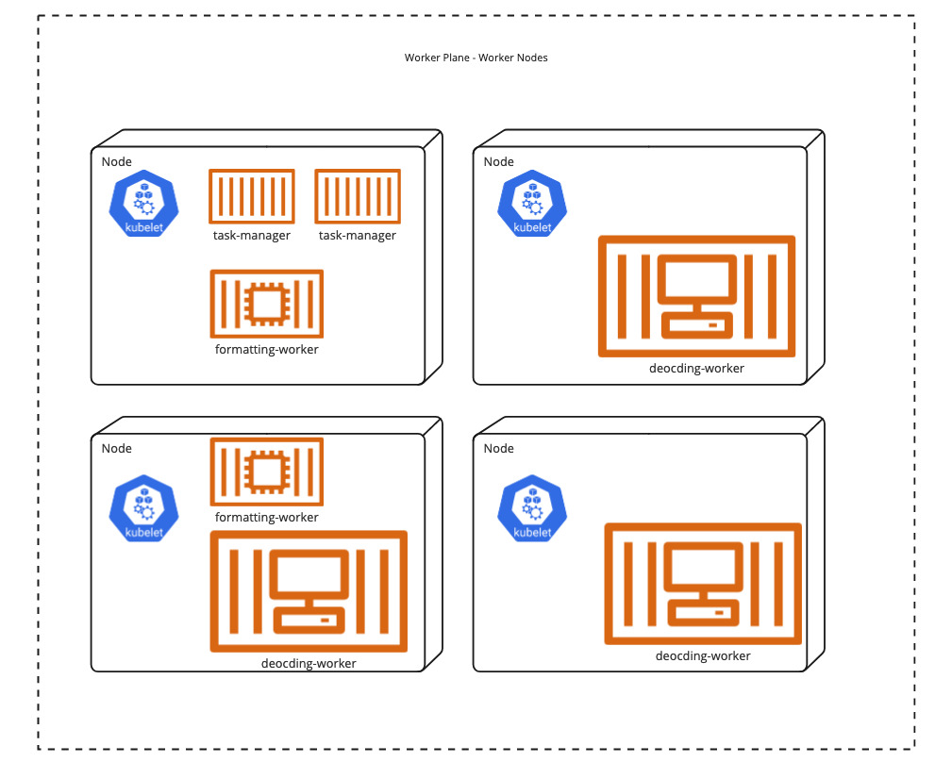

Slide 6
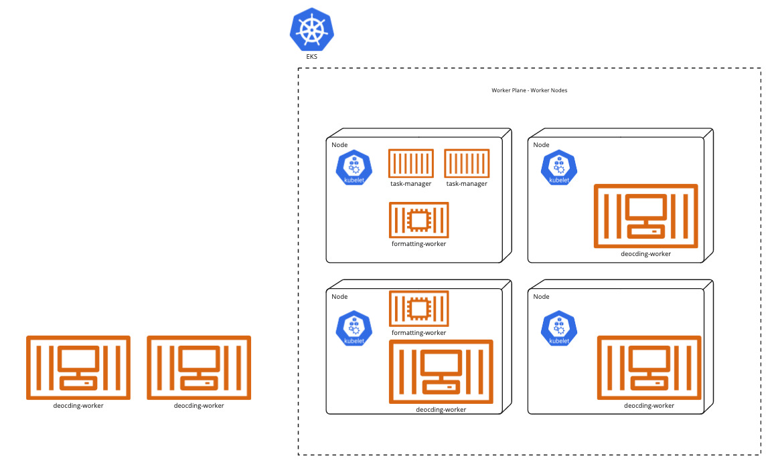

Slide 7
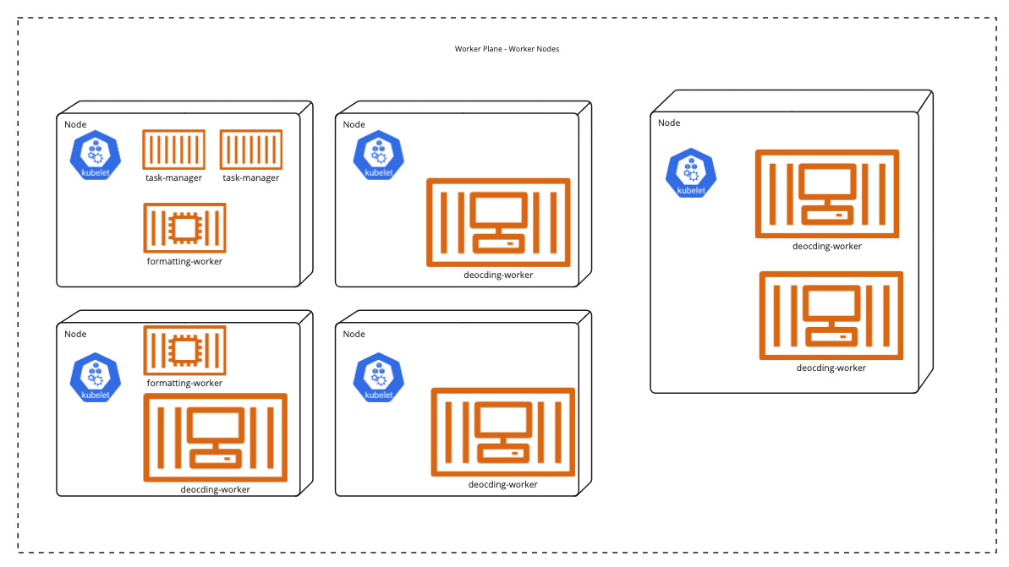

Slide 8
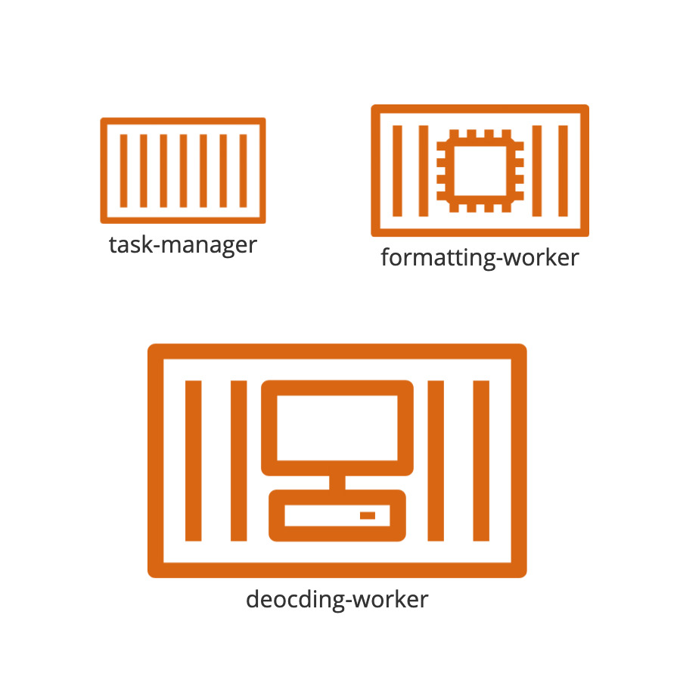
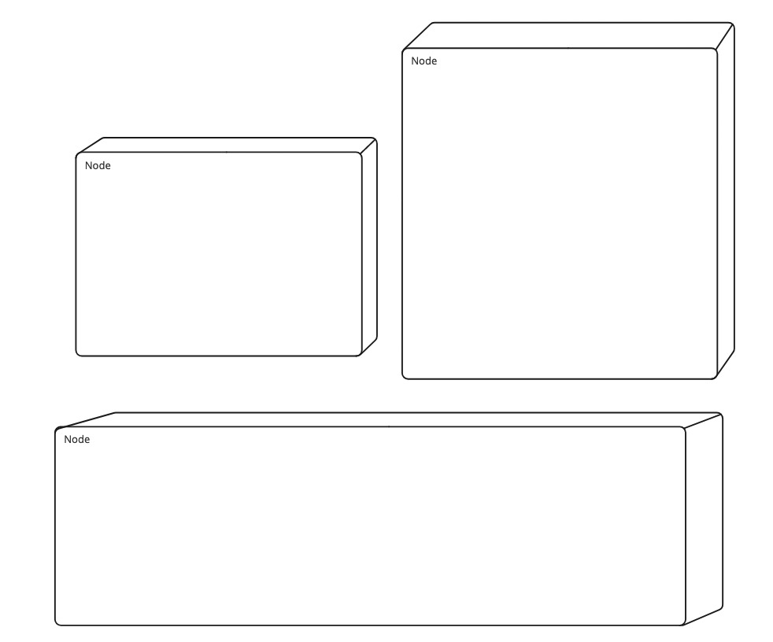
What problem are we trying to solve?
Kubernetes - manages containers
put containers onto existing nodes (scheduling)
smart - satisfies defined constraints
Karpenter - manages nodes
add / remove nodes (provisioning)
smart - satisfies defined constraints
Notes:
Karpenter observes the aggregate resource requests of unscheduled pods
makes decisions to launch and terminate nodes
in order to minimize scheduling latencies and infrastructure cost

Slide 9
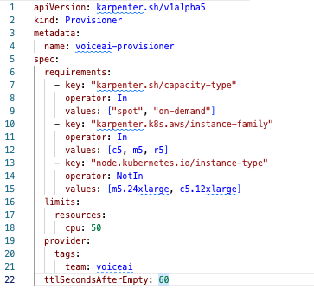
Provisioner - CRD

Slide 10
Pod - scheduling constraints
NodeSelector labels
limit zone, instance type, architecture
NodeAffinity
pods to schedule together or apart
Taints and Tolerations
exclude pods from certain nodes with taint, unless they have toleration
Topology Spread
spreading pods to different nodes/zones

Slide 11
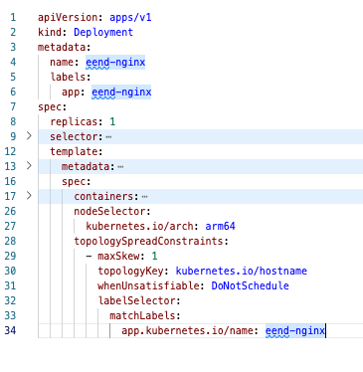
Pod - scheduling constraints

Slide 12
Demo
Notes:
add new deployment with specific - unmet constraints
wait for unschedulable pods
logs –selector karpenter=controller
Karpenter figures out correct instance type and other constraints - select cheapest-capacity optimized option
Pod is scheduled

Slide 13
kubectl get pods -n karpenter
kubectl -n karpenter logs pod/karpenter-5667fc5785-gbnpf controller
"message":"Found 1 provisionable pod(s)" "message":"Computed 1 new node(s) will fit 1 pod(s)" "message":"Launching node with 1 pods requesting {\"cpu\":\"2385m\",\"memory\":\"2800Mi\",\"pods\":\"7\"} from types t4g.xlarge, c6gd.xlarge, c6gn.xlarge, c6g.xlarge, m6gd.xlarge and 73 other(s)","commit":"346b7d7-dirty","provisioner":"default" "message":"Launched instance: i-09a2ea9e33008a95a, hostname: ip-10-12-31-81.us-west-2.compute.internal, type: t4g.xlarge, zone: us-west-2a, capacityType: spot","provisioner":"default" "message":"Found 2 provisionable pod(s)" "message":"Computed 1 new node(s) will fit 2 pod(s)" "message":"Launching node with 2 pods requesting {\"cpu\":\"4385m\",\"memory\":\"4848Mi\",\"pods\":\"8\"} from types t4g.2xlarge, c6gn.2xlarge, c6gd.2xlarge, c6g.2xlarge, m6gd.2xlarge and 60 other(s)" "message":"Launched instance: i-0a7e0cbd900edff30, hostname: ip-10-12-62-150.us-west-2.compute.internal, type: t4g.2xlarge, zone: us-west-2b, capacityType: spot"
"message":"Added TTL to empty node","node":"ip-10-12-31-81.us-west-2.compute.internal" "message":"Added TTL to empty node","node":"ip-10-12-62-150.us-west-2.compute.internal"
"message":"Triggering termination after 6m0s for empty node","node":"ip-10-12-31-81.us-west-2.compute.internal" "message":"Triggering termination after 6m0s for empty node","node":"ip-10-12-62-150.us-west-2.compute.internal"
"message":"Cordoned node","commit":"346b7d7-dirty","node":"ip-10-12-31-81.us-west-2.compute.internal" "message":"Cordoned node","commit":"346b7d7-dirty","node":"ip-10-12-62-150.us-west-2.compute.internal"
"message":"Deleted node","commit":"346b7d7-dirty","node":"ip-10-12-31-81.us-west-2.compute.internal" "message":"Deleted node","commit":"346b7d7-dirty","node":"ip-10-12-62-150.us-west-2.compute.internal"

Slide 14
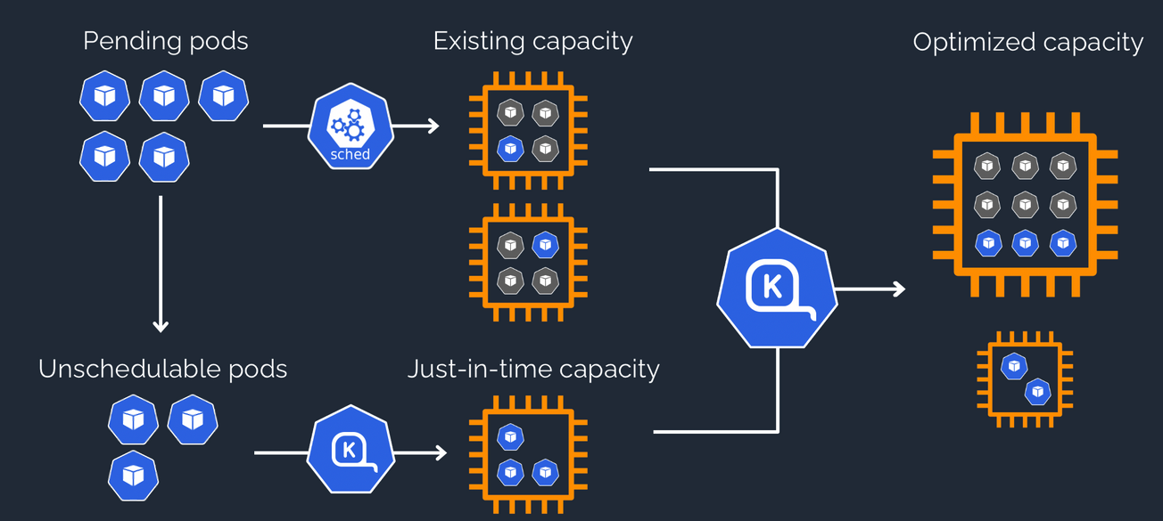

Slide 15
How does Karpenter dynamically select instance types?
Based on existing EC2 Fleet allocation strategies
On-demand capacity → lowest-price strategy
Spot capacity → price-capacity-optimized strategy

Slide 16
Alternatives
Kubernetes Cluster-Autoscaler
Limiting
Slower - uses node groups (EC2 Autoscaler) under the hood
Less flexible - each node group scales with the same instance types
Less configurable - no control over types, zones
Karpenter
Faster - groupless node management, directly with VMs/EC2 instances
Flexible - picks right instance type automatically based on constraints
More configurable

