Slide 1
WOMart Data Set Sales Forecasting A. Semoglou, Intern Machine Learning Engineer

Slide 2
Overview
Data Preparation & Feature Engineering
Exploratory Data Analysis
Modeling and Evaluation
Model Selection
Forecasting and Results

Slide 3
Data Preparation & Feature Engineering
Categorical Features
Time Based Features
Lag Features
Categorical Encoding
Store Type
Location Type
Region Code
Binary Encoding
Holiday and Discount
Day of the Week
Month
Year
Shifted Time Series Sales values by intervals of
1 Day back (Lag 1)
2 Days back (Lag 2)
1 Week back (Lag 7)

Slide 4
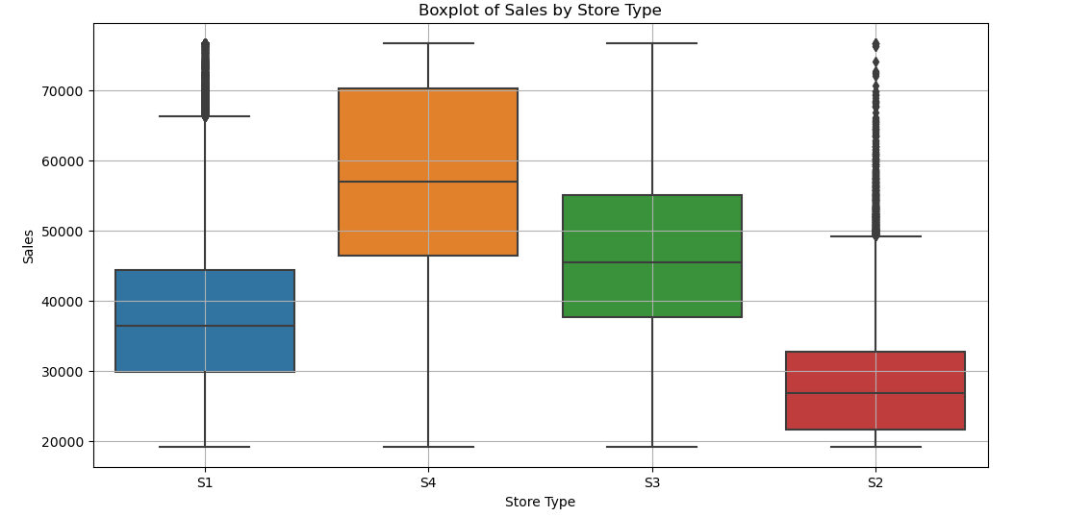
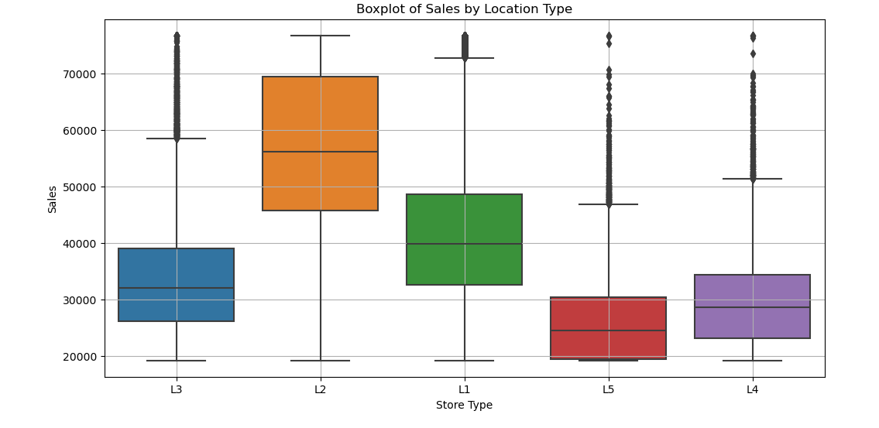
Exploratory Data Analysis (EDA)

Slide 5
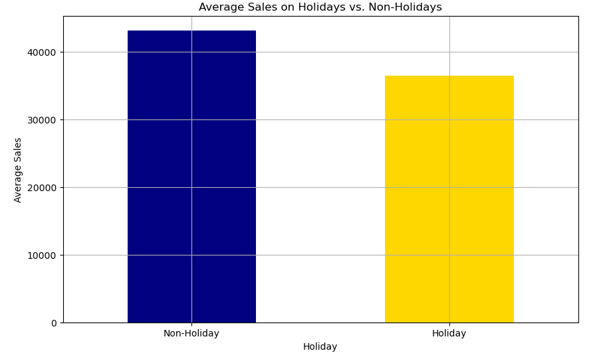
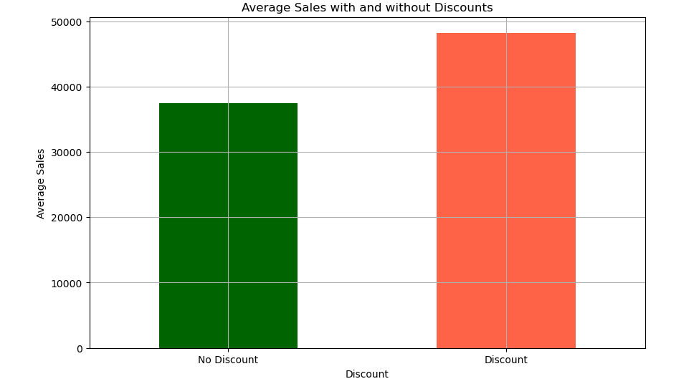
Exploratory Data Analysis (EDA)

Slide 6
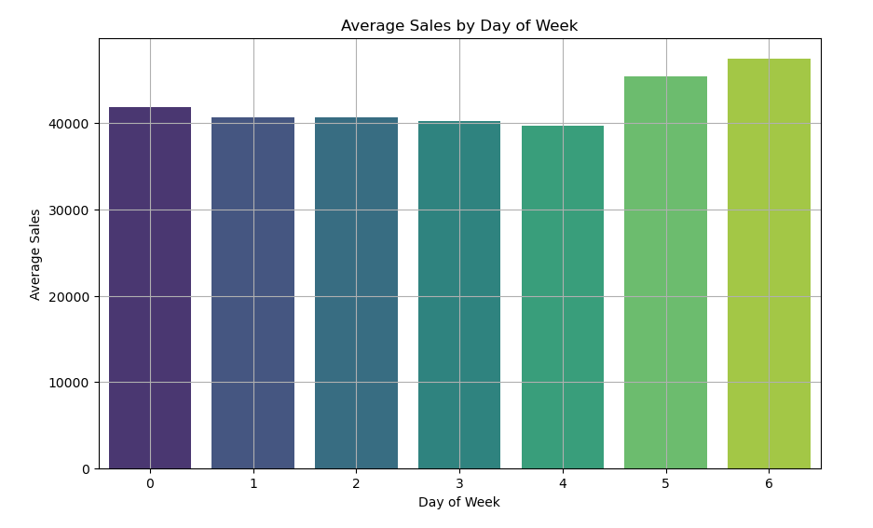
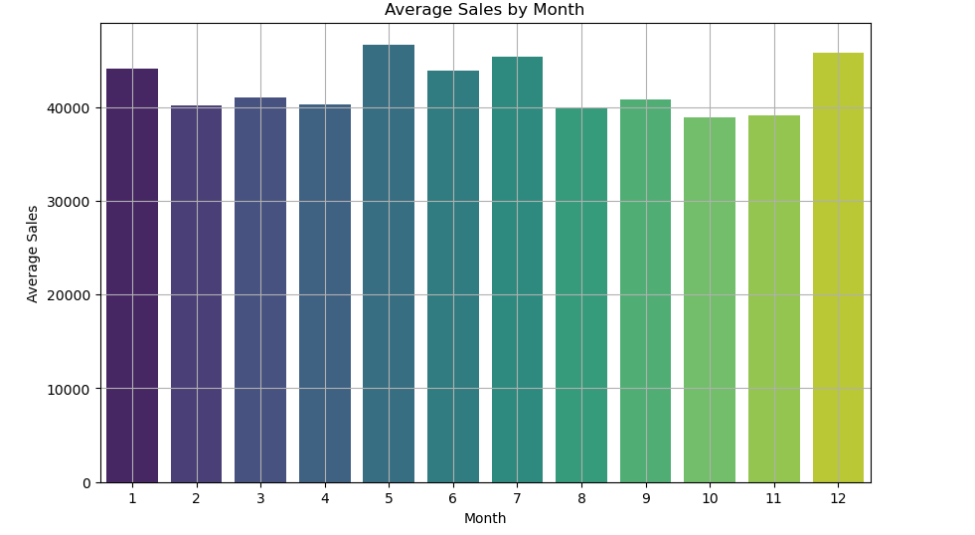
Exploratory Data Analysis (EDA)

Slide 7
Models & Evaluation Metrics
Models Implemented
Evaluation Metrics
Decision Tree
Random Forest
LightGBM
Elastic Net
K-Nearest Neighbors
Gradient Boost
CatBoost
XGBoost
R² Score
Mean Absolute Error (MAE)
Mean Squared Error (MSE)
Root Mean Squared Error (RMSE)
Mean Absolute % Error (MAPE)

Slide 8
Model Evaluation
Model | R² | MAE | MSE | RMSE | MAPE
Decision Tree | 0.645 | 6338.70 | 8.632e+07 | 9291.10 | 15.92%
Random Forest | 0.824 | 4628.94 | 4.276e+07 | 6539.39 | 11.82%
LightGBM | 0.752 | 5657.75 | 6.025e+07 | 7762.55 | 14.83%
Elastic Net | 0.614 | 7017.38 | 9.390e+07 | 9690.68 | 18.84%
KNN | 0.759 | 5495.99 | 5.855e+07 | 7651.94 | 13.95%
Gradient Boost | 0.753 | 5655.28 | 6.013e+07 | 7754.69 | 14.81%
CatBoost | 0.810 | 4619.17 | 4.610e+07 | 6789.74 | 11.84%
XGBoost | 0.848 | 4395.61 | 3.705e+07 | 6087.62 | 11.11%

Slide 9
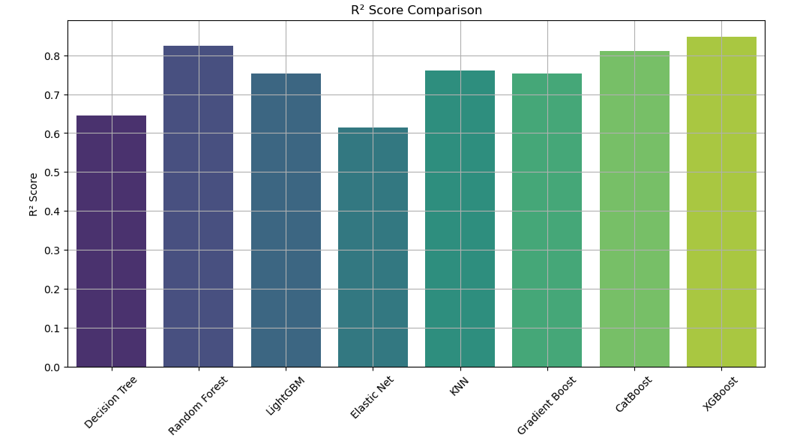
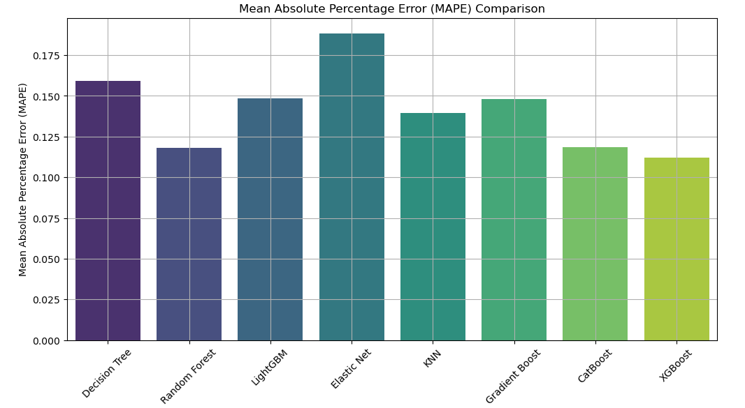
Model Evaluation

Slide 10
Choosing XGBoost for Sales Forecasting
Highest R² - XGBoost can explain a greater proportion of variance, showing higher accuracy and effectiveness in prediction. XGBoost explains 84.8% of the variance in sales data, signaling excellent predictive power.
Lowest Error Metrics
The lowest MAE and MAPE among models indicates XGBoost predictions are closest to actual outcomes.
Lower MSE and RMSE values indicate fewer and less severe errors in predictions made by XGBoost.
Why XGBoost?

Slide 11
XGBoost Performance with Unknown-Predicted Lag Features
Procedure
The evaluation was conducted in a manner consistent with initial training, using a separate validation set.
Unlike the training phase, actual historical lagged values were not used during testing. Instead, lag features were (iteratively) generated dynamically through model predictions from previous steps.
Starting with the last sales from the training data as lags for the first instances in the validation set.
After each prediction step, the model’s output is used to update the lag features for the next prediction cycle.
Performance Metrics
R²: 0.743 (Previous: 0.848)
MAE: 5725.65 (Previous: 4395.61)
RMSE: 8127.36 (Previous: 6087.62)
MAPE: 14.3% (Previous: 11.1%)
The decrease in R² and increases in MAE, RMSE, and MAPE when using predicted lags highlight the challenges of forecasting without direct historical data.
Although performance metrics with predicted lags show a decline, they remain robust, demonstrating the model’s effectiveness under less-than-ideal conditions.

Slide 12
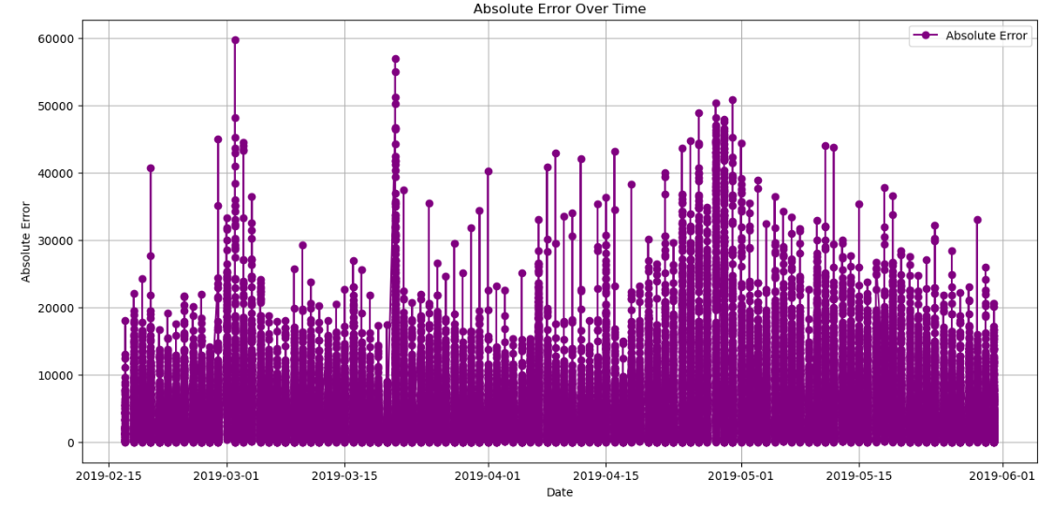
XGBoost Performance with Unknown-Predicted Lag Features

Slide 13
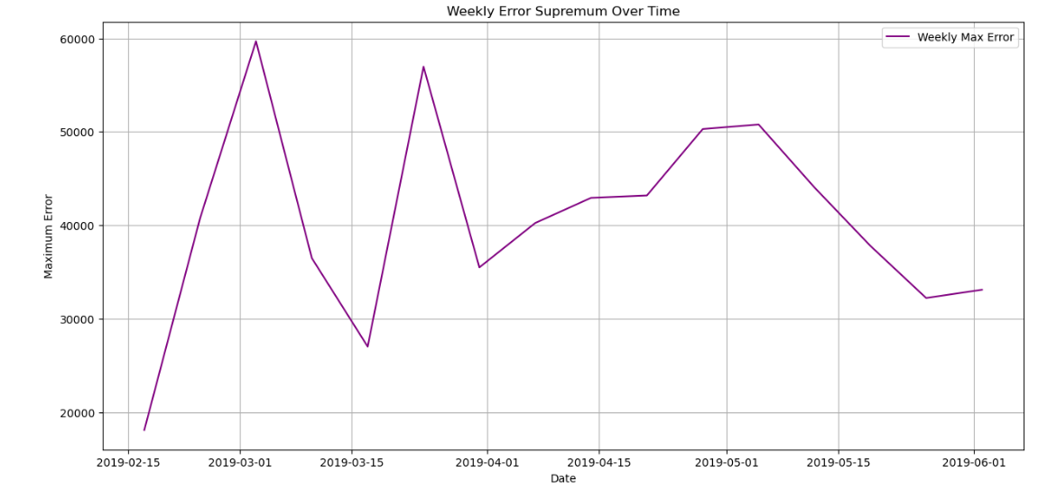
XGBoost Performance with Unknown-Predicted Lag Features

Slide 14
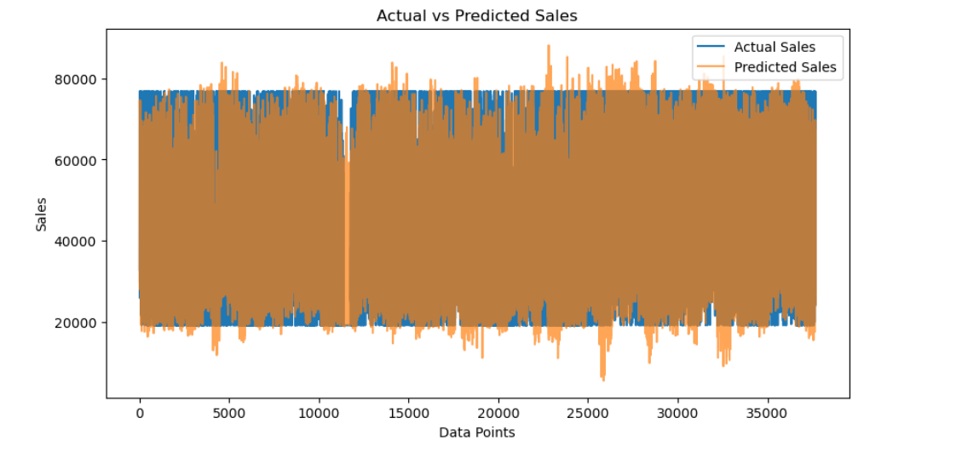
XGBoost Performance with Unknown-Predicted Lag Features

Slide 15
Actual vs. Predicted Sales Overview
ID | Predicted Sales | Actual Sales
T1150522 | 33915.32 | 33837.0
T1150521 | 53904.97 | 71976.0
T1150520 | 29067.58 | 30372.0
T1150472 | 73621.03 | 73869.0
T1150519 | 69423.50 | 63177.0
T1150540 | 66066.07 | 52998.0
T1150542 | 47979.43 | 48912.0
T1150561 | 41000.13 | 37599.0
T1150560 | 46741.21 | 46848.0
T1150559 | 38681.46 | 33231.0
T1150558 | 38650.51 | 31119.0

Slide 16
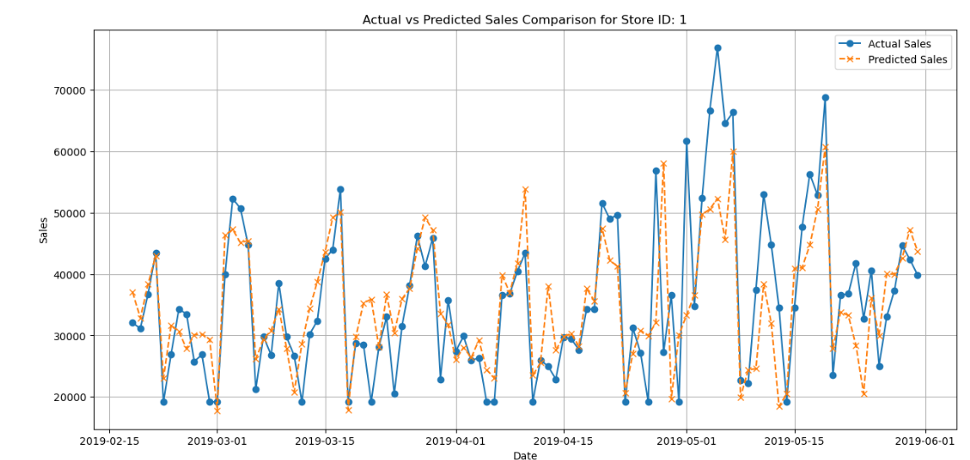
Actual vs. Predicted Sales Overview Store ID: 1

Slide 17
Actual vs. Predicted Sales Overview Store ID: 1
Dates | Actual | Predicted
2019-02-18 | 32070.00 | 37022.02
2019-02-19 | 31107.90 | 32809.39
2019-02-20 | 36735.00 | 38354.35
2019-02-21 | 43452.00 | 43008.07
2019-02-22 | 19191.00 | 23039.38
... | ... | ...
2019-05-27 | 33075.00 | 40027.05
2019-05-28 | 37317.00 | 39988.69
2019-05-29 | 44652.00 | 42589.16
2019-05-30 | 42387.00 | 47206.46
2019-05-31 | 39843.78 | 43736.15

Slide 18
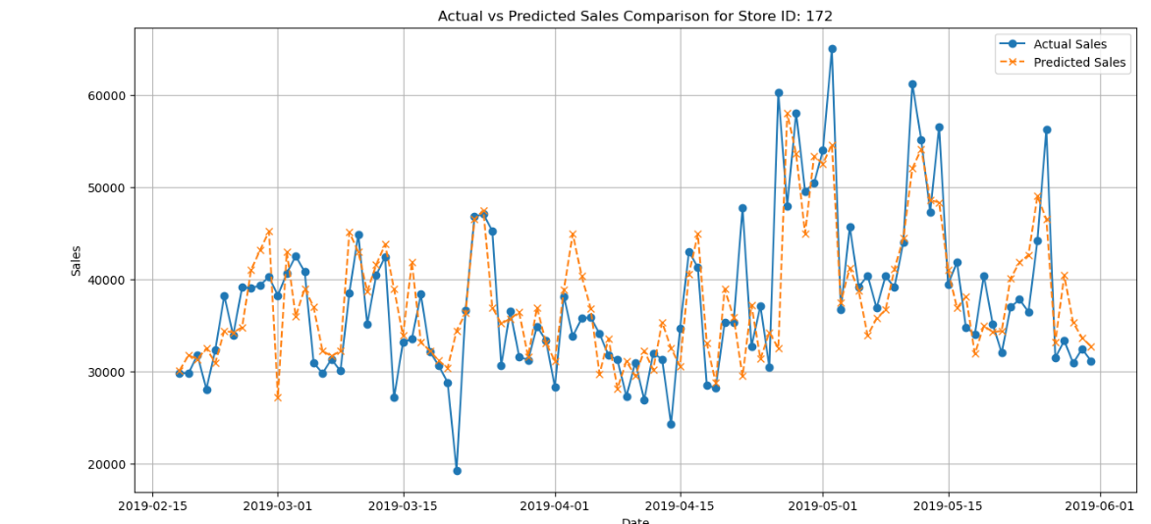
Actual vs. Predicted Sales Overview Store ID: 172

Slide 19
Actual vs. Predicted Sales Overview Store ID: 172
Date | Actual | Predicted
2019-02-18 | 29784.00 | 30084.36
2019-02-19 | 29784.00 | 31722.99
2019-02-20 | 31755.00 | 31324.00
2019-02-21 | 28050.00 | 32483.19
2019-02-22 | 32322.00 | 30892.76
... | ... | ...
2019-05-27 | 31437.00 | 33104.93
2019-05-28 | 33327.00 | 40411.37
2019-05-29 | 30873.00 | 35268.06
2019-05-30 | 32418.00 | 33636.33
2019-05-31 | 31121.28 | 32698.89

