Slide 1

Multi-way Characterization of US States and Cities
IBM Applied Data Science Capstone
Young Won Kim

Slide 2

Moving to a new location (whether for a new job or for new business) can be a daunting task…

Slide 3
A city can be characterized in numerous ways, including but not limited to size, population, ethnic diversity, political orientation, types of venues and amenities available, etc

Slide 4
Here, we will explore political aspects of cities and states in the US and how two example cities differ in the type of venues available.

Slide 5
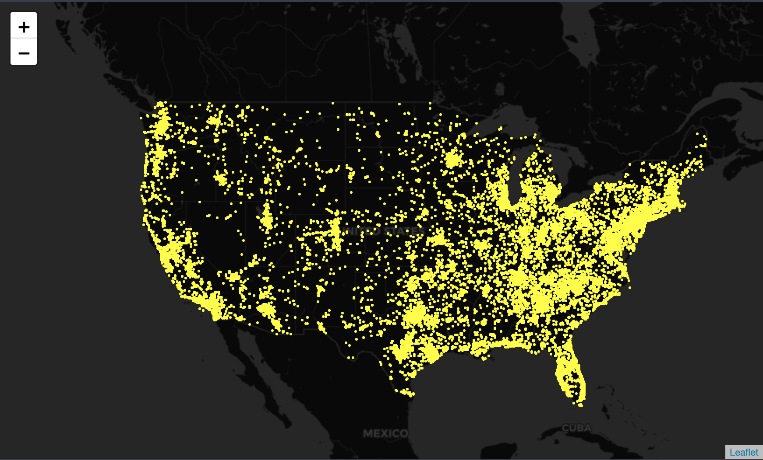
US map annotated with the location of Parler videos

Slide 6
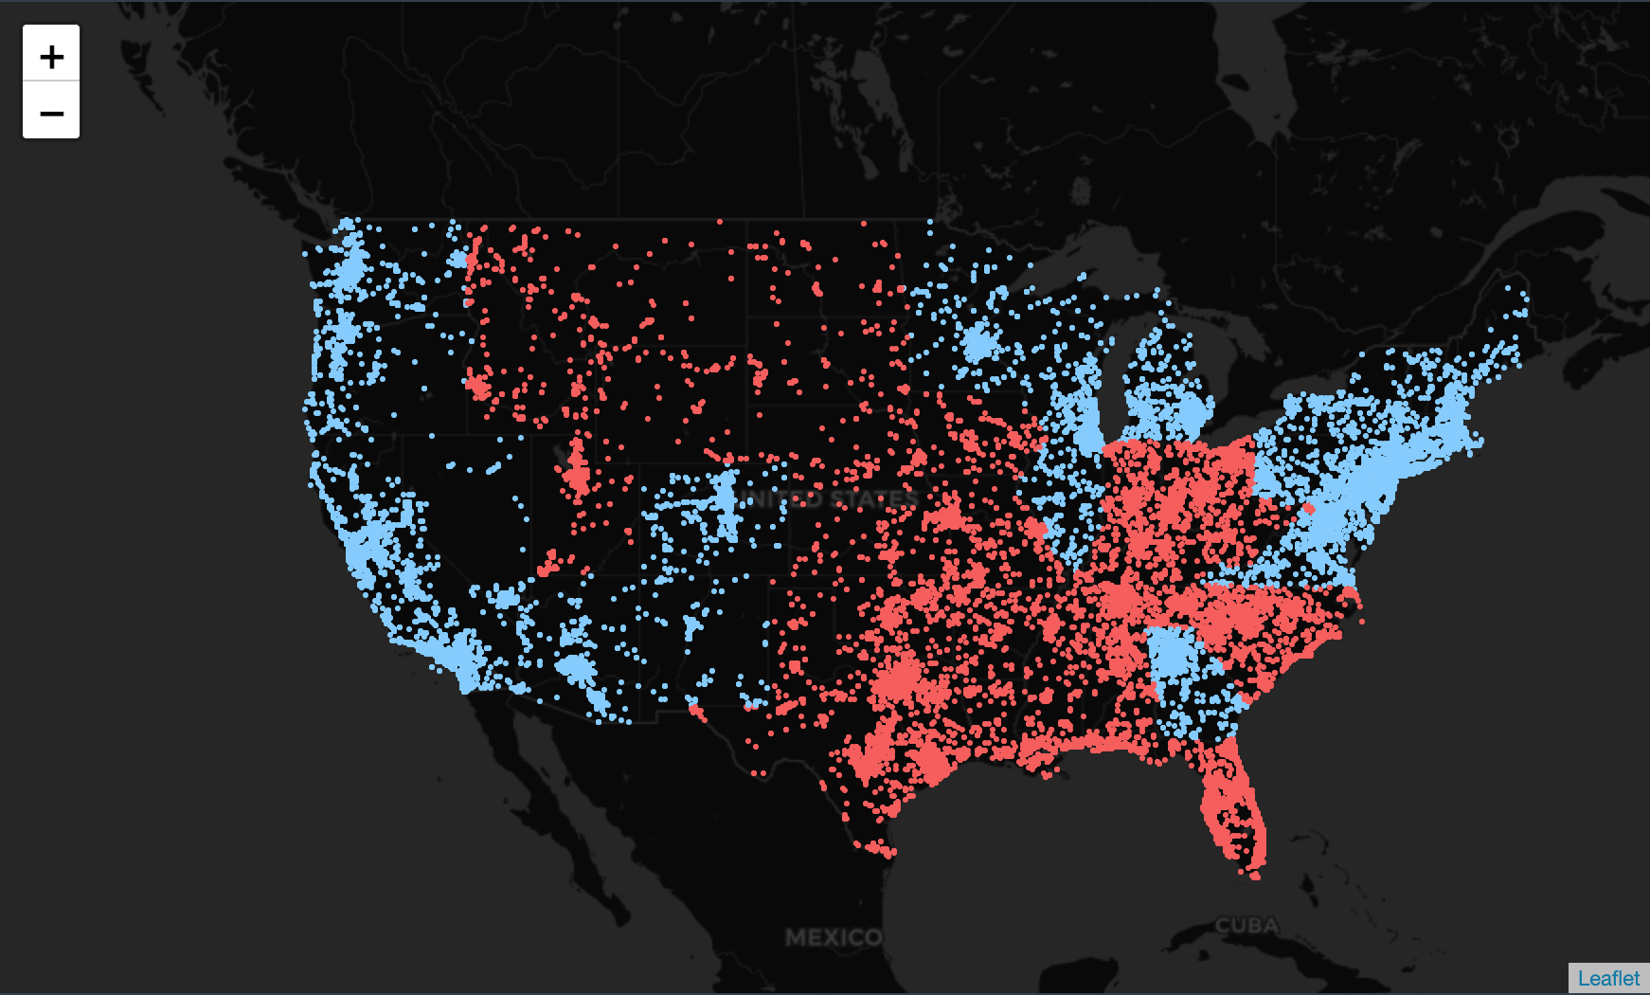
Each dot was colored to represent the political orientation of each state

Slide 7
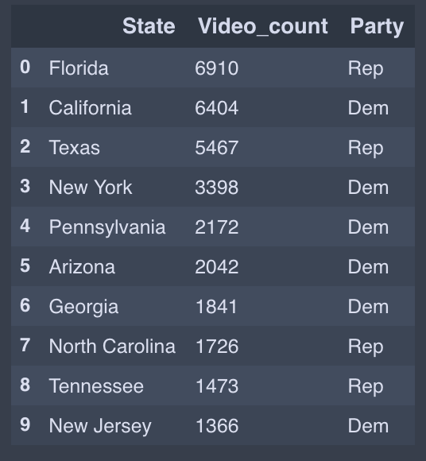
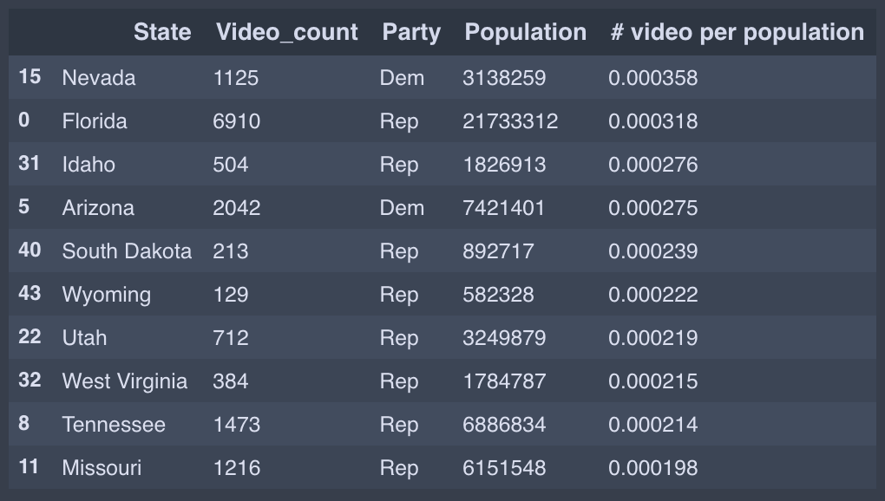
The top 10 states with Parler videos
The top 10 states with Parler videos normalized by population

Slide 8
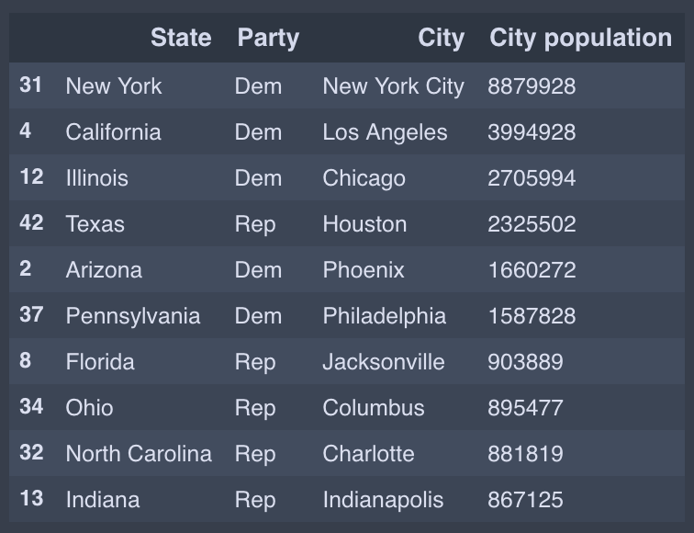
10 most populous cities:
We will compare NYC and Houston!

Slide 9
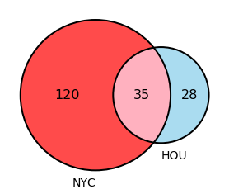
Only 35 unique venues overlap between the two cities

