Slide 1
Martin Camitz, Stockholm
Semyon Weibull, Umeå
Johhny Hooyberghs, ??
What’s new in .Net 8/C# 12?
eller How to pick a subject that requires literally no research?

Slide 2
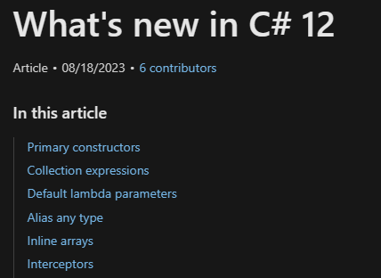

Slide 3
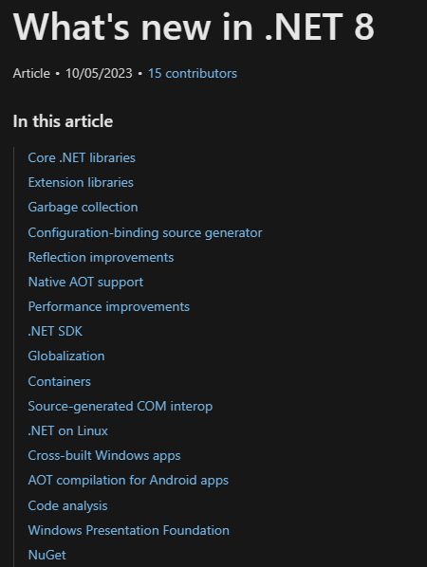

Slide 4
