Slide 1

Martin Camitz, Stockholm
Semyon Weibull, Umeå
Johhny Hooyberghs, ??
Vad ska vi prata om?
What’s new in .Net 8/C# 12?
or How to pick a subject that requires literally no research.

Slide 2
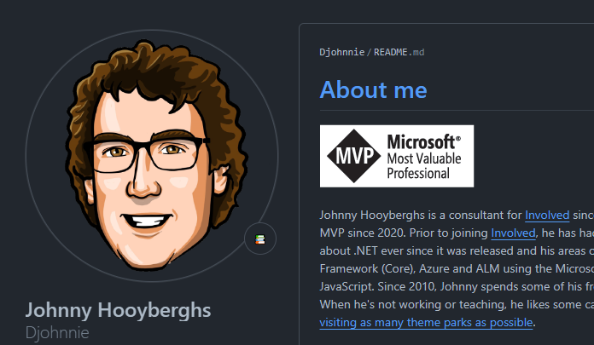
Here’s Johnny

Slide 3
Martin Camitz, Stockholm
Semyon Weibull, Umeå
Johhny Hooyberghs, ??
Vad ska vi prata om?
What’s new in .Net 8/C# 12?
or How to pick a subject that requires literally no research.
or How to fool yourself into picking a subject thinking it would require literally no research.

Slide 4


Vad ska vi prata om?
ⓘ Start presenting to display the poll results on this slide.

Slide 5
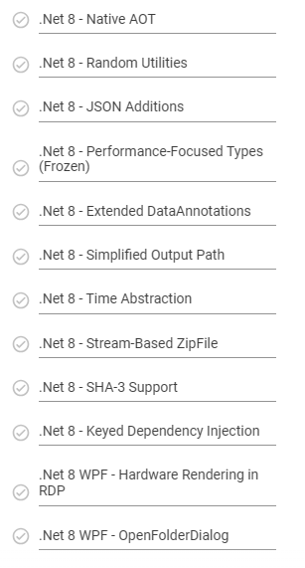
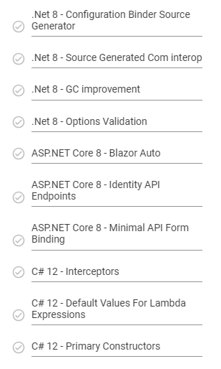
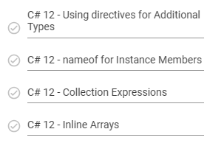
Entity Framework

Slide 6

Resurser
Microsoft Learn – What’s new?
C# 12
.NET
EF
ASP.NET Core
Nick Chapsas’ playlist – C# 12/.Net 8
.Net/C# on github
dotnet – documentation, discussion, feature descriptions etc
roslyn – compiler source code
semweiOP/DotNet8
semweiOP/DotNet8

