Slide 1
Unit 4 – User Testing (including Acceptance Testing)

Slide 2
User Testing
What is User Testing?
User (or customer) testing is a stage in the testing process in which users or customers provide input and guidance on system testing.
It is essential to perform, even after comprehensive system and release testing has been completed.
Influences from the user’s working environment may have a major effect on the reliability, performance, usability, and robustness of the software
Sometimes these can be hard to replicate in a developer’s test environment
Unit Testing
Component Testing
System Testing
Release Testing
Acceptance Testing
User Testing
Also known as Subsystem Integration
AKA System Integration
Development Testing

Slide 3
Three Types of User Testing
Alpha Testing
Beta Testing
Formal Acceptance Testing
User of the software work with the development team to test the software at the developer’s site
An early release (Beta release) of the software is made available to users to allow them to experiment with and raise problems/issues they discover
Customers participate in formal testing of the software to determine if it is ready to be accepted and deployed in the customer environment
Usually for custom systems where safety and reliability of the software are essential to operational use

Slide 4
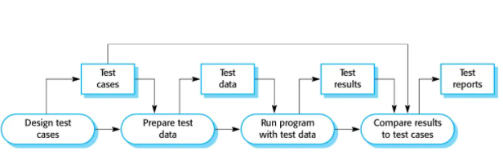
Acceptance Test Process
As shown in Software Engineering – 10th Edition by Ian Somerville

Slide 5
Stages in the Acceptance Test
Define acceptance criteria
Run acceptance tests
Review acceptance test results
Plan acceptance test
Derive acceptance tests
Negotiate test results (if required)
Reject / accept system

Slide 6
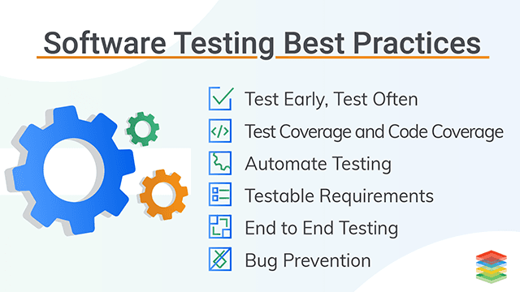
Major Takeaways….

Slide 7
Let’s Practice….

Slide 8
Unit 5 – Test-Driven Development

Slide 9
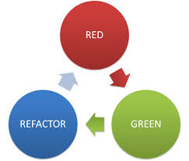
What is Test–driven Development (TDD)?
SFWE 101 | Test-driven development
An approach where you interleave testing and code development
Tests are written before code and “passing’ the test(s) is the critical driver of development
Develop the code incrementally
Develop the test for that code at the same time
Don’t move on to the next increment until the code that you have developed passes the test
TDD first introduced as part of Agile methods
Can also be used in “plan-drive” development (more traditional waterfall or V method of development)
Sometimes also referred to as “red-green-refactor”

Slide 10
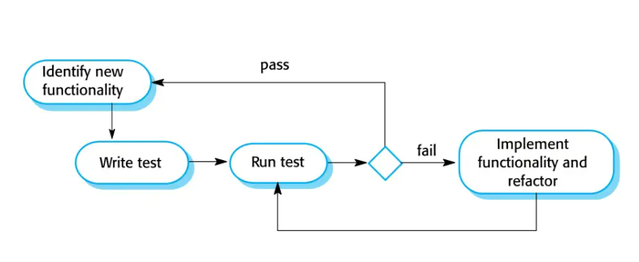
Test-driven Development Workflow
As shown in Software Engineering – 10th Edition by Ian Somerville

Slide 11
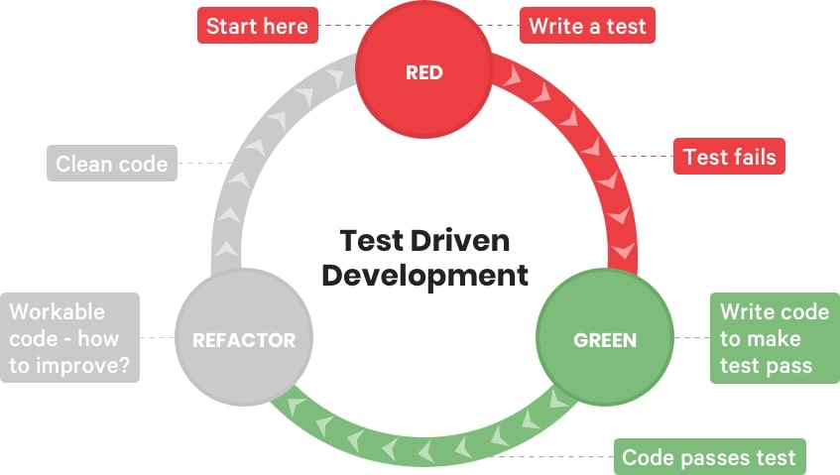
TDD Process Activities

Slide 12
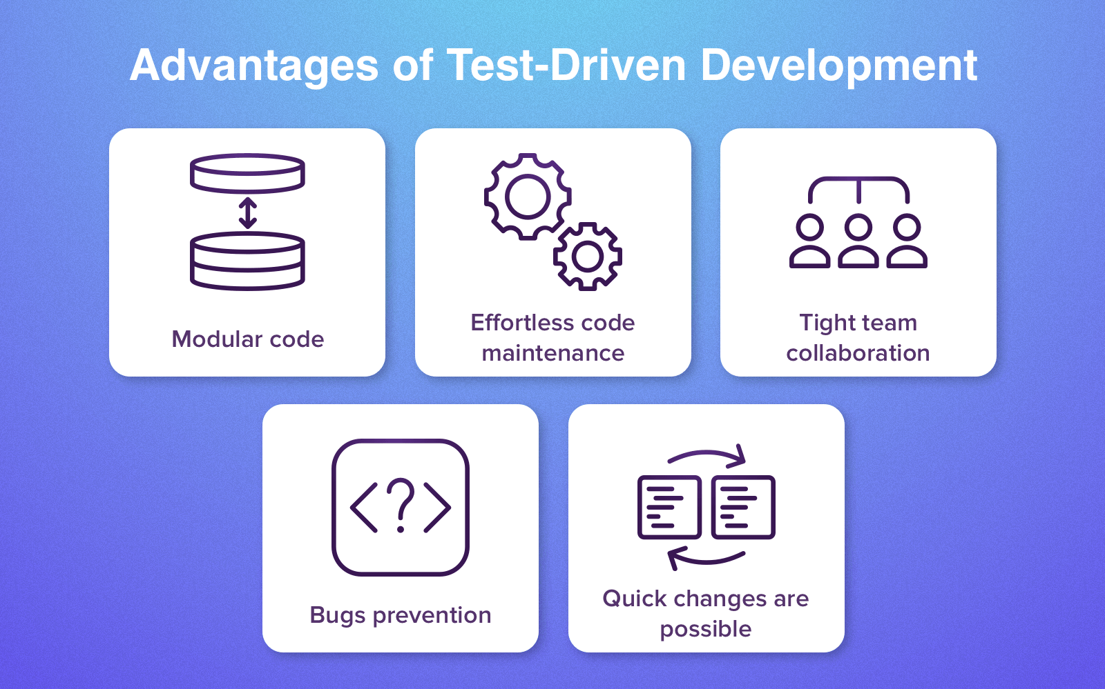
Benefits of TDD
#1 Code coverage:
Every code segment has at least one associated test, so all code written has at least one test.
#2 Regression Testing:
A regression test suite is developed incrementally as the program is developed.
#3 Simplified Debugging:
When a test fails, it should be obvious where the problem is. The newly written code needs to be checked and modified.
#4 System Documentation:
The tests themselves are a form of documentation that describe what the code should be doing.

Slide 13

If you want to learn more about test-driven development with a Python example ….
Test-Driven Development In Python // The power of red-green-refactor - YouTube

Slide 14
Let’s Practice….

Slide 15
Unit 6 – Setting Up a Python Development Environment

Slide 16
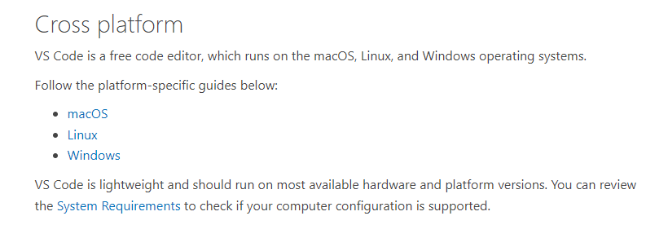
Let’s Set Up an External Python Integrated Development Environment (IDE)
For the past 3 modules, we have been working in a python environment that is integrated with the zyBooks – Programming Python 3
Its time for us to set up an external environment so that you can write Python programs outside of zyBooks
https://code.visualstudio.com/docs/setup/setup-overview

Slide 17
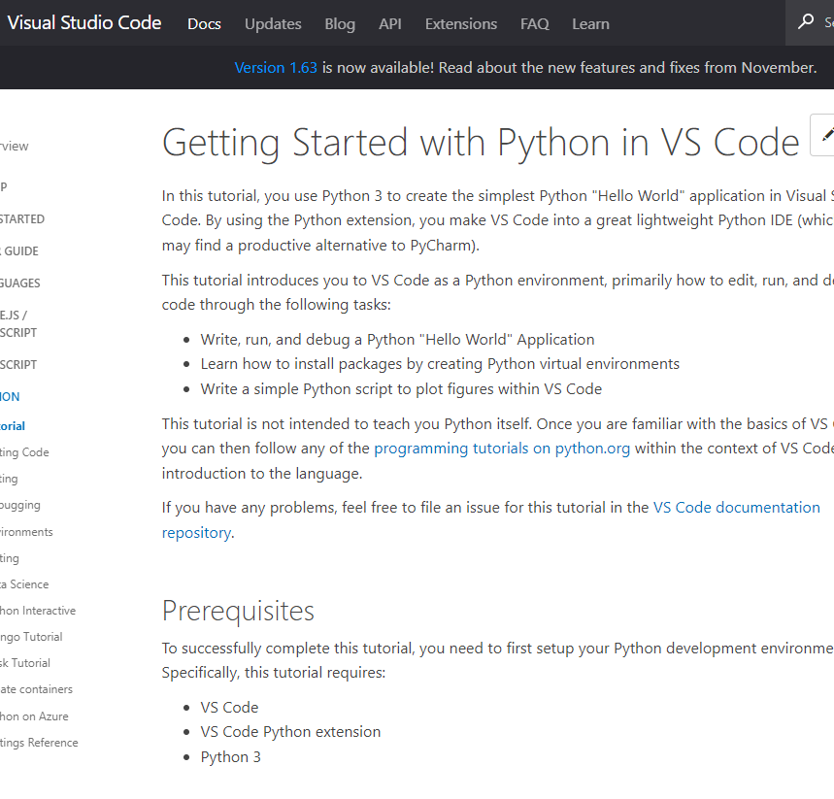
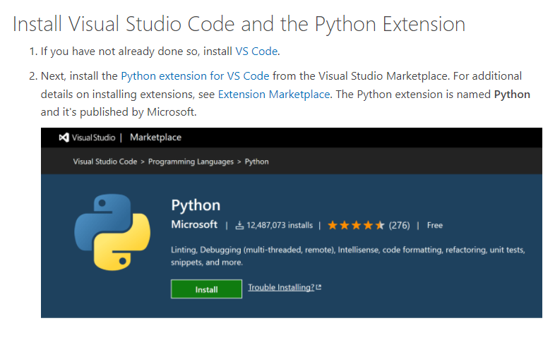
Start at the tutorial for installing Visual Studio Code and the Python Extension
https://code.visualstudio.com/docs/python/python-tutorial

Slide 18
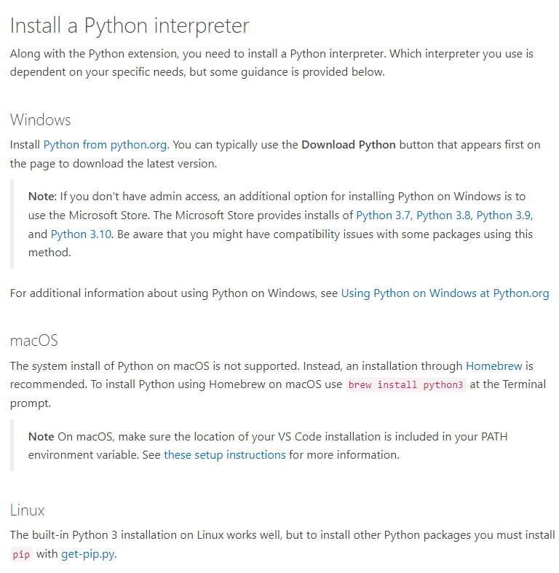
Follow the directions for installing a Python interpreter for the OS you are working with

Slide 19
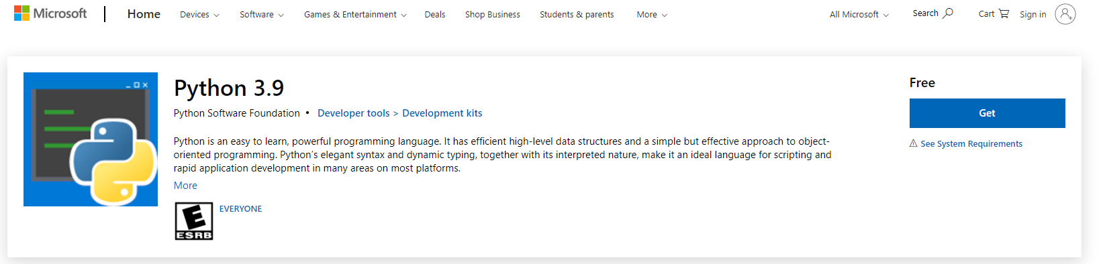
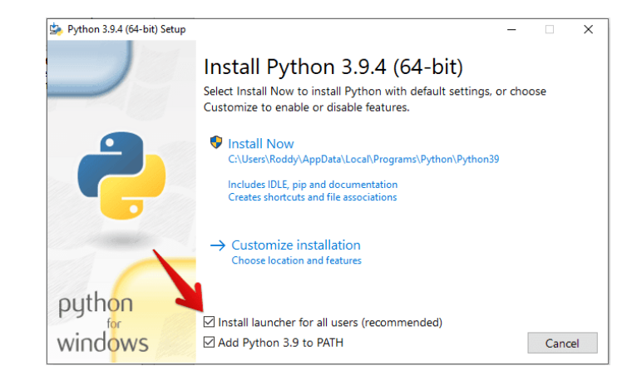
First, be sure that you have Python 3.9 installed on your Windows computer….
Be sure to click the box to add Python 3.9 to PATH!!!
https://www.microsoft.com/en-us/p/python-39/9p7qfqmjrfp7?rtc=1&activetab=pivot:overviewtab

Slide 20
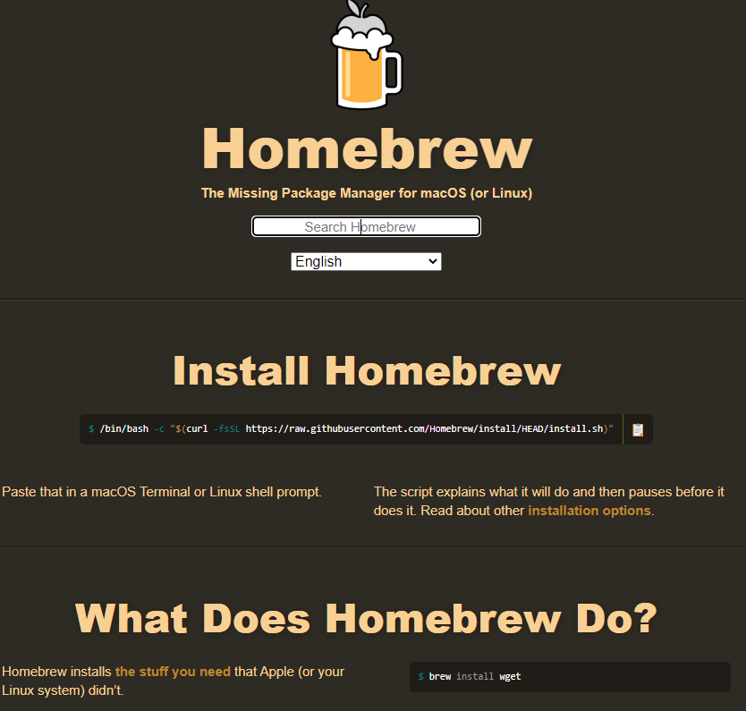
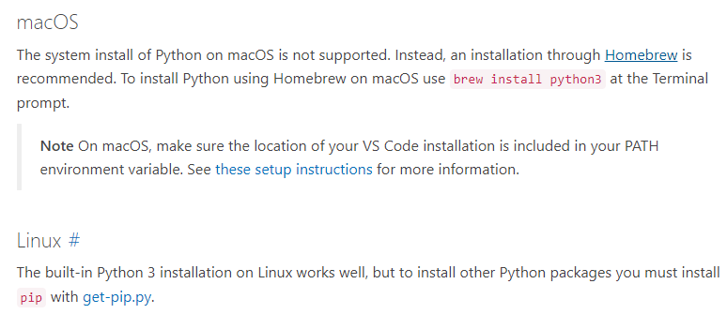
If you have a mac computer…you will have to use a different Python interpreter – the instructions suggest Homebrew
https://brew.sh/

Slide 21
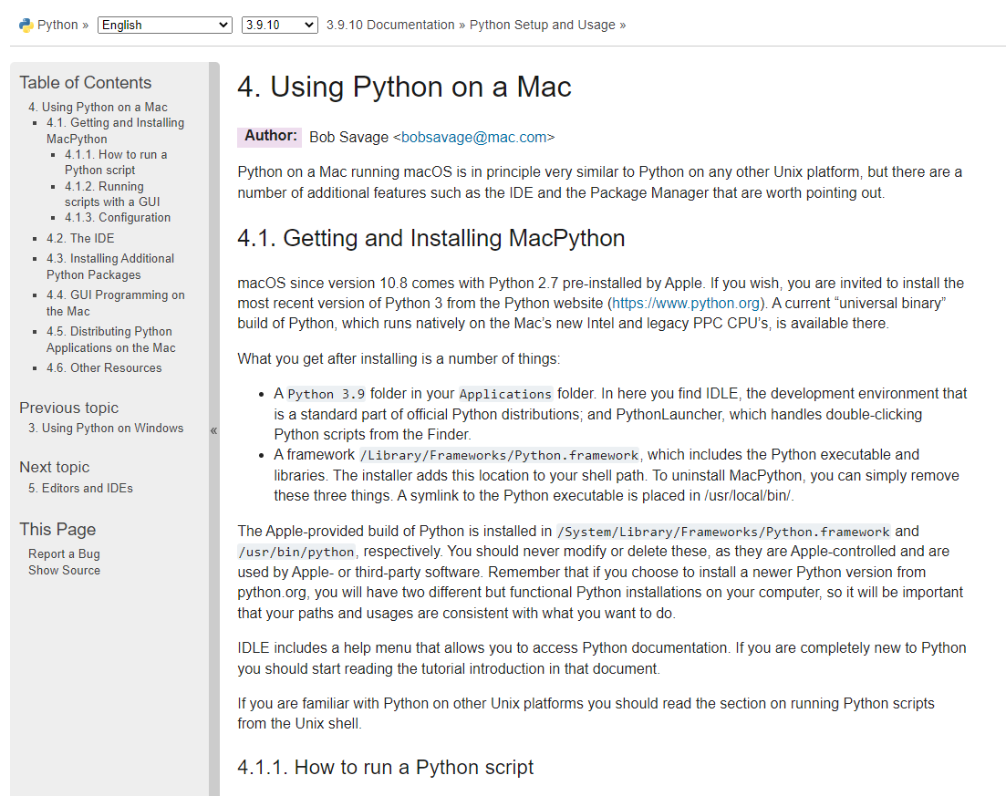
Your Mac may already have the Python interpreter installed … but make sure you upgrade to Python 3
4. Using Python on a Mac — Python 3.9.10 documentation

Slide 22
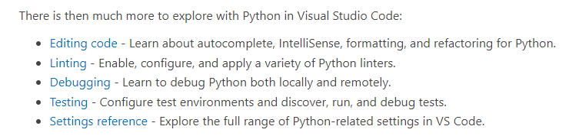
There are some great tutorials on the Python in Visual Studio Code website
https://code.visualstudio.com/docs/python/python-tutorial

Slide 23
Github Copilot
https://education.github.com/students
https://education.github.com/pack#offers
https://docs.github.com/en/copilot/quickstart

Slide 24
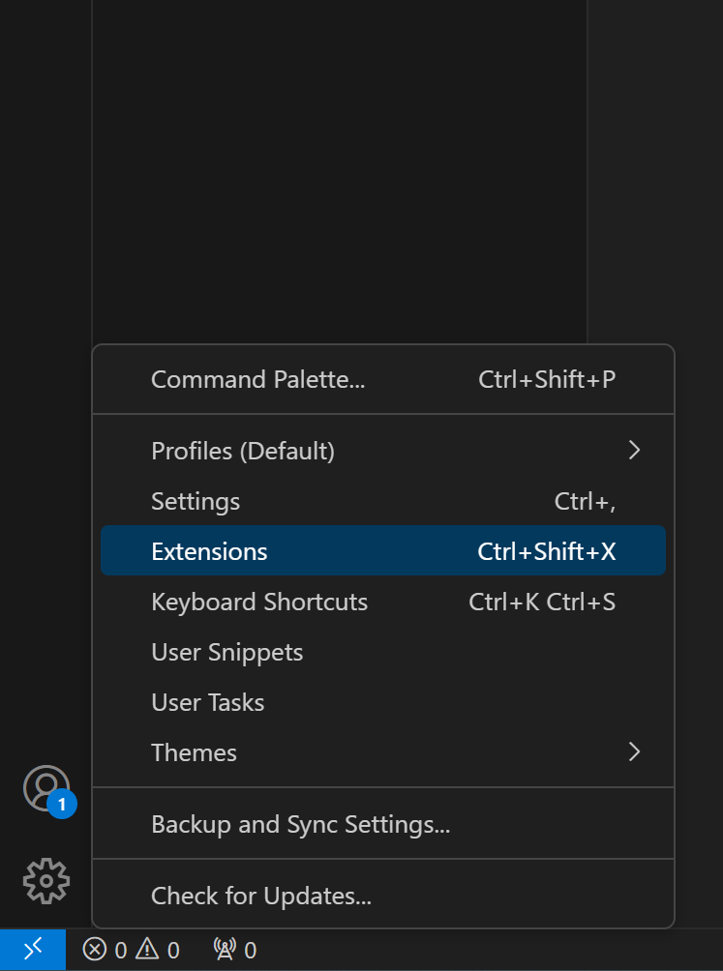
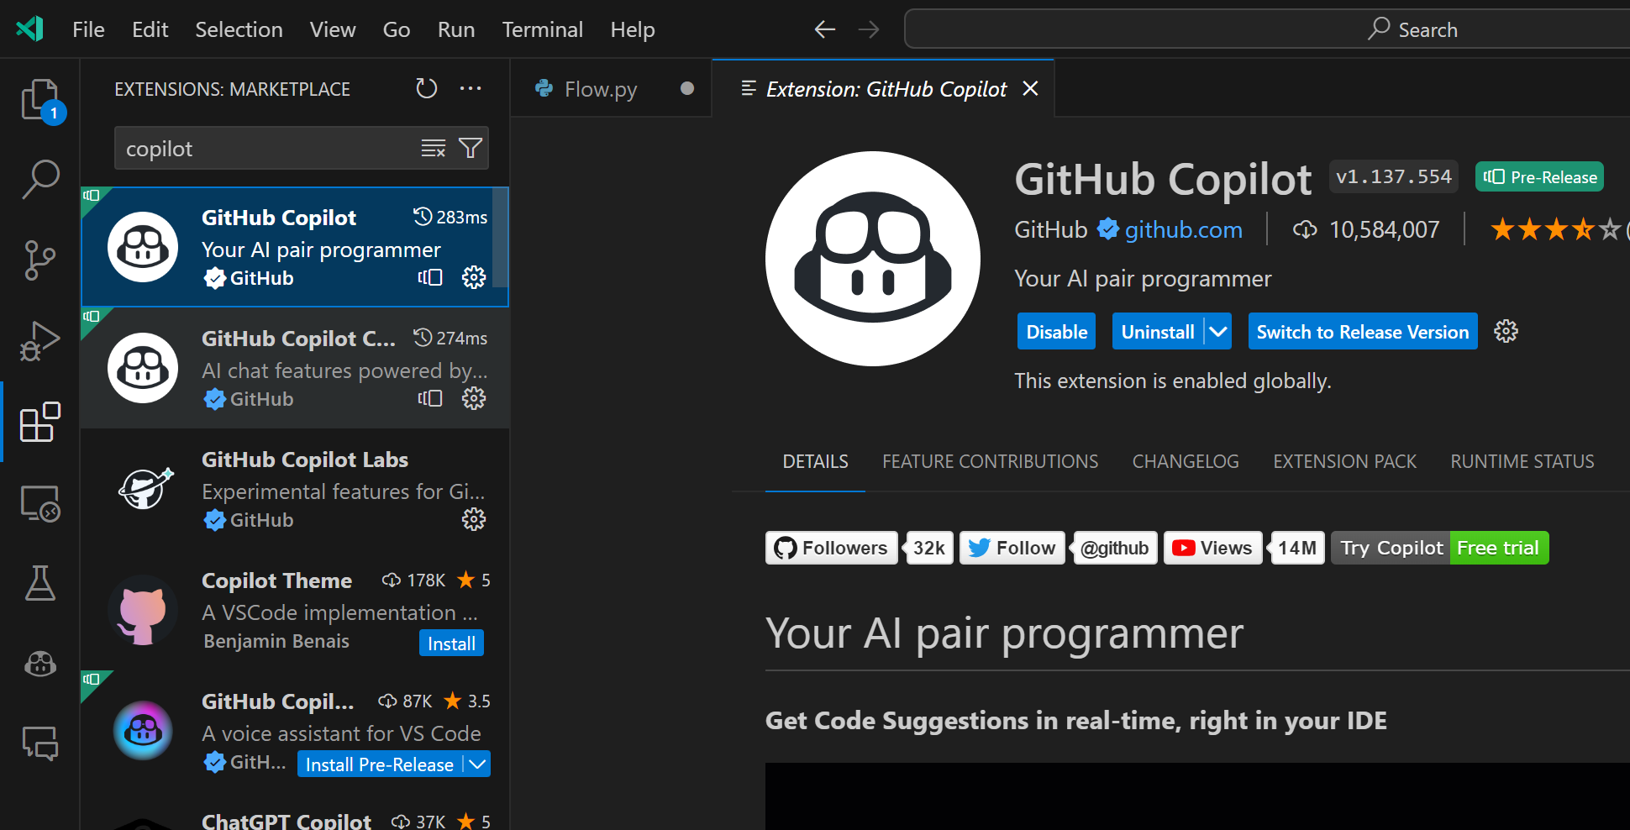
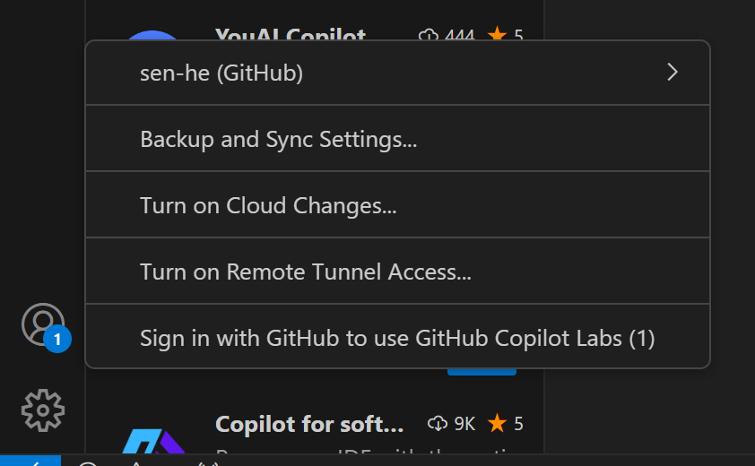
Github Copilot

Slide 25
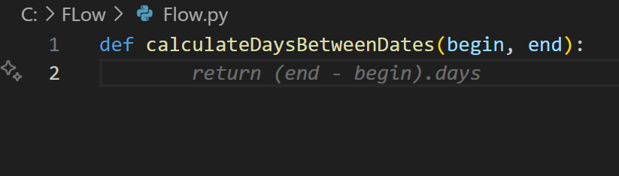
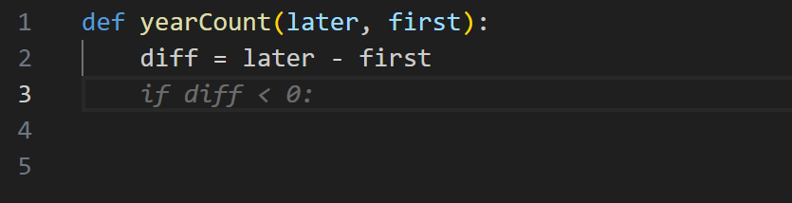
Github Copilot

Slide 26
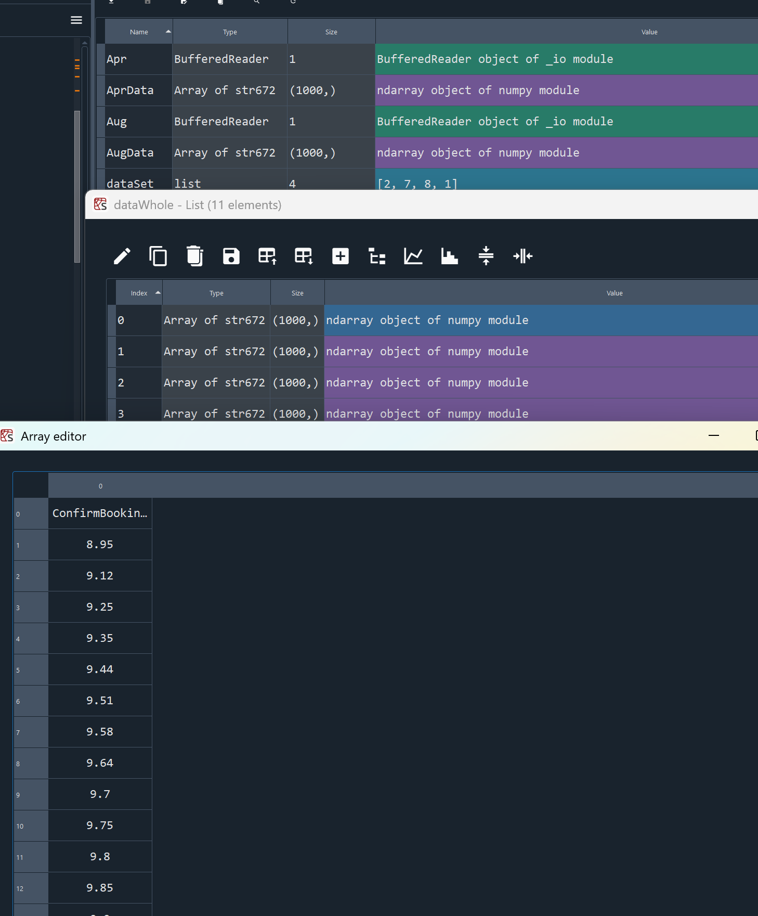
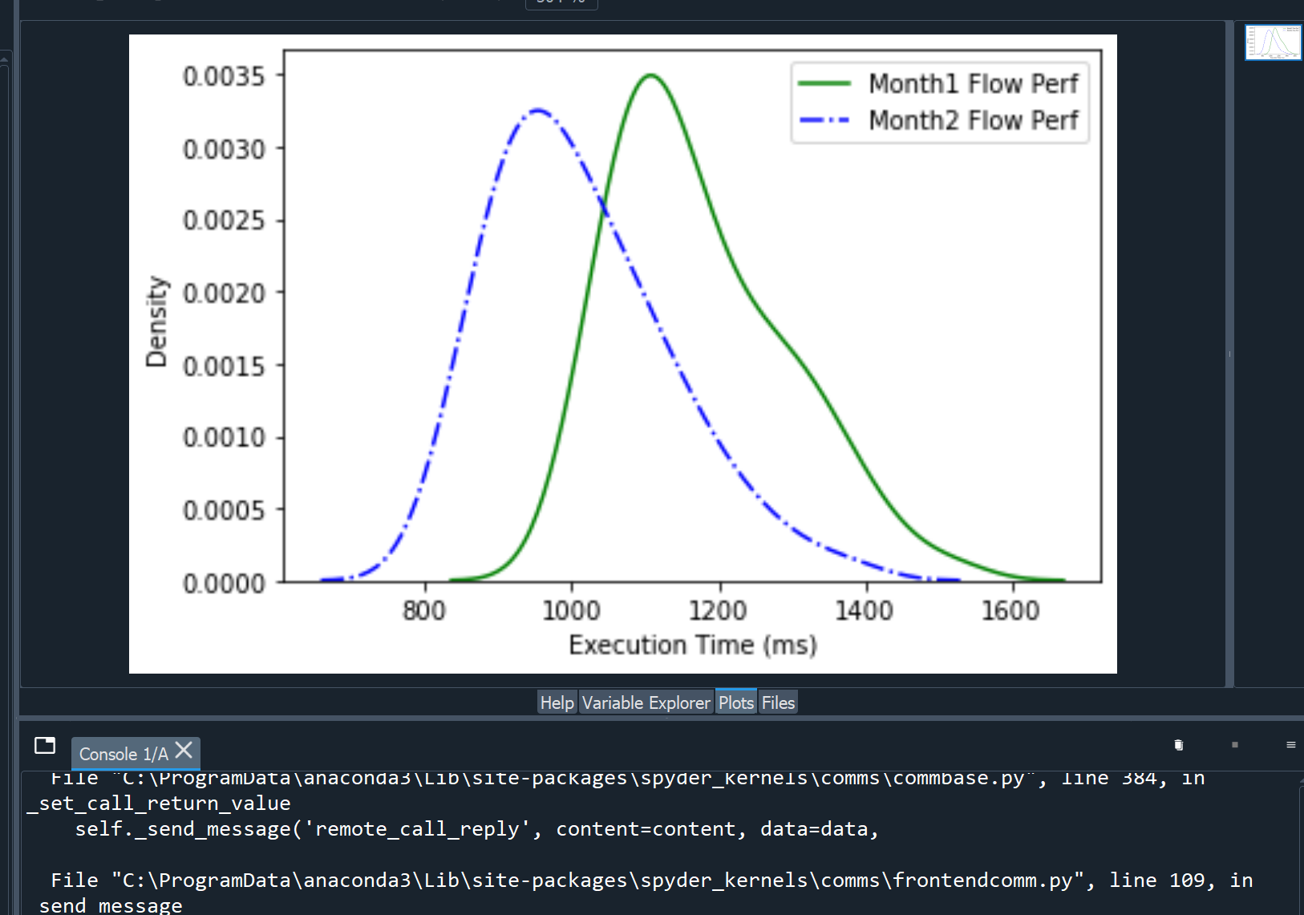
IDE for Data analysis/science
Anaconda - Spyder:
https://www.anaconda.com/download

Slide 27
In this class, we are not going to learn about setting up virtual environments, so you do not have to do that part of the instructions located in the instructions

Slide 28
Unit 7 – Introducing the Alien Invasion Game Source Code

Slide 29
Now That You Have Visual Studio Code Set Up
SFWE 101 | getting started with Alien Invasion
Let’s start building our Alien Invasion game!!!
We will spend the entire time in Module 8 writing the code for our Alien Invasion game
But before we get there….
Let’s make sure that we get some of the necessary code libraries installed and that you can create a blank gameboard
We will be using a package called Pygame and need to get it properly installed

Slide 30
Pygame User’s Manual
Pygame is a multimedia library for Python for making games and multimedia applications.
Saves us time from having to write a bunch of gaming methods and functions that have already been written for us
Thank goodness for Open-Source code!
Microsoft Word - PygameReferenceManual.doc

Slide 31
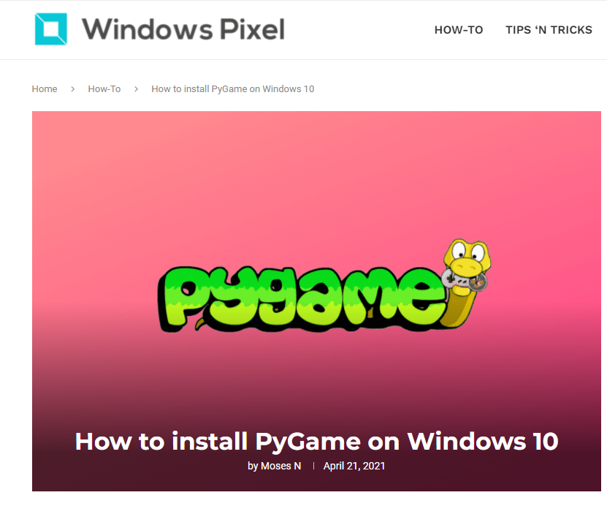
I found this YouTube video very helpful in installing Pygame on my computer
Be sure to follow each step carefully!!
If you did not click the box that says add Python to Path when you installed it, you may have to uninstall it and reinstall it with that box checked
(I learned the hard way ☺)
How to install pygame for python 3.9. - Bing video
If you prefer to read the directions, you can check this site out:
https://windowspixel.com/install-pygame-windows/

Slide 32
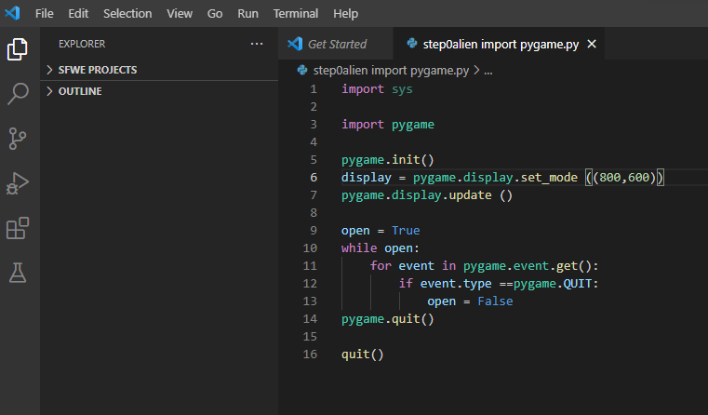
Once you have successfully installed Pygame, let’s start writing Alien Invasion in Visual Studio Code….

Slide 33
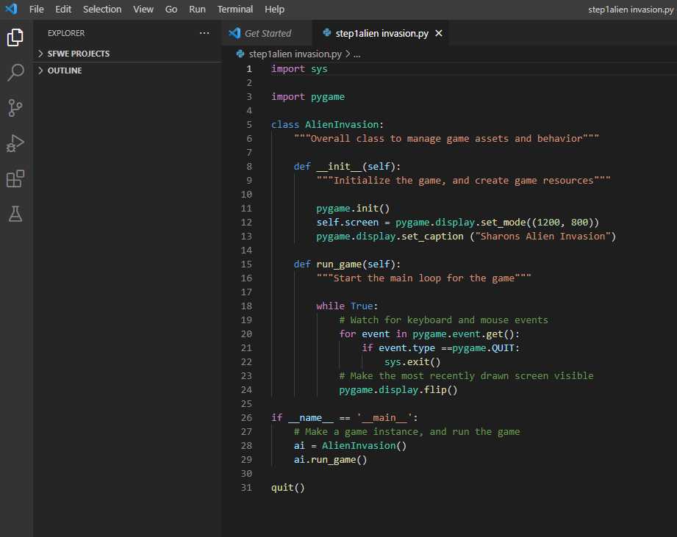
Let’s create a class called AlienInvasion and add a few things to the code to give it a better structure

